Slide 1
Vision for Jenkins
Kohsuke Kawaguchi | CTO, CloudBees, Inc.
kkawaguchi@cloudbees.com | @kohsukekawa

Slide 2
Let’s Put Users First

Slide 3
We are already GREAT at
Building integration with XYZ
Solving problems that blocks experts
Trying new ideas as plugins

Slide 4
What we can be BETTER
Make Jenkins great for ”the mass”
New users
People with less time
People with simple needs
People whose Jenkins is working well enough they don’t file bugs
Identify problems that are not bugs
Fixing bugs is only level 1 in software quality

Slide 5
Who are those “dark matter” users?

Slide 6
#1: Startup from Amsterdam
Frugal startup from college
3 engineers
CTO is the release & automation engineer
Ships cross-platform C++ app
Too busy to add agents. “It sounded complicated”
“I don’t have time to read blogs & put things together”
Haven’t heard of Pipeline nor Blue Ocean

Slide 7
#2: Startup from Boston
15 people engineering team, 1 engineering manager
CTO is still the release & automation engineer
Just a few apps, but established practices
Jenkins works with some annoyance here and there

Slide 8
Who are they?
Not connected to our outreach channel
Do not visit jenkins.io, file bugs, or participate in ML
Do not come to Jenkins World
Run an old version of Jenkins and doesn’t touch it
Stick to the same setup they did 2 years ago

Slide 9
How can we …
Make Jenkins better for them?
Communicate new things we’ve done to them?
Make Jenkins simpler to fit the limited time they have?
Reduce their trial & error to get to gratification sooner?
Prevent them from spending time with Google & Stack Overflow?

Slide 10
This requires us to change

Slide 11
For example, we need…
Some of us to go find & study these users
Expose less than the platform is capable of
Make Jenkins help users when they get stuck
User studies
Spend more time arming users, less time building new things
Ask ourselves “how does a user supposed to know this?”

Slide 12


Slide 13


Slide 14
With that, here’s where we need to go next

Slide 15

Goal: Make Jenkins easier

Slide 16
Hear it from people
10 reasons to switch from CruiseControl to Hudson
Why are you still not using Hudson?
What is the difference between Hudson and CruiseControl?
Circle vs Travis vs Jenkins

Slide 17
Good examples from the past
“java –jar jenkins.war”
Email vs email-ext
Error message you get when you run with older Java

Slide 18
Stake on the ground
A new user with a Git repo can start auto-deploying every new push
In 5 minutes, with 5 clicks
Regardless of programming language
Regardless of target platform

Slide 19
Launch in AWS

Slide 20
Reduce as much babysitting as possible
Auto-upgrade
Connected problem diagnosis like Advisor
Right JVM, kernel, docker, …
Proper DNS name & HTTPS certificate
Executors on master = 0
Ephemeral elastic agents out of the box

Slide 21
What requires work by admins?

Slide 22
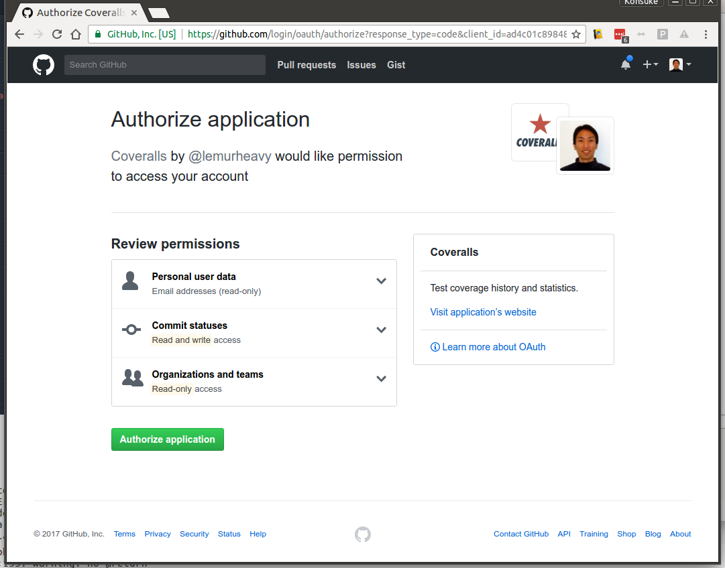
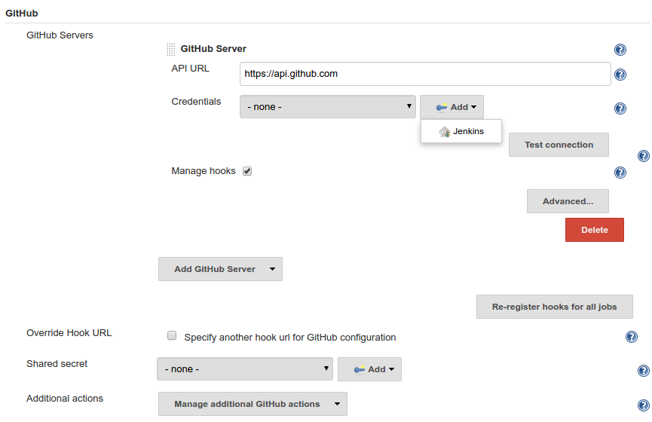
Setting up GitHub Webhook

Slide 23
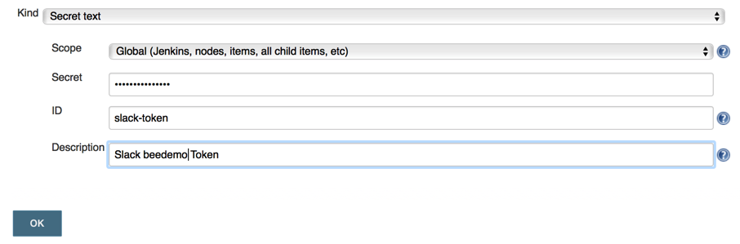
Setting up HipChat/Slack integration

Slide 24
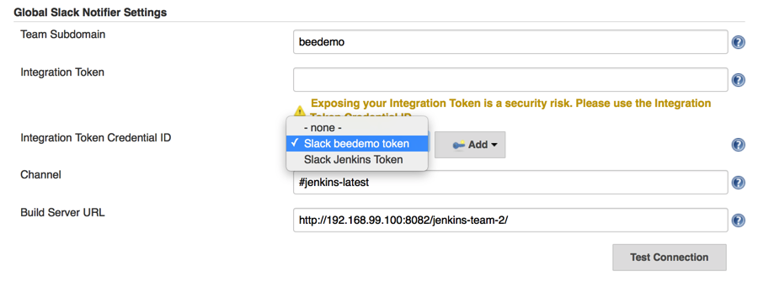
Setting up HipChat/Slack integration

Slide 25
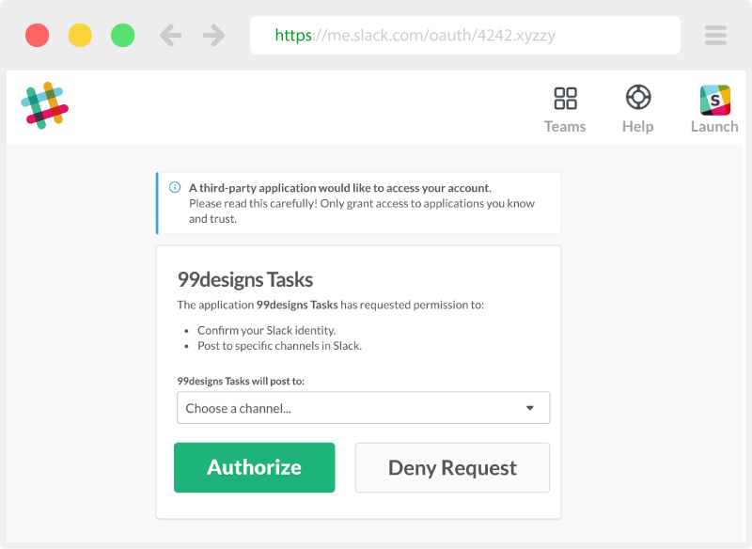

Setting up HipChat/Slack integration

Slide 26
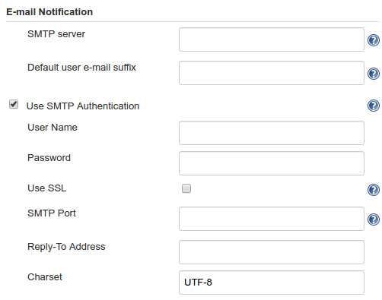
E-mail Setting

Slide 27
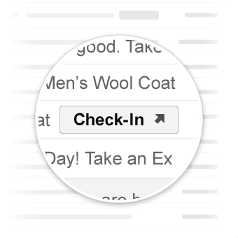
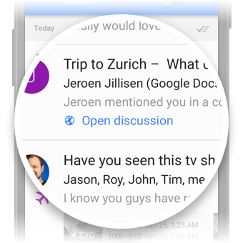
E-mail

Slide 28
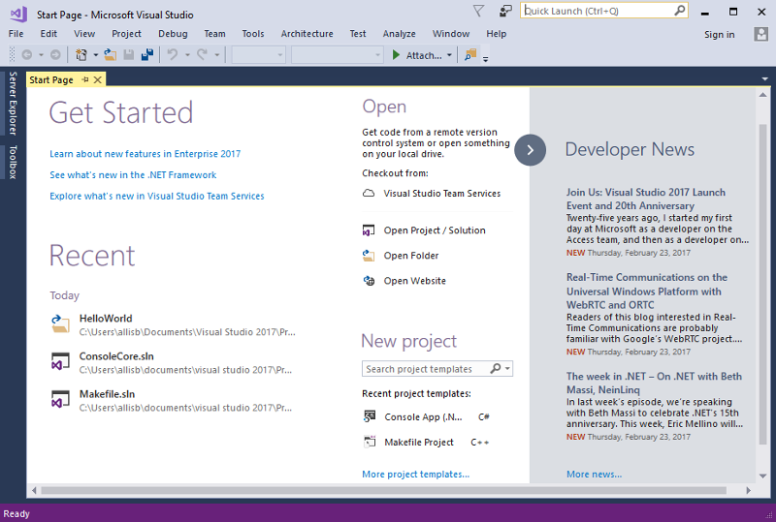
In-product News

Slide 29
In-product News

Slide 30
How can people get to CD quickly?

Slide 31

Building CI before Jenkins

Slide 32
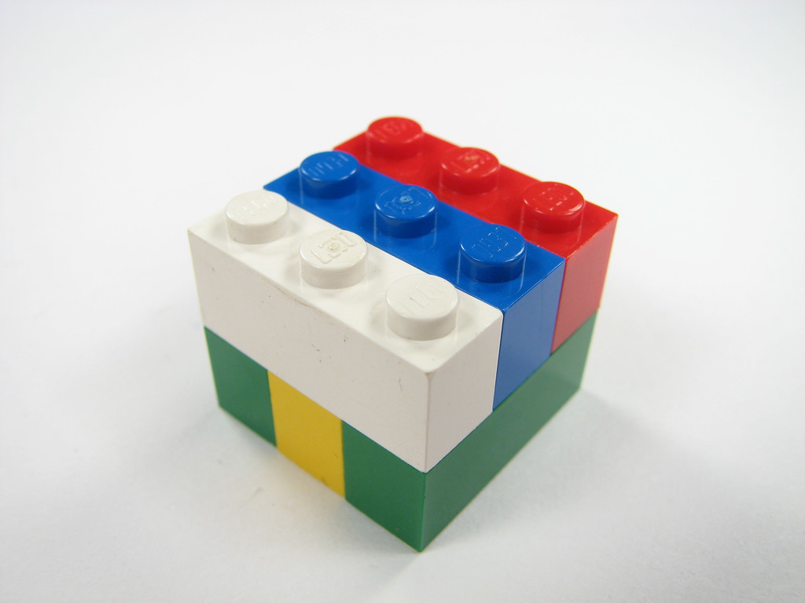
Building CI after Jenkins

Slide 33
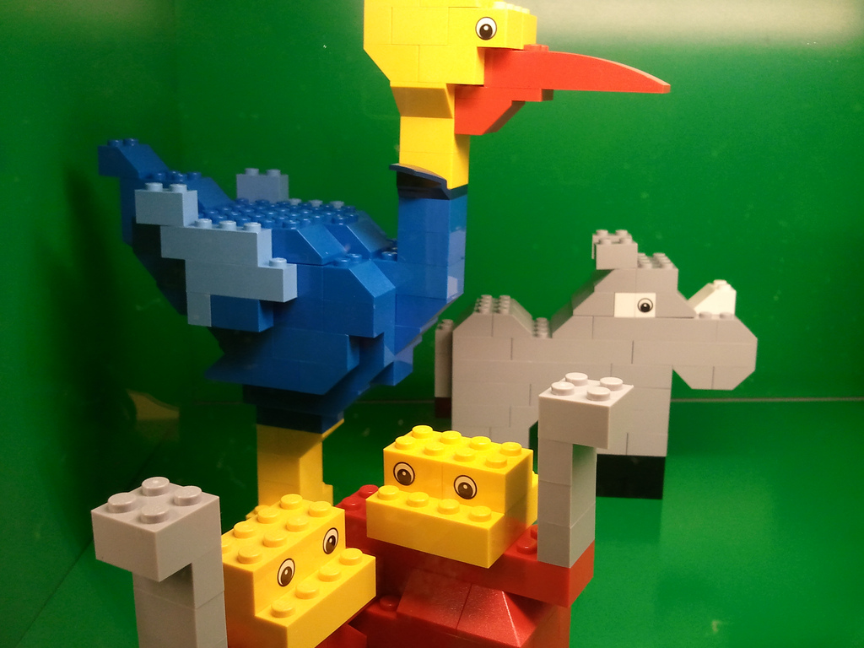
Can we do the same with Pipeline?
Imagine if you can get pre-assembled models for free

Slide 34
Can we do the same with Pipelines?
Happened x1300 over past 10 yrs
Goal: x1300 over next 3 years
Joe finds a micro-pattern in his CI process
Joe codifies it
Joe shares it with the community
Mary finds it, uses it, & saves time
Joe finds a micro-pattern in his pipeline
Joe codifies it
Joe shares it with the community
Mary finds it, uses it, & saves time

