Slide 1

The Technology Value Stream
by Jelani Jenkins

Slide 2
What is The Technology Stream
In DevOps, the technology value stream is the sequence of work from a business hypothesis through technology teams
It emphasizes flow of value (not just tasks) and aligns with Lean ideas of value streams.

Slide 3
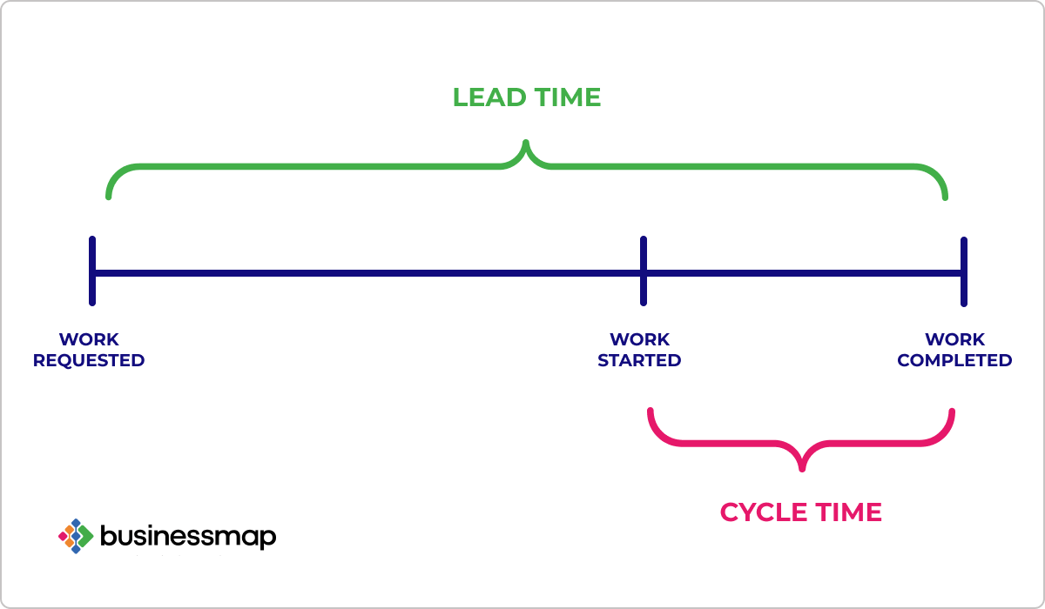
Defining Lead Time vs Processing Time
Lead Time (LT): the time elapsed from when work is requested/accepted until it is delivered.
Processing Time (PT): the actual “touch time” spent actively working on the item (excluding waiting, delays)

Slide 4
The Common Scenario: Deployment Lead Times of Months
Many technology value streams suffer from long delays: deployment lead times of months (or even more) are common
Causes include hand-offs, approvals, manual tests, environment setup, waiting for resources, large batch sizes.
The business pays a price: slower feedback, higher risk, slower value delivery.

Slide 5
Summary
The technology value stream is the end-to-end flow from idea to value.
Lead time vs processing time: we care about the full delay (lead).
Many organizations today have long lead times (months); DevOps aims for minutes.
Mapping, measuring, reducing waste in the value stream is key to making that leap.

