Slide 1
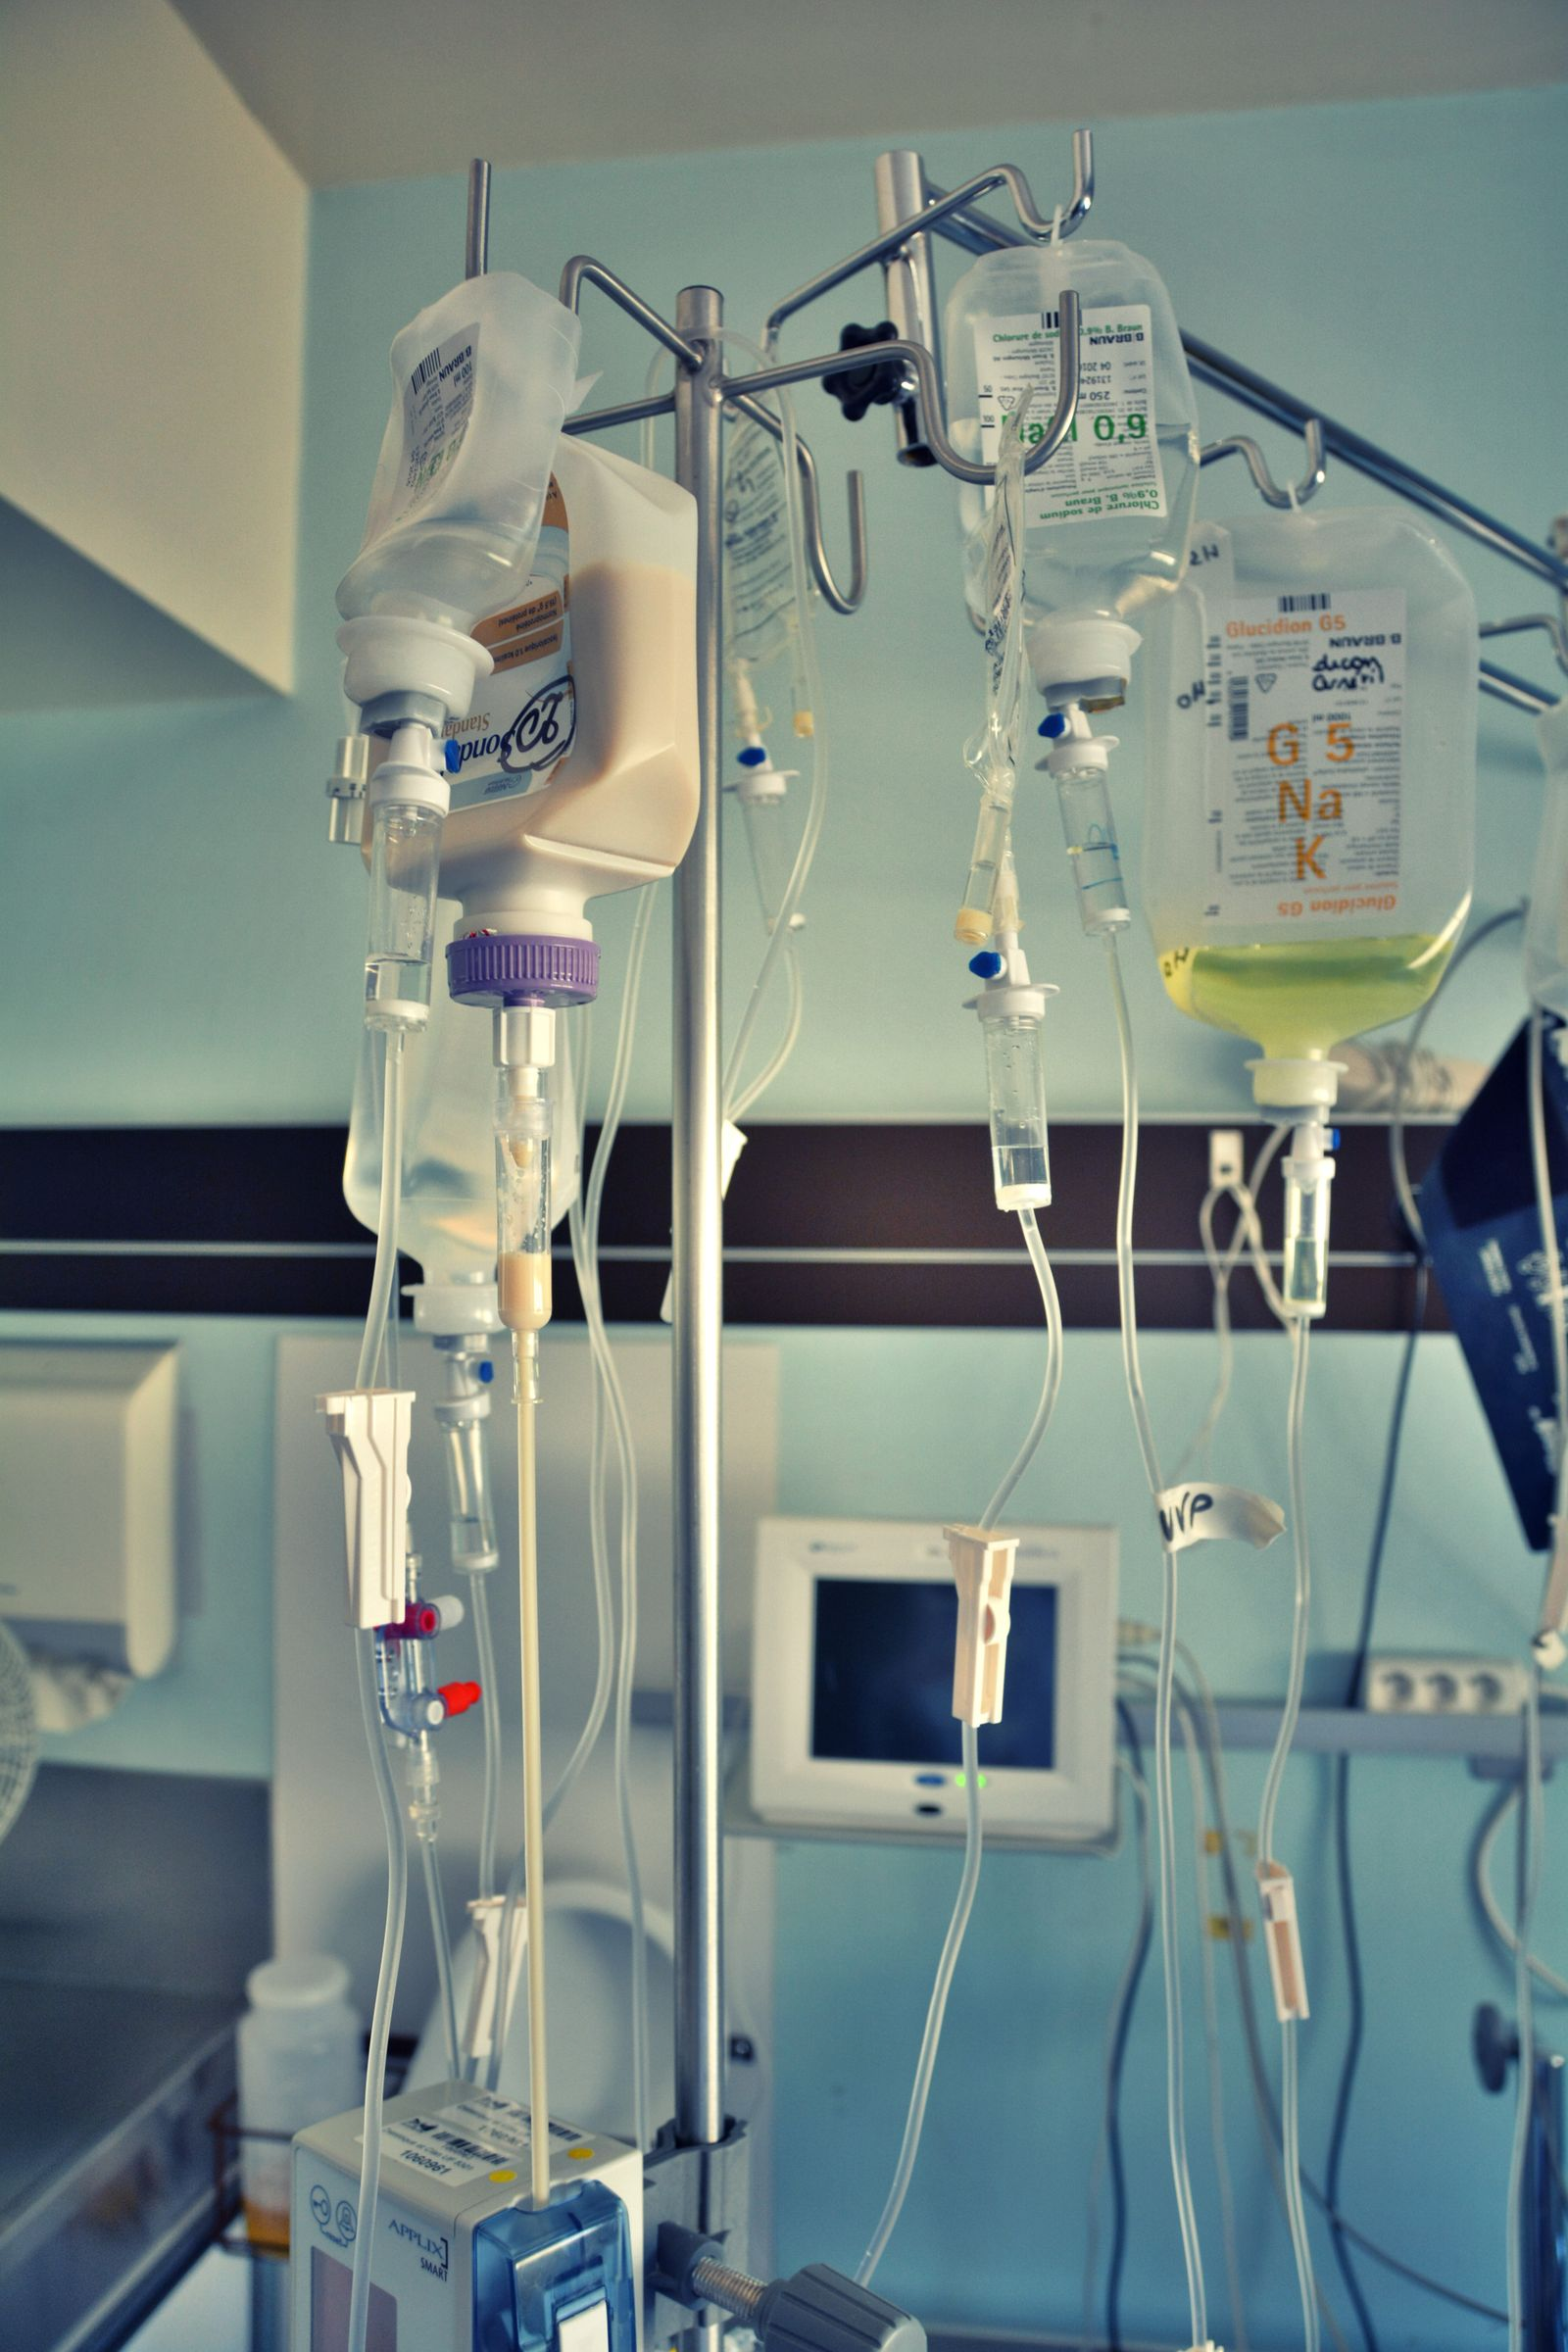
BROWARD-MIAMI HEALTH INSTITUTE
Parenteral Nutrition
Module 5 | 30-Hour Basic Intravenous Therapy
Student presentation • clinical examples • guided practice
Notes:
HEYGEN INSTRUCTOR SCRIPT
Welcome to Parenteral Nutrition, Module 5 of the BMHI thirty-hour intravenous therapy course. Explain that this module prepares learners for safe practice and the supervised in-person competency day. Preview the learning objectives and remind learners to complete the matching portal lesson and assessment.
PRODUCTION DIRECTION
Use a professional nursing instructor avatar, calm pace, neutral clinical background, and captions. Pronounce IV as I-V and IVPB as I-V piggyback.
SOURCES
Supplied Basic Intravenous Therapy Certification manual, pages 62; BMHI IVT 030 course content. Cover media: Pexels photo by Stéf -b., https://www.pexels.com/photo/iv-drip-in-hospital-11081177/, downloaded October 23, 2026 under the Pexels License.
Current legal reference: Florida Administrative Code Rule 64B9-12.005, effective July 20, 2023; Florida Statutes section 464.003 (2026). Instructor must verify current institutional policy and current drug/device guidance before use.

Slide 2
Learning objectives
02
MODULE 5
Explain indications and major components of parenteral nutrition
Distinguish peripheral from central administration
Recognize metabolic, infectious, and mechanical complications
Notes:
HEYGEN INSTRUCTOR SCRIPT
Welcome to this lesson segment on the learning objectives. First, Explain indications and major components of parenteral nutrition Next, Distinguish peripheral from central administration Next, Recognize metabolic, infectious, and mechanical complications Pause here and ask learners to identify the safety check they would complete before proceeding. Reinforce that students must follow current orders, facility policy, their authorized scope, and the supervising registered nurse's direction. Invite learners to replay this segment and record questions for the instructor.
PRODUCTION DIRECTION
Use a professional nursing instructor avatar, calm pace, neutral clinical background, and captions. Pronounce IV as I-V and IVPB as I-V piggyback.
SOURCES
Supplied Basic Intravenous Therapy Certification manual, pages 62; BMHI IVT 030 course content.
Current legal reference: Florida Administrative Code Rule 64B9-12.005, effective July 20, 2023; Florida Statutes section 464.003 (2026). Instructor must verify current institutional policy and current drug/device guidance before use.

Slide 3
Why parenteral nutrition is used
03
MODULE 5
Parenteral nutrition supports patients whose gastrointestinal tract cannot meet nutritional needs.
Formulations may contain amino acids, dextrose, electrolytes, vitamins, trace elements, fluid, and lipids.
Use current orders, facility policy, and authorized scope when applying this information.
Notes:
HEYGEN INSTRUCTOR SCRIPT
Welcome to this lesson segment on Why parenteral nutrition is used. First, Parenteral nutrition supports patients whose gastrointestinal tract cannot meet nutritional needs. Next, Formulations may contain amino acids, dextrose, electrolytes, vitamins, trace elements, fluid, and lipids. Pause here and ask learners to identify the safety check they would complete before proceeding. Reinforce that students must follow current orders, facility policy, their authorized scope, and the supervising registered nurse's direction. Invite learners to replay this segment and record questions for the instructor.
PRODUCTION DIRECTION
Use a professional nursing instructor avatar, calm pace, neutral clinical background, and captions. Pronounce IV as I-V and IVPB as I-V piggyback.
SOURCES
Supplied Basic Intravenous Therapy Certification manual, pages 62-66; BMHI IVT 030 course content.
Current legal reference: Florida Administrative Code Rule 64B9-12.005, effective July 20, 2023; Florida Statutes section 464.003 (2026). Instructor must verify current institutional policy and current drug/device guidance before use.

Slide 4
Route and concentration
04
MODULE 5
Peripheral formulations have lower osmolarity and limited duration.
Concentrated formulations generally require central access.
Verify the prescribed route, formulation, filter, tubing, and dedicated lumen.
Use current orders, facility policy, and authorized scope when applying this information.
Notes:
HEYGEN INSTRUCTOR SCRIPT
Welcome to this lesson segment on Route and concentration. First, Peripheral formulations have lower osmolarity and limited duration. Next, Concentrated formulations generally require central access. Next, Verify the prescribed route, formulation, filter, tubing, and dedicated lumen. Pause here and ask learners to identify the safety check they would complete before proceeding. Reinforce that students must follow current orders, facility policy, their authorized scope, and the supervising registered nurse's direction. Invite learners to replay this segment and record questions for the instructor.
PRODUCTION DIRECTION
Use a professional nursing instructor avatar, calm pace, neutral clinical background, and captions. Pronounce IV as I-V and IVPB as I-V piggyback.
SOURCES
Supplied Basic Intravenous Therapy Certification manual, pages 62-66; BMHI IVT 030 course content.
Current legal reference: Florida Administrative Code Rule 64B9-12.005, effective July 20, 2023; Florida Statutes section 464.003 (2026). Instructor must verify current institutional policy and current drug/device guidance before use.

Slide 5
Safe administration
05
MODULE 5
Use strict asepsis, compare the bag with the order, inspect for separation or precipitate, program the exact rate, and avoid unapproved concurrent medications.
Do not accelerate a delayed infusion.
Use current orders, facility policy, and authorized scope when applying this information.
Notes:
HEYGEN INSTRUCTOR SCRIPT
Welcome to this lesson segment on Safe administration. First, Use strict asepsis, compare the bag with the order, inspect for separation or precipitate, program the exact rate, and avoid unapproved concurrent medications. Next, Do not accelerate a delayed infusion. Pause here and ask learners to identify the safety check they would complete before proceeding. Reinforce that students must follow current orders, facility policy, their authorized scope, and the supervising registered nurse's direction. Invite learners to replay this segment and record questions for the instructor.
PRODUCTION DIRECTION
Use a professional nursing instructor avatar, calm pace, neutral clinical background, and captions. Pronounce IV as I-V and IVPB as I-V piggyback.
SOURCES
Supplied Basic Intravenous Therapy Certification manual, pages 62-66; BMHI IVT 030 course content.
Current legal reference: Florida Administrative Code Rule 64B9-12.005, effective July 20, 2023; Florida Statutes section 464.003 (2026). Instructor must verify current institutional policy and current drug/device guidance before use.

Slide 6
Monitoring
06
MODULE 5
Monitor glucose, fluid balance, weight, electrolytes, liver and renal indicators, triglycerides when lipids are used, site and line condition, temperature, and signs of refeeding syndrome or bloodstream infection.
Use current orders, facility policy, and authorized scope when applying this information.
Notes:
HEYGEN INSTRUCTOR SCRIPT
Welcome to this lesson segment on Monitoring. First, Monitor glucose, fluid balance, weight, electrolytes, liver and renal indicators, triglycerides when lipids are used, site and line condition, temperature, and signs of refeeding syndrome or bloodstream infection. Pause here and ask learners to identify the safety check they would complete before proceeding. Reinforce that students must follow current orders, facility policy, their authorized scope, and the supervising registered nurse's direction. Invite learners to replay this segment and record questions for the instructor.
PRODUCTION DIRECTION
Use a professional nursing instructor avatar, calm pace, neutral clinical background, and captions. Pronounce IV as I-V and IVPB as I-V piggyback.
SOURCES
Supplied Basic Intravenous Therapy Certification manual, pages 62-66; BMHI IVT 030 course content.
Current legal reference: Florida Administrative Code Rule 64B9-12.005, effective July 20, 2023; Florida Statutes section 464.003 (2026). Instructor must verify current institutional policy and current drug/device guidance before use.

Slide 7
Peripheral versus central parenteral nutrition
07
MODULE 5
Feature
Peripheral PN
Central PN
Concentration
Lower osmolarity
More concentrated
Typical use
Shorter-term or supplemental
Longer-term or full nutritional support
Access
Appropriate peripheral vein
Central venous access
Major concern
Phlebitis and limited tolerance
Central-line infection and metabolic complications
Notes:
HEYGEN INSTRUCTOR SCRIPT
Welcome to this lesson segment on Peripheral versus central parenteral nutrition. First, Concentration: Lower osmolarity; More concentrated Next, Typical use: Shorter-term or supplemental; Longer-term or full nutritional support Next, Access: Appropriate peripheral vein; Central venous access Next, Major concern: Phlebitis and limited tolerance; Central-line infection and metabolic complications Pause here and ask learners to identify the safety check they would complete before proceeding. Reinforce that students must follow current orders, facility policy, their authorized scope, and the supervising registered nurse's direction. Invite learners to replay this segment and record questions for the instructor.
PRODUCTION DIRECTION
Use a professional nursing instructor avatar, calm pace, neutral clinical background, and captions. Pronounce IV as I-V and IVPB as I-V piggyback.
SOURCES
Supplied Basic Intravenous Therapy Certification manual, pages 62-66; BMHI IVT 030 course content.
Current legal reference: Florida Administrative Code Rule 64B9-12.005, effective July 20, 2023; Florida Statutes section 464.003 (2026). Instructor must verify current institutional policy and current drug/device guidance before use.

Slide 8
Verify the PN bag before connection
08
MODULE 5
Match the patient, formula, components, additives, route, total volume, rate, and expiration to the order.
Inspect for separation, precipitate, particles, leaks, or damage.
Confirm the correct filter, tubing, pump channel, and dedicated lumen.
Resolve any discrepancy with pharmacy and the supervising clinician before starting.
Use current orders, facility policy, and authorized scope when applying this information.
Notes:
HEYGEN INSTRUCTOR SCRIPT
Welcome to this lesson segment on Verify the PN bag before connection. First, Match the patient, formula, components, additives, route, total volume, rate, and expiration to the order. Next, Inspect for separation, precipitate, particles, leaks, or damage. Next, Confirm the correct filter, tubing, pump channel, and dedicated lumen. Next, Resolve any discrepancy with pharmacy and the supervising clinician before starting. Pause here and ask learners to identify the safety check they would complete before proceeding. Reinforce that students must follow current orders, facility policy, their authorized scope, and the supervising registered nurse's direction. Invite learners to replay this segment and record questions for the instructor.
PRODUCTION DIRECTION
Use a professional nursing instructor avatar, calm pace, neutral clinical background, and captions. Pronounce IV as I-V and IVPB as I-V piggyback.
SOURCES
Supplied Basic Intravenous Therapy Certification manual, pages 62-66; BMHI IVT 030 course content.
Current legal reference: Florida Administrative Code Rule 64B9-12.005, effective July 20, 2023; Florida Statutes section 464.003 (2026). Instructor must verify current institutional policy and current drug/device guidance before use.

Slide 9
Monitoring connects the formula to the patient
09
MODULE 5
Monitor
What it can reveal
Glucose
Hyperglycemia or hypoglycemia
Daily weight and fluid balance
Fluid gain, deficit, or overload
Electrolytes
Shifts and possible refeeding syndrome
Temperature and line site
Possible infection
Liver, renal, and triglyceride results
Tolerance and need for regimen adjustment
Notes:
HEYGEN INSTRUCTOR SCRIPT
Welcome to this lesson segment on Monitoring connects the formula to the patient. First, Glucose: Hyperglycemia or hypoglycemia Next, Daily weight and fluid balance: Fluid gain, deficit, or overload Next, Electrolytes: Shifts and possible refeeding syndrome Next, Temperature and line site: Possible infection Next, Liver, renal, and triglyceride results: Tolerance and need for regimen adjustment Pause here and ask learners to identify the safety check they would complete before proceeding. Reinforce that students must follow current orders, facility policy, their authorized scope, and the supervising registered nurse's direction. Invite learners to replay this segment and record questions for the instructor.
PRODUCTION DIRECTION
Use a professional nursing instructor avatar, calm pace, neutral clinical background, and captions. Pronounce IV as I-V and IVPB as I-V piggyback.
SOURCES
Supplied Basic Intravenous Therapy Certification manual, pages 62-66; BMHI IVT 030 course content.
Current legal reference: Florida Administrative Code Rule 64B9-12.005, effective July 20, 2023; Florida Statutes section 464.003 (2026). Instructor must verify current institutional policy and current drug/device guidance before use.

Slide 10
If PN is delayed or interrupted
10
MODULE 5
Do not speed up the infusion to catch up.
Assess the reason for interruption and check the current glucose when indicated.
Notify the supervising clinician and follow the ordered contingency plan.
Document the actual amount infused, interruption, assessment, notifications, and new instructions.
Use current orders, facility policy, and authorized scope when applying this information.
Notes:
HEYGEN INSTRUCTOR SCRIPT
Welcome to this lesson segment on If PN is delayed or interrupted. First, Do not speed up the infusion to catch up. Next, Assess the reason for interruption and check the current glucose when indicated. Next, Notify the supervising clinician and follow the ordered contingency plan. Next, Document the actual amount infused, interruption, assessment, notifications, and new instructions. Pause here and ask learners to identify the safety check they would complete before proceeding. Reinforce that students must follow current orders, facility policy, their authorized scope, and the supervising registered nurse's direction. Invite learners to replay this segment and record questions for the instructor.
PRODUCTION DIRECTION
Use a professional nursing instructor avatar, calm pace, neutral clinical background, and captions. Pronounce IV as I-V and IVPB as I-V piggyback.
SOURCES
Supplied Basic Intravenous Therapy Certification manual, pages 62-66; BMHI IVT 030 course content.
Current legal reference: Florida Administrative Code Rule 64B9-12.005, effective July 20, 2023; Florida Statutes section 464.003 (2026). Instructor must verify current institutional policy and current drug/device guidance before use.

Slide 11
Practice and competency check
11
MODULE 5
Inspect a simulated PN label and identify discrepancies
Respond to a bag running two hours behind
Plan monitoring for a patient starting concentrated PN
Complete the matching online lesson and assessment before the in-person laboratory.
Notes:
HEYGEN INSTRUCTOR SCRIPT
Welcome to this lesson segment on practice and competency expectations. First, Inspect a simulated PN label and identify discrepancies Next, Respond to a bag running two hours behind Next, Plan monitoring for a patient starting concentrated PN Pause here and ask learners to identify the safety check they would complete before proceeding. Reinforce that students must follow current orders, facility policy, their authorized scope, and the supervising registered nurse's direction. Invite learners to replay this segment and record questions for the instructor.
PRODUCTION DIRECTION
Use a professional nursing instructor avatar, calm pace, neutral clinical background, and captions. Pronounce IV as I-V and IVPB as I-V piggyback.
SOURCES
Supplied Basic Intravenous Therapy Certification manual, pages 62; BMHI IVT 030 course content. Online preparation precedes live practice.
Current legal reference: Florida Administrative Code Rule 64B9-12.005, effective July 20, 2023; Florida Statutes section 464.003 (2026). Instructor must verify current institutional policy and current drug/device guidance before use.

Slide 12
Key points
12
MODULE 5
Explain indications and major components of parenteral nutrition
Peripheral formulations have lower osmolarity and limited duration. Concentrated formulations generally require central access. Verify the prescribed route, formulation, filter, tubing, and dedicated lumen.
Monitor glucose, fluid balance, weight, electrolytes, liver and renal indicators, triglycerides when lipids are used, site and line condition, temperature, and signs of refeeding syndrome or bloodstream infection.
Review the course lesson, complete the assessment, and bring questions to the live session.
Notes:
HEYGEN INSTRUCTOR SCRIPT
Welcome to this lesson segment on the module key points. First, Explain indications and major components of parenteral nutrition Next, Peripheral formulations have lower osmolarity and limited duration. Concentrated formulations generally require central access. Verify the prescribed route, formulation, filter, tubing, and dedicated lumen. Next, Monitor glucose, fluid balance, weight, electrolytes, liver and renal indicators, triglycerides when lipids are used, site and line condition, temperature, and signs of refeeding syndrome or bloodstream infection. Pause here and ask learners to identify the safety check they would complete before proceeding. Reinforce that students must follow current orders, facility policy, their authorized scope, and the supervising registered nurse's direction. Invite learners to replay this segment and record questions for the instructor.
PRODUCTION DIRECTION
Use a professional nursing instructor avatar, calm pace, neutral clinical background, and captions. Pronounce IV as I-V and IVPB as I-V piggyback.
SOURCES
Supplied Basic Intravenous Therapy Certification manual, pages 62; BMHI IVT 030 course content.
Current legal reference: Florida Administrative Code Rule 64B9-12.005, effective July 20, 2023; Florida Statutes section 464.003 (2026). Instructor must verify current institutional policy and current drug/device guidance before use.

