Slide 1
The Language of Medicine 13th edition
Davi-Ellen Chabner

Slide 2
Chapter 2 Terms Pertaining to the Body as a Whole

Slide 3
Chapter Goals (Slide 1 of 2)
Define terms that apply to the structural organization of the body.
Identify the body cavities and recognize the organs contained within those cavities.
Locate and identify the anatomical and clinical divisions of the abdomen.
Locate and name the anatomical divisions of the back.

Slide 4
Chapter Goals (Slide 2 of 2)
Become acquainted with terms that describe positions, directions, and planes of the body.
Identify the meanings for new word elements and use them to understand medical terms.

Slide 5
Chapter 2 Lesson 2.1
Structural Organization and Body Cavities
Define terms that apply to the structural organization of the body.
Identify the body cavities and recognize the organs contained within those cavities.
Locate and identify the anatomic and clinical divisions of the abdomen

Slide 6
Structural Organization of the Body (Slide 1 of 7)
CELLS
TISSUES
ORGANS
SYSTEMS

Slide 7
Structural Organization of the Body (Slide 2 of 7)
Cells—The fundamental unit of all living things
Major parts of a cell include:
Chromosomes
Nucleus
Cell membrane
Cytoplasm
Mitochondria
Endoplasmic reticulum
Notes:
What is karyotyping and when is it used? (Chromosomes are analyzed to determine if they are normal in number and structure. Obstetricians often recommend an amniocentesis for a pregnant woman.)
Have students identify parts of the cell. Answers appear on the following slide.
What is cytoplasm? (It includes all material outside the nucleus.)
What are mitochondria? (Small, sausage-shaped bodies that produce energy by burning food)

Slide 8
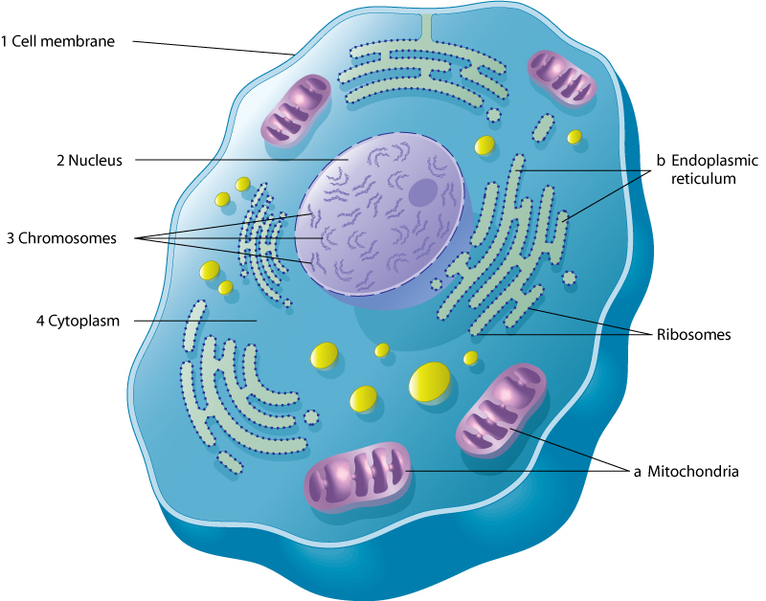
Structural Organization of the Body (Slide 3 of 7)
CELL—The fundamental unit of all living things
Notes:
What is karyotyping and when is it used? (Chromosomes are analyzed to determine if they are normal in number and structure. Obstetricians often recommend an amniocentesis for a pregnant woman.)
What is cytoplasm? (It includes all material outside the nucleus.)
What are mitochondria? (Small, sausage-shaped bodies that produce energy by burning food)

Slide 9
Study Section 1
Anabolism
Catabolism
Cell membrane
Chromosomes
Cytoplasm
DNA
Endoplasmic reticulum
Genes
Karyotype
Metabolism
Mitochondria
Nucleus

Slide 10
Structural Organization of the Body (Slide 4 of 7)
Cells are specialized to carry out individual functions.
Types of cells include:
Muscle cell
Nerve cell
Epithelial cell
Fat cell

Slide 11
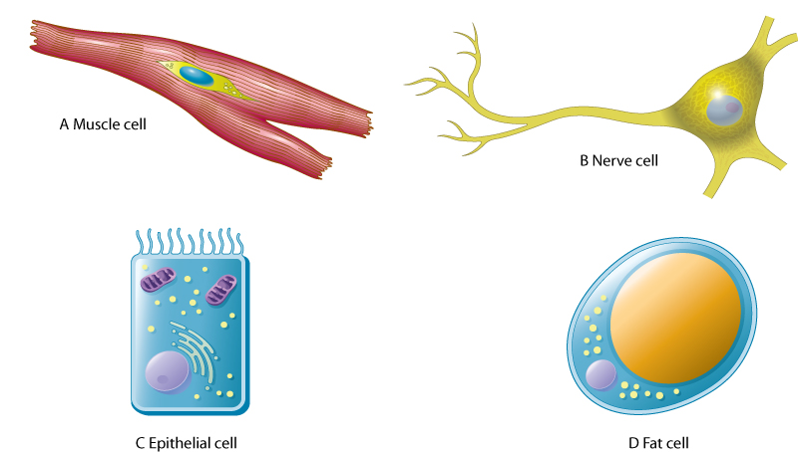
Structural Organization of the Body (Slide 5 of 7)
Types of cells

Slide 12
Structural Organization of the Body (Slide 6 of 7)
Tissues
A tissue is a group of similar cells working together to do a specific job.
Organs
Different types of tissue combine to form an organ
Systems
Groups of organs working together to perform complex functions
Notes:
What is the term for a scientist who specializes in the study of tissue? (Histologist)
Which tissue conducts impulses all over the body? (Nerve)
Examples of what type of tissue include fat and cartilage? (Connective)
What tissue forms the linings of internal organs and the outer surface of the skin? (Epithelial)
What defines a system? (Group of organs working together to perform complex functions)
Name the system in which these organs are found:
Thyroid gland and pituitary gland (endocrine)
Kidneys, ureters, urinary bladder urethra (urinary or excretory)
Skin, hair, nails, sweat glands (skin and sense organs)

Slide 13
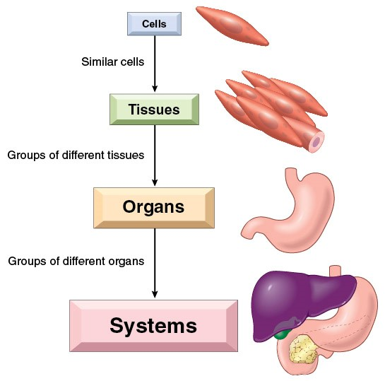
Structural Organization of the Body (Slide 7 of 7)

Slide 14
Study Section 2
Adipose tissue
Cartilage
Epithelial cells
Histologist
Larynx
Pharynx
Pituitary gland
Thyroid gland
Trachea
Ureter
Urethra
Uterus
Viscera

Slide 15
Body Cavities (Slide 1 of 2)
Body cavities are the spaces within the body that contain internal organs (viscera) and include:
Cranial
Thoracic
Abdominal Pelvic
Spinal
Notes:
Which cavities are dorsal and which are ventral? (Cranial and spinal are dorsal; thoracic, abdominal, and pelvic are ventral.)

Slide 16
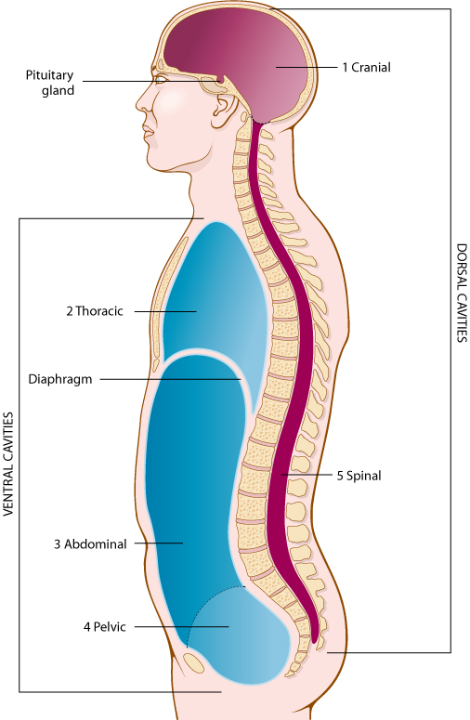
Body Cavities (Slide 2 of 2)
Body cavities are the spaces within the body that contain internal organs (viscera).

Slide 17
Body Cavities and Organs
Cavity | Organ(s)
Cranial | Brain
Thoracic | Lungs, heart, esophagus, trachea, bronchial tubes, thymus gland, aorta
Abdominal | Stomach, small and large intestines, spleen, pancreas, liver, gall bladder
Pelvic | Portions of the small and large intestines, bladder, rectum, urethra, ureters; uterus and vagina in female
Spinal | Nerves of the spinal cord

Slide 18
QUICK QUIZ (Slide 1 of 5)
Which body cavity contains the pleural cavity and the mediastinum?
Cranial
Pelvic
Spinal
Thoracic
Notes:
The correct answer is D: the thoracic cavity contains the pleural cavity and the mediastinum.

Slide 19
QUICK QUIZ (Slide 2 of 5)
Which body cavity contains the peritoneum?
Abdominal
Pelvic
Spinal
Thoracic
Notes:
The correct answer is A: the abdominal cavity contains the peritoneum.

Slide 20
Organs of the Abdominopelvic and Thoracic Cavities (Slide 1 of 2)
Trachea
Lung
Diaphragm
Liver
Gallbladder
Pancreas
Colon
Appendix
Bladder
Thyroid gland
Aorta
Heart
Spleen
Stomach
Colon
Small intestine
Sigmoid colon

Slide 21
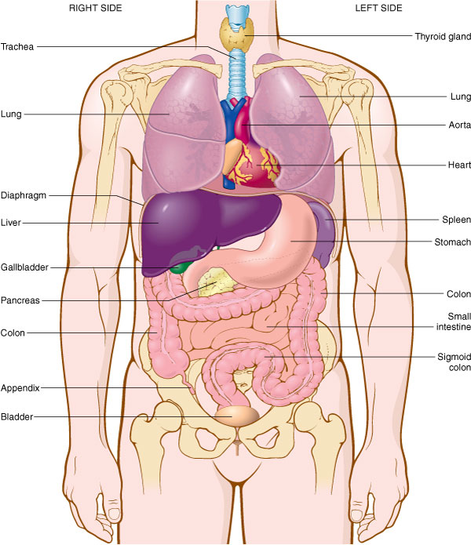
Organs of the Abdominopelvic and Thoracic Cavities (Slide 2 of 2)

Slide 22
Study Section 3
Abdominal cavity
Cranial cavity
Diaphragm
Dorsal (posterior)
Mediastinum
Pelvic cavity
Peritoneum
Pleura
Pleural cavity
Spinal cavity
Thoracic cavity
Ventral (anterior)

Slide 23
Abdominopelvic Regions (Slide 1 of 2)
Right hypochondriac region
Left hypochondriac region
Epigastric region
Right lumbar region
Left lumbar region
Umbilical region
Right inguinal region
Left inguinal region
Hypogastric region

Slide 24
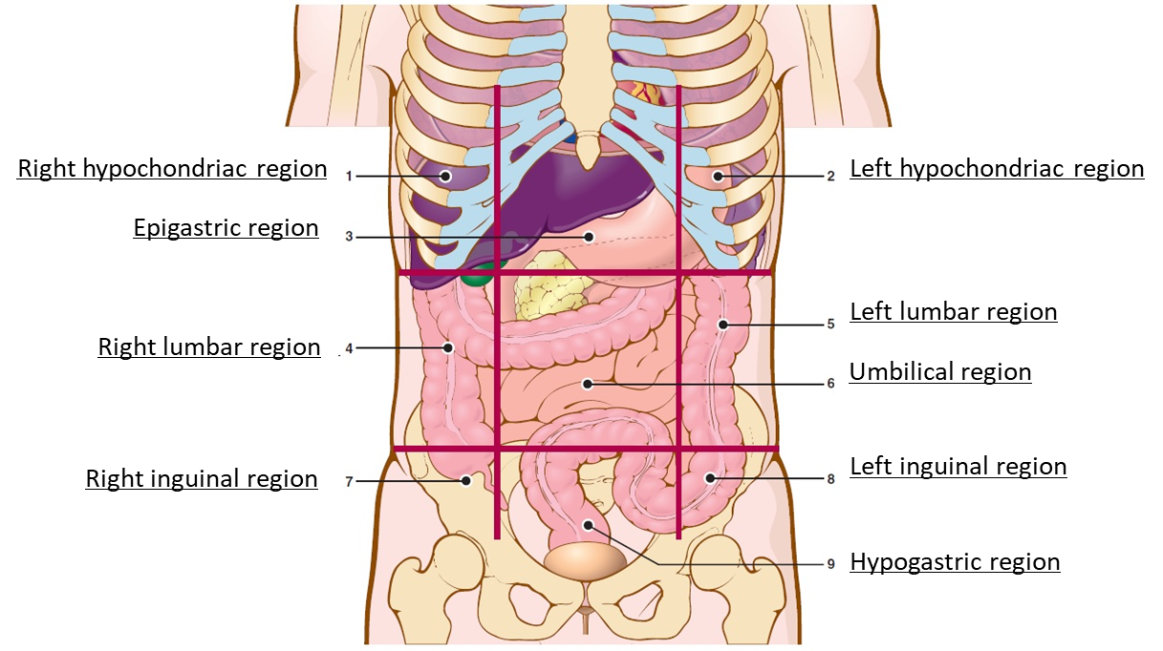
Abdominopelvic Regions (Slide 2 of 2)
Notes:
Have students verbally label the regions of the abdominopelvic cavity.

Slide 25
Abdominopelvic Quadrants (Slide 1 of 2)
Right upper quadrant (RUQ): contains liver (right lobe), gallbladder, part of the pancreas, parts of small and large intestines
Left upper quadrant (LUQ): contains liver (left lobe), stomach, spleen, part of the pancreas, parts of small and large intestines
Right lower quadrant (RLQ): contains parts of small and large intestines, right ovary, right fallopian tube, appendix, right ureter
Left lower quadrant (LLQ): contains parts of small and large intestines, left ovary, left fallopian tube, left ureter
Notes:
Discuss the organs in each quadrant.

Slide 26
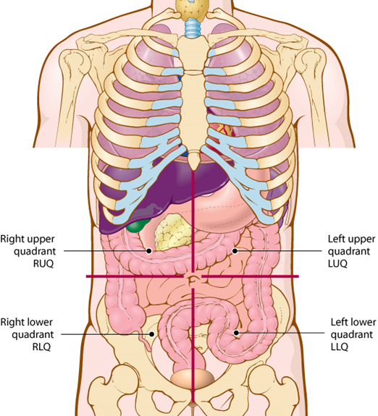
Abdominopelvic Quadrants (Slide 2 of 2)
Notes:
Where is the appendix located?
In which quadrant does the liver lie?

Slide 27
Chapter 2 Lesson 2.2
Positions, Directions, Planes, and Terminology
Locate and name the anatomic divisions of the back.
Become acquainted with terms that describe positions, directions, and planes of the body.
Identify the meaning for new word elements and use them to understand medical terms.

Slide 28
Anatomical Divisions of the Back (Slide 1 of 2)
Cervical
Thoracic
Lumbar
Sacral
Coccygeal
Notes:
What is cervical? (The neck region)
What is thoracic? (The chest region)
What is lumbar? (Waist or flank region)
What is sacral? (Five bones are fused to form the sacrum.)
What is coccygeal? (The tailbone is composed of four fused pieces.)

Slide 29
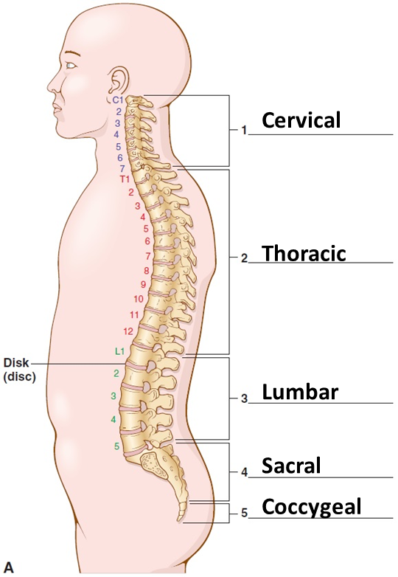
Anatomical Divisions of the Back (Slide 2 of 2)
Notes:
What is a disc? (A small pad of cartilage between the vertebrae)

Slide 30
Study Section 4 (Slide 1 of 2)
Abdominopelvic Regions:
Hypochondriac
Epigastric
Lumbar
Umbilical
Inguinal
Hypogastric
Abdominopelvic Quadrants:
RUQ
LUQ
RLQ
LLQ

Slide 31
Study Section 4 (Slide 2 of 2)
Divisions of the Back:
Cervical
Thoracic
Lumbar
Sacral
Coccygeal
Related Terms:
Vertebra
Vertebrae
Spinal column
Spinal cord
Disc

Slide 32
QUICK QUIZ (Slide 3 of 5)
Name the abdominopelvic region that is located in the central region near the navel.
Inguinal
Umbilical
Lumbar
Hypochondriac
Notes:
The correct answer is B: umbilical.

Slide 33
QUICK QUIZ (Slide 4 of 5)
Name the abdominopelvic region that is located in the lower middle below the umbilical region.
Inguinal
Epigastric
Lumbar
Hypogastric
Notes:
The correct answer is D: hypogastric.

Slide 34
Positional and Directional Terms of the Body
Inferior
Superior
Medial
Lateral
Supine
Prone
Positional and Directional Terms
Anterior
Posterior
Deep
Superficial
Proximal
Distal
Notes:
Match the definition to one of these terms:
The front side of the body (anterior)
The back side of the body (posterior)
Away from the surface (deep)
On the surface (superficial)
Near the point of attachment to the trunk or near the beginning of a structure (proximal)
Far from the point of attachment to the trunk or far from the beginning of a structure (distal)
Below another structure (inferior)
above another structure (superior)

Slide 35
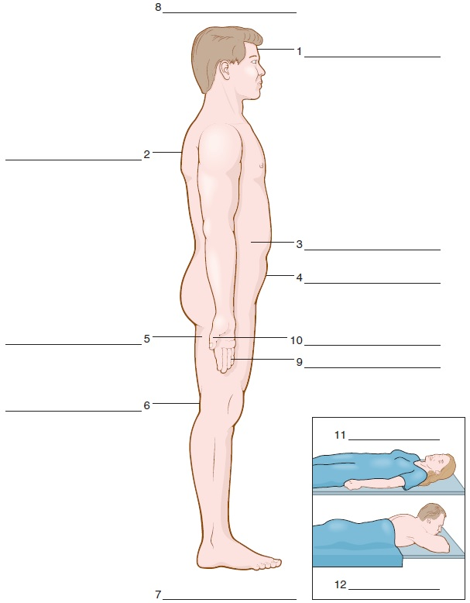
Positional and Directional Terms
1. anterior
2. posterior
3. deep
4. superficial
5. proximal
6. distal
7. inferior
8. superior
9. medial
10. lateral
11. supine
12. prone
Notes:
How could the following conditions be identified?
A bruise on the forehead (anterior; superficial)
A cramp in the left ovary (lateral; deep)
A callus on the ball of the foot (inferior)

Slide 36
Planes of the Body (Slide 1 of 2)
Frontal (coronal)
Sagittal (lateral)
Transverse (cross-sectional or axial)
Notes:
A plane running across the body parallel to the ground (transverse)
A vertical plane dividing the body into anterior and posterior portions (frontal)
A lengthwise vertical plane dividing the body into right and left sides (sagittal)

Slide 37
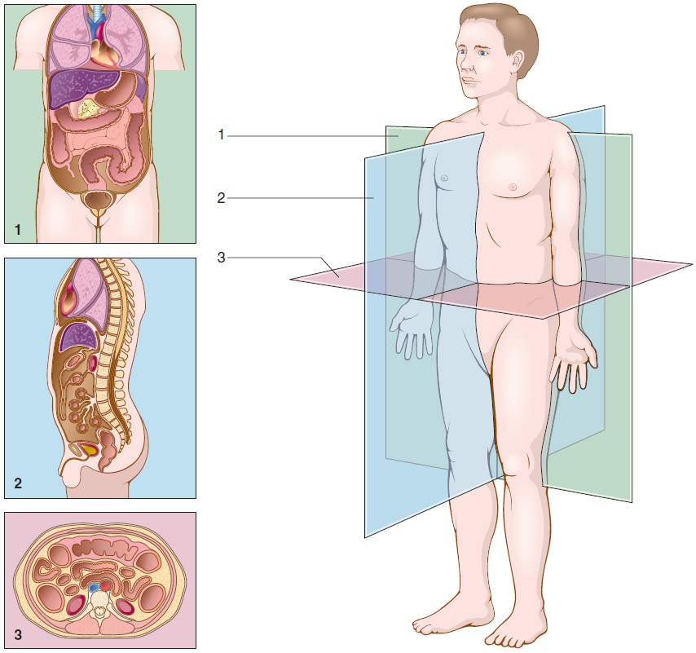
Planes of the Body (Slide 2 of 2)
1. Frontal (coronal) 2. Sagital (lateral) 3. Transverse (axial)

Slide 38
Study Section 5
Anterior (ventral)
Deep
Distal
Frontal (coronal) plane
Inferior
Lateral
Medial
Posterior (dorsal)
Prone
Proximal
Sagittal (lateral) plane
Superficial
Superior (cephalic)
Supine
Transverse (axial) plane

Slide 39
Combining Forms, Suffixes, and Prefixes (Slide 1 of 20)
Combining Form
abdomin/o
adip/o
anter/o

Slide 40
Combining Forms, Suffixes, and Prefixes (Slide 2 of 20)
Combining Form | Meaning
abdomin/o | abdomen
adip/o | fat
anter/o | front

Slide 41
Combining Forms, Suffixes, and Prefixes (Slide 3 of 20)
Combining Form
cervic/o
chondr/o
chrom/o
coccyg/o

Slide 42
Combining Forms, Suffixes, and Prefixes (Slide 4 of 20)
Combining Form | Meaning
cervic/o | neck (of the body or uterus)
chondr/o | cartilage
chrom/o | color
coccyg/o | coccyx (tailbone)

Slide 43
Combining Forms, Suffixes, and Prefixes (Slide 5 of 20)
Combining Form
crani/o
cyt/o
dist/o
dors/o

Slide 44
Combining Forms, Suffixes, and Prefixes (Slide 6 of 20)
Combining Form | Meaning
crani/o | skull
cyt/o | cell
dist/o | far, distant
dors/o | back portion of the body

Slide 45
Combining Forms, Suffixes, and Prefixes (Slide 7 of 20)
Combining Form
hist/o, histi/o
ili/o
inguin/o
kary/o

Slide 46
Combining Forms, Suffixes, and Prefixes (Slide 8 of 20)
Combining Form | Meaning
hist/o, histi/o | tissue
ili/o | ilium (of the hip bone)
inguin/o | groin
kary/o | nucleus

Slide 47
Combining Forms, Suffixes, and Prefixes (Slide 9 of 20)
Combining Form
later/o
lumb/o
medi/o
nucle/o

Slide 48
Combining Forms, Suffixes, and Prefixes (Slide 10 of 20)
Combining Form | Meaning
later/o | side
lumb/o | lower back
medi/o | middle
nucle/o | nucleus

Slide 49
Combining Forms, Suffixes, and Prefixes (Slide 11 of 20)
Combining Form
pelv/i
pharyng/o
poster/o
proxim/o
sacr/o

Slide 50
Combining Forms, Suffixes, and Prefixes (Slide 12 of 20)
Combining Form | Meaning
pelv/i | pelvis
pharyng/o | pharynx (throat)
poster/o | back, behind
proxim/o | nearest
sacr/o | sacrum

Slide 51
Combining Forms, Suffixes, and Prefixes (Slide 13 of 20)
Combining Form
sarc/o
spin/o
thel/o, theli/o
thorac/o
trache/o

Slide 52
Combining Forms, Suffixes, and Prefixes (Slide 14 of 20)
Combining Form | Meaning
sarc/o | flesh
spin/o | spine, backbone
thel/o, theli/o | nipple
thorac/o | chest
trache/o | trachea, windpipe

Slide 53
Combining Forms, Suffixes, and Prefixes (Slide 15 of 20)
Combining Form
umbilic/o
ventr/o
vertebr/o
viscer/o

Slide 54
Combining Forms, Suffixes, and Prefixes (Slide 16 of 20)
Combining Form | Meaning
umbilic/o | navel, umbilicus
ventr/o | belly side of the body
vertebr/o | vertebra(e), backbone(s)
viscer/o | internal organs

Slide 55
Combining Forms, Suffixes, and Prefixes (Slide 17 of 20)
Prefix
ana-
cata-
epi-
hypo-
inter-
intra-
meta-

Slide 56
Combining Forms, Suffixes, and Prefixes (Slide 18 of 20)
Prefix | Meaning
ana- | up
cata- | down
epi- | above
hypo- | below
inter- | between
intra- | within
meta- | change

Slide 57
Combining Forms, Suffixes, and Prefixes (Slide 19 of 20)
Suffix
-eal
-iac
-ior
-ism
-ose
-plasm
-somes
-type

Slide 58
Combining Forms, Suffixes, and Prefixes (Slide 20 of 20)
Suffix | Meaning
-eal | pertaining to
-iac | pertaining to
-ior | pertaining to
-ism | process, condition
-ose | pertaining to, full of
-plasm | formation
-somes | bodies
-type | picture, classification

Slide 59
QUICK QUIZ (Slide 5 of 5)
Which term means process of cutting the skull?
Thoracotomy
Craniotomy
Discectomy
Arthroscopy
Notes:
The correct answer is B: craniotomy.

