Slide 1
The Language of Medicine 13th edition
Davi-Ellen Chabner

Slide 2
Chapter 3 Suffixes

Slide 3
Chapter Goals
Define new suffixes and review those presented in previous chapters.
Gain practice in word analysis by using these suffixes with combining forms to build and understand terms.
Identify the functions of the different types of blood cells in the body.

Slide 4
Chapter 3 Lesson 3.1

Slide 5
Combining Forms (Slide 1 of 7)
Combining Form | Meaning
abdomin/o | abdomen
acr/o | extremities, top, extreme point
acu/o | sharp, severe, sudden
aden/o | gland
adip/o | fat
amni/o | amnion
angi/o | vessel
arteri/o | artery
arthr/o | joint
axill/o | armpit

Slide 6
Combining Forms (Slide 2 of 7)
Combining Form | Meaning
bi/o | life
blephar/o | eyelid
bronch/o | bronchial tubes
carcin/o | cancer
cardi/o | heart
chem/o | drug, chemical
chondr/o | cartilage
chron/o | time
col/o | colon (large intestine)
cyst/o | urinary bladder

Slide 7
Combining Forms (Slide 3 of 7)
Combining Form | Meaning
encephal/o | brain
erythr/o | red
hem/o | blood
hepat/o | liver
hydr/o | water, fluid
inguin/o | groin
isch/o | to hold back
lapar/o | abdomen, abdominal wall
laryng/o | larynx
leuk/o | white

Slide 8
Combining Forms (Slide 4 of 7)
Combining Form | Meaning
lymph/o | lymph
mamm/o | breast
mast/o | breast
morph/o | shape, form
muc/o | mucus
my/o | muscle
myel/o | spinal cord, bone marrow
necr/o | death (of cells or whole body)
nephr/o | kidney
neur/o | nerve

Slide 9
Combining Forms (Slide 5 of 7)
Combining Form | Meaning
neutr/o | neutrophil
nucle/o | nucleus
ophthalm/o | eye
oste/o | bone
ot/o | ear
path/o | disease
peritone/o | peritoneum
phag/o | to eat, swallow
phleb/o | vein
plas/o | formation, development

Slide 10
Combining Forms (Slide 6 of 7)
Combining Form | Meaning
pleur/o | pleura
pneumon/o | lungs
pulmon/o | lungs
radi/o | x-rays
rect/o | rectum
ren/o | kidney
rhin/o | nose
sarc/o | flesh
splen/o | spleen
staphyl/o | clusters

Slide 11
Combining Forms (Slide 7 of 7)
Combining Form | Meaning
strept/o | twisted chains
thorac/o | chest
thromb/o | clot
tonsill/o | tonsils
trache/o | trachea (windpipe)
ven/o | vein

Slide 12
Suffixes and Terminology – Noun Suffixes (Slide 1 of 7)
Suffix | Meaning
-algia | pain
-cele | hernia
-centesis | puncture to remove fluid
-coccus (plural: -cocci) | berry-shaped bacterium
-cyte | cell

Slide 13
Suffixes and Terminology – Noun Suffixes (Slide 2 of 7)
Suffix | Meaning
-dynia | pain
-ectomy | excision, removal, resection
-emia | blood condition
-genesis | condition of producing, forming
-gram | record

Slide 14
Suffixes and Terminology – Noun Suffixes (Slide 3 of 7)
Suffix | Meaning
-graph | instrument for recording
-graphy | process of recording
-itis | inflammation
-logy | study of
-lysis | breakdown, destruction, separation

Slide 15
Suffixes and Terminology – Noun Suffixes (Slide 4 of 7)
Suffix | Meaning
-malacia | softening
-megaly | enlargement
-oma | tumor, mass, collection of fluid
-opsy | to view
-osis | condition, usually abnormal

Slide 16
Suffixes and Terminology – Noun Suffixes (Slide 5 of 7)
Suffix | Meaning
-pathy | disease condition
-penia | deficiency
-phobia | fear
-plasia | development, formation, growth
-plasty | surgical repair

Slide 17
Suffixes and Terminology – Noun Suffixes (Slide 6 of 7)
Suffix | Meaning
-ptosis | drooping, falling, prolapse
-rrhea | flow, discharge
-sclerosis | hardening
-scope | instrument for visual examination
-scopy | process of visual examination (with an endoscope)
-stasis | controlling, stopping

Slide 18
Suffixes and Terminology – Noun Suffixes (Slide 7 of 7)
Suffix | Meaning
-stomy | opening to form a mouth (stoma)
-therapy | treatment
-tomy | incision, cutting into
-trophy | development, nourishment

Slide 19
QUICK QUIZ (Slide 1 of 3)
1. Which term means fear of heights?
A. Acromegaly
B. Hydrophobia
C. Acrophobia
D. Agoraphobia
Notes:
The correct answer is C: acrophobia.

Slide 20
Suffixes and Terminology – Shorter Noun Suffixes
Suffix | Meaning
-er | one who
-ia | condition
-ist | specialist
-ole | little, small
-ule | little, small
-um, -ium | structure, tissue
-us | structure, substance
-y | condition, process

Slide 21
Suffixes and Terminology – Adjective Suffixes (Slide 1 of 2)
Suffix | Meaning
-ac, -iac | pertaining to
-al | pertaining to
-ar | pertaining to
-ar | pertaining to
-eal | pertaining to
-genic | pertaining to producing, produced by, or in

Slide 22
Suffixes and Terminology – Adjective Suffixes (Slide 2 of 2)
Suffix | Meaning
-ic, -ical | pertaining to
-oid | resembling
-ose | pertaining to, full of
-ous | pertaining to
-tic | pertaining to

Slide 23
Build Terms with Suffixes and Combining Forms
Combining Form + Suffix | Meaning
arthr/itis | inflammation of joint
blephar/o/ptosis | drooping eyelid
isch/emia | loss of normal blood flow
oste/o/genic | produced by bone tissue
staphyl/o/cocci | berry-shaped bacteria that grow in clusters

Slide 24
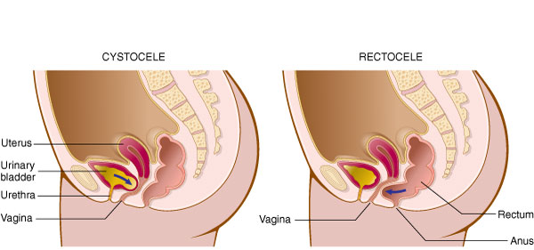
A Closer Look: Hernia
Protrusion of an organ or the muscular wall of an organ through the cavity that normally contains it

Slide 25
QUICK QUIZ (Slide 2 of 3)
2. A rectocele is:
a herniation of the intestines
protrusion of a portion of the rectum toward the vaginal wall
a hiatal hernia
an omphalocele
Notes:
The correct answer is B.

Slide 26
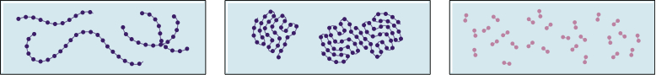
A Closer Look: Streptococcus
Streptococcus and Staphylococcus: Bacteria that grow in chains or clusters

Slide 27
A Closer Look: Blood Cells (Slide 1 of 8)
1. Erythrocytes
2. Leukocytes
3. Thrombocytes or platelets
Red blood cells
White blood cells
Clotting cells

Slide 28
A Closer Look: Blood Cells (Slide 2 of 8)
1. Erythrocytes
Red blood cells
Made in bone marrow
Carry oxygen from the lungs to all body cells
Hemoglobin: blood protein
Notes:
What is hemoglobin? What purpose does it serve?

Slide 29
A Closer Look: Blood Cells (Slide 3 of 8)
2. Leukocytes
White blood cells
Five different kinds of leukocytes, divided into two categories
Granulocytes
Mononuclear leukocytes
Notes:
What is the distinction between granulocytes and mononuclear leukocytes?
An easy way to remember the names of the five leukocytes is: Never (neutrophil) Let (lymphocyte) Monkeys (monocyte) Eat (eosinophil) Bananas (basophil).

Slide 30
A Closer Look: Blood Cells (Slide 4 of 8)
Granulocytes – three types
Eosinophils
Basophils
Neutrophils
Notes:
Formed in the blood marrow
Eosinophils – active and elevated in allergic conditions such as asthma
Basophils – play a role in inflammation
Neutrophils – important disease-fighting cells
What do the prefixes for each type reflect?
What are some other names for neutrophils?

Slide 31
A Closer Look: Blood Cells (Slide 5 of 8)
Mononuclear cells – two types
Lymphocytes
Monocytes
Notes:
Lymphocytes fight disease by producing antibodies that destroy foreign bodies.
Monocytes engulf and destroy cellular debris after neutrophils have attacked foreign cells.
What are two types of lymphocytes?
What are macrophages?

Slide 32
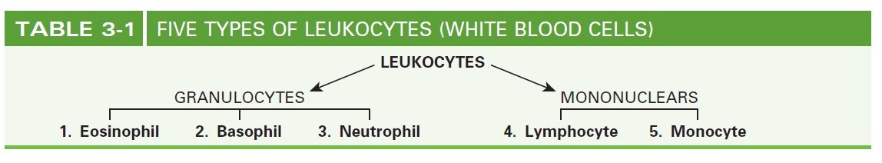
A Closer Look: Blood Cells (Slide 6 of 8)

Slide 33
A Closer Look: Blood Cells (Slide 7 of 8)
3. Thrombocytes
Also known as platelets
Tiny fragments of blood cells that are formed in the bone marrow
Necessary for blood clotting

Slide 34
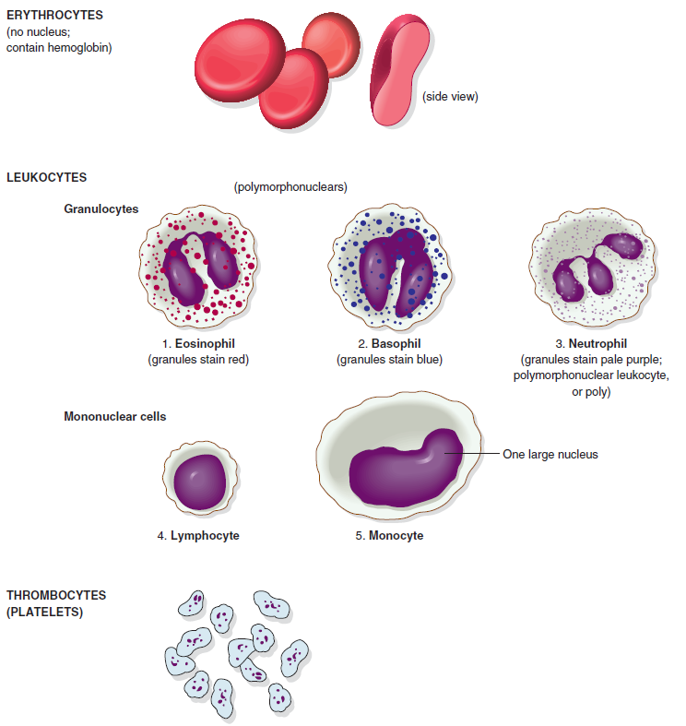
A Closer Look: Blood Cells (Slide 8 of 8)

Slide 35
QUICK QUIZ (Slide 3 of 3)
3. Which type of blood cells are necessary for clotting?
A. Erythrocytes
B. Granulocytes
C. Monocytes
D. Thrombocytes
Notes:
The correct answer is D: thrombocytes. Thrombocytes are actually tiny fragments of cells formed in the bone marrow and necessary for blood clotting.

Slide 36
A Closer Look: Acromegaly
Endocrine disorder
Occurs when the pituitary gland produces an excessive amount of growth hormone after completion of puberty
Often results from a benign tumor of the pituitary gland
Person typically is of normal height, but bones and soft tissue in the hands, feet, and face grow abnormally
Abraham Lincoln was believed to have features of acromegaly
Notes:
What usually causes the excessive amount of growth hormone found in acromegaly?

Slide 37
A Closer Look: Laparoscopy
A form of minimally invasive surgery
Visual examination of the abdominal cavity using a laparoscope, a lighted telescopic instrument
Surgeon inserts the laparoscope through an incision in the abdomen near the navel
Used to examine abdominal viscera for evidence of disease or for various procedures
Notes:
Laparoscope – a lighted telescopic instrument
What are the specific uses of laparoscopy?

Slide 38
A Closer Look: Adenoids
Small masses of lymphatic tissue
Located in the part of the pharynx near the nose and nasal passages
The literal meaning, “resembling glands,” is appropriate since they are neither endocrine nor exocrine glands
Adenoidectomy may be needed if they become enlarged and block the airway from the nose to the pharynx
Notes:
What is the literal meaning of adenoids?
What may happen if adenoids become enlarged?

