Slide 1
The Language of Medicine 13th edition
Davi-Ellen Chabner

Slide 2
Chapter 4 Prefixes

Slide 3
Chapter Goals
Define basic prefixes used in the medical language.
Analyze medical terms that combine prefixes and other word elements.
Learn about the Rh condition as an example of an antigen-antibody reaction.

Slide 4
Combining Forms (Slide 1 of 3)
Combining Form | Meaning
carp/o | wrist bones
cis/o | cut
cost/o | rib
cutane/o | skin
dactyl/o | fingers, toes
duct/o | lead, carry
flex/o | bend
gloss/o | tongue

Slide 5
Combining Forms (Slide 2 of 3)
Combining Form | Meaning
glyc/o | sugar
immun/o | protection
morph/o | shape, form
mort/o | death
nat/i | birth
norm/o | rule, order
ox/o | oxygen
pub/o | pubis; anterior portion of the pelvis
seps/o | infection

Slide 6
Combining Forms (Slide 3 of 3)
Combining Form | Meaning
somn/o | sleep
son/o | sound
the/o | put, place
thel/o, theli/o | nipple
tens/o | force, strain, stretch
thyr/o | thyroid gland; shield
top/o | place, position, location
tox/o | poison
trache/o | windpipe, trachea
urethr/o | urethra

Slide 7
Suffixes (Slide 1 of 2)
Suffix | Meaning
-crine | secrete
-drome | run
-fusion | coming together; to pour
-gea | substance that produces
-lapse | slide, fall, sag
-lysis | breakdown, destruction, separation
-meter | measure
-mission | send
-or | one who
-oxia | oxygen

Slide 8
Suffixes (Slide 2 of 2)
Suffix | Meaning
-partum | birth, labor
-phoria | bear, carry; feeling
-physis | grow
-plasia | development, formation, growth
-plasm | structure or formation
-pnea | breathing
-ptom | happening
-ptosis | falling, drooping, prolapse
-rrhea | flow, discharge
-stasis | stopping, controlling
-trophy | development, nourishment

Slide 9
Chapter 4 Lesson 4.1

Slide 10
Prefixes and Terminology (Slide 1 of 9)
Prefix | Meaning
a-, an- | no, not, without
ab- | away from
ad- | toward
ana- | up, apart
ante- | before, forward

Slide 11
Prefixes and Terminology (Slide 2 of 9)
Prefix | Meaning
anti- | against
auto- | self, own
bi- | two
brady- | slow
cata- | down
con- | with, together

Slide 12
Prefixes and Terminology (Slide 3 of 9)
Prefix | Meaning
contra- | against, opposite
de- | down, lack of
dia- | through, complete
dys- | abnormal, bad, painful, difficult
ec- | out, outside
endo- | in, within

Slide 13
Prefixes and Terminology (Slide 4 of 9)
Prefix | Meaning
epi- | upon, on, above
eu- | good, normal
ex- | out, outside
hemi- | half
hyper- | excessive, above
hypo- | deficient, under

Slide 14
Prefixes and Terminology (Slide 5 of 9)
Prefix | Meaning
in- | not
in- | into, within
infra- | beneath, under
inter- | between
intra- | in, within, into
macro- | large

Slide 15
Prefixes and Terminology (Slide 6 of 9)
Prefix | Meaning
mal- | bad
meta- | beyond, change
micro- | small
neo- | new
pan- | all
para- | abnormal, beside, near

Slide 16
Prefixes and Terminology (Slide 7 of 9)
Prefix | Meaning
per- | through
peri- | surrounding
poly- | many, much
post- | after, behind
pre- | before, in front of
pro- | before, forward

Slide 17
Prefixes and Terminology (Slide 8 of 9)
Prefix | Meaning
pros- | before, forward
re- | back, again
retro- | behind, backward
sub- | under
supra- | above, upper
syn-, sym- | together, with

Slide 18
Prefixes and Terminology (Slide 9 of 9)
Prefix | Meaning
tachy- | fast
trans- | across, through
ultra- | beyond, excess
uni- | one

Slide 19
QUICK QUIZ (Slide 1 of 3)
1. Which term means a muscle that draws a limb TOWARD the body? (Watch spelling!)
A. Adducter
B. Abductor
C. Adductor
D. Abducter
Notes:
The correct answer is C: adductor. (Answer A is misspelled. Answer B means a muscle that draws a limb away from the body. Answer D is misspelled.)

Slide 20
QUICK QUIZ (Slide 2 of 3)
2. Which term means painful breathing?
A. Dyspnea
B. Dysplasia
C. Apnea
D. Cephalgia
Notes:
The correct answer is A: dyspnea; dys- means painful; -pnea means breathing. Remember, medical terms do not need to have a root or combining form. Dyspnea, for example, has a prefix and a suffix with an imbedded root.

Slide 21
A Closer Look: Antigens and Antibodies; the Rh Condition
Background on Rh Condition
Antigen: A substance, usually foreign to the body, that stimulates the production of antibodies.
Antibodies: Protein substances made by white blood cells in response to the presence of foreign antigens.
Notes:
Antigen examples: poison, flu virus, bacterium
Immune reaction: reaction between an antigen and antibody
What is a common name for an immune reaction against normally nonthreatening antigens?

Slide 22
Rh Condition (Slide 1 of 2)
Rh Condition: An antigen-antibody condition that develops when there is a difference in Rh blood factor between that of the pregnant mother (Rh negative) and that of the fetus (Rh positive).
Notes:
Discuss how Rh condition occurs.
First pregnancy with Rh+ baby: the baby is not affected but the Rh- mother is sensitized.
Second pregnancy with Rh+ baby: the baby develops hemolytic disease of the newborn (HDN).
Symptom of HDN: jaundice.
How can the condition be prevented? (Prevent Rh condition with Rh immune globulin injection to Rh- woman within 72 hours of delivery, miscarriage, or abortion of an Rh+ fetus.)

Slide 23
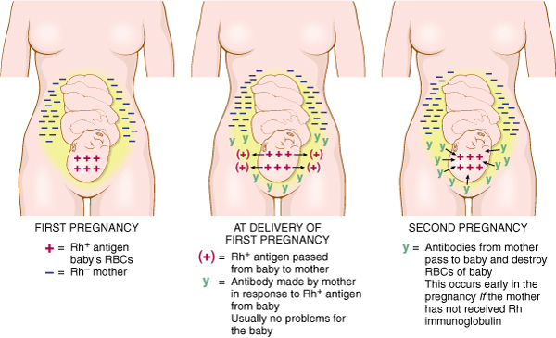
Rh Condition (Slide 2 of 2)

Slide 24
QUICK QUIZ (Slide 3 of 3)
3. Antibodies are made by what type of cell?
A. Platelets
B. Leukocytes
C. Thrombocytes
D. Erythrocytes
Notes:
The correct answer is B: leukocytes or white blood cells.

Slide 25
A Closer Look: Congenital Anomaly
Congenital anomaly: An irregularity in a structure or organ that an infant is born with.
Examples are webbed fingers or toes (syndactyly), heart defects, and clubbed feet
Some congenital anomalies are hereditary; others are produced by factors present during pregnancy; for example, fetal alcohol syndrome when a pregnant woman drinks high levels of alcohol, resulting in physical and mental defects in the infant at birth
Notes:
What are some examples of congenital anomalies?
What are some causes of nonhereditary congenital anomalies?

Slide 26
A Closer Look: Recombinant DNA
Recombinant DNA: Taking a gene from one organism and inserting it into the DNA of another organism.
Recombinant techniques are used to manufacture insulin outside the body
CRISPER is an acronym for a technique to change DNA sequences and turn off genes or replace them with new versions.
Notes:
Describe the recombinant DNA technique used to manufacture insulin outside the body.
CRISPER is an acronym: clustered regularly interspaced short palindromic repeats.

Slide 27
A Closer Look: Syndromes
Syndrome: A group of signs or symptoms that commonly occur together and indicate a particular disease or abnormal condition
Reye syndrome is characterized by vomiting, swelling of the brain, increased intracranial pressure, hypoglycemia, and dysfunction of the liver; may occur in children after a viral infection that has been treated with aspirin
Notes:
List a syndrome example (other than Reye syndrome and fetal alcohol syndrome), and ask students to list the symptoms.

Slide 28
A Closer Look: Transurethral Resection of the Prostate Gland
Transurethral resection of the prostate gland (TURP)
A portion of the prostate gland is removed with an instrument passed through (trans-) the urethra
The procedure is indicated when prostatic tissue increases (hyperplasia) and interferes with urination

Slide 29
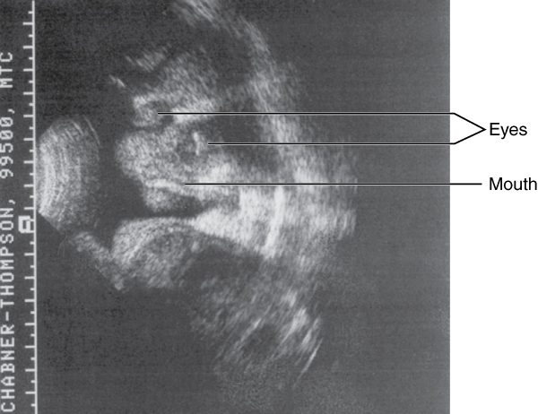
A Closer Look: Ultrasonography
Ultrasonography: Diagnostic technique using ultrasound waves to produce an image or photograph of an organ or tissue.
Echocardiogram: ultrasound image of the heart
Sonogram: fetal ultrasound image

