Slide 1
The Language of Medicine 13th edition
Davi-Ellen Chabner

Slide 2
Chapter 5 Digestive System

Slide 3
Chapter Goals
Name the organs of the digestive system and describe their locations and functions.
Define combining forms for organs and know the meaning of related terminology.
Describe signs, symptoms, and disease conditions affecting the digestive system.

Slide 4
Chapter 5 Lesson 5.1

Slide 5
Introduction
The digestive or gastrointestinal system
performs four main functions:
ingestion
digestion
absorption
elimination
Notes:
Define, discuss, and describe the three main functions of the digestive system.
What are enzymes?
What function do they serve in the digestive process?

Slide 6
Introduction: Ingestion and Digestion
Ingestion—food material taken into mouth
Digestion—food is broken down, mechanically and chemically, as it travels through the gastrointestinal tract.
Digestive enzymes aid the breakdown of complex nutrients.
Proteins → amino acids
Sugars → glucose
Fats → fatty acids or triglycerides

Slide 7
Introduction: Absorption
Digested food passes into the bloodstream through lining cells of the small intestine.
Nutrients travel to all cells of the body.
Cells burn nutrients to release the energy stored in food.

Slide 8
Introduction: Elimination
The body eliminates solid waste materials that cannot be absorbed into bloodstream.
The large intestine concentrates feces.
The wastes pass out of the body through the anus.

Slide 9
Organs of the Digestive System
The gastrointestinal tract begins with the oral cavity.
Notes:
In which major systems of the digestive tract do digestion, absorption, and elimination occur?

Slide 10
Oral Cavity (slide 1 of 4)
Major parts of the oral cavity:
Cheeks
Lips
Hard palate
Soft palate
Rugae
Uvula
Tongue
Papillae
Tonsils
Gums
Teeth
Pharynx
Notes:
Quiz students to complete labels.
What is mastication?
What is deglutition?

Slide 11
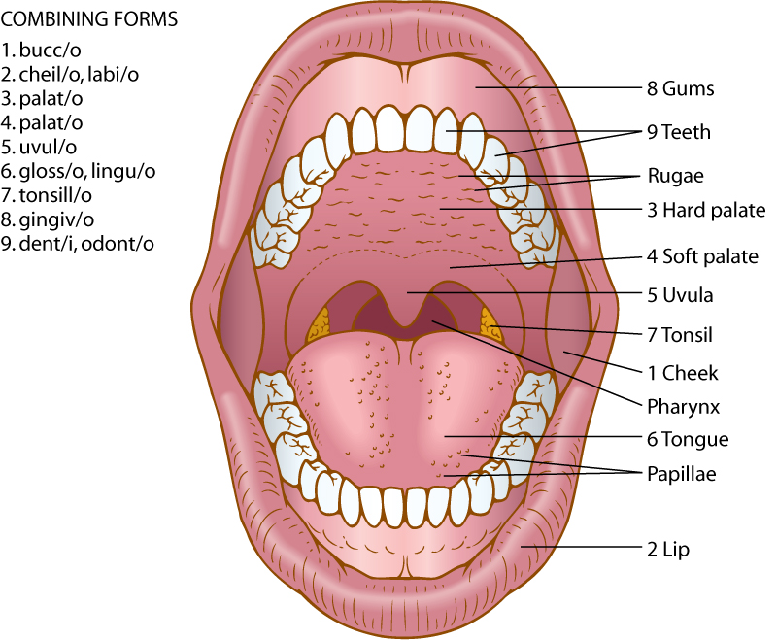
Oral Cavity (slide 2 of 4)
Major parts of the oral cavity
Notes:
Have the students check their answers.
What is mastication?
What is deglutition?

Slide 12
Oral Cavity (slide 3 of 8)
Anatomical terms of a tooth:
Crown
Root
Enamel
Dentin
Pulp
Gingiva
Cementum
Root canal
Periodontal membrane
Notes:
Quiz students to complete labels.
What is a root canal?
Why is it performed?

Slide 13
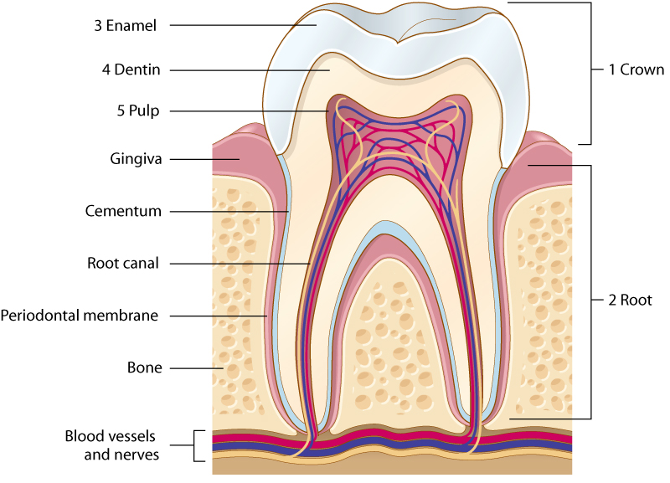
Oral Cavity (slide 4 of 4)
Anatomy of a tooth
Notes:
Have the students check their answers.
What is a root canal?
Why is it performed?

Slide 14
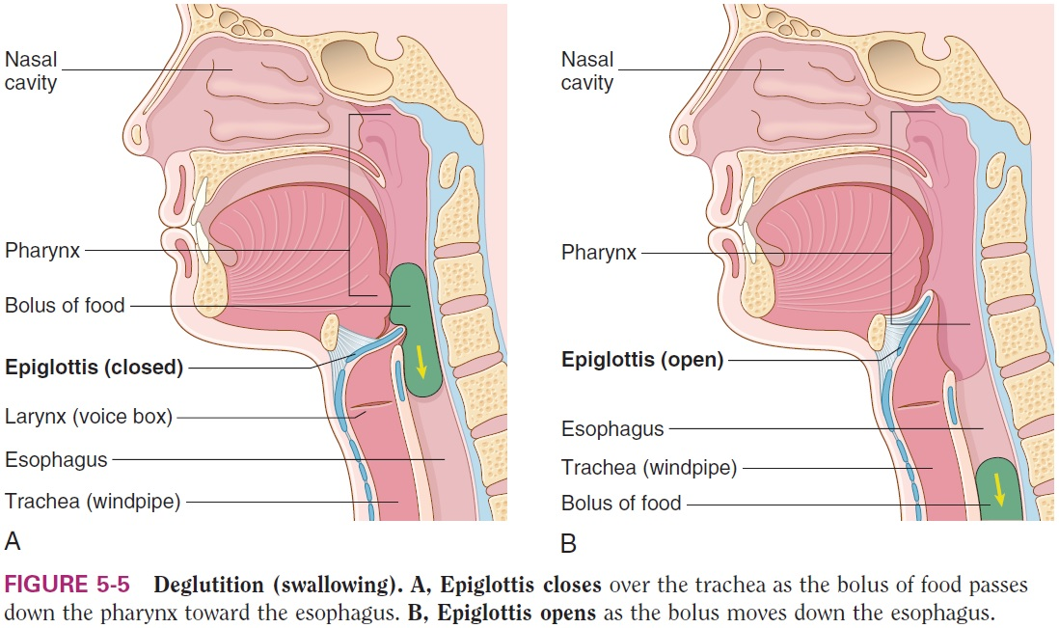
Deglutition (Swallowing)
Notes:
The pharynx is the common passageway for both air and food.
What potential problems do you see with this arrangement?
How does the body address this problem?

Slide 15
Esophagus/Stomach (slide 1 of 2)
Parts of the stomach include:
Lower esophageal sphincter (LES)
Fundus
Greater curvature
Lesser curvature
Rugae
Body
Antrum
Pylorus
Pyloric sphincter
Notes:
The esophagus is a 9- or 10-inch muscular tube that extends from the pharynx to the stomach.
What is a bolus?
How does the esophagus move the bolus toward the stomach?
What are the three parts of the stomach and what are their functions?

Slide 16
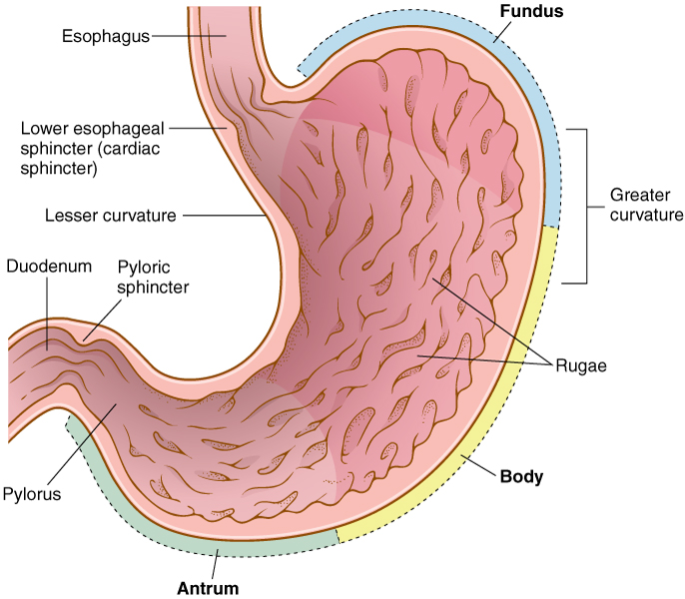
Esophagus/Stomach (slide 2 of 2)
Parts of the stomach
Notes:
The esophagus is a 9- or 10-inch muscular tube that extends from the pharynx to the stomach.
What is a bolus?
How does the esophagus move the bolus toward the stomach?
What are the three parts of the stomach and what are their functions?

Slide 17
The Digestive Tract (slide 1 of 2)
Anatomical terms of the digestive tract:
Esophagus
Stomach
Duodenum
Liver
Gallbladder
Pancreas
Jejunum
Ileum
Cecum
Appendix
Ascending colon
Transverse colon
Descending colon
Sigmoid colon
Rectum
Anus
Notes:
Quiz students to complete labels.
What is the name of the pigment produced from the breakdown of hemoglobin during red blood cell destruction?

Slide 18
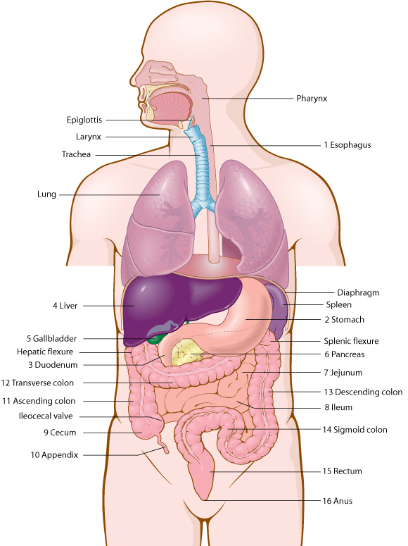
The Digestive Tract (slide 2 of 2)
Notes:
Have the students check their answers.
What is the name of the pigment produced from the breakdown of hemoglobin during red blood cell destruction?

Slide 19
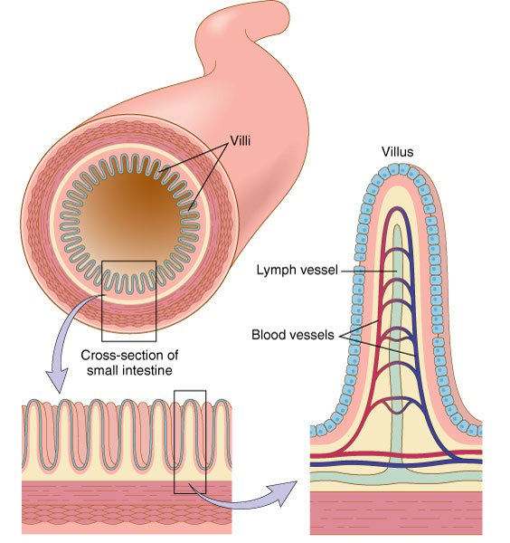
Small Intestine
Villi in the lining of the small intestine
Notes:
What is the function of the villi?

Slide 20
Large Intestine (slide 1 of 2)
Parts of the large intestine:
Cecum
Appendix
Ascending colon
Transverse colon
Descending colon
Sigmoid colon
Rectum
Anus
Notes:
Also known as the colon.
The large intestine extends from the end of the ileum to the anus.
The large intestine receives the fluid waste from digestion and stores it until it can be released from the body.
What are the three sections of the colon and what are their functions?

Slide 21
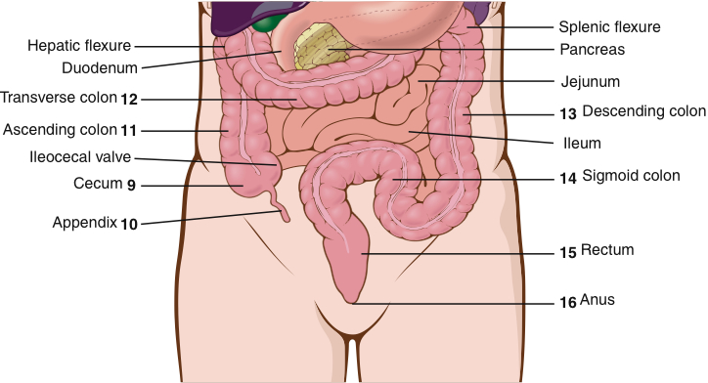
Large Intestine (slide 2 of 2)
Parts of the large intestine
Notes:
Also known as the colon.
The large intestine extends from the end of the ileum to the anus.
The large intestine receives the fluid waste from digestion and stores it until it can be released from the body.
What are the three sections of the colon and what are their functions?

Slide 22
Liver, Gallbladder, and Pancreas (Slide 1 of 5)
Parts of the liver, gallbladder, and pancreas:
Liver
Gallbladder
Common bile duct
Pancreas
Pancreatic duct
Duodenum
Notes:
Quiz students to complete the labels in this figure.
What is emulsification?

Slide 23
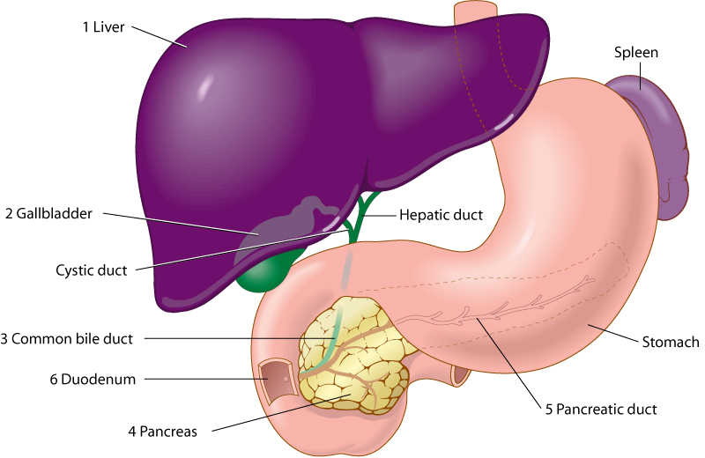
Liver, Gallbladder, and Pancreas (slide 2 of 5)
Parts of the liver, gallbladder, and pancreas
Notes:
Have the students check their answers.
What is emulsification?

Slide 24
Liver, Gallbladder, and Pancreas (slide 3 of 5)
Besides producing bile, the liver:
Helps maintain normal blood glucose levels
Manufactures blood proteins necessary for clotting
Releases bilirubin, a pigment in bile
Removes toxins and poisons from the blood
Notes:
How does the liver maintain blood glucose levels?

Slide 25
QUICK QUIZ (Slide 1 of 4)
1. What happens if bilirubin cannot leave the body and remains in the bloodstream?
Gluconeogenesis
Emulsification
Hyperbilirubinemia
Glycogenolysis
Notes:
The correct answer is C: hyperbilirubinemia (jaundice). Hyperbilirubinemia can show yellow discoloration of the skin, whites of the eyes, and mucous membranes.

Slide 26
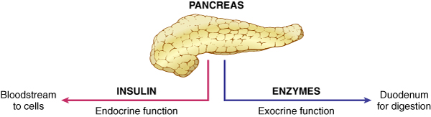
Liver, Gallbladder, and Pancreas (slide 5 of 5)
The pancreas and its functions
Notes:
The pancreas is both an exocrine and endocrine organ.
As an exocrine organ, it produces enzymes to digest starch (amylase), fat (lipase), and proteins (protease).
As an endocrine organ it secretes insulin.
What is the function of insulin?

Slide 27
Food Pathway through the GI Tract (slide 1 of 2)
Food enters through the oral cavity and exits through the anus
Notes:
Quiz students by having them complete the flow chart of how food progresses through the GI tract.

Slide 28
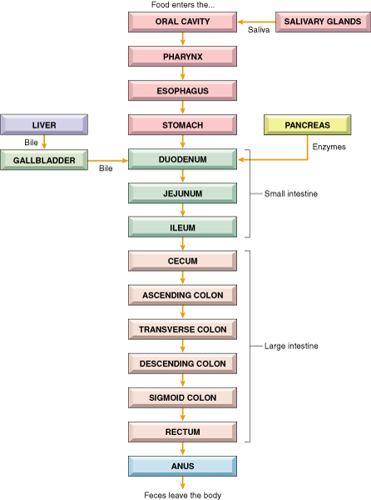
Food Pathway through the GI Tract (slide 2 of 2)

Slide 29
QUICK QUIZ (Slide 2 of 4)
2. Which term is the first part of the large intestine?
Cecum
Duodenum
Jejunum
Pylorus
Notes:
The correct answer is A: the cecum.

Slide 30
QUICK QUIZ (Slide 3 of 4)
3. Which term means swallowing?
Mastication
Deglutition
Emulsification
Peristalsis
Notes:
The correct answer is B: deglutition.

Slide 31
Vocabulary (Slide 1 of 15)
Term | Meaning/Definition
absorption | Passage of materials through the walls of the small intestine into the bloodstream
amino acids | Small building blocks of proteins; released when proteins are digested
amylase | Enzyme secreted by the pancreas and salivary glands to digest starch
anus | Terminal end or opening of the digestive tract to the outside of body

Slide 32
Vocabulary (Slide 2 of 15)
Term | Meaning/Definition
appendix | Blind pouch hanging from the cecum
bile | Digestive juice made in the liver and stored in the gallbladder; breaks up large fat globules; composed of bile pigments, cholesterol, and bile salts
bilirubin | Pigment released by the liver in bile
bowel | Intestine

Slide 33
Vocabulary (Slide 3 of 15)
Term | Meaning/Definition
canine teeth | Pointed, dog-like teeth next to the incisors; also called cuspids or eyeteeth
cecum | First part of the large intestine
colon | Consists of the ascending, transverse, descending, and sigmoid segments
common bile duct | Carries bile from the liver and gallbladder to the duodenum

Slide 34
Vocabulary (Slide 4 of 15)
Term | Meaning/Definition
defecation | Elimination of feces from the digestive tract through the anus
deglutition | Swallowing
dentin | Primary material found in teeth; covered by the enamel in the crown and a protective layer of cementum in the root
digestion | Breakdown of complex foods to simpler forms

Slide 35
Vocabulary (Slide 5 of 15)
Term | Meaning/Definition
duodenum | First part of the small intestine; measures 12 inches long
elimination | Act of removal of materials from the body
emulsification | Physical process of breaking up large fat globules into smaller globules
enamel | Hard, outermost layer of a tooth

Slide 36
Vocabulary (Slide 6 of 15)
Term | Meaning/Definition
enzyme | Chemical that speeds up reactions between substances; enzyme names end in –ase
esophagus | Tube connecting the throat to the stomach
fatty acids | Substances produced when fats are digested; a category of lipids
feces | Solid wastes; stool

Slide 37
Vocabulary (Slide 7 of 15)
Term | Meaning/Definition
gallbladder | Small sac under the liver; stores bile
glucose | Simple sugar
glycogen | Starch; glucose is stored in the form of glycogen in liver cells
hydrochloric acid | Substance produced in the stomach; necessary for digestion of food

Slide 38
Vocabulary (Slide 8 of 15)
Term | Meaning/Definition
ileum | Third part of the small intestine
incisor | One of four front teeth in the dental arch
insulin | Hormone produced by endocrine cells of the pancreas; transports sugar from the blood into cells and stimulates glycogen formation by the liver
jejunum | Second part of the small intestine

Slide 39
Vocabulary (Slide 9 of 15)
Term | Meaning/Definition
lipase | Pancreatic enzyme needed to digest fats
liver | Large organ located in the RUQ of the abdomen; secretes bile; stores sugar, iron, and vitamins; produces blood proteins; destroys worn-out RBCs; filters out toxins; normal adult liver weighs about 2 ½ to 3 pounds
lower esophageal sphincter (LES) | Ring of muscles between the esophagus and stomach

Slide 40
Vocabulary (Slide 10 of 15)
Term | Meaning/Definition
mastication | Chewing
molar teeth | Sixth, seventh, and eighth teeth from the middle on either side of the dental arch
palate | Roof of the mouth
pancreas | Organ behind the stomach; produces insulin and enzymes

Slide 41
Vocabulary (Slide 11 of 15)
Term | Meaning/Definition
papillae (singular: papilla) | Small, projections on the tongue
parotid gland | Salivary gland within the cheek, just anterior to the ear
peristalsis | Rhythmic contractions of the tubular organs
pharynx | Throat, the common passageway for food from the mouth and for air from the nose

Slide 42
Vocabulary (Slide 12 of 15)
Term | Meaning/Definition
portal vein | Large vein bringing blood to the liver from the intestines
protease | Enzyme that digests protein
pulp | Soft tissue within a tooth, containing nerves and blood vessels
pyloric sphincter | Ring of muscle at the end of the stomach, near the duodenum; opens when a wave of peristalsis passes over it

Slide 43
Vocabulary (Slide 13 of 15)
Term | Meaning/Definition
pylorus | Distal region of the stomach, opening to the duodenum
rectum | Last section of the large intestine, connecting the end of the colon and the anus
rugae | Ridges on the hard palate and the wall of the stomach
saliva | Digestive juice produced by salivary glands; contains the enzyme amylase

Slide 44
Vocabulary (Slide 14 of 15)
Term | Meaning/Definition
salivary glands | Parotid, sublingual, and submandibular glands
sigmoid colon | Fourth and last, S-shaped segment of the colon, just before the rectum; empties into the rectum
sphincter | Circular ring of muscle that constricts a passage or closes a natural opening
stomach | Muscular organ that receives food from the esophagus

Slide 45
Vocabulary (Slide 15 of 15)
Term | Meaning/Definition
triglycerides | Fat molecules composed of three parts fatty acids and one part glycerol; subgroup of lipids
uvula | Soft tissue hanging from the middle of the soft palate
villi (singular: villus) | Microscopic projections in the wall of the small intestine that absorb nutrients into the bloodstream

Slide 46
Terminology – Combining Forms Parts of the Body (Slide 1 of 5)
Combining Form | Meaning
an/o | anus
append/o, appendic/o | appendix
bucc/o | cheek
cec/o | cecum
celi/o | belly, abdomen
cheil/o | lip
cholecyst/o | gallbladder
choledoch/o | common bile duct

Slide 47
Terminology – Combining Forms Parts of the Body (Slide 2 of 5)
Combining Form | Meaning
col/o | colon
colon/o | colon
dent/i | tooth
duoden/o | duodenum
enter/o | intestines, usually small intestine
esophag/o | esophagus
faci/o | face
gastr/o | stomach
gingiv/o | gums

Slide 48
Terminology – Combining Forms Parts of the Body (Slide 3 of 5)
Combining Form | Meaning
gloss/o | tongue
hepat/o | liver
ile/o | ileum
jejun/o | jejunum
labi/o | lip
lapar/o | abdomen
lingu/o | tongue
mandibul/o | lower jaw, mandible
odont/o | tooth

Slide 49
Terminology – Combining Forms Parts of the Body (Slide 4 of 5)
Combining Form | Meaning
or/o | mouth
palat/o | palate
pancreat/o | pancreas
peritone/o | peritoneum
pharyng/o | throat
proct/o | anus and rectum
pylor/o | pyloric sphincter
rect/o | rectum
sialaden/o | salivary gland

Slide 50
Terminology – Combining Forms Parts of the Body (Slide 5 of 5)
Combining Form | Meaning
sigmoid/o | sigmoid colon
stomat/o | mouth
uvul/o | uvula

Slide 51
Terminology – Combining Forms Substances (Slide 1 of 2)
Combining Form | Meaning
amyl/o | starch
bil/i | gall, bile
bilirubin/o | bilirubin (bile pigment)
chol/e | gall or bile
chlorhydr/o | hydrochloric acid
gluc/o | sugar
glyc/o | sugar

Slide 52
Terminology – Combining Forms Substances (Slide 2 of 2)
Combining Form | Meaning
glycogen/o | glycogen, animal starch
lip/o | fat
lith/o | stone
prote/o | protein
py/o | pus
sial/o | saliva, salivary
steat/o | fat

Slide 53
Terminology – Suffixes
Suffix | Meaning
-ase | enzyme
-chezia | defecation, elimination of wastes
-iasis | abnormal condition
-prandial | meal

Slide 54
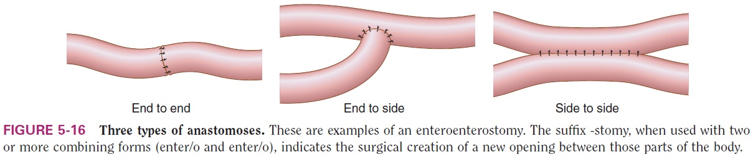
Anastomoses
Notes:
When -stomy is used with two or more combining forms for organs, it means the surgical creation of an opening between those organs inside the body.
Anastomosis is the surgical connection between two body parts such as vessels, ducts, or bowel segments.
In what other places might anastomoses be made?

Slide 55
QUICK QUIZ (Slide 4 of 4)
4. Which term means inflammation of the lip?
Cholecystitis
Celiac
Appendicitis
Cheilitis
Notes:
The correct answer is D: cheilitis.

Slide 56
Chapter 5 Lesson 5.2

Slide 57
Pathology of the Digestive System (slide 1 of 3)
Signs and symptoms
Anorexia – lack of appetite
Ascites – abnormal accumulation of fluid in the abdomen
Borborygmi (singular: borborygmus) – rumbling or gurgling noises produced by the movement of gas, fluid, or both in the GI tract
Constipation – difficulty in passing stools
Diarrhea – frequent passage of loose, watery stools
Notes:
Discuss symptoms such as ascites, borborygmus, constipation, diarrhea, dysphagia, flatus, hematochezia, jaundice, melena, and nausea.
Based on your knowledge of the functions of the liver, how might cirrhosis cause ascites?
For more signs and symptoms, see Chapter 5, Pathology Section.

Slide 58
Pathology of the Digestive System (slide 2 of 3)
Dysphagia – difficulty in swallowing
Eructation – gas expelled from the stomach through the mouth
Flatus – gas expelled through the anus
Hematochezia – passage of fresh, bright red blood from the rectum
Jaundice (icterus) – yellow-orange coloration of the skin and whites of the eyes caused by high levels of bilirubin in the blood

Slide 59
Pathology of the Digestive System (slide 3 of 3)
Melena – black, tarry stools; feces containing digested blood
Nausea – unpleasant sensation in the stomach with a tendency to vomit
Steatorrhea – fat in the feces; frothy, foul-smelling fecal matter

Slide 60
Pathologic Conditions Oral Cavity and Teeth
Aphthous stomatitis – inflammation of the mouth with small, painful ulcers
Dental caries – tooth decay
Herpetic stomatitis – inflammation of the mouth by infection with the herpes virus
Oral leukoplakia – white plaques or patches
Periodontal disease – inflammation and degeneration of the gums, teeth and surrounding bone
Notes:
Discuss herpetic stomatitis, oral leukoplakia, and periodontal disease.
How does tooth decay progress?
How is it treated?

Slide 61
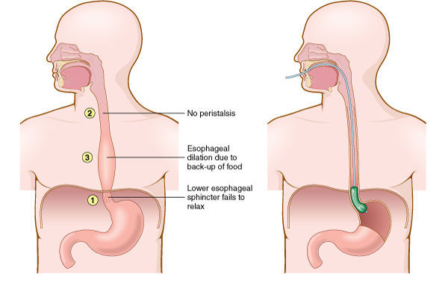
Pathologic Conditions Upper Gastrointestinal Tract (slide 1 of 5)
Achalasia – failure of the lower esophagus sphincter (LES) muscle to relax
Notes:
What kind of diet do physicians recommend to relieve symptoms of achalasia?

Slide 62
Pathologic Conditions Upper Gastrointestinal Tract (slide 2 of 5)
Esophageal cancer – malignant tumor of the esophagus
Gastric carcinoma – malignant tumor of the stomach
Notes:
Discuss the following terms: gastroesophageal reflux disease, hernia, and peptic ulcer.
What is a major risk factor for gastric carcinoma? How is it treated?
LES is lower esophagus sphincter.

Slide 63
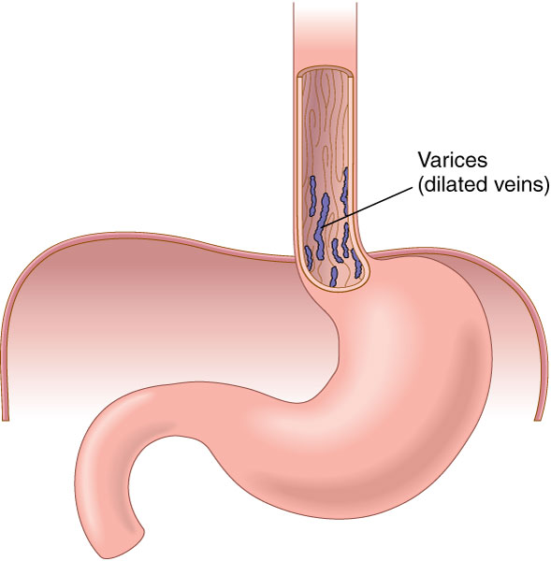
Pathologic Conditions Upper Gastrointestinal Tract (slide 3 of 5)
Esophageal varices – swollen, varicose veins at the lower end of the esophagus

Slide 64
Pathologic Conditions Upper Gastrointestinal Tract (slide 4 of 5)
Gastroesophageal reflux disease (GERD) – solids and fluids return to the mouth from the stomach
Peptic ulcer – open sore or lesion of the mucous membrane of the stomach or duodenum
Notes:
Discuss the following terms: gastroesophageal reflux disease, hernia, and peptic ulcer.

Slide 65
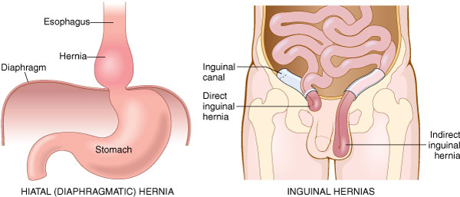
Pathologic Conditions Upper Gastrointestinal Tract (slide 5 of 5)
Hernia – protrusion of an organ or part through the muscle normally containing it

Slide 66
Pathologic Conditions Lower Gastrointestinal Tract Small and Large Intestines (slide 1 of 5)
Anal fistula – abnormal tubelike passageway near the anus
Colonic polyposis – polyps protrude from the mucous membrane of the colon

Slide 67
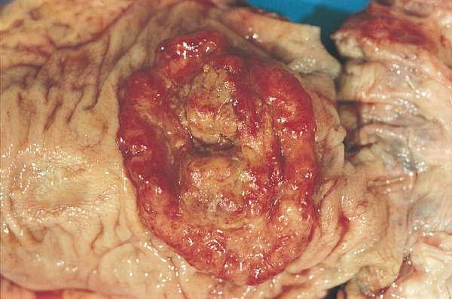
Pathologic Conditions Lower Gastrointestinal Tract Small and Large Intestines (slide 2 of 5)
Colorectal cancer – adenocarcinoma of the colon or rectum or both

Slide 68
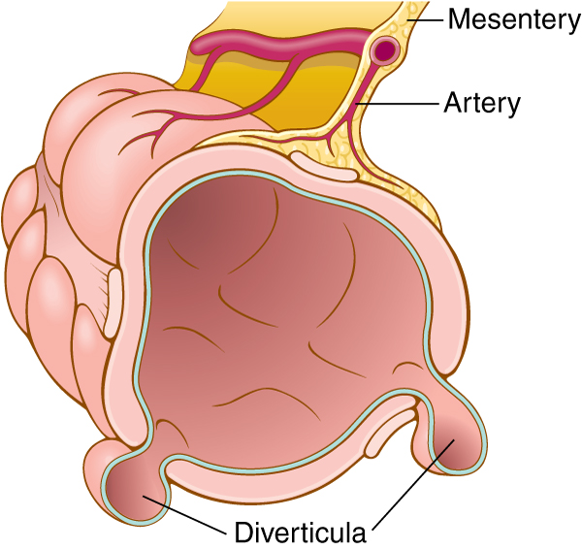
Pathologic Conditions Lower Gastrointestinal Tract Small and Large Intestines (slide 3 of 5)
Crohn disease – chronic inflammation of the intestinal tract
Diverticulosis – abnormal side pockets (outpouchings) in the intestinal wall

Slide 69
Pathologic Conditions Lower Gastrointestinal Tract Small and Large Intestines (slide 4 of 5)
Dysentery – painful, inflamed intestines
Hemorrhoids – swollen, twisted, varicose veins in the rectal region
Ileus – failure of peristalsis with resulting obstruction of the intestines
Inflammatory bowel disease (IBD) – inflammation of the colon and small intestine

Slide 70
Pathologic Conditions Lower Gastrointestinal Tract Small and Large Intestines (slide 5 of 5)
Intussusception – telescoping of the intestines
IBS – irritable bowel syndrome – group of gastrointestinal symptoms associated with stress and tension
Ulcerative colitis – chronic inflammation of the colon with the presence of ulcers
Volvulus – twisting of the intestines on itself

Slide 71
Pathologic Conditions Liver Gallbladder, and Pancreas (slide 1 of 2)
Cirrhosis – chronic degenerative disease of the liver
Hepatocellular carcinoma (HCC) – liver cancer
Pancreatic cancer – malignant tumor of the pancreas
Pancreatitis – inflammation of the pancreas
Viral hepatitis – inflammation of the liver caused by a virus
Notes:
What causes cirrhosis of the liver?

Slide 72
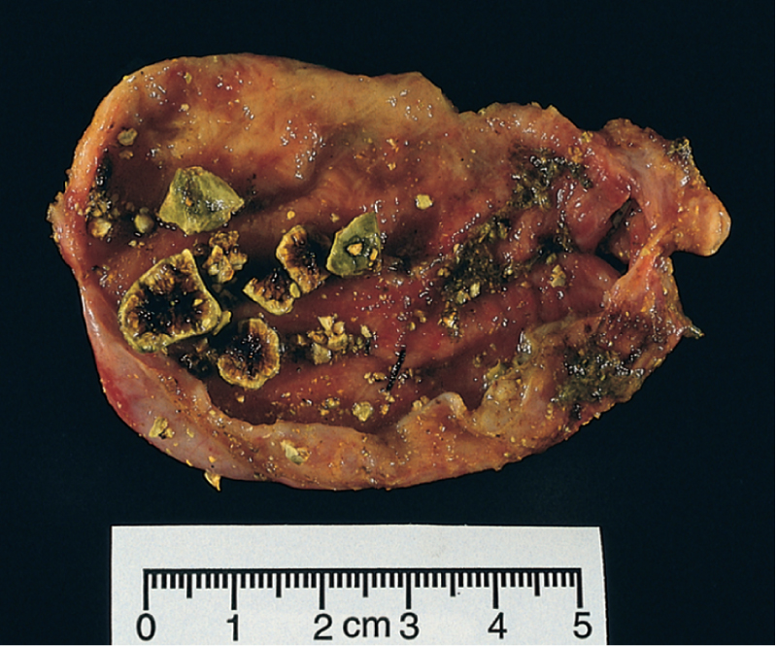
Pathologic Conditions Liver Gallbladder, and Pancreas (slide 2 of 2)
Cholelithiasis – gallstones in the gallbladder
Notes:
What is biliary colic?
What type of surgery is performed to remove the gallbladder and stones?

