Slide 1
The Language of Medicine 13th edition
Davi-Ellen Chabner

Slide 2
Chapter 7 Urinary System

Slide 3
Chapter Goals (Slide 1 of 2)
Name essential organs of the urinary system and describe their locations and functions.
Identify common pathological conditions.
Recognize how urinalysis is used and interpreted as a diagnostic test.
Define urinary-system-related combining forms, prefixes, and suffixes.

Slide 4
Chapter Goals (Slide 2 of 2)
List and explain clinical procedures, laboratory tests, and abbreviations that pertain to the urinary system.
Understand medical terms in their proper contexts, such as medical reports and records.

Slide 5
Chapter 7 Lesson 7.1

Slide 6
Introduction (Slide 1 of 2)
Nitrogenous wastes
Urea
Creatinine
Uric acid
Notes:
Why is nitrogenous waste excreted from the body in a soluble rather than gaseous form?
By what medium does urea travel to the kidneys?

Slide 7
Introduction (Slide 2 of 2)
Functions of the kidney
Filter nitrogenous wastes to form urine; about 200 quarts of blood are filtered every day to form 2 quarts of urine
Maintain proper balance of water, electrolytes (sodium, potassium), and acids
Release hormones:
Renin: enzyme important in adjusting blood pressure
Erythropoietin (EPO): hormone that stimulates red blood cell production in the bone marrow
Calciferol: active form of vitamin D necessary for the absorption of calcium from the intestine
Degrade and eliminate hormones from the bloodstream
Notes:
The kidneys also adjust the amount of water and electrolytes for proper muscle and nerve function.
Are there other important functions performed by the kidneys?

Slide 8
Anatomy of the Major Organs (Slide 1 of 4)
Organs of the male urinary system:
Kidney
Ureter
Urinary bladder
Urethra
Notes:
Have students name the organs of the urinary system labeled 1-4 in the figure.
What is the size and weight of a normal kidney?
What function is performed by the ureters?
What function is performed by the urinary bladder?
What function is performed by the urethra?

Slide 9
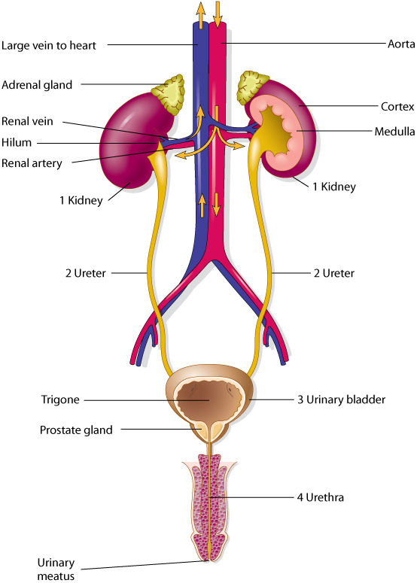
Anatomy of the Major Organs (slide 2 of 4)
Organs of the male urinary system
Notes:
Have students name the organs of the urinary system labeled 1-4 in the figure.
What is the size and weight of a normal kidney?
What function is performed by the ureters?
What function is performed by the urinary bladder?
What function is performed by the urethra?

Slide 10
Anatomy of the Major Organs (slide 3 of 4)
Organs of the female urinary system:
Kidney
Ureter
Urinary bladder
Urethra
Notes:
How does the female urinary system differ from the male urinary system?
What is the trigone? What function does it perform?
What is micturition?

Slide 11
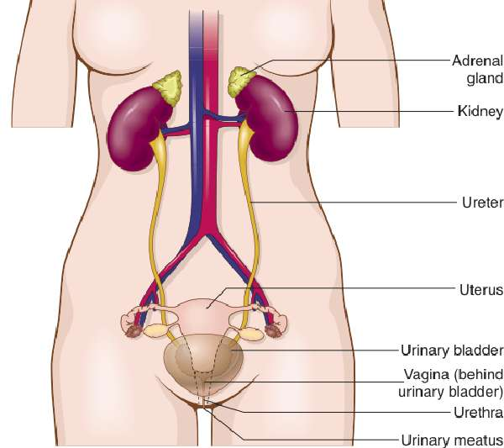
Anatomy of the Major Organs (slide 4 of 4)
Female urinary system
Notes:
How does the female urinary system differ from the male urinary system?
What is the trigone? What function does it perform?
What is micturition?

Slide 12
QUICK QUIZ (Slide 1 of 8)
1. What is voiding?
Nitrogenous waste
Urination
Outer section of the kidney
Triangular area in the bladder
Notes:
The correct answer is B: urination.

Slide 13
How Kidneys Produce Urine (Slide 1 of 12)
Blood enters the kidneys through the right and left renal arteries
Arterioles carry blood to the capillaries
Glomeruli filter the blood
Notes:
The renal artery branches into smaller arteries, arterioles, and glomeruli located throughout the cortex of the kidneys.
What is a glomerulus?
There are approximately one million glomeruli in the cortex of each kidney.
How does the kidney regulate blood pressure?
Why is maintenance of proper blood pressure important to the kidneys’ function?

Slide 14
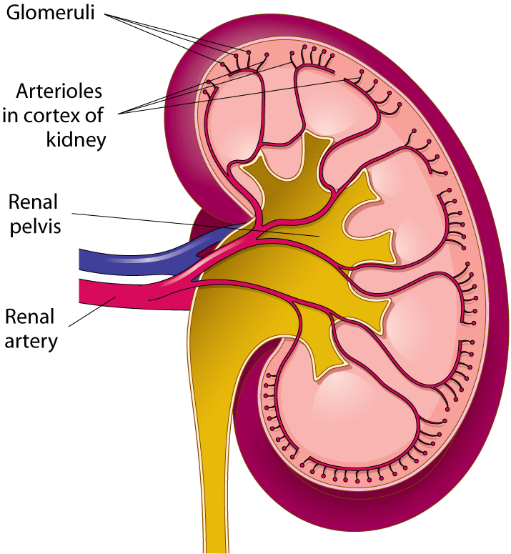
How Kidneys Produce Urine (Slide 2 of 12)
Blood enters the kidneys through the right and left renal arteries
Arterioles carry blood to the capillaries
Glomeruli filter the blood
Notes:
The renal artery branches into smaller arteries, arterioles, and glomeruli located throughout the cortex of the kidneys.
What is a glomerulus?
There are approximately one million glomeruli in the cortex of each kidney.
How does the kidney regulate blood pressure?
Why is maintenance of proper blood pressure important to the kidneys’ function?

Slide 15
How Kidneys Produce Urine (Slide 3 of 12)
Glomerulus and glomerular/Bowman capsule
Blood passes through the glomeruli
Glomerular (Bowman) capsule surrounds each glomerulus
Renal tubule is attached to each Bowman capsule
Notes:
What functions do the glomerulus, Bowman capsule, and renal tubule perform in the production of urine?
Why don’t proteins and blood cells usually appear in the urine?
What is the process of reabsorption?
What is secretion?
What substances make up urine? (Note: These substances become toxic if allowed to accumulate.)

Slide 16
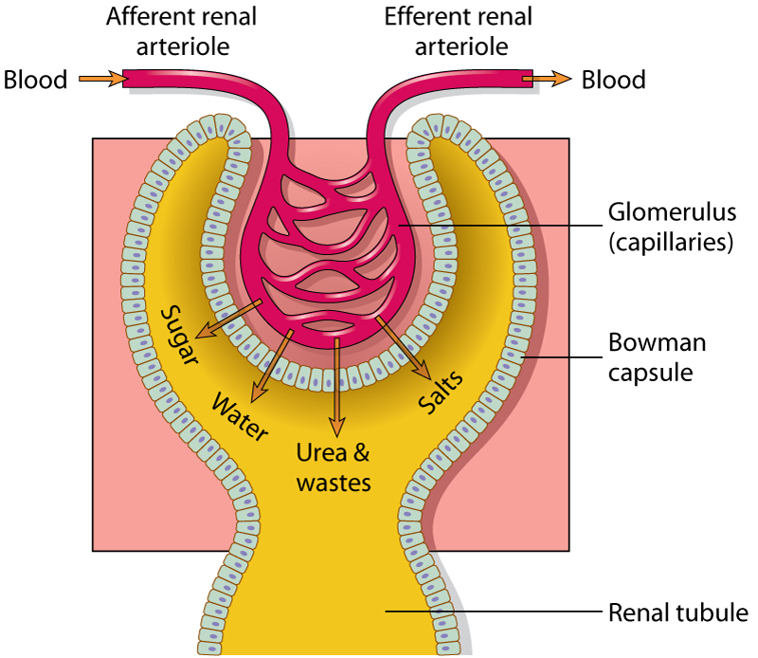
How Kidneys Produce Urine (Slide 4 of 12)
Glomerulus and glomerular/Bowman capsule
Notes:
What functions do the glomerulus, Bowman capsule, and renal tubule perform in the production of urine?
Why don’t proteins and blood cells usually appear in the urine?
What is the process of reabsorption?
What is secretion?
What substances make up urine? (Note: These substances become toxic if allowed to accumulate.)

Slide 17
How Kidneys Produce Urine (Slide 5 of 12)
Three steps in the formation of urine
Glomerular filtration (water, sugar, wastes, salts)
Tubular reabsorption (water, sugar, sodium)
Tubular secretion (acids, potassium, drugs)
Notes:
What functions are performed in each of the three steps in the formation of urine?
The combination of a glomerulus and a renal tubule is called a nephron. There are more than one million nephrons in a kidney.

Slide 18
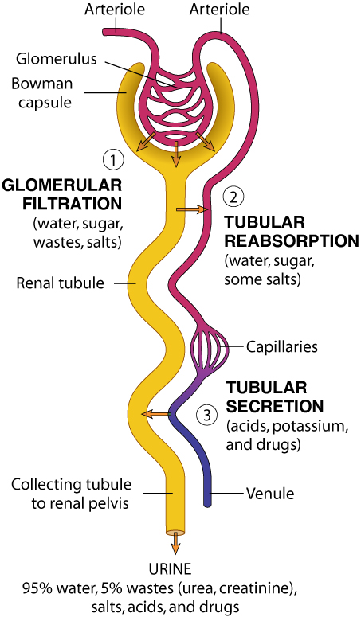
How Kidneys Produce Urine (Slide 6 of 12)
Notes:
What functions are performed in each of the three steps in the formation of urine?
The combination of a glomerulus and a renal tubule is called a nephron. There are more than one million nephrons in a kidney.

Slide 19
How Kidneys Produce Urine (Slide 7 of 12)
The glomerulus and a renal tubule combine to form a unit called a nephron.

Slide 20
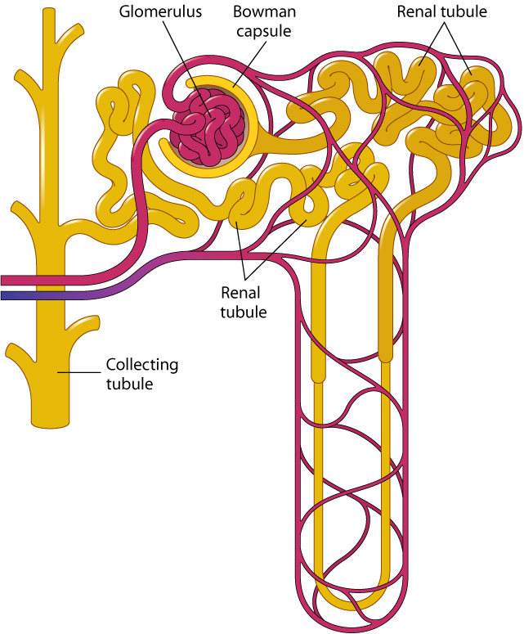
How Kidneys Produce Urine (Slide 8 of 12)

Slide 21
QUICK QUIZ (Slide 2 of 8)
Approximately how many nephrons are in a kidney?
100,000,000
10,000,000
1,000,000
100,000
Notes:
The correct answer is C: one million.

Slide 22
How Kidneys Produce Urine (Slide 9 of 12)
All collecting tubules lead to the renal pelvis.
Calyces or calices are small, cuplike regions of the renal pelvis; the term comes from the Greek, kalux, meaning a cup or case surrounding a flower bud.
Notes:
Notice how secretion and reabsorption are functions of the same organs.
Cup-like regions in the renal pelvis are called calyces or calices.
Where do all connecting tubules lead?
The renal pelvis narrows to form the ureter.
To which organ does the ureter lead?

Slide 23
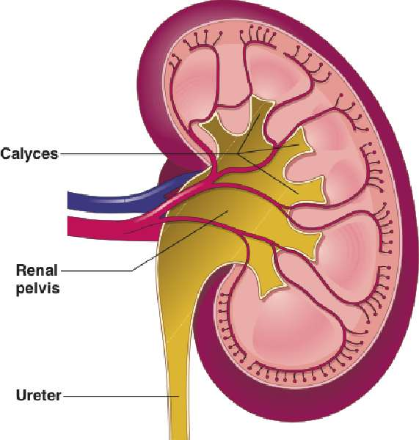
How Kidneys Produce Urine (Slide 10 of 12)
Notes:
Notice how secretion and reabsorption are functions of the same organs.
Cup-like regions in the renal pelvis are called calyces or calices.
Where do all connecting tubules lead?
The renal pelvis narrows to form the ureter.
To which organ does the ureter lead?

Slide 24
How Kidneys Produce Urine (Slide 11 of 12)
Functions of the Kidneys
Remove nitrogenous wastes
Balance water and electrolytes
Release hormones
Degrade and eliminate hormones
Notes:
How is urine flow from the bladder to the urethra controlled?
What triggers the need to urinate?
Urine finally exits the body through the urinary meatus.

Slide 25
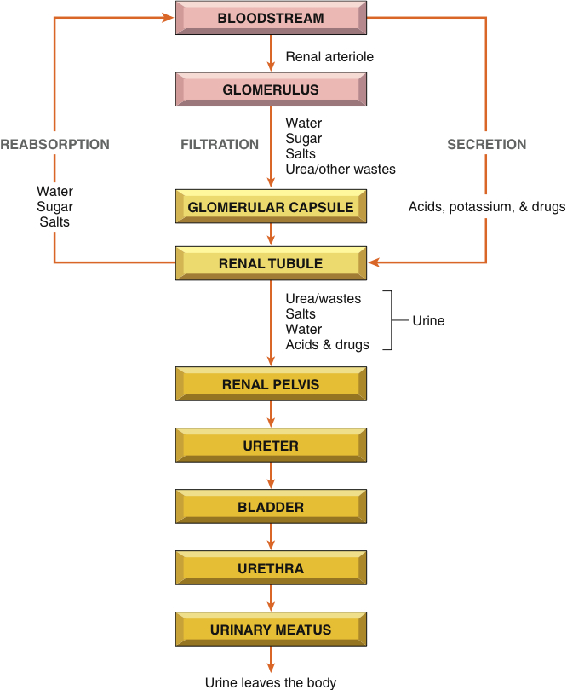
How Kidneys Produce Urine (Slide 12 of 12)
Notes:
How is urine flow from the bladder to the urethra controlled?
What triggers the need to urinate?
Urine finally exits the body through the urinary meatus.

Slide 26
Vocabulary (Slide 1 of 14)
Term
arteriole
calyx or calix
catheter
cortex
creatinine
electrolyte

Slide 27
Vocabulary (Slide 2 of 14)
Term | Meaning/Definition
arteriole | Small artery
calyx or calix | Cuplike collecting region of the renal pelvis; the term comes from the Greek, kalux, meaning a cup or case surrounding a flower bud
catheter | Tube for injecting or removing fluids
cortex | Outer region of an organ
creatinine | Nitrogenous waste excreted in urine
electrolyte | Chemical element that carries an electrical charge when dissolved in water.

Slide 28
Vocabulary (Slide 3 of 14)
Term
erythropoietin (EPO)
filtration
glomerular capsule
glomerulus
hilum

Slide 29
Vocabulary (Slide 4 of 14)
Term | Meaning/Definition
erythropoietin (EPO) | Hormone secreted by the kidney to stimulate production of red blood cells by bone marrow; -poietin means a substance that forms
filtration | Process whereby some substances pass through a filter
glomerular capsule | Enclosing structure surrounding each glomerulus; also called Bowman capsule
glomerulus | Tiny ball of capillaries in the kidney
hilum | Depression in the part of an organ where blood vessels and nerves enter and leave; comes from the Latin meaning a small thing

Slide 30
Vocabulary (Slide 5 of 14)
Term
kidney
meatus
medulla
nephron

Slide 31
Vocabulary (Slide 6 of 14)
Term | Meaning/Definition
kidney | One of two bean-shaped organs that filter nitrogenous waste from the bloodstream to form urine
meatus | Opening or canal
medulla | Inner region of an organ; the term comes from the Latin, medulla, meaning marrow
nephron | The functional unit of the kidney where filtration, reabsorption, and secretion take place

Slide 32
Vocabulary (Slide 7 of 14)
Term
nitrogenous waste
potassium (K⁺)
reabsorption
renal artery

Slide 33
Vocabulary (Slide 8 of 14)
Term | Meaning/Definition
nitrogenous waste | Substance containing nitrogen and excreted in urine; examples are urea, uric acid, and creatinine
potassium (K⁺) | An electrolyte regulated by the kidney
reabsorption | Renal tubules return materials necessary to the body back into the bloodstream
renal artery | Blood vessel that carries blood to the kidney

Slide 34
Vocabulary (Slide 9 of 14)
Term
renal pelvis
renal tubules
renal vein

Slide 35
Vocabulary (Slide 10 of 14)
Term | Meaning/Definition
renal pelvis | Central collection region in the kidney
renal tubules | Microscopic tubes in the kidney where urine is formed after filtration
renal vein | Blood vessel that carries blood away from the kidney

Slide 36
Vocabulary (Slide 11 of 14)
Term
renin
sodium (Na⁺)
trigone
urea

Slide 37
Vocabulary (Slide 12 of 14)
Term | Meaning/Definition
renin | Enzyme secreted by the kidney that raises blood pressure
sodium (Na⁺) | An electrolyte regulated in the blood and urine by the kidneys; a common form of sodium is sodium chloride (salt)
trigone | Triangular area in the urinary bladder
urea | Major nitrogenous waste excreted in urine

Slide 38
Vocabulary (Slide 13 of 14)
Term
ureter
urethra
uric acid
urinary bladder
urination (voiding)

Slide 39
Vocabulary (Slide 14 of 14)
Term | Meaning/Definition
ureter | One of two tubes leading from the kidneys to the urinary bladder
urethra | Tube leading from the urinary bladder to the outside of the body
uric acid | Nitrogenous waste product excreted in the urine
urinary bladder | Hollow, muscular sac that holds and stores urine
urination (voiding) | Process of expelling urine; also called micturition

Slide 40
Terminology: Structures (Slide 1 of 6)
Combining Form
cali/o, calic/o
cyst/o
glomerul/o
meat/o

Slide 41
Terminology: Structures (Slide 2 of 6)
Combining Form | Meaning
cali/o, calic/o | calyx (calix); cup-shaped
cyst/o | urinary bladder
glomerul/o | glomerulus
meat/o | meatus

Slide 42
Terminology: Structures (Slide 3 of 6)
Combining Form
nephr/o
pyel/o
ren/o
trigon/o

Slide 43
Terminology: Structures (Slide 4 of 6)
Combining Form | Meaning
nephr/o | kidney
pyel/o | renal pelvis
ren/o | kidney
trigon/o | trigone

Slide 44
Terminology: Structures (Slide 5 of 6)
Combining Form
ureter/o
urethr/o
vesic/o

Slide 45
Terminology: Structures (Slide 6 of 6)
Combining Form | Meaning
ureter/o | ureter
urethr/o | urethra
vesic/o | urinary bladder

Slide 46
Terminology: Substances and Symptoms (Slide 1 of 6)
Combining Form
albumin/o
azot/o
bacteri/o
dips/o

Slide 47
Terminology: Substances and Symptoms (Slide 2 of 6)
Combining Form | Meaning
albumin/o | albumin
azot/o | nitrogen
bacteri/o | bacteria
dips/o | thirst

Slide 48
Terminology: Substances and Symptoms (Slide 3 of 6)
Combining Form
kal/o
ket/o, keton/o
lith/o
natr/o
noct/o
olig/o

Slide 49
Terminology: Substances and Symptoms (Slide 4 of 6)
Combining Form | Meaning
kal/o | potassium
ket/o, keton/o | ketone bodies
lith/o | stone
natr/o | sodium
noct/o | night
olig/o | scanty

Slide 50
Terminology: Substances and Symptoms (Slide 5 of 6)
Combining Form or Suffix
-poietin
py/o
-tripsy
ur/o
-uria
urin/o

Slide 51
Terminology: Substances and Symptoms (Slide 6 of 6)
Combining Form or Suffix | Meaning
-poietin | substance that forms
py/o | pus
-tripsy | to crush
ur/o | urea
-uria | urination; urine condition
urin/o | urine

Slide 52
Urinalysis (Slide 1 of 2)
Tests Included in a Urinalysis
Color
Appearance
pH
Protein
Glucose
Notes:
Colorless urine = large amount of water in the urine. Smoky-red or brown = presence of blood in the urine.
Normal pH is 6.5 (slightly acidic).
Protein test looks for albumin, which indicates a leak in the glomerular membrane.
Glucose presence signals possibility of diabetes.

Slide 53
Urinalysis (Slide 2 of 2)
Tests Included in a Urinalysis (continued)
Specific gravity
Ketone bodies
Sediment
Phenylketonuria
Bilirubin
Notes:
Specific gravity reflects the amount of wastes and minerals.
Ketone bodies appear when the body breaks down fat.
Sediment are abnormal particles.
Phenylketonuria indicates a lack of enzyme, especially in infants. PKU test measures this.
Bilirubin results from a hemoglobin breakdown.

Slide 54
QUICK QUIZ (Slide 3 of 8)
In a urinalysis, what does the test of specific gravity reflect?
A. The chemical nature of urine
B. The presence of albumin
C. Blood in the urine
D. The amount of wastes, minerals, and solids in the urine
Notes:
The correct answer is D. Specific gravity compares the density of urine with that of water.

Slide 55
Chapter 7 Lesson 7.2

Slide 56
Pathologic Conditions (Slide 1 of 5)
Kidney
Glomerulonephritis
Interstitial nephritis
Nephrolithiasis
Nephrotic syndrome
Notes:
Glomerulonephritis is the inflammation of the glomeruli within the kidney due to infection; it can lead to hypertension and renal failure if untreated.
What is interstitial nephritis?
What procedure might a physician recommend for a patient with nephrolithiasis?
Nephrotic syndrome is a collection of symptoms caused by excessive protein loss in urine.
Polycystic kidneys are a hereditary condition characterized by a progressive growth of cysts. There are two types of hereditary PKD. One type is usually asymptomatic until middle age and then is marked by maturia, urinary tract infections, and nephrolithiasis. The other type of PKD occurs in infants or children and results in renal failure.

Slide 57
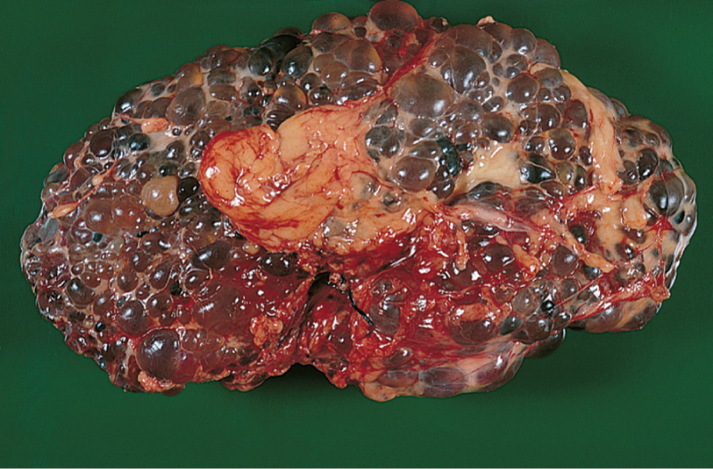
Pathologic Conditions (Slide 2 of 5)
Kidney
Polycystic
kidney
disease (PKD)
PKD—The kidneys contain masses of cysts. Typically, polycystic kidneys weigh 20 times more than their usual weight.
Notes:
Polycystic kidneys are a hereditary condition characterized by a progressive growth of cysts.

Slide 58
Pathologic Conditions (Slide 3 of 5)
Kidney
Pyelonephritis
Renal cell carcinoma
Renal failure
Renal hypertension
Wilms tumor
Notes:
Pyelonephritis is the inflammation of the lining of the renal pelvis and renal parenchyma.
Renal cell carcinoma is adult cancer of the kidney—2% of all adult cancers.
What occurs during renal failure?
How does renal hypertension differ from essential hypertension?
Wilms tumor is a malignant tumor of the kidney occurring in childhood and is an example of an eponym.

Slide 59
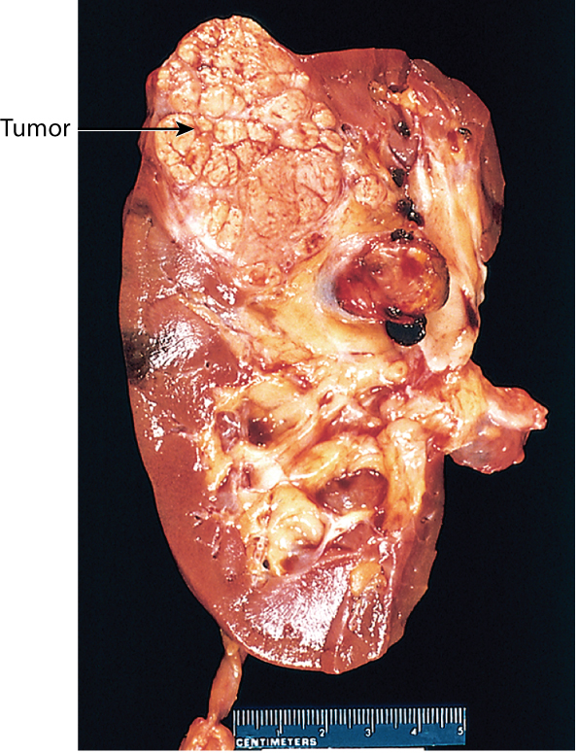
Pathologic Conditions (Slide 4 of 5)
Kidney
Renal cell
carcinoma

Slide 60
Pathologic Conditions (Slide 5 of 5)
Urinary bladder
Bladder cancer
Associated conditions
Diabetes insipidus (DI)
Diabetes mellitus (DM)
Notes:
What risk factors are associated with bladder cancer?
Diabetes insipidus: Antidiuretic hormone is not secreted adequately or the kidney is resistant to its effect.
Diabetes mellitus: Insulin is not secreted adequately or not used properly in the body.
How does each of these conditions affect the kidneys?

Slide 61
QUICK QUIZ (Slide 4 of 8)
A term that means frequent (voluntary) urination at night is:
anuria
nocturia
diuresis
hematuria
Notes:
The correct answer is B: nocturia.

Slide 62
Laboratory Tests and Clinical Procedures (Slide 1 of 10)
Laboratory tests
Blood urea nitrogen (BUN)
Creatinine clearance test
Notes:
Which procedure tests for uremia?
Which test measures the rate at which creatinine is cleared from the blood?
What is azotemia?
What role do the kidneys play in BUN levels?

Slide 63
Laboratory Tests and Clinical Procedures (Slide 2 of 10)
Clinical procedures
X-ray Studies
CT urography
Kidneys, ureters, and bladder (KUB)
Renal angiography
Retrograde pyelogram (RP)
Voiding cystourethrogram (VCUG)
Notes:
How do these x-rays differ?
Which tests require contrast material?
Why is it important to measure the size of the kidneys (KUB)?
Which tests require urinary catheterization?
Why would someone have RP instead of IVP?

Slide 64
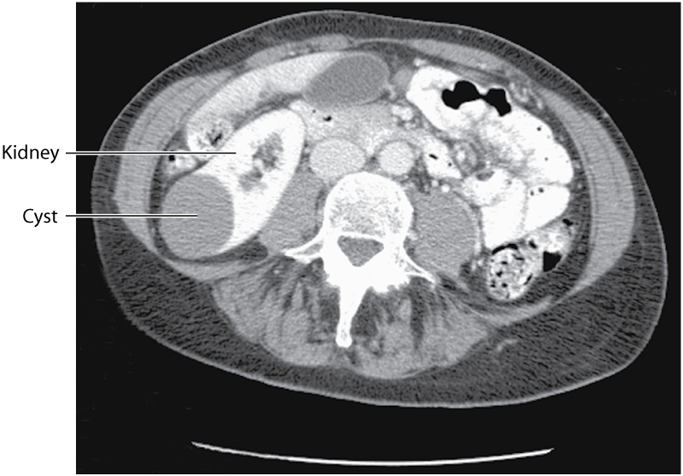
Laboratory Tests and Clinical Procedures (Slide 3 of 10)
CT-Computed tomography
The scan with contrast shows a benign cyst on the kidney.

Slide 65
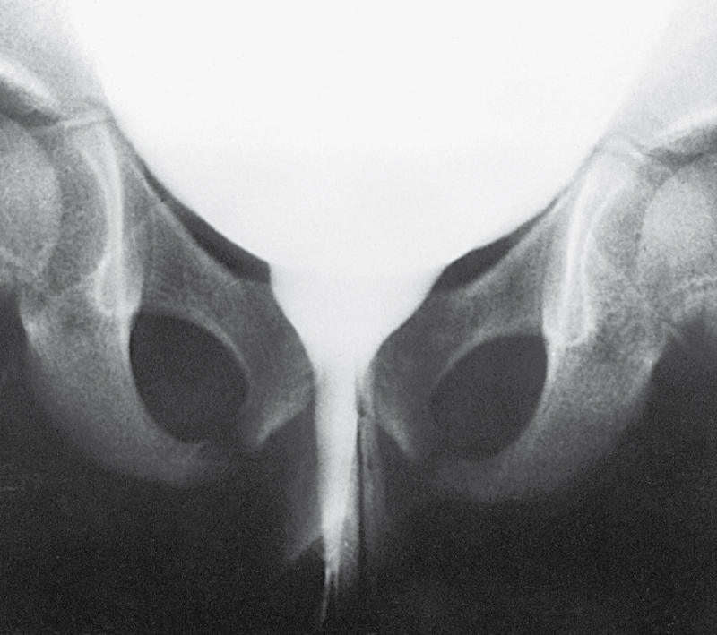
Laboratory Tests and Clinical Procedures (Slide 4 of 10)
Voiding cystourethrogram
(VCUG) showing a normal female urethra. The bladder is filled with contrast material, followed by x-ray imaging.

Slide 66
Laboratory Tests and Clinical Procedures (Slide 5 of 10)
Clinical Procedures
Ultrasound examination
Ultrasonography: imaging urinary tract structures using high frequency sound waves
Radioactive studies
Radioisotope scan: image of kidney after injecting a radioisotope into the bloodstream
Notes:
What is hydronephrosis?
What might cause the kidney to be enlarged?
What can be diagnosed in the urinary system using sound waves?

Slide 67
Laboratory Tests and Clinical Procedures (Slide 6 of 10)
Clinical Procedures
Magnetic imaging
Magnetic resonance imaging (MRI) urography: A changing magnetic field produces images of an organ and surrounding structures in three planes of the body
Notes:
How is an MRI of the kidney performed?

Slide 68
Laboratory Tests and Clinical Procedures (Slide 7 of 10)
Other Clinical Procedures
Cystoscopy
Dialysis
Lithotripsy
Renal angioplasty
Renal biopsy
Renal transplantation
Urinary catheterization
Notes:
Cystoscopy allows for visual examination through a hollow metal tube.
What is the difference between hemodialysis and peritoneal dialysis?
What procedure might be required to remove kidney stones?
Describe the process of catheterization.

Slide 69
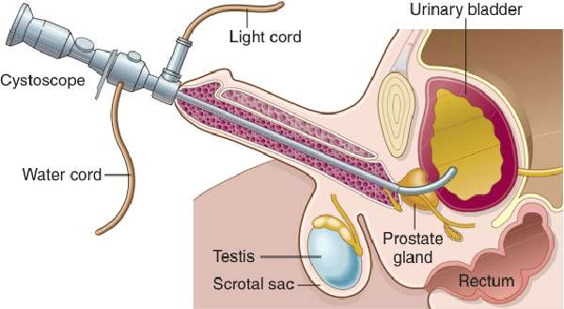
Laboratory Tests and Clinical Procedures (Slide 8 of 10)
Cystoscopy—direct visual examination of urinary bladder with an endoscope
Notes:
How is a cytoscopy performed?

Slide 70
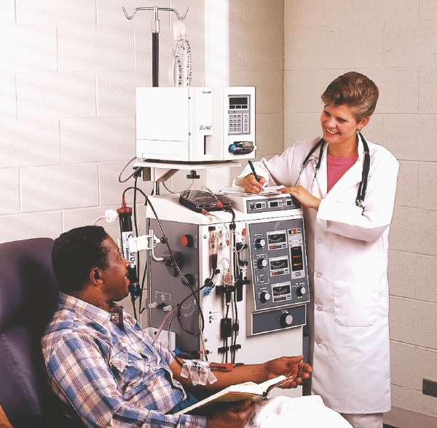
Laboratory Tests and Clinical Procedures (Slide 9 of 10)
Hemodialysis (HD)

Slide 71
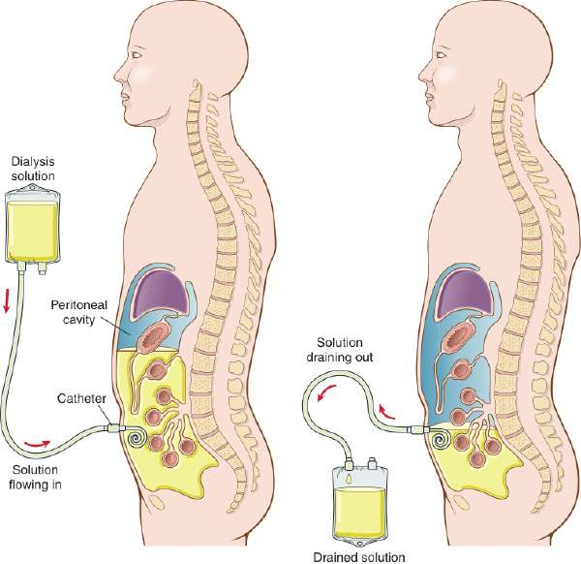
Laboratory Tests and Clinical Procedures (Slide 10 of 10)
Continuous ambulatory peritoneal dialysis (CAPD)
Notes:
CAPD can be performed continuously by the patient without artificial support.
What other peritoneal dialysis procedures may be performed?

Slide 72
Abbreviations (Slide 1 of 6)
Abbreviation
ADH
AKI
ARF
BILI
BUN
CAPD
Cath
CCPD
CKD

Slide 73
Abbreviations (Slide 2 of 6)
Abbreviation | Meaning
ADH | Antidiuretic hormone
AKI | Acute renal injury
ARF | Acute renal failure
BILI | Bilirubin
BUN | Blood urea nitrogen
CAPD | Continuous ambulatory peritoneal dialysis
Cath | Catheter; catheterization
CCPD | Continuous cycling peritoneal dialysis
CKD | Chronic kidney disease

Slide 74
Abbreviations (Slide 3 of 6)
Abbreviation
CL⁻
CrCl
CRF
C & S
Cysto
eGFR
ESRD
ESWL
HCO₃⁻
HD
IC

Slide 75
Abbreviations (Slide 4 of 6)
Abbreviation | Meaning
CL⁻ | Chloride, a kidney excretion
CrCl | Creatinine clearance
CRF | Chronic renal failure
C & S | Culture and sensitivity testing
Cysto | Cystoscopic examination
eGFR | Estimated glomerular filtration rate
ESRD | End-stage renal disease
ESWL | Extracorporeal shockwave lithrotripsy
HCO₃⁻ | Bicarbonate, an electrolyte conserved by the kidney
HD | Hemodialysis
IC | Interstitial cystitis, chronic inflammation of the bladder wall

Slide 76
Abbreviations (Slide 5 of 6)
Abbreviation
IVP
K⁺
KUB
Na⁺
PD
pH
PKD
sp gr
UA
UTI
VCUG

Slide 77
Abbreviations (Slide 6 of 6)
Abbreviation | Meaning
IVP | Intravenous pyelogram
K⁺ | Potassium, an electrolyte
KUB | Kidney ureter and bladder
Na⁺ | Sodium, an electrolyte
PD | Peritoneal dialysis
pH | Potential hydrogen; degree of acidity or alkalinity
PKD | Phenylketonuria
sp gr | Specific gravity
UA | Urinalysis
UTI | Urinary tract infection
VCUG | Voiding cystourethrogram

Slide 78
QUICK QUIZ (Slide 5 of 8)
The abbreviation RP is associated with which of the following?
A. Fluid is injected into the peritoneal
cavity and then drained out.
B. Contrast is injected into the urinary
bladder and ureters, and x-rays are
taken of the urinary tract.
C. Nitrogenous wastes are removed from
the patient’s blood.
D. An electrolyte is secreted by renal tubules.
Notes:
The correct answer is B; this is the abbreviation for retrograde pyelogram.
Incorrect answer A is CAPD—continuous ambulatory periotoneal dialysis.
Incorrect answer C is HD—hemodialysis.
Incorrect answer D is K⁺ potassium.

Slide 79
Review Sheet: Combining Forms (Slide 1 of 10)
Combining Form
albumino/o
angi/o
azot/o
bacteri/o
cali/o, calic/o
cyst/o

Slide 80
Review Sheet: Combining Forms (Slide 2 of 10)
Combining Form | Meaning
albumino/o | albumin (protein)
angi/o | vessel (blood)
azot/o | urea; nitrogen
bacteri/o | bacteria
cali/o, calic/o | calyx (calix); cup-shaped
cyst/o | urinary bladder

Slide 81
Review Sheet: Combining Forms (Slide 3 of 10)
Combining Form
dips/o
glomerul/o
glycos/o
hydr/o
isch/o
kal/o
ket/o; keton/o

Slide 82
Review Sheet: Combining Forms (Slide 4 of 10)
Combining Form | Meaning
dips/o | thirst
glomerul/o | glomerulus
glycos/o | sugar
hydr/o | water
isch/o | to hold back; back
kal/o | potassium
ket/o; keton/o | ketones; acetones

Slide 83
Review Sheet: Combining Forms (Slide 5 of 10)
Combining Form
lith/o
meat/o
natr/o
necr/o
nephr/o
noct/o
ogli/o

Slide 84
Review Sheet: Combining Forms (Slide 6 of 10)
Combining Form | Meaning
lith/o | stone
meat/o | meatus
natr/o | sodium
necr/o | death
nephr/o | kidney
noct/o | night
ogli/o | scanty

Slide 85
Review Sheet: Combining Forms (Slide 7 of 10)
Combining Form
py/o
pyel/o
ren/o
trigon/o
ur/o

Slide 86
Review Sheet: Combining Forms (Slide 8 of 10)
Combining Form | Meaning
py/o | pus
pyel/o | renal pelvis
ren/o | kidney
trigon/o | trigone
ur/o | urine; urinary tract

Slide 87
Review Sheet: Combining Forms (Slide 9 of 10)
Combining Form
ureter/o
urethr/o
urin/o
vesic/o

Slide 88
Review Sheet: Combining Forms (Slide 10 of 10)
Combining Form | Meaning
ureter/o | ureter
urethr/o | urethra
urin/o | urine
vesic/o | urinary bladder

Slide 89
Review Sheet: Suffixes (Slide 1 of 8)
Suffix
-ectasis
-ectomy
-emia
-esis
-gram
-lithiasis

Slide 90
Review Sheet: Suffixes (Slide 2 of 8)
Suffix | Meaning
-ectasis | stretching; dilation
-ectomy | removal; excision
-emia | blood condition
-esis | condition
-gram | record
-lithiasis | condition of stones

Slide 91
Review Sheet: Suffixes (Slide 3 of 8)
Suffix
-lithotomy
-lysis
-megaly
-ole
-osis
-pathy

Slide 92
Review Sheet: Suffixes (Slide 4 of 8)
Suffix | Meaning
-lithotomy | incision for removal of a stone
-lysis | breakdown
-megaly | enlargement
-ole | little; small
-osis | condition
-pathy | disease

Slide 93
Review Sheet: Suffixes (Slide 5 of 8)
Suffix
-plasty
-poietin
-ptosis
-rrhea
-sclerosis
-stomy

Slide 94
Review Sheet: Suffixes (Slide 6 of 8)
Suffix | Meaning
-plasty | surgical repair
-poietin | substance that forms
-ptosis | droop; sag
-rrhea | flow; discharge
-sclerosis | hardening
-stomy | new opening (to form a mouth)

Slide 95
Review Sheet: Suffixes (Slide 7 of 8)
Suffix
-tomy
-tripsy
-uria

Slide 96
Review Sheet: Suffixes (Slide 8 of 8)
Suffix | Meaning
-tomy | process of cutting
-tripsy | to crush
-uria | urination

Slide 97
Review Sheet: Prefixes (Slide 1 of 4)
Prefix
a-, an-
anti-
dia-
dys-

Slide 98
Review Sheet: Prefixes (Slide 2 of 4)
Prefix | Meaning
a-, an- | not; without
anti- | again
dia- | complete
dys- | bad; painful

Slide 99
Review Sheet: Prefixes (Slide 3 of 4)
Prefix
en-
peri-
poly-
retro-

Slide 100
Review Sheet: Prefixes (Slide 4 of 4)
Prefix | Meaning
en- | in; within
peri- | surrounding
poly- | many, much
retro- | behind; back

Slide 101
QUICK QUIZ (Slide 6 of 8)
The combining form dips/o means:
stone
scanty
thirst
water
Notes:
The correct answer is C: thirst.

Slide 102
QUICK QUIZ (Slide 7 of 8)
Which combining form means pus?
pyel/o
lith/o
ogli/o
py/o
Notes:
The correct answer is D: py/o.

Slide 103
QUICK QUIZ (Slide 8 of 8)
8. The combining form isch/o means:
scanty
to hold back; back
night
trigon
Notes:
The correct answer is B: to hold back.

