Slide 1
The Language of Medicine 13th edition
Davi-Ellen Chabner

Slide 2
Chapter 8 Female Reproductive System

Slide 3
Introduction (Slide 1 of 3)
Sexual reproduction
This is the union of the nuclei of ovum and sperm cell.
Ovum and sperm cells are called gametes.
Each gamete contains half the number of chromosomes of a normal body cell.

Slide 4
Introduction (Slide 2 of 3)
Gametes (ovum and sperm cell)
Gametes are produced in the gonads.
Female gonads are the ovaries; male gonads are the testes.

Slide 5
Introduction (Slide 3 of 3)
Fertilization
An ovum leaves the ovaries and travels through the fallopian tube.
Fertilization takes place if sperm cells are present and unite with the ovum.
The fertilized egg implants then divides to form a ball of cells, called a zygote (and later an embryo and then a fetus).

Slide 6
Organs of the Female Reproductive System (slide 1 of 6)
Organs of the female reproductive system (lateral view):
Ovaries
Fallopian tubes
Uterus
Cul-de-sac
Vagina
Bartholin glands
Clitoris
Perineum
Notes:
Students should label the figure:
1. Ovaries
2. Fallopian tube
3. Uterus
4. Cul-de-sac
5. Vagina
6. Bartholin glands
7. Clitoris
8. Perineum

Slide 7
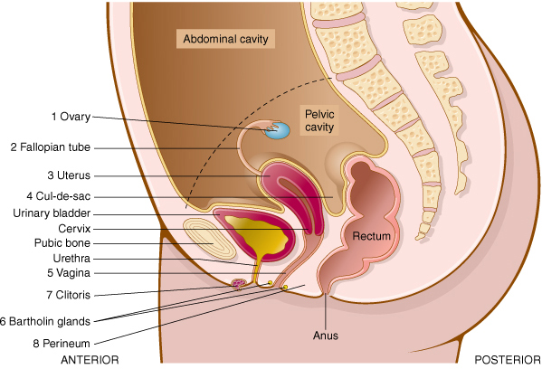
Organs of the Female Reproductive System (slide 2 of 6)
Organs of the female reproductive system (lateral view)

Slide 8
QUICK QUIZ (Slide 1 of 5)
The fertilized egg implants, then divides to form a ball of cells, called a(n):
embryo
fetus
follicle
zygote
Notes:
The correct answer is D: zygote.

Slide 9
Organs of the Female Reproductive System (slide 3 of 6)
Organs of the female reproductive system (anterior view):
Ovary
Utero-ovarian ligament
Ovarian follicles
Ovum
Corpus luteum
Fallopian tube
Fimbriae
Uterus
Endometrium
Myometrium
Uterine serosa
Cervix
Vagina
Notes:
See the next slide for answers.

Slide 10
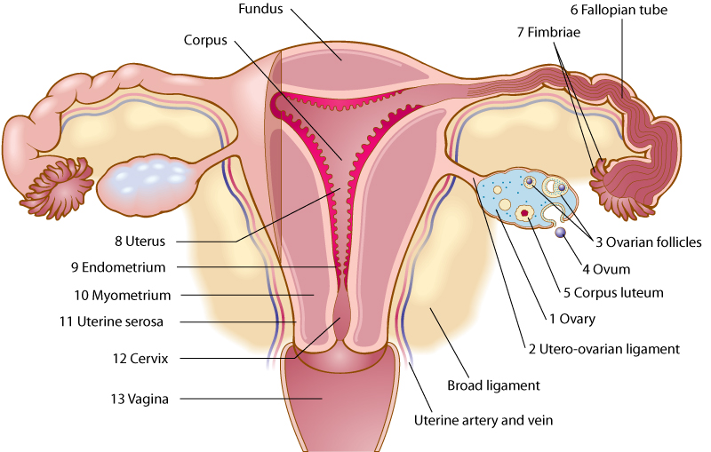
Organs of the Female Reproduction System (slide 4 of 6)
Organs of the female reproductive system (anterior view)

Slide 11
Organs of the Female Reproductive System (slide 5 of 6)
Anatomic structures of the breast (sagittal view):
Glandular tissue
Fatty tissue
Ducts
Sinuses
Notes:
What is the role of the sinuses in the breast?
Name the parts of the breast nipple.
Which hormones stimulate lactation?

Slide 12
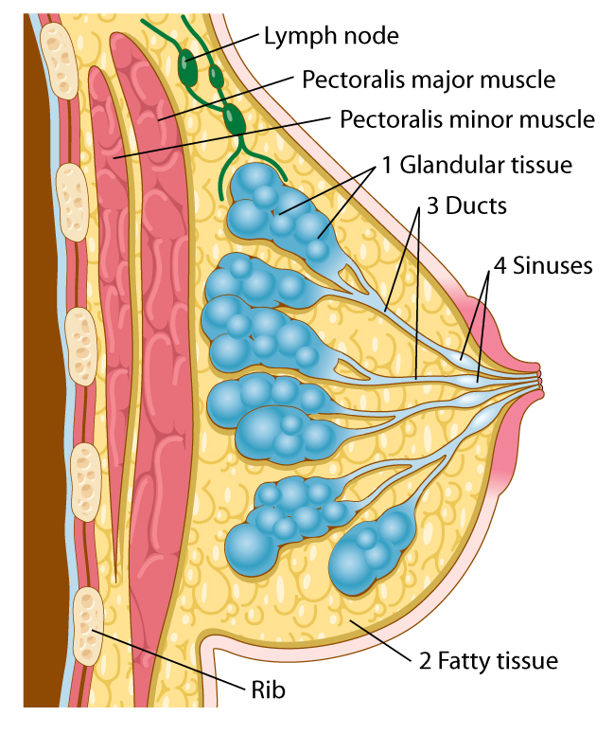
Organs of the Female Reproductive System (slide 6 of 6)
The breast (sagittal view)
Notes:
What is the role of the sinuses in the breast?
Name the parts of the breast nipple.
Which hormones stimulate lactation?

Slide 13
Menstruation (slide 1 of 2)
Menstrual cycle
Day 1-5 Blood cells, endometrial cells, and glandular
secretions discharge from the body.
Day 6-12 Estrogen aids repair of endometrium.
The ovum grows in the follicle.
Day 13-14 The egg leaves the ovary and passes through
the fallopian tube.
Day 15-28 The corpus luteum secretes progesterone;
the uterus lining builds up.
Notes:
Describe the menstrual cycle.
What is the first menstrual cycle called? (Menarche)

Slide 14
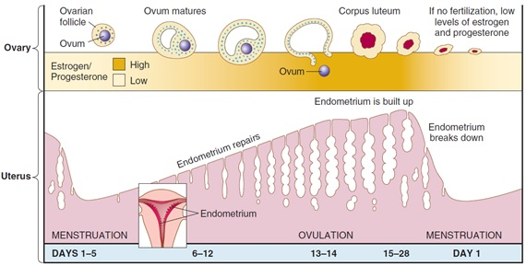
Menstruation (slide 2 of 2)
Menstrual cycle
Notes:
Does lack of fertilization cause low or high levels of progesterone and estrogen?
At what stage is the egg most likely to be fertilized?

Slide 15
Pregnancy (slide 1 of 6)
Pregnancy
If fertilization occurs, the egg implants in the uterine endometrium.
The placenta forms, attaches to the uterine wall.
Amnion holds the fetus in an amniotic cavity.
Nutrients, oxygen, and wastes exchange between the fetus and mother.
The placenta produces human chorionic gonadotropin (hCG).
Notes:
What is the placenta derived from?
What are the chorion and the amnion?
What is amniotic fluid?

Slide 16
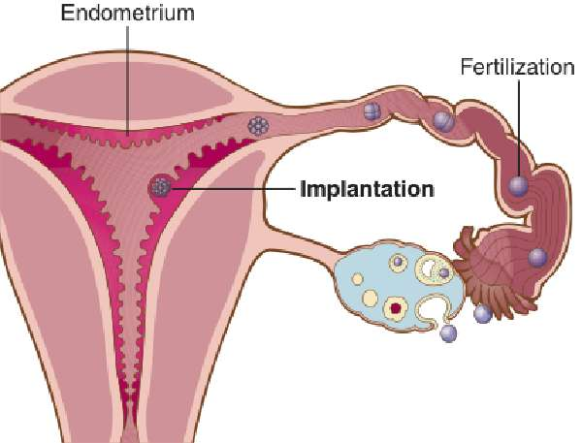
Pregnancy (slide 2 of 6)
Implantation in the uterus
Notes:
See next slide for labels

Slide 17
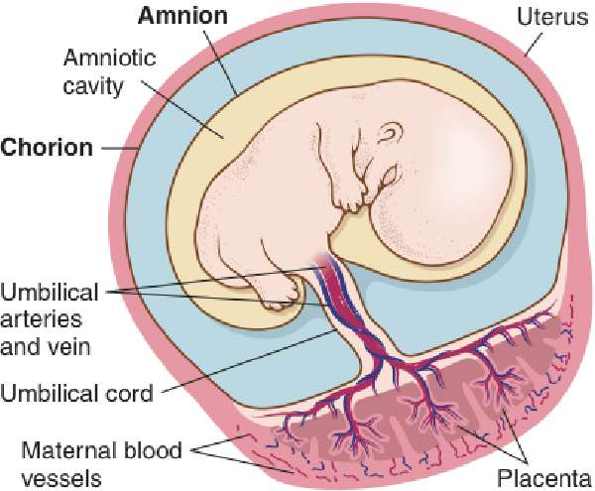
Pregnancy (slide 3 of 6)
The placenta, chorion, and amnion membranes

Slide 18
QUICK QUIZ (Slide 2 of 5)
The corpus luteum secretes this monthly to build up the lining of the uterus.
A. Adrenaline
B. Estrogen
C. Progesterone
D. hCG
Notes:
The correct answer is C: progesterone.

Slide 19
QUICK QUIZ (Slide 3 of 5)
3. What does the placenta secrete during pregnancy?
Adrenaline
hCG
Progesterone
Estrogen
Notes:
The correct answer is B: hGC (human chorionic gonadotropin).

Slide 20
Pregnancy (slide 4 of 6)
Pregnancy
Progesterone maintains placenta development.
The uterus expands as the fetus grows.
Normal delivery fetal position is cephalic presentation (head first).
Notes:
Which hormone does the placenta produce?
What does a pregnancy test look for? (Urine vs. blood)
How long does it take the fetus to reach the epigastric region?

Slide 21
Pregnancy (slide 5 of 6)
Pregnancy
Three phases of labor
Dilation and thinning of the cervix
Birth of the infant
Delivery of the placenta
Notes:
Which hormone does the placenta produce?
What does a pregnancy test look for? (Urine vs. blood)
How long does it take the fetus to reach the epigastric region?

Slide 22
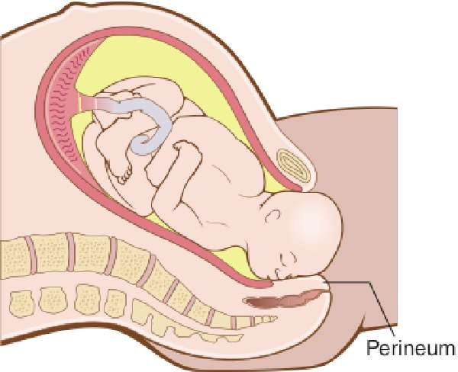
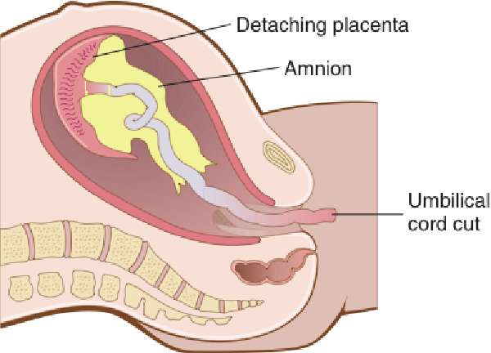
Pregnancy (slide 6 of 6)
A, Cephalic presentation.
B, Delivery of the placenta.

Slide 23
Hormonal Interactions (Slide 1 of 2)
The pituitary secretes:
Follicle-stimulating hormone (FSH)
Luteinizing hormone (LH)
The pituitary stops producing FSH and LH
During pregnancy
With oral contraceptives
Notes:
What is negative feedback?
How do oral contraceptives work?

Slide 24
Hormonal Interactions (Slide 2 of 2)
Menopause
Gradual ending of the menstrual cycle
Normally begins between ages 45 and 55
Falling estrogen levels
Option for estrogen replacement therapy (careful consideration of risks required)
Notes:
How does the IUD function to prevent pregnancy?
How does the diaphragm work to prevent pregnancy?
What are the risks of either method?

Slide 25
Vocabulary (Slide 1 of 34)
Term
adnexa of the uterus
amnion
areola

Slide 26
Vocabulary (Slide 2 of 34)
Term | Meaning/Definition
adnexa of the uterus | Fallopian tubes, ovaries, and supporting ligaments
amnion | Innermost membranous sac surrounding the developing fetus
areola | Dark-pigmented area surrounding the breast nipple

Slide 27
Vocabulary (Slide 3 of 34)
Term
Bartholin glands
cervix
chorion

Slide 28
Vocabulary (Slide 4 of 34)
Term | Meaning/Definition
Bartholin glands | Small, mucus-secreting exocrine glands at the vaginal orifice; named for Caspar Bartholin, a Danish anatomist who described them in 1637
cervix | Lower, neck-like portion of the uterus
chorion | Outermost layer of the two membranes surrounding the embryo

Slide 29
Vocabulary (Slide 5 of 34)
Term
clitoris
coitus
corpus luteum

Slide 30
Vocabulary (Slide 6 of 34)
Term | Meaning/Definition
clitoris | Sensitive erectile tissue anterior to the opening of the female urethra
coitus | Sexual intercourse; copulation
corpus luteum | Empty ovarian follicle; secretes progesterone after release of egg cell; means “yellow body”

Slide 31
Vocabulary (Slide 7 of 34)
Term
cul-de-sac
embryo
endometrium

Slide 32
Vocabulary (Slide 8 of 34)
Term | Meaning/Definition
cul-de-sac | Region in lower abdomen, midway between the rectum and the uterus
embryo | Stage in prenatal development from 2 to 8 weeks
endometrium | Inner, mucous membrane lining of the uterus

Slide 33
Vocabulary (Slide 9 of 34)
Term
estrogen
fallopian tube
fertilization

Slide 34
Vocabulary (Slide 10 of 34)
Term | Meaning/Definition
estrogen | Hormone produced by the ovaries that promotes female secondary sex characteristics
fallopian tube | One of a pair of ducts through which the ovum travels to the uterus; oviduct; named for Gabriello Fallopia, an Italian anatomist
fertilization | Union of sperm cell and ovum from which the embryo develops

Slide 35
Vocabulary (Slide 11 of 34)
Term
fetus
fimbriae (sing.: fimbria)
follicle-stimulating hormone (FSH)

Slide 36
Vocabulary (Slide 12 of 34)
Term | Meaning/Definition
fetus | Stage in prenatal development from 8 to 39 or 40 weeks
fimbriae (sing.: fimbria) | Finger- or fringe-like projections at the end of the fallopian tubes
follicle-stimulating hormone (FSH) | Secreted by the pituitary gland to stimulate maturation of the ovum

Slide 37
Vocabulary (Slide 13 of 34)
Term
gamete
genitalia
gestation

Slide 38
Vocabulary (Slide 14 of 34)
Term | Meaning/Definition
gamete | Male or female sexual reproductive cell; sperm cell or ovum
genitalia | Reproductive organs; also called genitals
gestation | Period from fertilization of the ovum to birth

Slide 39
Vocabulary (Slide 15 of 34)
Term
gonad
gynecology
human chorionic gonadotropin (hCG)

Slide 40
Vocabulary (Slide 16 of 34)
Term | Meaning/Definition
gonad | Female or male reproductive organ that produces sex cells and hormones; ovary or testis
gynecology | Study of the female reproductive organs, including the breasts
human chorionic gonadotropin (hCG) | Hormone produced by the placenta to sustain pregnancy by stimulating ovaries to produce estrogen and progesterone

Slide 41
Vocabulary (Slide 17 of 34)
Term
hymen
labia
lactiferous ducts

Slide 42
Vocabulary (Slide 18 of 34)
Term | Meaning/Definition
hymen | Mucous membrane partially or completely covering the opening to the vagina
labia | Lips of the vagina
lactiferous ducts | Tubes that carry milk within the breast

Slide 43
Vocabulary (Slide 19 of 34)
Term
luteinizing hormone (LH)
mammary papilla
menarche

Slide 44
Vocabulary (Slide 20 of 34)
Term | Meaning/Definition
luteinizing hormone (LH) | Secreted by the pituitary gland to promote ovulation
mammary papilla | Nipple of the breast
menarche | Beginning of the first menstrual period and ability to reproduce

Slide 45
Vocabulary (Slide 21 of 34)
Term
menopause
menstruation
myometrium
neonatology

Slide 46
Vocabulary (Slide 22 of 34)
Term | Meaning/Definition
menopause | Gradual ending of menstruation
menstruation | Monthly shedding of the uterine lining
myometrium | Muscle layer of the uterus
neonatology | Branch of medicine that studies the disorders and care of the newborn (neonate)

Slide 47
Vocabulary (Slide 23 of 34)
Term
obstetrics
orifice
ovarian follicle

Slide 48
Vocabulary (Slide 24 of 34)
Term | Meaning/Definition
obstetrics | The branch of medicine concerned with pregnancy and childbirth
orifice | An opening
ovarian follicle | Developing sac enclosing each ovum within the ovary

Slide 49
Vocabulary (Slide 25 of 34)
Term
ovary
ovulation
ovum (pl.: ova)

Slide 50
Vocabulary (Slide 26 of 34)
Term | Meaning/Definition
ovary | One of a pair of female organs on each side of the pelvis; almond-shaped; produced egg cells and hormones
ovulation | Release of the ovum from the ovary
ovum (pl.: ova) | Mature egg cell (female gamete)

Slide 51
Vocabulary (Slide 27 of 34)
Term
parturition
perineum
pituitary gland

Slide 52
Vocabulary (Slide 28 of 34)
Term | Meaning/Definition
parturition | Act of giving birth
perineum | Area between the anus and the vagina in females
pituitary gland | Endocrine gland at the base of the brain that produces hormones to stimulate the ovaries; also regulates other endocrine organs

Slide 53
Vocabulary (Slide 29 of 34)
Term
placenta
pregnancy
progesterone

Slide 54
Vocabulary (Slide 30 of 34)
Term | Meaning/Definition
placenta | Vascular organ attached to uterine wall during pregnancy; allows exchange of oxygen, nutrients, and fetal waste products between mother and fetus
pregnancy | Condition of having a developing embryo and fetus in female uterus for about 40 weeks
progesterone | Hormone produced by corpus luteum in ovary and placenta of pregnant women

Slide 55
Vocabulary (Slide 31 of 34)
Term
puberty
uterine serosa
uterus

Slide 56
Vocabulary (Slide 32 of 34)
Term | Meaning/Definition
puberty | Point in life cycle at which sex characteristics appear and gametes are produced
Perimetrium (uterine serosa) | Outermost layer surrounding the uterus
uterus | Hollow, pear-shaped muscular female organ in which embryo and fetus develop, and from which menstruation occurs

Slide 57
Vocabulary (Slide 33 of 34)
Term
vagina
vulva
zygote

Slide 58
Vocabulary (Slide 34 of 34)
Term | Meaning/Definition
vagina | Muscular, mucosa-lined canal extending from the uterus to the exterior of the body
vulva | External female genitalia; includes the labia, hymen, clitoris, and vaginal orifice
zygote | The stage in prenatal development from fertilization and implantation to 2 weeks

Slide 59
QUICK QUIZ (Slide 4 of 5)
Which term refers to the inner, mucous membrane lining of the uterus?
A. Endometrium
B. Fallopian tube
C. Chorion
D. Amnion
Notes:
The correct answer is A: endometrium.

Slide 60
Terminology: Combining Forms, Suffixes, and Prefixes (Slide 1 of 6)
Combining Form | Meaning
amni/o | amnion
bartholin/o | Bartholin gland
cervic/o | cervix, neck
chori/o | chorion
chorion/o | chorion
colp/o | vagina

Slide 61
Terminology: Combining Forms, Suffixes, and Prefixes (Slide 2 of 6)
Combining Form | Meaning
culd/o | cul-de-sac
episi/o | vulva
galact/o | milk
gynec/o | woman, female
hyster/o | uterus, womb

Slide 62
Terminology: Combining Forms, Suffixes, and Prefixes (Slide 3 of 6)
Combining Form | Meaning
lact/o | milk
mamm/o | breast
mast/o | breast
men/o | menses, menstruation
metr/o | uterus

Slide 63
Terminology: Combining Forms, Suffixes, and Prefixes (Slide 4 of 6)
Combining Form | Meaning
my/o | muscle
myom/o | muscle tumor
nat/i | birth
obstetr/o | midwife
o/o | egg

Slide 64
Terminology: Combining Forms, Suffixes, and Prefixes (Slide 5 of 6)
Combining Form | Meaning
oophor/o | ovary
ov/o | egg
ovari/o | ovary
ovul/o | egg
perine/o | perineum

Slide 65
Terminology: Combining Forms, Suffixes, and Prefixes (Slide 6 of 6)
Combining Form | Meaning
phor/o | to bear
salping/o | fallopian tubes
uter/o | uterus
vagin/o | vagina
vulv/o | vulva

Slide 66
Terminology: Combining Forms, Suffixes, and Prefixes (Slide 1 of 2)
Suffix | Meaning
-arche | beginning
-cyesis | pregnancy
-gravida | pregnancy
-parous | to bear, bring forth

Slide 67
Terminology: Combining Forms, Suffixes, and Prefixes (Slide 2 of 2)
Suffix | Meaning
-rrhea | discharge
-salpinx | uterine tube
-tocia | labor, birth
-version | act of turning

Slide 68
Terminology: Combining Forms, Suffixes, Prefixes (Slide 1 of 2)
Prefix | Meaning
dys- | painful
endo- | within
in- | in
intra- | within
multi- | many

Slide 69
Terminology: Combining Forms, Suffixes, & Prefixes (Slide 2 of 2)
Prefix | Meaning
nulli- | no, not, none
pre- | before
primi- | first
retro- | backward

Slide 70
QUICK QUIZ (Slide 5 of 5)
Which term means removal of the breast?
A. Hysterectomy
B. Mastectomy
C. Mastitis
D. Mammoplasty
Notes:
The correct answer is B: mastectomy. Mammoplasty means surgical repair of the breast; mastitis means inflammation of the breast; hysterectomy means removal of the uterus.

Slide 71
Chapter 8 Lesson 8.2

Slide 72
Pathology: Uterus (slide 1 of 2)
Cervical cancer
Malignant cells within the cervix
Cervicitis
Inflammation of the cervix
Endometrial cancer
Malignant tumor of the uterine lining
Endometriosis
Endometrial tissue located outside the uterus
Notes:
Name the risk factors for carcinoma of the cervix.

Slide 73
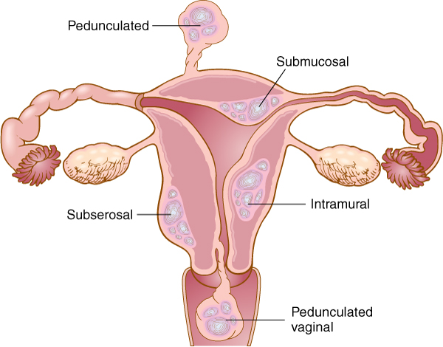
Pathology: Uterus (slide 2 of 2)
Fibroids are benign tumors of the uterus
Notes:
Name the risk factors for carcinoma of the cervix.
What is conization?
How is conization used to diagnose and treat CIS?

Slide 74
Pathology: Gynecological
Ovaries
Ovarian cancer
Malignant tumor of the ovary
Ovarian cysts
Collections of fluid within a sac in the ovary
Fallopian tubes
Pelvic inflammatory disease
Examples: salpingitis, oophoritis, endometritis
Leading causes of PID are sexually transmitted diseases

Slide 75
Pathology: Breast (slide 1 of 2)
Breast
Breast cancer
Fibrocystic disease
Notes:
What is the most common type of breast cancer?

Slide 76
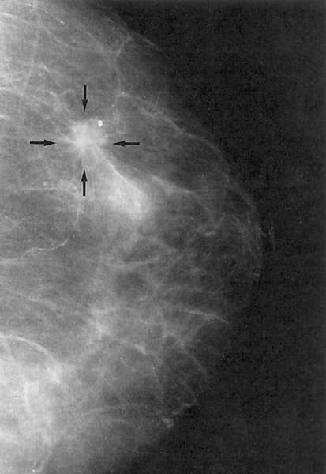
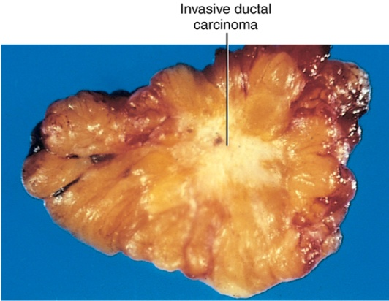
Pathology: Breast (slide 2 of 2) Breast Cancer
Arrows in mammogram point to invasive carcinoma of the breast.
Cut section of invasive ductal carcinoma of the breast.

Slide 77
Chapter 8 Lesson 8.3

Slide 78
Pathology: Pregnancy
Abruptio placentae
Premature separation of the normally implanted placenta
Choriocarcinoma
Malignant tumor of the placenta
Ectopic pregnancy
Misplaced implantation of egg
Placenta previa
Preeclampsia
Notes:
What is an ectopic pregnancy?
Which term describes the emergence of the placenta before the baby?

Slide 79
Pathology: Neonatal (slide 1 of 2)
Down syndrome
Hemolytic disease of the newborn
Hyaline membrane disease
Hydrocephalus
Meconium aspiration syndrome
Pyloric stenosis

Slide 80
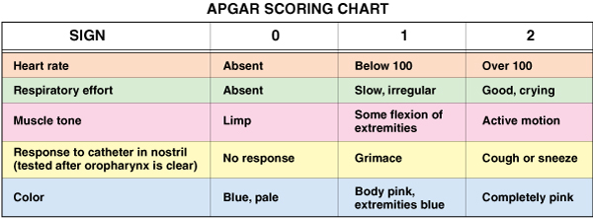
Pathology: Neonatal (slide 2 of 2)
APGAR scoring chart
Assessment of newborn
Scoring 1 to 5 min after birth

Slide 81
Clinical Tests and Procedures
Clinical tests
Pap test (Pap smear)
Pregnancy test
Procedures
Hystersalpingography
Mammography
Breast ultrasound/breast MRI
Pelvic ultrasonography
Notes:
For what tests is a speculum used?
What types of x-rays are used to examine the reproductive organs?
What is the purpose of hysterosalpingography (HSG)?

Slide 82
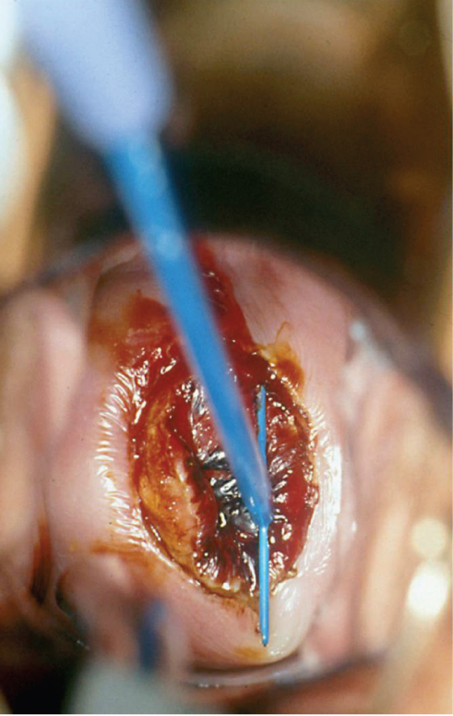
Clinical Procedures (Slide 1 of 2)
Gynecological procedures
Conization
Removal of a cone-shaped section of the cervix.
Figure shows LEEP for cone biopsy

Slide 83
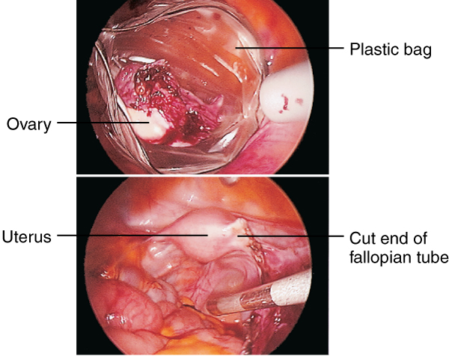
Clinical Procedures (Slide 2 of 2)
Gynecological procedures
Laparoscopic
oophorectomy
A, Ovary placed in plastic bag
B, Extracted through the laparoscope

Slide 84
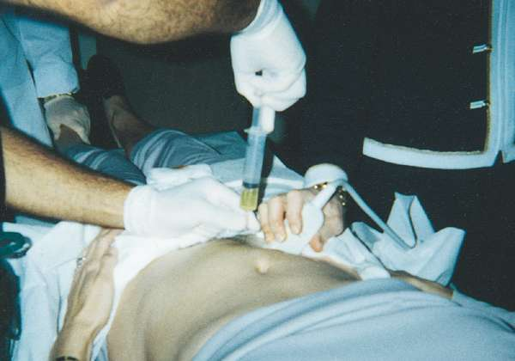
Clinical Tests & Procedures
Procedures
Procedures during pregnancy
Amniocentesis
Needle placement guided by ultrasound images

Slide 85
Abbreviations (Slide 1 of 8)
Abbreviation
AB
AFP
BRCA1/BRCA2
BSE
CA 125
C-section, CS
CIN
CIS
CVS
Cx
D & C

Slide 86
Abbreviations (Slide 2 of 8)
Abbreviation | Meaning
AB | Abortion
AFP | Alpha-fetoprotein-high levels in amniotic fluid of fetus or maternal serum
BRCA1/BRCA2 | Breast cancer 1 and 2 - genetic mutations associated with increased risk for breast cancer
BSE | Breast self-examination
CA 125 | Protein marker elevated in ovarian cancer
C-section, CS | Cesarean section
CIN | Cervical intraepithelial neoplasia
CIS | Carcinoma in situ
CVS | Chorionic villus sampling
Cx | Cervix
D & C | Dilation (dilation and curettage

Slide 87
Abbreviations (Slide 3 of 8)
Abbreviation
DCIS
DUB
FHR
FSH
G
GnRH
GYN
hCG OR HCG
HDN
HPV
HRT
HSG
IUD

Slide 88
Abbreviations (Slide 4 of 8)
Abbreviation | Meaning
DCIS | Ductal carcinoma in situ
DUB | Dysfunctional uterine bleeding
FHR | Fetal heart rate
FSH | Follicle-stimulating hormone
G | Gravida (pregnant)
GnRH | Gonadotropin-releasing hormone
GYN | Gynecology
hCG OR HCG | Human chorionic gonadotropin
HDN | Hemolytic disease of the newborn
HPV | Human papillomavirus
HRT | Hormone replacement therapy
HSG | Hysterosalpingography
IUD | Intrauterine device; contraceptive

Slide 89
Abbreviations (Slide 5 of 8)
Abbreviation
IVF
LEEP
LH
LMP
multip
OB
para 2-0-1-2
Pap test
PID
PMS

Slide 90
Abbreviations (Slide 6 of 8)
Abbreviation | Meaning
IVF | In vitro fertilization
LEEP | Loop electrocautery excision procedure
LH | Luteinizing hormone
LMP | Last menstrual period
multip | Multipara; multiparous
OB | Obstetrics
para 2-0-1-2 | A woman’s reproductive history: 2 full-term infants, 0 preterm, 1 abortion, and 2 living children
Pap test | Papanicolaou smear-test
PID | Pelvic inflammatory disease
PMS | Premenstrual syndrome

Slide 91
Abbreviations (Slide 7 of 8)
Abbreviation
primip
SLN biopsy or SNB
TAH-BSO
UAE
VH

Slide 92
Abbreviations (Slide 8 of 8)
Abbreviation | Meaning
primip | Primipara; primiparous
SLN biopsy or SNB | Sentinel lymph node biopsy
TAH-BSO | Total abdominal hysterectomy with bilateral salpingo-oophorectomy
UAE | Uterine artery embolization
VH | Vaginal hysterectomy

Slide 93
Review Sheet – Combining Forms (Slide 1 of 12)
Combining Form
amni/o
bartholin/o
cephal/o
cervic/o
chori/o, chorion/o
colp/o

Slide 94
Review Sheet – Combining Forms (Slide 2 of 12)
Combining Form | Meaning
amni/o | amnion
bartholin/o | Bartholin gland
cephal/o | head
cervic/o | cervix, neck
chori/o, chorion/o | chorion
colp/o | vagina

Slide 95
Review Sheet – Combining Forms (Slide 3 of 12)
Combining Form
culd/o
episi/o
galact/o
gynec/o
hyster/o

Slide 96
Review Sheet – Combining Forms (Slide 4 of 12)
Combining Form | Meaning
culd/o | cul-de-sac
episi/o | vulva
galact/o | milk
gynec/o | woman, female
hyster/o | uterus, womb

Slide 97
Review Sheet – Combining Forms (Slide 5 of 12)
Combining Form
lact/o
mamm/o
mast/o
men/o
metr/o

Slide 98
Review Sheet – Combining Forms (Slide 6 of 12)
Combining Form | Meaning
lact/o | milk
mamm/o | breast
mast/o | breast
men/o | menses, menstruation
metr/o | uterus

Slide 99
Review Sheet – Combining Forms (Slide 7 of 12)
Combining Form
my/o
myom/o
nat/i
obstetr/o
olig/o
o/o

Slide 100
Review Sheet – Combining Forms (Slide 8 of 12)
Combining Form | Meaning
my/o | muscle
myom/o | muscle tumor
nat/i | birth
obstetr/o | pregnancy and childbirth
olig/o | scanty
o/o | egg

Slide 101
Review Sheet – Combining Forms (Slide 9 of 12)
Combining Form
oophor/o
ov/o
ovari/o
ovul/o
perine/o

Slide 102
Review Sheet – Combining Forms (Slide 10 of 12)
Combining Form | Meaning
oophor/o | ovary
ov/o | egg
ovari/o | ovary
ovul/o | egg
perine/o | perineum

Slide 103
Review Sheet – Combining Forms (Slide 11 of 12)
Combining Form
phor/o
py/o
salping/o
uter/o
vagin/o
vulv/o

Slide 104
Review Sheet – Combining Forms (Slide 12 of 12)
Combining Form | Meaning
phor/o | to bear
py/o | pus
salping/o | fallopian tubes
uter/o | uterus
vagin/o | vagina
vulv/o | vulva

Slide 105
Review Sheet – Suffixes (Slide 1 of 10)
Suffix
-arche
-cele
-cyesis
-ectasis
-ectomy

Slide 106
Review Sheet – Suffixes (Slide 2 of 10)
Suffix | Meaning
-arche | beginning
-cele | hernia
-cyesis | pregnancy
-ectasis | stretching, dilation
-ectomy | removal, excision

Slide 107
Review Sheet – Suffixes (Slide 3 of 10)
Suffix
-flexion
-genesis
-gravida
-itis
-pareunia
-parous

Slide 108
Review Sheet – Suffixes (Slide 4 of 10)
Suffix | Meaning
-flexion | flexible
-genesis | producing; forming
-gravida | pregnancy
-itis | inflammation
-pareunia | sexual intercourse
-parous | to bear, bring forth

Slide 109
Review Sheet – Suffixes (Slide 5 of 10)
Suffix
-plasia
-plasty
-ptosis
-rrhagia
-rrhaphy

Slide 110
Review Sheet – Suffixes (Slide 6 of 10)
Suffix | Meaning
-plasia | development, formation
-plasty | surgical repair
-ptosis | dropping, sagging
-rrhagia | bursting forth (blood)
-rrhaphy | suture

Slide 111
Review Sheet – Suffixes (Slide 7 of 10)
Suffix
-rrhea
-salpinx
-scopy
-stenosis
-stomy

Slide 112
Review Sheet – Suffixes (Slide 8 of 10)
Suffix | Meaning
-rrhea | discharge
-salpinx | uterine tube
-scopy | visual examination
-stenosis | tightening
-stomy | new opening

Slide 113
Review Sheet – Suffixes (Slide 9 of 10)
Suffix
-tocia
-tomy
-tresia
-version

Slide 114
Review Sheet – Suffixes (Slide 10 of 10)
Suffix | Meaning
-tocia | labor, birth
-tomy | process of cutting
-tresia | opening
-version | act of turning

Slide 115
Review Sheet – Prefixes (Slide 1 of 6)
Prefix
bi-
dys-
endo-
in-
intra-
multi-

Slide 116
Review Sheet – Prefixes (Slide 2 of 6)
Prefix | Meaning
bi- | two
dys- | painful
endo- | within
in- | in
intra- | within
multi- | many

Slide 117
Review Sheet – Prefixes (Slide 3 of 6)
Prefix
nulli-
oxy-
peri-
pre-

Slide 118
Review Sheet – Prefixes (Slide 4 of 6)
Prefix | Meaning
nulli- | no, not, none
oxy- | swift, sharp
peri- | surrounding
pre- | before

Slide 119
Review Sheet – Prefixes (Slide 5 of 6)
Prefix
primi-
pseudo-
retro-
uni-

Slide 120
Review Sheet – Prefixes (Slide 6 of 6)
Prefix | Meaning
primi- | first
pseudo- | false
retro- | backward
uni- | one

