Slide 1
The Language of Medicine 13th edition
Davi-Ellen Chabner

Slide 2
Chapter 9 Male Reproductive System

Slide 3
Chapter Goals (Slide 1 of 2)
Name, locate, and describe the functions of the organs of the male reproductive system.
Define abnormal conditions and infections that affect the male reproductive system.
Differentiate among several types of sexually transmitted infections.

Slide 4
Chapter Goals (Slide 2 of 2)
Define combining forms used to describe the structures of this system.
Describe various laboratory tests and clinical procedures that are pertinent to the disorders of the male reproductive system and recognize related abbreviations.
Apply your new knowledge to understanding medical terms in their contexts, such as medical reports and records.

Slide 5
Chapter 9 Lesson 9.1

Slide 6
Introduction (Slide 1 of 4)
The male sex cell is called a spermatozoon, or sperm cell.
The sperm cell carries its nuclear hereditary material, or chromosomes, in its head region.
The tail consists of a flagellum, which makes the sperm cell mobile.
Notes:
What are the parts of a sperm cell?
What is the sperm cell’s purpose?
How does the sperm navigate?

Slide 7
Introduction (Slide 2 of 4)
Only one spermatozoon out of 300 million sperm cells released during ejaculation can fertilize a single female ovum.
If more than one egg is present in the fallopian tubes during ejaculation, multiple fertilizations are possible.
Notes:
Ask students to describe the process of fertilization.

Slide 8
Introduction (Slide 3 of 4)
Twins resulting from the fertilization of separate ova by separate sperm cells are called fraternal twins.
Twins resulting from the fertilization of a single egg by a single sperm are called identical twins.
Notes:
What is the difference between fraternal and identical twins?
Which twins are a perfect genetic match?

Slide 9
Introduction (Slide 4 of 4)
The organs of the male reproductive system are designed to produce and release billions of sperm cells throughout the man’s lifetime.
The hormone called testosterone is responsible for the bodily characteristics of the male (such as beard, pubic hair, and deeper voice).
Notes:
Describe the role of testosterone.
What is the difference between the number of eggs vs. sperm cells?

Slide 10
Anatomy of the Male Reproductive System (slide 1 of 4)
Testis
Scrotum
Perineum
Seminiferous tubules
Epididymis
Vas deferens
Seminal vesicles
Ejaculatory duct
Urethra
Prostate gland
Bulbourethral glands
Penis
Glans penis
Prepuce (foreskin)
Notes:
What are the male gonads called and where are they located?
How does temperature affect the scrotum?
What is the function of the interstitial cells and where are they located?
What are the supportive tissues of the testes?
Labeling answers are on the next slide.

Slide 11
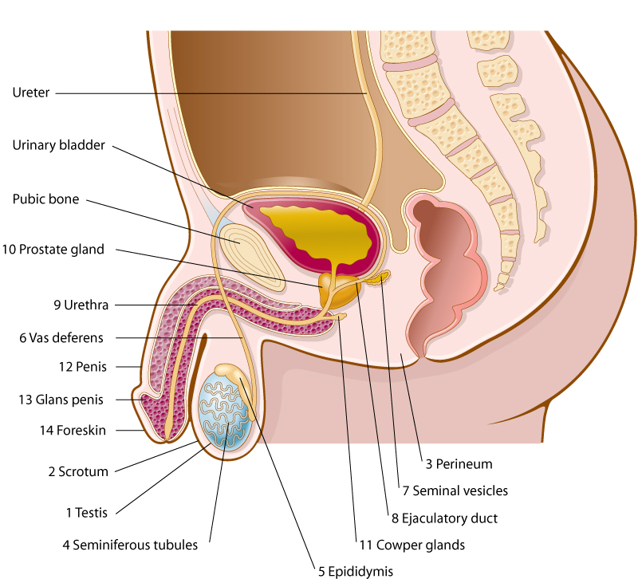
Anatomy of the Male Reproductive System (slide 2 of 4)

Slide 12
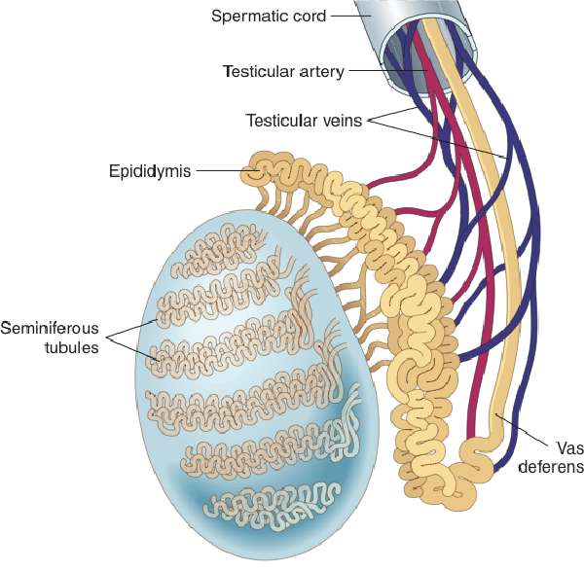
Anatomy of the Male Reproductive System (slide 3 of 4)
Internal structure of the testis and the epididymis

Slide 13
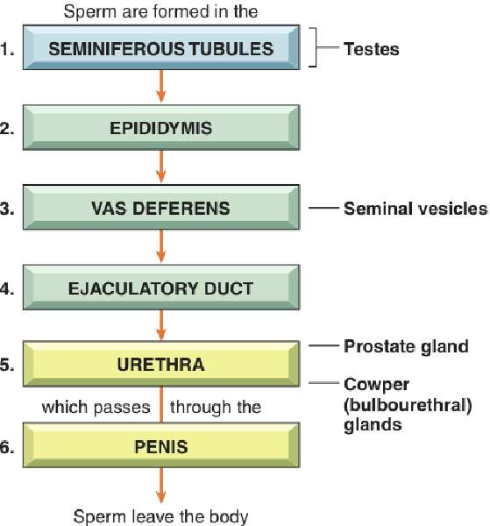
Anatomy of the Male Reproductive System (slide 4 of 4)
The passage of sperm from the seminiferous tubules to the outside of the body

Slide 14
Vocabulary (Slide 1 of 16)
Term
bulbourethral glands
ejaculation
ejaculatory duct

Slide 15
Vocabulary (Slide 2 of 16)
Term | Meaning/Definition
bulbourethral glands | Pair of exocrine glands near male urethra; Cowper glands
ejaculation | Ejection of sperm and fluid from male urethra
ejaculatory duct | Tube through which semen enters the male urethra

Slide 16
Vocabulary (Slide 3 of 16)
Term
epididymis (pl.: epididymides)
erectile dysfunction
flagellum

Slide 17
Vocabulary (Slide 4 of 16)
Term | Meaning/Definition
epididymis (pl.: epididymides) | One of a pair of long, tightly coiled tubes above each testis that stores and carries sperm to the vas deferens
erectile dysfunction | Inability of an adult male to achieve an erection; impotence
flagellum | Hair-like projection on a sperm cell that makes it motile

Slide 18
Vocabulary (Slide 5 of 16)
Term
fraternal twins
glans penis
identical twins

Slide 19
Vocabulary (Slide 6 of 16)
Term | Meaning/Definition
fraternal twins | Two infants resulting from fertilization of two separate ova by two separate sperm cells
glans penis | Sensitive tip of the penis; comparable to the clitoris in the female
identical twins | Two infants resulting from division of one fertilized egg into two distinct embryos; conjoined (“Siamese”) twins are incompletely separated identical twins

Slide 20
Vocabulary (Slide 7 of 16)
Term
interstitial cells of the testes
parenchymal tissue
penis

Slide 21
Vocabulary (Slide 8 of 16)
Term | Meaning/Definition
interstitial cells of the testes | Specialized cells adjacent to the seminiferous tubules in the testes; produce testosterone; also called Leydig cells
parenchymal tissue | Essential distinctive cells of an organ
penis | Male external organ of reproduction

Slide 22
Vocabulary (Slide 9 of 16)
Term
perineum
prepuce
prostate gland
scrotum

Slide 23
Vocabulary (Slide 10 of 16)
Term | Meaning/Definition
perineum | External region between the anus and scrotum in the male
prepuce | Foreskin; fold of skin covering tip of penis
prostate gland | Exocrine gland at base of male urinary bladder; secretes fluid part of semen into urethra during ejaculation
scrotum | External sac that contains the testes

Slide 24
Vocabulary (Slide 11 of 16)
Term
semen
seminal vesicles
seminiferous tubules

Slide 25
Vocabulary (Slide 12 of 16)
Term | Meaning/Definition
semen | Spermatozoa and seminal fluid discharged from the urethra during ejaculation
seminal vesicles | Paired sac-like exocrine glands that secrete fluid into the vas deferens
seminiferous tubules | Narrow, coiled tubules that produce sperm in the testes

Slide 26
Vocabulary (Slide 13 of 16)
Term
spermatozoon (pl. spermatozoa)
sterilization
stromal tissue

Slide 27
Vocabulary (Slide 14 of 16)
Term | Meaning/Definition
spermatozoon (pl. spermatozoa) | Sperm cell
sterilization | Procedure that removes a person’s ability to produce or release reproductive cells through removal of testicles, vasectomy, or oophorectomy
stromal tissue | Supportive, connective tissue or an organ; stroma

Slide 28
Vocabulary (Slide 15 of 16)
Term
testis (plural: testes)
testosterone
vas deferens

Slide 29
Vocabulary (Slide 16 of 16)
Term | Meaning/Definition
testis (plural: testes) | Male gonad (testicle) that produces spermatozoa and testosterone
testosterone | Hormone secreted by interstitial tissue of the testes; responsible for male sex characteristics
vas deferens | Narrow tube carrying sperm from the epididymis toward the urethra; ductus deferens

Slide 30
QUICK QUIZ (Slide 1 of 4)
1. Which term refers to the skin covering the tip of the penis?
A. Stroma
B. Vas deferens
C. Prepuce
D. Seminal vesicle
Notes:
The correct answer is C: prepuce.

Slide 31
Terminology – Combining Forms (Slide 1 of 2)
Combining Form | Meaning
andr/o | male
balan/o | glans penis
cry/o | cold
crypt/o | hidden
epididym/o | epididymis
gon/o | seed
hydr/o | water, fluid
orch/o, orchi/o, orchid/o | testis, testicle

Slide 32
Terminology – Combining Forms (Slide 2 of 2)
Combining Form | Meaning
pen/o | penis
prostat/o | prostate gland
semin/i | semen, seed
sperm/o | spermatozoa, semen
terat/o | monster
test/o | testis, testicle
varic/o | varicose veins
vas/o | vessel duct
zo/o | animal life

Slide 33
Terminology – Suffixes (Slide 1 of 1)
Suffix | Meaning
-genesis | formation
-one | hormone
-pexy | fixation, put in place
-stomy | new opening

Slide 34
Chapter 9 Lesson 9.2

Slide 35
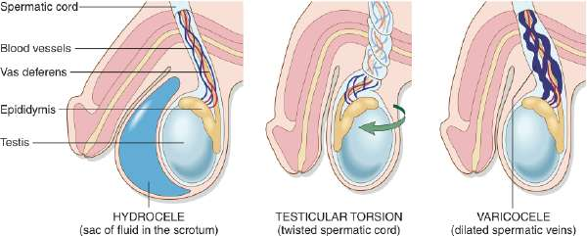
Pathologic Conditions (Slide 1 of 3)
Hydrocele, Testicular Torsion, and Varicocele
Notes:
How is hydrocele treated?
What are the risks of an undescended testis?
How common is carcinoma of the testes?
What are varicoceles?
What is the treatment for testicular torsion?

Slide 36
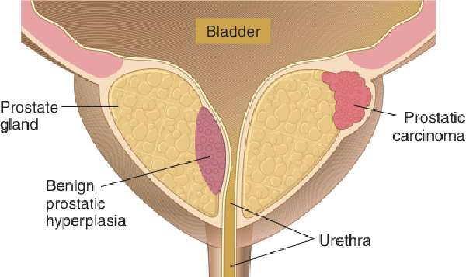
Pathologic Conditions (Slide 2 of 3)
Prostate Gland with Carcinoma and BPH
Notes:
How are carcinomas of the prostate and prostatic hyperplasia diagnosed?
How are they treated?

Slide 37
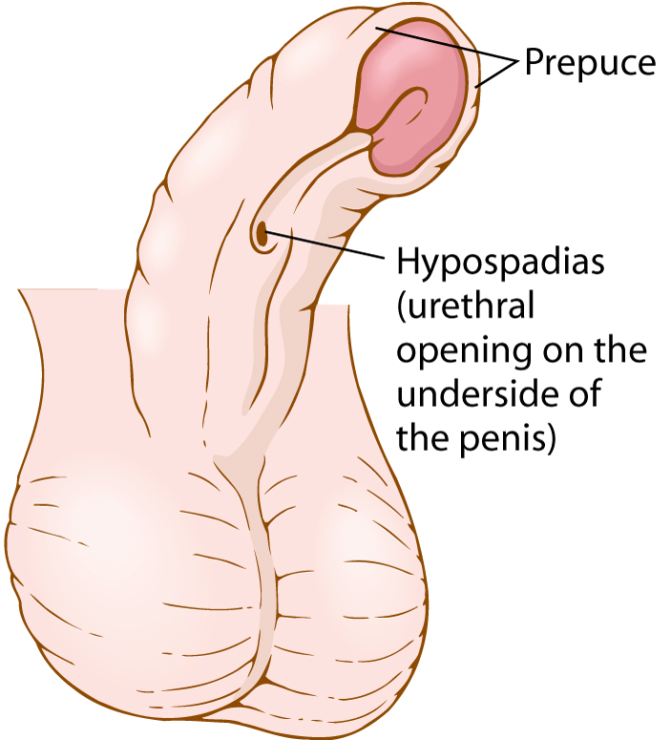
Pathologic Conditions (Slide 3 of 3)
Hypospadias
Surgical repair involves exciding a portion of the prepuce, wrapping it around a catheter, suturing it to the distal part of the urethra, bringing it to the end of the penis
Notes:
What are the odds of a male having hypospadias?
How is hypospadias treated?
How is phimosis treated?

Slide 38
Sexually Transmitted Infections
STIs
Chlamydial infection
Gonorrhea
Herpes genitalis
Human papilloma virus (HPV)
Syphilis
Notes:
What are the symptoms of a chlamydial infection? Gonorrhea? Herpes genitalis? Syphilis?
What types of drugs are given to treat these infections?
Which infections can occur without symptoms?

Slide 39
Laboratory Tests and Clinical Procedures
Laboratory tests
PSA test
Semen analysis
Notes:
What does the PSA test measure?
What does a semen analysis look for? When might this test be performed?

Slide 40
QUICK QUIZ (Slide 2 of 4)
2. What does the PSA test for?
A. Levels of infection
B. Sperm mobility
C. Sperm motility
D. Levels of an antigen
Notes:
The correct answer is D: levels of an antigen. PSA tests for prostate-specific antigen (PSA) in the blood. Elevated levels of PSA are associated with enlargement of the prostate gland and may be a sign of prostate cancer.

Slide 41
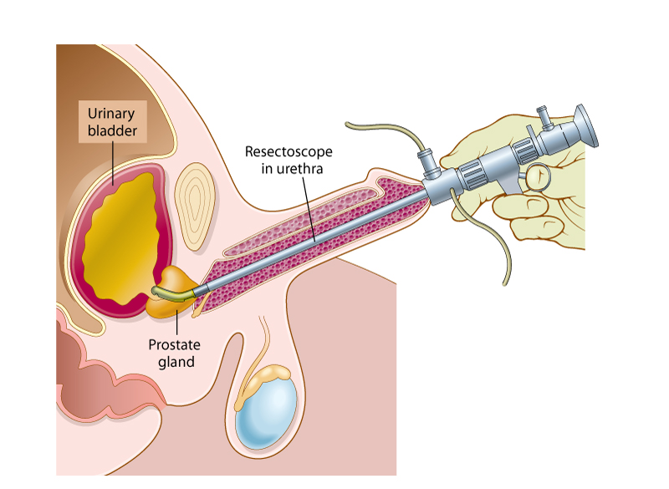
Laboratory Tests and Clinical Procedures (Slide 1 of 2)
Clinical procedures
Transurethral resection of the prostate—TURP
Notes:
What procedure treats prostatic hyperplasia (BPH)? How is it performed?
What is the purpose of a digital rectal exam?

Slide 42
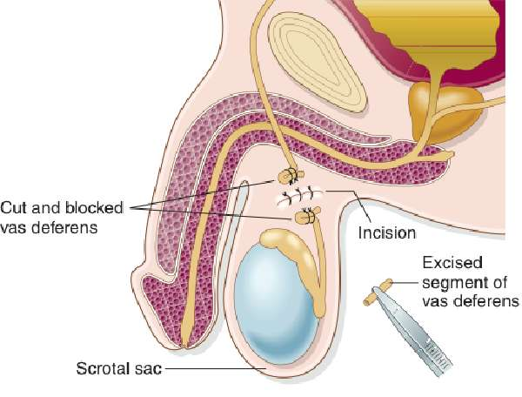
Laboratory Tests and Clinical Procedures (Slide 2 of 2)
Clinical procedures
Vasectomy
Notes:
How does the urologist perform a vasectomy?
Are there any side affects to a vasectomy?
What is reversal of a vasectomy? (Vasovasostomy)

Slide 43
QUICK QUIZ (Slide 3 of 4)
3. Which term means removal of the prostate?
A. Orchiectomy
B. Prostatectomy
C. Vasectomy
D. Prostatitis
Notes:
The correct answer is B: prostatectomy.

Slide 44
Abbreviations (Slide 1 of 2)
Abbreviation | Meaning
BPH | benign prostatic hyperplasia
DRE | digital rectal examination
ED | erectile dysfunction
GU | genitourinary
HPV | human papilloma virus
HSV | herpes simplex virus
PID | pelvic inflammatory disease
PIN | prostatic intraepithelial neoplasia
PSA | prostate-specific antigen

Slide 45
Abbreviations (Slide 2 of 2)
Abbreviation | Meaning
RPR | rapid plasma reagin
STI | sexually transmitted infections (diseases)
TRUS | transrectal ultrasound
TUIP | transurethral incision of the prostate
TUMT | transurethral microwave thermotherapy
TUNA | transurethral needle ablation
TURP | transurethral resection of the prostate

Slide 46
Review Sheet – Combining Forms (Slide 1 of 4)
Combining Form
andr/o
balan/o
cry/o
crypt/o
epididym/o
gon/o
hydr/o
orch/o, orchi/o

Slide 47
Review Sheet – Combining Forms (Slide 2 of 4)
Combining Form | Meaning
andr/o | male
balan/o | glans penis
cry/o | cold
crypt/o | hidden
epididym/o | epididymis
gon/o | seed
hydr/o | water, fluid
orch/o, orchi/o | testis, testicle

Slide 48
Review Sheet – Combining Forms (Slide 3 of 4)
Combining Form
pen/o
prostat/o
semin/i
sperm/o
terat/o
test/o
varic/o
vas/o
zo/o

Slide 49
Review Sheet – Combining Forms (Slide 4 of 4)
Combining Form | Meaning
pen/o | penis
prostat/o | prostate gland
semin/i | semen, seed
sperm/o | spermatozoa, semen
terat/o | monster
test/o | testis, testicle
varic/o | varicose veins
vas/o | vessel duct
zo/o | animal life

Slide 50
Review Sheet – Suffixes (Slide 1 of 2)
Suffix
-genesis
-one
-pexy
-stomy

Slide 51
Review Sheet – Suffixes (Slide 2 of 2)
Suffix | Meaning
-genesis | formation
-one | hormone
-pexy | fixation, put in place
-stomy | new opening

Slide 52
QUICK QUIZ (Slide 4 of 4)
4. Which term means “no sperm or semen are produced”?
A. Aspermia
B. Oligospermia
C. Anorchism
D. Spermolytic
Notes:
The correct answer is A: aspermia

