Slide 1
The Language of Medicine 13th edition
Davi-Ellen Chabner

Slide 2
Chapter 10 Nervous System

Slide 3
Chapter Goals (Slide 1 of 2)
Name, locate, and describe major organs of the nervous system and their functions.
Learn nervous system combining forms and use them with suffixes and prefixes.
Define pathologic conditions affecting the nervous system.

Slide 4
Chapter Goals (Slide 2 of 2)
Describe nervous system-related laboratory tests, clinical procedures, and abbreviations.
Apply your new knowledge to understanding medical terms in the proper contexts, such as medical reports and records.

Slide 5
Chapter 10 Lesson 10.1

Slide 6
Introduction (Slide 1 of 2)
Nervous system:
Complex: 10 billion nerve cells
Voluntary and involuntary functions
Carries electrical messages
External and internal receptors
Notes:
What are external stimuli?
How can internal chemicals be stimuli?
What are some of the involuntary body functions controlled by the nervous system?

Slide 7
Introduction (Slide 2 of 2)
Nerve cells (neurons):
Microscopic
Collected into macroscopic nerves
Carry electrical messages all over the body
Notes:
Internal and external stimuli activate the cell membranes to release stored electrical energy called the nervous impulse.
External and internal receptors receive and transmit these impulses to the brain and spinal cord (central nervous system).
The central nervous system recognizes, interprets, and relays impulses to other nerve cells that extend through parts of the body, such as muscles, glands, and organs.
What is the scope of influence nerve cells have on bodily function?

Slide 8
General Structure of the Nervous System (Slide 1 of 3)
Two major divisions:
Central nervous system—CNS
Brain
Spinal cord
Peripheral nervous system—PNS
Cranial nerves
Spinal nerves
Plexuses
Peripheral nerves throughout the body
Notes:
Cranial nerves carry electrical impulses between the brain and the head and neck (except the vagus nerve).
Spinal nerves carry impulses between the spinal cord and the chest, abdomen, and extremities.
Why is the 10th cranial nerve called the vagus nerve? What does it do?

Slide 9
General Structure of the Nervous System (Slide 2 of 3)
Cranial and spinal nerves
Sensory nerves carry messages toward the brain
Motor nerves carry messages from the brain
Mixed nerves carry both sensory and motor fibers
Sensory receptors
Notes:
What is the difference between voluntary and involuntary functioning?
What are parasympathetic and sympathetic nerves?

Slide 10
General Structure of the Nervous System (Slide 3 of 3)
Autonomic nervous system:
Carries impulses from the central nervous system to the organs
Sympathetic nerves stimulate the body under stress
Parasympathetic nerves balance the sympathetic system
Slow heart rate
Lower blood pressure
Notes:
The autonomic nervous system contains a large group of nerves that function automatically.
It controls the heart, blood vessels, glands, and involuntary muscles like the intestines, and hollow organs such as the stomach and urinary bladder.
Why is the autonomic nervous system necessary?

Slide 11
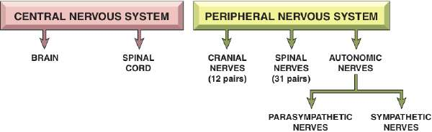
Divisions of the Central and Peripheral Nervous System
Notes:
How are stimuli processed by the nervous system?
What are the parenchymal cells of the nervous system?

Slide 12
Neurons, Nerves, and Glia (slide 1 of 5)
Neuron = Individual nerve cell
Dendrite
Cell nucleus
Axon
Myelin sheath
Neurilemma
Terminal end fibers (secrete neurotransmitters)
Neurotransmitters transfer impulse across synapse
Ganglia = Small clusters of nerve cell bodies
Notes:
What structure carries the nerve impulse away from the cell body?
What substances are examples of neurotransmitters?
What is the singular form of “ganglia”?

Slide 13
Neurons, Nerves, and Glia (slide 2 of 5)
The anatomical parts of a neuron contain:
Dendrites
Cell body
Cell nucleus
Axon
Myelin sheath
Terminal end fibers
Synapse
Notes:
Answers are on the next slide.
What are the parts of the neurons shown in this slide?
What structures comprise the parenchymal cells of the nervous system?

Slide 14
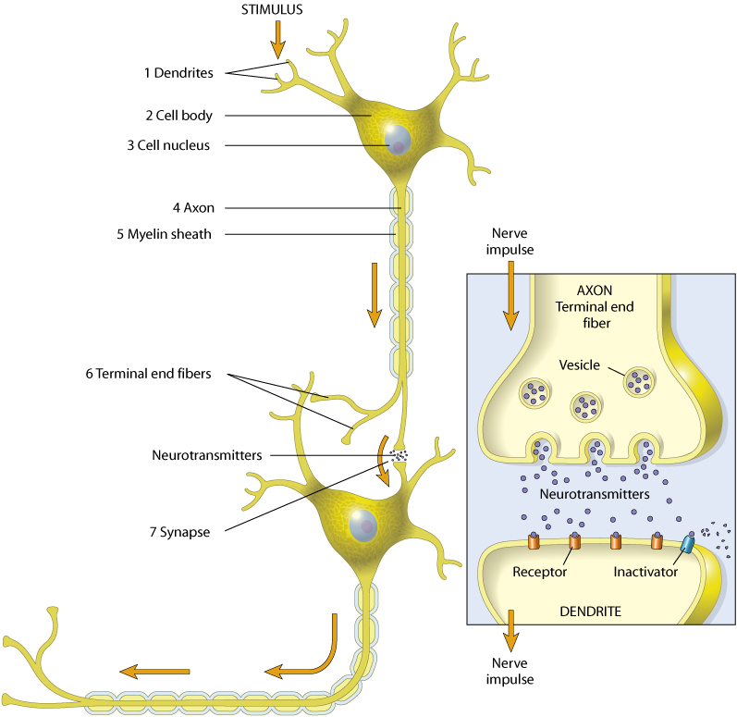
Neurons, Nerves, and Glia (slide 3 of 5)
The image shows the parts of a neuron. Review the path of a nervous impulse
Notes:
What are the parts of the neurons shown in this slide?
What structures comprise the parenchymal cells of the nervous system?

Slide 15
Neurons, Nerves, and Glia (slide 4 of 5)
Glia cells:
Maintain the health of the nervous system
Do not transmit impulses
Notes:
How do the glia cells keep the nervous system healthy?

Slide 16
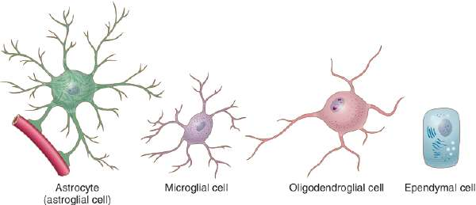
Neurons, Nerves, and Glia (slide 5 of 5)
Four types:
Astrocytes (astroglial cells)
Microglia (microglial cells)
Oligodendroglia (oligodendroglial cells)
Ependymal cells
Notes:
These are the supportive, protective, and connective cells of the central nervous system.
(Recap) What purpose does stromal tissue serve?

Slide 17
Chapter 10 Lesson 10.2

Slide 18
The Brain (slide 1 of 7)
The anatomical structures of the brain include:
Frontal lobe
Sulci
Gyri
Parietal lobe
Occipital lobe
Wernicke area
Temporal lobe
Broca area
Notes:
.

Slide 19
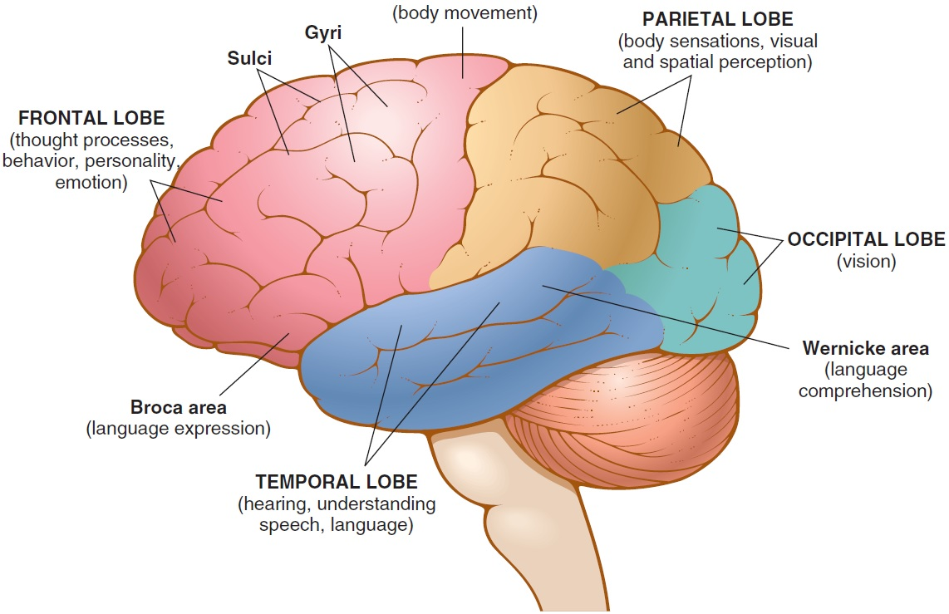
The Brain (slide 2 of 7)
Notes:
The brain is divided into right and left hemispheres.
The brain consists of four major lobes: the frontal lobe, parietal lobe, temporal lobe, and occipital lobe.
What are the parts of the left cerebral hemisphere as shown in the diagram?
What primary functions are carried out by the different lobes of the brain?

Slide 20
The Brain (slide 3 of 7)
Cerebrum
The largest section of the brain
Surface nerve cells called cerebral cortex
Manages speech, vision, smell, movement, hearing, and thought
Notes:
What is the purpose of the cerebral cortex?
How many major divisions can be applied to the entire cerebral cortex?

Slide 21
The Brain (slide 4 of 7)
Cerebellum
Coordinates voluntary movements
Maintains balance
Thalamus
Integrates and monitors impulses from skin (pain)
Notes:
What is the value of the ability to sense pain?

Slide 22
The Brain (slide 5 of 7)
Hypothalamus
Controls body temperature, sleep, appetite, sexual desire, and emotions
Regulates release of hormones from the pituitary gland
Monitors sympathetic and parasympathetic nervous systems
Notes:
How do messages travel from one side of the brain to another?

Slide 23
The Brain (slide 6 of 7)
Brainstem
Pons
Bridges the cerebrum and cerebellum with the rest of the brain
Houses nerves for the face and eyes
Midbrain
Uppermost portion of the brainstem
Contains pathways connecting the cerebrum with lower portions of brain

Slide 24
The Brain (slide 7 of 7)
Brainstem
Medulla oblongata
Connects the spinal cord to the brain
Nerve tracts from side to side
Regulates:
Blood vessels
Heart
Respiratory system
Notes:
How does the word “crossover” apply to a function of the medulla oblongata?

Slide 25
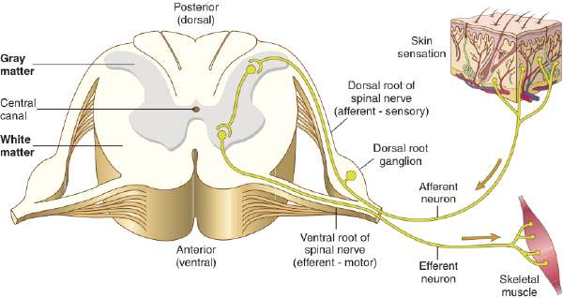
The Spinal Cord
Notes:
The spinal cord is the column of nervous tissue from the medulla oblongata to the second lumbar vertebra.
It serves as a pathway for impulses to and from the brain.
The inner section of the cross section of the spinal cord is gray matter.
The outer section of the cross section of the spinal cord is white matter.
What is the difference between efferent and afferent neurons?

Slide 26
Meninges (slide 1 of 2)
Meninges contain:
Dura mater
Subdural space
Arachnoid membrane
Subarachnoid space
Pia mater
Notes:
Meninges are the three layers of connective tissue membranes that surround the brain and spinal cord.
What is the function of the outer dura mater? (It channels blood to brain tissue.)
What fluid lies between the arachnoid membrane and the subarachnoid space?
The inner pia mater offers a rich supply of blood vessels.
Where are the layers of the meninges in the figure?

Slide 27
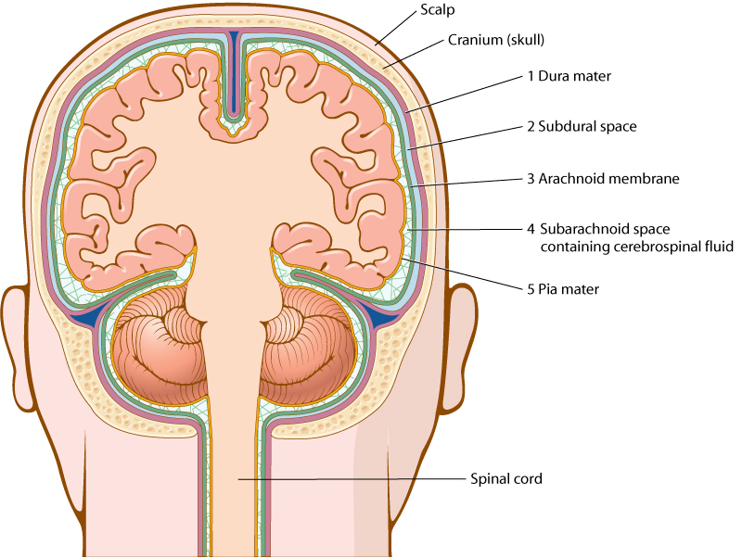
Meninges (slide 2 of 2)
Notes:
Meninges are the three layers of connective tissue membranes that surround the brain and spinal cord.
What is the function of the outer dura mater? (It channels blood to brain tissue.)
What fluid lies between the arachnoid membrane and the subarachnoid space?
The inner pia mater offers a rich supply of blood vessels.
Where are the layers of the meninges in the figure?

Slide 28
Vocabulary (Slide 1 of 34)
Term
acetylcholine
afferent nerve
arachnoid membrane

Slide 29
Vocabulary (Slide 2 of 34)
Term | Meaning/Definition
acetylcholine | Neurotransmitter chemical released at ends of nerve cells
afferent nerve | Carries messages toward the brain and spinal cord
arachnoid membrane | Middle layer of the three membranes that surround the brain and spinal cord

Slide 30
Vocabulary (Slide 3 of 34)
Term
astrocyte
autonomic nervous system
axon

Slide 31
Vocabulary (Slide 4 of 34)
Term | Meaning/Definition
astrocyte | Glial cell that transports water and salts from capillaries
autonomic nervous system | Nerves that control involuntary body functions of muscles, glands, and internal organs
axon | Microscopic fiber that carries the nervous impulse along a nerve cell

Slide 32
Vocabulary (Slide 5 of 34)
Term
blood-brain barrier
brainstem
cauda equina

Slide 33
Vocabulary (Slide 6 of 34)
Term | Meaning/Definition
blood-brain barrier | Protective separation between the blood and brain cells that keeps substances (such as anticancer drugs) from penetrating capillary walls and entering the brain
brainstem | Posterior portion of the brain that connects the cerebrum with the spinal cord: includes the midbrain, pons, and medulla oblongata
cauda equina | Collection of spinal nerves below the end of the spinal cord

Slide 34
Vocabulary (Slide 7 of 34)
Term
cell body
central nervous system (CNS)
cerebellum

Slide 35
Vocabulary (Slide 8 of 34)
Term | Meaning/Definition
cell body | The part of a nerve cell that contains the nucleus
central nervous system (CNS) | The brain and spinal cord
cerebellum | The posterior part of the brain that coordinates muscle movements and maintains balance

Slide 36
Vocabulary (Slide 9 of 34)
Term
cerebral cortex
cerebrospinal fluid
cerebrum

Slide 37
Vocabulary (Slide 10 of 34)
Term | Meaning/Definition
cerebral cortex | Outer region of the cerebrum; contains sheets of nerve cells; gray matter
cerebrospinal fluid | Circulates throughout the brain and spinal cord
cerebrum | The largest part of the brain; responsible for voluntary muscle activity, vision, speech, taste, hearing, thought, and memory

Slide 38
Vocabulary (Slide 11 of 34)
Term
cranial nerves
dendrite
dura mater

Slide 39
Vocabulary (Slide 12 of 34)
Term | Meaning/Definition
cranial nerves | Twelve pairs; carry messages to and from the brain with regard to the head and neck (except the vagus nerve)
dendrite | Microscopic branching fiber of a nerve cell; the first part to receive the nervous impulse
dura mater | The thick, outermost layer of the meninges surrounding and protecting the brain and spinal cord

Slide 40
Vocabulary (Slide 13 of 34)
Term
efferent nerve
ependymal cell
ganglion (plural: ganglia)

Slide 41
Vocabulary (Slide 14 of 34)
Term | Meaning/Definition
efferent nerve | Carries messages away from the brain and spinal cord; motor nerve
ependymal cell | Glial cell that lines the membranes within the brain and spinal cord; helps form cerebrospinal fluid
ganglion (plural: ganglia) | Collection of nerve cell bodies in the peripheral nervous system

Slide 42
Vocabulary (Slide 15 of 34)
Term
glial cell (neuroglial cell)
gyrus (plural: gyri)
hypothalamus

Slide 43
Vocabulary (Slide 16 of 34)
Term | Meaning/Definition
glial cell (neuroglial cell) | Supportive and connective nerve cell that does not carry nervous impulses; can reproduce itself
gyrus (plural: gyri) | Sheet of nerve cells that produces a rounded ridge on the surface of the cerebral cortex; convolution
hypothalamus | The portion of the brain beneath the thalamus; controls sleep, appetite, body temperature, and pituitary gland secretions

Slide 44
Vocabulary (Slide 17 of 34)
Term
medulla oblongata
meninges
microglial cell

Slide 45
Vocabulary (Slide 18 of 34)
Term | Meaning/Definition
medulla oblongata | The part of the brain just above the spinal cord; controls breathing, heartbeat, and size of blood vessels
meninges | Three protective membranes that surround the brain and spinal cord
microglial cell | Phagocytic glial cell that removes waste products from the central nervous system

Slide 46
Vocabulary (Slide 19 of 34)
Term
midbrain
motor nerve
myelin sheath
nerve

Slide 47
Vocabulary (Slide 20 of 34)
Term | Meaning/Definition
midbrain | Uppermost portion of the brainstem
motor nerve | Carries messages away from the brain and spinal cord to muscles and organs; efferent nerve
myelin sheath | Covering of white fatty tissue that surrounds and insulates the axon of a nerve cell; speeds impulse conduction
nerve | Macroscopic cord-like collection of fibers (axons and dendrites) that carry electrical impulses

Slide 48
Vocabulary (Slide 21 of 34)
Term
neuron
neurotransmitter
oligodendroglial cell

Slide 49
Vocabulary (Slide 22 of 34)
Term | Meaning/Definition
neuron | Nerve cell that carries impulses throughout body; parenchyma of the nervous system
neurotransmitter | Chemical messenger released at the end of a nerve cell; stimulates or inhibits another cell
oligodendroglial cell | Glial cell that forms the myelin sheath covering axons; oligodendrocyte

Slide 50
Vocabulary (Slide 23 of 34)
Term
parasympathetic nerves
parenchyma
peripheral nervous system

Slide 51
Vocabulary (Slide 24 of 34)
Term | Meaning/Definition
parasympathetic nerves | Involuntary, autonomic nerves that regulate normal body functions such as heart rate, breathing, and muscles of the gastrointestinal tract
parenchyma | Essential, distinguishing tissue of any organ or system; for the nervous system, neurons and nerves that carry impulses
peripheral nervous system | Nerves outside the brain and spinal cord; cranial, spinal, and autonomic nerves

Slide 52
Vocabulary (Slide 25 of 34)
Term
pia mater
plexus (plural: plexuses)
pons

Slide 53
Vocabulary (Slide 26 of 34)
Term | Meaning/Definition
pia mater | The thin, delicate inner membrane of the meninges
plexus (plural: plexuses) | A large, interlacing network of nerves
pons | The part of the brain anterior to the cerebellum and between the medulla and the rest of the midbrain

Slide 54
Vocabulary (Slide 27 of 34)
Term
receptor
sciatic nerve
sensory nerve

Slide 55
Vocabulary (Slide 28 of 34)
Term | Meaning/Definition
receptor | An organ that receives a nervous stimulus and passes it on to afferent nerves; the skin, ears, eyes, and taste buds are receptors
sciatic nerve | The nerve extending from the base of the spine down the thigh, lower leg, and foot
sensory nerve | Carries messages toward the brain and spinal cord from receptor; afferent nerve

Slide 56
Vocabulary (Slide 29 of 34)
Term
spinal nerves
stimulus (plural: stimuli)
stroma

Slide 57
Vocabulary (Slide 30 of 34)
Term | Meaning/Definition
spinal nerves | Thirty-one pairs arising from the spinal cord
stimulus (plural: stimuli) | An agent of change (light, sound, touch, pressure, pain) in internal or external environment that evokes a response
stroma | Connective and supporting tissue of an organ; glial cells are the stromal tissue of the brain

Slide 58
Vocabulary (Slide 31 of 34)
Term
sulcus (plural: sulci)
sympathetic nerves
synapse

Slide 59
Vocabulary (Slide 32 of 34)
Term | Meaning/Definition
sulcus (plural: sulci) | Depression or groove in the surface of the cerebral cortex; fissure
sympathetic nerves | Autonomic nerves that influence bodily functions involuntarily in times of stress
synapse | The space through which a nervous impulse travels between nerve cells or between nerve and muscle or glandular cells

Slide 60
Vocabulary (Slide 33 of 34)
Term
thalamus
vagus nerve
ventricles of the brain

Slide 61
Vocabulary (Slide 34 of 34)
Term | Meaning/Definition
thalamus | Main relay center of the brain; conducts impulses between the spinal cord and the cerebrum
vagus nerve | Tenth cranial nerve; branches reach to the larynx, trachea, bronchi, lungs, aorta, esophagus, and stomach
ventricles of the brain | Canals in the brain that contain cerebrospinal fluid

Slide 62
QUICK QUIZ (Slide 1 of 4)
1. A sheet of nerve cells that produces a rounded fold on the surface of the cerebellum is the:
A. microglial
B. gyrus
C. parenchyma
D. stroma
Notes:
The correct answer is B: gyrus.

Slide 63
QUICK QUIZ (Slide 2 of 4)
2. The thin, delicate inner membrane of the meninges is the:
A. pia mater
B. dura mater
C. parenchyma
D. stroma
Notes:
The correct answer is A: pia mater.

Slide 64
Terminology – Organs and Structures (Slide 1 of 3)
Combining Form | Meaning
cerebell/o | cerebellum
cerebr/o | cerebrum
dur/o | dura mater
encephal/o | brain
gli/o | glial cells

Slide 65
Terminology – Organs and Structures (Slide 2 of 3)
Combining Form | Meaning
lept/o | thin, slender
mening/o, meningi/o | membranes, meninges
my/o | muscle
myel/o | spinal cord
neur/o | nerve

Slide 66
Terminology – Organs and Structures (Slide 3 of 3)
Combining Form | Meaning
pont/o | pons
radicul/o | nerve root
thalam/o | thalamus
thec/o | sheath (refers to meninges)
vag/o | vagus nerve

Slide 67
Terminology – Signs and Symptoms (Slide 1 of 3)
Combining Form or Suffix | Meaning
alges/o, -algesia | excessive sensitivity to pain
-algia | pain
caus/o | burning
comat/o | deep sleep
esthesi/o, -esthesia | feeling, nervous sensation
kines/o, -kinesia | movement

Slide 68
Terminology – Signs and Symptoms (Slide 2 of 3)
Combining Form or Suffix | Meaning
-kinesis, kinetic | movement
-lepsy | seizure
lex/o | word, phrase
-paresis | slight paralysis
-phasia | speech

Slide 69
Terminology – Signs and Symptoms (Slide 3 of 3)
Combining Form or Suffix | Meaning
-plegia | paralysis
-praxia | action
-sthenia | strength
syncop/o | cut off
tax/o | order, coordination

Slide 70
QUICK QUIZ (Slide 3 of 4)
3. Which term means nerve pain?
A. Cephalgia
B. Analgesia
C. Hypalgesia
D. Neuralgia
Notes:
The correct answer is D: neuralgia.

Slide 71
QUICK QUIZ (Slide 4 of 4)
4. Which type of hematoma occurs between the skull and the dura as a result of a ruptured meningeal artery, usually after a fracture of the skull?
A. Subdural
B. Epidural
C. Intracerebral
Notes:
The correct answer is B: epidural.

Slide 72
Chapter 10 Lesson 10.3

Slide 73
Pathology
Congenital disorders
Hydrocephalus
Spina bifida
Spina bifida cystica
Spina bifida occulta
Notes:
How is hydrocephalus treated?
What are the two types of spina bifida? Ask students to describe the differences between the two types.

Slide 74
Degenerative Movement, and Seizure Disorders
Alzheimer disease (AD)
Amyotrophic lateral sclerosis (ALS)
Epilepsy
Huntington disease (Huntington chorea)
Multiple sclerosis (MS)
Myasthenia gravis (MG)
Palsy
Parkinson disease
Tourette syndrome
Notes:
Which conditions are movement related?
Which conditions are degenerative?

Slide 75
Infectious Disorders
Herpes zoster (shingles)
Meningitis
Human immunodeficiency virus (HIV) encephalopathy
Notes:
What is a viral infection caused by chickenpox?
What types of meningitis exist, and how is meningitis treated?
What is the most malignant form of brain tumor?

Slide 76
Traumatic Disorders
Cerebral concussion:
Type of traumatic brain injury caused by a blow to the head
Usually no evidence of structural damage to brain tissue
Rest is very important to allow the brain to heal
Cerebral contusion:
Bruising of brain tissue as a result of direct trauma to the head
May be associated with a fracture of the skull, edema and increased intracranial pressure
Subdural and epidural hematomas can occur leading to permanent brain injury
Notes:
What is the primary difference between a concussion and a contusion?

Slide 77
Vascular Disorders (slide 1 of 2)
Cerebrovascular accident (CVA)
Thrombotic — blood clot in arteries leaving the brain
Embolic — dislodged blood clot travels to cerebral arteries
Hemorrhagic — blood vessel breaks and bleeding occurs
Notes:
What is the primary difference between a concussion and a contusion?

Slide 78
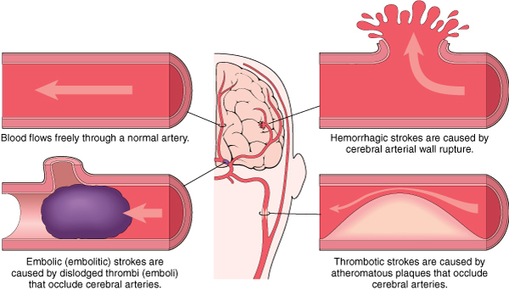
Vascular Disorders (slide 2 of 2)
Cerebrovascular accident (CVA)
Notes:
There are three types of cerebrovascular accident (CVA): thrombotic, embolic, and hemorrhagic.
What is another name for CVA?
What causes a transient ischemic attack (TIA)?

Slide 79
Clinical Procedures
X-ray tests:
Cerebral angiography
Computed tomography (CT) of the brain
Other procedures:
MRI—Magnetic resonance Imaging
PET—Positron emission scan
EEG—Electroencephalography
Doppler ultrasound studies
Notes:
Which x-ray uses a contrast medium?

Slide 80
Abbreviations (Slide 1 of 3)
Abbreviation | Meaning
AD | Alzheimer disease
AFP | alpha-fetoprotein
ALS | amyotrophic lateral sclerosis
AVM | arteriovenous malformation
BBB | blood brain barrier
CNS | central nervous system
CT | computed tomography
CSF | cerebrospinal fluid
CVA | cerebrovascular accident

Slide 81
Abbreviations (Slide 2 of 3)
Abbreviation | Meaning
EEG | electroencephalogram
GABA | gamma-aminobutyric acid (neurotransmitter)
ICP | intracranial pressure; normal pressure is 5 to 15 mmHG
LP | lumbar puncture
MAC | monitored anesthetic care
MG | myasthenia gravis
MRA | magnetic resonance angiography
MRI | magnetic resonance imaging

Slide 82
Abbreviations (Slide 3 of 3)
Abbreviation | Meaning
1/2 P | hemiparesis
PCA | patient-controlled anesthesia
PNS | peripheral nervous system
PET | positron emission tomography
Sz | seizure
TBI | traumatic brain injury
TENS | transcutaneous electrical nerve stimulation
TIA | transient ischemic attack
TLE | temporal lobe epilepsy
tPA | tissue plasminogen activator

Slide 83
Practical Applications
What symptoms signal nervous system problems?
What tests are conducted to diagnose these problems?
Why are an MRI and an MRA ordered?
What are common pathologies of the nervous system?

Slide 84
Review Sheet (Slide 1 of 5)
Combining Form | Meaning
alges/o | sensitivity to pain
angi/o | vessel, blood
caus/o | burn, burning
cephal/o | head
cerebell/o | cerebellum
cerebr/o | cerebrum

Slide 85
Review Sheet (Slide 2 of 5)
Combining Form | Meaning
comat/o | deep sleep
crani/o | skull
cry/o | cold
dur/o | dura mater
encephal/o | brain
esthesi/o | nervous sensation

Slide 86
Review Sheet (Slide 3 of 5)
Combining Form | Meaning
gli/o | glue
hydr/o | water
kines/o | movement
lept/o | thin, slender
lex/o | word, phrase
mening/o, meningi/o | membranes, meninges
my/o | muscle

Slide 87
Review Sheet (Slide 4 of 5)
Combining Form | Meaning
myel/o | spinal cord
narc/o | sleep
neur/o | nerve
olig/o | scanty
pont/o | pons
radicul/o | nerve root

Slide 88
Review Sheet (Slide 5 of 5)
Combining Form | Meaning
spin/o | spine
syncop/o | cut off
tax/o | order
thalam/o | thalamus
thec/o | sheath (refers to meninges)
troph/o | nourishment
vag/o | vagus nerve

