Slide 1
The Language of Medicine 13th edition
Davi-Ellen Chabner

Slide 2
Chapter 11 Cardiovascular System

Slide 3
Chapter Goals (Slide 1 of 2)
Name the parts of the heart and associated blood vessels and their functions in the circulation of blood.
Trace the pathway of blood through the heart.
Identify and describe major pathologic conditions affecting the heart and blood vessels.

Slide 4
Chapter Goals (Slide 2 of 2)
Define combining forms that relate to the cardiovascular system.
Describe important laboratory tests and clinical procedures pertaining to the cardiovascular system and recognize relevant abbreviations.
Apply your new knowledge to understand medical terms in their proper context, such as in medical reports and records.

Slide 5
Chapter 11 Lesson 11.1

Slide 6
Introduction
Cardiovascular system: delivers oxygen and nutrients to cells of body tissue
Heart (muscular pump)
Blood vessels (fuel line and transportation network)
Notes:
What are three types of blood vessels in the body?
What are the primary differences between them? (See the next slide.)

Slide 7
Blood Vessels and the Circulation of Blood
Arteries are the vessels that lead away from the heart.
Veins have thinner walls than arteries and move deoxygenated blood toward the heart from the tissues.
Capillaries are the smallest vessels. They form the point of exchange for oxygen and nutrients into body cells and waste products coming from body cells.
Notes:
What are smaller branches of arteries called? (Arterioles)
What are small veins that carry waste-filled blood back to the heart called? (Venules)

Slide 8
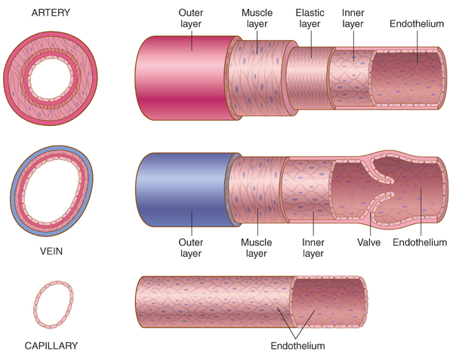
Blood Vessels
Notes:
Point out the discrete layers of each vessel.
Compare and contrast the substructures of each type of vessel.
Why is the muscle layer in an artery thicker than that of a vein?

Slide 9
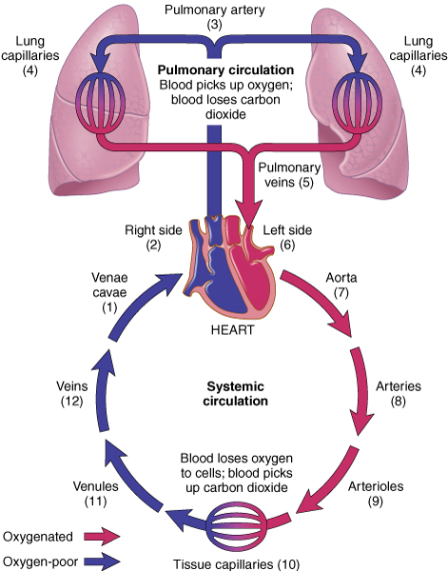
Blood Circulation/Systemic Circulation
Notes:
Make sure students understand this basic flow in order to fully understand the pathology.
The anatomic terminology here is often associated with any pathology.

Slide 10
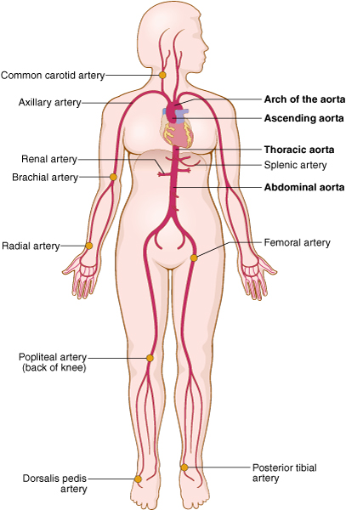
The Aorta and Arteries
Notes:
The major pulse points should be considered. For example, the brachial artery is important because blood pressure is routinely measured at this junction.
What symptoms are associated with potential blockage in these vessels?

Slide 11
Anatomy of the Heart
Anatomical structures of the heart include:
Superior vena cava
Inferior vena cava
Right atrium
Tricuspid valve
Right ventricle
Pulmonary valve
Pulmonary artery
Pulmonary veins
Left atrium
Mitral valve
Left ventricle
Aortic valve
Aorta
Notes:
Which of the four chambers has the thickest walls and why? (The left ventricle walls are three times the thickness of the right ventricle walls; it requires great force to pump blood throughout the body.)

Slide 12
Major Valves of the Heart
Tricuspid valve (cusps are flaps of the valves): between the right atrium and right ventricle
Pulmonary valve: between the right ventricle and pulmonary artery
Mitral valve: between the left atrium and left ventricle
Aortic valve: between the left atrium and aorta
Notes:
Point these out on the diagram from the previous slide.

Slide 13
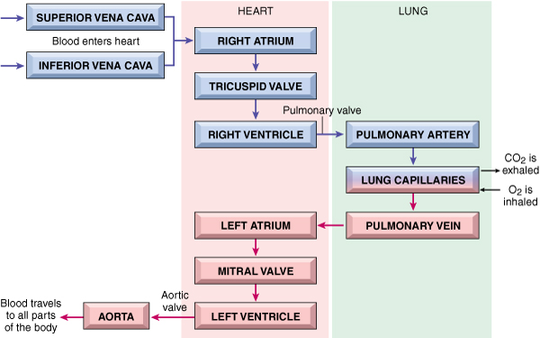
Pathway of Blood through the Heart
Notes:
Go through each step of how the blood travels through the heart.

Slide 14
Heartbeat
Two phases of the heartbeat:
Diastole: relaxation
Systole: contraction
The diastole-systole cardiac cycle occurs between 70 to 80 times per minute (100,000 times per day).
The heart pumps 3 ounces of blood with each contraction. This means that about 5 quarts are pumped per minute (75 gallons an hour and about 2000 gallons a day).
Notes:
Which valves open and which valves close during diastole? (The tricuspid and mitral valves open as blood passes from the right and left atria into the ventricles. The pulmonary and aortic valves close.)

Slide 15
Heart Sounds
Closure of valves associated with sounds “lubb-dubb, lubb-dubb”
lubb: closure of the tricuspid and mitral valves at the beginning of systole
dubb: closure of the aortic and pulmonary valves at the end of systole
murmur: an abnormal heart sound caused by improper valve closure
Notes:
Borrow a stethoscope to demonstrate.
Audio recordings are also available online. Many also contain pathological sounds.

Slide 16
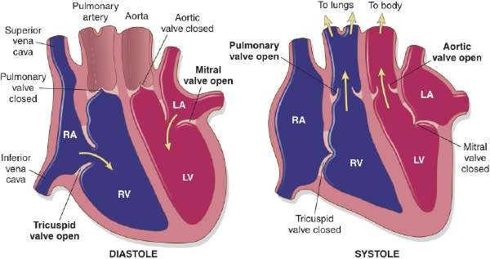
Phases of the Heartbeat
Notes:
Have students fill in the labels using this slide.

Slide 17
Conduction System of the Heart (slide 1 of 2)
Sinoatrial node (SA node): the pacemaker of the heart
Pacemaker: origin of electrical impulse causing walls of the atria to contract and force blood into the ventricles (ending diastole)
Notes:
Where in the heart is the SA node located? (In a small region of specialized muscle tissue in the posterior portion of the right atrium)

Slide 18
Conduction System of the Heart (slide 2 of 2)
Atrioventricular node (AV node): This sends the excitation wave to a bundle of specialized fibers called the atrioventricular bundle or Bundle of His.
Bundle of His (pronounced “hiss”): Helps form conduction myofibers that extend to ventricle walls and stimulate them to contract, beginning systole. A short rest period follows.
The pacemaker begins wave of excitation again.
ECG or EKG (electrocardiogram): The record used to detect electrical changes in heart muscle as the heart beats.
Notes:
Where is the AV node? (In the posterior portion of the interatrial septum)
The normal ECG shows five waves (deflections) that represent the electrical changes as a wave of excitation spreads through the heart. What are the deflections called? (P, QRS, and T waves)

Slide 19
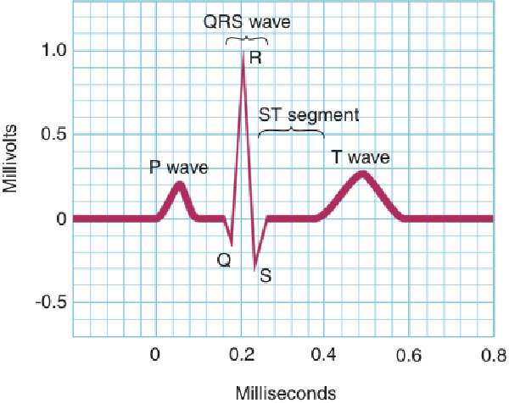
Electrocardiogram (slide 1 of 3)
P wave = spread of excitation wave over the atria just before contraction
QRS wave = spread of excitation wave over the ventricles as the ventricles contract;
T wave = electrical recovery and relaxation of ventricles. A heart attack (myocardial infarction or MI) can be recognized by an elevation in the S-T segment of the ECG. Thus, one type of MI is an S-T elevation MI or STEMI
Notes:
The ECG diagnoses electrical problems in the heart, such as arrhythmias.
Identify deflections on the ECG.
What is happening in the heart with each wave complex?

Slide 20
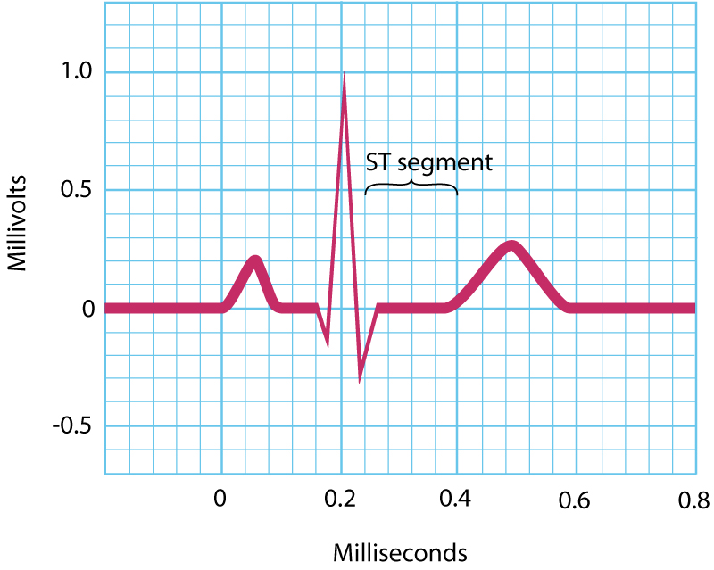
Electrocardiogram (slide 2 of 3)
Notes:
The ECG diagnoses electrical problems in the heart, such as arrhythmias.
Identify deflections on the ECG.
What is happening in the heart with each wave complex?

Slide 21
Electrocardiogram (slide 3 of 3)
Notes:
The ECG diagnoses electrical problems in the heart, such as arrhythmias.
Identify deflections on the ECG.
What is happening in the heart with each wave complex?

Slide 22
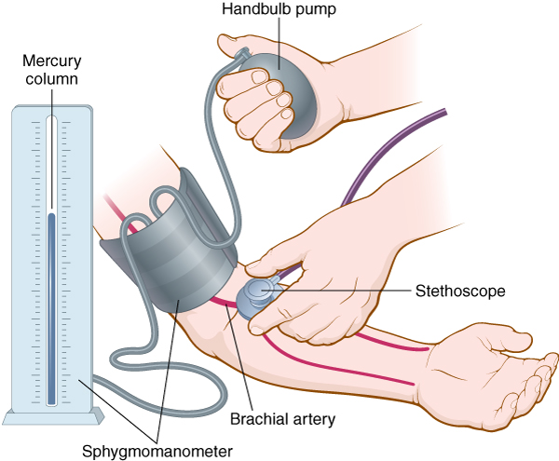
Blood Pressure
Blood pressure: The force that blood exerts on arterial walls
Measured using a sphygmomanometer
Expressed as a fraction: systolic pressure/diastolic pressure
Example: 120/80 mm Hg
Notes:
How does the sphygmomanometer work?
Compare this device to over-the-counter electronic monitors.
What effect does exercise have on blood pressure measurements?
What causes increases and decreases in blood pressure?

Slide 23
Vocabulary (Slide 1 of 22)
Term
aorta
apex of the heart
arteriole
artery

Slide 24
Vocabulary (Slide 2 of 22)
Term | Meaning/Definition
aorta | The largest artery in the body
apex of the heart | The lower tip of the heart
arteriole | A small artery
artery | The largest type of blood vessel; carries blood away from the heart to all parts of the body

Slide 25
Vocabulary (Slide 3 of 22)
Term
atrioventricular bundle (bundle of His)
atrioventricular node (AV node)
atrium (plural: atria)

Slide 26
Vocabulary (Slide 4 of 22)
Term | Meaning/Definition
atrioventricular bundle (bundle of His) | Specialized muscle fibers connecting the atria with the ventricles and transmitting electrical impulses between them
atrioventricular node (AV node) | Specialized tissue in the wall between atria; electrical impulses pass from pacemaker through AV node and bundle of His toward ventricles
atrium (plural: atria) | One of two upper chambers of the heart

Slide 27
Vocabulary (Slide 5 of 22)
Term
capillary
carbon dioxide (CO₂)
coronary arteries
deoxygenated blood

Slide 28
Vocabulary (Slide 6 of 22)
Term | Meaning/Definition
capillary | The smallest blood vessel
carbon dioxide (CO₂) | Waste gas released by body cells, transported via veins to the heart, and then to lungs for exhalation
coronary arteries | Blood vessels that branch from the aorta and carry oxygen-rich blood to the heart muscle
deoxygenated blood | Oxygen-poor blood

Slide 29
Vocabulary (Slide 7 of 22)
Term
diastole
electrocardiogram
endocardium
endothelium

Slide 30
Vocabulary (Slide 8 of 22)
Term | Meaning/Definition
diastole | Relaxation phase of the heartbeat
electrocardiogram | Record of the electricity flowing through the heart
endocardium | Inner lining of the heart
endothelium | Innermost lining of blood vessels

Slide 31
Vocabulary (Slide 9 of 22)
Term
mitral valve
murmur
myocardium
normal sinus rhythm

Slide 32
Vocabulary (Slide 10 of 22)
Term | Meaning/Definition
mitral valve | Valve between the left atrium and left ventricle; bicuspid valve
murmur | Abnormal swishing sound caused by improper closure of heart valves
myocardium | Muscular, middle layer of the heart
normal sinus rhythm | Heart rhythm originating in sinoatrial node with resting rate of 60-100 beats/min

Slide 33
Vocabulary (Slide 11 of 22)
Term
oxygen
pacemaker (sinoatrial node)
pericardium
pulmonary artery

Slide 34
Vocabulary (Slide 12 of 22)
Term | Meaning/Definition
oxygen | Gas carried by the blood from the lungs to the heart to be pumped via arteries to all body cells
pacemaker (sinoatrial node) | Specialized nervous tissue in the right atrium that begins the heartbeat
pericardium | Double-layered membrane surrounding the heart
pulmonary artery | Artery carrying oxygen-poor blood from the heart to the lungs

Slide 35
Vocabulary (Slide 13 of 22)
Term
pulmonary circulation
pulmonary valve
pulmonary vein

Slide 36
Vocabulary (Slide 14 of 22)
Term | Meaning/Definition
pulmonary circulation | Flow of blood from the heart to the lungs and back to the heart
pulmonary valve | Valve positioned between the right ventricle and the pulmonary artery
pulmonary vein | Carries oxygenated blood from the lungs to the left atrium of the heart

Slide 37
Vocabulary (Slide 15 of 22)
Term
pulse
septum (plural: septa)
sinoatrial node (SA node)

Slide 38
Vocabulary (Slide 16 of 22)
Term | Meaning/Definition
pulse | The beat of the heart as felt through the walls of the arteries
septum (plural: septa) | A partition or wall dividing a cavity, such as that between the right and left atria and right and left ventricles
sinoatrial node (SA node) | The pacemaker of the heart

Slide 39
Vocabulary (Slide 17 of 22)
Term
sphygmomanometer
systemic circulation
systole
tricuspid valve

Slide 40
Vocabulary (Slide 18 of 22)
Term | Meaning/Definition
sphygmomanometer | An instrument to measure blood pressure
systemic circulation | Flow of blood from body tissue to the heart and back
systole | The contraction phase of the heartbeat
tricuspid valve | Located between the right atrium and right ventricle; has three leaflets or cusps

Slide 41
Vocabulary (Slide 19 of 22)
Term
valve
vein

Slide 42
Vocabulary (Slide 20 of 22)
Term | Meaning/Definition
valve | A structure in veins or in the heart that temporarily closes an opening so blood flows in only one direction
vein | A thin-walled vessel that carries blood from body tissues and lungs back to the heart; contains valves to prevent the backflow of blood

Slide 43
Vocabulary (Slide 21 of 22)
Term
vena cava (plural: venae cavae)
ventricle
venule

Slide 44
Vocabulary (Slide 22 of 22)
Term | Meaning/Definition
vena cava (plural: venae cavae) | The largest vein in the body; superior and inferior venae cavae return blood to the right atrium of heart
ventricle | One of two lower chambers of the heart
venule | A small vein

Slide 45
Combining Forms and Terminology (Slide 1 of 4)
Combining Form | Meaning
angi/o | vessel
aort/o | aorta
arter/o | artery
arteri/o | artery
ather/o | yellowish plaque
atri/o | atrium

Slide 46
Combining Forms and Terminology (Slide 2 of 4)
Combining Form | Meaning
brachi/o | arm
cardi/o | heart
cholesterol/o | cholesterol
coron/o | heart
cyan/o | blue
myx/o | mucus

Slide 47
Combining Forms and Terminology (Slide 3 of 4)
Combining Form | Meaning
ox/o | oxygen
pericardi/o | pericardium
phleb/o | vein
sphygm/o | pulse
steth/o | chest
thromb/o | clot

Slide 48
Combining Forms and Terminology (Slide 4 of 4)
Combining Form | Meaning
valvul/o | valve
valv/o | valve
vas/o | vessel
vascul/o | vessel
ven/o, ven/i | vein
ventricul/o | ventricle

Slide 49
QUICK QUIZ (Slide 1 of 4)
The double-layered membrane surrounding the heart is the:
pericardium
arteriole
endocardium
endothelium
Notes:
The correct answer is A: pericardium.

Slide 50
QUICK QUIZ (Slide 2 of 4)
2. The contraction phase of the heartbeat is called:
diastole
vena cava
systole
septum
Notes:
The correct answer is C: systole.

Slide 51
Chapter 11 Cardiovascular System Lesson 11.2

Slide 52
Pathology: Heart (Slide 1 of 7)
Heart
Arrhythmias
Heart block (atrioventricular block)
Flutter
Fibrillation
Notes:
What device establishes normal heart rhythm?
What term describes the action of applying a defibrillator to give an electric shock to the heart?
On the list, which terms are associated with “palpitations”?

Slide 53
Pathology: Heart (Slide 2 of 7)
Heart
Congenital heart disease
Coarctation of the aorta (CoA)
Patent ductus arteriosus (PDA)
Septal defects (ASD and VSD)
Tetralogy of Fallot
Notes:
What is a “blue baby”?
In terms of septal defects, what are two recent procedures that serve as alternatives to traditional surgery? (Trans-catheter closure and minimally invasive heart surgery)

Slide 54
Pathology:Heart ( Slide 3 of 7)
Heart
Congestive heart disease (CHF): The heart is unable to pump the required amount of blood.
In the U.S., primarily the result of high blood pressure and coronary artery disease (see next slide)
Results in pulmonary edema
Fatal if untreated
Notes:
What drugs improve the performance of the heart and its pumping activity? (Angiotensin-converting enzyme (ACE) inhibitors and beta-blockers)
What device do patients awaiting a transplant use to help assist the heart’s pumping? (A left ventricular assist device or LVAD)

Slide 55
Pathology: Heart (Slide 4 of 7)
Heart
Coronary artery disease (CAD)
Atherosclerosis
Thrombotic occlusion (occlusive/mural)
Ischemia
Necrosis
Infarction
Acute Coronary Syndromes (ACS)
Unstable angina
Myocardial infarction (MI)
Notes:
What is atherosclerosis? (The deposition of fatty compounds on the inner lining of the coronary arteries)
What is ACS? (It describes the consequences after plaque rupture in coronary arteries.)
What is unstable angina? (Chest pain at rest or chest pain of increasing frequency)

Slide 56
Pathology: Heart (Slide 5 of 7)
Heart
Coronary artery disease (CAD)
Drug therapies for CAD
Nitrates (nitroglycerin)
Aspirin
Beta-blockers
ACE inhibitors
Calcium channel blockers
Statins
Notes:
What drug is given for acute attacks of angina? (Nitroglycerin is given sublingually.)
This drug is one of several nitrates that is a powerful vasodilator that increases coronary blood flow and lowers blood pressure.
What do statins do?

Slide 57
Pathology: Heart (Slide 6 of 7)
Heart
Coronary artery disease (CAD)
Surgical therapies for CAD
Coronary artery bypass grafting (CABG)
Percutaneous coronary intervention (PCI)
Notes:
What is CABG? (An open heart operation to treat coronary artery disease by replacing clogged vessels)
What is PTCA? (Catheterization with balloons and stents to open clogged coronary arteries)
What is TMLR? (A laser makes holes in the heart muscle to induce angiogenesis or growth of new blood vessels)

Slide 58
Pathology: Heart (Slide 7 of 7)
Heart
Other pathologic conditions
Endocarditis (vegetations)
Hypertensive heart disease
Mitral valve prolapse (MVP)
Murmur
Pericarditis
Rheumatic heart disease
Notes:
What is endocarditis? (Inflammation of the inner lining of the heart caused by bacteria)
What is MVP? (Improper closure of the mitral valve)
What is rheumatic heart disease? (Heart disease caused by rheumatic fever)

Slide 59
Pathology: Blood Vessels
Blood vessels
Aneurysm
Deep vein thrombosis (DVT)
Hypertension (HTN)
Peripheral vascular disease (PVD)
Raynaud’s disease
Varicose veins
Notes:
What is PVD? (Blockage of blood vessels outside the heart)
A sign of PVD in the lower extremities is intermittent claudication, an absence of pain or discomfort in a leg at rest, but a recurrence of pain, tension, and weakness after walking has begun.
What are the signs of Raynaud disease?

Slide 60
QUICK QUIZ (Slide 3 of 4)
3. Which arrhythmia refers to rapid, random, inefficient, and irregular contractions of the atria and ventricles (350 beats or more per minute)?
Fibrillation
Flutter
Bradycardia
Notes:
The correct answer is A: fibrillation.

Slide 61
Chapter 11 Lesson 11.3

Slide 62
Laboratory Tests
BNP test
Cardia biomarkers
Lipid test profile
Lipoprotein electrophoresis
Notes:
What are lipid tests?
What is lipoprotein electrophoresis? Why is this test ordered?
What are serum enzyme tests? Why is this test ordered?

Slide 63
Clinical Procedures: Diagnostic (Slide 1 of 3)
X-ray
Angiography and arteriography
Computerized tomography angiography
Digital subtraction angiography (DSA)
Electron beam computed tomography (EBCT or EBT)
Ultrasound tests
Doppler ultrasound
Echocardiography (ECHO)
Notes:
What determines when each of these tests should be used?
Differentiate between invasive and noninvasive diagnostic tests.

Slide 64
Clinical Procedures: Diagnostic (Slide 2 of 3)
Nuclear cardiology
Positron emission tomography (PET) scan
Technetium TC 99m scan
Thallium-201 scan
Magnetic resonance imaging (MRI)
Cardiac MRI
Notes:
Are there any risks or side effects from having these tests performed?

Slide 65
Clinical Procedures: Diagnostic (Slide 3 of 3)
Other diagnostic procedures
Cardiac catheterization
Electrocardiography (ECG, EKG)
Holter monitoring
Stress test
Notes:
What is the anticipated or theorized cardiac problem that leads a person to get a test?
Be as specific as possible when describing the procedures. Find one unique thing about each test that makes it memorable. Have the students help you do this.

Slide 66
Clinical Procedures: Treatment (Slide 1 of 2)
Cardioversion (defibrillation)
Endarterectomy
Extracorporeal circulation
Heart transplantation
Thrombolytic therapy
Transcatheter aortic valve replacement (TAVR)
Notes:
Use photographs or online images to show some of the equipment used routinely to diagnose and treat the heart during acute abnormalities.

Slide 67
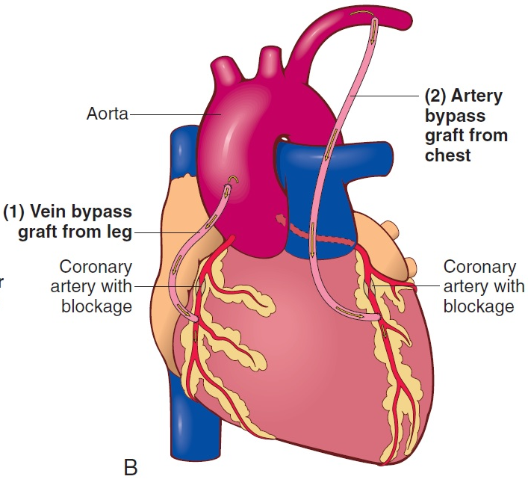
Clinical Procedures: Treatment (Slide 2 of 2)
Coronary artery bypass graft (CABG) surgery
1, A section of a vein is removed from the leg and anastomosed to a coronary artery to bypass an area of arteriosclerotic blockage.
2, An internal mammary artery is grafted to a coronary artery to bypass blockage.

Slide 68
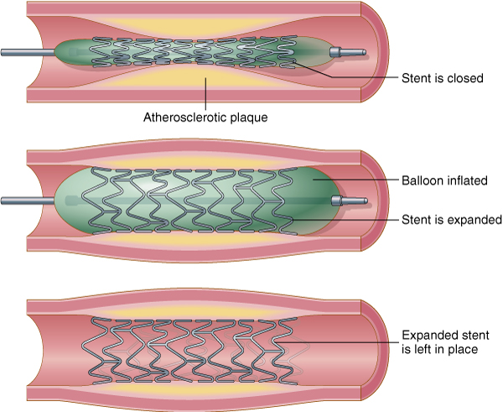
Treatment Procedures
Percutaneous coronary intervention (PCI)
Includes: percutaneous transluminal coronary angioplasty (PTCA), stent placement, laser angioplasty, and atherectomy

Slide 69
Abbreviations (Slide 1 of 9)
Abbreviation | Meaning
AAA | Abdominal aortic aneurysm
ACE inhibitor | Angiotensin-converting enzyme inhibitor
ACLS | Advanced cardiac life support
ACS | Acute coronary syndrome
ADP | Adenosine diphosphate
AED | Automatic external defibrillator
AF, a-fib | Atrial fibrillation
AICD | Automatic implantable cardioverter-defibrillator
AMI | Acute myocardial infarction
ARVD | Arrhythmogenic right ventricular dysplasia
ARB | angiotension II receptor blocker
AS | Aortic stenosis
ASD | Atrial septal defect

Slide 70
Abbreviations (Slide 2 of 9)
Abbreviation | Meaning
AV, A-V | Atrioventricular
AVR | Aortic valve replacement
BBB | Bundle branch block
BNP | Brain natriuretic peptide
BP | Blood pressure
CABG | Coronary artery bypass grafting
CAD | Coronary artery disease
CCU | Coronary care unit
Cath | Catheterization
CHF | Congestive heart failure
CK | Creatinine kinase
CoA | Coarctation of the aorta

Slide 71
Abbreviations (Slide 3 of 9)
Abbreviation | Meaning
CPR | Cardiopulmonary resuscitation
CRT | Cardiac resynchronization therapy
CTNI or cTnI; CTNT or cTnT | Cardiac troponin-I and cardiac troponin-T
DES | Drug-eluting stent
DSA | Digital subtraction angiography
DVT | Deep vein thrombosis
ECMO | Extracorporeal membrane oxygenation
ECG; also EKG | Electrocardiography
ECHO | Echocardiography
EF | Ejection fraction
EPS | Electrophysiology study

Slide 72
Abbreviations (Slide 4 of 9)
Abbreviation | Meaning
ETT | Exercise tolerance test
ETT-MIBI | Exercise tolerance test combined with a radioactive tracer (sestamibi) scan
EVAR | Endovascular aneurysm repair
FFR | Fractional flow reserve
HDL | High-density lipoprotein
hsCRP | High sensitivity C-reactive protein
HTN | Hypertension (high blood pressure)
IABP | Intra-aortic balloon pump

Slide 73
Abbreviations (Slide 5 of 9)
Abbreviation | Meaning
ICD | Implantable cardioverter-defibrillator
IVUS | Intravascular ultrasound
LAD | Left anterior descending (coronary artery)
LDL | Low-density lipoprotein
LMWH | Low-molecular-weight heparin
LV | Left ventricle
LVAD | Left ventricular assist device

Slide 74
Abbreviations (Slide 6 of 9)
Abbreviation | Meaning
LVH | Left ventricular hypertrophy
MI | Myocardial infarction
MUGA | Multiple-gated acquisition scan
MVP | Mitral valve prolapse
NSR | Normal sinus rhythm
NSTEMI | Non-ST elevation myocardial infarction

Slide 75
Abbreviations (Slide 7 of 9)
Abbreviation | Meaning
NT-proBNP | N-terminal pro-peptide of BNP
PAC | Premature atrial contraction
PCI | Percutaneous coronary intervention
PDA | Patent ductus arteriosus; posterior descending artery
PE | Pulmonary embolus
PVC | Premature ventricular contraction
SA, S-A node | Sinoatrial node

Slide 76
Abbreviations (Slide 8 of 9)
Abbreviation | Meaning
SCD | Sudden cardiac death
SOB | Shortness of breath
SPECT | Single photon emission computed tomography
STEMI | ST elevation myocardial infarction
SVT | Supraventricular tachycardia
TAVR | Transcatheter aortic valve replacement
TEE | Transesophageal echocardiography
TEVAR | Thoracic endovascular aneurysm repair

Slide 77
Abbreviations (Slide 9 of 9)
Abbreviation | Meaning
TGA | Transposition of the great arteries
tPA | Tissue-type plasminogen activator
UA | Unstable angina
VF | Ventricular fibrillation
VSD | Ventricular septal defect
VT | Ventricular tachycardia
WPW | Wolff-Parkinson-White syndrome

Slide 78
QUICK QUIZ (Slide 4 of 4)
4. Which procedure involves insertion of a balloon-tipped catheter into a coronary artery?
Thrombolytic therapy
Coronary artery bypass grafting
Percutaneous coronary intervention
Endarterectomy
Notes:
The correct answer is C: percutaneous coronary intervention (also known as PCI). See the text for more information.

Slide 79
Review Sheet – Combining Forms (Slide 1 of 8)
Combining Form
aneurysm/o
angi/o
aort/o
arter/o
arteri/o
ather/o
atri/o

Slide 80
Review Sheet – Combining Forms (Slide 2 of 8)
Combining Form | Meaning
aneurysm/o | aneurysm
angi/o | vessel
aort/o | aorta
arter/o | artery
arteri/o | artery
ather/o | yellowish plaque
atri/o | atrium

Slide 81
Review Sheet – Combining Forms (Slide 3 of 8)
Combining Form
axill/o
brachi/o
cardi/o
cholesterol/o
coron/o
cyan/o
isch/o
my/o
myx/o

Slide 82
Review Sheet – Combining Forms (Slide 4 of 8)
Combining Form | Meaning
axill/o | armpit
brachi/o | arm
cardi/o | heart
cholesterol/o | cholesterol
coron/o | heart
cyan/o | blue
isch/o | to hold back
my/o | muscle
myx/o | mucus

Slide 83
Review Sheet – Combining Forms (Slide 5 of 8)
Combining Form
ox/o
pericardi/o
phleb/o
pulmon/o
rrhythm/o
sphygm/o
steth/o
thromb/o

Slide 84
Review Sheet – Combining Forms (Slide 6 of 8)
Combining Form | Meaning
ox/o | oxygen
pericardi/o | pericardium
phleb/o | vein
pulmon/o | long
rrhythm/o | rhythm
sphygm/o | pulse
steth/o | chest
thromb/o | clot

Slide 85
Review Sheet – Combining Forms (Slide 7 of 8)
Combining Form
valvul/o
valv/o
vas/o
vascul/o
ven/o, ven/i
ventricul/o

Slide 86
Review Sheet – Combining Forms (Slide 8 of 8)
Combining Form | Meaning
valvul/o | valve
valv/o | valve
vas/o | vessel
vascul/o | vessel
ven/o, ven/i | vein
ventricul/o | ventricle

Slide 87
Review Sheet – Suffixes (Slide 1 of 4)
Suffix
-constriction
-dilation
-emia
-graphy
-lysis
-megaly

Slide 88
Review Sheet – Suffixes (Slide 2 of 4)
Suffix | Meaning
-constriction | narrowing
-dilation | widening; stretching; expanding
-emia | blood condition
-graphy | process of recording
-lysis | breakdown; separation; destruction; loosening
-megaly | enlargement

Slide 89
Review Sheet – Suffixes (Slide 3 of 4)
Suffix
-meter
-oma
-osis
-plasty
-sclerosis
-stenosis
-tomy

Slide 90
Review Sheet – Suffixes (Slide 4 of 4)
Suffix | Meaning
-meter | measure
-oma | tumor; mass; fluid collection
-osis | condition; usually abnormal
-plasty | surgical repair
-sclerosis | hardening
-stenosis | tightening; structure
-tomy | process of cutting

Slide 91
Review Sheet – Prefixes (Slide 1 of 4)
Prefix
a-, an
brady-
de-
dys-
endo-
hyper-

Slide 92
Review Sheet – Prefixes (Slide 2 of 4)
Prefix | Meaning
a-, an | no; not; without
brady- | slow
de- | lack of; down; less; removal of
dys- | bad; painful; difficult; abnormal
endo- | in; within
hyper- | above; excessive

Slide 93
Review Sheet – Prefixes (Slide 3 of 4)
Prefix
hypo-
inter-
peri-
tachy-
tetra-
tri-

Slide 94
Review Sheet – Prefixes (Slide 4 of 4)
Prefix | Meaning
hypo- | deficient; below; under; less than normal
inter- | between
peri- | surrounding
tachy- | fast
tetra- | four
tri- | three

