Slide 1
The Language of Medicine 13th edition
Davi-Ellen Chabner

Slide 2
Chapter 12 Respiratory System

Slide 3
Chapter Goals (Slide 1 of 2)
Name the organs of the respiratory system and describe their location and function.
Identify various pathologic conditions that affect the system.
Learn medical terms that pertain to respiration.

Slide 4
Chapter Goals (Slide 2 of 2)
Describe important clinical procedures related to the respiratory system and recognize relevant abbreviations.
Apply your new knowledge to understanding medical terms in their proper contexts, such as medical reports and records.

Slide 5
Chapter 12 Lesson 12.1

Slide 6
Introduction (Slide 1 of 2)
External respiration: Exchange of air in lung capillaries
Oxygen inhaled into the air sacs of the lungs
Immediately passes into capillaries
Carbon dioxide passes from capillaries into air sacs, to be exhaled
Notes:
What percent of oxygen does inhaled air contain? (About 21%)
What percent of oxygen does exhaled air contain? (About 16%)
What is the medical term for air sacs?

Slide 7
Introduction (Slide 2 of 2)
Internal respiration: Exchange of gases in the cells
Occurs simultaneously between cells and capillaries
Oxygen passes out of the bloodstream into the tissues
Carbon dioxide passes out of tissues back into the bloodstream to travel to the lungs

Slide 8
Respiratory Anatomy
Mediastinum: Middle of chest where trachea divides into two branches
Bronchi: Each leads to a separate lung
Lungs: Lobes are not mirror images
Hilum: Blood vessels, nerves, lymphatic tissue, and bronchial tubes enter and exit
Notes:
What is the singular form of bronchi? (Bronchus)
Which lung is larger? (Right)
How many lobes does each lung have? (Right: three, left: two)

Slide 9
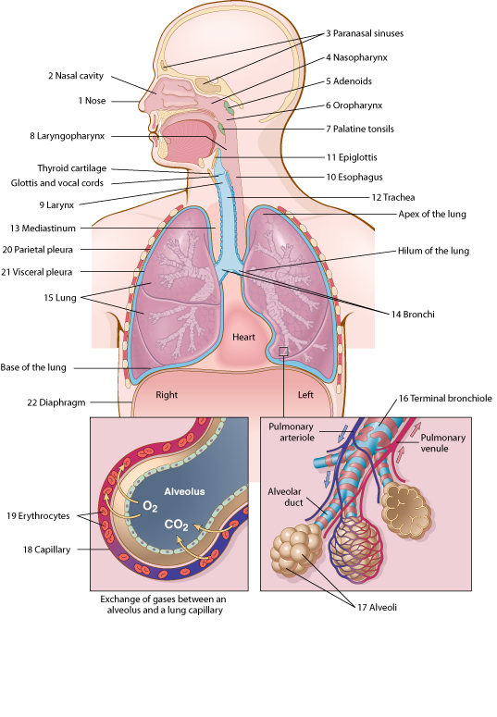
Anatomy of Respiration
Notes:
Engage the class to identify the organs of the respiratory system.
Trace the path of a breath of air.

Slide 10
Respiratory Structures
Conduct air
Nose
Nasal cavities and paranasal sinuses
Pharynx
Larynx
Trachea
Exchange gases
Bronchioles
Alveoli
Lung capillaries

Slide 11
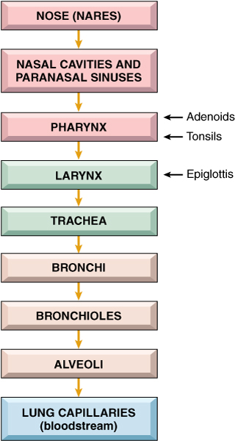
Respiratory Flow Chart
Notes:
Trace the flow, and then conduct the class activity in the lesson plan by dividing the class into two groups and assigning each a gas.

Slide 12
Vocabulary (Slide 1 of 20)
Term
adenoids
alveolus (plural: alveoli)
apex of the lung

Slide 13
Vocabulary (Slide 2 of 20)
Term | Meaning/Definition
adenoids | Lymphatic tissue in the nasopharynx; pharyngeal tonsils
alveolus (plural: alveoli) | Air sac in the lung
apex of the lung | Tip or uppermost portion of the lung

Slide 14
Vocabulary (Slide 3 of 20)
Term
base of the lung
bronchioles
bronchus (plural: bronchi)

Slide 15
Vocabulary (Slide 4 of 20)
Term | Meaning/Definition
base of the lung | The lower portion of the lung
bronchioles | The smallest branches of the bronchi
bronchus (plural: bronchi) | The branch of the trachea (windpipe) that is a passageway into the lung; bronchial tube

Slide 16
Vocabulary (Slide 5 of 20)
Term
carbon dioxide (CO₂)
cilia
diaphragm

Slide 17
Vocabulary (Slide 6 of 20)
Term | Meaning/Definition
carbon dioxide (CO₂) | Gas produced by body cells when oxygen and carbon atoms from food combine; exhaled through the lungs
cilia | Thin hairs attached to mucous membrane epithelium lining the respiratory tract
diaphragm | Muscle separating the chest and abdomen; contracts to pull air into lungs; relaxes to push air out

Slide 18
Vocabulary (Slide 7 of 20)
Term
epiglottis
expiration
glottis

Slide 19
Vocabulary (Slide 8 of 20)
Term | Meaning/Definition
epiglottis | Lid-like piece of cartilage that covers the larynx; keeps food from entering the larynx and trachea during swallowing
expiration | Breathing out (exhalation)
glottis | Slit-like opening to the larynx

Slide 20
Vocabulary (Slide 9 of 20)
Term
hilum (of lung)
inspiration
larynx

Slide 21
Vocabulary (Slide 10 of 20)
Term | Meaning/Definition
hilum (of lung) | Midline region where the bronchi, blood vessels, and nerves enter and exit the lungs
inspiration | Breathing in (inhalation)
larynx | Voice box; contains the vocal cords

Slide 22
Vocabulary (Slide 11 of 20)
Term
lobe
mediastinum
nares

Slide 23
Vocabulary (Slide 12 of 20)
Term | Meaning/Definition
lobe | Division of a lung
mediastinum | The region between lungs in the chest cavity; contains the trachea, heart, lymph nodes, aorta, esophagus, and bronchial tubes
nares | Openings through the nose carrying air into the nasal cavities

Slide 24
Vocabulary (Slide 13 of 20)
Term
oxygen (O₂)
palatine tonsil

Slide 25
Vocabulary (Slide 14 of 20)
Term | Meaning/Definition
oxygen (O₂) | Gas that makes up 21% of air; passes into the bloodstream at the lungs and travels to all body cells
palatine tonsil | One of a pair of almond-shaped masses of lymphatic tissue in the oropharynx

Slide 26
Vocabulary (Slide 15 of 20)
Term
paranasal sinus
parietal pleura
pharynx

Slide 27
Vocabulary (Slide 16 of 20)
Term | Meaning/Definition
paranasal sinus | One of the air cavities in the bones near the nose
parietal pleura | Outer fold of pleura lying closer to the ribs and chest wall
pharynx | The throat; including the nasopharynx, oropharynx, and laryngopharynx

Slide 28
Vocabulary (Slide 17 of 20)
Term
pleura
pleural cavity
pulmonary parenchyma

Slide 29
Vocabulary (Slide 18 of 20)
Term | Meaning/Definition
pleura | Double-folded membrane surrounding each lung
pleural cavity | Space between the folds of the pleura
pulmonary parenchyma | Essential parts of the lung, responsible for respiration; bronchioles and alveoli

Slide 30
Vocabulary (Slide 19 of 20)
Term
respiration
trachea
visceral pleura

Slide 31
Vocabulary (Slide 20 of 20)
Term | Meaning/Definition
respiration | The process of moving air into and out of the lungs; breathing
trachea | Windpipe
visceral pleura | Inner fold of pleura lying closer to the lung tissue

Slide 32
QUICK QUIZ
1. What is the tip or uppermost portion of the lung?
Base
Lobe
Apex
Nares
Notes:
The correct answer is C: apex.

Slide 33
Combining Forms and Terminology (Slide 1 of 5)
Combining Form | Meaning
adenoid/o | adenoids
alveol/o | alveolus, air sac
bronch/o | bronchial tube
bronchi/o | bronchus
bronchiol/o | bronchiole, small bronchus
capn/o | carbon dioxide

Slide 34
Combining Forms and Terminology (Slide 2 of 5)
Combining Form | Meaning
coni/o | dust
cyan/o | blue
epiglott/o | epiglottis
laryng/o | larynx, voice box
lob/o | lobe of the lung
mediastin/o | mediastinum

Slide 35
Combining Forms and Terminology (Slide 3 of 5)
Combining Form | Meaning
nas/o | nose
orth/o | straight, upright
ox/o | oxygen
pector/o | chest
pharyng/o | pharynx, throat
phon/o | voice

Slide 36
Combining Forms and Terminology (Slide 4 of 5)
Combining Form | Meaning
phren/o | diaphragm
pleur/o | pleura
pneum/o | air, lung
pneumon/o | lung
pulmon/o | lung
rhin/o | nose

Slide 37
Combining Forms and Terminology (Slide 5 of 5)
Combining Form | Meaning
sinus/o | sinus cavity
spir/o | breathing
tel/o | complete
thorac/o | chest
tonsill/o | tonsils
trache/o | trachea, windpipe

Slide 38
Combining Forms, Suffixes, and Terminology (Slide 1 of 1)
Suffix | Meaning
-ema | condition
-osmia | smell
-pnea | breathing
-ptysis | spitting
-sphyxia | pulse
-thorax | pleural cavity, chest

Slide 39
Chapter 12 Lesson 12.2

Slide 40
Diagnostic Terms
Auscultation
Percussion
Pleural rub
Rales (crackles
Rhonchi (singular rhonchus)
Sputum
Stridor
Wheezes
Notes:
Many of these terms are ways to help identify respiratory abnormalities that can be heard.
Discuss the fact that auscultation, though not high tech, is still a very effective way to uncover disease.

Slide 41
Pathology (Slide 1 of 4)
Upper respiratory disorders
Croup
Diphtheria
Epistaxis
Pertussis
Notes:
Distinguish between disorders arising from infectious agents, trauma, neoplasms, or genetic disorders. Which are most often caused by smoking?
Epistaxis is also known as rhinorrhagia, but epistaxis is the more commonly used term for nosebleed.

Slide 42
Pathology (Slide 2 of 4)
Bronchial tube disorders
Asthma
Bronchiectasis
Chronic bronchitis
Cystic fibrosis
Notes:
Distinguish between disorders arising from infectious agents, trauma, neoplasms, or genetic disorders. Which are most often caused by smoking?
Epistaxis is also known as rhinorrhagia, but epistaxis is the more commonly used term for nosebleed.

Slide 43
Pathology (Slide 3 of 4)
Lung disorders
Atelectasis
Emphysema
Lung cancer
Pneumoconiosis
Pneumonia
Pulmonary abscess
Pulmonary edema
Pulmonary embolism (PE)
Pulmonary fibrosis
Sarcoidosis
Tuberculosis (TB)
Notes:
Distinguish between disorders arising from infectious agents, trauma, neoplasms, or genetic disorders.
What are the types of pneumoconiosis?

Slide 44
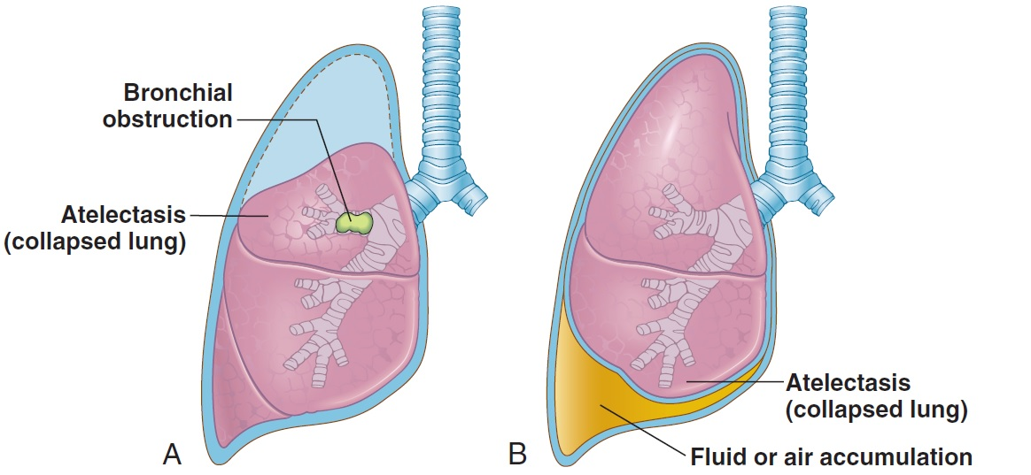
Pathology Lung Disorders
Atelectasis
Two forms
Proximal obstruction of distal airways
Accumulations of fluid, blood, or air in the pleural cavity
Notes:
Distinguish between atelectasis and pneumothorax.

Slide 45
Pathology (Slide 4 of 4)
Pleural disorders
Mesothelioma
Pleural effusion
Pleurisy (pleuritis)
Pneumothorax
Notes:
Distinguish between disorders arising from infectious agents, trauma, neoplasms, or genetic disorders.
Use slides to discuss definitions, context, spelling, and derivations.

Slide 46
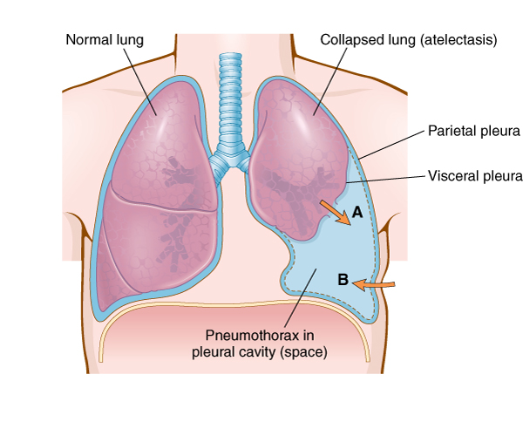
Pathology Pleural Disorders
Pneumothorax: Air gathers in the pleural cavity
Notes:
Explain collapsed lung.
What conditions may cause a lung to collapse?
What are some examples of trauma- and disease-induced collapsed lung?

Slide 47
Study Section
Anthracosis
Asbestosis
Bacilli
Chronic obstructive pulmonary disease (COPD)
Cor pulmonale
Exudate
Hydrothorax
Infiltrate
Palliative
Paroxysmal
Pulmonary infarction
Purulent
Silicosis
Notes:
Distinguish between disorders arising from infectious agents, trauma, neoplasms, or genetic disorders.

Slide 48
Chapter 12 Lesson 12.3

Slide 49
Clinical Procedures (Slide 1 of 9)
X-rays
Chest x-ray (CXR)
Computed tomography (CT) scan of the chest
Pulmonary angiography
Notes:
Briefly discuss the technology of each type of x-ray.
For what kinds of information (hard tissues, soft tissue, etc.) and which conditions is each type best suited?

Slide 50
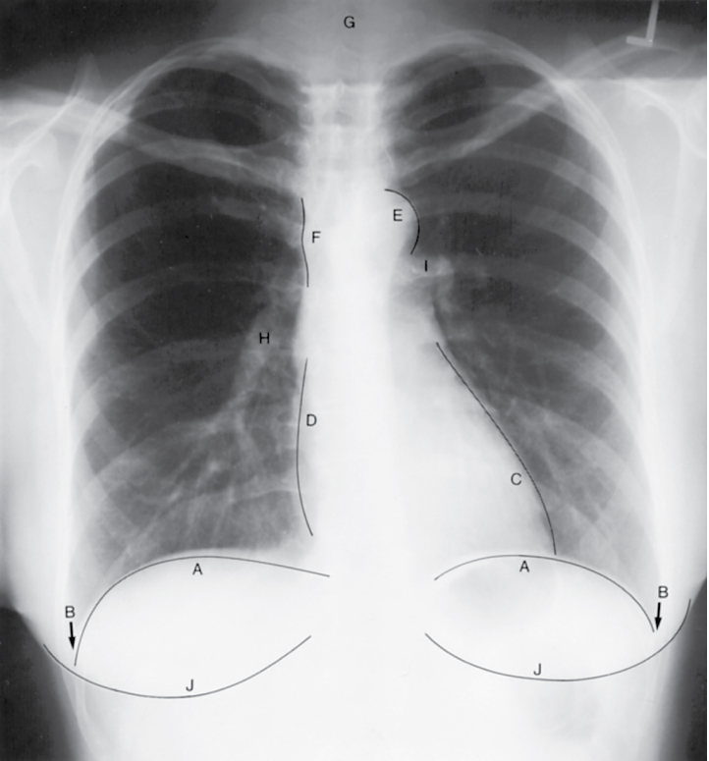
Clinical Procedures (Slide 2 of 9)
X-rays: radiographic imaging
This is a normal chest x-ray taken from the PA (posteroanterior) view—x-ray passes from back to front.
Notes:
Use this slide to discuss point of view, right and left, dorsal and ventral, and landmarks.

Slide 51
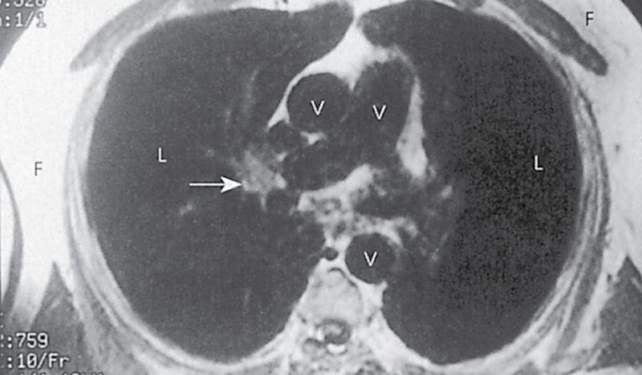
Clinical Procedures (Slide 3 of 9)
Magnetic resonance imaging (MRI):
magnetic waves create images

Slide 52
Clinical Procedures (Slide 4 of 9)
Nuclear tests
Positron emission tomography (PET) scan of the lung
Ventilation-perfusion (V/Q) scan: inhalation of radioactive gas for imaging, followed by injection of different radioactive material for imaging

Slide 53
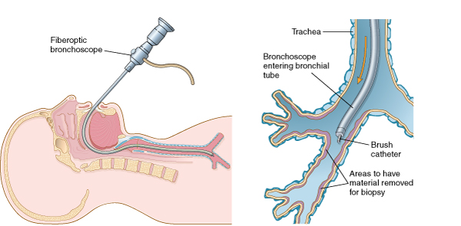
Clinical Procedures (Slide 5 of 9)
Bronchoscopy: fiberoptic or rigid endoscope inserted into the bronchial tubes for diagnosis, biopsy, or collection of secretions
Notes:
Why would a physician recommend this invasive diagnostic procedure?
What are the pros and cons?
What can the physician expect to learn?

Slide 54
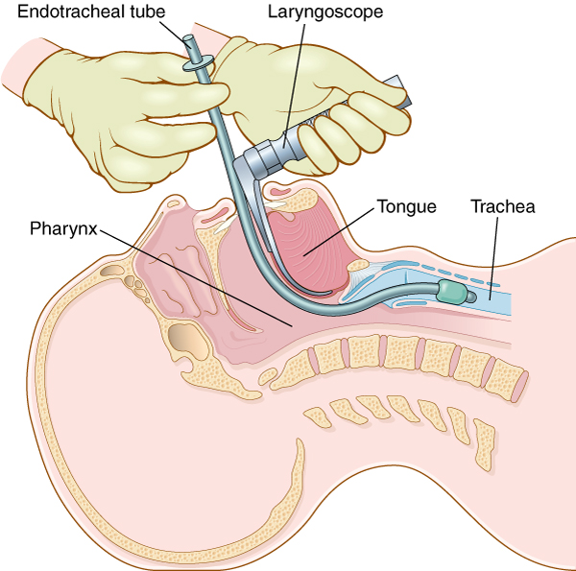
Clinical Procedures (Slide 6 of 9)
Endotracheal intubation: placement of tube from mouth to trachea to establish airway
Notes:
Watch an episode of ER and count how many times they do this procedure in the ER.
Why do many people coming into the emergency room need this procedure?
Why is this done for surgical patients?

Slide 55
Clinical Procedures (Slide 7 of 9)
Laryngoscopy
Lung biopsy
Mediastinoscopy
Pulmonary function tests (PFTs)
Thoracentesis
Thoracotomy
Thorascopy
Tracheostomy
Tuberculin test
Tube thoracostomy
Notes:
Why do many of these procedures start with “thor”?
What is the difference between laryngoscopy, mediastinoscopy, and thorascopy?

Slide 56
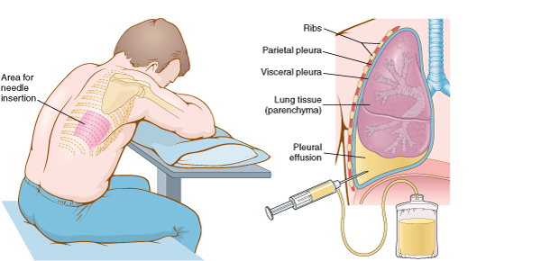
Clinical Procedures (Slide 8 of 9)
Thoracentesis: surgical puncture to
remove fluid from pleural space

Slide 57
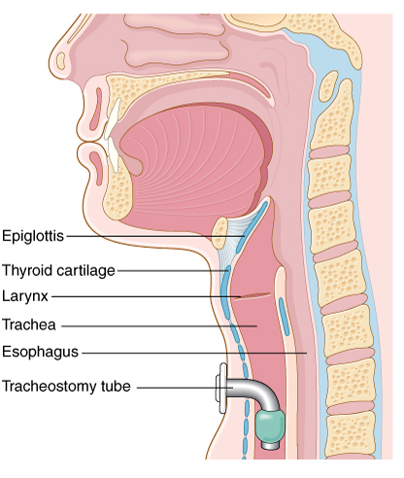
Clinical Procedures (Slide 9 of 9)
Tracheostomy: surgical creation of an opening into the trachea through the neck
Notes:
Under what conditions would a physician perform this invasive procedure?
Explain the advantages and disadvantages.

Slide 58
Abbreviations (Slide 1 of 5)
Abbreviation | Meaning
ABGs | Arterial blood gases
AFB | Acid-fast bacillus
ARDS | Acute respiratory distress syndrome
BAL | Bronchioalveolar lavage
Bronch | Bronchoscopy
CF | Cystic fibrosis
CO₂ | Carbon dioxide
COPD | Chronic obstructive pulmonary disease
CPAP | Continuous positive airway pressure
CPR | Cardiopulmonary resuscitation

Slide 59
Abbreviations (Slide 2 of 5)
Abbreviation | Meaning
C & S | Culture and sensitivity testing (of sputum)
CTPA | Computed tomography pulmonary angiography
CXR | Chest x-ray (film)
DI_{CO} | Diffusion capacity of lung for carbon monoxide
DOE | Dyspnea on exertion
DPT | Diphtheria, pertussis, tetanus
FEV₁ | Forced expiratory volume in 1 second
FVC | Forced vital capacity
ICU | Intensive care unit

Slide 60
Abbreviations (Slide 3 of 5)
Abbreviation | Meaning
LLL | Left lower lobe (of lung)
LUL | Left upper lobe (of lung)
MAC | Mycobacterium avium
MDI | Metered-dose inhaler
NSCLC | Non-small cell lung cancer
O₂ | Oxygen
OSA | Obstructive sleep apnea
Pa^{CO2} | Carbon dioxide partial pressure
Pa^{O2} | Oxygen partial pressure
PCP | Pneumocystis pneumonia
PE | Pulmonary embolism

Slide 61
Abbreviations (Slide 4 of 5)
Abbreviation | Meaning
PEP | Positive expiratory pressure
PEEP | Positive end-expiratory pressure
PFTs | Pulmonary function tests
PND | Paroxysmal nocturnal dyspnea
PPD | Purified protein derivative
RDS | Respiratory distress syndrome
RLL | Right lower lobe (of lung)
RML | Right middle lobe
RSV | Respiratory syncytial virus
RUL | Right upper lobe (of lung)
RV | Residual volume

Slide 62
Abbreviations (Slide 5 of 5)
Abbreviation | Meaning
SABA | Short-acting beta agonist
SCLC | Small cell lung cancer
SOB | Shortness of breath
TB | Tuberculosis
TLC | Total lung capacity
URI | Upper respiratory infection
V_{T} | Tidal volume
VATS | Video-assisted thoracic surgery
VC | Vital capacity
V/Q scan | Ventilation-perfusion scan

Slide 63
Review Sheet – Combining Forms (Slide 1 of 10)
Combining Form
adenoid/o
alveol/o
bronch/o
bronchi/o
bronchiol/o
capn/o

Slide 64
Review Sheet – Combining Forms (Slide 2 of 10)
Combining Form | Meaning
adenoid/o | adenoids
alveol/o | alveolus; air sac; small sac
bronch/o | bronchial tube
bronchi/o | bronchial tube
bronchiol/o | bronchiole
capn/o | carbon dioxide

Slide 65
Review Sheet – Combining Forms (Slide 3 of 10)
Combining Form
coni/o
cyan/o
epiglott/o
laryng/o
lob/o
mediastin/o

Slide 66
Review Sheet – Combining Forms (Slide 4 of 10)
Combining Form | Meaning
coni/o | dust
cyan/o | blue
epiglott/o | epiglottis
laryng/o | larynx (voice box)
lob/o | lobe
mediastin/o | mediastinum

Slide 67
Review Sheet – Combining Forms (Slide 5 of 10)
Combining Form
nas/o
orth/o
ox/o
pector/o
pharyng/o
phon/o

Slide 68
Review Sheet – Combining Forms (Slide 6 of 10)
Combining Form | Meaning
nas/o | nose
orth/o | straight
ox/o | oxygen
pector/o | chest
pharyng/o | throat (pharynx)
phon/o | voice; sound

Slide 69
Review Sheet – Combining Forms (Slide 7 of 10)
Combining Form
phren/o
pleur/o
pneum/o
pneumon/o
pulmon/o
rhin/o

Slide 70
Review Sheet – Combining Forms (Slide 8 of 10)
Combining Form | Meaning
phren/o | diaphragm; mind
pleur/o | pleura
pneum/o | lung; air; gas
pneumon/o | lung; air; gas
pulmon/o | lung
rhin/o | nose

Slide 71
Review Sheet – Combining Forms (Slide 9 of 10)
Combining Form
sinus/o
spir/o
tel/o
thorac/o
tonsill/o
trache/o

Slide 72
Review Sheet – Combining Forms (Slide 10 of 10)
Combining Form | Meaning
sinus/o | sinus
spir/o | to breathe
tel/o | complete
thorac/o | chest
tonsill/o | tonsil
trache/o | trachea (windpipe)

Slide 73
Review Sheet – Suffixes (Slide 1 of 2)
Suffix
-ema
-osmia
-pnea
-ptysis
-sphyxia
-thorax

Slide 74
Review Sheet – Suffixes (Slide 2 of 2)
Suffix | Meaning
-ema | condition
-osmia | smell
-pnea | breathing
-ptysis | spitting
-sphyxia | pulse
-thorax | chest; pleural cavity

