Slide 1
The Language of Medicine 13th edition
Davi-Ellen Chabner

Slide 2
Chapter 13 Blood System

Slide 3
Chapter Goals (Slide 1 of 3) Identify terms relating to the composition, formation, and function of blood.

Slide 4
Chapter Goals (Slide 2 of 3)
Differentiate among the four major blood types.
Differentiate among the different types of blood groups.
Identify terms related to blood clotting.
Build words and recognize combining forms used in blood system terminology.

Slide 5
Chapter Goals (Slide 3 of 3)
Describe various pathologic conditions affecting blood.
Describe various laboratory tests and clinical procedures used with hematologic disorders and recognize relevant abbreviations.
Apply your new knowledge to understanding medical terms in their proper contexts, such as medical reports and records.

Slide 6
Chapter 13 Lesson 13.1

Slide 7
Introduction
Blood: transports foods, gases, and wastes to and from the cells of the body
Other transported items:
Chemical messengers
Blood proteins, white blood cells, and platelets
Notes:
What are chemical messengers called? (Hormones)
What do white blood cells do? (Fight infection)
What do platelets do? (Help the blood clot)
What is the medical term for WBC? (Leukocyte)
What is the medical term for platelet? (Thrombocyte)

Slide 8
Composition of Blood
Cells
Erythrocytes
Leukocytes
Platelets
Plasma
Water
Wastes
Nutrients
Salts
Hormones
Lipids
Vitamins
Notes:
What are cells? (Formed elements, suspended in a clear, straw-colored liquid called plasma.)
What percentage of blood volume do cells constitute? (45%. The other 55% are items listed here.)

Slide 9
Cell Types and Function (Slide 1 of 2)
Cells—45% Blood Volume
Erythrocytes: red blood cells transport nutrients and oxygen
Leukocytes: white blood cells
Thrombocytes: platelets; clot blood
Notes:
What is an immature red blood cell called? (Erythroblast)
Where do erythrocytes originate? (In bone marrow)
What are cells in the spleen, liver, and bone marrow that destroy worn-out erythrocytes? (Macrophages)
What is a phagocyte?
See the next slide. Review a normal differential of these cell types in a smear of whole peripheral blood.

Slide 10
Cell Types and Function (Slide 2 of 2)
Leukocytes: or white blood cells
Basophils: contain heparin (prevents clotting) and histamine (involved in allergic responses)
Eosinophils: phagocytic cells involved in allergic responses and parasitic infections
Neutrophils: phagocytic cells that accumulate at sites of infection
Monocytes: phagocytic cells that become macrophages and digest bacteria and tissue debris
Lymphocytes: control the immune response; make antibodies to antigens

Slide 11
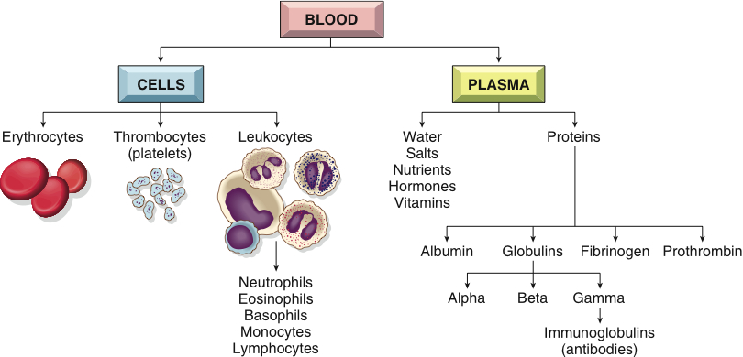
Review: Composition of Blood
Notes:
Describe each section of the chart.

Slide 12
Plasma
Plasma proteins
Albumin
Globulins: immunoglobulins (IgG, IgA, IgM, IgD, IgE)
Fibrinogen
Prothrombin
Notes:
What are fibrinogen and prothrombin? (Clotting proteins)
What does albumin do? (Maintains the proper proportion and concentration of water in the blood)
What are globulins? (Another part of the blood containing plasma proteins: alpha, beta, and gamma globulins)
What are immunoglobulins? (Antibodies that bind to and sometimes destroy antigens or foreign substances, ie., IgG, IgA)

Slide 13
Blood Types
Type A: A antigen and anti-B antibody
Type B: B antigen and anti-A antibody
Type AB: A and B antigens and no antibodies (universal recipient)
Type O: no A or B antigens and both anti-A and anti-B antibodies (universal donor)
Rh factor (positive and negative)
Notes:
Why is blood type matching important for transfusions?
What is Rh factor? What is the difference between Rh-positive and Rh-negative?
Why is blood type matching important for identification of pregnancy? (Most people are Rh positive so problem arises with Rh negative mother with Rh positive fetus.)

Slide 14
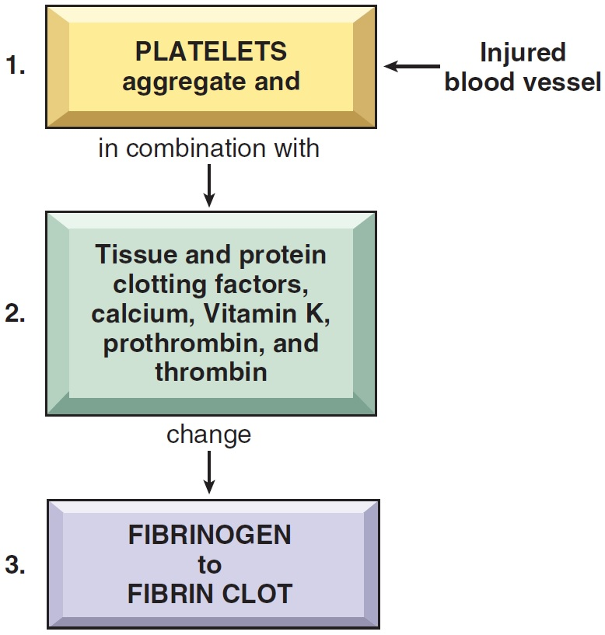
Blood Clotting
Coagulation: fibrin clot
Anticoagulants: heparin, warfarin (Coumadin)
Notes:
What is blood clotting or coagulation?
The final result (usually taking less than 15 minutes) is the formation of a fibrin clot from the plasma protein fibrinogen.
Why are platelets important in the beginning of the process following injury to tissues or blood vessels?

Slide 15
QUICK QUIZ (Slide 1 of 3)
The blood contains which of the following to transport oxygen?
White blood cells
Plasma
Platelets
Red blood cells
Notes:
The correct answer is D: red blood cells.

Slide 16
QUICK QUIZ (slide 2 of 3)
2. Blood contains which clotting cells?
Erythrocytes
Plasma
Thrombocytes
Leukocytes
Notes:
The correct answer is C: thrombocytes.

Slide 17
Vocabulary (Slide 1 of 28)
Term
albumin
antibody (Ab)
antigen

Slide 18
Vocabulary (Slide 2 of 28)
Term | Meaning/Definition
albumin | Protein in the blood; maintains the proper amount of water in blood
antibody (Ab) | A specific protein produced by the lymphocytes in response to bacteria, viruses, or other antigens
antigen | A substance that stimulates production of an antibody

Slide 19
Vocabulary (Slide 3 of 28)
Term
basophil
bilirubin
coagulation

Slide 20
Vocabulary (Slide 4 of 28)
Term | Meaning/Definition
basophil | White blood cell that contains granules that stain blue
bilirubin | Orange-yellow pigment in bile; formed by breakdown of hemoglobin when RBCs are destroyed
coagulation | Blood clotting

Slide 21
Vocabulary (Slide 5 of 28)
Term
colony-stimulating factor (CSF)
differentiation
electrophoresis

Slide 22
Vocabulary (Slide 6 of 28)
Term | Meaning/Definition
colony-stimulating factor (CSF) | Protein that stimulates growth of white blood cells
differentiation | The change in structure and function of a cell as it matures; specialization
electrophoresis | A method of separating serum proteins by electrical charge and size

Slide 23
Vocabulary (Slide 7 of 28)
Term
eosinophil
erythroblast
erythrocyte

Slide 24
Vocabulary (Slide 8 of 28)
Term | Meaning/Definition
eosinophil | White blood cell that contains granules that stain red
erythroblast | An immature red blood cell
erythrocyte | A red blood cell

Slide 25
Vocabulary (Slide 9 of 28)
Term
erythropoietin (EPO)
fibrin
fibrinogen

Slide 26
Vocabulary (Slide 10 of 28)
Term | Meaning/Definition
erythropoietin (EPO) | Hormone secreted by the kidneys that stimulates red blood cell formation
fibrin | Protein that forms the basis of a blood clot
fibrinogen | Plasma protein that is converted to fibrin in the clotting process

Slide 27
Vocabulary (Slide 11 of 28)
Term
globulin
granulocyte
hematopoietic stem cell

Slide 28
Vocabulary (Slide 12 of 28)
Term | Meaning/Definition
globulin | Plasma protein
granulocyte | White blood cell with numerous dark-staining granules
hematopoietic stem cell | A cell in bone marrow that gives rise to all types of blood cells

Slide 29
Vocabulary (Slide 13 of 28)
Term
hemoglobin
hemolysis
heparin

Slide 30
Vocabulary (Slide 14 of 28)
Term | Meaning/Definition
hemoglobin | Blood protein containing iron; carries oxygen in red blood cells
hemolysis | Breakdown of red blood cells
heparin | An anticoagulant found in blood and tissue cells

Slide 31
Vocabulary (Slide 15 of 28)
Term
immune reaction
immunoglobulin
leukocyte

Slide 32
Vocabulary (Slide 16 of 28)
Term | Meaning/Definition
immune reaction | Response of the immune system to foreign invasion
immunoglobulin | A protein with antibody activity
leukocyte | A white blood cell

Slide 33
Vocabulary (Slide 17 of 28)
Term
lymphocyte
macrophage
megakaryocyte

Slide 34
Vocabulary (Slide 18 of 28)
Term | Meaning/Definition
lymphocyte | Mononuclear leukocyte that produces antibodies
macrophage | Monocyte that migrates from the blood to tissue spaces; as a phagocyte, it engulfs foreign material and debris; destroys worn out RBCs
megakaryocyte | Large platelet precursor cell found in the bone marrow

Slide 35
Vocabulary (Slide 19 of 28)
Term
monocyte
mononuclear
myeloblast

Slide 36
Vocabulary (Slide 20 of 28)
Term | Meaning/Definition
monocyte | Leukocyte with one large nucleus; engulfs foreign material and debris; becomes macrophage
mononuclear | Pertaining to cell (leukocyte) with single round nucleus
myeloblast | Immature bone marrow that gives rise to granulocytes

Slide 37
Vocabulary (Slide 21 of 28)
Term
neutrophil
plasma
plasmapheresis

Slide 38
Vocabulary (Slide 22 of 28)
Term | Meaning/Definition
neutrophil | Granulocytic leukocyte formed in bone marrow; polymorphonuclear leukocyte
plasma | Liquid portion of blood; contains water, proteins, salts, nutrients, lipids, hormones, and vitamins
plasmapheresis | Removal of plasma from withdrawn blood by centrifuge

Slide 39
Vocabulary (Slide 23 of 28)
Term
platelet
polymorphonuclear
prothrombin

Slide 40
Vocabulary (Slide 24 of 28)
Term | Meaning/Definition
platelet | A small blood fragment important in clotting
polymorphonuclear | Pertaining to a white blood cell with multi-shaped nucleus; neutrophil
prothrombin | Plasma protein; converted to thrombin in the clotting process

Slide 41
Vocabulary (Slide 25 of 28)
Term
reticulocyte
Rh factor
serum

Slide 42
Vocabulary (Slide 26 of 28)
Term | Meaning/Definition
reticulocyte | Immature erythrocyte
Rh factor | Antigen on red blood cells of Rh⁻positive (RH⁺) individuals
serum | Plasma minus clotting proteins and cells

Slide 43
Vocabulary (Slide 27 of 28)
Term
stem cell
thrombin
thrombocyte

Slide 44
Vocabulary (Slide 28 of 28)
Term | Meaning/Definition
stem cell | Unspecialized cell that gives rise to mature, specialized forms
thrombin | Enzyme that converts fibrinogen to fibrin during coagulation
thrombocyte | Platelets

Slide 45
Combining Forms and Terminology (Slide 1 of 4)
Combining Form | Meaning
bas/o | base
chrom/o | color
coagul/o | clotting
cyt/o | cell
eosin/o | red, dawn, rosy
erythr/o | red

Slide 46
Combining Forms and Terminology (Slide 2 of 4)
Combining Form | Meaning
granul/o | granules
hem/o | blood
hemat/o | blood
hemoglobin/o | hemoglobin
is/o | same, equal
kary/o | nucleus

Slide 47
Combining Forms and Terminology (Slide 3 of 4)
Combining Form | Meaning
leuk/o | white
mon/o | one, single
morph/o | shape, form
myel/o | bone marrow
neutr/o | neutral
nucle/o | nucleus

Slide 48
Combining Forms and Terminology (Slide 4 of 4)
Combining Form | Meaning
phag/o | eat, swallow
poikil/o | varied, irregular
sider/o | iron
spher/o | globe, round
thromb/o | clot

Slide 49
Suffixes
-apheresis
-blast
-cyte
-cytosis
-emia
-gen
-globin
-globulin
-lytic
-oid
-osis
-penia
-phage
-philia
-phoresis
-poiesis
-stasis
Notes:
Ask meanings and examples of terms.
What is thrombolytic therapy? (Used to dissolve clots)
What is plasmapheresis? (A centrifuge spins blood to remove plasma from the other parts of the blood.)

Slide 50
Chapter 13 Lesson 13.2

Slide 51
Diseases of Red Blood Cells: Anemia
Anemia: A deficiency in erythrocytes or hemoglobin
Aplastic anemia
Hemolytic anemia
Pernicious anemia
Sickle cell anemia
Thalassemia
Notes:
What is the most common type of anemia? (Iron-deficiency anemia)
What is an example of hemolytic anemia? (Congenital spherocytic anemia)

Slide 52
Types of Anemia (Slide 1 of 2)
Aplastic anemia: failure of blood cell production due to aplasia or absence of cell formation of bone marrow cells
Hemolytic anemia: reduction in red cells due to excessive destruction
Pernicious anemia: lack of mature erythrocytes caused by inability to absorb vitamin B₁₂ into the bloodstream
Sickle cell: hereditary disorder of abnormal hemoglobin producing sickle shape erythrocytes and hemolysis
Thalassemia: an inherited defect in the ability to produce hemoglobin, leading to hypochromia

Slide 53
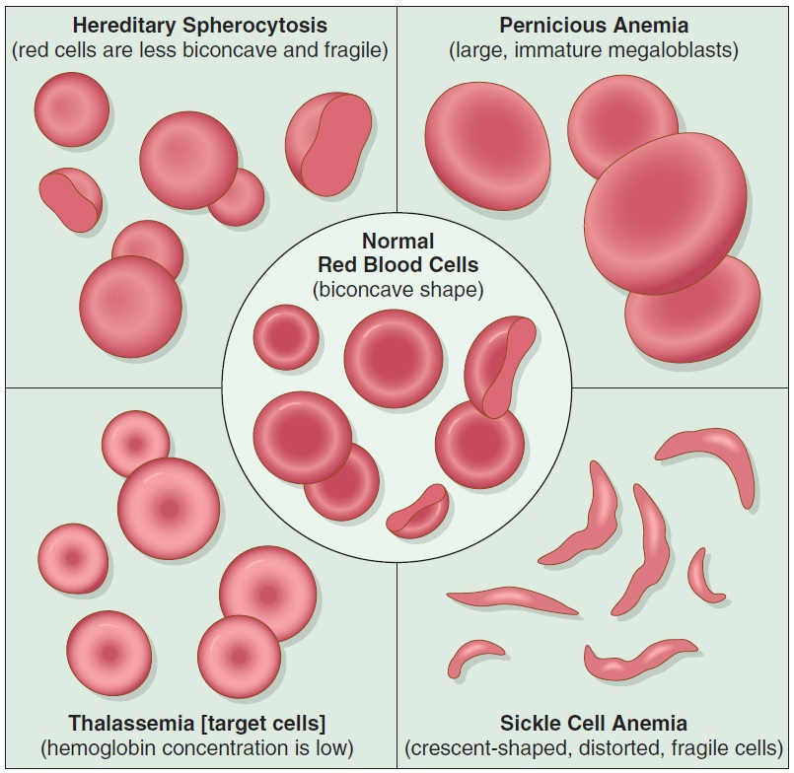
Types of Anemia (Slide 2 of 2)

Slide 54
QUICK QUIZ (Slide 3 of 3)
3. What is the most common type of anemia?
Hemolytic anemia
Sickle cell anemia
Iron deficiency anemia
Aplastic anemia
Notes:
The correct answer is C: iron deficiency anemia.

Slide 55
Other Diseases of Red Blood Cells
Hemochromatosis: excess iron deposits throughout the body
Polycythemia vera: general increase in red blood cells
Notes:
Persons of what background are prone to thalassemia? (Mediterranean)
Sickle cell is prevalent among which group? (Black people of African or African-American ancestry) Why? (Sickling is a genetic response to malaria.)
What treatment is used for polycythemia vera? How is this similar to doping?

Slide 56
Disorders of Blood Clotting
Hemophilia: excessive bleeding caused by hereditary lack of factors VIII and IX necessary for blood clotting. Patients often bleed into weight-bearing joints, especially the ankles and knees
Purpura: multiple pinpoint hemorrhages and accumulation of blood under the skin
Notes:
What is a treatment for hemophilia? (Administration of the deficient factor)
What is autoimmune thrombocytopenic purpura? (A condition in which a patient’s body makes an antibody that destroys platelets)

Slide 57
Diseases of White Blood Cells: Leukemia
Leukemia: an increase in cancerous white blood cells
Acute myeloid leukemia (AML)
Acute lymphoid leukemia (ALL)
Chronic myeloid leukemia (CML)
Chronic lymphoid leukemia (CLL)
Notes:
What are characteristics of acute leukemia?
What form of leukemia is most often in children and adolescents? (ALL)
What form of leukemia usually occurs in the elderly and follows a slowly progressive course? (CLL)

Slide 58
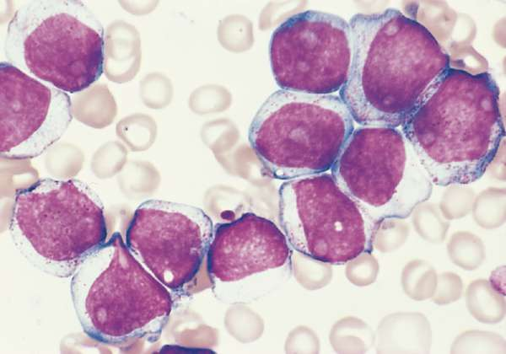
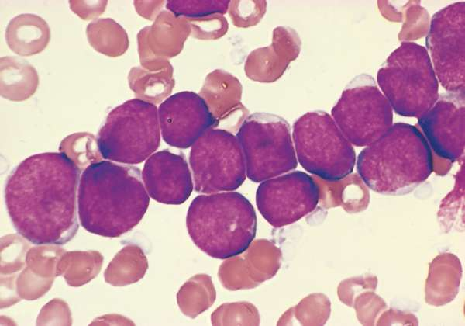
Acute Leukemia
Acute myeloid leukemia
Acute lymphoid leukemia
Notes:
The terms acute and chronic discriminate between leukemias of primarily immature and mature leukocytes.

Slide 59
Other Diseases of White Blood Cells
Granulocytosis: abnormal increase in granulocytes in the blood
Mononucleosis: an infectious disease marked by increased numbers of mononuclear leukocytes and enlarged cervical lymph nodes
Notes:
How is mononucleosis usually transmitted? (By oral contact)
Is treatment necessary for EBV infections? (No)
What is eosinophilia? (An increase in eosinophilic granulocytes, seen in certain allergic conditions)

Slide 60
Disease of Bone Marrow Cells
Multiple myeloma: malignant neoplasm of bone marrow. Malignant cells (lymphocytes called plasma cells that produce antibodies) destroy bone tissue and cause overproduction of immunoglobulins, including Bence Jones protein.
Notes:
The malignant cells destroy bone tissue and cause the overproduction of immunoglobulins, including Bence Jones protein.
What is Bence Jones protein? (An immunoglobulin fragment found in urine)
How is this treated?

Slide 61
Chapter 13 Lesson 13.3

Slide 62
Laboratory Blood Tests (Slide 1 of 2)
Antiglobulin test (Coombs test)
Complete blood count (CBC)
Erythrocyte sedimentation rate (ESR)
Hematocrit (Hct)
Hemoglobin test (H, Hg, Hgb)
Partial thromboplastin time (PTT)
Notes:
What is the speed at which erythrocytes settle out of plasma? (ESR or sed rate)
What test finds the total amount of hemoglobin in a sample of peripheral blood? (Hemoglobin test)

Slide 63
Laboratory Blood Tests (Slide 2 of 2)
Platelet count
Prothrombin time (PT)
Red blood cell count (RBC)
Red blood cell morphology
White blood cell count (WBC)
White blood cell differential
Notes:
What is the number of leukocytes per cubic millimeter or microliter? (WBC)
What determines the percentage of the total WBC made up by different types of leukocytes? (White blood cell differential)

Slide 64
Clinical Procedures
Apheresis: separation of blood into component parts and removal of a select part from the blood
Blood transfusion: whole blood or cells taken from a donor and infused into a patient
Bone marrow biopsy: microscopic examination of a core of bone marrow removed with a needle
Hematopoietic stem cell transplantation: peripheral stem cells from a compatible donor administered into a recipient
Notes:
What is plasma exchange? (A procedure in which plasma is removed from the patient and fresh plasma is given)
What is autologous transfusion? (The collection and later reinfusion of a patient’s own blood or blood components)
What is a bone marrow aspirate? (When bone marrow is removed by brief suction produced by a syringe)

Slide 65
Abbreviations (Slide 1 of 5)
Abbreviation | Meaning
Ab | Antibody
ABMT | Autologous bone marrow transplantation
ABO | Four main blood types – A, B, AB, and O
ALL | Acute lymphoid leukemia
AML | Acute myeloid leukemia
ANC | Absolute neutrophil count
ASCT | Autologous stem cell transplantation
banda | Immature white blood cells (granulocytes)
baso | Basophils
BMT | Bone marrow transplantation

Slide 66
Abbreviations (Slide 2 of 5)
Abbreviation | Meaning
CBC | Complete blood count
CLL | Chronic lymphoid leukemia
CML | Chronic myeloid leukemia
DIC | Disseminated intravascular coagulation
diff | Differential count (white blood cells)
EBV | Epstein-Barr virus
eos | Eosinophils
EPO | Erythropoietin
ESR | Erythrocyte sedimentation rate
Fe | Iron

Slide 67
Abbreviations (Slide 3 of 5)
Abbreviation | Meaning
G-CSF | Granulocyte colony-stimulating factor
GM-CSF | Granulocyte-macrophage colony-stimulating factor
g/dL | Gram per deciliter
GVHD | Graft-versus-host disease
HCL | Hairy cell leukemia
Hct | Hematocrit
Hgh, HGB | Hemoglobin
H and H | Hemoglobin and hematocrit
HLA | Human leukocyte antigen

Slide 68
Abbreviations (Slide 4 of 5)
Abbreviation | Meaning
IgS, IgD, IgE, IgG, IgM | Immunoglobulins
ITP | Idiopathic thromocytic purpura
lymphs | Lymphocytes
MCH | Mean corpuscular hemoglobin
MCHC | Mean corpuscular hemoglobin concentration
MCV | Mean corpuscular volume
MDS | Myelodysplastic syndrome
Mm³ | Cubic millimeter
mono | Monocyte
Polys, PMNs, PMNLs | Polymorphonuclear leukocytes

Slide 69
Abbreviations (Slide 5 of 5)
Abbreviation | Meaning
PT, pro time | Prothrombin time
PTT | Partial thromboplastin time
RBC | Red blood cell; red blood cell c
sed rate | Erythrocyte sedimentation rate
segs | Segmented, mature white blood cells
SMAC | Sequential Multiple Analyzer Computer
WBC | White blood cell; white blood cell count
WNL | Within normal limits

Slide 70
Review Sheet – Combining Forms (Slide 1 of 8)
Combining Form
bas/o
chrom/o
coagul/o
cyt/o
eosin/o
erythr/o

Slide 71
Review Sheet – Combining Forms (Slide 2 of 8)
Combining Form | Meaning
bas/o | base
chrom/o | color
coagul/o | clotting
cyt/o | cell
eosin/o | red, dawn, rosy
erythr/o | red

Slide 72
Review Sheet – Combining Forms (Slide 3 of 8)
Combining Form
granul/o
hem/o
hemat/o
hemoglobin/o
is/o
kary/o

Slide 73
Review Sheet – Combining Forms (Slide 4 of 8)
Combining Form | Meaning
granul/o | granules
hem/o | blood
hemat/o | blood
hemoglobin/o | hemoglobin
is/o | same, equal
kary/o | nucleus

Slide 74
Review Sheet – Combining Forms (Slide 5 of 8)
Combining Form
leuk/o
mon/o
morph/o
myel/o
neutr/o
nucle/o

Slide 75
Review Sheet – Combining Forms (Slide 6 of 8)
Combining Form | Meaning
leuk/o | white
mon/o | one, single
morph/o | shape, form
myel/o | bone marrow
neutr/o | neutral
nucle/o | nucleus

Slide 76
Review Sheet – Combining Forms (Slide 7 of 8)
Combining Form
phag/o
poikil/o
sider/o
spher/o
thromb/o

Slide 77
Review Sheet – Combining Forms (Slide 8 of 8)
Combining Form | Meaning
phag/o | eat, swallow
poikil/o | varied, irregular
sider/o | iron
spher/o | globe, round
thromb/o | clot

