Slide 1
The Language of Medicine 13th edition
Davi-Ellen Chabner

Slide 2
Chapter 14 Lymphatic and Immune System

Slide 3
Chapter Goals (Slide 1 of 2)
Identify the structures and analyze terms related to the lymphatic and immune systems.
Learn basic terminology, combining forms, and other word parts related to these systems.
Recognize terms describing pathologic conditions.

Slide 4
Chapter Goals (Slide 2 of 2)
Identify laboratory tests, clinical procedures, and abbreviations.
Apply your new knowledge to understanding medical terms in their proper contexts, such as medical reports and records.

Slide 5
Chapter 14 Lesson 14.1

Slide 6
Introduction (Slide 1 of 2)
Lymph: clear watery fluid that surrounds body cells and flows in a system of lymph vessels throughout the body
Originates in blood
Rich in lymphocytes and monocytes
Flows in lymph capillaries and vessels
Flows through lymph nodes and lymphatic organs (liver, spleen, thymus, and nodes)
Absorbs lipids in the intestine
Notes:
Tonsils are aggregate lymphatic organs.
Lymphocytes and monocytes in lymph organs protect the body from foreign invaders.
What are the three functions of the lymphatic system?

Slide 7
Introduction (Slide 2 of 2)
Lymphatic System Functions
Transports proteins and fluid that have leaked, back to the bloodstream
Lymphatic vessels absorb lipids from intestines and transport them to the bloodstream
Lymphocytes and monocytes protect the body by mounting a cellular attack on foreign cells and organisms.
Notes:
Tonsils are aggregate lymphatic organs.
Lymphocytes and monocytes in lymph organs protect the body from foreign invaders.
What are the three functions of the lymphatic system?

Slide 8
Interstitial Fluid and Lymph Capillaries (Slide 1 of 2)
Structures of interstitial fluid and lymph capillaries include:
Blood capillaries
Lymph capillaries
Lymph vessel
Interstitial fluid
Tissue cells
Notes:
Have students label the figure or use the next figure, which has the labels in place.
Review the circulation of blood in blood vessels.
Compare and contrast with lymph in lymph capillaries.
How do the blood and lymph systems complement each other?
How are the structures of lymph vessels and veins similar? (Valves, no pump)

Slide 9
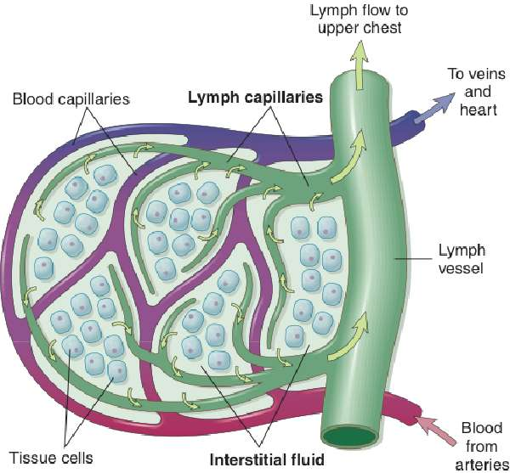
Interstitial Fluid and Lymph Capillaries (Slide 2 of 2)
Notes:
Review the circulation of blood in blood vessels.
Compare and contrast with lymph in lymph capillaries.
How do the blood and lymph systems complement each other?
How are the structures of lymph vessels and veins similar? (Valves, no pump)

Slide 10
Blood and Lymph (Slide 1 of 2)
Lymph originates from the blood and filters out of tiny blood capillaries into the spaces between cells.
Fluid that surrounds body cells is called interstitial fluid, which passes continuously into thin-walled vessels called lymph capillaries that course through tissue spaces.
Lymph passes through larger lymphatic vessels through clusters of lymph tissues, finally reaching large lymphatic vessels in the upper chest.
Lymph enters these large lymphatic vessels, which then empty into the bloodstream.
Notes:
Use this slide to continue your discussion from the previous slide.
What happens in situations such as edema?

Slide 11
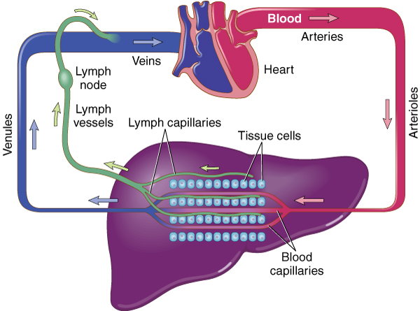
Blood and Lymph (Slide 2 of 2)
Notes:
Use this slide to continue your discussion from the previous slide.
What happens in situations such as edema?

Slide 12
Lymphatic System Anatomy
Lymph capillaries
Lymph vessels
Lymph nodes
Cervical (neck)
Axillary (armpit)
Mediastinal (chest)
Mesenteric (intestinal)
Paraaortic (lumbar)
Inguinal (groin)
Notes:
What are lymph capillaries and lymph vessels?
What does each do?
Describe lymph nodes and what they do.

Slide 13
Lymph Nodes
Macrophages phagocytose foreign substances
B lymphocytes (B cells) produce antibodies; mature in the bone marrow
T lymphocytes (T cells) attack bacteria and foreign cells; originate in the thymus gland
Notes:
What happens in a lymph node?
How do T cells act to attack foreign cells?

Slide 14
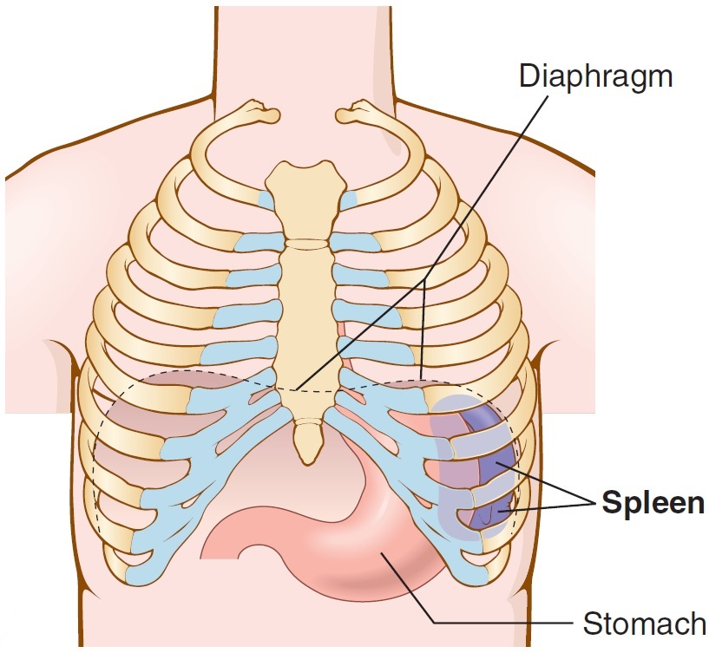
Spleen
Destroys old red blood cells
Filters microorganisms and other foreign material out of the blood
Activates lymphocytes during blood filtration (Activated B lymphocytes (B cells) produce antibodies; Activated T lymphocytes (T cells) attack foreign materials)
Stores blood, especially erythrocytes (RBCs) and platelets
Notes:
The spleen and thymus gland are composed of lymph tissue.
Note their locations.
What are the functions of the spleen?
Is the thymus proportionately larger in infants or adults? Why?

Slide 15
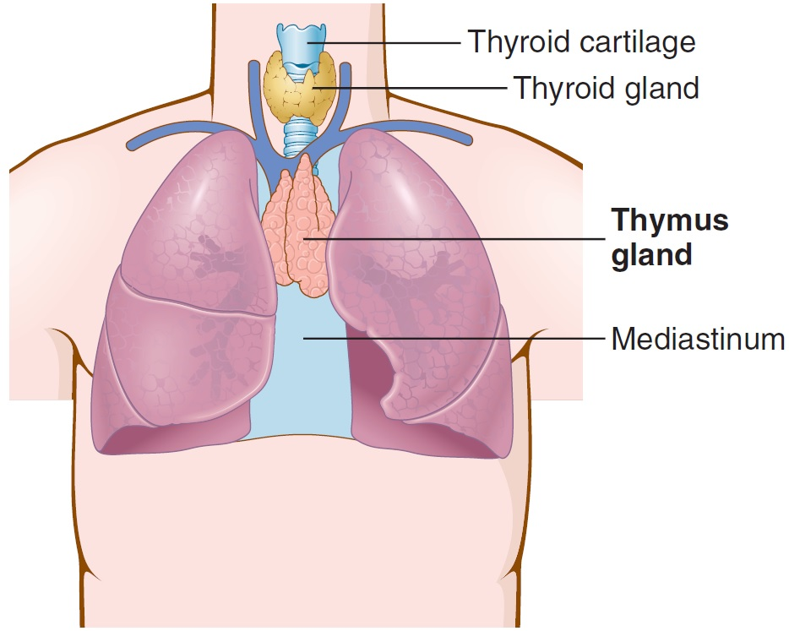
Thymus Gland
Provides immunity in fetal life and in early years of growth
Makes cells immunocompetent in early life
Early removal from an animal impairs its ability to make antibodies and produce cells to fight antigens
Notes:
The spleen and thymus gland are composed of lymph tissue.
Note their locations.
What are the functions of the spleen?
Is the thymus proportionately larger in infants or adults? Why?

Slide 16
Immune System
Leukocytes: neutrophils, monocytes, and macrophages
Lymphoid organs: lymph nodes, spleen, thymus gland, tonsils, and adenoids; produce lymphocytes and antibodies
Immunity: the body’s ability to resist foreign organisms and toxins that damage tissues and organs; can be natural or adaptive

Slide 17
Natural Immunity
Natural immunity: resistance present at birth; not dependent on prior exposure to an antigen
Phagocytosis
Macrophages
Natural killer cells
Notes:
Why is it important for infants to possess natural immunity at birth?
What is an example of genetic predisposition? (Humans cannot contract feline leukemia.)

Slide 18
Adaptive Immunity (slide 1 of 4)
Adaptive immunity: body’s ability to recognize and remember specific antigens in an immune response:
Lymphocytes: T and B cells
Antibodies produced after exposure to antigen
Memory: second exposure
Vaccination
Immunoglobulins
Maternal antibodies
Notes:
Ask students to provide an example for each method of acquiring active immunity.
Ask students what vaccinations they have had.

Slide 19
Adaptive Immunity (Slide 2 of 4)
B lymphocytes (B cells) are responsible for humoral immunity.
Originate in bone marrow from stem cells
B cells produce antibodies after exposure to specific antigens (viruses and bacteria)
B cell matures into plasma cell that produces antibodies called immunoglobulins to block the effects of antigens

Slide 20
Adaptive Immunity (Slide 3 of 4)
T lymphocytes (T cells) are responsible for cell-mediated immunity; does not involve antibodies
Cytotoxic T cells (CD8+ T cells) attach to and directly kill antigens.
Other T cells secrete cytokines (interferons and interleukins) that help cells respond to antigens.
Helper T cells (CD4+ T cells) promote antibody synthesis by B cells and stimulate other T cells.
Suppressor T cells (regulatory T cell or Tregs) inhibit B and T cells and prevent them from attacking the body’s own good cells.
Notes:
T-cell lymphocytes originate from bone marrow stem cells. They are processed in the thymus gland.

Slide 21
Adaptive Immunity (Slide 4 of 4)
Dendritic cells
Dendritic cells are a macrophage derived from monocytes.
They recognize and digest foreign antigens.
They present antigens on the surface to stimulate B and T cells.
They transfer immunity by exposing dendritic cells in culture; then transfuse them and get them to stimulate T and B cells.
Notes:
Some of the dendritic cell work (sensitizing them in a culture) is under investigation in clinical studies used to treat tumors and tumor antigens, thus getting the patient’s own immune system to attack the tumor.

Slide 22
Immunotherapy Examples
Monoclonal antibodies (MoAb): multiple copies of cells or genes that kill tumor cells; passive immunotherapy
Vaccines: contain antigens from the patient’s tumor cells; stimulate the patient’s own T cells to recognize and kill the cancerous cells; active immunotherapy
Transfer of immune cells: In bone marrow transplantation, T lymphocytes from a donor can replace a patient's immune system with new cells that recognize tumor cells as foreign and kill them.

Slide 23
Vocabulary (Slide 1 of 30)
Term
adaptive immunity
adenoids
antibody

Slide 24
Vocabulary (Slide 2 of 30)
Term | Meaning/Definition
adaptive immunity | Ability to recognize and remember specific antigens and mount an attack on them
adenoids | Mass of lymphatic tissue in the nasopharynx
antibody | Protein produced by B cells to destroy antigens

Slide 25
Vocabulary (Slide 3 of 30)
Term
antigen
axillary nodes
B cell (B lymphocyte)

Slide 26
Vocabulary (Slide 4 of 30)
Term | Meaning/Definition
antigen | Substance that the body recognizes as foreign; evokes an immune response
axillary nodes | Lymph nodes in the armpit
B cell (B lymphocyte) | Lymphocyte that matures into a plasma cell to secrete antibodies

Slide 27
Vocabulary (Slide 5 of 30)
Term
cell-mediated immunity
cervical nodes
complement system

Slide 28
Vocabulary (Slide 6 of 30)
Term | Meaning/Definition
cell-mediated immunity | T cells that respond to antigens and destroy them
cervical nodes | Lymph nodes in the neck region
complement system | Proteins in the blood that help antibodies and kill their target

Slide 29
Vocabulary (Slide 7 of 30)
Term
cytokines
cytotoxic T cell (CD8+ T cell)
dendritic cell

Slide 30
Vocabulary (Slide 8 of 30)
Term | Meaning/Definition
cytokines | Proteins secreted by cytotoxic T cells to aid in antigen destruction
cytotoxic T cell (CD8+ T cell) | Lymphocyte that directly kills antigens
dendritic cell | Antigen-presenting cell; shows T and B cells what to attack

Slide 31
Vocabulary (Slide 9 of 30)
Term
helper T cell (CD4+ T cell)
humoral immunity
immunity

Slide 32
Vocabulary (Slide 10 of 30)
Term | Meaning/Definition
helper T cell (CD4+ T cell) | Lymphocyte that aids B cells and stimulates T cells
humoral immunity | B cells produce antibodies after exposure to specific antigens; type of adaptive immunity
immunity | Body’s ability to resist foreign organisms and toxins that damage tissues and organs

Slide 33
Vocabulary (Slide 11 of 30)
Term
immunoglobulins
immunotherapy
inguinal nodes

Slide 34
Vocabulary (Slide 12 of 30)
Term | Meaning/Definition
immunoglobulins | Antibodies secreted by plasma cells in response to the presence of an antigen
immunotherapy | Use of immune cells, antibodies, or vaccines to treat or prevent disease
inguinal nodes | Lymph nodes in the groin region

Slide 35
Vocabulary (Slide 13 of 30)
Term
interferons
interleukins
interstitial fluid

Slide 36
Vocabulary (Slide 14 of 30)
Term | Meaning/Definition
interferons | Proteins secreted by T cells and other cells to aid and regulate the immune response
interleukins | Proteins that stimulate the growth of B and T lymphocytes
interstitial fluid | Fluid in the spaces between cells; becomes lymph in lymph capillaries

Slide 37
Vocabulary (Slide 15 of 30)
Term
lymph
lymph capillaries
lymphoid organs

Slide 38
Vocabulary (Slide 16 of 30)
Term | Meaning/Definition
lymph | Thin, watery fluid within lymphatic vessels and collected from tissues throughout the body
lymph capillaries | Tiniest lymphatic vessels
lymphoid organs | Lymph nodes, spleen, and thymus gland

Slide 39
Vocabulary (Slide 17 of 30)
Term
lymph node
lymph vessel
macrophage

Slide 40
Vocabulary (Slide 18 of 30)
Term | Meaning/Definition
lymph node | Collection of stationary solid lymphatic tissue along lymph vessels
lymph vessel | Carrier of lymph throughout the body
macrophage | Large phagocyte found in lymph nodes and other tissues of the body

Slide 41
Vocabulary (Slide 19 of 30)
Term
mediastinal nodes
mesenteric nodes
monoclonal antibody

Slide 42
Vocabulary (Slide 20 of 30)
Term | Meaning/Definition
mediastinal nodes | Lymph nodes in the area between the lungs in the thoracic cavity
mesenteric nodes | Lymph nodes in the mesentery
monoclonal antibody | An antibody produced in a laboratory to attack antigens and to destroy cells

Slide 43
Vocabulary (Slide 21 of 30)
Term
natural immunity
paraaortic nodes
plasma cell

Slide 44
Vocabulary (Slide 22 of 30)
Term | Meaning/Definition
natural immunity | Protection that an individual is born with to fight infection
paraaortic nodes | Lymph nodes near the aorta in the lumbar area of the body
plasma cell | Lymphocyte that secretes antibodies; matures from B lymphocytes

Slide 45
Vocabulary (Slide 23 of 30)
Term
Right lymphatic duct
Spleen

Slide 46
Vocabulary (Slide 24 of 30)
Term | Meaning/Definition
Right lymphatic duct | Vessel in the chest that drains lymph from the upper right part of body; empties into large neck vein
Spleen | Organ in the left upper quadrant of the abdomen that destroys worn-out RBCs, activates lymphocytes, and stores blood

Slide 47
Vocabulary (Slide 25 of 30)
Term
suppressor T cell (Treg)
T cell (T lymphocyte)
tolerance

Slide 48
Vocabulary (Slide 26 of 30)
Term | Meaning/Definition
suppressor T cell (Treg) | Lymphocyte that inhibits the activity of B and T cells
T cell (T lymphocyte) | Lymphocyte that acts directly on antigens to destroy them or produces chemicals toxic to antigens
tolerance | Ability of T lymphocytes to recognize and accept the body’s own antigens as “self” or friendly

Slide 49
Vocabulary (Slide 27 of 30)
Term
thoracic duct
thymus gland
tonsils

Slide 50
Vocabulary (Slide 28 of 30)
Term | Meaning/Definition
thoracic duct | Drains lymph from the lower and left side of body; empties into large veins in neck
thymus gland | Lymphoid organ in the mediastinum that conditions T cells to react to foreign cells
tonsils | Masses of lymphatic tissue in back of the oropharynx

Slide 51
Vocabulary (Slide 29 of 30)
Term
toxin
vaccination
vaccine

Slide 52
Vocabulary (Slide 30 of 30)
Term | Meaning/Definition
toxin | Poison; a protein produced by certain bacteria, animals, or plants
vaccination | Exposure of an individual to an antigen that provokes an immune response that will destroy any cell with the antigen and will protect against infection
vaccine | Weakened or killed microorganisms, toxins, or other proteins given to induce immunity to infection or disease

Slide 53
QUICK QUIZ (Slide 1 of 5)
Which lymphocyte originates in the bone marrow and transforms into a plasma cell to secrete antibodies?
Dendritic cell
Helper T cell
B cell
Cytotoxic T cell
Notes:
The correct answer is B: helper T cell.

Slide 54
QUICK QUIZ (Slide 2 of 5)
2. The formation of antibodies and lymphocytes after exposure to an antigen is:
cell-mediated immunity
humoral immunity
natural immunity
Notes:
The correct answer is B: humoral immunity.

Slide 55
Combining Forms, Prefixes, and Terminology (Slide 1 of 2)
Combining Form | Meaning
immun/o | protection
lymph/o | lymph
lymphaden/o | lymph node
splen/o | spleen
thym/o | thymus gland
tox/o | poison

Slide 56
Combining Forms, Prefixes, and Terminology (Slide 2 of 2)
Prefix | Meaning
ana- | again, anew
inter- | between

Slide 57
Chapter 14 Lesson 14.2

Slide 58
Disorders of the Lymphatic and Immune Systems
Immunodeficiency
Acquired immunodeficiency syndrome (AIDS)
Destroys T helper cells (CD4+ cells)
Opportunistic infections
Malignancies
(Kaposi sarcoma, wasting syndrome)

Slide 59
Opportunistic Infections with AIDS
Candidiasis
Cryptococcus (Crypto)
Cryptosporidiosis
Cytomegalovirus (CMV) infection
Herpes simplex
Histoplasmosis (Histo)
Mycobacterium avium-intracellulare (MAI) infection
Pneumocystis pneumonia (PCP)
Toxoplasmosis (Toxo)
Tuberculosis (TB)
Notes:
Ask students to provide symptoms for the opportunistic infections listed.

Slide 60
Drugs to Treat AIDS
Reverse transcriptase inhibitors (RTI) inhibit viral enzyme called reverse transcriptase.
Protease inhibitors inhibit viral proteolytic enzyme.
Combiniation of RTI and protease inhibitors is HAART (highly active anti-retroviral therapy).
Notes:
HIV needs protease at a later stage than it needs RT to make viral parts that will spread throughout the body.

Slide 61
Hypersensitivity
Allergy: abnormal sensitivity acquired by exposure to antigen
Ranges from
Allergic rhinitis or hay fever to anaphylaxis
Other allergies:
Atopic dermatitis
Asthma
Urticaria (hives)
Notes:
Review examples of hypersensitivity reactions. Discuss reactions that students have had.
What is anaphylaxis? Why is it dangerous?
What is the common name for urticaria?

Slide 62
Tumors
Lymphoma: malignant tumor of lymph nodes and lymph tissue
Hodgkin lymphoma (Reed-Sternberg cell)
Non-Hodgkin lymphoma (follicular lymphoma, large cell lymphoma)
Multiple myeloma: malignant tumor of bone marrow cells
Thymoma: tumor of the thymus gland
Associated with myasthenia gravis
Patients may have other autoimmune disorders such as lupus erythematosus and rheumatoid arthritis
Notes:
Ask students to define associated terms:
Splenomegaly
Lymphadenopathy
Radiotherapy

Slide 63
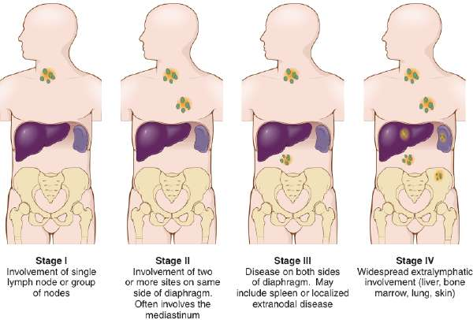
Staging of Hodgkin Lymphoma
Notes:
Ask students to define associated terms and reuse them correctly in another context:
Mediastinum
Extranodal
Extralymphatic
Splenectomy

Slide 64
QUICK QUIZ (Slide 3 of 5)
3. What is a malignant condition associated with AIDS?
Anaphylaxis
Non-Hodgkin lymphoma
Kaposi sarcoma
Hodgkin disease
Notes:
The correct answer is C: Kaposi sarcoma.

Slide 65
Laboratory Tests
CD4+ cell count: measures the number of CD4+ T cells (helper T cells) in the bloodstream with patients with AIDS
ELISA test: detects anti-HIV antibodies; Western blot given as follow-up
Immunoelectrophoresis: separates immunoglobulins (IgG, IgM, IgE, IgA, IgD)
Viral load test: measures the amount of AIDS virus (HIV) in the bloodstream.
Notes:
ELISA is an acronym that stands for what? (Enzyme-linked immunosorbent assay)
For what conditions is immunoelectrophoresis used?

Slide 66
Clinical Procedure
Computed tomography (CT) scan
X-ray imaging produces cross-sectional and other views of anatomic structures. These x-ray views show abnormalities of lymphoid organs, such as lymph nodes, spleen, and thymus gland.

Slide 67
Abbreviations (Slide 1 of 3)
Abbreviation | Meaning
AIDS | Acquired immunodeficiency syndrome
CD4+ cell | Helper T cell
CD8+ cell | Cytotoxic T cell
CMV | Cytomegalovirus
Crypto | Cryptococcus
ELISA | Enzyme-linked immunosorbent assay
G-CSF | Granulocyte colony-stimulating factor
GM-CSF | Granulocyte-macrophage colony-stimulating factor
HAART | Highly active antiretroviral therapy

Slide 68
Abbreviations (Slide 2 of 3)
Abbreviation | Meaning
Histo | Histoplasmosis
HIV | Human immunodeficiency virus
HSV | Herpes simplex virus
IgA, IgD, IgE, IgG, IgM | Immunoglobulins
IL38 to IL5 | Interleukins
KS | Kaposi sarcoma
MAI | Mycobacterium avium-intracellulare (MAI) complex
MoAb | Monoclonal antibody

Slide 69
Abbreviations (Slide 3 of 3)
Abbreviation | Meaning
NHL | Non-Hodgkin lymphoma
PCP | Pneumocystis pneumonia
PI | Protease inhibitor
RTI | Reverse transcriptase inhibitor
SCID | Severe combined immunodeficiency disease
Treg | Regulatory T cell (suppressor T cell)
Toxo | toxoplasmosis

Slide 70
Review Sheet: Combining Forms (Slide 1 of 4)
Combining Form
axill/o
cervic/o
immun/o
inguin/o
lymph/o
lymphaden/o

Slide 71
Review Sheet: Combining Forms (Slide 2 of 4)
Combining Form | Meaning
axill/o | armpit
cervic/o | neck; cervix (neck of uterus)
immun/o | immune; protection; safe
inguin/o | groin
lymph/o | lymph
lymphaden/o | lymph gland (node)

Slide 72
Review Sheet: Combining Forms (Slide 3 of 4)
Combining Form
splen/o
thym/o
tox/o

Slide 73
Review Sheet: Combining Forms (Slide 4 of 4)
Combining Form | Meaning
splen/o | spleen
thym/o | thymus gland
tox/o | poison

Slide 74
Review Sheet: Suffixes (Slide 1 of 4)
Suffix
-cytosis
-edema
-globulin
-megaly
-oid
-pathy

Slide 75
Review Sheet: Suffixes (Slide 2 of 4)
Suffix | Meaning
-cytosis | condition of cells; slight increase in numbers
-edema | swelling
-globulin | protein
-megaly | enlargement
-oid | resembling
-pathy | disease; emotion

Slide 76
Review Sheet: Suffixes (Slide 3 of 4)
Suffix
-penia
-phylaxis
-poiesis
-stitial
-suppression

Slide 77
Review Sheet: Suffixes (Slide 4 of 4)
Suffix | Meaning
-penia | deficiency
-phylaxis | protection
-poiesis | formation
-stitial | to set; pertaining to standing or positioned
-suppression | to stop

Slide 78
Review Sheet: Prefixes (Slide 1 of 2)
Prefix
ana-
auto-
hyper-
inter-
retro-

Slide 79
Review Sheet: Prefixes (Slide 2 of 2)
Prefix | Meaning
ana- | up; apart; backward; again; anew
auto- | self; own
hyper- | above; excessive
inter- | between
retro- | behind; back; backward

Slide 80
QUICK QUIZ (Slide 4 of 5)
4. What is the name of the fluid that lies between cells throughout the body?
Atopy
Lymphadema
Interstitial
Lymphopoiesis
Notes:
The correct answer is C: interstitial fluid.

Slide 81
QUICK QUIZ (Slide 5 of 5)
5. Malignant tumor of the lymph nodes and spleen marked by the presence of Reed-Sternberg cells in lymph nodes:
HIV
Kaposi sarcoma
Hodgkin lymphoma
Hodgkin disease
Notes:
The correct answer is D: Hodgkin lymphoma.

