Slide 1
The Language of Medicine 13th edition
Davi-Ellen Chabner

Slide 2
Chapter 15 Musculoskeletal System

Slide 3
Chapter Goals (Slide 1 of 3)
Define terms relating to the structure and function of bones, joints, and muscles.
Describe the process of bone formation and growth.
Locate and name the major bones of the body.

Slide 4
Chapter Goals (Slide 2 of 3)
Analyze the combining forms, prefixes, and suffixes used to describe bones, joints, and muscles.
Explain various musculoskeletal disease conditions and terms related to bone fractures.

Slide 5
Chapter Goals (Slide 3 of 3)
Describe important laboratory tests and clinical procedures related to the musculoskeletal system, and recognize relevant abbreviations.
Apply your new knowledge to understanding medical terms in their proper contexts, such as medical reports and records.

Slide 6
Chapter 15 Lesson 15.1

Slide 7
Introduction
Musculoskeletal System: bones, muscles, and joints of the body
Bones: structural support and protection of internal organs
Muscles: internal and external movement
Joints: where bones come together/type determined by need for flexibility
Tendons: bind muscles to bones
Ligaments: bind bones to other bones
Notes:
Which bones are located in the face?
Which bones support and protect the internal organs of the body?
Which muscles are most often used when an athlete is in training to run in a marathon?
What are common joint injuries?

Slide 8
Physicians Associated with Musculoskeletal System
Orthopedist: MD
Rheumatologist: MD
Physiatrist: MD
Osteopathic physician: DO
Notes:
Ask students who have had a broken bone to report to the class about the situation. Which bone was broken? How long did it take to heal? What was the treatment? Were any tests or procedures given prior to the diagnosis?

Slide 9
Bone Formation (Slide 1 of 3)
Ossification: replacement of cartilage with bone
Cells:
Osteoblast: produce immature bony tissue that replaces cartilage
Osteocyte: nourishes and maintains bone
Osteoclast: reabsorb or digest bone (remodels bone)
Notes:
Discuss bone formation and remodeling throughout life.
What steps can people take to help with bone formation?
Calcium: what role does it play? How much is enough? Where can you find it?
How does phosphorous affect bones?
Why is Vitamin D so valuable to the bones?

Slide 10
Bone Formation (Slide 2 of 3)
Osteoblasts and osteoclasts work to deposit and tear down bone throughout life.
The skeleton is a source of calcium.
Proper formation of bone depends on sources of calcium, phosphorous, and
vitamin D.
Calcium phosphate enzyme helps create hard bone from these sources.
Notes:
Which foods provide Vitamin D? How does Vitamin D affect bones?
How much Vitamin D do you need per day?

Slide 11
Bone Formation (Slide 3 of 3)
Reservoir for calcium storage
Calcium necessary for nerve transmittal to muscle, including heart muscle and muscles attached to bones
Calcium level maintained in blood by parathyroid gland, which secretes a hormone to release calcium from bone
Notes:
Where is the parathyroid gland located and how does it function?
What happens when you have too much calcium?
What happens if you have too little calcium?

Slide 12
Bone Structure (Slide 1 of 4)
Long, short, flat, sesamoid (in shape)
Diaphysis: shaft
Epiphysis: end
Metaphysis: conelike flared portion between end and shaft
Epiphyseal line or plate: growth plate where cartilage replaced by bone for bone growth (in length)
Notes:
What minerals and vitamins help with bone formation?
What happens if a bone is incorrectly formed?

Slide 13
Bone Structure (Slide 2 of 4)
Interior bone structure includes:
Articular cartilage
Epiphyseal line or plate
Cancellous bone
Compact (cortical) bone
Medullary cavity
Periosteum
Notes:
Fill in the correct names where the numbers are located using the text.

Slide 14
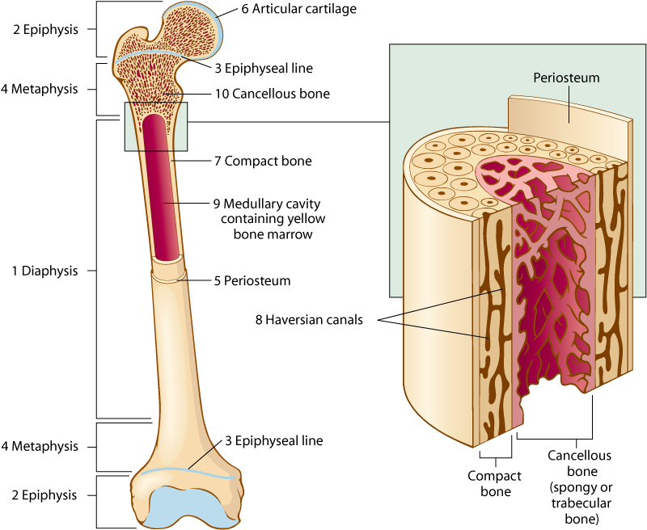
Bone Structure (Slide 3 of 4)

Slide 15
Bone Structure (Slide 4 of 4)
Ends of bones covered by articular cartilage in the joint: cushions joint and allows it to move smoothly
Compact bone: contains haversian systems for blood vessels, nerves, and yellow bone marrow (mostly fat)
Cancellous (spongy/trabecular bone): spaces contain red bone marrow with elements for blood formation
Notes:
Which of these bones is porous? How does this occur?
As a child ages, what happens to the red bone marrow? Where is it located in young children?

Slide 16
Bone Marrow
Yellow marrow: chiefly fat
Red marrow: rich with blood vessels and immature and mature blood cells in various stages of development; in later life replaced with yellow marrow; hematopoieses is the production of all types of blood cells in the bone marrow
Notes:
What is the function of bone marrow?

Slide 17
Bone Processes and Depressions (Slide 1 of 2)
Processes: serve as attachments for muscles, tendons, and ligaments
Depressions: openings or hollow regions help join bones or serve as passageways for nerves and/or vessels
Notes:
What are the major named processes and depressions?

Slide 18
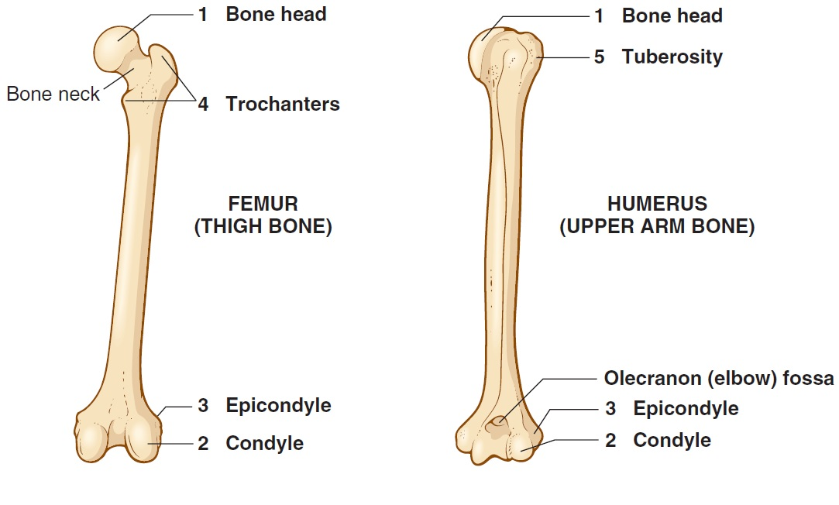
Bone Processes and Depressions (Slide 2 of 2)

Slide 19
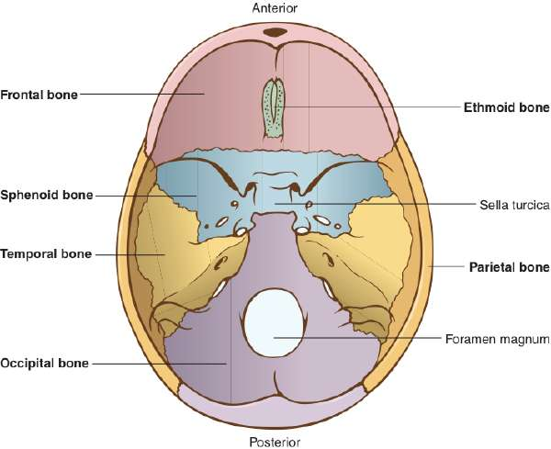
Cranial Bones (Slide 1 of 2)
Notes:
What are the important bones of the skull?
How do they correspond to the brain?
Why do newborn babies need to have their heads well protected?
What happens when a baby is severely shaken?

Slide 20
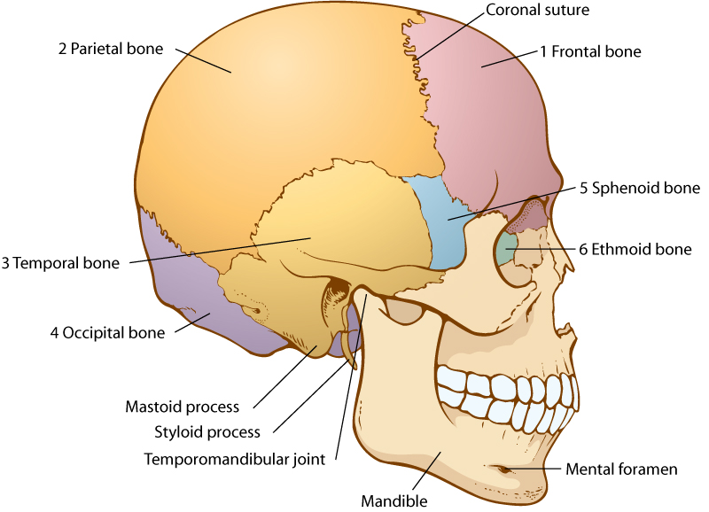
Cranial Bones (Slide 2 of 2)
Notes:
What are the important bones of the skull?
How do they correspond to the brain?
Why do newborn babies need to have their heads well protected?
What happens when a baby is severely shaken?

Slide 21
Cranial Bones and Associated Structures
Frontal bone
Parietal bone
Temporal bone
temporomandibular (TMJ) joint
mastoid process
styloid process
Occipital bone
foramen magnum
Sphenoid bone
sella turcica
Ethmoid bone
Notes:
Which bones aid in chewing, seeing, and breathing?

Slide 22
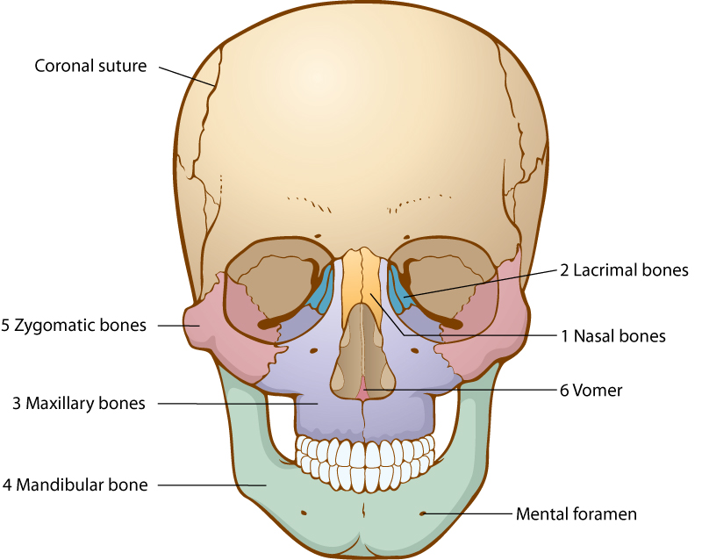
Facial Bones (Slide 1 of 2)
Notes:
Ask students to review correct names of bones in the numbered diagram.

Slide 23
Facial Bones (Slide 2 of 2)
Nasal bones
Lacrimal bones
Maxillary bones
Mandibular bones
Zygomatic bones
Vomer
Notes:
Which bones contain fossae for lacrimal gland and canals for duct?
What condition occurs if the maxillary bones do not separate at birth? (cleft palate)
Which bones might be adjusted during rhinoplasty?
What are the “cheek bones”?

Slide 24
Sinuses
Air cavities located in facial and cranial bone lighten the skull and warm and moisten the air as it passes into the respiratory system.

Slide 25
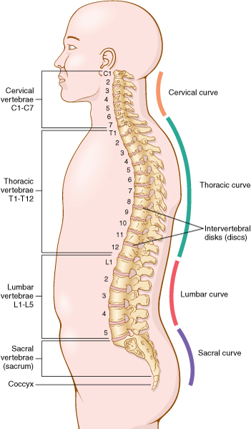
Vertebral Column and Vertebrae (Slide 1 of 2)
Notes:
Why is the human vertebral column subject to injury?

Slide 26
Vertebral Column and Vertebrae (Slide 2 of 2)
Vertebrae: 26 bone segments from base of skull to tailbone in five divisions and separated by pads of cartilage called intervertebral discs
Cervical, thoracic, lumbar, sacral
Coccyx: tailbone
Notes:
What are the 4 vertebral regions?
How many bones are there in each region?
Way to help students remember the numbers:
Cervical 7 am breakfast
Thoracic 12 pm lunch
Lumbar 5 pm dinner

Slide 27
Bones: Thorax, Pelvis and Extremities
Thorax
clavicle
scapula
sternum
ribs
Pelvis
pelvic girdle
ilium
ischium
pubis
Arm and Hand
humerus
ulna
radius
carpals
metacarpals
phalanges

Slide 28
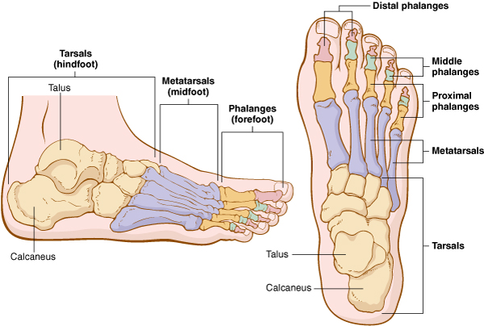
Bones of Leg and Foot
Notes:
There are seven bones of the leg and foot.
Have students identify bones shown in the figure.

Slide 29
Bones of Leg and Foot and Associated Structures
Femur
acetabulum
Patella
Tibia
medial malleolus
Fibula
lateral malleolus
talus
Tarsals
calcaneus
talus
Metatarsals
Phalanges
Notes:
Which are the bones of the foot?
What happens if you wear shoes that are too small?
Which is the largest bone in the body?

Slide 30
Vocabulary – Bones (Slide 1 of 32)
Term
acetabulum
acromion

Slide 31
Vocabulary – Bones (Slide 2 of 32)
Term | Meaning/Definition
acetabulum | Rounded depression in pelvis that joins the femur, forming the hip joint
acromion | Outward extension of shoulder blade forming the point of the shoulder

Slide 32
Vocabulary – Bones (Slide 3 of 32)
Term
bone
bone depression
bone process

Slide 33
Vocabulary – Bones (Slide 4 of 32)
Term | Meaning/Definition
bone | Dense, hard connective tissue composing the skeleton
bone depression | Opening or hollow region serving as a connection for bones, or passageway for blood vessels and nerves
bone process | Enlarged area that extends from bones as an attachment for muscles, tendons, and ligaments

Slide 34
Vocabulary – Bones (Slide 5 of 32)
Term
calcium
cancellous bone
cartilage

Slide 35
Vocabulary – Bones (Slide 6 of 32)
Term | Meaning/Definition
calcium | A mineral constituent of bone
cancellous bone | Spongy, porous bone tissue in inner part of bone
cartilage | Flexible, connective tissue

Slide 36
Vocabulary – Bones (Slide 7 of 32)
Term
collagen
compact bone
cranial bones

Slide 37
Vocabulary – Bones (Slide 8 of 32)
Term | Meaning/Definition
collagen | Dense, connective tissue protein strands found in bone and other tissues
compact bone | Hard, dense bone tissue, usually found around outer portion of bones
cranial bones | Skull bones: ethmoid, frontal, occipital, parietal, sphenoid, and temporal

Slide 38
Vocabulary – Bones (Slide 9 of 32)
Term
diaphysis
disc
epiphyseal plate

Slide 39
Vocabulary – Bones (Slide 10 of 32)
Term | Meaning/Definition
diaphysis | Shaft, or mid-portion, of a long bone
disc | Flat, round, plate-like structure
epiphyseal plate | Cartilaginous area at the ends of long bones where lengthwise growth takes in the immature skeleton

Slide 40
Vocabulary – Bones (Slide 11 of 32)
Term
epiphysis
facial bones
fontanelle

Slide 41
Vocabulary – Bones (Slide 12 of 32)
Term | Meaning/Definition
epiphysis | Each end of a long bone; area beyond the epiphyseal plate
facial bones | Bones of the face: lacrimal, mandibular, maxillary, nasal, vomer, and zygomatic
fontanelle | Soft spot (incomplete bone formation) between the skull bones of an infant

Slide 42
Vocabulary – Bones (Slide 13 of 32)
Term
foramen magnum
haversian canals
ligament

Slide 43
Vocabulary – Bones (Slide 14 of 32)
Term | Meaning/Definition
foramen magnum | Opening of the occipital bone through which the spinal cord passes
haversian canals | Minute spaces filled with blood vessels; found in compact bone
ligament | Fibrous connective tissue that binds bones to other

Slide 44
Vocabulary – Bones (Slide 15 of 32)
Term
malleolus
manubrium
mastoid process

Slide 45
Vocabulary – Bones (Slide 16 of 32)
Term | Meaning/Definition
malleolus | Round process on both sides of the ankle joint
manubrium | Upper portion of the sternum
mastoid process | Round projection on the temporal bone behind the ear

Slide 46
Vocabulary – Bones (Slide 17 of 32)
Term
medullary cavity
metaphysis
olecranon

Slide 47
Vocabulary – Bones (Slide 18 of 32)
Term | Meaning/Definition
medullary cavity | Central, hollowed-out area in the shaft of a long bone
metaphysis | Flared portion of a long bone, between the diaphysis and the epiphyseal plate
olecranon | Large process on the proximal end of the ulna

Slide 48
Vocabulary – Bones (Slide 19 of 32)
Term
orthopedist
osseous tissue
ossification

Slide 49
Vocabulary – Bones (Slide 20 of 32)
Term | Meaning/Definition
orthopedist | Medical doctor who specializes in bone, joint, and muscle conditions
osseous tissue | Bone tissue
ossification | Process of bone formation

Slide 50
Vocabulary – Bones (Slide 21 of 32)
Term
ossification
osteoblast
osteoclast

Slide 51
Vocabulary – Bones (Slide 22 of 32)
Term | Meaning/Definition
ossification | Process of bone formation
osteoblast | Bone cell that helps form bony tissue
osteoclast | Bone cell that absorbs and removes unwanted bony tissue

Slide 52
Vocabulary – Bones (Slide 23 of 32)
Term
periosteum
phosphorus
physiatrist

Slide 53
Vocabulary – Bones (Slide 24 of 32)
Term | Meaning/Definition
periosteum | Membrane surrounding bones; rich in blood vessels and nerve tissue
phosphorus | Mineral substance found in bones in combination with calcium
physiatrist | Medical doctor who specializes in rehabilitation

Slide 54
Vocabulary – Bones (Slide 25 of 32)
Term
pubic symphysis
red bone marrow
ribs

Slide 55
Vocabulary – Bones (Slide 26 of 32)
Term | Meaning/Definition
pubic symphysis | Area of confluence of the two pubic bones in the pelvis
red bone marrow | Found in cancellous bone; site of hematopoiesis
ribs | Twelve pairs of curved bones that form the chest wall; true ribs are the first 7 pairs; false ribs are pairs 8-10; floating ribs are pairs 11 and 12

Slide 56
Vocabulary – Bones (Slide 27 of 32)
Term
sella turcica
sinus
styloid process

Slide 57
Vocabulary – Bones (Slide 28 of 32)
Term | Meaning/Definition
sella turcica | Depression in the sphenoid bone where the pituitary gland is located
sinus | Hollow air cavity within a bone
styloid process | Pole-like process extending downward from the temporal bone on each side of the skull

Slide 58
Vocabulary – Bones (Slide 29 of 32)
Term
suture
temporomandibular joint
tendon

Slide 59
Vocabulary – Bones (Slide 30 of 32)
Term | Meaning/Definition
suture | Immovable joint between bones
temporomandibular joint | Connection on either side of the head between the temporal bone of the skull and the mandibular bone of the jaw
tendon | Fibrous connective tissue that binds muscles to bones

Slide 60
Vocabulary – Bones (Slide 31 of 32)
Term
trabeculae
vertebra
xiphoid process
yellow bone marrow

Slide 61
Vocabulary – Bones (Slide 32 of 32 )
Term | Meaning/Definition
trabeculae | Supporting bundles of bony fibers in cancellous bone
vertebra | Individual segment of the spine composed of the vertebral body, vertebral arch, spinous process, transverse process, and lamina
xiphoid process | Lower, narrow portion of sternum
yellow bone marrow | Fatty tissue found in the medullary cavity of most adult long bones

Slide 62
QUICK QUIZ (Slide 1 of 4)
The knuckle-like process at the end of a bone near the joint…
fossa
condyle
tubercle
diaphysis
Notes:
Correct answer is B. condyle

Slide 63
QUICK QUIZ (Slide 2 of 4)
The process of bone formation is ____________.
olecranon
ossification
osteoblast
xiphoid process
Notes:
Correct answer is B. ossification

Slide 64
Terminology – Bones Combining Forms (Slide 1 of 2)
Combining Form | Meaning
calc/o | calcium
calci/o | calcium
kyph/o | posterior curvature in thoracic region
lamin/o | lamina
lord/o | curve
lumb/o | loins, lower back

Slide 65
Terminology – Bones Combining Forms (Slide 2 of 2)
Combining Form | Meaning
myel/o | bone marrow
orth/o | straight
oste/o | bone
scoli/o | crooked
spondyl/o | vertebra
vertebr/o | vertebra

Slide 66
Terminology – Bones Suffixes
Suffix | Meaning
-blast | embryonic cell
-clast | to break
-listhesis | slipping
-malacia | softening
-physis | to grow
-porosis | pore, passage
-tome | instrument to cut

Slide 67
Terminology Related to Specific Bones Combining Forms (Slide 1 of 5)
Combining Form | Meaning
acetabul/o | acetabulum (hip socket)
calcane/o | calcaneus (heal)
carp/o | carpals (wrist bones)
clavicul/o | clavicle (collar bone)
cost/o | ribs
crani/o | cranium (skull)

Slide 68
Terminology Related to Specific Bones Combining Forms (Slide 2 of 5)
Combining Form | Meaning
femor/o | femur (thigh bones)
fibul/o | fibula (smaller lower leg bone)
humer/o | humerus (upper arm bone)
ili/o | ilium (upper part of pelvic bone)
ischi/o | ischium (part of pelvic bone)
malleol/o | malleolus

Slide 69
Terminology Related to Specific Bones Combining Forms (Slide 3 of 5)
Combining Form | Meaning
mandibul/o | mandible (lower jaw bone)
maxill/o | maxilla (upper jaw bone)
metacarp/o | metacarpals (hand bones)
metatars/o | metatarsals (foot bones)
olecran/o | olecranon (elbow)
patell/o | patella (kneecap)
pelv/i | pelvis

Slide 70
Terminology Related to Specific Bones Combining Forms (Slide 4 of 5)
Combining Form | Meaning
perone/o | fibula
phalang/o | phalanges (finger, toe bones)
pub/o | pubis
radi/o | radius
scapul/o | scapula (shoulder blade)

Slide 71
Terminology Related to Specific Bones Combining Forms (Slide 5 of 5)
Combining Form | Meaning
stern/o | sternum (breastbone)
tars/o | tarsals
tibi/o | tibia (shin bone)
uln/o | ulna (lower arm bone)

Slide 72
Pathology — Bones
Ewing sarcoma: malignant bone tumor
exostosis: bony growth on surface of bone
osteogenic sarcoma: malignant tumor arising from bone
osteomalacia: softening of bone
osteomyelitis: inflammation secondary to infection
talipes: congenital abnormality of hindfoot involving the talus (clubfoot)
Notes:
Ask students to describe a Ewing sarcoma. How old are people who suffer from this condition? What treatment can be given?
Is there any treatment for clubfoot?
What is the difference between osteogenic sarcoma and bone cancer that has metastasized from the breast cancer or prostate?
How does a broken leg with internal fixation increase the chance of osteomyelitis?

Slide 73
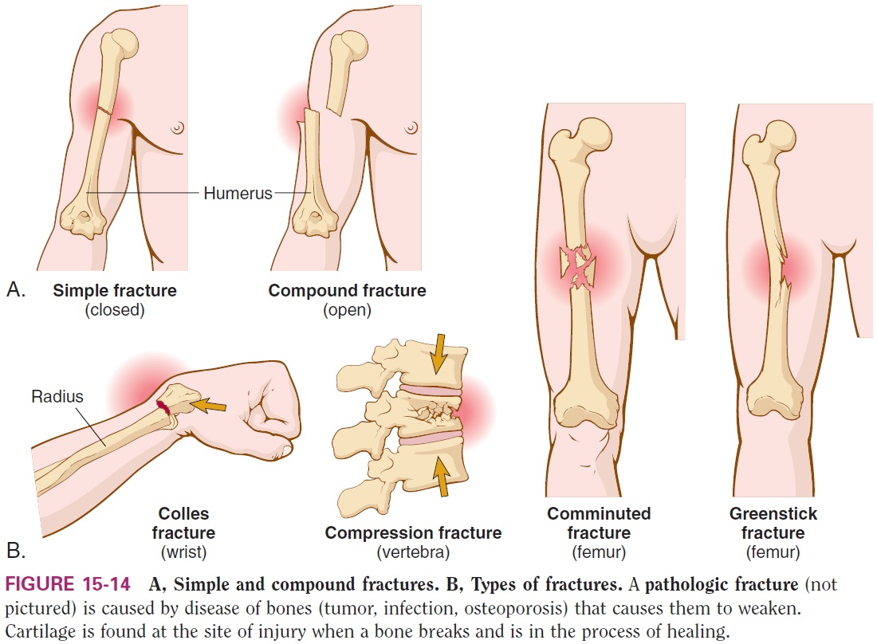
Pathologic Conditions Fractures of Bones
Notes:
What is the definition of a fracture?
What are the common names used for specific types of fractures?
What does reduction mean as it pertains to fractures?

Slide 74
Chapter 15 Lesson 15.2

Slide 75
Joints (Slide 1 of 2)
Joint (articulation): coming together of two or more bones
Suture joints: immovable (skull)
Synovial joints: freely movable (ball and socket types, e.g., hip or shoulder), (hinge type, for example, elbow, knee, ankle)
Notes:
What are some examples of places on the body with joints?

Slide 76
Synovial Joints
Joint capsule surrounds bone.
Ligaments band bones together.
Bones are covered by articular cartilage.
Synovial membrane lies under capsule and lines synovial cavity; filled with synovial fluid.
A meniscus is a crescent-shaped fibrocartilaginous structure that partly divides a join cavity; acts as a protective cushion; present in the knee.

Slide 77
Bursae
Closed sacks of synovial fluid with a synovial membrane located near, but not within a joint. Needed where sliding must take place.
Common sites:
between tendons (connective tissue connecting muscle to bone) and bones
between ligaments (binding bone to bone) and bones
between skin and bones (with prominent bony anatomy)
Notes:
Name examples of bursae, such as elbow, knee and shoulder joints.
Which sports injuries are related to this topic?
Which bursae are associated with the knee and elbow?

Slide 78
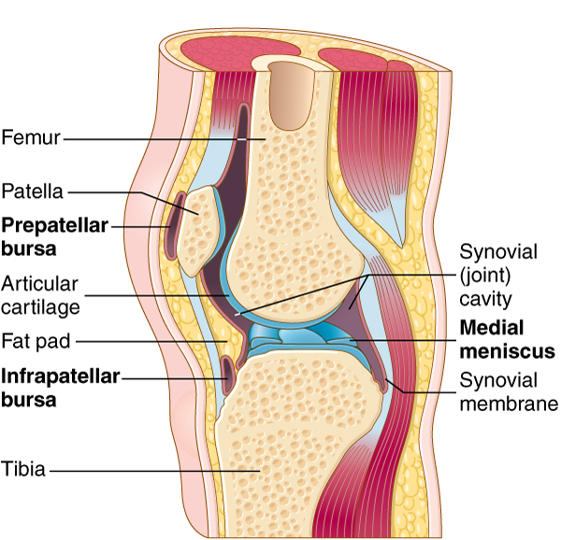
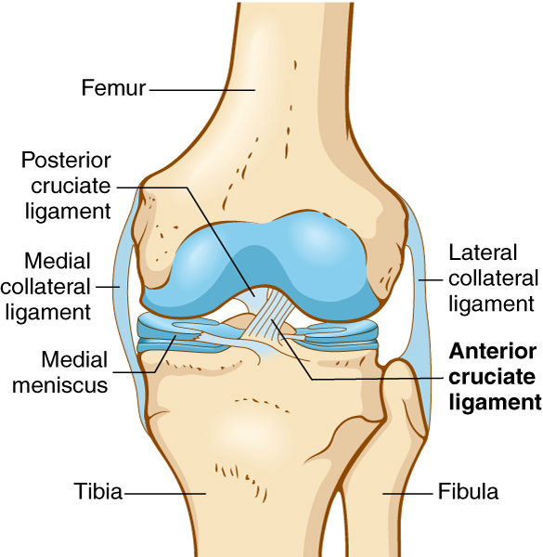
Joints (Slide 2 of 2)
Notes:
Give the students examples of joints that look like the ones depicted in these figures.

Slide 79
Vocabulary – Joints (Slide 1 of 6)
Term
articular cartilage
articulation
bursa (plural: bursae)
ligament

Slide 80
Vocabulary – Joints (Slide 2 of 6)
Term | Meaning/Definition
articular cartilage | Smooth, glistening white tissue that covers the surface of a joint
articulation | Any type of joint
bursa (plural: bursae) | Sac of fluid near a joint
ligament | Fibrous connective bands binding bones to other bones

Slide 81
Vocabulary – Joints (Slide 3 of 6)
Term
meniscus
suture joint
synovial cavity

Slide 82
Vocabulary – Joints (Slide 4 of 6)
Term | Meaning/Definition
meniscus | Crescent-shaped fibrocartilaginous structure found in the knee
suture joint | Immovable joint
synovial cavity | Space between bones at a synovial joint

Slide 83
Vocabulary – Joints (Slide 5 of 6)
Term
synovial fluid
synovial joint
synovial membrane
tendon

Slide 84
Vocabulary – Joints (Slide 6 of 6)
Term | Meaning/Definition
synovial fluid | Viscous fluid within the synovial cavity
synovial joint | Freely movable joint
synovial membrane | Tissue lining the synovial cavity; produces synovial fluid
tendon | Fibrous connective bands that connect muscles to bones

Slide 85
QUICK QUIZ (Slide 3 of 4)
The fibrous connective band that binds muscles to bones is ___________.
ligament
articulation
synovial membrane
tendon
Notes:
Correct answer is D. tendon

Slide 86
Combining Forms and Terminology Joints (Slide 1 of 2)
Combining Form | Meaning
ankyl/o | stiff
arthr/o | joint
articul/ | joint
burs/o | bursa
chondr/o | cartilage

Slide 87
Combining Forms and Terminology Joints (Slide 2 of 2)
Combining Form | Meaning
ligament/o | ligament
rheumat/o | watery flow
synov/o | synovial membrane
ten/o | tendon
tendin/o | tendon

Slide 88
Suffixes and Terminology Joints
Combining Form | Meaning
-desis | to bind, tie together
-stenosis | narrowing

Slide 89
Pathology — Joints
Arthritis: inflammation of any joint
Ankylosing spondylitis: chronic progressive stiffening of joints, mostly spine
Gouty arthritis: inflammation due to excessive uric acid in body
Osteoarthritis (OA): loss of articular cartilage and formation of bone spurs at articular surfaces; can occur in any joint, but mainly in spine, hips, and knees of older people
Rheumatoid arthritis (RA): autoimmune reaction against joint tissues (synovial membrane)
Notes:
Can young people suffer from arthritis?
What is the most common complaint of older individuals?
What treatments are available for people who suffer from osteoarthritis? Rheumatoid arthritis?
What is commonly known as degenerative joint disease?

Slide 90
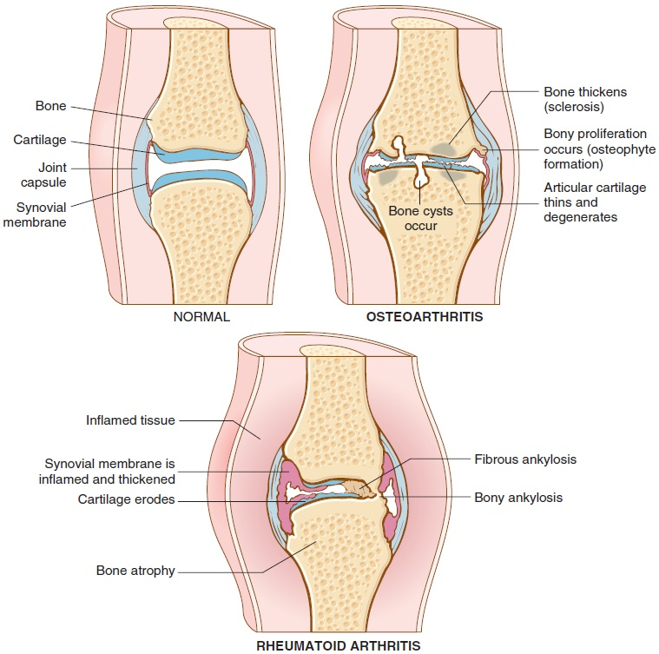
Osteoarthritis and Rheumatoid Arthritis
Notes:
Why do osteoarthritis and rheumatoid arthritis occur?
What are the differences between the two types of arthritis?

Slide 91
Pathology — Joints (Slide 1-4)
Bunion: swelling of medial aspect of joint between big toe and first metatarsal bone
Carpal tunnel syndrome: compression of median nerve as it passes between transverse ligament and bones and tendons of the wrist
Dislocation: displacement of bone from a joint
Notes:
Why do women get bunions more often than men?

Slide 92
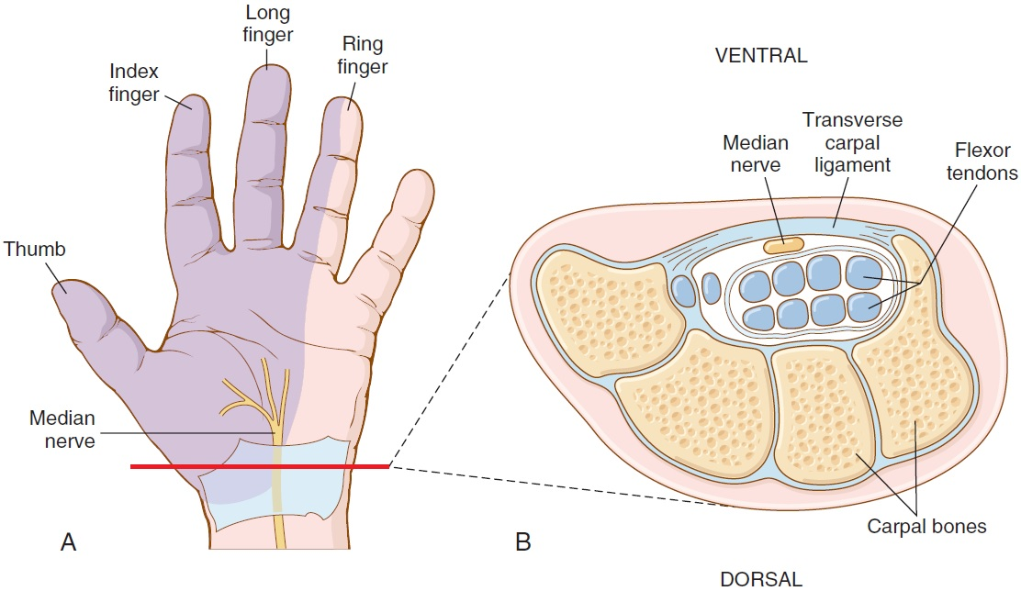
Pathology — Joints (Slide 2 of 4) Carpal Tunnel Syndrome
Notes:
Why is carpal tunnel syndrome considered a repetitive stress injury?
What can be done to alleviate carpal tunnel syndrome?
Ask students if they have suffered from carpal tunnel syndrome, and if so, what treatment was applied?
Ganglion: fluid filled cyst arising from joint capsule or tendon in the wrist

Slide 93
Pathology — Joints (Slide 3 of 4)
Ganglion: a fluid-filled cyst arising from the joint capsule or a tendon in the wrist.
Herniation of an intervertebral disc: abnormal protrusion of the disc into the neural canal or against spinal nerves; “slipped disc”.
Lyme disease: recurrent arthritis, myalgia, malaise and neurologic and cardiac symptoms; often marked by a “bull’s eye” rash at the site of the tick bite.
Notes:
How is sciatica related to herniated nucleus pulposus (HNP)?
What is the cause of Lyme disease?
What is the main carrier of Lyme disease in the United States (deer tick)
Define the term “vector”.

Slide 94
Pathology — Joints (Slide 4 of 4)
Sprain: trauma to joint with pain, swelling and injury to ligaments without rupture
Systemic lupus erythematosus (SLE): chronic inflammatory disease involving joints, skin, kidneys, nervous system, heart and lungs affecting collagen in tendons, ligaments, bones, and cartilage all over the body
Notes:
Ask the students if they have ever had a sprain to an ankle or knee.
Systemic lupus erythematosus (SLE), commonly called “lupus,” is believed to be an autoimmune disease. What is the accepted treatment?
Why does a rheumatologist treat a lupus patient? (arthritis)

Slide 95
Chapter 15 Lesson 15.3

Slide 96
Muscles
Three types of muscles: striated, smooth, cardiac
Striated: under voluntary control—they move all the bones as well as face and eyes
Smooth: control is involuntary—they move internal organs (digestive tract, blood vessels, ducts of glands)
Cardiac: not consciously controlled and found exclusively in the heart
Notes:
Which muscles are striated in appearance, smooth in character?

Slide 97
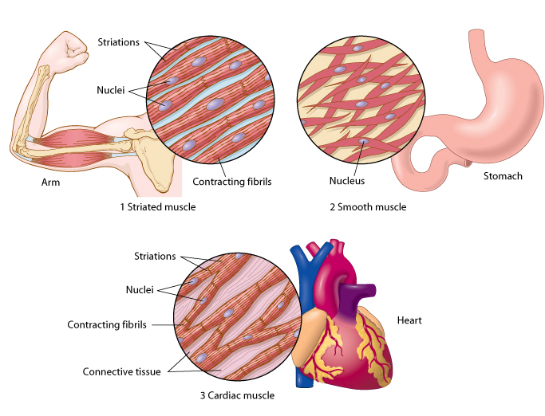
Types of Muscle
Notes:
Go over the figure with students, pointing to the parts of the arm where they are most likely to notice striations.
Ask the students to describe smooth muscles.

Slide 98
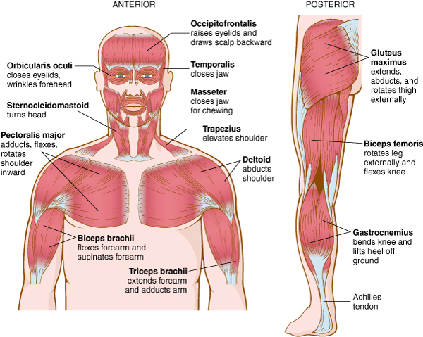
Actions of Skeletal Muscles (slide 1 of 3)
Notes:
Go over the figure with the students.
Students who exercise or are in weight training may be familiar with various muscle groups.
Can students name some muscle groups that are not pictured here? (e.g., latissimus dorsii, abductors, adductors)

Slide 99
Actions of Skeletal Muscles (slide 2 of 3)
flexion
extension
abduction
adduction
rotation
dorsiflexion
plantar flexion
supination
pronation
Notes:
Go over these definitions and demonstrate the movement on individuals.

Slide 100
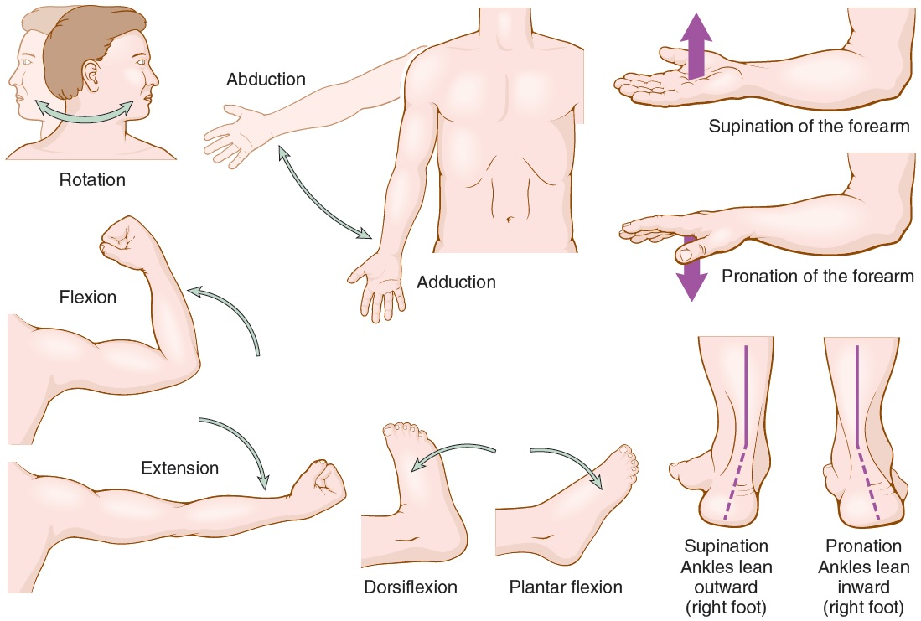
Actions of Muscles (slide 3 of 3)

Slide 101
Vocabulary – Muscles (Slide 1 of 8)
Term
abduction
adduction
dorsiflexion
extension

Slide 102
Vocabulary – Muscles (Slide 2 of 8)
Term | Meaning/Definition
abduction | Movement away from midline of body
adduction | Movement toward midline of body
dorsiflexion | Upper movement of the foot
extension | Straightening of a flexed limb

Slide 103
Vocabulary – Muscles (Slide 3 of 8)
Term
fascia
flexion
insertion of a muscle
origin of a muscle

Slide 104
Vocabulary – Muscles (Slide 4 of 8)
Term | Meaning/Definition
fascia | Fibrous membrane separating and enveloping muscles
flexion | Downward movement of the foot
insertion of a muscle | Connection of the muscle to a bone that moves
origin of a muscle | Connection of the muscle to a stationary bone

Slide 105
Vocabulary – Muscles (Slide 5 of 8)
Term
plantar flexion
pronation
rotation
skeletal muscle

Slide 106
Vocabulary – Muscles (Slide 6 of 8)
Term | Meaning/Definition
plantar flexion | Bending the sole of the foot downward toward the ground
pronation | Turning the palm downward
rotation | Circular movement around a central point
skeletal muscle | Muscle connected to bones; voluntary or striated muscle

Slide 107
Vocabulary – Muscles (Slide 7 of 8)
Term
smooth muscle
striated muscle
supination
visceral muscle

Slide 108
Vocabulary – Muscles (Slide 8 of 8)
Term | Meaning/Definition
smooth muscle | Visceral muscle
striated muscle | Skeletal muscle
supination | Turning the palm upward
visceral muscle | Muscle connected to internal organs; involuntary or smooth muscle

Slide 109
QUICK QUIZ (Slide 4 of 4)
Movement AWAY from the midline of the body is ____________.
adduction
abduction
flexion
dorsiflexion
Notes:
Correct answer is B. adbuction

Slide 110
Combining Forms and Terminology Muscles (Slide 1 of 2)
Combining Form | Meaning
fasci/o | fascia
fibr/o | fibrous
leiomy/o | smooth muscle
my/o | muscle

Slide 111
Combining Forms and Terminology Muscles (Slide 2 of 2)
Combining Form | Meaning
myocardi/o | heart muscle
myos/o | muscle
plant/o | sole of the foot
rhabdomy/o | skeletal muscle connected to bones
sarco | muscles and flesh

Slide 112
Suffixes and Terminology Muscles
Suffix | Meaning
-asthenia | lack of strength
-trophy | development, nourishment

Slide 113
Prefixes and Terminology Muscles
Prefix | Meaning
ab- | away from
ad- | toward
dorsi- | back
poly- | many, much

Slide 114
Pathology — Muscles
Muscular dystrophy: group of inherited diseases with progressive muscle weakness and degeneration without nervous system involvement
Polymyositis: chronic inflammatory myopathy; may be an autoimmune disorder
Notes:
Muscular dystrophy typically affects children.

Slide 115
Laboratory Tests
Antinuclear antibody test (ANA)
Erythrocyte sedimentation rate (ESR)
Rheumatoid factor test (RF)
Serum calcium (Ca)
Serum creatine kinase (CK)
Uric acid test
Notes:
For what conditions might an ESR be requested?
For what conditions would CK be indicated?
What is a uric acid test used to diagnose? (gout)

Slide 116
Clinical Procedures Related to Bones, Joints, and Muscle
Arthrocentesis
Arthrography
Arthroplasty
Arthroscopy
Bone density test
Bone scan
Computed tomography (CT)
Discography
Electromyography (EMG)
Magnetic resonance imaging (MRI)
Muscle biopsy
Notes:
If there are tests that students have seen before, discuss why they are appropriate for use in muscle-related disorders.
If they are new, discuss how they are uniquely able to diagnose and treat conditions pertaining to muscle.

Slide 117
Abbreviations (Slide 1 of 6)
Prefix
AC
ACL
ANA
BKA
BMD
C1 TO C7
Ca
CK
CMC
CTS
DEXA or DXA
DMARD

Slide 118
Abbreviations (Slide 2 of 6)
Prefix | Meaning
AC | Acromioclavicular (joint)
ACL | Anterior cruciate ligament of the knee
ANA | Antinuclear antibody
BKA | Below-knee amputation
BMD | Bone mineral density
C1 TO C7 | Cervical vertebrae
Ca | Calcium
CK | Creatine kinase
CMC | Carpometacarpal (joint)
CTS | Carpal tunnel syndrome
DEXA or DXA | Dual-energy x-ray absorptiometry
DMARD | Disease-modifying antirheumatic drug

Slide 119
Abbreviations (Slide 3 of 6)
Prefix
DO
DTRs
EMG
ESR (sed rate)
HNP
IM
L1 to L5
NSAID
OA
ORIF
ortho

Slide 120
Abbreviations (Slide 4 of 6)
Prefix | Meaning
DO | Doctor of osteopathy
DTRs | Deep tendon reflexes
EMG | Electromyography
ESR (sed rate) | Erythrocyte sedimentation rate
HNP | Herniated nucleus pulposus
IM | Intramuscular
L1 to L5 | Lumbar vertebrae
NSAID | Nonsteroidal anti-inflammatory drug
OA | Osteoarthritis
ORIF | Open reduction (of fracture)/ internal fixation
ortho | Orthopedics (or orthopaedics)

Slide 121
Abbreviations (Slide 5 of 6)
Prefix
OT
P
PT
RA
RF
ROM
SLE
T1 to T12
TKR
THR
TMJ

Slide 122
Abbreviations (Slide 6 of 6)
Prefix | Meaning
OT | Occupational therapy
P | Phosphorus
PT | Physical therapy
RA | Rheumatoid arthritis
RF | Rheumatoid factor
ROM | Range of motion
SLE | Systemic lupus erythematosus
T1 to T12 | Thoracic vertebrae
TKR | Total knee replacement/arthroplasty
THR | Total hip replacement/arthroplasty
TMJ | Temporomandibular joint

