Slide 1
The Language of Medicine 13th edition
Davi-Ellen Chabner

Slide 2
Chapter 16 Skin

Slide 3
Chapter Goals (Slide 1 of 2)
Name the layers of the skin and the accessory structures associated with the skin.
Build medical words using the combining forms that are related to the specialty of dermatology.
Identify lesions, signs, and symptoms, and pathologic conditions that relate to the skin.

Slide 4
Chapter Goals (Slide 2 of 2)
Describe laboratory tests and clinical procedures that pertain to the skin and recognize relevant abbreviations.
Apply your new knowledge to understanding medical terms in their proper contexts, such as medical reports and records.

Slide 5
Chapter 16 Lesson 16.1

Slide 6
Introduction
Skin: integumentary system
Weighs 8 to 10 lbs.
Covers 22 sq. ft. in the average adult
Notes:
What tissues can you predict will be integrated into this organ system?
What are the unique qualities of epithelium that make it a suitable tissue for covering the body?
How is the epithelium on the “outside” (part of the skin) similar to that on the inside of the body?

Slide 7
Functions of Skin (Slide 1 of 2)
Provides protective membrane
Skin glands lubricate and cool the skin
Receptor for sensations
Helps maintain body temperature
Notes:
Have students define desiccation. Ask them to list three ways that skin guards against desiccation.
How does the skin guard against acidic secretions?

Slide 8
Functions of Skin (Slide 2 of 2)
Produces sweat: sweat glands produce a watery secretion that evaporates and cools
Produces sebum: sebaceous glands produce an oily secretion that lubricates the skin and hair
Receives sensation: pain, temperature, pressure, and touch
Thermoregulates: interprets message from heat center in the brain
Notes:
Ask the students to define the word thermoregulate. How does the skin thermoregulate?
There are multiple mechanisms for thermal control. Describe at least three or four.

Slide 9
Structure of the Skin (Slide 1 of 3)
Epidermis: outermost, thin cellular membrane
Dermis: next layer; dense fibrous, connective tissue
Subcutaneous tissue: thick, fat-containing tissue
Notes:
What does the epidermis lack? Ask the students to describe what it is dependent upon.
What is the dermis composed of? Ask the students to describe what supports this layer.
Ask the students what lipocytes are and where they are found.

Slide 10
Structure of the Skin (Slide 2 of 3)
Epidermis layer contains:
Basal layer
Stratum corneum
Melanocytes
Notes:
In the inset of this picture (upper right) you can see what are called dermal papillae. They look like wavy folds. What is the advantage of this kind of tissue architecture?
The dermis appears to be pushing up folds into the epidermis. Why?
Is the epithelium vascular? Why is that an advantage or disadvantage?

Slide 11
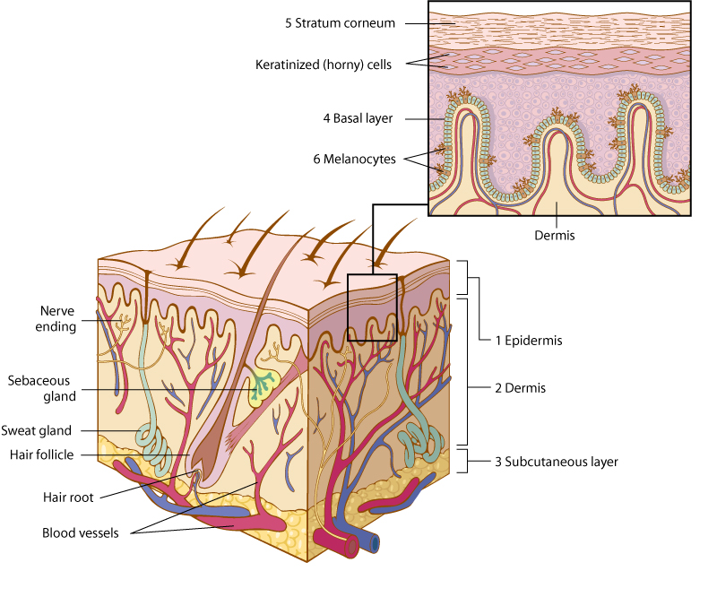
Structure of the Skin (Slide 3 of 3)
Notes:
In the inset of this picture (upper right) you can see what are called dermal papillae. They look like wavy folds. What is the advantage of this kind of tissue architecture?
The dermis appears to be pushing up folds into the epidermis. Why?
Is the epithelium vascular? Why is that an advantage or disadvantage?

Slide 12
Accessory Organs of the Skin: Hair (Slide 1 of 2)
Hair cells are filled with the hard protein;
keratin
Hair follicles: shafts that hold the hair
Five million hairs on the body; 100,000 on the head
Melanocytes at the root form the color
Grows .5 inch (1.3 cm) per month
Cutting does not affect growth
Notes:
Ask the students to describe melanocytes and where they can be found.
What functions does hair have? (Sensory, thermoregulation)

Slide 13
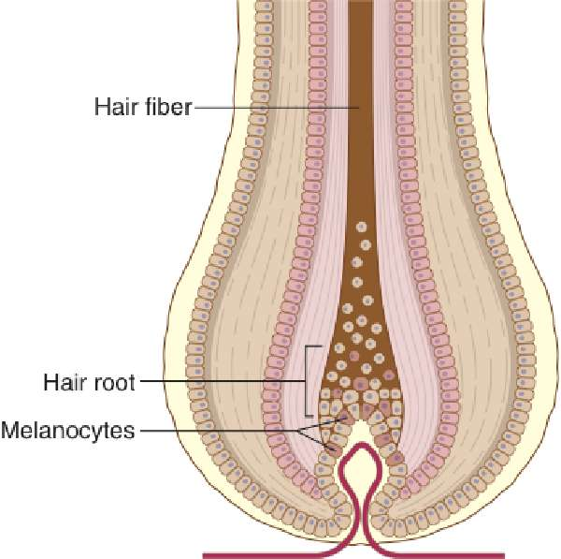
Accessory Organs of the Skin: Hair (Slide 2 of 2)

Slide 14
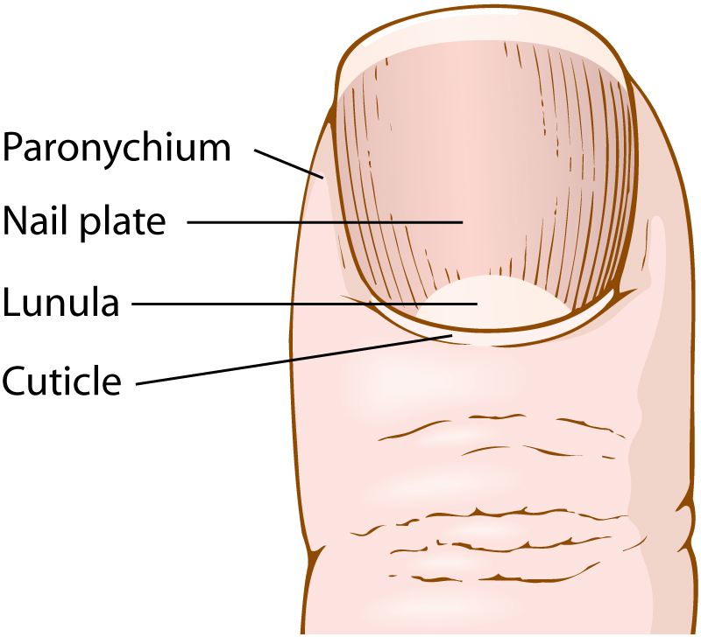
Accessory Organs of Skin: Nails
Hard keratin plates covering the toes and fingers
Lunula
Cuticle
Paronychium
Notes:
How are hair, nails, and epidermis alike?
How do these structures grow and slough off cells?

Slide 15
Accessory Organs of Skin: Glands (Slide 1 of 2)
Glands: sebaceous and sweat
Sebaceous glands secrete oily sebum into the hair follicle to lubricate.
Sweat glands secrete into pores to moisten and cool.
Both are subject to bacterial growth.
Notes:
Why do people have so many sweat glands?
Could people live without sweat glands?
Do sebaceous glands make hair feel oily?

Slide 16
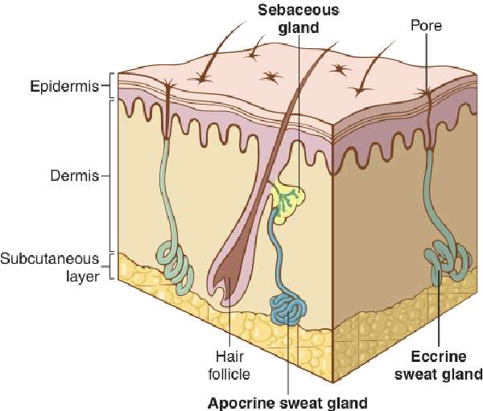
Accessory Organs of Skin: Glands (Slide 2 of 2)
Sebaceous gland, eccrine sweat gland, and apocrine sweat gland
Notes:
Why do people have so many sweat glands?
Could people live without sweat glands?
Do sebaceous glands make hair feel oily?

Slide 17
Vocabulary (Slide 1 of 16)
Term
adipocyte
albino
apocrine sweat gland

Slide 18
Vocabulary (Slide 2 of 16)
Term | Meaning/Definition
adipocyte | Fat cell
albino | Person with skin deficient in pigment
apocrine sweat gland | One of the large dermal exocrine glands located in the axilla and genital areas

Slide 19
Vocabulary (Slide 3 of 16)
Term
basal layer
collagen
cuticle

Slide 20
Vocabulary (Slide 4 of 16)
Term | Meaning/Definition
basal layer | Deepest region of the epidermis; gives rise to all the epidermal cells
collagen | Structural protein found in the skin and connective tissue
cuticle | Band of epidermis at the base and sides of the nail plate

Slide 21
Vocabulary (Slide 5 of 16)
Term
dermis
ecocrine sweat gland
epidermis

Slide 22
Vocabulary (Slide 6 of 16)
Term | Meaning/Definition
dermis | Middle layer of the skin
eccrine sweat gland | Most numerous sweat-producing exocrine gland in skin
epidermis | Outermost layer of the skin

Slide 23
Vocabulary (Slide 7 of 16)
Term
epithelium
hair follicle
integumentary system

Slide 24
Vocabulary (Slide 8 of 16)
Term | Meaning/Definition
epithelium | Layer of skin cells forming the outer and inner surfaces of the body
hair follicle | Sac within which each hair grows
integumentary system | The skin and its accessory structures such as hair and nails

Slide 25
Vocabulary (Slide 9 of 16)
Term
keratin
lunula
melanin

Slide 26
Vocabulary (Slide 10 of 16)
Term | Meaning/Definition
keratin | Hard protein material found in the epidermis, hair, and nails
lunula | Half-moon-shaped, whitish area at the base of a nail
melanin | Skin pigment formed by melanocytes in the epidermis

Slide 27
Vocabulary (Slide 11 of 16)
Term
paronychium
pore
sebaceous gland

Slide 28
Vocabulary (Slide 12 of 16)
Term | Meaning/Definition
paronychium | Soft tissue surrounding the nail border
pore | Tiny opening on the surface of the skin
sebaceous gland | Oil-secreting gland in the dermis that is associated with hair follicles

Slide 29
Vocabulary (Slide 13 of 16)
Term
sebum
squamous epithelium
stratified

Slide 30
Vocabulary (Slide 14 of 16)
Term | Meaning/Definition
sebum | Oily substance secreted by sebaceous glands
squamous epithelium | Flat, scale-like cells composing the epidermis
stratified | Arranged in layers

Slide 31
Vocabulary (Slide 15 of 16)
Term
stratum (plural: strata)
stratum corneum
subcutaneous layer

Slide 32
Vocabulary (Slide 16 of 16)
Term | Meaning/Definition
stratum (plural: strata) | A layer (of cells)
stratum corneum | Outermost layer of the epidermis; consists of flattened, keratinized cells
subcutaneous layer | Innermost layer of the skin, containing fat tissue

Slide 33
Combining Forms (Slide 1 of 5)
Combining Form | Meaning
adip/o | fat
albin/o | white
caus/o | burn, burning
cauter/o | heat, burn
cutane/o | skin
derm/o | skin

Slide 34
Combining Forms (Slide 2 of 5)
Combining Form | Meaning
dermat/o | skin
diaphor/o | profuse sweating
erythem/o | redness
erythemat/o | redness
hidr/o | sweat
ichthy/o | scaly, dry

Slide 35
Combining Forms (Slide 3 of 5)
Combining Form | Meaning
kerat/o | hard, horny tissue
leuk/o | white
lip/o | fat
melan/o | black
myc/o | fungus
onych/o | nail

Slide 36
Combining Forms (Slide 4 of 5)
Combining Form | Meaning
phyt/o | plant
pil/o | hair, hair follicle
py/o | pus
rhythid/o | wrinkle
seb/o | sebum
squam/o | scale-like

Slide 37
Combining Forms (Slide 5 of 5 )
Combining Form | Meaning
steat/o | fat
trich/o | hair
ungu/o | nail
xanth/o | yellow
xer/o | dry

Slide 38
QUICK QUIZ (Slide 1 of 2)
Which combining form refers to white?
chlor/o
jaund/o
melan/o
albin/o
Notes:
The correct answer is D: albin/o, which means white as in albinism.

Slide 39
QUICK QUIZ (Slide 2 of 2)
2. Which combining form refers to the same color as jaund/o?
A. xanth/o
B. chlor/o
C. erythr/o
D. cyan/o
Notes:
The correct answer is A: xanth/o, which means yellow as in xanthoma.

Slide 40
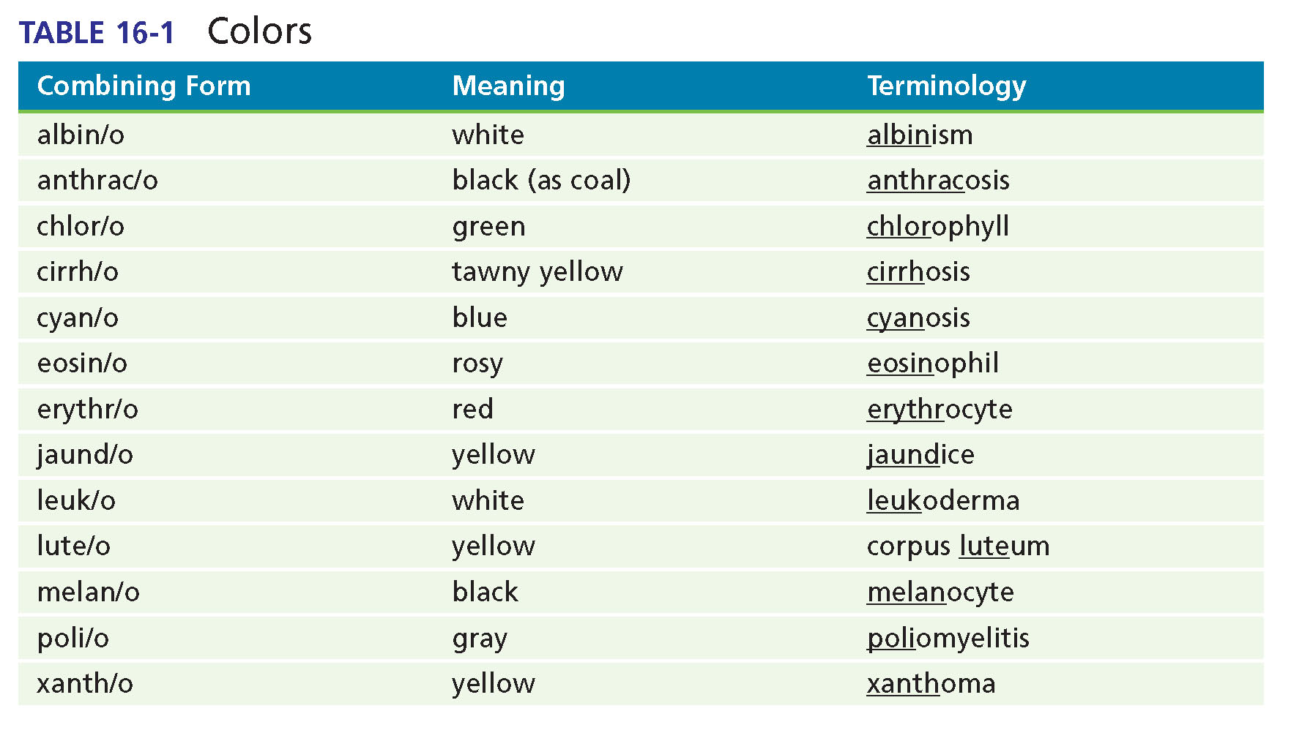
Colors

Slide 41
Chapter 16 Lesson 16.2

Slide 42
Cutaneous Lesions
Types of cutaneous lesions:
Crust (scab)
Cyst
Erosion
Fissure
Macule
Nodule
Papule
Pustule
Ulcer
Vesicle
Wheal
Notes:
What is the definition of a lesion?
Which of these lesions are similar but are differentiated by size?
Which lesions involve the dermis layer?

Slide 43
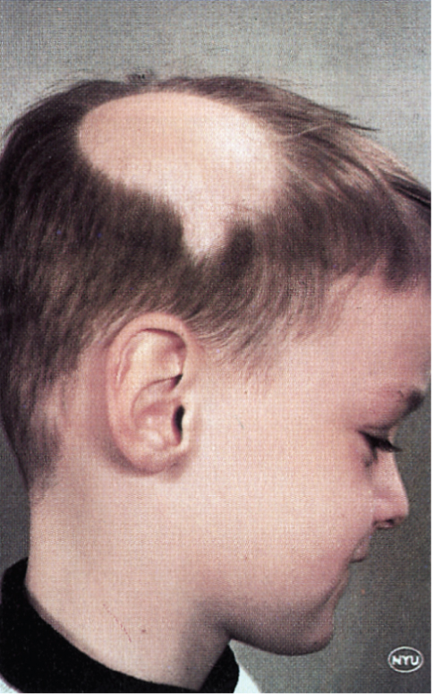
Signs and Symptoms (Slide 1 or 4)
Alopecia: the absence of hair where it normally grows
Notes:
What are some causes of alopecia?
Are there any treatments for baldness? Are they successful?
Another form of alopecia is a result of trichotillomania, or obsessive hair-pulling.

Slide 44
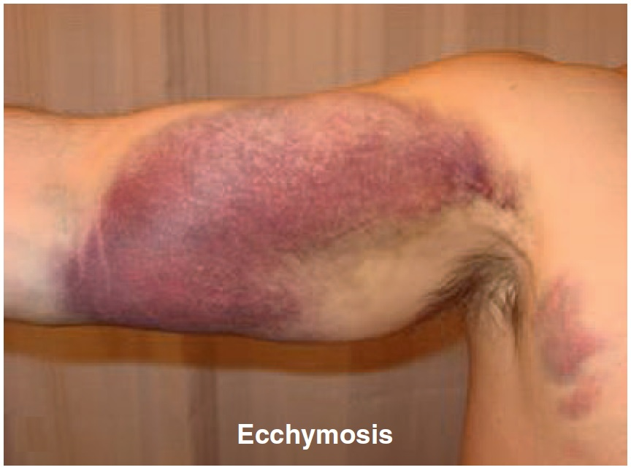
Signs and Symptoms (Slide 2 of 4)
Ecchymosis: blue-purple marks on the skin
Notes:
What can cause ecchymosis?
What is the treatment?

Slide 45
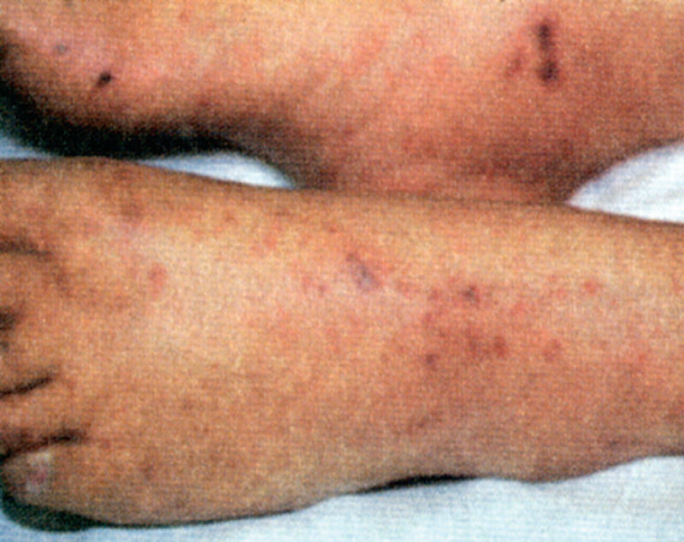
Signs and Symptoms (Slide 3 of 4)
Petechia: small pinpoint hemorrhage
Notes:
Use the pictures as examples. Ask students whether they have ever been diagnosed with any of the skin conditions mentioned.
What diseases are associated with these symptoms?
What is pruritus?
What is purpura?

Slide 46
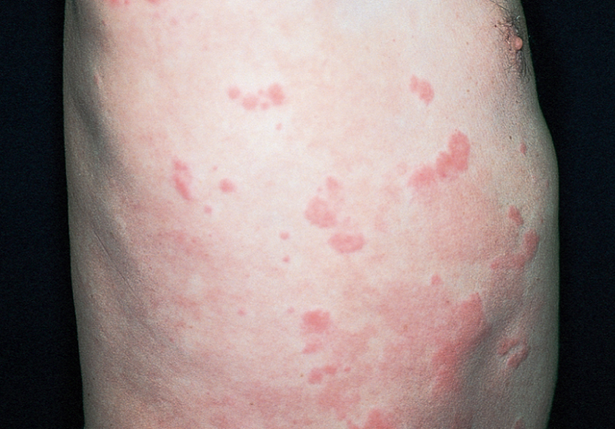
Signs and Symptoms (Slide 4 of 4)
Urticaria: an acute allergic reaction with red, round wheals on the skin
Notes:
What is the common term for urticaria?
Have students discuss their experiences (or that of someone they know) with hives.
What causes hives? How long do they last?

Slide 47
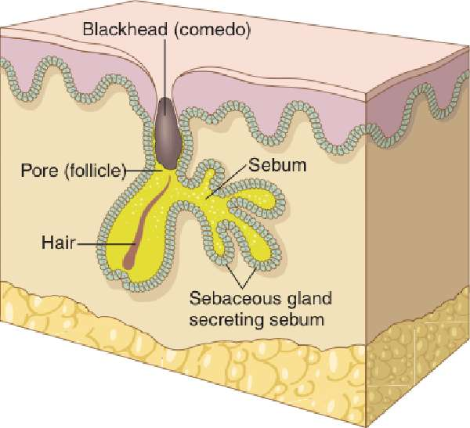
Abnormal Conditions (Slide 1 of 7)
Acne: papular and pustular eruption of skin with increased production of sebum
Notes:
What is the medical term for a blackhead?
Why are adolescents so prone to acne? Myths and reality.
Are over-the-counter treatments effective?

Slide 48
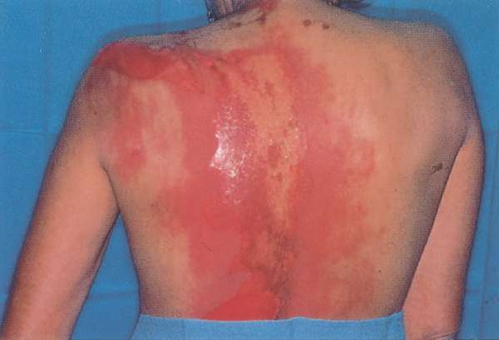
Abnormal Conditions (Slide 2 of 7)
Burns: injury to tissue due to heat, chemical, electric shock, lightning, or radiation. Second degree burn shown in figure.
Notes:
Go over the different degrees of burns and use a chart with the layers of the skin to demonstrate how deep the burns go.
What percentage of body burn results in death? Why?

Slide 49
Abnormal Conditions (Slide 3 of 7)
Cellulitis: a diffuse acute infection of the skin
Eczema (atopic dermatitis): inflammation of the skin with erythematous and papulovesicular lesions caused by allergy
Exanthematous viral diseases: a rash due to virus (for example, rubella)
Gangrene: the death of tissue with loss of blood supply
Notes:
Which of these diseases is/are common in children? Why?
What are other diseases that are similar to eczema? Are they all treated in the same way?

Slide 50
Abnormal Conditions (Slide 4 of 7)
Impetigo: contagious pyoderma caused by staph or strep
Psoriasis: chronic recurrent dermatosis with silver gray scales that itch
Scabies: parasitic (tiny mites) and infectious pruritus
Scleroderma: chronic and progressive disease of the skin with hardening of connective tissue
Notes:
Which of these diseases are NOT contagious?
Which disease may worsen if the patient experiences anxiety?

Slide 51
Abnormal Conditions (Slide 5 of 7)
Systemic lupus erythematosus (SLE): an inflammatory disease of collagen in the skin, joints, and internal organs
Urticaria (hives): an acute allergic reaction in which red, round wheals develop on the skin
Notes:
What are the current thoughts about the origin of SLE? How is it treated?
Where have we discussed it before because of the other organ systems it affects?

Slide 52
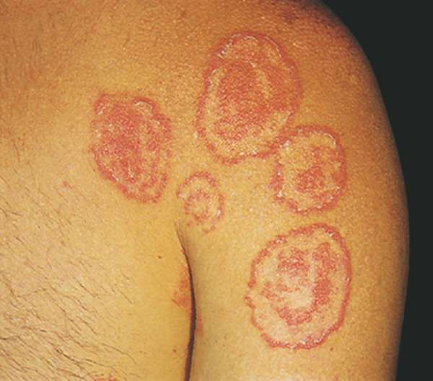
Abnormal Conditions (Slide 6 of 7)
Tinea: infection of the skin caused by a fungus— Tinea corporis shown in figure
Notes:
What is tinea? (A fungal infection of skin or nails, that is, ringworm, athlete’s foot.)

Slide 53
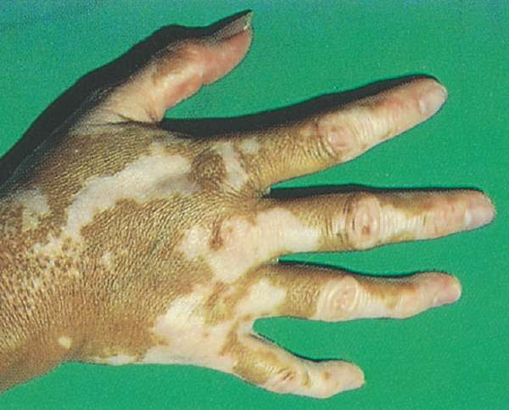
Abnormal Conditions (Slide 7 of 7)
Vitiligo: loss of pigment in areas of the skin
Notes:
What is vitiligo? (Loss of pigment in areas of skin causing milk-white patches)

Slide 54
Chapter 16 Lesson 16.3

Slide 55
Skin Neoplasms — Benign
Keratosis: thickened area of epidermis
Leukoplakia: white, thickened patches on tongue or cheek
Nevus (pl. nevi): pigmented lesion
Verruca: warts caused by virus
Notes:
Have students find images for abnormalities not shown in the text. Images are very useful for remembering these conditions.

Slide 56
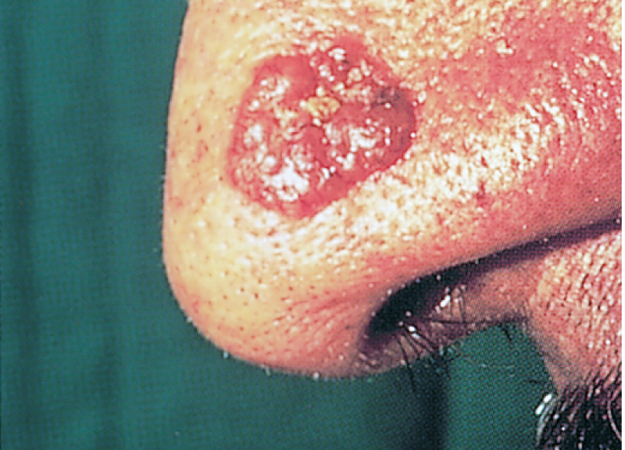
Skin Neoplasms — Cancerous (Slide 1 of 3)
Basal cell carcinoma—Malignant tumor of the basal cell layer of the epidermis
Notes:
Refer back to the chapter that included AIDS.
Why are AIDS patients susceptible to this condition?
Why does it rarely occur in the rest of the population?

Slide 57
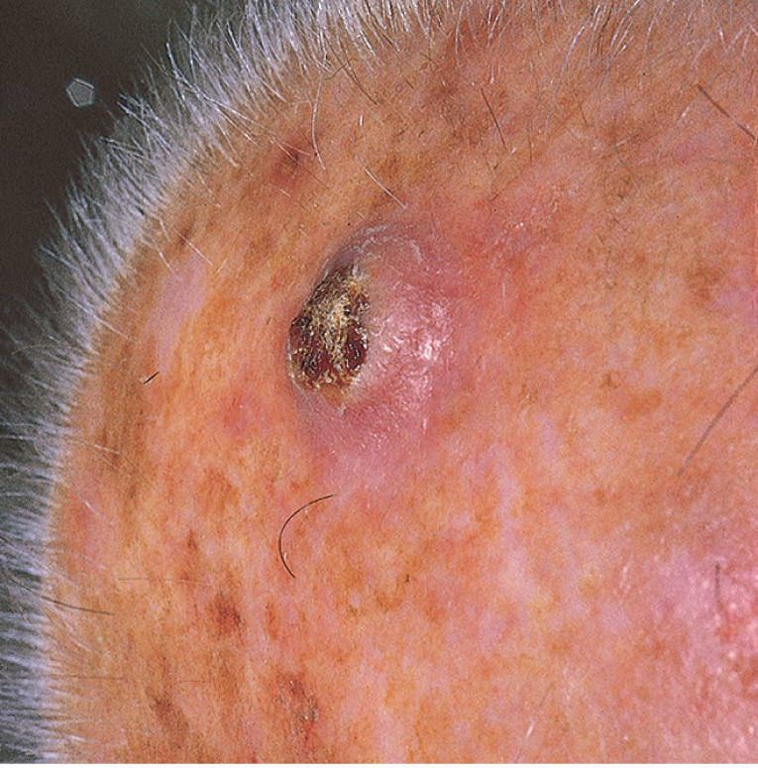
Skin Neoplasms — Cancerous (Slide 2 of 3)
Squamous cell carcinoma--Malignant tumor of the squamous epithelial cells of the epidermis
Notes:
Refer back to the chapter that included AIDS.
Why are AIDS patients susceptible to this condition?
Why does it rarely occur in the rest of the population?

Slide 58
Skin Neoplasms — Cancerous (Slide 3 of 3)
Kaposi sarcoma
Malignant, vascular, neoplastic growth characterized by cutaneous nodules
Notes:
Refer back to the chapter that included AIDS.
Why are AIDS patients susceptible to this condition?
Why does it rarely occur in the rest of the population?

Slide 59
Laboratory Tests
Bacterial analyses: pus or fluid samples examined to detect microorganisms
Fungal tests: scrapings for culture and microscopic examination after treatment with KOH

Slide 60
Clinical Procedures (Slide 1 of 2)
Cryosurgery: destroy tissue with subzero temperatures using liquid nitrogen
Curettage: scrape lesion with sharp curet
Electrodesiccation: destroy tissue by burning with electric spark
Notes:
For what conditions is electrodesiccation recommended?

Slide 61
Clinical Procedures (Slide 2 of 2)
Mohs surgery: removes thin layers of growth to examine under a microscope (basal and squamous cell)
Skin biopsy: punch and shave to remove for examination in path lab
Skin test: test reaction of body to allergen with skin test (scratch or patch tests)
Notes:
Discuss how some of the surgeries are for both diagnosis and treatment. Removal is done whether or not the physician knows that the lesion is cancerous.
All suspicious-looking tissues removed from the body are sent to the pathology lab for analysis. Why?

Slide 62
Abbreviations (Slide 1 of 2)
Abbreviation
ABCDE
Bx
Derm.
DLE
PPD
PUVA
SLE
SC

Slide 63
Abbreviations (Slide 2 of 2)
Abbreviation | Meaning
ABCDE | asymmetry, border, color, diameter, evolution (or change) —characteristics associated with melanoma
Bx | biopsy
Derm. | dermatology
DLE | discoid lupus erythematosus
PPD | purified protein derivative
PUVA | psoralen-ultravoilet A light therapy
SLE | systemic lupus erythematosus
SC | subcutaneous

Slide 64
Review Sheet – Combining Forms (Slide 1 of 10)
Combining Form
adip/o
albin/o
caus/o
cauter/o
cutane/o
derm/o

Slide 65
Review Sheet – Combining Forms (Slide 2 of 10)
Combining Form | Meaning
adip/o | fat
albin/o | white
caus/o | burn, burning
cauter/o | heat, burn
cutane/o | skin
derm/o | skin

Slide 66
Review Sheet – Combining Forms (Slide 3 of 10)
Combining Form
dermat/o
diaphor/o
erythem/o
erythemat/o
hidr/o
ichthy/o

Slide 67
Review Sheet – Combining Forms (Slide 4 of 10)
Combining Form | Meaning
dermat/o | skin
diaphor/o | profuse sweating
erythem/o | redness
erythemat/o | redness
hidr/o | sweat
ichthy/o | scaly, dry

Slide 68
Review Sheet – Combining Forms (Slide 5 of 10)
Combining Form
kerat/o
leuk/o
lip/o
melan/o
myc/o
onych/o

Slide 69
Review Sheet – Combining Forms (Slide 6 of 10)
Combining Form | Meaning
kerat/o | hard, horny tissue
leuk/o | white
lip/o | fat
melan/o | black
myc/o | fungus
onych/o | nail

Slide 70
Review Sheet – Combining Forms (Slide 7 of 10)
Combining Form
phyt/o
pil/o
py/o
rhythid/o
seb/o
squam/o

Slide 71
Review Sheet – Combining Forms (Slide 8 of 10)
Combining Form | Meaning
phyt/o | plant
pil/o | hair, hair follicle
py/o | pus
rhythid/o | wrinkle
seb/o | sebum
squam/o | scale-like

Slide 72
Review Sheet – Combining Forms (Slide 9 of 10)
Combining Form
steat/o
trich/o
ungu/o
xanth/o
xer/o

Slide 73
Review Sheet – Combining Forms (Slide 10 of 10)
Combining Form | Meaning
steat/o | fat
trich/o | hair
ungu/o | nail
xanth/o | yellow
xer/o | dry

Slide 74
Review Sheet – Suffixes (Slide 1 of 4)
Suffix
-algia
-derma
-esis
-lysis
-ose

Slide 75
Review Sheet – Suffixes (Slide 2 of 4)
Suffix | Meaning
-algia | pain
-derma | skin
-esis | condition
-lysis | breakdown; separation; destruction; loosening
-ose | full of; pertaining to; sugar

Slide 76
Review Sheet – Suffixes (Slide 3 of 4)
Suffix
-osis
-ous
-plakia
-plasty
-rrhea

Slide 77
Review Sheet – Suffixes (Slide 4 of 4)
Suffix | Meaning
-osis | condition, usually abnormal
-ous | pertaining to
-plakia | plaque
-plasty | surgical repair
-rrhea | flow; discharge

