Slide 1
The Language of Medicine 13th edition
Davi-Ellen Chabner

Slide 2
Chapter 17 Sense Organs: The Eye and Ear

Slide 3
Chapter Goals (Slide 1 of 2)
Identify locations and functions of the major parts of the eye and ear.
Name the combining forms, prefixes, and suffixes most commonly used to describe these organs and their parts.
Describe the abnormal conditions that may affect the eye and ear.

Slide 4
Chapter Goals (Slide 2 of 2)
Identify clinical procedures that pertain to ophthalmology and otology.
Apply your new knowledge to understanding medical terms in their proper contexts, such as medical reports and records.

Slide 5
Chapter 17 Lesson 17.1

Slide 6

Introduction
Notes:
Light and sound applied to the sense organs of the eye and ear activate receptors that send signals to the appropriate brain regions in the cortex where they are translated into images and sounds.
What types of receptors exist to process information about our environment?

Slide 7
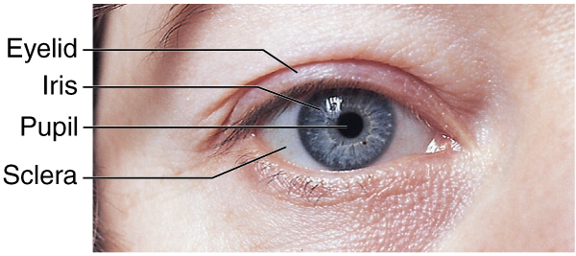
The Eye (Slide 1 of 3)
Notes:
What are the parts of the eye labeled in the diagram?
What are the functions of the different parts of the eye?
See the Vocabulary section in the text for definitions of the parts of the eye and their functions.

Slide 8
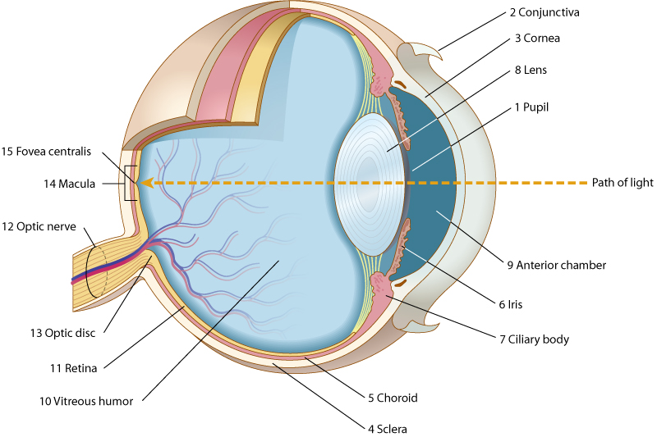
The Eye (Slide 2 of 3)
Notes:
What are the parts of the eye labeled in the diagram?
What are the functions of the different parts of the eye?
See Vocabulary list in the text for definitions of the parts of the eye and their functions.

Slide 9
The Eye (Slide 3 of 3)
Pupil
Conjunctiva
Cornea
Sclera
Choroid
Iris
Ciliary body
Lens
Fundus
Anterior chamber
Aqueous humor
Vitreous chamber
Vitreous humor
Retina
Optic nerve
Optic disc
Macula
Fovea centralis
Notes:
Why are corneal transplants often successful?
How many cones and rods are in the retina? (There are approximately 6.5 million cones and 120 million rods in the retina.)
There are three types of cones, each stimulated by one of the primary colors of light (red, blue, and green).
Which cones are most affected by color blindness? (Either the red or green cones)

Slide 10
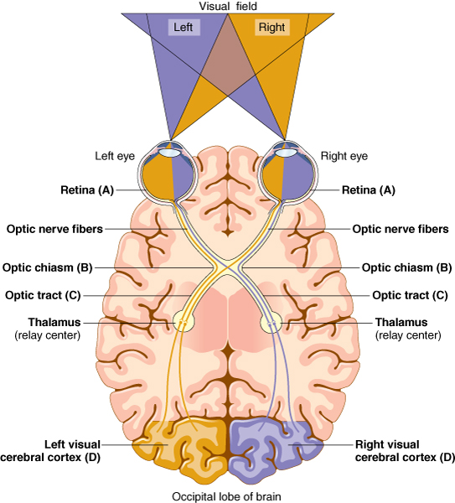
Visual Pathways from Retina to Cortex
Notes:
Describe how light travels through the eye by following the pathways of the color coordinated tracts and visual fields.
What might happen if there are lesions in areas along the pathway leading to the right and left cerebral cortices?
Lesions of the cortical areas of the occipital lobe will likewise cause visual disturbance in the areas of the visual field where the information is normally interpreted by the brain.

Slide 11
QUICK QUIZ (Slide 1 of 3)
What is the soft, jellylike material behind the lens in the vitreous chamber that helps maintain the shape of the eyeball?
Sclera
Vitreous humor
Aqueous humor
Fovea centralis
Notes:
The correct answer is B: vitreous humor.

Slide 12
Vocabulary – The Eye (Slide 1 of 16)
Term
accommodation
anterior chamber
aqueous humor

Slide 13
Vocabulary – The Eye (Slide 2 of 16)
Term | Meaning/Definition
accommodation | Normal adjustment of the eye to focus on objects from far to near
anterior chamber | The area behind the cornea and in front of the lens and iris
aqueous humor | Fluid produced by the ciliary body and found in anterior chamber

Slide 14
Vocabulary – The Eye (Slide 3 of 16)
Term
biconvex
choroid
ciliary body

Slide 15
Vocabulary – The Eye (Slide 4 of 16)
Term | Meaning/Definition
biconvex | Consisting of two surfaces that are rounded, elevated, and curved evenly; lens of the eye is biconvex
choroid | Middle, vascular layer of the eye, between the retina and the sclera
ciliary body | Structure surrounding the lens that connects the choroid and iris; controls shape of lens and secretes aqueous humor

Slide 16
Vocabulary – The Eye (Slide 5 of 16)
Term
cone
conjunctiva
cornea

Slide 17
Vocabulary – The Eye (Slide 6 of 16)
Term | Meaning/Definition
cone | Photoreceptor cell in the retina that transforms light energy into a nerve impulse; responsible for color and central vision
conjunctiva | Delicate membrane that lines the undersurface of eyelids and covers anterior eyeball
cornea | Fibrous transparent layer of clear tissue that extends over the anterior portion of eyeball

Slide 18
Vocabulary – The Eye (Slide 7 of 16)
Term
fovea centralis
fundus of the eye
iris

Slide 19
Vocabulary – The Eye (Slide 8 of 16)
Term | Meaning/Definition
fovea centralis | Tiny depression in the retina that is the region of clearest vision
fundus of the eye | Posterior, inner part of the eye
iris | Pigmented layer that opens and closes to allow more or less light into the eye

Slide 20
Vocabulary – The Eye (Slide 9 of 16)
Term
lens
macula
optic chiasm

Slide 21
Vocabulary – The Eye (Slide 10 of 16)
Term | Meaning/Definition
lens | Transparent, biconvex body behind the pupil of the eye
macula | Yellowish region on the retina lateral to and slightly below the optic disc
optic chiasm | The point at which optic nerve fibers cross in the brain

Slide 22
Vocabulary – The Eye (Slide 11 of 16)
Term
optic disc
optic nerve
pupil

Slide 23
Vocabulary – The Eye (Slide 12 of 16)
Term | Meaning/Definition
optic disc | The region at the back of the eye where the optic nerve meets the retina; blind spot
optic nerve | Cranial nerve carrying impulses from the retina to the brain
pupil | Central opening of the eye, surrounded by the iris, through which light rays pass

Slide 24
Vocabulary – The Eye (Slide 13 of 16)
Term
refraction
retina
rod

Slide 25
Vocabulary – The Eye (Slide 14 of 16)
Term | Meaning/Definition
refraction | Bending of light rays by the cornea, lens, and fluids of the eye to bring the rays into focus on the retina
retina | Light-sensitive nerve cell layer of the eye containing photoreceptor cells
rod | Photoreceptor cell of retina essential for vision in dim light and for peripheral vision

Slide 26
Vocabulary – The Eye (Slide 15 of 16)
Term
sclera
thalamus
vitreous humor

Slide 27
Vocabulary – The Eye (Slide 16 of 16)
Term | Meaning/Definition
sclera | Tough, white outer coat of the eyeball
thalamus | Relay center of the brain
vitreous humor | Soft, jelly-like material behind the lens in the vitreous chamber

Slide 28
Terminology – Structures and Fluids (Slide 1 of 4)
Combining Form | Meaning
aque/o | water
blephar/o | eyelid
conjunctiv/o | conjunctiva
cor/o | pupil
corne/o | cornea
cycl/o | ciliary body

Slide 29
Terminology – Structures and Fluids (Slide 2 of 4)
Combining Form | Meaning
dacry/o | tears, tear duct
ir/o | iris
irid/o | iris
kerat/o | cornea
lacrim/o | tears
ocul/o | eye

Slide 30
Terminology – Structures and Fluids (Slide 3 of 4)
Combining Form | Meaning
ophthalm/o | eye
opt/o | eye, vision
optic/o | eye, vision
palpebr/o | eyelid
papill/o | optic disc
phac/o | lens of the eye

Slide 31
Terminology – Structures and Fluids (Slide 4 of 4)
Combining Form | Meaning
phak/o | lens of the eye
pupill/o | pupil
retin/o | retina
scler/o | sclera (white of the eye)
uve/o | uvea
vitre/o | glassy

Slide 32
Terminology – Conditions (Slide 1 of 2)
Combining Form | Meaning
ambly/o | dull, dim
dipl/o | double
glauc/o | gray
mi/o | smaller, less
mydr/o | widen, enlarge
nyct/o | night

Slide 33
Terminology – Conditions (Slide 2 of 2)
Combining Form | Meaning
phot/o | light
presby/o | old age
scot/o | darkness
xer/o | dry

Slide 34
Terminology – Suffixes--Conditions
Suffix | Meaning
-opia | vision
-opsia | vision
-tropia | to turn

Slide 35
QUICK QUIZ (Slide 2 of 3)
Which term means inflammation of the eyelid?
Ophthalmoplegia
Keratitis
Blepharitis
Blepharoptosis
Notes:
The correct answer is C: blepharitis.

Slide 36
Errors of Refraction (Slide 1 of 2)
Astigmatism: defective curvature of the cornea or lens of the eye
Hyperopia: farsightedness
Myopia: nearsightedness
Presbyopia: impairment of vision due to old age reducing lens accommodation
Notes:
Do any of the students have any of these conditions? What are the causes?
How are these conditions corrected? (The following slide provides images of the errors and the correction.)
What is lens accommodation? (The refractory adjustment resulting when the muscles of the ciliary body produce flattening of the lens [for distant vision] and thickening and rounding [for close vision].)

Slide 37
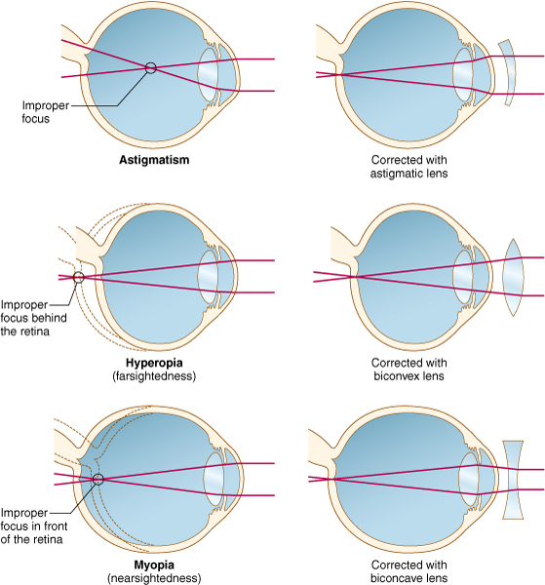
Errors of Refraction (Slide 2 of 2)
Notes:
The dashed lines indicate the contour and size of the normal eye.
What error of refraction is associated with presbyopia? (An inability to adjust the lens for accommodation to near vision)

Slide 38
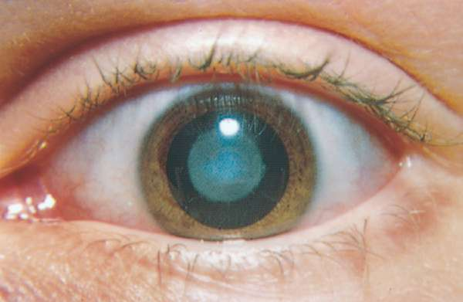
Abnormal Conditions (Slide 1 of 6) Cataract: Clouding of the Lens
Notes:
What is the surgical treatment for cataracts? How can vision be corrected in this process?
Surgical removal of the lens and implantation of an artificial lens behind the iris are treatments for cataracts.
If surgery isn’t possible, are there other treatments?
If an intraocular lens cannot be inserted, the patient may wear eyeglasses or contact lenses to help refraction.

Slide 39
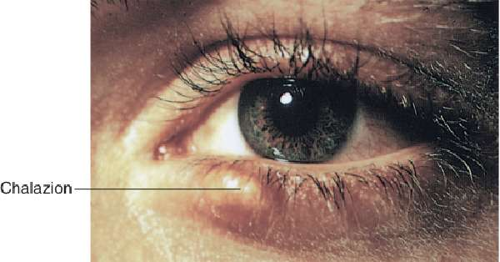
Abnormal Conditions (Slide 2 of 6)
Chalazion: a small, hard, cystic mass on the eyelid; formed as a result of chronic inflammation of sebaceous gland along margin of eyelid
Notes:
What is the treatment for this condition?
Chalazions often require incision and drainage.
Besides chalazion, what are some of the other eyelid abnormalities?

Slide 40
Abnormal Conditions (Slide 3 of 6)
Diabetic retinopathy: retinal effects caused by diabetes mellitus include:
Microaneurysms
Hemorrhages
Dilation of retinal veins
Neovascularization
Notes:
What is a treatment for diabetic retinopathy?
For severe hemorrhaging, laser photocoagulation and vitrectomy are helpful.
What is neovascularization?
An Internet search will lead to multiple sites focused on diabetes and vision.

Slide 41
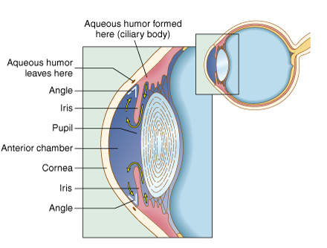
Abnormal Conditions (Slide 4 of 6)
Glaucoma: increased intraocular pressure damages the retina and optic nerve
Notes:
Discuss the many forms of glaucoma.
Do most people have glaucoma in one eye or both eyes? Why?
If a patient has glaucoma in one eye, what is the likely cause? What is the likely treatment?
What is tonometry?
Tonometry measures intraocular pressure to detect glaucoma.

Slide 42
Abnormal Conditions (Slide 5 of 6)
Hordeolum (stye): staph infection of a sebaceous gland in the eyelid
Macular degeneration: progressive damage to the macular of the retina
Nystagmus: repetitive rhythmic movements of one or both eyes
Strabismus: abnormal deviation of the eye
Notes:
Discuss the location of the retina and macula.
Which form of macular degeneration (dry or wet) has a better prognosis and possible treatment?
Why is it important to treat strabismus in early childhood?

Slide 43
Abnormal Conditions (Slide 6 of 6)
Retinal detachment: two layers of the retina separate from each other
Photopsia: bright flashes of light
Floaters: vitreous clumps of retina
Scleral buckle: a belt used to buckle the retina to the sclera
Pneumatic retinopexy: a gas bubble is injected in vitreous cavity to help reattach the retina
Notes:
What are the symptoms, causes, and treatments for retinal detachments?

Slide 44
Chapter 17 Lesson 17.2

Slide 45
Diagnostic Procedures (Slide 1 of 3)
Fluorescein angiography: dye injection to examine blood flow in the retina
Ophthalmoscopy: visual examination of the interior of the eye through dilated pupil
Slit lamp microscopy: magnified view of expanded number of eye structures
Notes:
Ask students to name conditions that are diagnosed by the tests listed.
What type of eyedrop dilates the pupil? (Mydriatic)

Slide 46
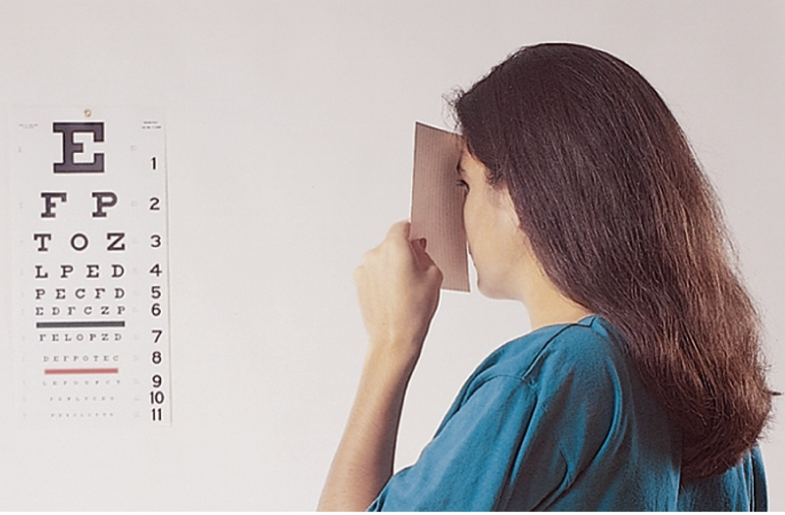
Diagnostic Procedures (Slide 2 of 3)
Visual acuity test: assesses clarity of vision
Notes:
How is the Snellen chart used?
How is the ratio that describes visual acuity interpreted?
Have students perform the visual acuity test on each other.

Slide 47
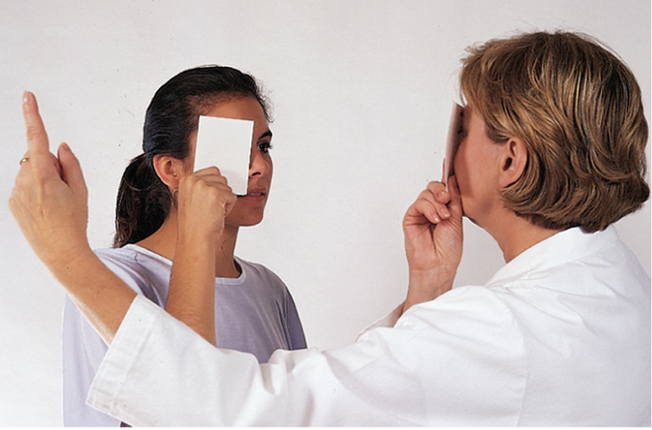
Diagnostic Procedures (Slide 3 of 3)
Visual field test: measures visual fields when eyes are fixed forward
Notes:
Have students take the visual field test in class (noted in lesson plan).
Are students surprised by the results of the test? Why or why not?

Slide 48
Treatment (Slide 1 of 4)
Enucleation: removal of the entire eyeball
Laser photocoagulation: an argon laser creates an inflammatory reaction that seals retinal tears and leaky blood vessels
LASIK: laser to correct errors of refraction by sculpting the cornea
Notes:
LASIK is an acronym for laser in situ keratomileusis (shaping of the cornea).
Why can’t LASIK correct presbyopia?

Slide 49
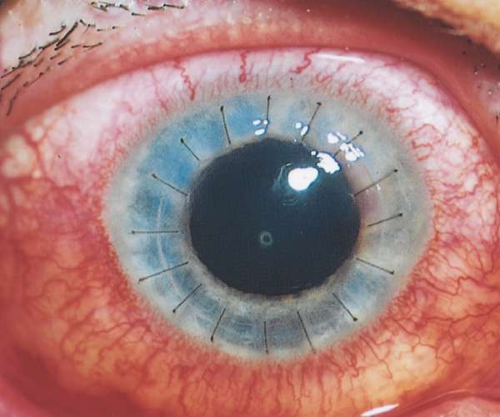
Treatment (Slide 2 of 4)
Keratoplasty: surgical repair of the cornea
Notes:
Keratoplasty: Also known as corneal transplant, the patient’s scarred or opaque cornea is replaced with a donor cornea.
Why does this procedure have such a high success rate compared to other transplants?

Slide 50
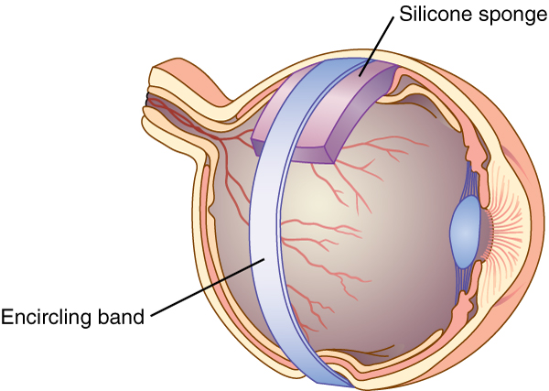
Treatment (Slide 3 of 4)
Scleral buckle: suture of a silicone band to the sclera over the detached portion of retina
Notes:
In this procedure, the band pushes the two parts of the retina against each other to bring together the two layers of the detached retina.

Slide 51
Treatment (Slide 4 of 4)
Phacoemulsification: ultrasound to break up lens for aspiration for cataract removal
Vitrectomy: removal of vitreous and replacement with a clear solution
Notes:
What sorts of conditions use these treatments?
Are they successful in curing both the symptoms and the cause?

Slide 52
Abbreviations – The Eye (Slide 1 of 2)
Abbreviation | Meaning
ALT | Argon laser trabeculoplasty
AMD | Age-related macular degeneration
HEENT | Head, eyes, ears, nose, and throat
IOL | Intraocular lens
IOP | Intraocular pressure
LASER | light amplification by stimulated emission of radiation
LASIK | Laser in situ keratomileusis
OD | Right eye; doctor or optometry
OS | Left eye
OU | Both eyes

Slide 53
Abbreviations – The Eye (Slide 2 of 2)
Abbreviation | Meaning
PERRLA | Pupils equal, round, reactive to light and accommodation
POAG | Primary, open-angle glaucoma
PRK | Photorefractive keratectomy
SLT | Selective laser trabeculoplasty
VA | Visual acuity
VF | Visual field

Slide 54
Chapter 17 Lesson 17.3

Slide 55
The Ear
ANATOMY AND PHYSIOLOGY
The outer ear receives sound waves.
Sound waves travel to the middle ear.
Sound vibrations reach the inner ear (labyrinth).
Notes:
Name the three bones in the middle ear that move in response to vibrations of the tympanic membrane? (Malleus, incus, stapes)
What is another name for the inner ear, and why is it referred to by this name? (It is called the labyrinth due to its circular, mazelike structure.)
What is the name of the bony, snail-shaped structure of the inner ear? (Cochlea)
In addition to being the organ for hearing, what other important function is performed by the ear? (Equilibrium)

Slide 56
Anatomy of the Ear (Slide 1 of 2)
Pinna (auricle)
External auditory meatus (auditory canal)
Tympanic membrane (eardrum)
Malleus
Incus
Stapes
Oval window
Eustachian tube
Cochlea
Auditory nerve fibers
Vestibule
Semicircular canals

Slide 57
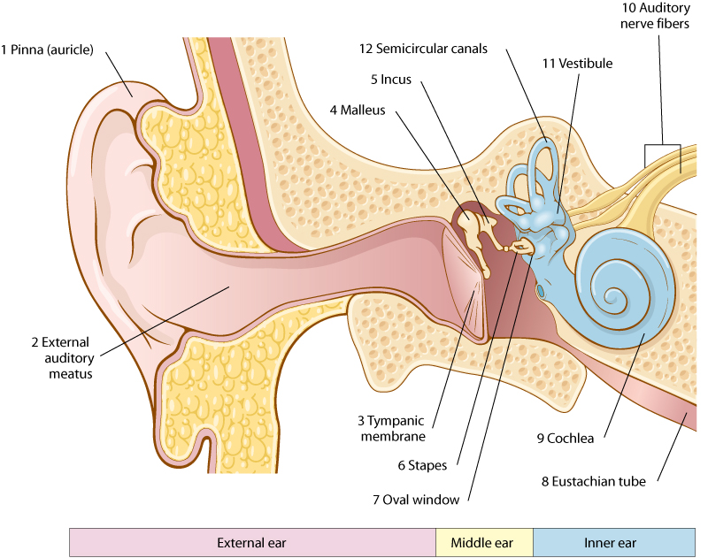
Anatomy of the Ear (Slide 2 of 2)

Slide 58
Ear Anatomy and Physiology (Slide 1 of 4)
Outer ear
Pinna or auricle: projecting flap
External auditory meatus (auditory canal)
Notes:
The external auditory meatus is lined with numerous cerumen glands that produce a waxy substance that lubricates and protects the ear.
Which part of the ear is most often pierced?

Slide 59
Ear Anatomy and Physiology (Slide 2 of 4)
Middle ear
Tympanic membrane (eardrum)
Malleus
Incus
Stapes
Oval window
Eustachian tube
Notes:
How do these structures contribute to vibration?
Why are they susceptible to infection?
Why do conditions that affect the respiratory system also affect these structures?
The malleus, incus, and stapes make up the ossicles.

Slide 60
Ear Anatomy and Physiology (Slide 3 of 4)
Inner ear: labyrinth
Cochlea
Auditory nerve fibers
Notes:
The oval window separates the middle and inner ear.
The cochlea contains perilymph and endolymph through which vibrations travel.
The cochlea also contains the organ of Corti in which tiny hair cells receive vibrations from the auditory liquids and relay the sound waves to the auditory nerve fibers.

Slide 61
Ear Anatomy and Physiology (Slide 4 of 4)
Balance and equilibrium
Vestibule
Semicircular canals
Notes:
The semicircular canals contain the saccule and utricle.
The canals contain endolymph and hair cells.
Fluid and hair cells fluctuate in response to movement of the head. This information is transmitted through nerve fibers to the brain.
The brain sends information to the body’s muscles to maintain equilibrium.

Slide 62
Vocabulary – The Ear (Slide 1 of 14)
Term
auditory canal
auditory meatus
auditory nerve fibers

Slide 63
Vocabulary – The Ear (Slide 2 of 14)
Term | Meaning/Definition
auditory canal | Channel that leads from the pinna to the eardrum
auditory meatus | Auditory canal
auditory nerve fibers | Carry impulses from the inner ear to the brain

Slide 64
Vocabulary – The Ear (Slide 3 of 14)
Term
auditory tube
auricle
cerumen

Slide 65
Vocabulary – The Ear (Slide 4 of 14)
Term | Meaning/Definition
auditory tube | Channel between the middle ear and nasopharynx; eustachian tube
auricle | Flap of the ear; protruding part of external ear, or pinna
cerumen | Waxy substance secreted by the external ear; also called earwax

Slide 66
Vocabulary – The Ear (Slide 5 of 14)
Term
cochlea
endolymph
eustachian tube

Slide 67
Vocabulary – The Ear (Slide 6 of 14)
Term | Meaning/Definition
cochlea | Snail-shaped, spirally wound tube in the inner ear
endolymph | Fluid within the labyrinth of the inner ear
eustachian tube | Auditory tube

Slide 68
Vocabulary – The Ear (Slide 7 of 14)
Term
incus
labyrinth
malleus

Slide 69
Vocabulary – The Ear (Slide 8 of 14)
Term | Meaning/Definition
incus | Second ossicle of the middle ear
labyrinth | Maze-like series of canals of the inner ear
malleus | First ossicle of the middle ear

Slide 70
Vocabulary – The Ear (Slide 9 of 14)
Term
organ of Corti
ossicle
oval window

Slide 71
Vocabulary – The Ear (Slide 10 of 14)
Term | Meaning/Definition
organ of Corti | Sensitive auditory receptor area found in the cochlea of the inner ear
ossicle | Small bone of the ear
oval window | Membrane between the middle ear and the inner ear

Slide 72
Vocabulary – The Ear (Slide 11 of 14)
Term
perilymph
pinna
semicircular canals

Slide 73
Vocabulary – The Ear (Slide 12 of 14)
Term | Meaning/Definition
perilymph | Fluid contained in the labyrinth of the inner ear
pinna | Auricle; flap of the ear
semicircular canals | Passages in the inner ear associated with maintaining equilibrium

Slide 74
Vocabulary – The Ear (Slide 13 of 14)
Term
stapes
tympanic membrane
vestibule

Slide 75
Vocabulary – The Ear (Slide 14 of 14)
Term | Meaning/Definition
stapes | Third ossicle of the middle ear
tympanic membrane | Membrane between the outer and the middle ear; eardrum
vestibule | Central cavity of the labyrinth, connecting the semicircular canals and the cochlea

Slide 76
QUICK QUIZ (Slide 3 of 3)
What is the snail-shaped, spirally wound tube in the inner ear that contains hearing-sensitive receptor cells?
Pinna
Auricle
Ossicle
Cochlea
Notes:
The correct answer is D: cochlea.

Slide 77
Combining Forms Ear Terminology (Slide 1 of 2)
Combining Form | Meaning
acous/o | hearing
audi/o | hearing
audit/o | hearing
aur/o | ear
auricul/o | ear
cochle/o | cochlea
mastoid/o | mastoid process

Slide 78
Combining Forms Ear – Terminology (Slide 2 of 2)
Combining Form | Meaning
myring/o | eardrum, tympanic membrane
ossicul/o | ossicle
ot/o | ear
salping/o | Eustachian tube
staped/o | stapes
tyman/o | eardrum, tympanic membrane
vestibul/o | vestibule

Slide 79
Terminology Ear- Suffixes (Slide 1 of 1)
Suffix | Meaning
-acusis or-cusis | hearing
-meter | instrument for measure
-otia | ear condition

Slide 80
Symptoms and Pathologic Conditions (Slide 1 of 3)
Acoustic neuroma: benign tumor arising from 8th cranial nerve, causes tinnitus, vertigo, dizziness, and decreased hearing
Cholesteatoma: skin cells and cholesterol in a sac in the middle ear (cyst-like mass associated with chronic infections)
Deafness: loss of ability to hear
Notes:
Why can surgery for acoustic neuroma lead to deafness and facial paralysis?
Nerve deafness (sensorineural hearing loss) results from impairment of the cochlea or auditory nerve.
What constitutes conductive deafness? (It results from impairment of the middle ear ossicles and membranes transmitting sound waves into the cochlea.)

Slide 81
Symptoms and Pathologic Conditions (Slide 2 of 3)
Ménière disease: disorder of the labyrinth with elevated endolymph pressure in the cochlea and semicircular canals causing tinnitus, sensitivity to sound, progressive hearing loss, headache, nausea, and vertigo
Otitis media: inflammation of the middle ear
Otosclerosis: hardening of bony tissue in the labyrinth
Notes:
Why does fixation of the stapes bone cause deafness? What is the current therapy for this condition?
What is the current therapy for Ménière disease? How effective is the therapy?
Why do doctors put tubes in the ears?
What is the proper term for a surgical incision in the tympanic membrane and the insertion of a draining tube device?
Why does the anatomical structure of the Eustachian tube in children make them more susceptible to otitis media?

Slide 82
Symptoms and Pathologic Conditions (Slide 3 of 3)
Tinnitus: sensation of noises (ringing, buzzing, whistling, booming) in the ears
Vertigo: sensation of irregular motion (whirling) from disease of the inner ear or nerve carrying messages from the semicircular canals
Notes:
Ask students to make some quick head movements and ask if any students are experiencing vertigo.
What sorts of situations induce vertigo (for example, rides at amusement parks, ear infections, elevator rides, and so on)? Does the vertigo described in these situations stem from the wrong message being carried by the vestibular nerve or from movement of the fluids in the semicircular canals?

Slide 83
Clinical Procedures (Slide 1 of 2)
Audiometry: an audiometer is an electric device used to determine hearing loss by frequency
Cochlear implant: a surgically implanted device that allows sensorineural hearing-impaired persons to understand speech
Ear thermometry: body temperature measured with infrared radiation from the eardrum
Notes:
How is audiometry performed?
With a cochlear implant, a small computer converts sound waves to electronic impulses that stimulate nerve fibers in ears.
What types of pathologies might require a cochlear implant for treatment?

Slide 84
Clinical Procedures (Slide 2 of 2)
Otoscopy: visual examination of the ear with a small, hand-held scope
Tuning fork test: hearing tests using a vibrating fork
Rinne: fork is place against the mastoid bone (bone conduction) and in front of the auditory meatus (air conduction)
Weber: fork is placed on the center of the forehead; normal hearing has equal loudness in both ears
Notes:
Obtain tuning forks and ask students to perform the Rinne and Weber tests on each other.
Obtain ear and oral thermometers. Ask students to compare their temperatures using both methods.
Is there a difference between the methods? If so, why?

Slide 85
Abbreviations – The Ear
Abbreviation | Meaning
AD | Right ear
AOM | Acute otitis media
AS | Left ear
EENT | Eyes, ears, nose, and throat
ENG | Electronystagmography
ENT | Ears, nose, and throat
ETD | Eustachian tube dysfunction
HEENT | Head, eyes, ears, nose, and throat
PE tube | Pressure-equalizing tube
SOM | Serous otitis media

Slide 86
Review Sheet – Combining Forms (Slide 1 of 14)
Combining Form
acous/o
ambly/o
aque/o
audi/o
audit/o
aur/o

Slide 87
Review Sheet – Combining Forms (Slide 2 of 14)
Combining Form | Meaning
acous/o | hearing
ambly/o | dull, dim
aque/o | water
audi/o | hearing
audit/o | hearing
aur/o | ear

Slide 88
Review Sheet – Combining Forms (Slide 3 of 14)
Combining Form
auricul/o
blephar/o
conjunctiv/o
cor/o
corne/o
cycl/o

Slide 89
Review Sheet – Combining Forms (Slide 4 of 14)
Combining Form | Meaning
auricul/o | ear
blephar/o | eyelid
conjunctiv/o | conjunctiva
cor/o | pupil
corne/o | cornea
cycl/o | ciliary body

Slide 90
Review Sheet – Combining Forms (Slide 5 of 14)
Combining Form
dacry/o
dipl/o
glauc/o
ir/o
irid/o
kerat/o
lacrim/o

Slide 91
Review Sheet – Combining Forms (Slide 6 of 14)
Combining Form | Meaning
dacry/o | tears
dipl/o | double
glauc/o | gray
ir/o | iris
irid/o | iris
kerat/o | cornea
lacrim/o | tears

Slide 92
Review Sheet – Combining Forms (Slide 7 of 14)
Combining Form
mastoid/o
mi/o
mydr/o
myring/o
nyct/o
ocul/o

Slide 93
Review Sheet – Combining Forms (Slide 8 of 14)
Combining Form | Meaning
mastoid/o | mastoid process
mi/o | smaller, less
mydr/o | widen, enlarge
myring/o | eardrum
nyct/o | night
ocul/o | eye

Slide 94
Review Sheet – Combining Forms (Slide 9 of 14)
Combining Form
ophthalm/o
opt/o
optic/o
ossicul/o
palpebr/o
papill/o
phac/o

Slide 95
Review Sheet – Combining Forms (Slide 10 of 14)
Combining Form | Meaning
ophthalm/o | eye
opt/o | eye
optic/o | eye
ossicul/o | ossicle
palpebr/o | eyelid
papill/o | optic disc
phac/o | lens of the eye

Slide 96
Review Sheet – Combining Forms (Slide 11 of 14)
Combining Form
phak/o
phot/o
presby/o
pupill/o
retin/o
salpin/o
scler/o

Slide 97
Review Sheet – Combining Forms (Slide 12 of 14)
Combining Form | Meaning
phak/o | lens of the eye
phot/o | light
presby/o | old age
pupill/o | pupil
retin/o | retina
salpin/o | Eustachian tube
scler/o | sclera (white of eye)

Slide 98
Review Sheet – Combining Forms (Slide 13 of 14)
Combining Form
scot/o
staped/o
tympan/o
uve/o
vestibul/o
vitre/o
xer/o

Slide 99
Review Sheet – Combining Forms (Slide 14 of 14)
Combining Form | Meaning
scot/o | darkness
staped/o | stapes
tympan/o | eardrum
uve/o | uvea
vestibul/o | vestibule
vitre/o | glassy
xer/o | dry

Slide 100
Review Sheet – Suffixes (Slide 1 of 4)
Suffix
-acusis
-cusis
-meter
-metry
-opia

Slide 101
Review Sheet – Suffixes (Slide 2 of 4)
Suffix | Meaning
-acusis | hearing
-cusis | hearing
-meter | instrument for measure
-metry | process of measurement
-opia | vision

Slide 102
Review Sheet – Suffixes (Slide 3 of 4)
Suffix
-opsia
-otia
-phobia
-plegic
-tropia

Slide 103
Review Sheet – Suffixes (Slide 4 of 4)
Suffix | Meaning
-opsia | vision
-otia | ear condition
-phobia | fear
-plegic | paralysis; palsy
-tropia | to turn

