Slide 1
The Language of Medicine 13th edition
Davi-Ellen Chabner

Slide 2
Chapter 18 Endocrine System

Slide 3
Chapter Goals (Slide 1 of 2)
Identify the endocrine glands and their hormones.
Gain an understanding of the functions of these hormones in the body.
Analyze medical terms related to the endocrine glands and their hormones.

Slide 4
Chapter Goals (Slide 2 of 2)
Identify abnormal conditions resulting from excessive and deficient secretions of the endocrine glands.
Describe laboratory tests and clinical procedures related to endocrinology, and recognize relevant abbreviations.
Apply your new knowledge to understanding medical terms in their proper contexts, such as medical reports and records.

Slide 5
Chapter 18 Lesson 18.1

Slide 6
Introduction Endocrine System (Slide 1 of 2)
Glands release hormones.
Hormones regulate the many and varied functions of an organism.
Hormones bind to receptors.
Receptors are recognition sites in the various target tissues on which hormones act.

Slide 7
Introduction Endocrine System (Slide 2 of 2)
ENDOCRINE glands—
Secrete their hormones directly into the bloodstream
EXOCRINE glands—
Send chemical substances (tears, sweat, milk, saliva) via ducts to the outside of the body

Slide 8
Endocrine Glands
Thyroid gland
Parathyroid glands (four glands)
Adrenal glands (one pair)
Pancreas (islets of Langerhans)
Pituitary gland
Ovaries (one pair)
Testes (one pair)
Pineal gland
Notes:
How are endocrine glands different from exocrine glands?
Endocrine glands secrete hormones directly into the bloodstream; exocrine glands send their chemical substances into ducts and out of the body.

Slide 9
The Endocrine System
Exocrine glands include the following:
Thyroid gland
Parathroid glands (four glands)
Adrenal glands (one pair)
Pancreas (islet of Langerhans)
Pituitary gland
Ovaries in female (one pair)
Testes in male (one pair)
Pineal gland
Notes:
Ask students to label the figure.

Slide 10
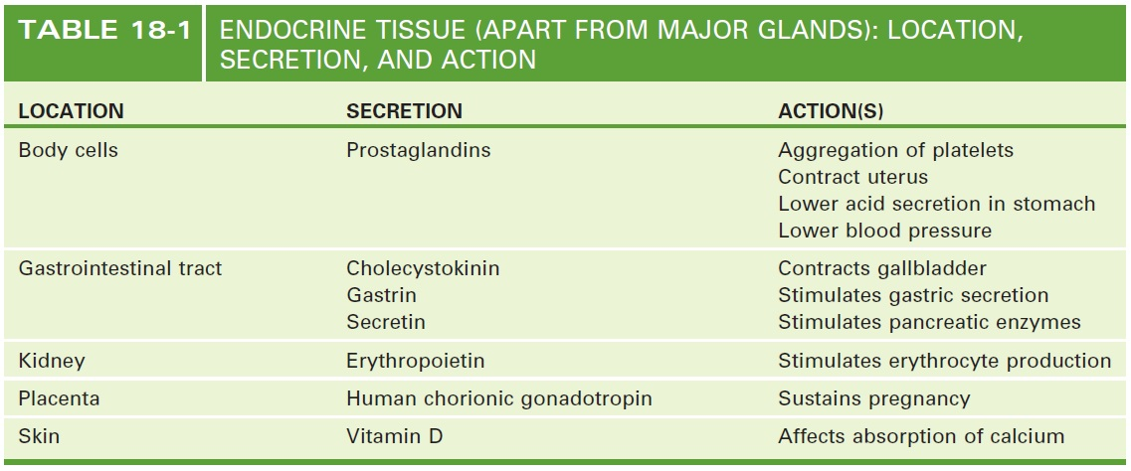
Endocrine Tissue (Not including major glands)
Notes:
Identify other locations (tissues) in the body that secrete hormones apart from the major glands.
Hormones are secreted from endocrine tissue throughout the body. These hormones play an important role in body functions and they should not be understated or ignored just because they are produced by cells in organs that are not endocrine.
Many of these organs have both endocrine and exocrine functions, and should be examined by students who later report their findings to the class.

Slide 11
Thyroid Gland (Slide 1 of 2)
Anatomical structures of the thyroid gland:
Thyroid
Trachea
Thyroid cartilage
Isthmus
Notes:
Right and left lobes are located on either side of the trachea.
Thyroid cartilage produces the “Adam’s apple.”
An isthmus connects the two lobes.

Slide 12
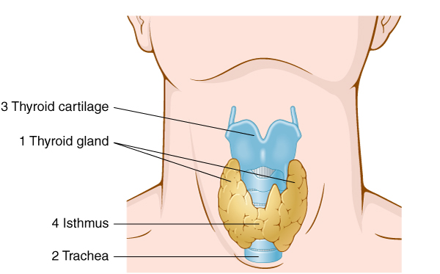
Thyroid Gland (Slide 2 of 2)
Notes:
Right and left lobes are located on either side of the trachea.
Thyroid cartilage produces the “Adam’s apple.”
An isthmus connects the two lobes.

Slide 13
Thyroid Function
There are two hormones:
Thyroxine or tetraiodothyronine (T₄)
Triiodothyronine (T₃).
Thyroid hormones aid cells in their uptake of oxygen and regulate metabolic rate.
Calcitonin: stimulates calcium to leave the blood and enter the bone.
Notes:
What are some of the hormones secreted by the thyroid gland?

Slide 14
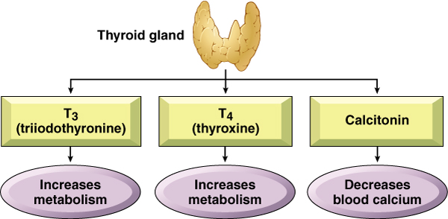
Thyroid Gland: Hormones and Actions
Notes:
What are some of the hormones secreted by the thyroid gland?

Slide 15
Parathyroid Glands (Slide 1 of 3)
Parathyroid glands are four small oval bodies located on the dorsal aspect of the thyroid gland.
Notes:
What are some of the hormones secreted by the thyroid gland?

Slide 16
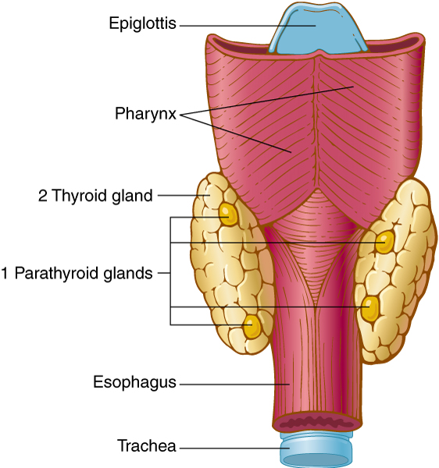
Parathyroid Glands (Slide 2 of 3)
Notes:
What are some of the hormones secreted by the thyroid gland?

Slide 17
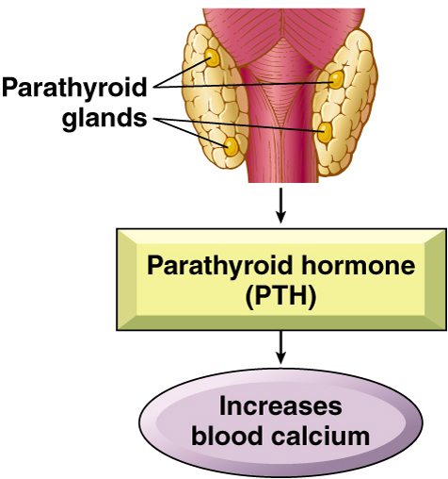
Parathyroid Glands (slide 3 of 3)
Notes:
Four glands located in the dorsal aspect of the thyroid gland.
What hormone is secreted by the parathyroid glands? What role does it play in regulating the level of calcium in the blood?

Slide 18
Parathyroid Function
Parathyroid hormone (PTH): causes calcium to mobilize from bones into the bloodstream
Notes:
How is the adjustment of the level of calcium in the blood a good example of the way hormones control the homeostasis of the body?

Slide 19
Adrenal Glands (Slide 1 of 2)
Adrenal glands are located on top of each kidney. Each gland consists of two parts:
Adrenal cortex (outer portion)
Adrenal medulla (inner portion)
Notes:
Two small glands: one on top of each kidney

Slide 20
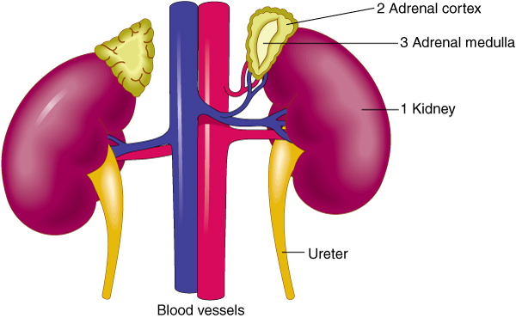
Adrenal Glands (Slide 2 of 2)
Notes:
Two small glands: one on top of each kidney

Slide 21
Adrenal Glands: Location and Structure
Each gland has two parts
An outer portion, the adrenal cortex
Secretes corticosteriods or steriods, chemicals derived from cholesterol
An inner portion, adrenal medulla
Secretes catecholamines
chemicals derived from amino acids

Slide 22
Function: Adrenal Cortex Secretes
Glucocorticoids: influence metabolism of sugars, fats, and proteins (cortisol) and are anti-inflammatory (cortisone). Influences—SUGAR
Mineralocorticoids: regulate electrolytes
Aldosterone: reabsorption of sodium/excretion of potassium. Influences—SALT
Sex Hormones: androgens (testosterone) and estrogens influence secondary sex characteristics
Notes:
What are the three types of corticosteroids secreted by the adrenal cortex?
Glucocorticoids: influence metabolism of sugars, fats, and proteins. Antiinflammatory efffect.
Mineralocorticoids: regulate the level of mineral salts (electrolytes) in the body.
Sex Hormones: androgends and estrogens influence secondary sex characteristics such as pubic and axillary hair.

Slide 23
Function: Adrenal Medulla Secretes
Two types of catecholamine hormones
Epinephrine (adrenaline): increases heart rate and blood pressure, dilates bronchial tubes, releases glucose from storage
Norepinephrine (noradrenaline): constricts vessels to raise blood pressure
Both are sympathomimetic agents.
Notes:
What are two types of catecholamine secreted by the adrenal medulla?
Epinephrine: increases cardiac rate, dilates bronchial tubes, stimulates glucose production.
Norepinephrine: constricts vessels, raises blood pressure.

Slide 24
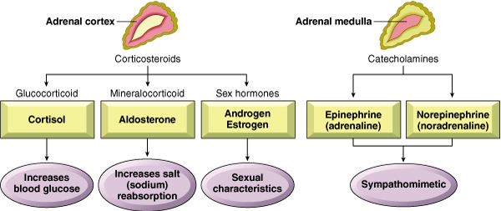
The Adrenal Cortex and Adrenal Medulla

Slide 25
Pancreas
Located near and partially behind the stomach
Exocrine and endocrine organ
Notes:
The endocrine tissue of the pancreas consists of hormone-producing cells: islets of Langerhans.
Most of the pancreas consists of exocrine cells that secrete digestive enzymes.
What percent of the pancreas consists of exocrine cells? (98%)

Slide 26
Pancreas Function (Slide 1 of 2)
Endocrine function
Islets of Langerhans produce:
Insulin: promotes movement of glucose into cells and promotes storage as glycogen
Glucagon: promotes movement of glucose into the blood by breaking down glycogen stored in liver cells
Notes:
How is the movement of glucose out of the blood and into cells promoted by insulin?
How is the movement of glucose into the blood promoted by glucagon?

Slide 27
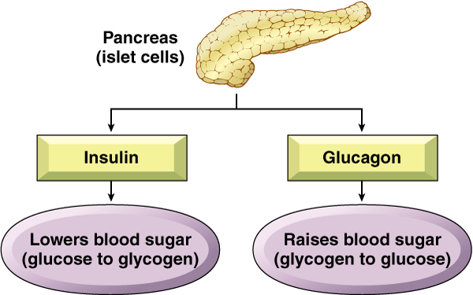
Pancreas Function (Slide 2 of 2)
Notes:
How is the movement of glucose out of the blood and into cells promoted by insulin?
How is the movement of glucose into the blood promoted by glucagon?

Slide 28
Chapter 18 Lesson 18.2

Slide 29
Pituitary Gland (Slide 1 of 3)
Pea-sized gland in depression of skull (sella turcica) also called the hypophysis
Anterior lobe (adenohypophysis)
Posterior lobe (neurohypophysis)
Hypothalamus controls secretions of the pituitary via releasing factors (hormones)
Notes:
Describe the interactions between the hypothalamus and the pituitary gland that control the secretions by the pituitary gland.

Slide 30
Pituitary Gland (Slide 2 of 3)
The pituitary gland consists of two distinct parts:
Anterior lobe or adenohypophysis
Posterior lobe or neurohypophysis

Slide 31
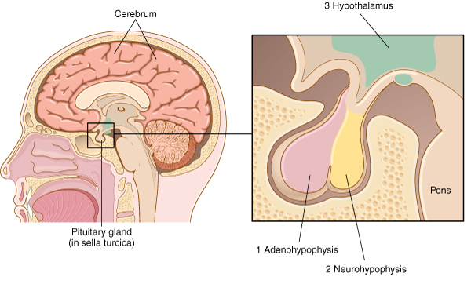
Pituitary Gland (Slide 3 of 3)

Slide 32
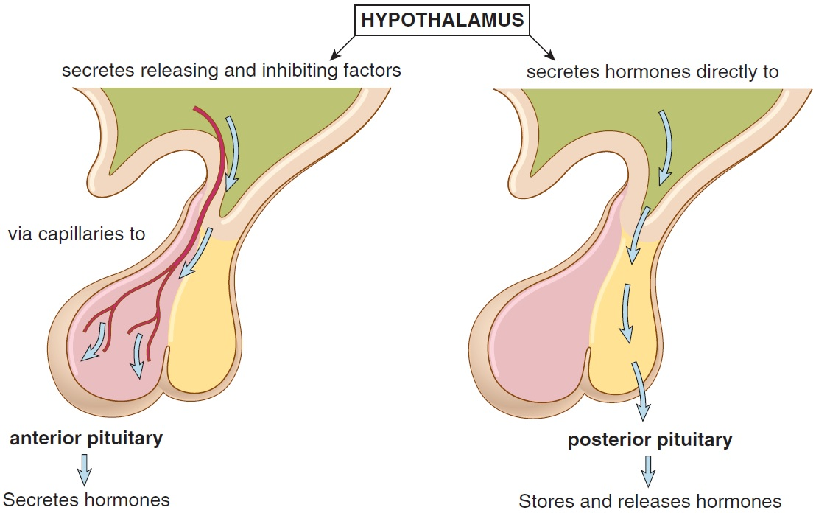
Relationship of the Hypothalamus to the Pituitary Gland

Slide 33
Pituitary Function (Slide 1 of 2)
Anterior pituitary
Growth hormone (GH) or somatotropin (STH)
Thyroid-stimulating hormone (TSH; thyrotropin)
Adrenocorticotropic hormone (ACTH)
Gonadotropic hormones (FSH, LH)
Prolactin (PRL)
Notes:
Go over the basic function of each of these hormones/factors.
Show where there is feedback inhibition.
Discuss how feedback from the targets regulates further release and the general concept of regulation.

Slide 34
Pituitary Function (Slide 2 of 2)
Posterior pituitary: stores and releases hormones synthesized in the hypothalamus
Antidiuretic hormone (ADH; vasopressin)
Oxytocin (OT)
Notes:
What are two important hormones released by the posterior pituitary gland?
Antidiuretic hormone (ADH) and oxytocin (OT)

Slide 35
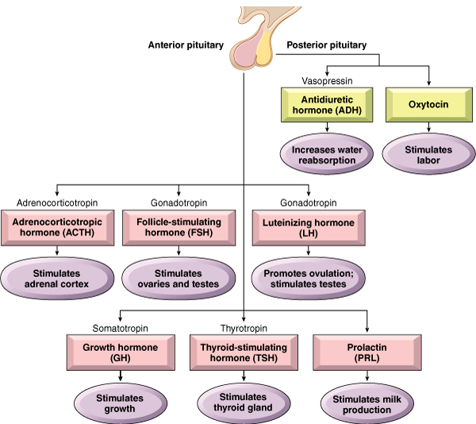
Pituitary Gland: Hormones and Actions

Slide 36
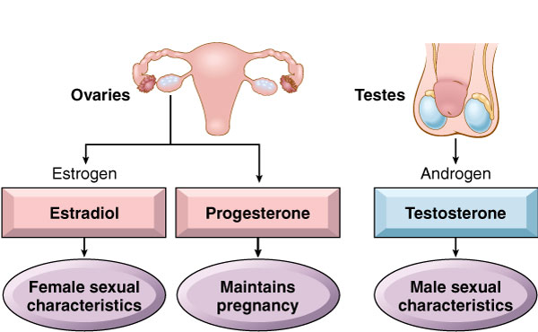
Ovaries and Testes: Hormones and Actions

Slide 37
Male Female
Testes
Hormone: testosterone
Maintains germ cell formation and secondary sexual characteristics
Ovaries
Hormones: estrogen and progesterone
Maintains menstrual cycle, release of ovum, secondary sexual characteristics, preparation of uterus for pregnancy
Notes:
Review the menstrual cycle and a graph of changes of levels of estrogen and progesterone during the cycle.
Describe how these hormones promote the ovulation and development of the uterus for potential pregnancy.

Slide 38
Vocabulary – Major Endocrine Glands (Slide 1 of 4)
Term
adrenal cortex
adrenal medulla
ovaries
pancreas

Slide 39
Vocabulary – Major Endocrine Glands (Slide 2 of 4)
Term | Meaning/Definition
adrenal cortex | Outer section of each adrenal gland; secretes cortisol, aldosterone, and sex hormones
adrenal medulla | Inner section of each adrenal gland; secretes epinephrine and norepinephrine
ovaries | Located in the lower abdomen of female; responsible for egg production and estrogen and progesterone secretion
pancreas | Located behind the stomach

Slide 40
Vocabulary – Major Endocrine Glands (Slide 3 of 4)
Term
parathyroid glands
pituitary gland (hypophysis)
testes
thyroid gland

Slide 41
Vocabulary – Major Endocrine Glands (Slide 4 of 4)
Term | Meaning/Definition
parathyroid glands | Four small glands on the posterior of the thyroid gland
pituitary gland (hypophysis) | Located at the base of brain in the sella turcica
testes | Two glands enclosed in the scrotal sac of a male; responsible for sperm production and testosterone secretion
thyroid gland | Located in the neck on either side of the trachea; secretes thyroxine, triiodothyronine, and calcitonin

Slide 42
Vocabulary – Hormones (Slide 1 of 14)
Term
adrenaline (epinephrine)
adrenocortico-tropic hormone (ACTH)
aldosterone
androgen

Slide 43
Vocabulary – Hormones (Slide 2 of 14)
Term | Meaning/Definition
adrenaline (epinephrine) | Secreted by the adrenal medulla; increases heart rate and blood pressure
adrenocortico-tropic hormone (ACTH) | Secreted by the anterior lobe of the pituitary gland; stimulates adrenal cortex
aldosterone | Secreted by the adrenal cortex; increases salt reabsorption
androgen | Male hormone secreted by the testes and adrenal cortex (to a lesser extent)

Slide 44
Vocabulary – Hormones (Slide 3 of 14)
Term
antidiuretic hormone (ADH)
calcitonin
cortisol
epinephrine (adrenaline)

Slide 45
Vocabulary – Hormones (Slide 4 of 14)
Term | Meaning/Definition
antidiuretic hormone (ADH) | Secreted by the posterior lobe of the pituitary gland; increases reabsorption of water by kidney
calcitonin | Secreted by the thyroid gland; decreases blood calcium levels
cortisol | Secreted by the adrenal cortex; increases blood sugar
epinephrine (adrenaline) | Secreted by the adrenal medulla; increases heart rate and blood pressure

Slide 46
Vocabulary – Hormones (Slide 5 of 14)
Term
estradiol
estrogen
follicle-stimulating hormone (FSH)
glucagons

Slide 47
Vocabulary – Hormones (Slide 6 of 14)
Term | Meaning/Definition
estradiol | Estrogen secreted by the ovaries
estrogen | Female hormone secreted by the ovaries and adrenal cortex (to lesser extent)
follicle-stimulating hormone (FSH) | Secreted by the anterior lobe of the pituitary gland; stimulates hormone secretion and egg production by ovaries and sperm production by testes
glucagons | Secreted by alpha islet cells of pancreas; increases blood sugar

Slide 48
Vocabulary – Hormones (Slide 7 of 14)
Term
growth hormone (GH); somatotropin
insulin
luteinizing hormone (LH)

Slide 49
Vocabulary – Hormones (Slide 8 of 14)
Term | Meaning/Definition
growth hormone (GH); somatotropin | Secreted by the anterior lobe of the pituitary gland; stimulates growth of bones and soft tissues
insulin | Secreted by beta islet cells of pancreas; helps glucose pass into cells and promotes conversion of glucose to glycogen
luteinizing hormone (LH) | Secreted by the anterior lobe of pituitary gland; stimulates ovulation in females and testosterone secretion in males

Slide 50
Vocabulary – Hormones (Slide 9 of 14)
Term
norepinephrine
oxytocin (OT)
parathormone (PTH)
progesterone

Slide 51
Vocabulary – Hormones (Slide 10 of 14)
Term | Meaning/Definition
norepinephrine | Secreted by the adrenal medulla; increases heart rate and blood pressure
oxytocin (OT) | Secreted by the posterior lobe of the pituitary gland; stimulates contraction of uterus during labor and childbirth
parathormone (PTH) | Secreted by parathyroid glands; increases blood calcium
progesterone | Secreted by the ovaries; prepares the uterus for pregnancy

Slide 52
Vocabulary – Hormones (Slide 11 of 14)
Term
prolactin (PRL)
somatotropin (STH)
testosterone
thyroid-stimulating hormone (TSH); thyrotropin

Slide 53
Vocabulary – Hormones (Slide 12 of 14)
Term | Meaning/Definition
prolactin (PRL) | Secreted by the anterior lobe of the pituitary gland; promotes milk secretion
somatotropin (STH) | Secreted by the anterior lobe of the pituitary gland; growth hormone
testosterone | Male hormone secreted by the testes
thyroid-stimulating hormone (TSH); thyrotropin | Secreted by the anterior lobe of the pituitary gland; promotes thyroid function

Slide 54
Vocabulary – Hormones (Slide 13 of 14)
Term
thyroxine (T₄)
triiodothyronine (T₃)
vasopressin

Slide 55
Vocabulary – Hormones (Slide 14 of 14)
Term | Meaning/Definition
thyroxine (T₄) | Secreted by the thyroid gland; increases cell metabolism
triiodothyronine (T₃) | Secreted by the thyroid gland; increases cell metabolism
vasopressin | Secreted by the posterior lobe of the pituitary gland; antidiuretic hormone (ADH); raises water reabsorption and raises blood pressure

Slide 56
Vocabulary – Related Terms (Slide 1 of 8)
Term
catecholamines
corticosteroids
electrolyte
glucocorticoid

Slide 57
Vocabulary – Related Terms (Slide 2 of 8)
Term | Meaning/Definition
catecholamines | Hormones derived from an amino acid and secreted by the adrenal medulla
corticosteroids | Hormones produced by the adrenal cortex
electrolyte | Mineral salt found in blood and tissues
glucocorticoid | Steroid hormone secreted by the adrenal cortex; regulates glucose, fat, and protein metabolism

Slide 58
Vocabulary – Related Terms (Slide 3 of 8)
Term
homeostasis
hormone
hypothalamus
mineralocorticoid

Slide 59
Vocabulary – Related Terms (Slide 4 of 8)
Term | Meaning/Definition
homeostasis | Tendency of an organism to maintain a constant internal environment
hormone | Substance secreted by an endocrine gland to influence structure or function of an organ or gland
hypothalamus | Region of the brain lying below the thalamus and above the pituitary gland
mineralocorticoid | Steroid hormone secreted by the adrenal cortex to regulate mineral salts and water balance in the body

Slide 60
Vocabulary – Related Terms (Slide 5 of 8)
Term
receptor
sella turcica
sex hormones

Slide 61
Vocabulary – Related Terms (Slide 6 of 8)
Term | Meaning/Definition
receptor | Cellular or nuclear protein that binds to a hormone so that a response can be elicited
sella turcica | Cavity in the skull that contains the pituitary gland
sex hormones | Steroids produced by the adrenal cortex to influence male and female sexual characteristics

Slide 62
Vocabulary – Related Terms (Slide 7 of 8)
Term
steroid
sympatho-mimetic
target tissue

Slide 63
Vocabulary – Related Terms (Slide 8 of 8)
Term | Meaning/Definition
steroid | Complex substance related to fats and of which many hormones are made
sympatho-mimetic | Pertaining to mimicking or copying the effect of the sympathetic nervous system
target tissue | Cells of an organ that are affected or stimulated by specific hormones

Slide 64
QUICK QUIZ (Slide 1 of 5)
The outer section of each adrenal gland is the:
adrenal medulla
adrenal cortex
adrenaline
adrenocorticotropic hormone
Notes:
The correct answer is B: adrenal cortex.

Slide 65
QUICK QUIZ (Slide 2 of 5)
Secreted by the anterior lobe of the pituitary gland; stimulates ovulation in females and testosterone secretion in males:
luteinizing hormone (LH)
estrodoil
oxytocin
prolactin
Notes:
The correct answer is A: luteinizing hormone (LH).

Slide 66
Combining Forms, Suffixes, Prefixes, and Terminology – Glands (Slide 1 of 2)
Combining Form | Meaning
aden/o | gland
adrenal/o | adrenal glands
gonad/o | sex glands (ovaries, testes)
pancreat/o | pancreas
parathyroid/o | parathyroid gland

Slide 67
Combining Forms, Suffixes, Prefixes, and Terminology – Glands (Slide 2 of 2)
Combining Form | Meaning
pituitar/o | pituitary gland; hypophysis
thyr/o | thyroid gland
thyroid/o | thyroid gland

Slide 68
Combining Forms, Suffixes, Prefixes, and Terminology – Related Forms (Slide 1 of 3)
Combining Form | Meaning
andr/o | male
calc/o, calici/o | calcium
cortic/o | cortex, outer region
crin/o | secrete
dips/o | thirst
estr/o | female
gluc/o, glyc/o | sugar

Slide 69
Combining Forms, Suffixes, Prefixes, and Terminology – Glands (Slide 2 of 3)
Combining Form | Meaning
home/o | sameness
hormon/o | hormone
kal/I | potassium (an electrolyte)
lact/o | milk
myx/o | mucus
natr/o | sodium (an electrolyte)

Slide 70
Combining Forms, Suffixes, Prefixes, and Terminology – Related Forms (Slide 3 of 3)
Combining Form | Meaning
phys/o | growing
somat/o | body
ster/o | solid structure
toc/o | childbirth
toxic/o | position
ur/o | urine

Slide 71
Combining Forms, Suffixes, Prefixes, and Terminology – Suffixes
Suffix | Meaning
-agon | assemble, gather together
-emia | blood condition
-in, -ine | a substance
-tropin | stimulating the function of
-uria | urine condition

Slide 72
Combining Forms, Suffixes, Prefixes, and Terminology – Prefixes (Slide 1 of 1)
Prefix | Meaning
eu- | good, normal
hyper- | excessive, above
hypo- | deficient, below
oxy- | rapid, sharp, acid
pan- | all
poly- | much or increased
tetra- | four
tri | three

Slide 73
QUICK QUIZ (Slide 3 of 5)
Which term means surgical excision of the adrenal gland (specifically)?
Adenectomy
Adrenopathy
Adrenalectomy
Pancreatectomy
Notes:
The correct answer is C: adrenalectomy.

Slide 74
QUICK QUIZ (Slide 4 of 5)
Which term means a blood condition of too little potassium?
Hyperkalemia
Hypocalcemia
Hypercalciuria
Hypokalemia
Notes:
The correct answer is D: hypokalemia.

Slide 75
Chapter 18 Lesson 18.3

Slide 76
Pathology—Thyroid Gland
Goiter: Enlargement of the thyroid
Hypersecretion
Hyperthyroidism
Graves’disease
Exophthalmos and proptosis
Hyposecretion
Hypothyroidism
Myxedema
Cretinism
Neoplasms
Thyroid carcinoma
Notes:
What are some treatment options for goiter?
Increased supply of iodine, thyroid-blocking drugs, radioactive iodine.
What are some conditions that can produce hypothyroidism?
What symptoms are associated with hypothyroidism? (fatigue, muscular and mental sluggishness, weight gain, fluid retention, slow heart rate, low body temperature, constipation)

Slide 77
Pathology—Parathyroid
Hypersecretion
Hyperparathyroidism
Loss of bone density
Kidney stones
Hypercalcemia
Hyposecretion
Hypoparathyroidism
Muscle and nerve weakness
Tetany
Hypocalcemia
Notes:
What is hypercalcemia and what are its effects?
What is hypocalcemia and what are its effects?

Slide 78
Pathology—Adrenal Cortex
Hypersecretion
Adrenal virilism
Amenorrhea, hirsutism, acne, voice deepening
Cushing syndrome
Obesity, moonface, thoracic fat deposition
Hyposecretion
Addison disease
Deficient mineralocorticoids and glucocorticoids, hyponatremia, fatigue, weakness, weight loss, low blood pressure
Notes:
Have students state the potential causes of these abnormalities and whether or not they can be treated.
If so, how are they treated and what is the prognosis?

Slide 79
Pathology—Adrenal Medulla
Hypersecretion
Pheochromocytoma
Benign tumor of adrenal medulla
Excess epinephrine and norepinephrine
Hypertension, tachycardia, palpitations, severe headaches, sweating, flushing of the face, and muscle spasms

Slide 80
Pathology—Pancreas
Hypersecretion
Hyperinsulinism
Hypoglycemia, convulsions, fainting
Hyposecretion
Diabetes mellitus
Lack of insulin secretion or resistance of insulin in promoting sugar, starch, and fat metabolism in cells
Type 1 : childhood onset, typically; can occur in adulthood
Type 2 : adult onset, typically

Slide 81
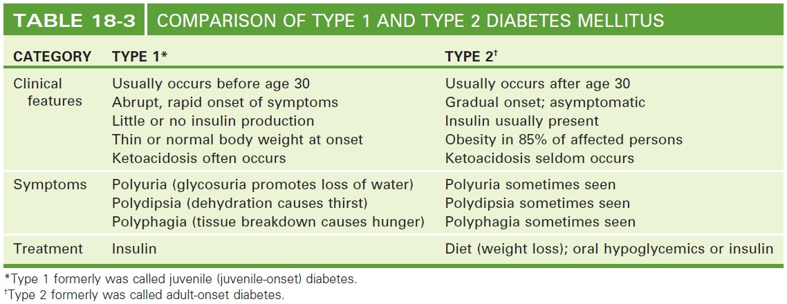
Comparison of Type 1 and Type 2 Diabetes
Notes:
After reviewing the table, discuss the secondary complications of diabetes.

Slide 82
Pathology Pituitary Gland: (Anterior Lobe)
Hypersecretion
Acromegaly
Gigantism
Hyposecretion
Dwarfism
Panhypopituitarism

Slide 83
Pathology Pituitary Gland: (Posterior Lobe)
Hypersecretion
Syndrome of inappropriate ADH (SIADH)
Excess ADH
Excess water retention
Hyposecretion
Diabetes insipidus
Deficient ADH
Polyuria and polydipsia

Slide 84
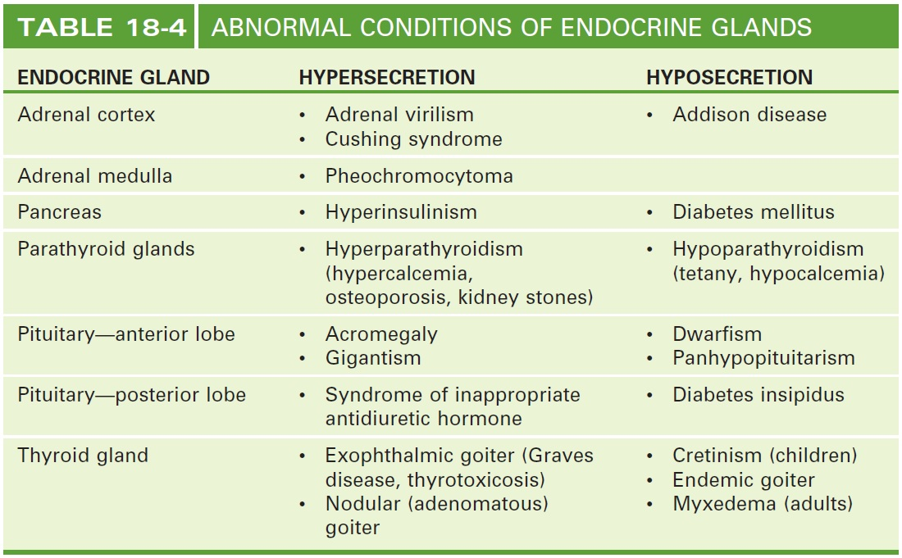
Review Abnormal Conditions of Endocrine Glands
Notes:
Review all the abnormalities.
Ask students to create the table first and then show this slide to review.

Slide 85
Chapter 18 Lesson 18.4

Slide 86
Laboratory Tests
Fasting plasma glucose (FPG)
Measures circulating glucose in a patient who has fasted at least 8 hours
Serum and urine tests
Measures hormones, electrolytes, glucose, etc., in blood and urine as indicators of endocrine function
Thyroid function tests
Measures T3, T4, and TSH in the bloodstream
Notes:
What symptoms would prompt these tests to be ordered?

Slide 87
Clinical Procedures
Exophthalmometry
Computed tomography (CT) scan
Magnetic resonance imaging (MRI)
Thyroid scan
Ultrasound examination
Notes:
When would these procedures be ordered?
For what symptoms?
Review previous lessons.

Slide 88
Abbreviations (Slide 1 of 3)
Abbreviation | Meaning
A1C | Blood test that measures glycosylated hemoglobin (HbA_{1c}) to assess glucose control
ACTH | Adrenocorticotropic hormone
ADH | Antidiuretic hormone – vasopressin
Ca+ | Calcium
CGMS | Continuous glucose monitoring system
DI | Diabetes insipidus
DKA | Diabetic ketoacidosis
DM | Diabetes mellitus
FBG | Fasting blood glucose
FBS | Fasting blood sugar
FSH | Follicle-stimulating hormone

Slide 89
Abbreviations (Slide 2 of 3)
Abbreviation | Meaning
GH | Growth hormone
GTT | Glucose tolerance test
HbA1_{c} | Test for the presence of glucose attached to hemoglobin; also called AIC
hCG or HCG | Human chorionic gonadotropin
IGF | Insulin-like growth factor
K | Potassium
LH | Luteinizing hormone
MDI | Multiple daily injection
Na | Sodium
OT, OXT | Oxytocin
PRL | prolactin

Slide 90
Abbreviations (Slide 3 of 3)
Abbreviation | Meaning
PTH | Parathyroid hormone (parathormone)
RAI | Radioactive iodine
RIA | Radioimmunoassay
RAIU | Radioactive iodine uptake (imaging test or scan)
SIADH | Syndrome of inappropriate antidiuretic hormone
SMBG | Self-monitoring of blood glucose
STH | Somatotropin – growth hormone
T₃ | Triiodothyronine
T₄ | Thyroxine – tetraiodothyronine
TFT | Thyroid function test
TSH | Thyroid-stimulating hormone

Slide 91
Review Sheet – Combining Forms (Slide 1 of 5)
Combining Form | Meaning
aden/o | gland
adrenal/o | adrenal glands
andr/o | male
calc/o, calici/o | calcium
cortic/o | cortex, outer region

Slide 92
Review Sheet – Combining Forms (Slide 2 of 5)
Combining Form | Meaning
crin/o | secrete
dips/o | third
estr/o | female
gluc/o, glyc/o | sugar
gonad/o | sex glands (ovaries, testes)
home/o | sameness

Slide 93
Review Sheet – Combining Forms (Slide 3 of 5)
Combining Form | Meaning
hormon/o | hormone
kal/i | potassium (an electrolyte)
insulin/o | insulin
lact/o | milk
myx/o | mucus
natr/o | sodium (an electrolyte)

Slide 94
Review Sheet – Combining Forms (Slide 4 of 5)
Combining Form | Meaning
pancreat/o | pancreas
parathyroid/o | parathyroid gland
phys/o | growing
pituitar/o | pituitary gland; or hypophysis
somat/o | body
ster/o | solid structure

Slide 95
Review Sheet – Combining Forms (Slide 5 of 5)
Combining Form | Meaning
thyr/o | thyroid gland
thyroid/o | thyroid gland
toc/o | childbirth
toxic/o | position
ur/o | urine

Slide 96
Review Sheet – Suffixes
Suffix | Meaning
-agon | assemble, gather together
-emia | blood condition
-in, -ine | a substance
-tropin | stimulating the function of
-uria | urine condition

Slide 97
Review Sheet – Prefixes
Prefix | Meaning
eu- | good, normal
hyper- | excessive, above
hypo- | deficient, below
oxy- | rapid, sharp, acid
pan- | all
tetra- | four
tri- | three

Slide 98
QUICK QUIZ (Slide 5 of 5)
What is the pathologic condition in which enlargement of the extremities is caused by hypersecretion of the anterior pituitary after puberty?
Addison disease
Acromegaly
Cushing syndrome
Graves disease
Notes:
The correct answer is B: acromegaly.

