Slide 1
The Language of Medicine 13th edition
Davi-Ellen Chabner

Slide 2
Chapter 19 Cancer Medicine (Oncology)

Slide 3
Chapter Goals (Slide 1 of 2)
Identify medical terms that describe the growth and spread of tumors.
Recognize terms related to the causes, diagnosis, and treatment of cancer.
Review how tumors are classified and described by pathologists.

Slide 4
Chapter Goals (Slide 2 of 2)
Describe x-ray studies, laboratory tests, and other procedures used by physicians for determining the presence and extent of spread (staging) of tumors.
Apply your new knowledge to understanding medical terms in their proper contexts, such as medical reports and records.

Slide 5
Chapter 19 Lesson 19.1

Slide 6
Introduction
Cancer: characterized by unrestrained and excessive growth of cells
Malignant tumors: compress, invade, and destroy surrounding tissues
Notes:
Go over recent morbidity numbers that you can obtain from the NIH website.
How do cancer cells spread throughout the body?

Slide 7
Cancer
Cancer is responsible for 20% of all deaths in the United States.
More than half of people who develop cancer are cured.
Notes:
What are the most common causes of cancer death in the U.S.? In men? In women?

Slide 8
QUICK QUIZ (Slide 1 of 2)
Which cancers are the most common causes of cancer death for women?
Lung, breast, colorectal
Lung, colorectal, breast
Breast, lung, colorectal
Colorectal, breast, lung
Notes:
The correct answer is A. For women, it is lung, breast, then colorectal that are the most common causes of death from cancer

Slide 9
QUICK QUIZ (Slide 2 of 2)
Which cancers are the most common causes of cancer death for men?
Lung, prostate, colorectal
Lung, colorectal, prostate
Prostate, lung, colorectal
Colorectal, prostate, lung
Notes:
The correct answer is B. For men it is lung, colorectal, then prostate that are the most common causes of cancer death for men.

Slide 10
Carcinogenesis
Environmental agents
Chemical carcinogens
Radiation
Viruses (RNA and DNA)
Oncogenes (ras/colon cancer, myc/lymphoma, and bcr-abl/chronic myelogenous leukemia)
Heredity
Retinoblastoma, polyposis coli
Notes:
What are some chemical carcinogens? (Cigarette smoke, exhaust, insecticides, etc.)
Name some sources of radiation. (Sunlight, x-rays, etc.)
What are oncogenes? (Pieces of normal DNA that cause normal cells to become malignant when activated by mutation)

Slide 11
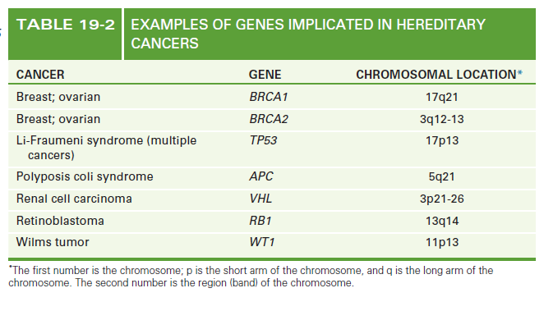
Genes Implicated in Hereditary Cancers
Notes:
What is genetic screening? (Testing family members’ blood to determine whether the cancer is inherited)

Slide 12
Classification of Cancerous Tumors
Carcinomas: epithelial cell origin, 90% of all malignancies are carcinomas
Notes:
What does histogenesis mean?
What type of tissue are carcinomas derived from?
What is the name for benign tumors? Malignant tumors?

Slide 13
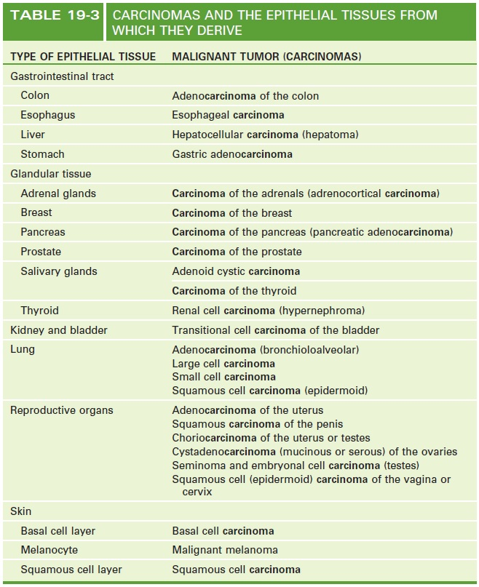
Carcinomas and the Epithelial Tissues from Which They Derive

Slide 14
Classification of Cancerous Tumors (Slide 1 of 2)
Sarcomas: connective tissue origin, 5% of all malignancies
Notes:
What type of tissue are sarcomas derived from? Give specific examples.
What are benign tumors called? Malignant tumors?

Slide 15
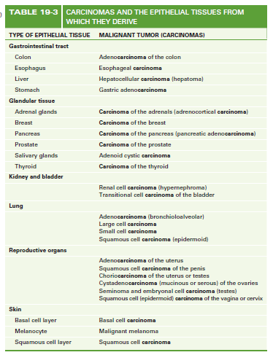
Sarcomas and the Connective Tissues from Which They Derive

Slide 16
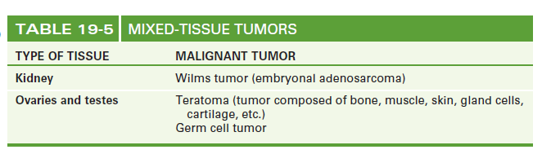
Classification of Cancerous Tumors (Slide 2 of 2)
Mixed tissue tumors: tissues capable of differentiating into epithelial and connective tissue
Notes:
Where are mixed-tissue tumors commonly found?

Slide 17
Chapter 19 Lesson 19.2

Slide 18
Pathological Descriptions Gross
Cystic
Fungating
Inflammatory
Medullary
Necrotic
Polypoid
Ulcerating
Verrucous
Notes:
Describe each of the above types of tumors. Where is each likely to be found?
List and describe the two types of polypoid tumors and cystic tumors.

Slide 19
Pathological Descriptions Microscopic
Alveolar
Carcinoma in situ
Diffuse
Dysplastic
Epidermoid
Follicular
Nodular
Papillary
Pleomorphic
Scirrhous
Undifferentiated
Notes:
What are alveolar tumors?
What are dysplastic tumors?
What does scirrhous mean when referring to tumors?

Slide 20
Grading and Staging of Tumors
Grade: degree of maturity or differentiation under the microscope
Stage: extent of spread in the body
Notes:
Describe how a tumor is graded and staged.
Explain how this relates to therapy and prognosis.

Slide 21
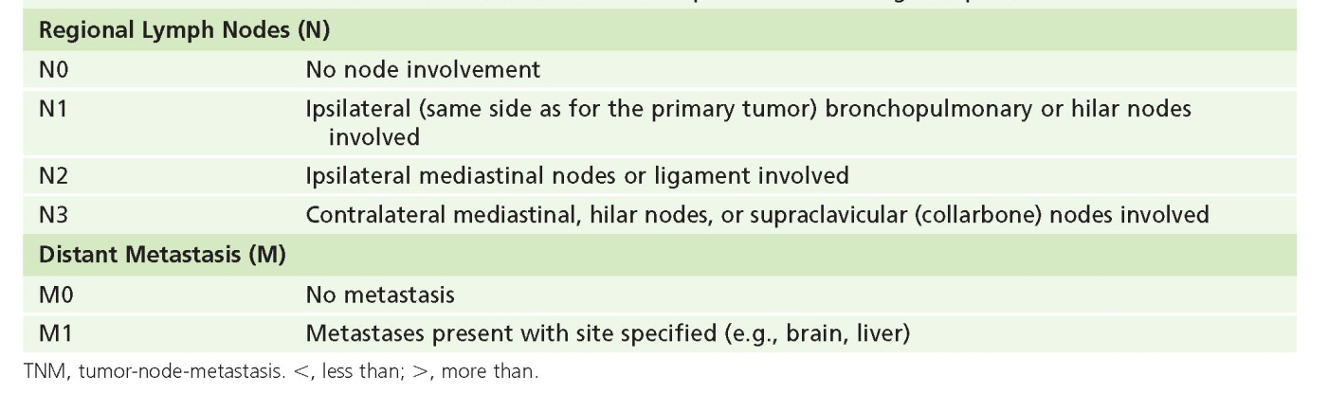
International TNM Staging System for Lung Cancer

Slide 22
Chapter 19 Lesson 19.3

Slide 23
Cancer Treatment: Surgery (Slide 1 of 2)
Debulking procedure: may be used to remove as much of primary tumor mass as possible
Adjuvant (assisting) radiation therapy and/or chemotherapy: after removal of primary tumor to prevent recurrence at distant sites

Slide 24
Cancer Treatment: Surgery (Slide 2 of 2)
Cauterization
Core needle biopsy
Cryosurgery
En bloc resection
Excisional biopsy
Exenteration
Fine needle aspiration biopsy
Fulguration
Incisional biopsy
Notes:
What is adjuvant chemotherapy?

Slide 25
Cancer Treatment: Radiation Therapy (Radiation Oncology)
Brachytherapy
Electron beams
External beam radiation (teletherapy)
Fields
Fractionation
Gray (Gy)
Linear accelerator
Photon therapy
Proton therapy
Radiocurable tumor
Radioresistant tumor
Radiosensitive tumor
Radiosensitizers
Simulation
Stereotactic radiosurgery
Notes:
What is normal cell damage referred to in radiation? (Morbidity)

Slide 26
Radiation Therapy Side Effects
Alopecia (baldness)
Fibrosis (increase in connective tissue)
Infertility (inability to contribute to conception of a child)
Mucositis (inflammation and ulceration of mucous membranes)
Myelosuppression (bone marrow depression)
Nausea and vomiting
Pneumonitis
Secondary tumors (new types of tumors)
Xerostomia (dryness of mouth)
Notes:
Discuss the possible causes of these side effects.
Which side effects reverse after treatment is discontinued?

Slide 27
Chapter 19 Lesson 19.4

Slide 28
Chemotherapy, Biological Therapy, and Differentiating Agents
Alkylating agents
Antibiotics
Antimetabolites
Antimitotics
Hormonal agents
Notes:
What are common side effects of alkylating agents?
How do antibiotic drugs work in cancer therapy?
What are antimitotics derived from?
Name a particular type of cancer on which hormonal agents might be effective.

Slide 29
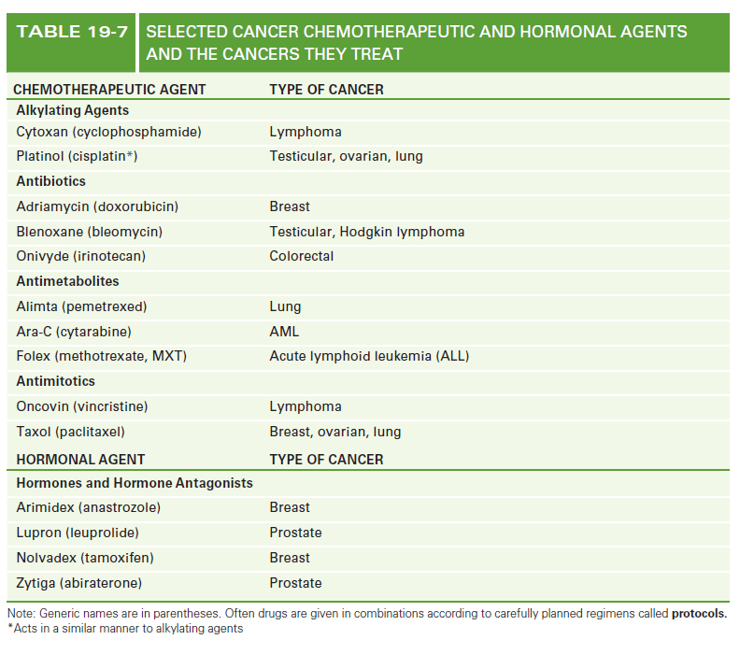
Cancer Chemotherapeutic Agents and the Cancers They Treat (slide 1 of 2)

Slide 30
Cancer Chemotherapeutic Agents and the Cancers They Treat (slide 2 of 2)

Slide 31
Vocabulary (Slide 1 of 18)
Term | Meaning/Definition
adjuvant chemotherapy | Assisting primary treatment
alkylating agents | Synthetic chemicals containing alkyl groups that attack DNA
anaplasia | Loss of differentiation of cells
angiogenesis | Process of forming new blood vessels

Slide 32
Vocabulary (Slide 2 of 18)
Term | Meaning/Definition
antibiotics | Chemicals produced by bacteria or primitive plants; inhibit growth of cells
antimetabolites | Chemicals that prevent cell division; inhibit formation of substances needed to make DNA
antimitotics | Drugs that block cell division
apoptosis | Programmed cell death

Slide 33
Vocabulary (Slide 3 of 18)
Term | Meaning/Definition
benign tumor | Noncancerous growth (neoplasm)
biological response modifiers | Produced by normal cells; directly block tumor growth or stimulate immune system to fight cancer
biological therapy | Use of the body’s own defenses to destroy tumor cells
brachytherapy | Use of radiation placed directly on or within the cancer

Slide 34
Vocabulary (Slide 4 of 18)
Term | Meaning/Definition
carcinogens | Agents that cause cancer
carcinoma | Cancerous tumor made up of cells of epithelial origin
cellular oncogenes | Pieces of DNA, activated by mutations or dislocation, that can cause a normal cell to become malignant
chemotherapy | Treatment with drugs

Slide 35
Vocabulary (Slide 5 of 18)
Term | Meaning/Definition
combination chemotherapy | Use of several chemotherapeutic agents together in treatment of tumors
dedifferentiation | Loss of differentiation of cells
deoxyribonucleic acid (DNA) | Genetic material within the nucleus of a cell; controls cell division and protein synthesis
differentiating agents | Drugs that promote tumor cells to differentiate, stop growing, and die

Slide 36
Vocabulary (Slide 6 of 18)
Term | Meaning/Definition
differentiation | Specialization of cells
electron beams | Low-energy beams of radiation for treatment of skin or surface tumors
encapsulated | Surrounded by a capsule; benign tumors are encapsulated
external beam irradiation | Applying radiation to a tumor from a source outside the body

Slide 37
Vocabulary (Slide 7 of 18)
Term | Meaning/Definition
fields | Dimensions of body areas undergoing irradiation
fractionation | Giving radiation in small, repeated doses
genetic screening | Testing family members to determine if they have inherited a cancer-causing gene
grading tumors | Evaluating the degree of maturity of tumor cells

Slide 38
Vocabulary (Slide 8 of 18)
Term | Meaning/Definition
gray (gy) | Unit of absorbed radiation dose
gross description of tumors | Visual appearance of tumors to the naked eye
infiltrative | Extending beyond normal tissue boundaries into adjacent tissues
invasive | Having the ability to enter and destroy surrounding tissue

Slide 39
Vocabulary (Slide 9 of 18)
Term | Meaning/Definition
irradiation | Exposure to any form of radiant energy such as light, heat, or x-rays
linear accelerator | Large electronic device that produces high-energy x-ray beams for treatment of deep-seated tumors
malignant tumor | Tumor having the characteristics of continuous growth, invasiveness, and metastasis
mesenchymal | Embryonic connective tissue

Slide 40
Vocabulary (Slide 10 of 18)
Term | Meaning/Definition
metastasis | Spread of a malignant tumor to a secondary site
microscopic description of tumors | Appearance of tumors when viewed under a microscope
mitosis | Replication of cells
mixed-tissue tumors | Tumors composed of different types of tissue

Slide 41
Vocabulary (Slide 11 of 18)
Term | Meaning/Definition
modality | Method of treatment, such as surgery, chemotherapy, or irradiation
molecularly targeted therapy | Anticancer drugs designed to block the function of growth factors, their receptors, and signaling pathways in specific tumor cells
morbidity | Condition of being unwell; deficient in normal function
mucinous | Containing mucus

Slide 42
Vocabulary (Slide 12 of 18)
Term | Meaning/Definition
mutation | Change in DNA; may be spontaneous or caused by chemicals, radiation, or viruses
neoplasm | New growth; benign or malignant tumors
nucleotide | Unit of DNA composed of a sugar, phosphate, and a base
oncogene | Region of DNA in tumor cells or in viruses that causes cancer

Slide 43
Vocabulary (Slide 13 of 18)
Term | Meaning/Definition
palliative | Relieving, but not curing symptoms
pedunculated | Possessing a stem or stalk
photon therapy | Radiation therapy using energy in the form of x-rays or gamma rays
protocol | Detailed plan for treatment of an illness

Slide 44
Vocabulary (Slide 14 of 18)
Term | Meaning/Definition
proton therapy | Use of protons produced by a cyclotron to deposit a dose of radiation at a tightly focused point in the body
radiation | Energy carried by a stream of particles
radiocurable tumor | Tumor that is destroyed by radiation therapy
radioresistant tumor | Tumor that requires large doses of radiation to be destroyed

Slide 45
Vocabulary (Slide 15 of 18)
Term | Meaning/Definition
radiosensitive tumor | Tumor in which radiation can cause the death of cells without serious damage to surrounding tissue
radiosensitizers | Drugs that increase the sensitivity of tumors to x-rays
radiotherapy | Treatment of tumors using doses or radiation
relapse | Recurrence of tumor after treatment

Slide 46
Vocabulary (Slide 16 of 18)
Term | Meaning/Definition
remission | Partial or complete disappearance of symptoms of disease
ribonucleis acid (RNA) | Cellular substance that represents a copy of DNA; directs formation of new protein inside cells
sarcoma | Cancerous tumor derived from connective or flesh tissue
serous | Having the appearance of a thin, watery fluid
sessile | Having no stem

Slide 47
Vocabulary (Slide 17 of 18)
Term | Meaning/Definition
simulation | Study using CT scan or MRI to map treatment before RT is g
solid tumor | Tumor composed of a mass of cells
staging of tumors | System of evaluating the extent of spread of tumors
stereotactic radiosurgery | Delivery of dose of radiation under stereotactic guidance

Slide 48
Vocabulary (Slide 18 of 18)
Term | Meaning/Definition
steroids | Complex, naturally occurring chemicals derived from cholesterol
surgical procedures to treat cancer | Methods of removing cancerous tissue
viral oncogenes | Pieces of DNA from viruses that infect a normal cell and cause it to become malignant
virus | Infectious agent that reproduces by entering a host cell and using the host’s genetic material to copy itself

Slide 49
Clinical Procedures to Detect or Treat Malignancies
Bone marrow biopsy
Bone marrow or stem cell transplant
CT scans
Fiberoptic colonoscopy
Exfoliative cytology
Laparoscopy
Mammography
MRI
Needle biopsy
Radionuclide scans
Ultrasound
X-rays
Notes:
Describe a bone marrow biopsy and how it can detect cancer.
What is exfoliative cytology and what types of cancer does it detect?
What is a needle biopsy and what types of cancer can it detect?

Slide 50
Abbreviations (Slide 1 of 4)
Abbreviation | Meaning
AFP | Alpha-fetoprotein
ATRA | All-transretinoic acid
BMT | Bone marrow transplantation
BRC | breakpoint cluster region
bx | Biopsy
CA | Cancer
CEA | Carcinoembryonic antigen
cGy | Centigray (one hundredth of a gray) or rad
chemo | Chemotherapy
CR | Complete response – disappearance of all tumor
CSF | Colony-stimulating factor
DES | Diethylstilbestrol
DNA | Deoxyribonucleic acid

Slide 51
Abbreviations (Slide 2 of 4)
Abbreviation | Meaning
EGFR | Epidermal growth factor receptor
ER | Estrogen receptor
EPO | Erythropoietin
FNA | Fine needle aspiration
5-FU | 5-fluorouracil
Ga | Gallium
GIST | Gastrointestinal stromal tumor
Gy | Gray
H & E | Hematoxylin and eosin
HER2-neu | Growth factor gene highly activated on certain types of breast cancer
HNPCC | Hereditary non-polyposis

Slide 52
Abbreviations (Slide 3 of 4)
Abbreviation | Meaning
IGRT | Intensity-modulated gated radiation therapy
IHC | Immunohistochemistry
IMRT | Intensity-modulated radiation therapy
IORT | Intraoperative radiation therapy
Mets | Metastases
MoAb | Monoclonal antibody
NED | No evidence of disease
NF | Neurofirbromatosis
NHL | Non–Hodgkin lymphoma
NSCLC | Non-small cell lung cancer
Pap smear | Papanicolaou smear
PD | Progressive disease – tumor increases in size

Slide 53
Abbreviations (Slide 4 of 4)
Abbreviation | Meaning
PR | Partial response – tumor one half its original size
prot | Protocol
PSA | Prostate-specific antigen
PSCT | Peripheral stem cell transplantation
PSRS | Proton stereotactic radiosurgery
RNA | Ribonucleic acid
RT | Radiation therapy
SD | Stable disease – tumor does not shrink or grow
TNM | Tumor, nodes, metastases
VEGF | Vascular endothelial growth factor
XRT, RT | Radiation therapy

