Slide 1
The Language of Medicine 13th edition
Davi-Ellen Chabner

Slide 2
Chapter 20 Radiology and Nuclear Medicine

Slide 3
Chapter Goals (Slide 1 of 2)
List the physical properties of x-rays.
Identify diagnostic techniques used by radiologists and nuclear physicians.
Name x-ray views and patient positions used in x-ray examinations.
Describe the role of radioactivity in the diagnosis of disease.

Slide 4
Chapter Goals (Slide 2 of 2)
Recognize medical terms used in the specialties of radiology and nuclear medicine.
Apply your new knowledge to understanding medical terms in their proper contexts, such as medical reports and records.

Slide 5
Chapter 20 Lesson 20.1

Slide 6
Introduction
Radiology: medical specialty concerned with the study of x-rays and other technologies (such as ultrasound and magnetic resonance) to produce and interpret images of the human body for diagnosis of disease
X-rays: invisible waves of energy
Nuclear medicine: use of radioactive substances in the diagnosis of disease
Notes:
What is another name for radiology? (Roentgenology)
What is the name for a physician who practices radiology? (Radiologist)
Name the three types of radioactivity. (Alpha particles, beta particles, and gamma rays)

Slide 7
Personnel in This Medical Field
Radiologist
Nuclear physician
Radiologic technologists
Radiographers, nuclear medicine technologists, sonographers
Notes:
What functions does a radiologist perform? (The practice of diagnostic radiology)
What are the functions of each type of radiologic technician?

Slide 8
Characteristics of X-rays
Expose photographic plates
Penetrate substances
Invisible
Travel in straight lines
Scatter
Ionization
Notes:
What is the characteristic of a substance if it permits passage of most x-rays? (Radiolucent)
Substances that absorb most x-rays are ______________? (Radiopaque)
What is ionization?
Scatter and ionization causes tissue damage.

Slide 9
Diagnostic Techniques (Slide 1 of 2)
X-Ray studies
Digital radiography
Computed tomography (CT)
Contrast studies
Barium sulfate: upper GI, lower GI
Iodine compounds: angiography, arthrography, cholangiography, digital subtraction angiography (DSA), hysterosalpingography, myelography, pyelography
Notes:
Make sure all these terms are defined as in the text.
Why are contrast media used?
What is a “double-contrast study”?
Which test is also known as “urography”?

Slide 10
Diagnostic Techniques (Slide 2 of 2)
Fluoroscopy
Digital imaging techniques
Interventional radiology
Ultrasound
Magnetic imaging or magnetic resonance imaging (MRI or MR)
Notes:
Note which techniques require the use of radioactive substances.
Which of the techniques listed can be used with a patient in motion?
What are the specialized ultrasound techniques used to record blood velocity or flow?

Slide 11
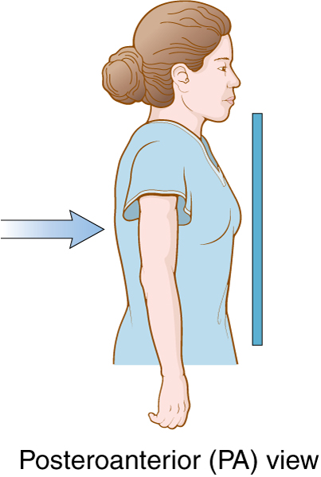
X-ray Positioning (Slide 1 of 6)
Posteroanterior (PA) view: posterior source to anterior detector
Notes:
The posteroanterior view of the chest is the most commonly requested chest x-ray.
What is the likely reason for this?
What structures are best viewed with the anteroposterior view?

Slide 12
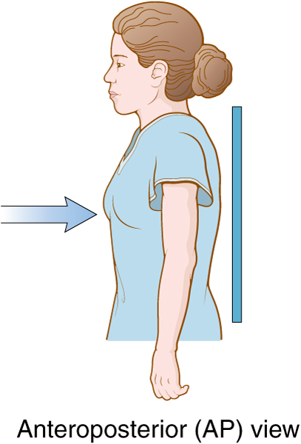
X-ray Positioning (Slide 2 of 6)
Anteroposterior (AP) view: anterior source to posterior detector
Notes:
The posteroanterior view of the chest is the most commonly requested chest x-ray.
What is the likely reason for this?
What structures are best viewed with the anteroposterior view?

Slide 13
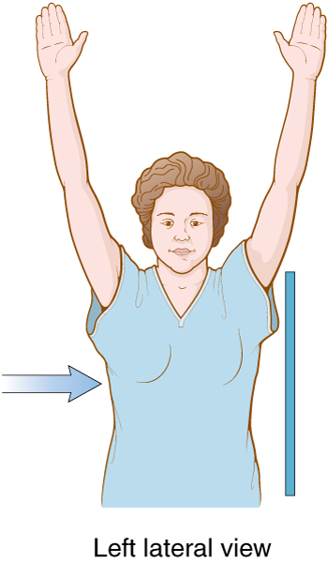
X-ray Positioning (Slide 3 of 6)
Lateral view: in left lateral view, source at right of patient, to detector at left of patient
Notes:
Why are oblique views necessary?

Slide 14
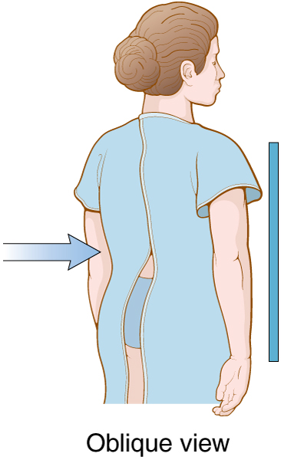
X-ray Positioning (Slide 4 of 6)
Oblique view: source slanting direction at angle from perpendicular plane
Notes:
Why are oblique views necessary?

Slide 15
X-ray Positioning (Slide 5 of 6)
To describe the position of patient:
Abduction—movement away from the midline
Adduction—movement toward the midline
Eversion—turning outward
Extension—lengthening or straightening a flexed limb
Flexion—bending a part of the body

Slide 16
X-ray Positioning (Slide 6 of 6)
To describe the position of patient:
Decubitus—lying down on the side
Prone—lying on the belly (face down)
Recumbent—lying down (prone or supine)
Supine—lying on the back (face up)

Slide 17
QUICK QUIZ (Slide 1 of 4)
Obstructing the passage of
x-rays:
radiopaque
radiolucent
radioisotope
radiopharmaceutical
Notes:
The correct answer is A: radiopaque.

Slide 18
Chapter 20 Lesson 20.2

Slide 19
Nuclear Medicine
Radionuclides/radioisotopes
Alpha particles, beta particles, gamma rays
Nuclear medicine tests
In vitro: test tube
In vivo: in the body
Notes:
Half-life of a particle is the time required to lose half of its radioactivity (disintegration).
Important to know this because the length of time the diagnostic tool will stay in the body is critical to the test and critical in keeping the patient safe from radiation effects.

Slide 20
In Vitro Procedures
Analysis of blood and urine
Radioimmunoassay (RIA) uses radioactive chemicals and antibodies to detect hormones and drugs in the patient’s blood (for example, digitalis detection, hypothyroidism in newborns).
Notes:
What is the meaning of in vitro? (Latin for “in the test tube”)
Describe in vivo tests.

Slide 21
In Vivo Procedures
Radioactive substance given directly to patient to evaluate organ function or image
Radiopharmaceutical (labeled compound) concentrates in organ
Scintiscanner (gamma camera) detection instrument produces picture (scintiscan)
Notes:
Amounts of radiopharmaceuticals detected at a given location or organ are proportional to the rate at which the gamma rays are emitted.
What is the meaning of in vivo? (Latin for “in the body” )

Slide 22
Procedures Using Radionuclides
Bone scan
Lymphoscintigraphy
Positron emission tomography (PET) scan
PET/CT scan
Single-photon emission computed tomography (SPECT)
Technetium Tc-99m sestamibi (Cardiolite) scan
Thallium (Tl) scan
Thyroid scan
Notes:
What name can be applied to this group of tests? (Tracer studies)
What is another name for radionuclide scanning? (Scintigraphy)

Slide 23
Focus on PET Scan
Radioisotopes (emission of positrons) instead of contrast x-rays
Intravenous injection
Concentrates radioisotopes in tissues where the radionuclide is or is not being metabolized
Useful in treating stroke, epilepsy, Alzheimer disease, brain tumors, abdominal and pulmonary malignancies
Notes:
PET is an acronym for positron emission tomography.
How are the radionuclides incorporated into the tissue?

Slide 24
Focus on SPECT
Intravenous injection of radioactive tracer
Computer reconstruction of 3-D image based on many views
Detects liver tumors, cardiac ischemia, diseases of bone and spine
Notes:
SPECT is an acronym for single-photon emission computed tomography.
What is an example of a radioactive tracer?

Slide 25
Vocabulary (Slide 1 of 8)
Term | Meaning/Definition
computed tomography (CT) | Diagnostic x-ray procedure that produces a cross-sectional image of a specific body segment
contrast studies | Radiopaque materials are injected to obtain contrast with surrounding tissue when shown on x-ray film
gamma camera | Machine to detect gamma rays emitted from radiopharmaceuticals
gamma rays | High-energy rays emitted by radioactive substances in tracer studies

Slide 26
Vocabulary (Slide 2 of 8)
Term | Meaning/Definition
half-life | Time required for a radioactive substance to lose half its radioactivity by disintegration
interventional radiology | Therapeutic or diagnostic procedures performed by a radiologist
in vitro | Process, test, or procedure performed, measured, or observed outside a living organism
in vivo | Process, test, or procedure is performed, measured, or observed within a living organism

Slide 27
Vocabulary (Slide 3 of 8)
Term | Meaning/Definition
ionization | Transformation of electrically neutral substances into electrically charged particles
magnetic resonance imaging (MRI) | Use of magnetic field and radio waves to produce sagittal, coronal, and axial images of the body
nuclear medicine | Medical specialty that studies uses of radioactive substances in diagnosis of disease

Slide 28
Vocabulary (Slide 4 of 8)
Term | Meaning/Definition
positron emission tomography (PET) | Use of positron-emitting radioactive substances given intravenously to create a cross-sectional image of cellular metabolism
radioimmunoassay | Test that combines radioactive chemicals and antibodies to detect minute quantities of substances in a patient’s blood
radioisotope | Radioactive form of an element ; radionuclide

Slide 29
Vocabulary (Slide 5 of 8)
Term | Meaning/Definition
radiolabeled compound | Radiopharmaceutical; used in nuclear medicine studies
radiology | Medical specialty concerned with the study of x-rays and their use in diagnosis of disease
radiolucent | Permitting the passage of x-rays
radionuclide | Radioactive form of an element; radioisotope

Slide 30
Vocabulary (Slide 6 of 8)
Term | Meaning/Definition
radiopaque | Obstructing the passage of x-rays
radiopharmaceutical | Radioactive drug used for diagnostic and therapeutic purposes
scan | Image of an area, organ or tissue of the body obtained from ultrasound, radioactive tracer studies, CT, or MRI
scintigraphy | Diagnostic nuclear medicine test using radiopharmaceuticals and gamma cameras to create images

Slide 31
Vocabulary (Slide 7 of 8)
Term | Meaning/Definition
single photon emission computed tomography (SPECT) | Radioactive tracer is injected intravenously and a computer reconstructs a 3D-image based on a composite of many views
tagging | Attaching a radionuclide to a chemical and following its path in the body
tracer studies | Use of radionuclide tags attached to chemicals and followed as they travel through the body

Slide 32
Vocabulary (Slide 8 of 8)
Term | Meaning/Definition
ultrasonography (US, U/S) | Diagnostic technique that projects and retrieves high-frequency sound waves as they echo off body parts
ultrasound transducer | Handheld device that sends and receives ultrasound signals
uptake | Rate of absorption of a radionuclide into an organ or tissue
ventilation-perfusion studies | Ventilation and perfusion of a radiopharmaceutical followed by imaging its passage through the respiratory tract

Slide 33
QUICK QUIZ (Slide 2 of 4)
Which of the following is a handheld device that sends and receives ultrasound signals?
Gamma camera
Roentgenology
Radioisotope
Transducer
Notes:
The correct answer is D: transducer.

Slide 34
Combining Forms, Suffixes, Prefixes, and Terminology (Slide 1 of 4)
Combining Form | Meaning
fluor/o | luminous
is/o | same
pharmaceut/o | drug
radi/o | x-rays
roentgen/o | x-rays

Slide 35
Combining Forms, Suffixes, Prefixes, and Terminology (Slide 2 of 4)
Combining Form | Meaning
son/o | sound
therapeut/o | treatment
vitr/o | glass
viv/o | life

Slide 36
Combining Forms, Suffixes, Prefixes, and Terminology (Slide 3 of 4)
Suffix | Meaning
-gram | record
-graphy | process of recording
-lucent | to shine
-opaque | obscure

Slide 37
Combining Forms, Suffixes, Prefixes, and Terminology (Slide 4 of 4)
Prefix | Meaning
cine- | movement
echo- | a repeated sound
ultra- | beyond

Slide 38
Abbreviations (Slide 1 of 4)
Abbreviation | Meaning
Angio | Angiography
AP | Anteroposterior
Ba | Barium
BE | Barium enema
C-spine | Cervical spine films
CT | Computed tomography
CXR | Chest x-ray (film)
Decub | Decubitus – lying down
DICOM | Digital image communication in medicine
DI | Diagnostic imaging

Slide 39
Abbreviations (Slide 2 of 4)
Abbreviation | Meaning
DSA | Digital subtraction angiography
ECHO | Echocardiography
EUS | Endoscopic ultrasonography
¹⁸F-FDG | Fluorodeoxyglucose
Gd | Gadolinium
¹²³I | Isotope of radioactive iodine
¹³¹I | Isotope of radioactive iodine
IVP | Intravenous pyelogram
KUB | Kidneys, ureters, bladder (series)
LAT | Lateral

Slide 40
Abbreviations (Slide 3 of 4)
Abbreviation | Meaning
LS films | Lumbosacral (spine) films
L-spine | Lumbar spine
MDCT | Multidetector CT scanner
MR, MRI | Magnetic resonance, magnetic resonance imaging
MRA | Magnetic resonance angiography
MRV | Magnetic resonance venography
MUGA | Multiple-gated acquisitions (scan)
PA | Posteroanterior
PACS | Picture archival and communications system
PET | Positron emission tomography
PET/CT | Positron emission tomography/computed tomography
RAIU | Radioactive iodine uptake (test)

Slide 41
Abbreviations (Slide 4 of 4)
Abbreviation | Meaning
RFA | Radiofrequency ablation
SBFT | Small bowel follow-through
SPECT | Singe photon emission computed tomography
⁹⁹TC | Radioactive technetium
²⁰¹Tl | Thallium-201
T-spine | Thoracic spine
UGI | Upper gastrointestinal (series)
US, U/S | Ultrasound; ultrasonography
V/Q scan | Ventilation-perfusion scan of the lungs

Slide 42
QUICK QUIZ: (Slide 3 of 4)
Which term refers to movement away from the midline of the body?
Adduction
Abduction
PA
Inversion
Notes:
The correct answer is B: abduction.

Slide 43
QUICK QUIZ (Slide 4 of 4)
Which term refers to a patient lying on the back?
Prone
Supine
Flexion
Decubitus
Notes:
The correct answer is B: supine.

