Slide 1
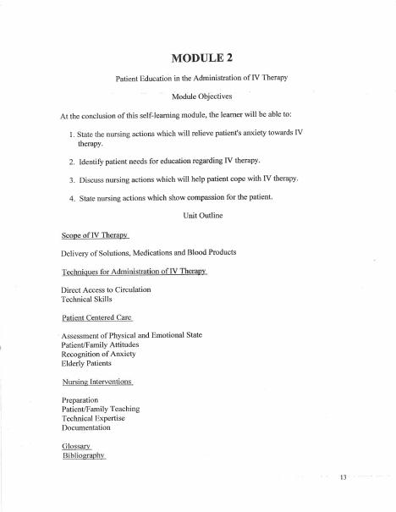
BROWARD-MIAMI HEALTH INSTITUTE
Patient Education and Support
Module 2
30-Hour Basic Intravenous Therapy
Notes:
Sources: Supplied Basic Intravenous Therapy Certification manual, pages 13.
Current legal reference: Florida Administrative Code Rule 64B9-12.005, effective July 20, 2023; Florida Statutes section 464.003 (2026). Instructor must verify current institutional policy and drug/device guidance before use.

Slide 2
Learning objectives
02
1. Assess physical condition, prior experience, and anxiety
2. Explain IV therapy in clear patient-centered language
3. Document teaching and the patient's response
Notes:
Sources: Supplied Basic Intravenous Therapy Certification manual, pages 13.
Current legal reference: Florida Administrative Code Rule 64B9-12.005, effective July 20, 2023; Florida Statutes section 464.003 (2026). Instructor must verify current institutional policy and drug/device guidance before use.

Slide 3
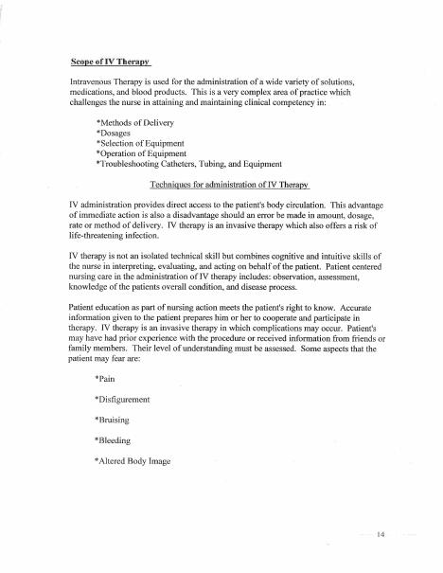
Assessment before teaching
03
Ask what the patient understands, what happened during previous IV therapy, and what worries them now. Consider cognition, language, culture, pain, vision, hearing, and readiness to learn.
Notes:
Sources: Supplied Basic Intravenous Therapy Certification manual, pages 13-14.
Current legal reference: Florida Administrative Code Rule 64B9-12.005, effective July 20, 2023; Florida Statutes section 464.003 (2026). Instructor must verify current institutional policy and drug/device guidance before use.

Slide 4
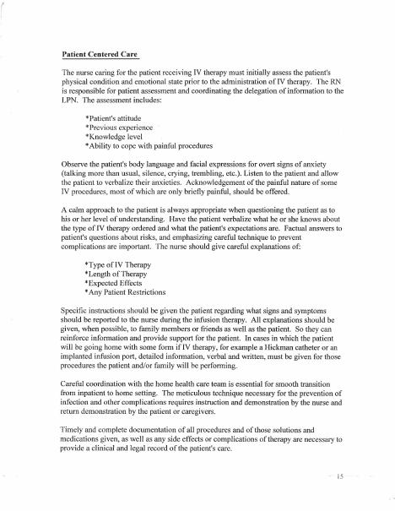
Information patients need
04
Explain the purpose, expected duration, likely sensations, activity limits, equipment, monitoring, and symptoms that require immediate reporting. Use qualified language assistance when needed.
Notes:
Sources: Supplied Basic Intravenous Therapy Certification manual, pages 13-15.
Current legal reference: Florida Administrative Code Rule 64B9-12.005, effective July 20, 2023; Florida Statutes section 464.003 (2026). Instructor must verify current institutional policy and drug/device guidance before use.

Slide 5
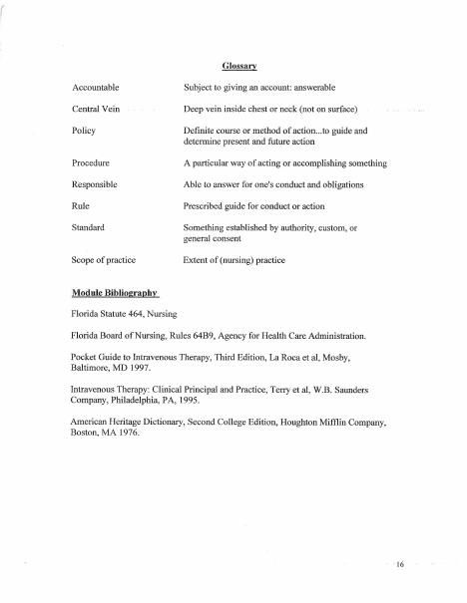
Reducing anxiety
05
Prepare supplies before approaching the patient. Use a calm explanation, preserve privacy, position the patient comfortably, and invite questions. Do not minimize fear or promise a painless procedure.
Notes:
Sources: Supplied Basic Intravenous Therapy Certification manual, pages 13-16.
Current legal reference: Florida Administrative Code Rule 64B9-12.005, effective July 20, 2023; Florida Statutes section 464.003 (2026). Instructor must verify current institutional policy and drug/device guidance before use.

Slide 6
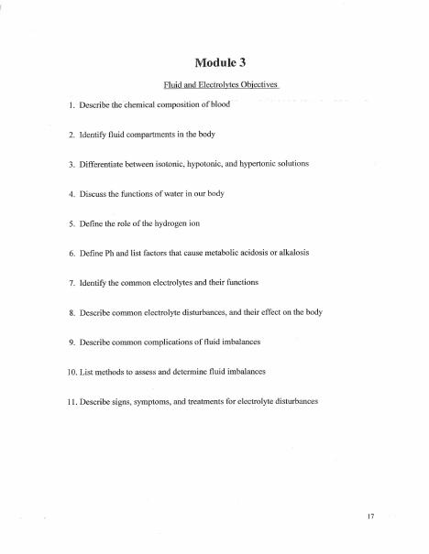
Teach-back and documentation
06
Ask the patient to explain how they will protect the site and which symptoms they will report. Record topics taught, learning barriers, teaching method, demonstrated understanding, and follow-up needs.
Notes:
Sources: Supplied Basic Intravenous Therapy Certification manual, pages 13-17.
Current legal reference: Florida Administrative Code Rule 64B9-12.005, effective July 20, 2023; Florida Statutes section 464.003 (2026). Instructor must verify current institutional policy and drug/device guidance before use.

Slide 7
Practice and competency check
07
1. Use teach-back for site protection and reportable symptoms
2. Adapt teaching for an older adult with hearing loss
3. Respond therapeutically to a patient who refuses insertion
Complete the matching online lesson and quiz before attending the skills lab.
Notes:
Sources: Supplied Basic Intravenous Therapy Certification manual, pages 13. Online preparation precedes live practice.
Current legal reference: Florida Administrative Code Rule 64B9-12.005, effective July 20, 2023; Florida Statutes section 464.003 (2026). Instructor must verify current institutional policy and drug/device guidance before use.

