Slide 1
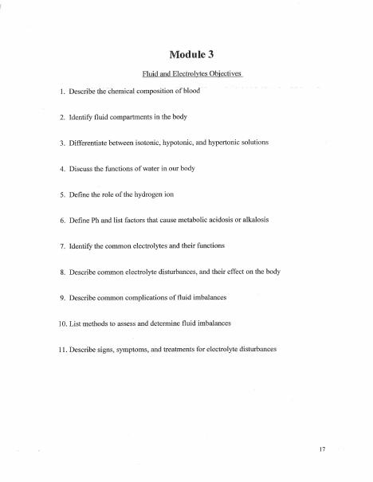
BROWARD-MIAMI HEALTH INSTITUTE
Fluids, Electrolytes, and Calculations
Module 3
30-Hour Basic Intravenous Therapy
Notes:
Sources: Supplied Basic Intravenous Therapy Certification manual, pages 17.
Current legal reference: Florida Administrative Code Rule 64B9-12.005, effective July 20, 2023; Florida Statutes section 464.003 (2026). Instructor must verify current institutional policy and drug/device guidance before use.

Slide 2
Learning objectives
02
1. Relate fluid compartments to IV solution effects
2. Recognize common volume and electrolyte disturbances
3. Calculate pump and gravity infusion rates safely
Notes:
Sources: Supplied Basic Intravenous Therapy Certification manual, pages 17.
Current legal reference: Florida Administrative Code Rule 64B9-12.005, effective July 20, 2023; Florida Statutes section 464.003 (2026). Instructor must verify current institutional policy and drug/device guidance before use.

Slide 3
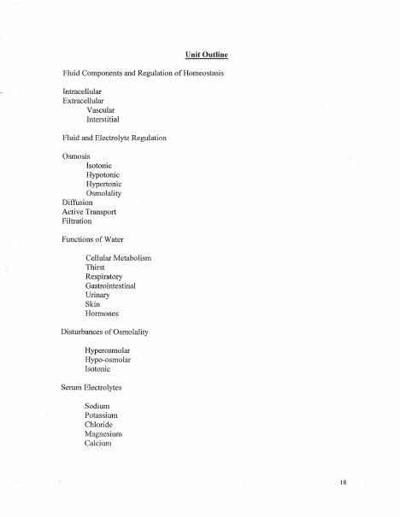
Fluid compartments
03
Intracellular fluid lies within cells. Extracellular fluid includes intravascular and interstitial spaces. Osmosis moves water across a semipermeable membrane, while diffusion moves solutes down a concentration gradient.
Notes:
Sources: Supplied Basic Intravenous Therapy Certification manual, pages 17-18.
Current legal reference: Florida Administrative Code Rule 64B9-12.005, effective July 20, 2023; Florida Statutes section 464.003 (2026). Instructor must verify current institutional policy and drug/device guidance before use.

Slide 4
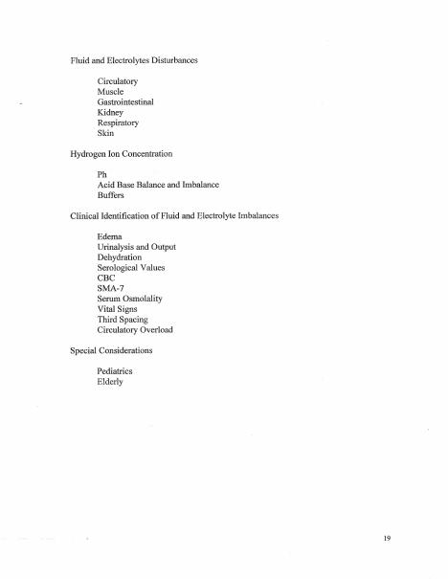
Tonicity
04
Isotonic solutions have an effective concentration similar to plasma. Hypotonic solutions promote movement of water into cells. Hypertonic solutions draw water out of cells and require close monitoring.
Notes:
Sources: Supplied Basic Intravenous Therapy Certification manual, pages 17-19.
Current legal reference: Florida Administrative Code Rule 64B9-12.005, effective July 20, 2023; Florida Statutes section 464.003 (2026). Instructor must verify current institutional policy and drug/device guidance before use.

Slide 5
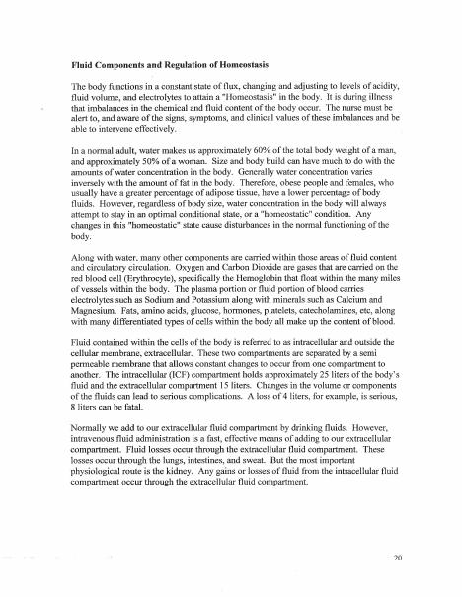
Assessment
05
Track intake and output, daily weight, vital signs, lung sounds, edema, mucous membranes, cognition, urine output, and relevant laboratory values. Escalate rapid changes or critical results.
Notes:
Sources: Supplied Basic Intravenous Therapy Certification manual, pages 17-20.
Current legal reference: Florida Administrative Code Rule 64B9-12.005, effective July 20, 2023; Florida Statutes section 464.003 (2026). Instructor must verify current institutional policy and drug/device guidance before use.

Slide 6
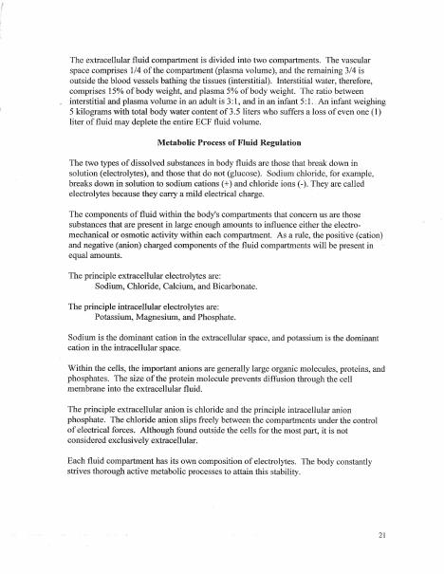
Calculations
06
mL/hour equals volume divided by hours. gtt/min equals volume times tubing drop factor divided by minutes. Label units, round only at the final step, and check whether the result is clinically reasonable.
Notes:
Sources: Supplied Basic Intravenous Therapy Certification manual, pages 17-21.
Current legal reference: Florida Administrative Code Rule 64B9-12.005, effective July 20, 2023; Florida Statutes section 464.003 (2026). Instructor must verify current institutional policy and drug/device guidance before use.

Slide 7
Practice and competency check
07
1. Calculate 1,000 mL over 8 hours on a pump
2. Calculate 250 mL over 90 minutes using 15 gtt/mL tubing
3. Choose monitoring priorities for fluid deficit and fluid excess
Complete the matching online lesson and quiz before attending the skills lab.
Notes:
Sources: Supplied Basic Intravenous Therapy Certification manual, pages 17. Online preparation precedes live practice.
Current legal reference: Florida Administrative Code Rule 64B9-12.005, effective July 20, 2023; Florida Statutes section 464.003 (2026). Instructor must verify current institutional policy and drug/device guidance before use.

