Slide 1
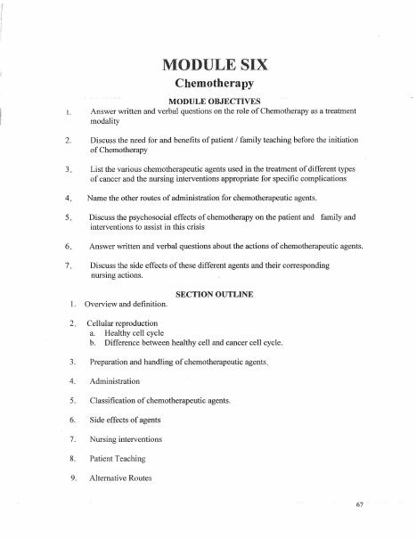
BROWARD-MIAMI HEALTH INSTITUTE
Chemotherapy Safety
Module 6
30-Hour Basic Intravenous Therapy
Notes:
Sources: Supplied Basic Intravenous Therapy Certification manual, pages 67.
Current legal reference: Florida Administrative Code Rule 64B9-12.005, effective July 20, 2023; Florida Statutes section 464.003 (2026). Instructor must verify current institutional policy and drug/device guidance before use.

Slide 2
Learning objectives
02
1. Explain major treatment concepts and common adverse effects
2. Describe safe handling and exposure precautions
3. Recognize extravasation and other urgent complications
Notes:
Sources: Supplied Basic Intravenous Therapy Certification manual, pages 67.
Current legal reference: Florida Administrative Code Rule 64B9-12.005, effective July 20, 2023; Florida Statutes section 464.003 (2026). Instructor must verify current institutional policy and drug/device guidance before use.

Slide 3
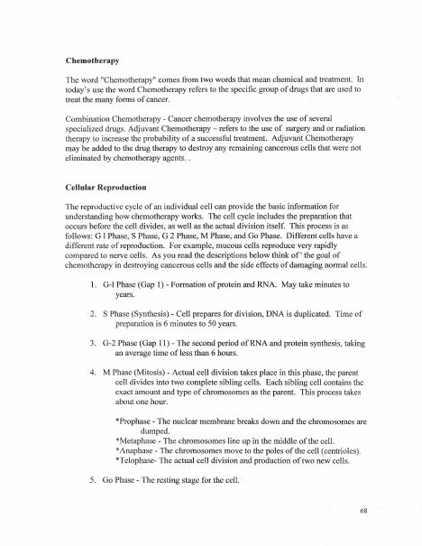
Role and limits
03
Cancer therapy may use multiple agents and routes. LPN participation must stay within current Florida rules, direct-supervision requirements, validated competency, and institutional policy.
Notes:
Sources: Supplied Basic Intravenous Therapy Certification manual, pages 67-68.
Current legal reference: Florida Administrative Code Rule 64B9-12.005, effective July 20, 2023; Florida Statutes section 464.003 (2026). Instructor must verify current institutional policy and drug/device guidance before use.

Slide 4
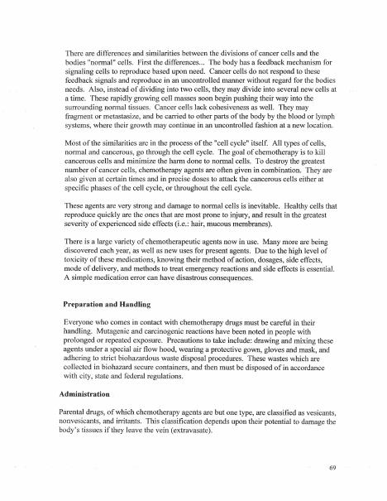
Patient assessment
04
Review the regimen, laboratory results, allergies, access device, premedications, hydration, current symptoms, and emergency plan. Verify the protocol and independent checks required for high-alert therapy.
Notes:
Sources: Supplied Basic Intravenous Therapy Certification manual, pages 67-69.
Current legal reference: Florida Administrative Code Rule 64B9-12.005, effective July 20, 2023; Florida Statutes section 464.003 (2026). Instructor must verify current institutional policy and drug/device guidance before use.

Slide 5
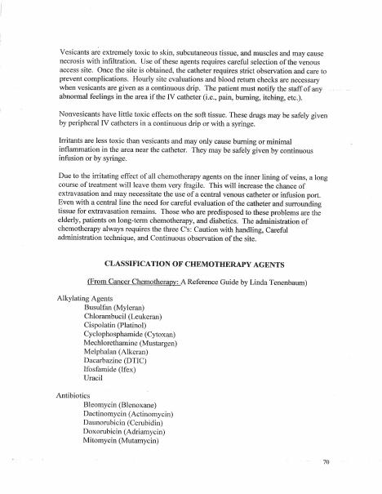
Exposure prevention
05
Use chemotherapy-rated PPE and closed or secure connections according to policy. Keep required spill materials available. Dispose of contaminated supplies and bodily waste using hazardous-drug procedures.
Notes:
Sources: Supplied Basic Intravenous Therapy Certification manual, pages 67-70.
Current legal reference: Florida Administrative Code Rule 64B9-12.005, effective July 20, 2023; Florida Statutes section 464.003 (2026). Instructor must verify current institutional policy and drug/device guidance before use.

Slide 6
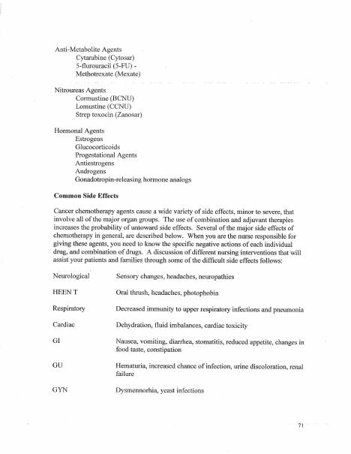
Extravasation
06
Pain, burning, swelling, resistance, leakage, or loss of blood return can signal extravasation. Stop the drug, leave access in place when the agent-specific protocol requires aspiration or antidote, notify the qualified clinician, and follow the exact drug protocol.
Notes:
Sources: Supplied Basic Intravenous Therapy Certification manual, pages 67-71.
Current legal reference: Florida Administrative Code Rule 64B9-12.005, effective July 20, 2023; Florida Statutes section 464.003 (2026). Instructor must verify current institutional policy and drug/device guidance before use.

Slide 7
Practice and competency check
07
1. Identify findings that require an immediate stop
2. Select PPE for preparation, administration, and spill response
3. Rehearse the facility extravasation algorithm
Complete the matching online lesson and quiz before attending the skills lab.
Notes:
Sources: Supplied Basic Intravenous Therapy Certification manual, pages 67. Online preparation precedes live practice.
Current legal reference: Florida Administrative Code Rule 64B9-12.005, effective July 20, 2023; Florida Statutes section 464.003 (2026). Instructor must verify current institutional policy and drug/device guidance before use.

