Slide 1
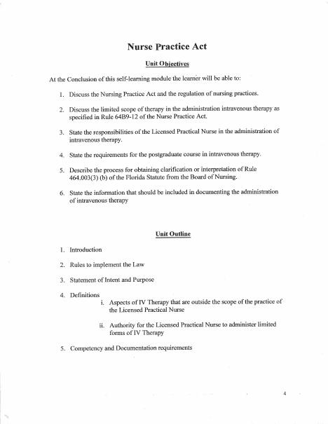
BROWARD-MIAMI HEALTH INSTITUTE
Florida Scope and Safe IV Practice
Module 1
30-Hour Basic Intravenous Therapy
Notes:
Sources: Supplied Basic Intravenous Therapy Certification manual, pages 4.
Current legal reference: Florida Administrative Code Rule 64B9-12.005, effective July 20, 2023; Florida Statutes section 464.003 (2026). Instructor must verify current institutional policy and drug/device guidance before use.

Slide 2
Learning objectives
02
1. Explain how Florida law and Board rules govern practical nursing
2. Identify IV activities that require direction or direct supervision
3. Describe education, competency verification, and documentation duties
Notes:
Sources: Supplied Basic Intravenous Therapy Certification manual, pages 4.
Current legal reference: Florida Administrative Code Rule 64B9-12.005, effective July 20, 2023; Florida Statutes section 464.003 (2026). Instructor must verify current institutional policy and drug/device guidance before use.

Slide 3
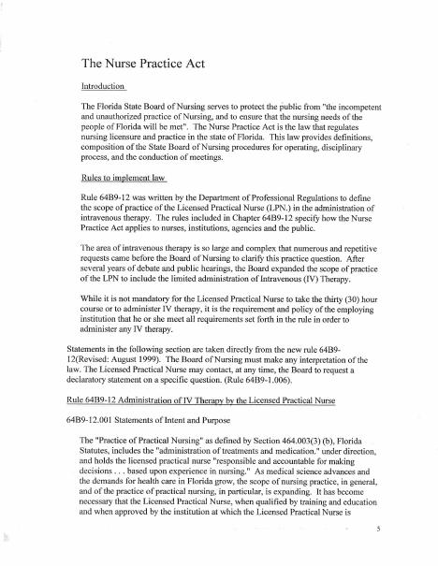
Scope begins with current authority
03
Florida Statutes define practical nursing as selected nursing acts performed under authorized direction. Education and experience set personal limits. Employer policy may narrow the permitted role.
Notes:
Sources: Supplied Basic Intravenous Therapy Certification manual, pages 4-5.
Current legal reference: Florida Administrative Code Rule 64B9-12.005, effective July 20, 2023; Florida Statutes section 464.003 (2026). Instructor must verify current institutional policy and drug/device guidance before use.

Slide 4
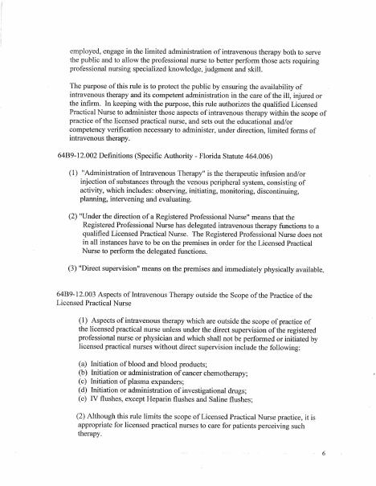
The 30-hour qualification
04
Florida Administrative Code Rule 64B9-12.005 requires at least 30 hours of post-graduate IV education for an LPN or graduate practical nurse who needs this qualification. Course content must cover the required cognitive and clinical areas.
Notes:
Sources: Supplied Basic Intravenous Therapy Certification manual, pages 4-6.
Current legal reference: Florida Administrative Code Rule 64B9-12.005, effective July 20, 2023; Florida Statutes section 464.003 (2026). Instructor must verify current institutional policy and drug/device guidance before use.

Slide 5
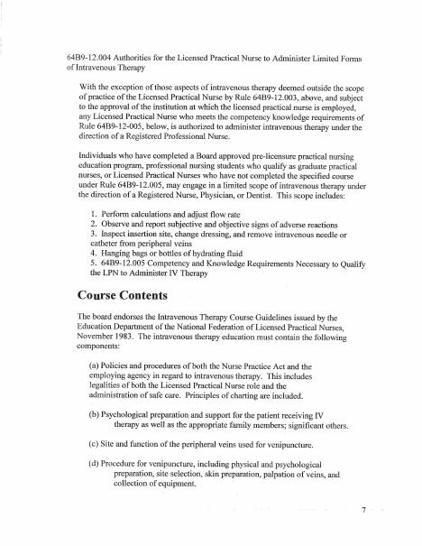
Central-line preparation
05
Central-line practice requires at least four hours of instruction that may count within the 30 hours. Training includes anatomy, site assessment, dressing and cap changes, flushing, administration, blood collection, and complication response.
Notes:
Sources: Supplied Basic Intravenous Therapy Certification manual, pages 4-7.
Current legal reference: Florida Administrative Code Rule 64B9-12.005, effective July 20, 2023; Florida Statutes section 464.003 (2026). Instructor must verify current institutional policy and drug/device guidance before use.

Slide 6
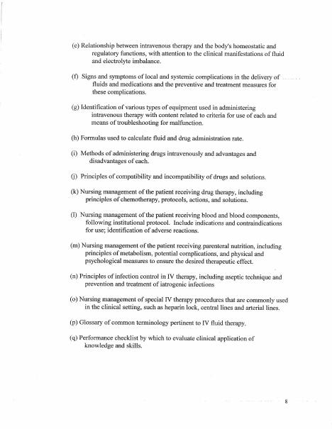
Clinical competence and records
06
A Florida-licensed RN witnesses clinical practice and files a proficiency statement. The employing institution verifies competence under its protocol. Documentation identifies the device, site, solution, delivery method, assessment, response, and complications.
Notes:
Sources: Supplied Basic Intravenous Therapy Certification manual, pages 4-8.
Current legal reference: Florida Administrative Code Rule 64B9-12.005, effective July 20, 2023; Florida Statutes section 464.003 (2026). Instructor must verify current institutional policy and drug/device guidance before use.

Slide 7
Practice and competency check
07
1. Classify five IV tasks as permitted, restricted, or requiring direct supervision
2. Review an incomplete order and identify the clarification needed
3. Write a complete peripheral IV documentation entry
Complete the matching online lesson and quiz before attending the skills lab.
Notes:
Sources: Supplied Basic Intravenous Therapy Certification manual, pages 4. Online preparation precedes live practice.
Current legal reference: Florida Administrative Code Rule 64B9-12.005, effective July 20, 2023; Florida Statutes section 464.003 (2026). Instructor must verify current institutional policy and drug/device guidance before use.

