Slide 1
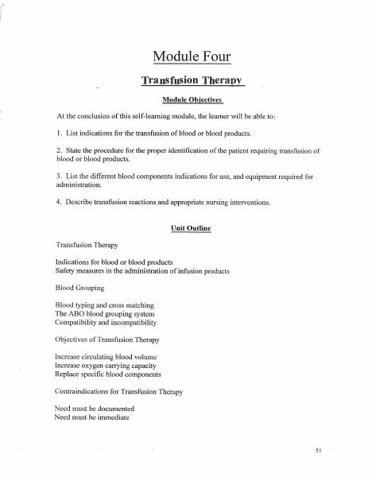
BROWARD-MIAMI HEALTH INSTITUTE
Transfusion Therapy
Module 4
30-Hour Basic Intravenous Therapy
Notes:
Sources: Supplied Basic Intravenous Therapy Certification manual, pages 51.
Current legal reference: Florida Administrative Code Rule 64B9-12.005, effective July 20, 2023; Florida Statutes section 464.003 (2026). Instructor must verify current institutional policy and drug/device guidance before use.

Slide 2
Learning objectives
02
1. Identify common blood components and indications
2. Apply patient and product verification safeguards
3. Recognize transfusion reactions and initiate the correct response
Notes:
Sources: Supplied Basic Intravenous Therapy Certification manual, pages 51.
Current legal reference: Florida Administrative Code Rule 64B9-12.005, effective July 20, 2023; Florida Statutes section 464.003 (2026). Instructor must verify current institutional policy and drug/device guidance before use.

Slide 3
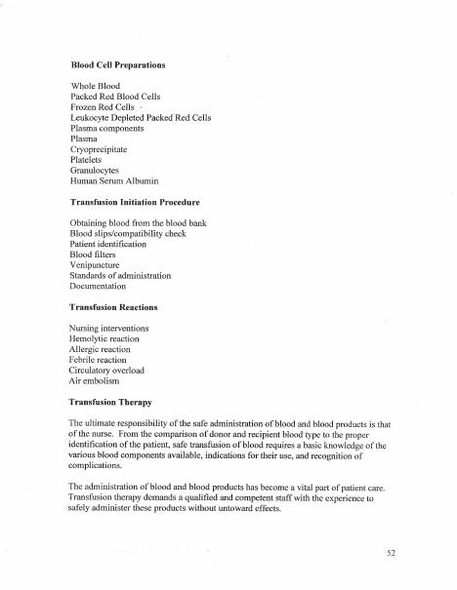
Therapeutic goals
03
Blood components may restore oxygen-carrying capacity, circulating volume, platelets, or coagulation factors. Verify the current indication and prescriber order for the specific component.
Notes:
Sources: Supplied Basic Intravenous Therapy Certification manual, pages 51-52.
Current legal reference: Florida Administrative Code Rule 64B9-12.005, effective July 20, 2023; Florida Statutes section 464.003 (2026). Instructor must verify current institutional policy and drug/device guidance before use.

Slide 4
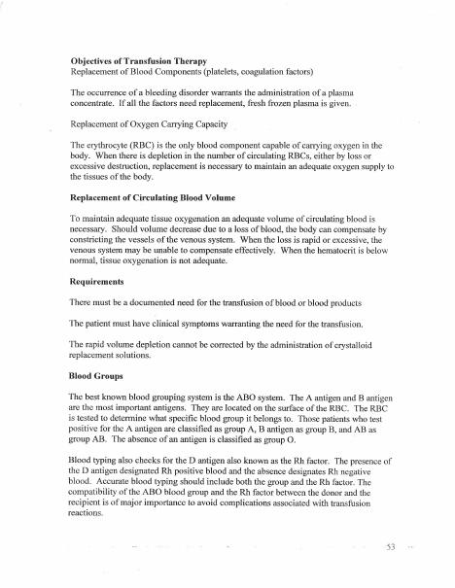
Verification
04
Use the institution's approved two-person or electronic verification process. Match the patient, order, compatibility record, unit identifiers, expiration, and product appearance before connection.
Notes:
Sources: Supplied Basic Intravenous Therapy Certification manual, pages 51-53.
Current legal reference: Florida Administrative Code Rule 64B9-12.005, effective July 20, 2023; Florida Statutes section 464.003 (2026). Instructor must verify current institutional policy and drug/device guidance before use.

Slide 5
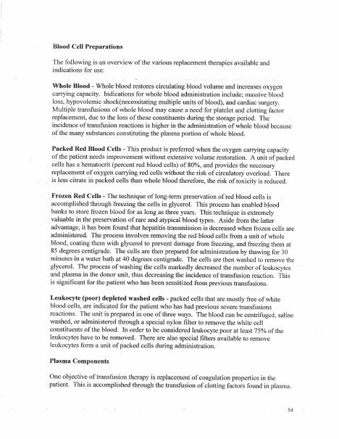
Administration
05
Obtain baseline assessment, use approved blood tubing and compatible solution, begin within the required time, remain available during the early period, and monitor at policy-defined intervals.
Notes:
Sources: Supplied Basic Intravenous Therapy Certification manual, pages 51-54.
Current legal reference: Florida Administrative Code Rule 64B9-12.005, effective July 20, 2023; Florida Statutes section 464.003 (2026). Instructor must verify current institutional policy and drug/device guidance before use.

Slide 6
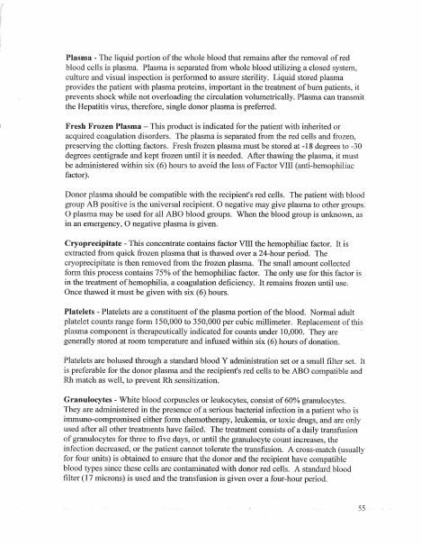
Suspected reaction
06
Stop the transfusion immediately. Maintain access as policy directs, assess airway and circulation, obtain vital signs, notify the RN and prescriber, recheck identification, and complete required specimens and documentation.
Notes:
Sources: Supplied Basic Intravenous Therapy Certification manual, pages 51-55.
Current legal reference: Florida Administrative Code Rule 64B9-12.005, effective July 20, 2023; Florida Statutes section 464.003 (2026). Instructor must verify current institutional policy and drug/device guidance before use.

Slide 7
Practice and competency check
07
1. Complete a mock bedside verification
2. Differentiate allergic, febrile, hemolytic, overload, and septic findings
3. Use SBAR to report a suspected reaction
Complete the matching online lesson and quiz before attending the skills lab.
Notes:
Sources: Supplied Basic Intravenous Therapy Certification manual, pages 51. Online preparation precedes live practice.
Current legal reference: Florida Administrative Code Rule 64B9-12.005, effective July 20, 2023; Florida Statutes section 464.003 (2026). Instructor must verify current institutional policy and drug/device guidance before use.

