Slide 1
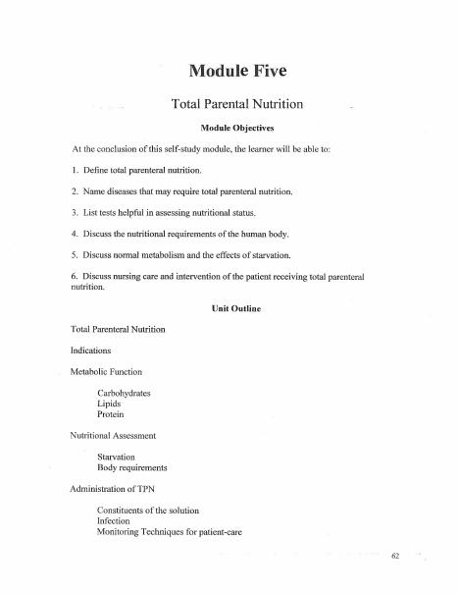
BROWARD-MIAMI HEALTH INSTITUTE
Parenteral Nutrition
Module 5
30-Hour Basic Intravenous Therapy
Notes:
Sources: Supplied Basic Intravenous Therapy Certification manual, pages 62.
Current legal reference: Florida Administrative Code Rule 64B9-12.005, effective July 20, 2023; Florida Statutes section 464.003 (2026). Instructor must verify current institutional policy and drug/device guidance before use.

Slide 2
Learning objectives
02
1. Explain indications and major components of parenteral nutrition
2. Distinguish peripheral from central administration
3. Recognize metabolic, infectious, and mechanical complications
Notes:
Sources: Supplied Basic Intravenous Therapy Certification manual, pages 62.
Current legal reference: Florida Administrative Code Rule 64B9-12.005, effective July 20, 2023; Florida Statutes section 464.003 (2026). Instructor must verify current institutional policy and drug/device guidance before use.

Slide 3
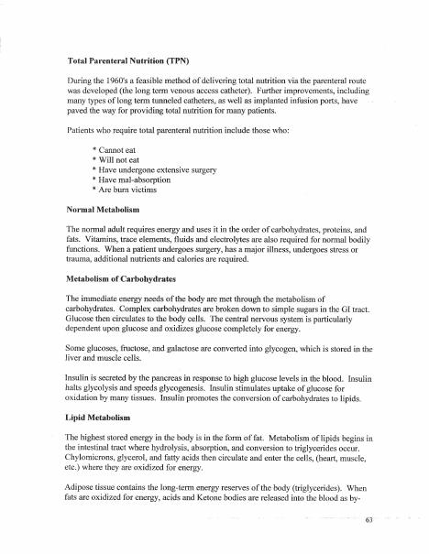
Why parenteral nutrition is used
03
Parenteral nutrition supports patients whose gastrointestinal tract cannot meet nutritional needs. Formulations may contain amino acids, dextrose, electrolytes, vitamins, trace elements, fluid, and lipids.
Notes:
Sources: Supplied Basic Intravenous Therapy Certification manual, pages 62-63.
Current legal reference: Florida Administrative Code Rule 64B9-12.005, effective July 20, 2023; Florida Statutes section 464.003 (2026). Instructor must verify current institutional policy and drug/device guidance before use.

Slide 4
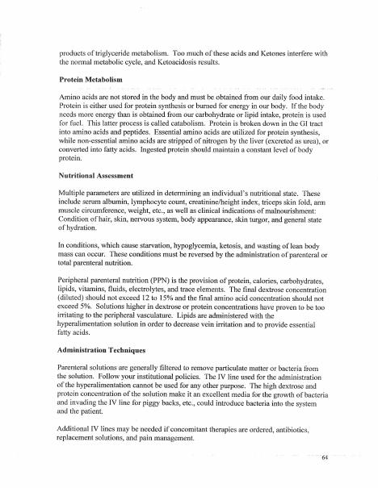
Route and concentration
04
Peripheral formulations have lower osmolarity and limited duration. Concentrated formulations generally require central access. Verify the prescribed route, formulation, filter, tubing, and dedicated lumen.
Notes:
Sources: Supplied Basic Intravenous Therapy Certification manual, pages 62-64.
Current legal reference: Florida Administrative Code Rule 64B9-12.005, effective July 20, 2023; Florida Statutes section 464.003 (2026). Instructor must verify current institutional policy and drug/device guidance before use.

Slide 5
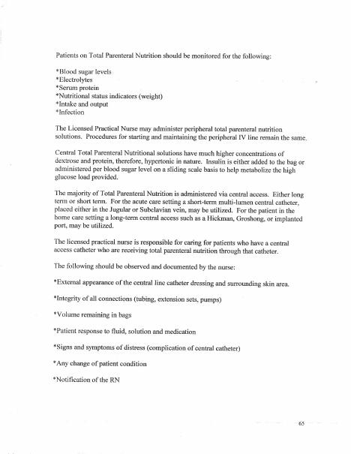
Safe administration
05
Use strict asepsis, compare the bag with the order, inspect for separation or precipitate, program the exact rate, and avoid unapproved concurrent medications. Do not accelerate a delayed infusion.
Notes:
Sources: Supplied Basic Intravenous Therapy Certification manual, pages 62-65.
Current legal reference: Florida Administrative Code Rule 64B9-12.005, effective July 20, 2023; Florida Statutes section 464.003 (2026). Instructor must verify current institutional policy and drug/device guidance before use.

Slide 6
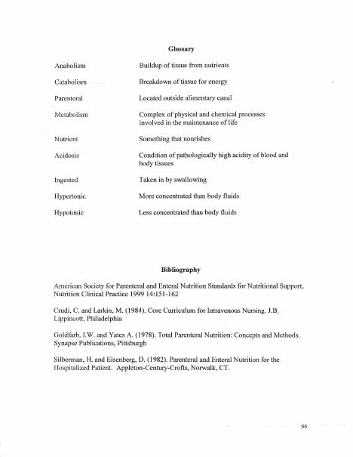
Monitoring
06
Monitor glucose, fluid balance, weight, electrolytes, liver and renal indicators, triglycerides when lipids are used, site and line condition, temperature, and signs of refeeding syndrome or bloodstream infection.
Notes:
Sources: Supplied Basic Intravenous Therapy Certification manual, pages 62-66.
Current legal reference: Florida Administrative Code Rule 64B9-12.005, effective July 20, 2023; Florida Statutes section 464.003 (2026). Instructor must verify current institutional policy and drug/device guidance before use.

Slide 7
Practice and competency check
07
1. Inspect a simulated PN label and identify discrepancies
2. Respond to a bag running two hours behind
3. Plan monitoring for a patient starting concentrated PN
Complete the matching online lesson and quiz before attending the skills lab.
Notes:
Sources: Supplied Basic Intravenous Therapy Certification manual, pages 62. Online preparation precedes live practice.
Current legal reference: Florida Administrative Code Rule 64B9-12.005, effective July 20, 2023; Florida Statutes section 464.003 (2026). Instructor must verify current institutional policy and drug/device guidance before use.

