Slide 1
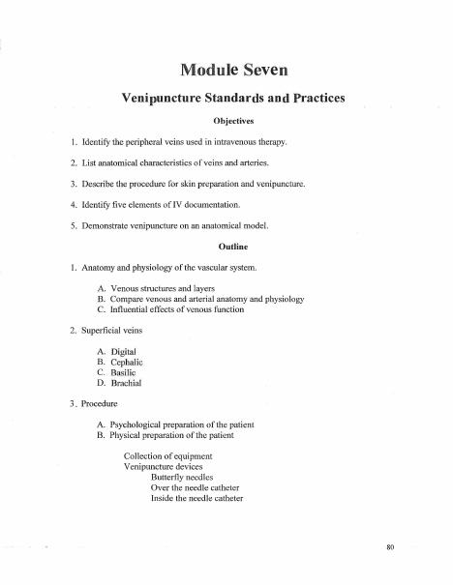
BROWARD-MIAMI HEALTH INSTITUTE
Venipuncture Standards and Practice
Module 7
30-Hour Basic Intravenous Therapy
Notes:
Sources: Supplied Basic Intravenous Therapy Certification manual, pages 80.
Current legal reference: Florida Administrative Code Rule 64B9-12.005, effective July 20, 2023; Florida Statutes section 464.003 (2026). Instructor must verify current institutional policy and drug/device guidance before use.

Slide 2
Learning objectives
02
1. Select an appropriate peripheral vein and catheter
2. Perform aseptic insertion and securement on a task trainer
3. Assess, maintain, and discontinue a peripheral IV safely
Notes:
Sources: Supplied Basic Intravenous Therapy Certification manual, pages 80.
Current legal reference: Florida Administrative Code Rule 64B9-12.005, effective July 20, 2023; Florida Statutes section 464.003 (2026). Instructor must verify current institutional policy and drug/device guidance before use.

Slide 3
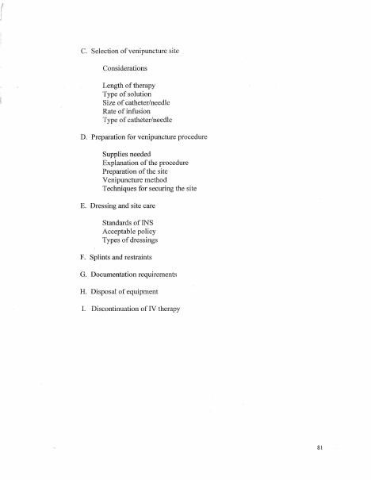
Site and device selection
03
Begin distally when appropriate. Avoid compromised extremities and sites of infection, flexion, poor circulation, or prior complications. Select the smallest gauge and shortest catheter that can support the ordered therapy.
Notes:
Sources: Supplied Basic Intravenous Therapy Certification manual, pages 80-81.
Current legal reference: Florida Administrative Code Rule 64B9-12.005, effective July 20, 2023; Florida Statutes section 464.003 (2026). Instructor must verify current institutional policy and drug/device guidance before use.

Slide 4
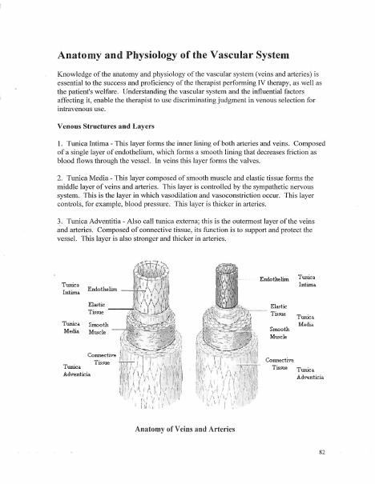
Aseptic insertion
04
Perform hand hygiene, prepare and position the patient, apply the tourniquet, cleanse the site with the approved antiseptic, let it dry, stabilize the vein, observe flashback, thread the catheter, and activate sharps protection.
Notes:
Sources: Supplied Basic Intravenous Therapy Certification manual, pages 80-82.
Current legal reference: Florida Administrative Code Rule 64B9-12.005, effective July 20, 2023; Florida Statutes section 464.003 (2026). Instructor must verify current institutional policy and drug/device guidance before use.

Slide 5
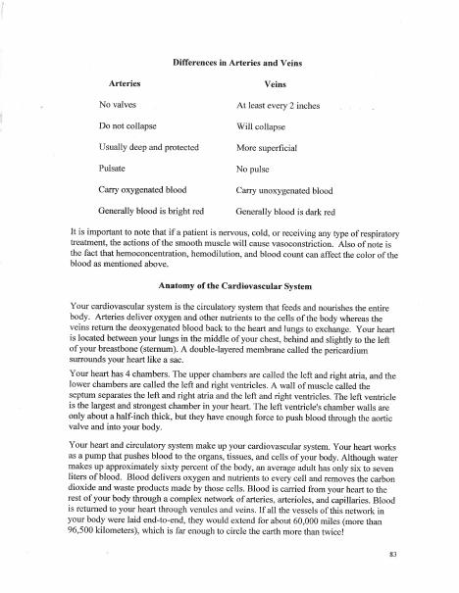
Securement and maintenance
05
Connect a primed extension aseptically, assess patency without force, secure the catheter, apply and label the dressing, trace tubing, start the ordered therapy, and reassess the site and patient.
Notes:
Sources: Supplied Basic Intravenous Therapy Certification manual, pages 80-83.
Current legal reference: Florida Administrative Code Rule 64B9-12.005, effective July 20, 2023; Florida Statutes section 464.003 (2026). Instructor must verify current institutional policy and drug/device guidance before use.

Slide 6
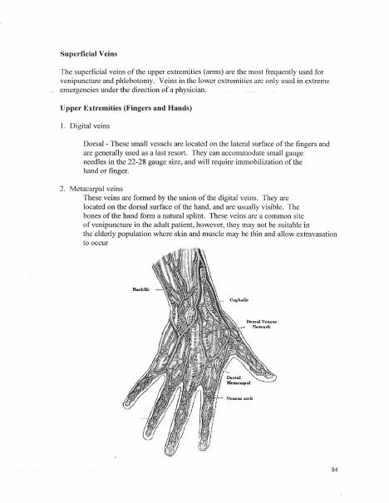
Complication cues
06
Cool swelling suggests infiltration. Pain, warmth, redness, or a venous cord suggests phlebitis. Burning or tissue injury with a vesicant suggests extravasation. Stop unsafe therapy and follow the condition-specific protocol.
Notes:
Sources: Supplied Basic Intravenous Therapy Certification manual, pages 80-84.
Current legal reference: Florida Administrative Code Rule 64B9-12.005, effective July 20, 2023; Florida Statutes section 464.003 (2026). Instructor must verify current institutional policy and drug/device guidance before use.

Slide 7
Practice and competency check
07
1. Palpate and select veins on a task trainer
2. Perform the complete insertion sequence without contamination
3. Discontinue the catheter and verify that it remains intact
Complete the matching online lesson and quiz before attending the skills lab.
Notes:
Sources: Supplied Basic Intravenous Therapy Certification manual, pages 80. Online preparation precedes live practice.
Current legal reference: Florida Administrative Code Rule 64B9-12.005, effective July 20, 2023; Florida Statutes section 464.003 (2026). Instructor must verify current institutional policy and drug/device guidance before use.

