Slide 1
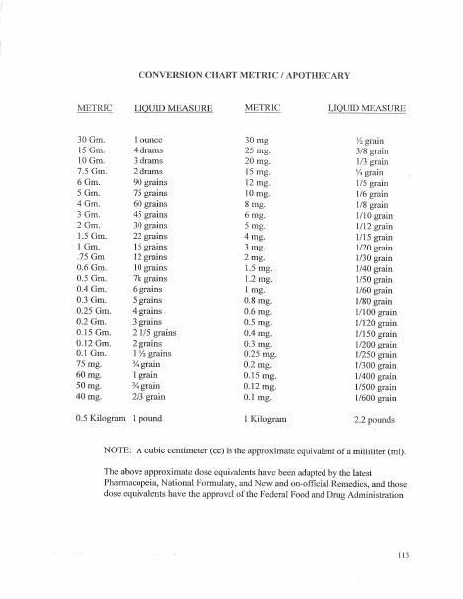
BROWARD-MIAMI HEALTH INSTITUTE
In-Person IV Skills Lab
Module 8
30-Hour Basic Intravenous Therapy
Notes:
Sources: Supplied Basic Intravenous Therapy Certification manual, pages 109.
Current legal reference: Florida Administrative Code Rule 64B9-12.005, effective July 20, 2023; Florida Statutes section 464.003 (2026). Instructor must verify current institutional policy and drug/device guidance before use.

Slide 2
Learning objectives
02
1. Demonstrate required psychomotor skills under direct observation
2. Respond to infusion problems and complications
3. Complete RN-verified competency records
Notes:
Sources: Supplied Basic Intravenous Therapy Certification manual, pages 109.
Current legal reference: Florida Administrative Code Rule 64B9-12.005, effective July 20, 2023; Florida Statutes section 464.003 (2026). Instructor must verify current institutional policy and drug/device guidance before use.

Slide 3
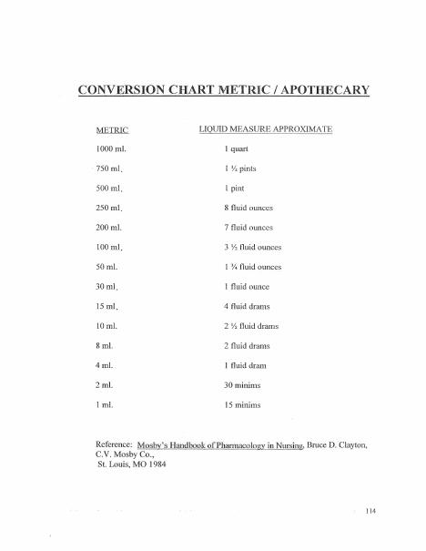
Station 1: equipment and calculations
03
Verify orders, select fluids and tubing, inspect supplies, prime without air, calculate pump and gravity rates, trace lines, and correct common pump alarms.
Notes:
Sources: Supplied Basic Intravenous Therapy Certification manual, pages 109-110.
Current legal reference: Florida Administrative Code Rule 64B9-12.005, effective July 20, 2023; Florida Statutes section 464.003 (2026). Instructor must verify current institutional policy and drug/device guidance before use.

Slide 4
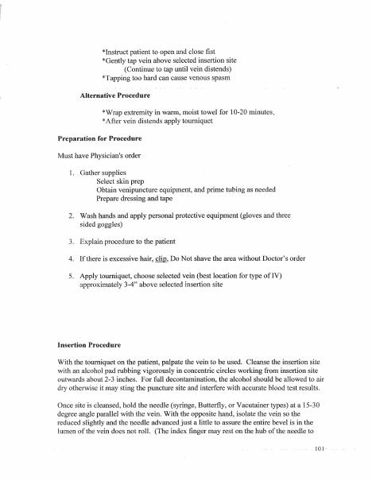
Station 2: peripheral insertion
04
Prepare the patient and site, select a vein and catheter, insert on a task trainer, connect and assess patency, secure and dress the site, initiate therapy, teach the patient, and document.
Notes:
Sources: Supplied Basic Intravenous Therapy Certification manual, pages 109-111.
Current legal reference: Florida Administrative Code Rule 64B9-12.005, effective July 20, 2023; Florida Statutes section 464.003 (2026). Instructor must verify current institutional policy and drug/device guidance before use.

Slide 5
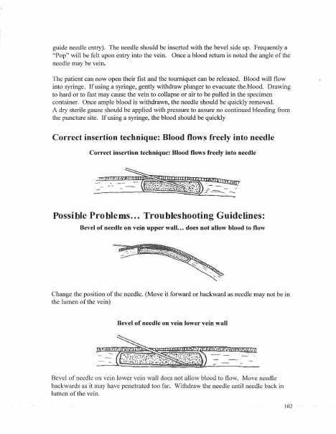
Station 3: secondary infusion and access care
05
Verify compatibility, prepare an IV piggyback, program the pump, use the required flushing sequence, evaluate peripheral and central-device dressings, and identify actions outside the learner's authorized role.
Notes:
Sources: Supplied Basic Intravenous Therapy Certification manual, pages 109-112.
Current legal reference: Florida Administrative Code Rule 64B9-12.005, effective July 20, 2023; Florida Statutes section 464.003 (2026). Instructor must verify current institutional policy and drug/device guidance before use.

Slide 6
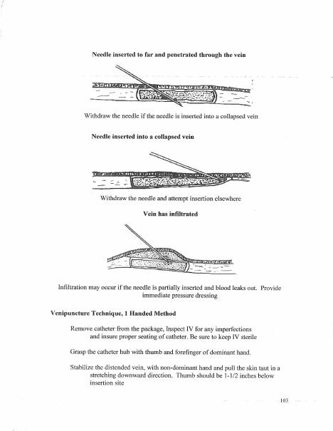
Station 4: complications
06
Respond to infiltration, extravasation, phlebitis, fluid overload, allergic reaction, transfusion reaction, air risk, occlusion, and suspected catheter damage. State the immediate action and escalation path.
Notes:
Sources: Supplied Basic Intravenous Therapy Certification manual, pages 109-113.
Current legal reference: Florida Administrative Code Rule 64B9-12.005, effective July 20, 2023; Florida Statutes section 464.003 (2026). Instructor must verify current institutional policy and drug/device guidance before use.

Slide 7
Practice and competency check
07
1. Pass every critical element on the skills checklist
2. Repeat any missed critical step after remediation
3. Obtain the Florida RN evaluator's dated proficiency statement
In-person evaluation: every critical element must pass under direct observation.
Notes:
Sources: Supplied Basic Intravenous Therapy Certification manual, pages 109. Skills evaluation requires direct observation and written RN verification.
Current legal reference: Florida Administrative Code Rule 64B9-12.005, effective July 20, 2023; Florida Statutes section 464.003 (2026). Instructor must verify current institutional policy and drug/device guidance before use.

