Slide 1
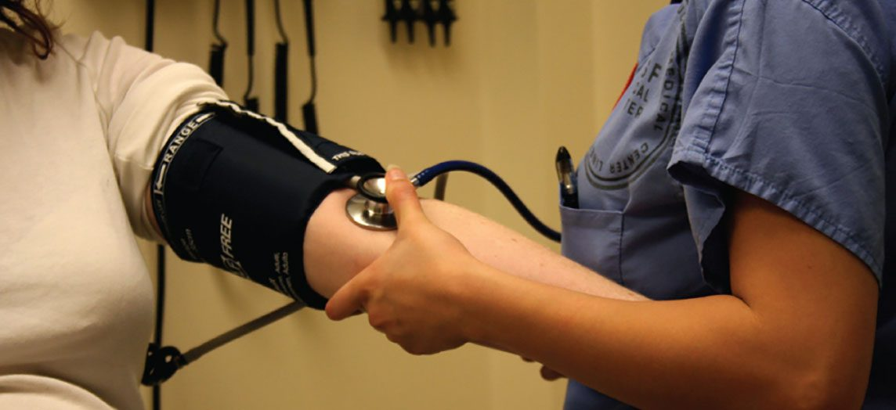
CHAPTER 1
An Introduction to the Human Body
Anatomy, physiology, levels of organization, homeostasis,
and the language of the body.
Anatomy & Physiology · Broward-Miami Health Institute
FACULTY EDITION

Slide 2
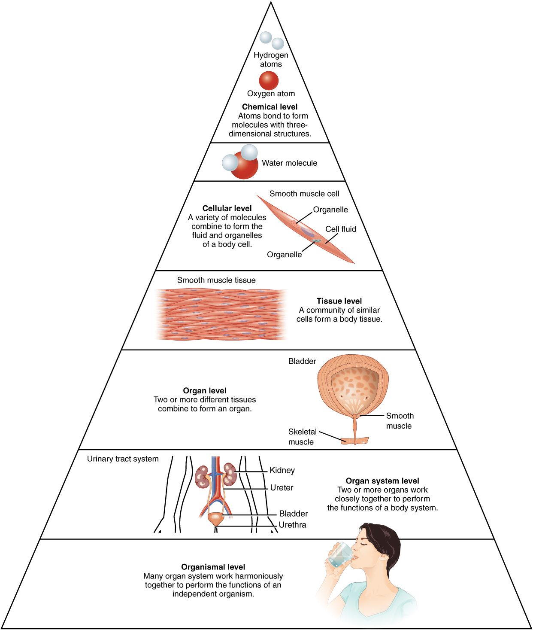
CHAPTER 1
Learning Objectives
After studying this chapter, students will be able to:
1
Distinguish between anatomy and physiology, and identify several branches of each
2
Describe the structure of the body, from simplest to most complex, in terms of the six levels of organization
3
Identify the functional characteristics of human life
4
Identify the four requirements for human survival
5
Define homeostasis and explain its importance to normal human functioning
6
Use appropriate anatomical terminology to identify key body structures, body regions, and directions in the body
The body's levels of organization — the roadmap for this chapter.
PN 104 · Ch 1 — An Introduction to the Human Body
2
Notes:
Set up the chapter: this is the foundation for the whole course. Anatomy and physiology, the hierarchy of organization, what defines life, what the body requires, how it stays balanced (homeostasis), and the standardized terminology used in every clinical setting. Preview that nearly every concept here reappears in patient assessment.

Slide 3
1.1
SECTION
Overview of Anatomy and Physiology
The study of the body's structure and how its parts function — and why the two are inseparable.

Slide 4
SECTION 1.1
Anatomy & Physiology in Action
Anatomy = structure; physiology = function
Form and function are always linked
Gross (macroscopic) vs. microscopic anatomy
A blood-pressure reading is physiology at the bedside
Measuring blood pressure — physiology you assess every shift
PN 104 · Ch 1 — An Introduction to the Human Body
4
Notes:
Open with the core distinction: anatomy is what structures are and where; physiology is how they work. Stress that structure and function are inseparable — a structure's shape enables its job. Note the subdivisions: gross/macroscopic versus microscopic (cytology, histology), and regional versus systemic approaches. The blood-pressure cuff is a perfect example of physiology you assess at the bedside.

Slide 5
1.2
SECTION
Structural Organization of the Human Body
From atoms to the whole organism — six levels of increasing complexity, and the eleven organ systems.

Slide 6
SECTION 1.2
The Six Levels of Organization
Chemical → cellular → tissue → organ → system → organism
Each level builds on the one below it
The cell is the smallest unit of life
Complexity rises from atom to whole person
The levels of structural organization in the body
PN 104 · Ch 1 — An Introduction to the Human Body
6
Notes:
Walk up the pyramid: atoms and molecules (chemical level) build organelles and cells; similar cells form tissues; tissues combine into organs; organs working together form organ systems; all systems together form the organism. Emphasize the cell as the basic unit of life. This hierarchy is the scaffolding for the entire course.

Slide 7
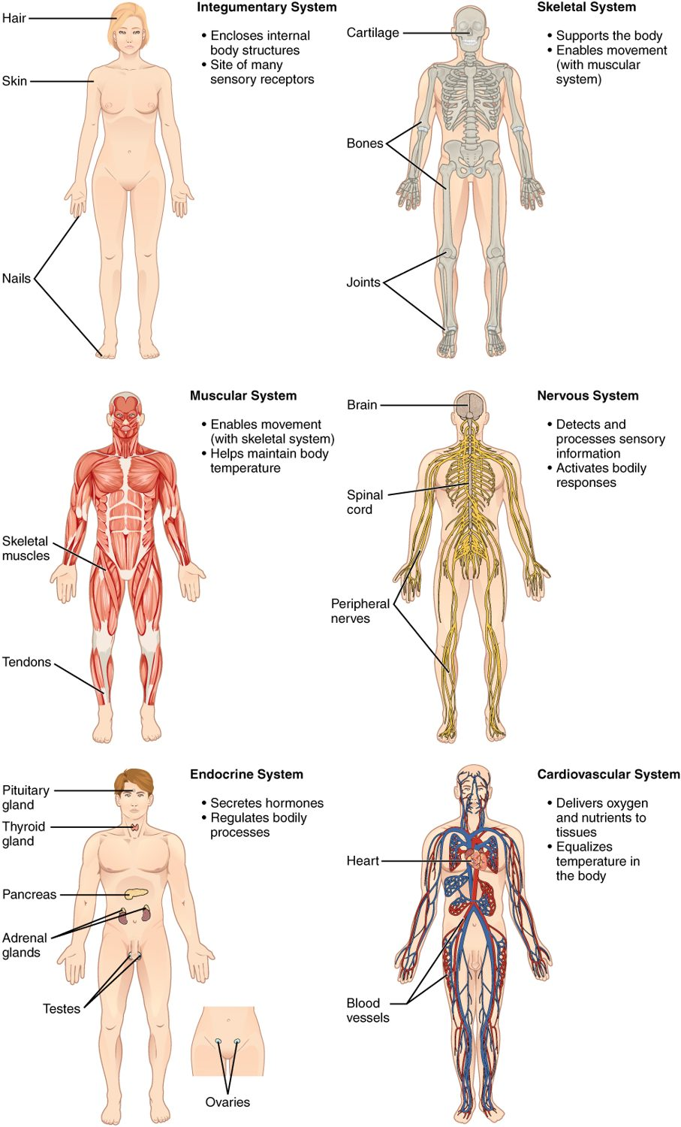
SECTION 1.2
Organ Systems of the Body (I)
Integumentary, skeletal, and muscular systems
Nervous and endocrine — the body's control systems
Cardiovascular system transports blood
Each system has distinct organs and roles
Organ systems and their major organs (part 1)
PN 104 · Ch 1 — An Introduction to the Human Body
7
Notes:
Survey the first set of organ systems and their primary jobs: integumentary (protection, temperature), skeletal (support, movement, blood-cell formation), muscular (movement, heat), nervous (rapid control), endocrine (hormonal control), and cardiovascular (transport). Students don't need mastery yet — this is the map; each system gets its own chapter later.

Slide 8
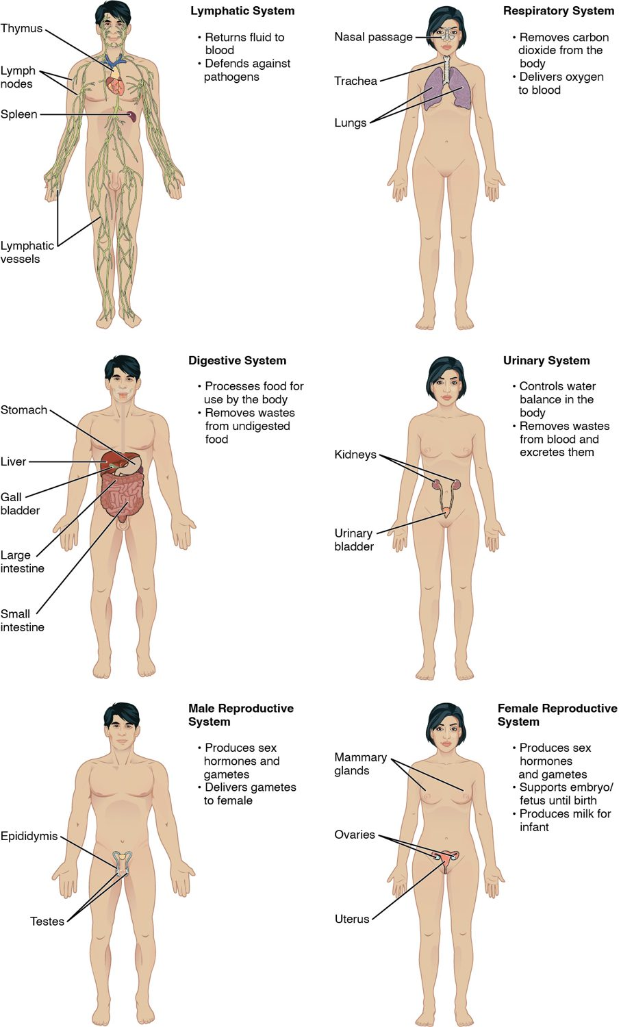
SECTION 1.2
Organ Systems of the Body (II)
Lymphatic/immune and respiratory systems
Digestive and urinary systems
Male and female reproductive systems
All eleven systems work interdependently
Organ systems and their major organs (part 2)
PN 104 · Ch 1 — An Introduction to the Human Body
8
Notes:
Continue the survey: lymphatic/immune (defense and fluid balance), respiratory (gas exchange), digestive (nutrient breakdown and absorption), urinary (waste removal and fluid balance), and reproductive (continuation of the species). Reinforce that the eleven systems are interdependent — no system functions alone.

Slide 9
1.3
SECTION
Functions of Human Life
The processes that distinguish the living human body — organization, metabolism, responsiveness, and more.

Slide 10
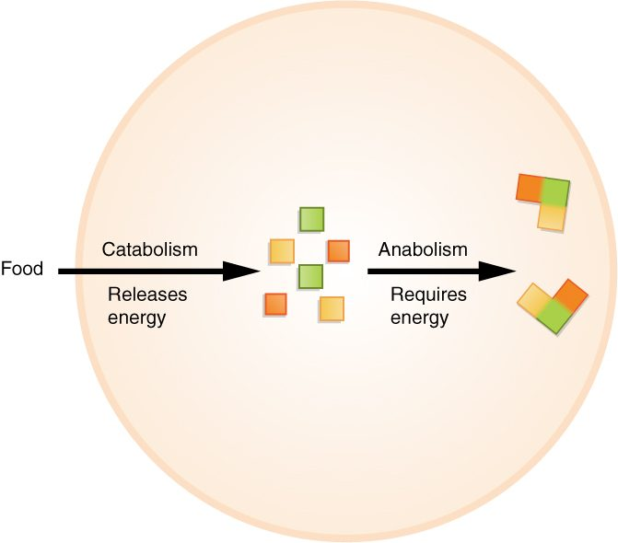
SECTION 1.3
Functions of Human Life
Organization, metabolism, responsiveness
Movement, development, and reproduction
Metabolism = catabolism + anabolism
Catabolism releases energy; anabolism builds
Metabolism: catabolism releases energy, anabolism uses it
PN 104 · Ch 1 — An Introduction to the Human Body
10
Notes:
List the characteristics that define human life: organization, metabolism, responsiveness, movement, development, and reproduction. Use the figure to teach metabolism — catabolism breaks molecules down and releases energy, while anabolism uses that energy to build larger molecules. Together they keep the body running.

Slide 11
1.4
SECTION
Requirements for Human Life
Oxygen, nutrients, water, and narrow ranges of temperature and atmospheric pressure.

Slide 12
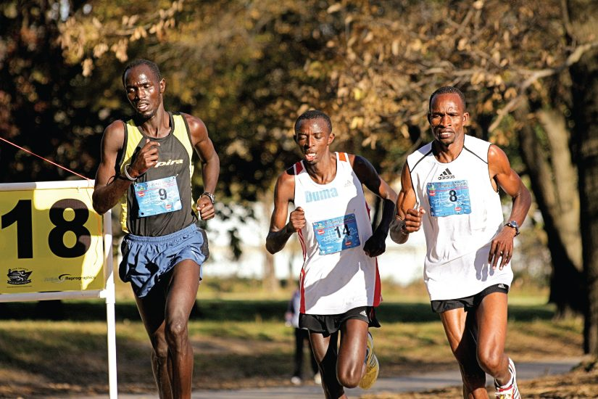
SECTION 1.4
Requirements for Human Survival
Oxygen, nutrients, and water
Narrow ranges of temperature and pressure
Demand rises sharply during activity
Survival depends on meeting all of these
The body's demands climb steeply with activity
PN 104 · Ch 1 — An Introduction to the Human Body
12
Notes:
The body requires oxygen (to make ATP), nutrients (energy and building blocks), water (the medium for most reactions and about 70% of body mass), a narrow temperature range, and appropriate atmospheric pressure for gas exchange. Activity multiplies oxygen and nutrient demand — a useful tie-in to exercise tolerance and respiratory and cardiac assessment.

Slide 13
1.5
SECTION
Homeostasis
How the body maintains a stable internal environment through feedback.

Slide 14
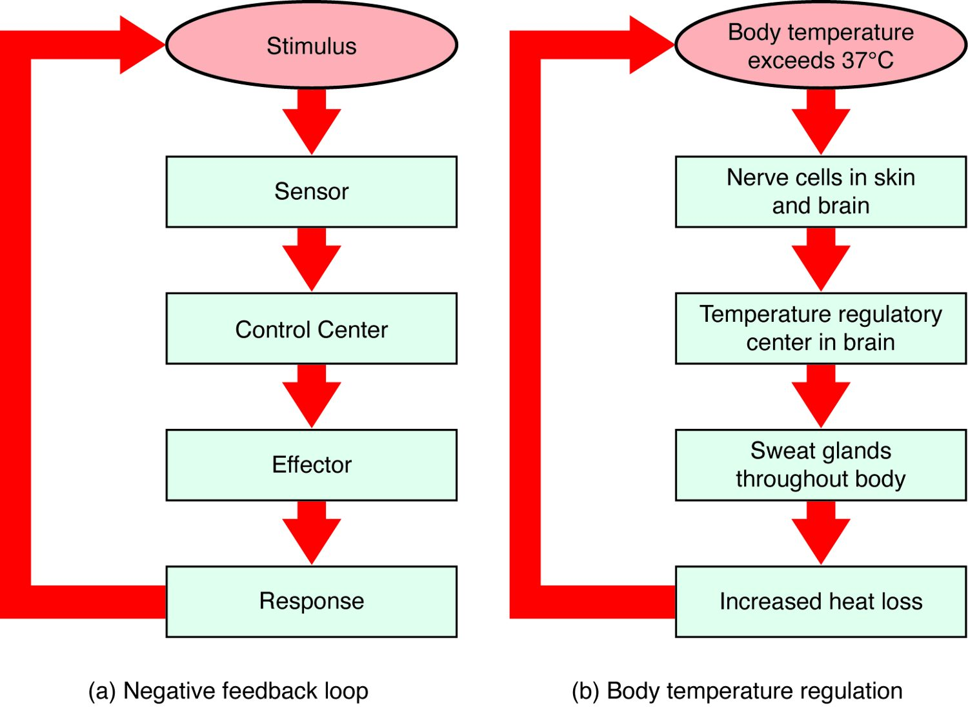
SECTION 1.5
Homeostasis & Negative Feedback
Homeostasis = a stable internal environment
Negative feedback reverses a change
Stimulus → sensor → control center → effector
Example: temperature regulation by sweating
The negative-feedback loop and body-temperature control
PN 104 · Ch 1 — An Introduction to the Human Body
14
Notes:
Define homeostasis as the maintenance of stable internal conditions despite external change. Negative feedback is the main mechanism: a receptor detects a deviation, a control center compares it to a set point, and effectors reverse the change. Body-temperature regulation is the classic example — overheating triggers sweating and vasodilation to shed heat. This underlies nearly all vital-sign assessment.

Slide 15
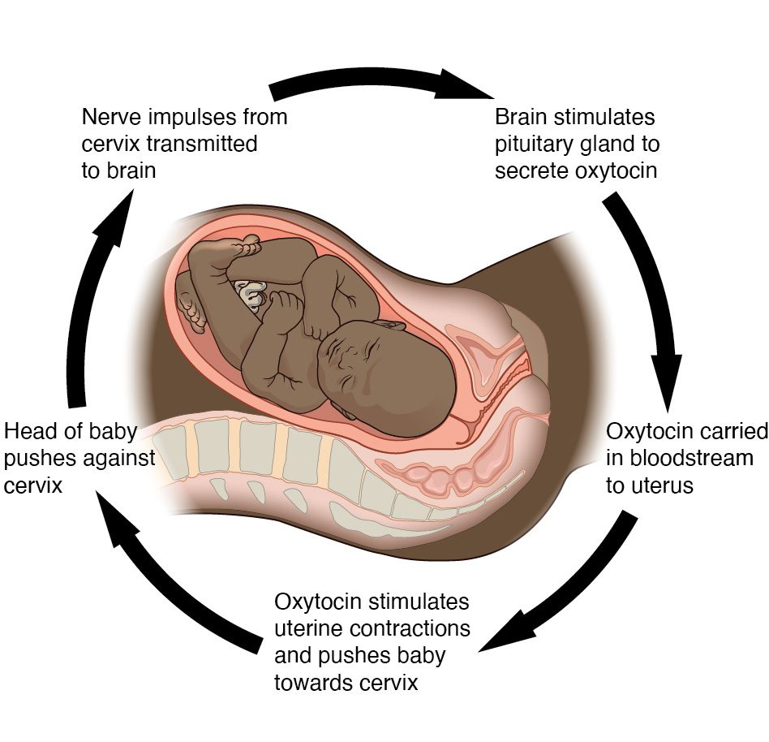
SECTION 1.5
Positive Feedback
Amplifies a change rather than reversing it
Reserved for rapid, self-limiting events
Example: oxytocin during labor and childbirth
Also drives the blood-clotting cascade
Positive feedback: oxytocin intensifies labor contractions
PN 104 · Ch 1 — An Introduction to the Human Body
15
Notes:
Positive feedback intensifies the original stimulus until an endpoint is reached. It is less common and reserved for processes that must complete quickly: childbirth (oxytocin increases contractions until delivery) and blood clotting (each step accelerates the next). Contrast it sharply with negative feedback so students don't confuse the two.

Slide 16
1.6
SECTION
Anatomical Terminology
The standardized language of position, direction, planes, cavities, and regions.

Slide 17
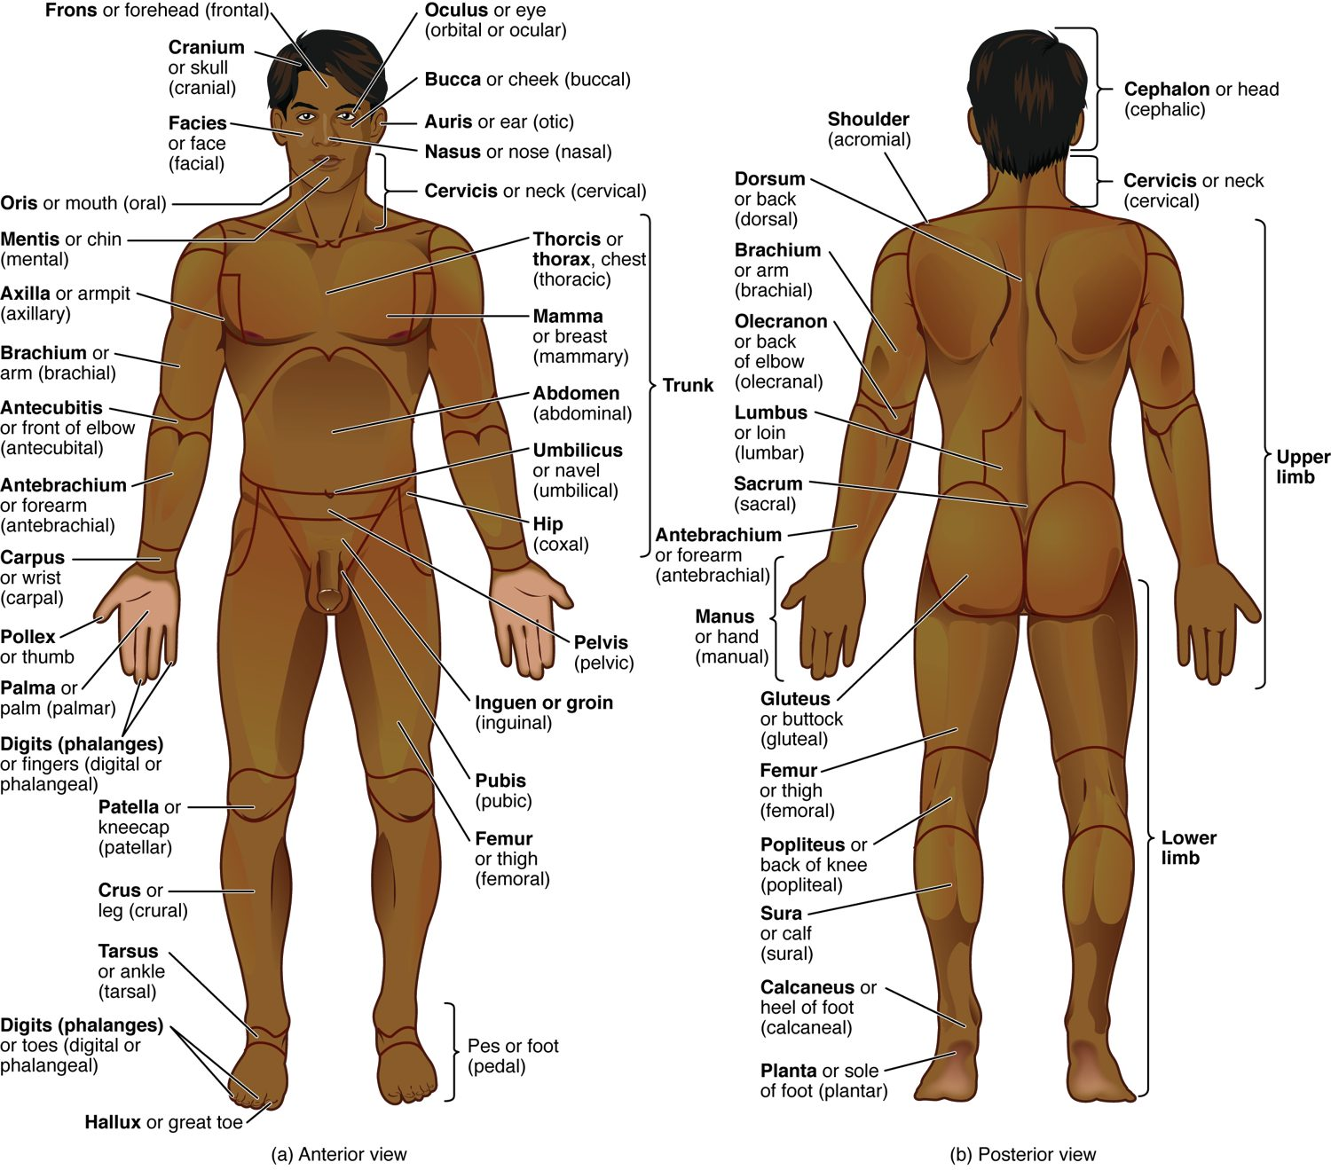
SECTION 1.6
Anatomical Position & Body Regions
Anatomical position is the reference posture
Standing, facing forward, palms forward
Regional terms name specific body areas
A shared language prevents miscommunication
Anatomical position with regional terms (anterior and posterior)
PN 104 · Ch 1 — An Introduction to the Human Body
17
Notes:
All directional terms assume the anatomical position: standing erect, face forward, arms at the sides, palms forward. Regional terms (brachial, femoral, and so on) name precise areas. Emphasize that consistent terminology is a patient-safety issue — vague descriptions cause errors in documentation and hand-off.

Slide 18
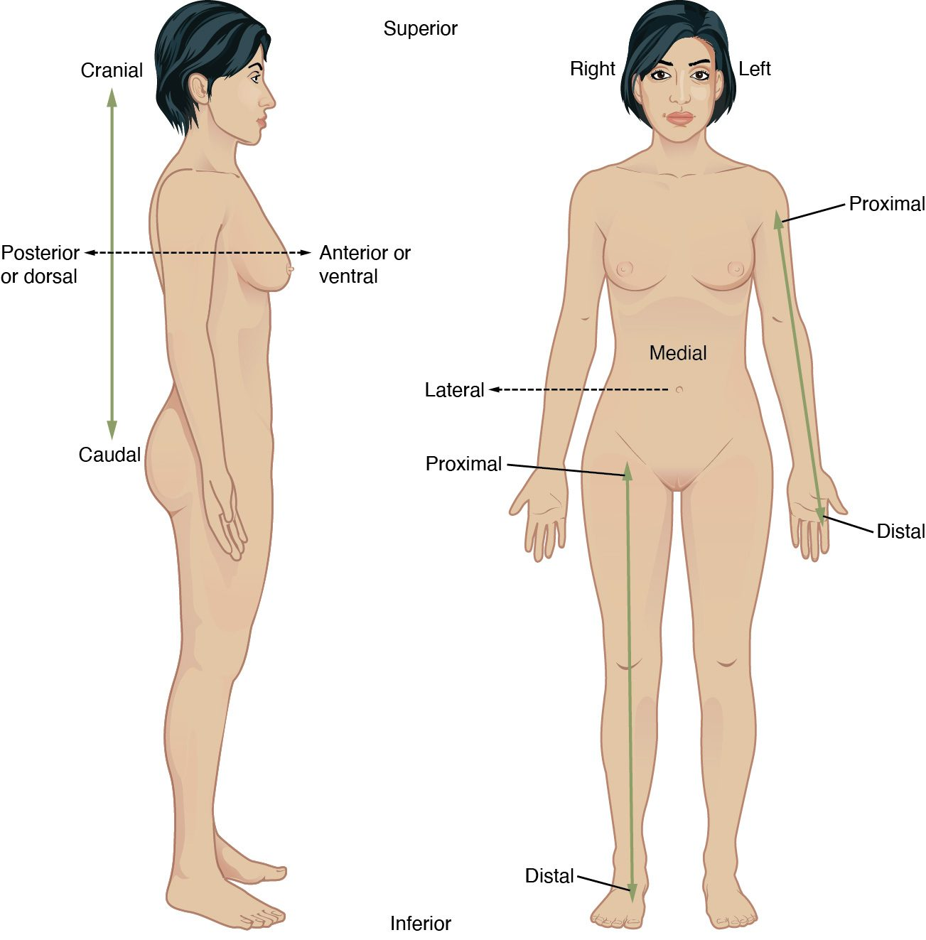
SECTION 1.6
Directional Terms
Superior/inferior, anterior/posterior
Medial/lateral, proximal/distal
Superficial/deep
Always described from anatomical position
Directional terms used to relate body structures
PN 104 · Ch 1 — An Introduction to the Human Body
18
Notes:
Drill the paired directional terms: superior/inferior (above/below), anterior or ventral / posterior or dorsal (front/back), medial/lateral (toward/away from the midline), proximal/distal (near/far from the trunk, for limbs), and superficial/deep. Have students locate structures relative to one another aloud — these appear constantly in charting and orders.

Slide 19
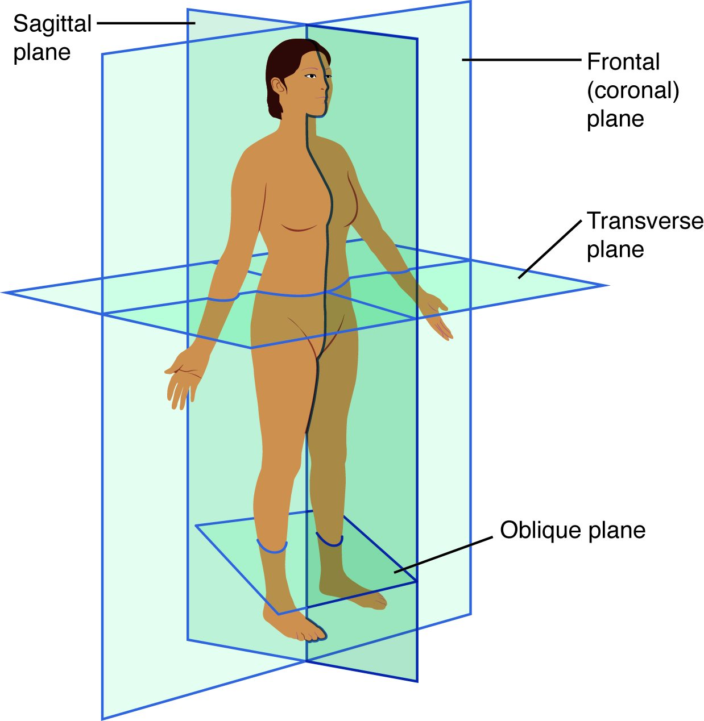
SECTION 1.6
Planes of Section
Sagittal plane divides left and right
Frontal (coronal) divides front and back
Transverse divides superior and inferior
Imaging studies are read in these planes
The sagittal, frontal, and transverse planes
PN 104 · Ch 1 — An Introduction to the Human Body
19
Notes:
The three cardinal planes: sagittal (vertical, left/right; midsagittal makes equal halves), frontal or coronal (vertical, anterior/posterior), and transverse or horizontal (a cross-section, superior/inferior). CT and MRI images are displayed in these planes, so understanding them helps students interpret diagnostic studies.

Slide 20
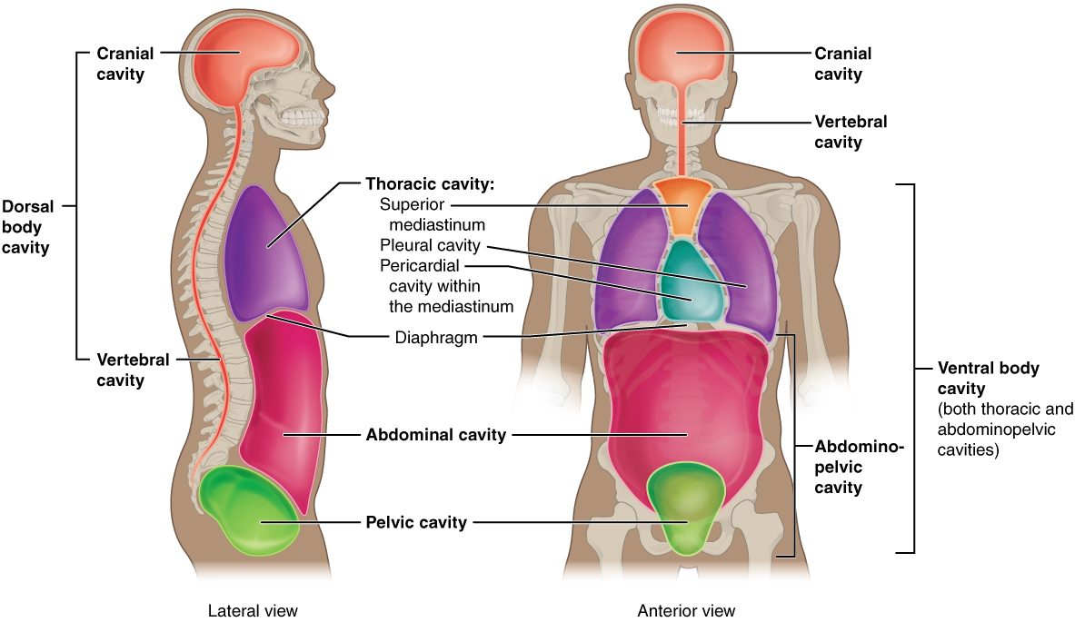
SECTION 1.6
Body Cavities & Membranes
The dorsal and ventral body cavities
Dorsal cavity: cranial and vertebral
Ventral cavity: thoracic and abdominopelvic
The diaphragm separates thorax and abdomen
Cavities protect and organize the organs
PN 104 · Ch 1 — An Introduction to the Human Body
20
Notes:
Two major closed cavities. The dorsal cavity (cranial plus vertebral) houses the brain and spinal cord. The ventral cavity divides into the thoracic cavity (pleural and pericardial) and the abdominopelvic cavity, separated by the diaphragm. Knowing cavity boundaries helps localize pain and organs.

Slide 21
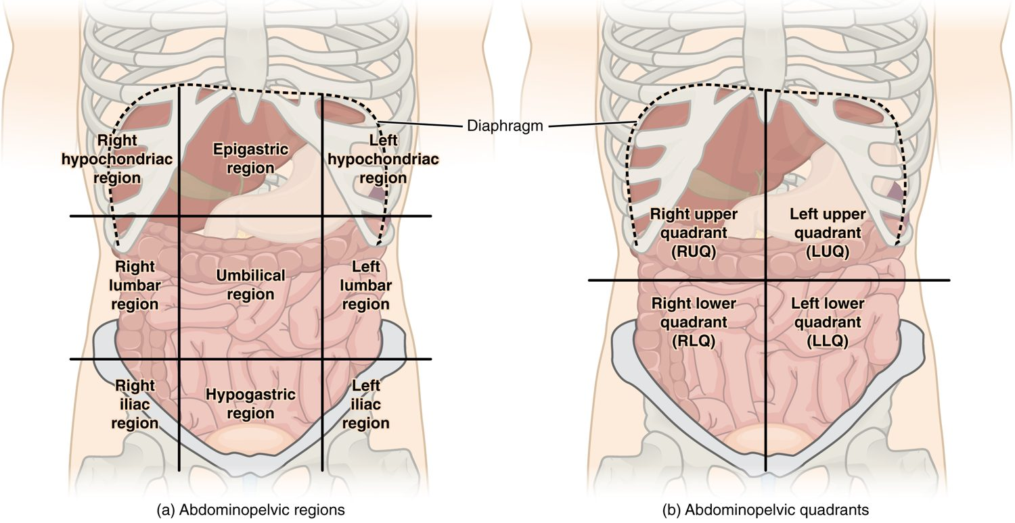
SECTION 1.6
Abdominal Regions & Quadrants
The nine abdominal regions and four quadrants
Four quadrants: RUQ, LUQ, RLQ, LLQ
Nine regions allow finer localization
Used to describe pain and organ location
RLQ pain → think appendicitis
PN 104 · Ch 1 — An Introduction to the Human Body
21
Notes:
Two mapping systems for the abdomen: the four quadrants (a quick clinical reference) and the nine regions (more precise). These let you localize pain and the underlying organs — for example, RLQ tenderness suggests the appendix, and RUQ the liver or gallbladder. This applies directly to abdominal assessment.

Slide 22
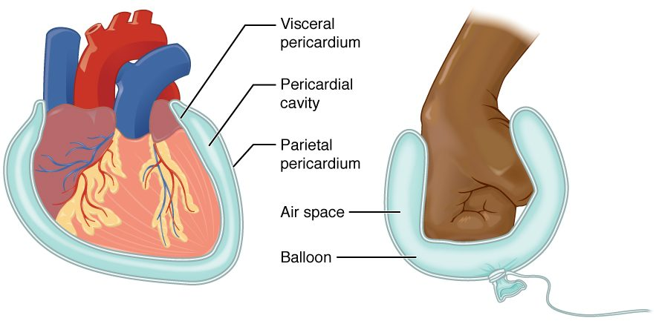
SECTION 1.6
Serous Membranes
Line cavities and cover the organs
Parietal layer lines the wall; visceral covers the organ
Serous fluid reduces friction
Examples: pericardium, pleura, peritoneum
Serous membrane structure (balloon-and-fist analogy)
PN 104 · Ch 1 — An Introduction to the Human Body
22
Notes:
Serous membranes are double-layered: the parietal layer lines the cavity wall and the visceral layer covers the organ, with a thin film of serous fluid between them to reduce friction during movement such as heartbeat and breathing. Use the balloon-and-fist analogy. Inflammation produces the -itis terms: pericarditis, pleuritis, peritonitis.

Slide 23
1.7
SECTION
Medical Imaging
Seeing inside the living body — radiography, CT, MRI, PET, and ultrasound.

Slide 24
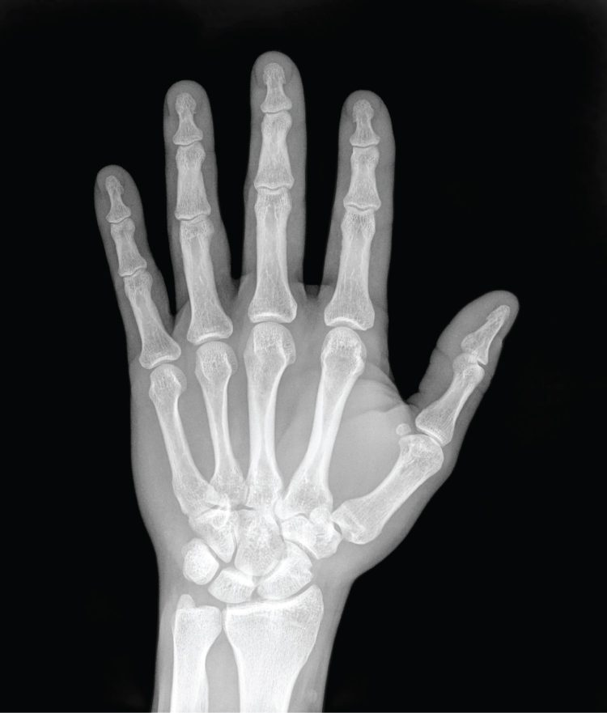
SECTION 1.7
Medical Imaging — Radiography
X-rays show dense structures like bone
Quick, inexpensive, and widely available
Limited soft-tissue detail
First-line for suspected fractures
A plain radiograph (X-ray) of the hand
PN 104 · Ch 1 — An Introduction to the Human Body
24
Notes:
Introduce imaging as applied anatomy. Plain radiography passes radiation through the body; dense tissue such as bone absorbs more and appears white. It is fast and inexpensive, ideal for fractures and chest films, but shows soft tissue poorly. Mention radiation safety and why exposure is limited.

Slide 25
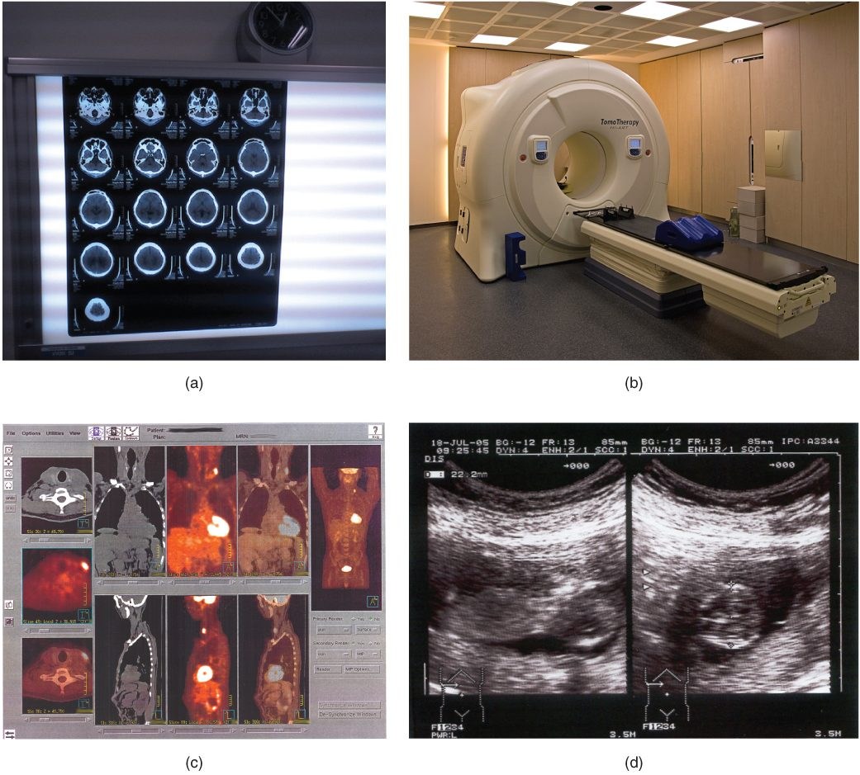
SECTION 1.7
Imaging Modalities Compared
CT: cross-sectional X-ray, excellent for trauma
MRI: magnetic, superb soft-tissue detail
PET: shows metabolic activity
Ultrasound: safe, real-time, no radiation
Common imaging modalities and their uses
PN 104 · Ch 1 — An Introduction to the Human Body
25
Notes:
Compare the major modalities: CT (stacked X-ray slices, fast, excellent for trauma and bleeding), MRI (magnetic fields, best soft-tissue contrast, no radiation but slow and loud), PET (tracks metabolic activity, used in oncology), and ultrasound (sound waves, real-time, safe in pregnancy). Match the tool to the clinical question.

Slide 26
CHAPTER 1
Key Takeaways
Anatomy is structure and physiology is function — the two are inseparable.
The body is organized in six levels, from the chemical level to the organism.
Eleven organ systems work together to keep the body alive.
Homeostasis, maintained mainly by negative feedback, keeps internal conditions stable.
Anatomical terminology gives a precise, shared language for safe practice.
PN 104 · Ch 1 — An Introduction to the Human Body
26
Notes:
Recap the arc: from defining anatomy and physiology, through the levels of organization and organ systems, to the functions and requirements of life, homeostasis, terminology, and imaging. Remind students that this vocabulary and these concepts return in every later chapter and at every patient encounter.

Slide 27
CLINICAL CONNECTIONS
Why the Basics Matter in Practical Nursing
Vital Signs
Assessment Language
Temperature, BP, HR, and RR are homeostasis you measure every shift.
Directional terms and quadrants make documentation precise and safe.
Abdominal Assessment
Feedback Loops
Quadrants and regions localize pain to the underlying organs.
Fever, blood-glucose, and BP control all follow feedback mechanisms.
Reading Imaging
Whole-Person Care
Knowing the planes and modalities helps you interpret and explain studies.
Systems are interdependent — one failing system affects the rest.
Notes:
Close by anchoring the chapter to bedside priorities. Ask students which concept applies to a patient with a fever (negative feedback), to documenting a wound location (directional terms), or to describing abdominal pain (quadrants). This is the bridge from foundational A&P into hands-on assessment.

