Slide 1
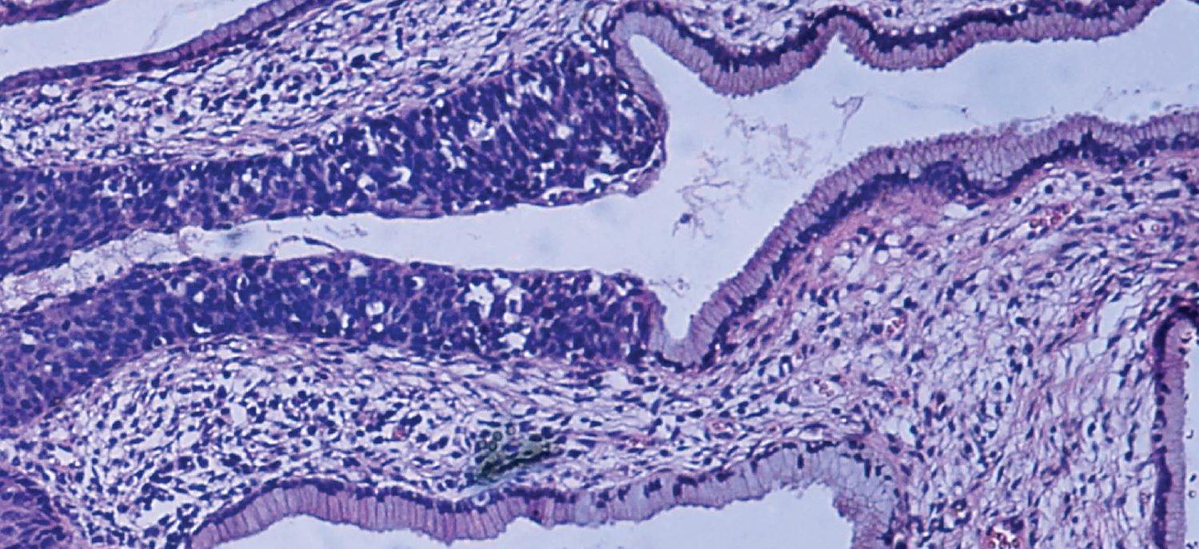
CHAPTER 4
The Tissue Level of Organization
The four primary tissues, their membranes, and how tissues heal.
Anatomy & Physiology · Broward-Miami Health Institute
FACULTY EDITION

Slide 2
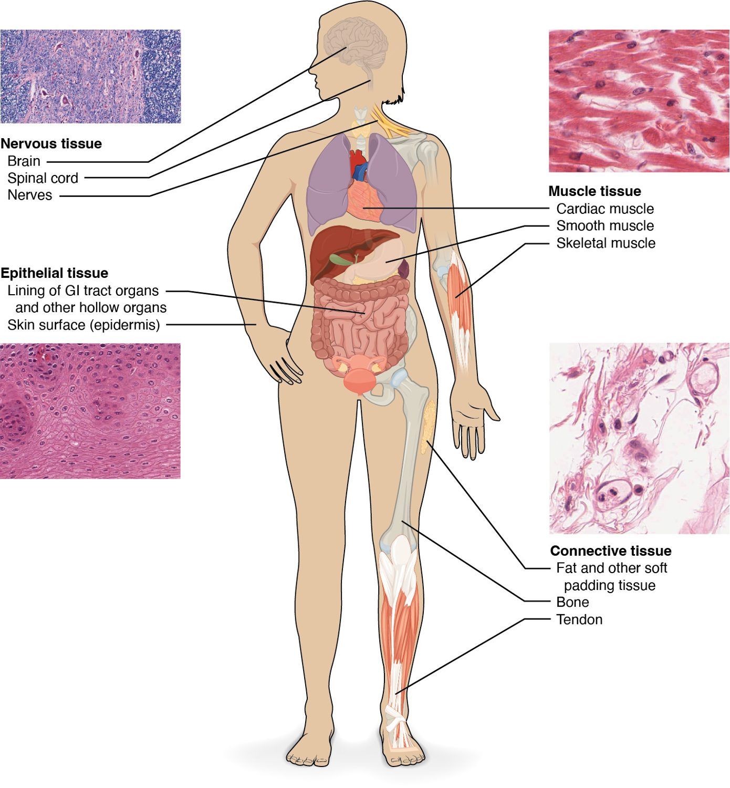
CHAPTER 4
Learning Objectives
After studying this chapter, students will be able to:
1
Identify the main tissue types and discuss their roles in the human body
2
Identify the four types of tissue membranes and the characteristics of each that make them functional
3
Explain the functions of various epithelial tissues and how their forms enable their functions
4
Explain the functions of various connective tissues and how their forms enable their functions
5
Describe the characteristics of muscle tissue and how these enable function
Four primary tissue types build every organ.
PN 104 · Ch 4 — The Tissue Level of Organization
2
Notes:
Preview the four tissue types — epithelial, connective, muscle, and nervous — and how they combine into organs and membranes. End with how tissues respond to injury and change with age, which underlies wound care and assessment.

Slide 3
4.1
SECTION
Types of Tissues
The four primary tissues and the membranes they form.

Slide 4
SECTION 4.1
The Four Tissue Types
Epithelial, connective, muscle, nervous
Tissue = similar cells + their matrix
Tissues combine to form organs
Each type has distinct functions
The four primary tissue types
PN 104 · Ch 4 — The Tissue Level of Organization
4
Notes:
A tissue is a group of similar cells working together. The four primary types are epithelial (covers and lines), connective (supports and binds), muscle (produces movement), and nervous (communicates). Organs are built from combinations of these.

Slide 5
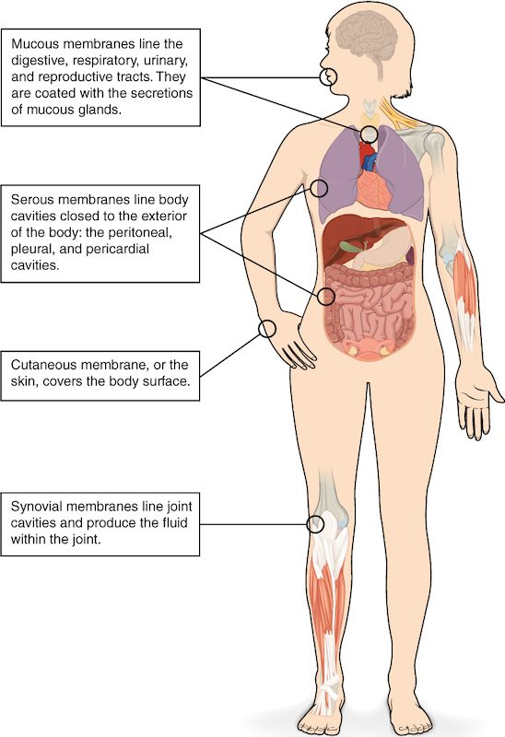
SECTION 4.1
Body Membranes
Membranes line and cover surfaces
Mucous membranes line passages to the outside
Serous membranes line closed cavities
The cutaneous membrane is the skin
The body's epithelial membranes
PN 104 · Ch 4 — The Tissue Level of Organization
5
Notes:
Epithelial membranes pair epithelium with connective tissue. Mucous membranes line cavities open to the exterior (respiratory, GI); serous membranes line closed cavities and reduce friction; the cutaneous membrane is the skin; synovial membranes (connective only) line joints.

Slide 6
4.2
SECTION
Epithelial Tissue
Covering and lining tissue — classified by cell shape and layering.

Slide 7
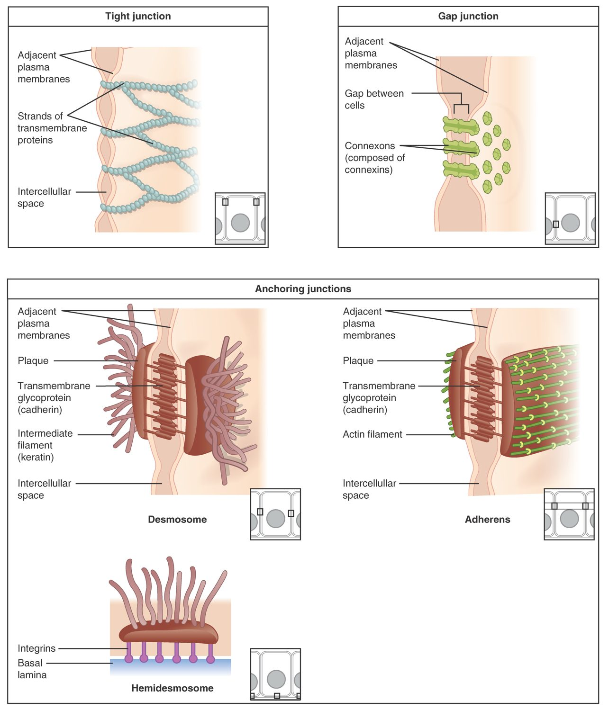
SECTION 4.2
Cell Junctions
Bind epithelial cells together
Tight junctions seal gaps
Desmosomes anchor cells
Gap junctions allow communication
Types of cell junctions
PN 104 · Ch 4 — The Tissue Level of Organization
7
Notes:
Epithelial cells are tightly bound. Tight junctions form leak-proof seals (as in the bladder); desmosomes rivet cells against mechanical stress (as in skin); gap junctions let small molecules and signals pass directly between cells (as in cardiac muscle).

Slide 8
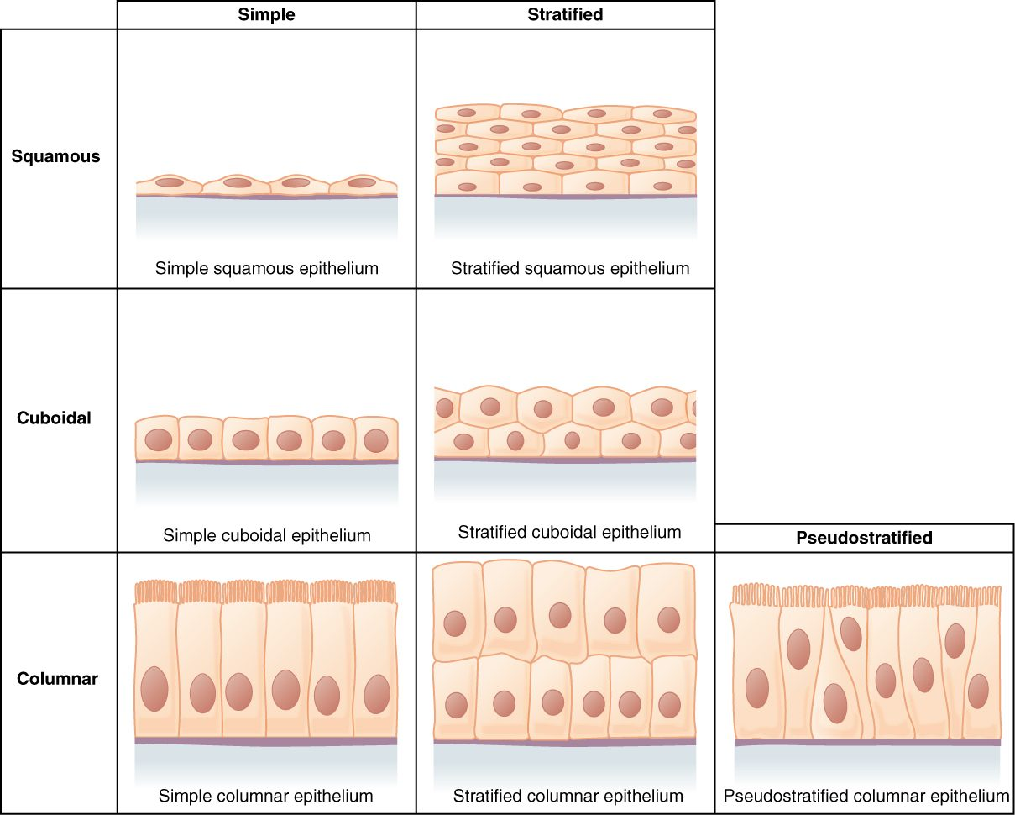
SECTION 4.2
Classifying Epithelium
Named by cell shape and number of layers
Shapes: squamous, cuboidal, columnar
Simple (one layer) vs. stratified (many)
Structure matches function
Classification of epithelial tissues
PN 104 · Ch 4 — The Tissue Level of Organization
8
Notes:
Epithelium is named by cell shape — squamous (flat), cuboidal (cube), columnar (tall) — and layering — simple (one layer, for absorption or diffusion) versus stratified (many layers, for protection). Pseudostratified and transitional are special cases. Form follows function.

Slide 9
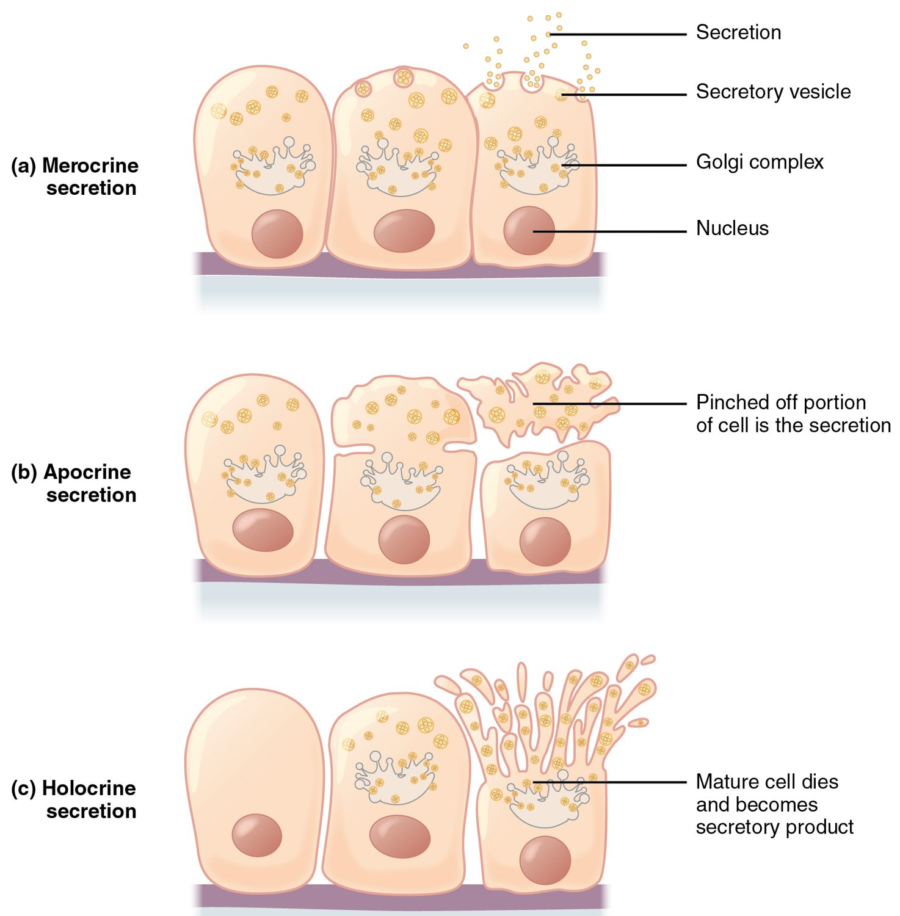
SECTION 4.2
Modes of Glandular Secretion
Exocrine glands secrete onto surfaces
Merocrine: released by exocytosis
Apocrine: part of the cell pinches off
Holocrine: the whole cell ruptures
Merocrine, apocrine, and holocrine secretion
PN 104 · Ch 4 — The Tissue Level of Organization
9
Notes:
Glands derive from epithelium. Exocrine glands release products through ducts in three ways: merocrine (sweat glands, by exocytosis), apocrine (some sweat glands), and holocrine (sebaceous glands, where the whole cell breaks down). Endocrine glands instead release hormones into the blood.

Slide 10
4.3
SECTION
Connective Tissue Supports and Protects
The body's most diverse tissue — binding, supporting, and transporting.

Slide 11
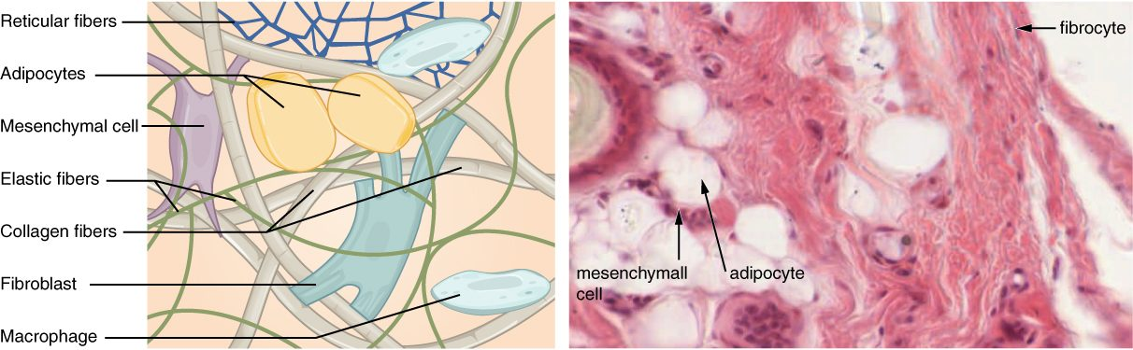
SECTION 4.3
Connective Tissue Overview
Loose connective tissue and its components
Cells scattered in an extracellular matrix
Matrix = ground substance + fibers
Fibroblasts and immune cells reside here
The most abundant, diverse tissue
PN 104 · Ch 4 — The Tissue Level of Organization
11
Notes:
Connective tissue is defined by abundant extracellular matrix — ground substance plus protein fibers (collagen, elastic, reticular) — with relatively few cells. It binds, supports, protects, and stores. It includes loose and dense CT, cartilage, bone, blood, and fat.

Slide 12
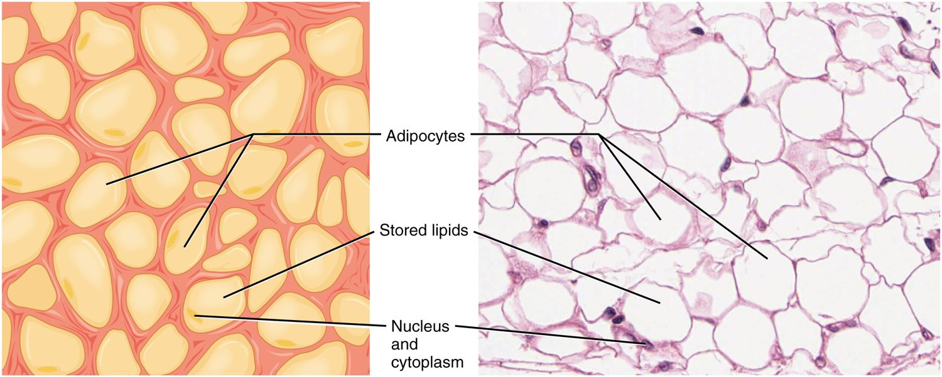
SECTION 4.3
Adipose Tissue
Adipose (fat) tissue
Stores energy as fat
Cushions and insulates organs
Cells are filled with lipid droplets
An active endocrine tissue
PN 104 · Ch 4 — The Tissue Level of Organization
12
Notes:
Adipose is loose connective tissue specialized for energy storage; it also insulates, cushions, and secretes hormones such as leptin that regulate appetite. Its amount and distribution carry major clinical and metabolic significance.

Slide 13
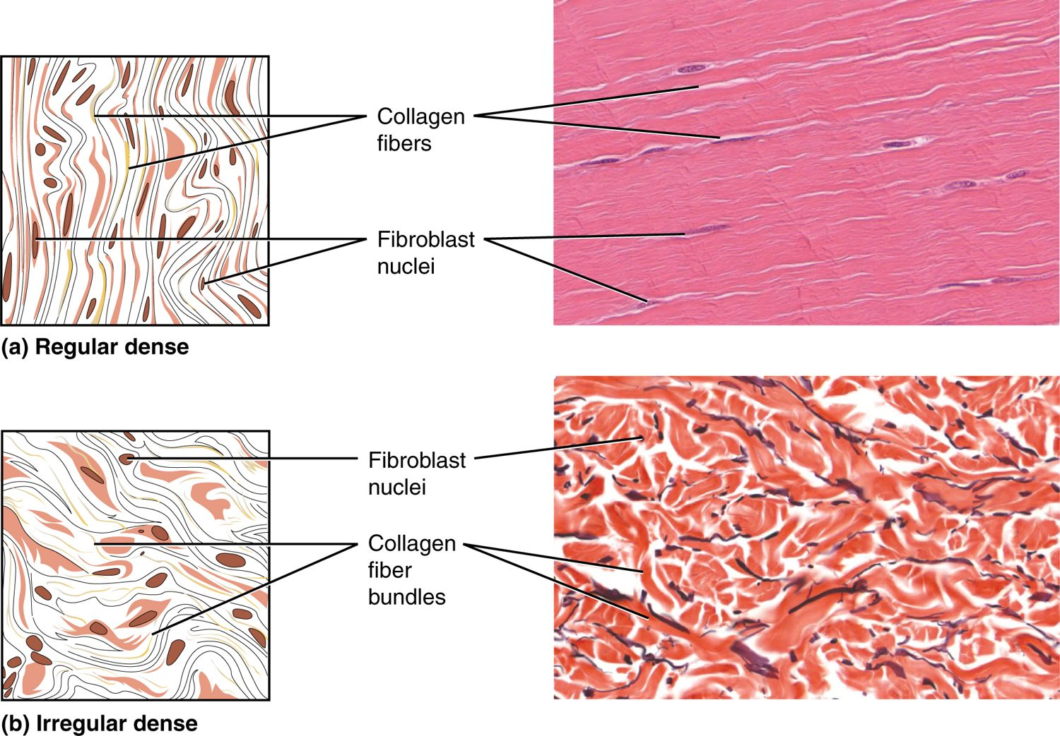
SECTION 4.3
Dense Connective Tissue
Packed with collagen fibers
Dense regular: tendons and ligaments
Dense irregular: dermis and capsules
Provides tensile strength
Dense regular and irregular connective tissue
PN 104 · Ch 4 — The Tissue Level of Organization
13
Notes:
Dense connective tissue is rich in collagen for strength. Dense regular tissue has parallel fibers and forms tendons and ligaments that resist pull in one direction; dense irregular tissue has woven fibers and forms the dermis and organ capsules, resisting stress from many directions.

Slide 14
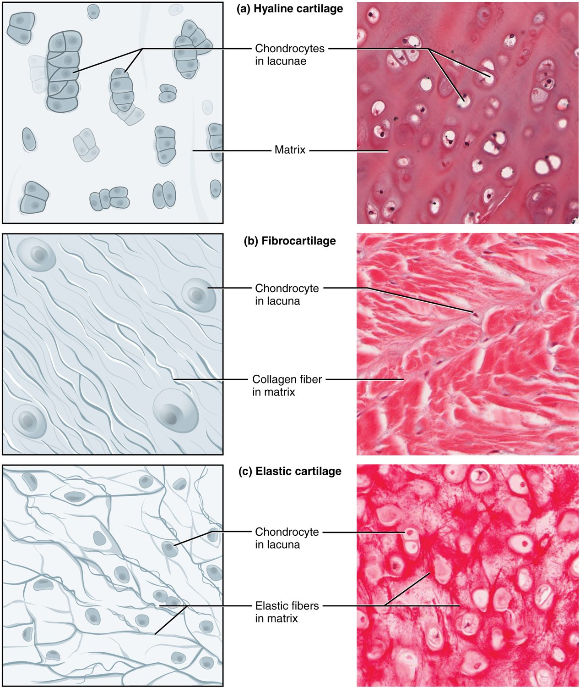
SECTION 4.3
Cartilage
Firm but flexible matrix
Hyaline: joints, nose, trachea
Fibrocartilage: discs and menisci
Elastic: ear and epiglottis
Hyaline, fibrocartilage, and elastic cartilage
PN 104 · Ch 4 — The Tissue Level of Organization
14
Notes:
Cartilage is a tough, flexible connective tissue with chondrocytes in lacunae. Hyaline cushions joints and forms the fetal skeleton; fibrocartilage absorbs shock (intervertebral discs); elastic cartilage gives flexible shape (the ear). It heals slowly because it lacks a blood supply.

Slide 15
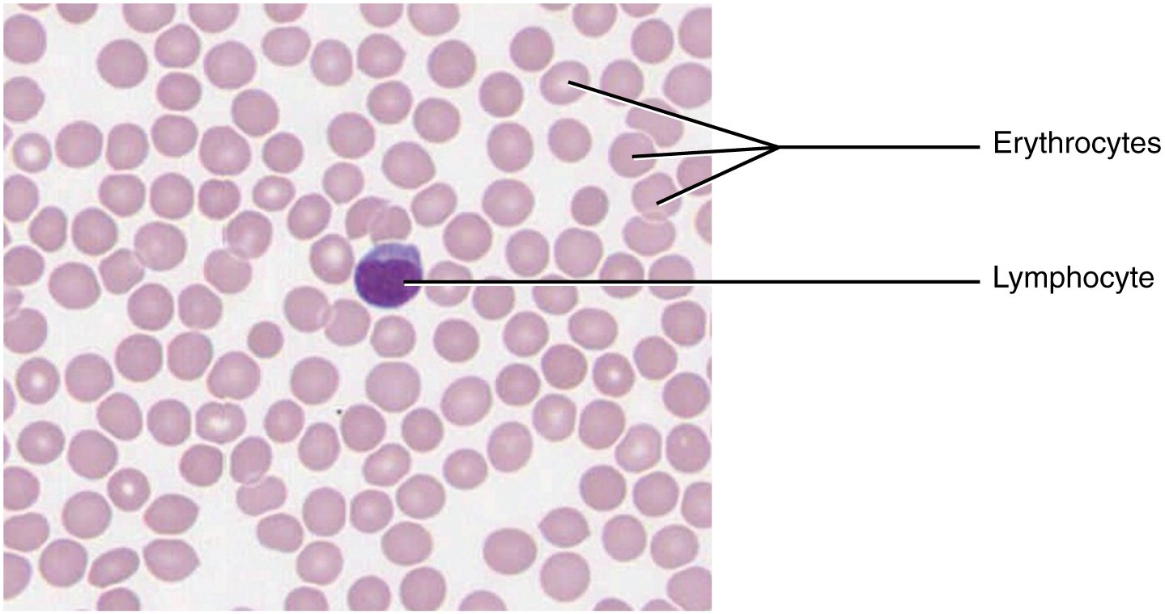
SECTION 4.3
Blood
Blood: erythrocytes and leukocytes
A fluid connective tissue
Plasma is the liquid matrix
Red cells carry oxygen
White cells defend; platelets clot
PN 104 · Ch 4 — The Tissue Level of Organization
15
Notes:
Blood is classified as connective tissue because its cells sit in an extracellular matrix — plasma. Erythrocytes transport oxygen, leukocytes provide immune defense, and platelets enable clotting. Blood links every tissue in the body.

Slide 16
4.4
SECTION
Muscle Tissue and Motion
The three muscle types that generate movement.

Slide 17
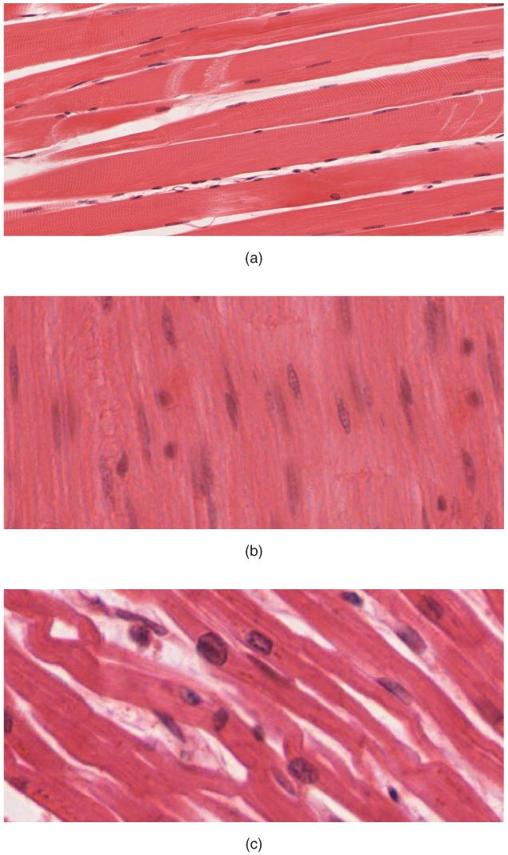
SECTION 4.4
The Three Muscle Tissues
Skeletal: voluntary, striated
Cardiac: involuntary, striated, branched
Smooth: involuntary, non-striated
All convert energy into movement
Skeletal, cardiac, and smooth muscle
PN 104 · Ch 4 — The Tissue Level of Organization
17
Notes:
Three muscle types: skeletal (attached to bone, voluntary, striated), cardiac (heart only, involuntary, striated with intercalated discs), and smooth (in walls of organs and vessels, involuntary, non-striated). Each is specialized for its role — a preview of the muscle chapters.

Slide 18
4.5
SECTION
Nervous Tissue Mediates Perception and Response
The communication tissue — neurons and their supporting cells.

Slide 19
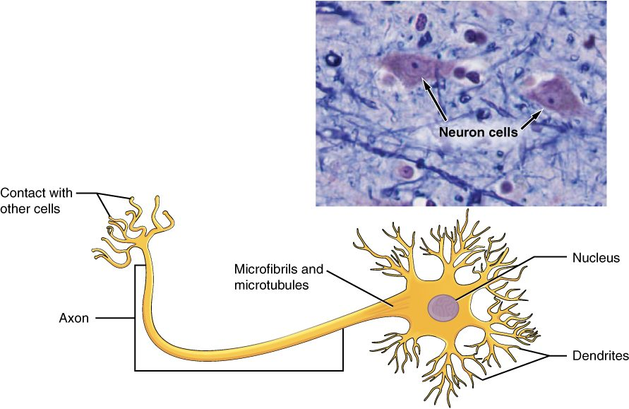
SECTION 4.5
Nervous Tissue
A neuron of nervous tissue
Neurons transmit electrical signals
Cell body, dendrites, and axon
Dendrites receive; axons send
Glial cells support neurons
PN 104 · Ch 4 — The Tissue Level of Organization
19
Notes:
Nervous tissue enables rapid communication. A neuron receives signals through its dendrites, integrates them in the cell body, and sends impulses down its axon to other cells. Glial cells protect, nourish, and insulate neurons — a preview of the nervous-system chapters.

Slide 20
4.6
SECTION
Tissue Injury and Aging
How tissues respond to damage, repair themselves, and change with age.

Slide 21
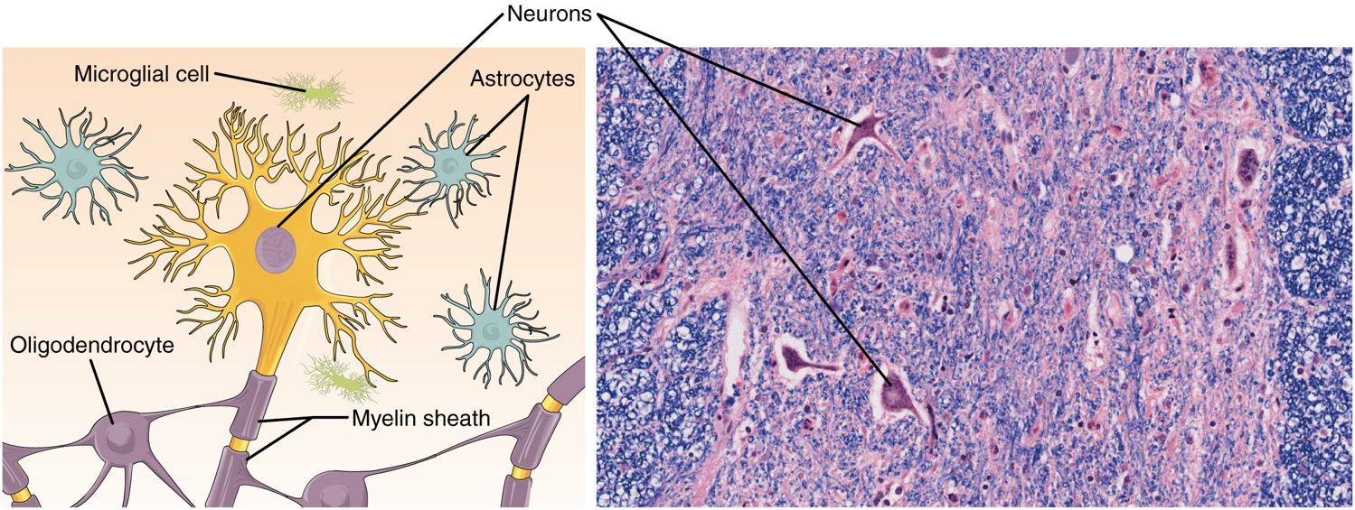
SECTION 4.6
Tissue Injury & Repair
The tissue inflammation and repair process
Inflammation is the first response
A clot forms and immune cells arrive
Granulation tissue rebuilds the area
Healing by regeneration or scarring
PN 104 · Ch 4 — The Tissue Level of Organization
21
Notes:
After injury, inflammation — redness, heat, swelling, pain — brings blood and immune cells to clear debris and fight infection. New granulation tissue forms, and the wound heals by regeneration (same tissue) or fibrosis (scar). This underlies all wound care.

Slide 22
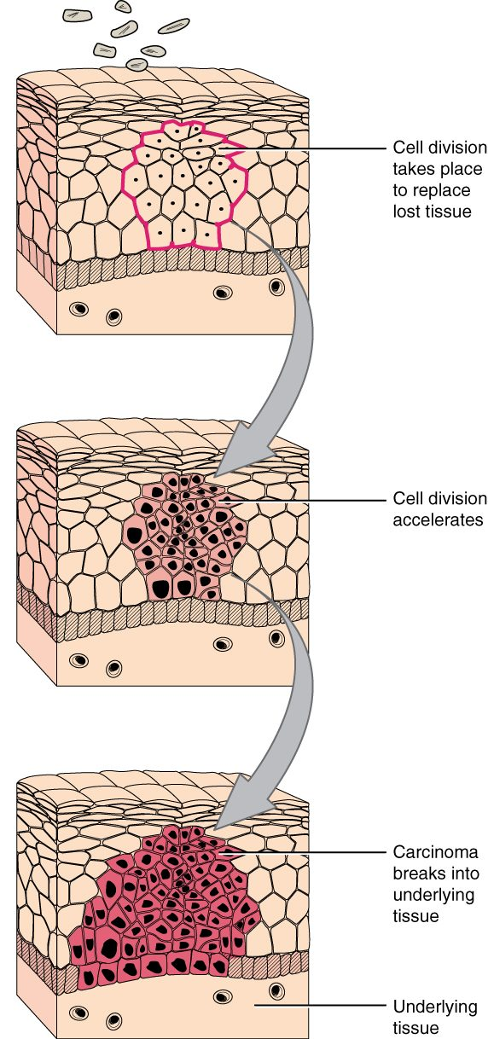
SECTION 4.6
Tissue Aging & Neoplasia
Tissues lose efficiency with age
Repair slows and tissues thin
Uncontrolled division → neoplasia
Malignant tumors invade and spread
Abnormal cell division and tissue change
PN 104 · Ch 4 — The Tissue Level of Organization
22
Notes:
With age, cell division slows, tissues thin, and repair becomes less efficient. When division escapes control, abnormal growths (neoplasms or tumors) form; malignant ones invade nearby tissue and metastasize. Connect this to cancer screening and skin-integrity assessment in older adults.

Slide 23
CHAPTER 4
Key Takeaways
Four primary tissues — epithelial, connective, muscle, and nervous — build every organ.
Epithelium covers and lines, classified by cell shape and layering.
Connective tissue is the most diverse, defined by its extracellular matrix.
Muscle generates movement; nervous tissue enables communication.
Tissues respond to injury through inflammation and repair, and change with age.
PN 104 · Ch 4 — The Tissue Level of Organization
23
Notes:
Recap the chapter and reconnect each idea to patient care.

Slide 24
CLINICAL CONNECTIONS
Why Tissues Matter in Practical Nursing
Wound Care
Skin Integrity
Inflammation and repair guide every dressing change and healing assessment.
Epithelial membranes are the body's first barrier against infection.
Mobility
Mucous Membranes
The three muscle types underlie movement, heartbeat, and organ function.
Assessing moist linings reveals hydration status and infection.
Cancer Awareness
Aging Patients
Uncontrolled cell division produces tumors that invade and spread.
Slower tissue repair raises the risk of pressure injuries and delayed healing.
Notes:
Anchor the chapter's concepts to bedside priorities.

