Slide 1
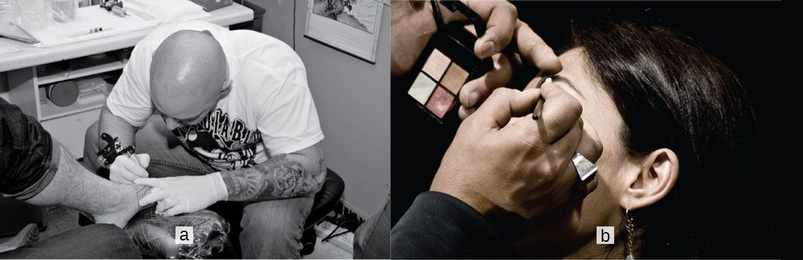
CHAPTER 5
The Integumentary System
The skin, its accessory structures, functions, and disorders.
Anatomy & Physiology · Broward-Miami Health Institute
FACULTY EDITION

Slide 2
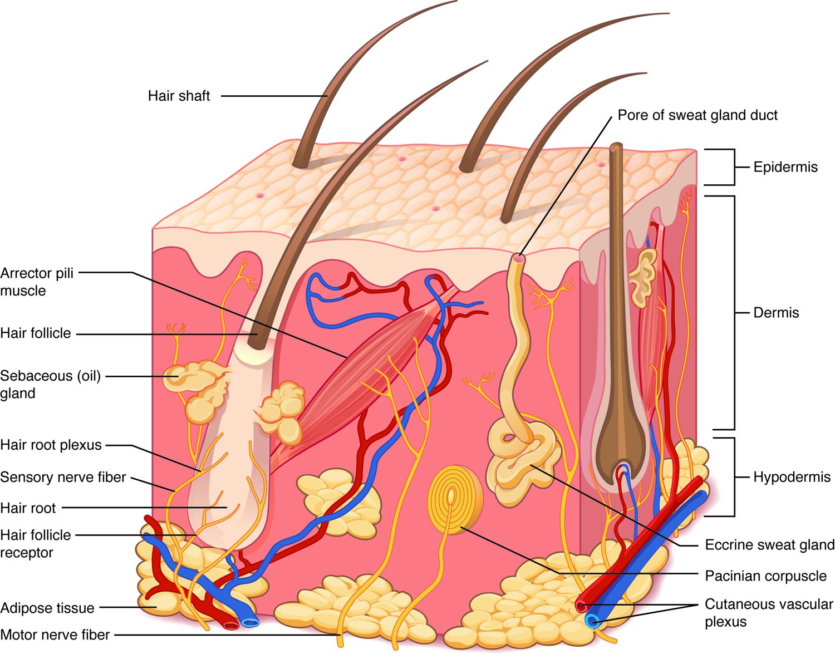
CHAPTER 5
Learning Objectives
After studying this chapter, students will be able to:
1
Describe the integumentary system and the role it plays in homeostasis
2
Describe the layers of the skin and the functions of each layer
3
Describe the accessory structures of the skin and the functions of each
4
Describe the changes that occur in the integumentary system during the aging process
5
Discuss several common diseases, disorders, and injuries that affect the integumentary system
The skin — the body's largest organ.
PN 104 · Ch 5 — The Integumentary System
2
Notes:
Preview the skin as a true organ system: layered structure, accessory structures (hair, nails, glands), and major functions — protection, sensation, temperature regulation, and vitamin D. End with common disorders that you will assess and manage at the bedside.

Slide 3
5.1
SECTION
Layers of the Skin
The epidermis, dermis, and hypodermis — the layered structure of the skin.

Slide 4
SECTION 5.1
Structure of the Skin
Three layers: epidermis, dermis, hypodermis
Epidermis is avascular epithelium
Dermis holds vessels, nerves, glands
Hypodermis stores fat and anchors skin
The layers of the skin and underlying tissue
PN 104 · Ch 5 — The Integumentary System
4
Notes:
The skin has three layers: a superficial epidermis (avascular stratified squamous epithelium), a deeper dermis of connective tissue holding vessels, nerves, and glands, and the hypodermis (subcutaneous fat) that anchors the skin and insulates. It is the body's largest organ.

Slide 5
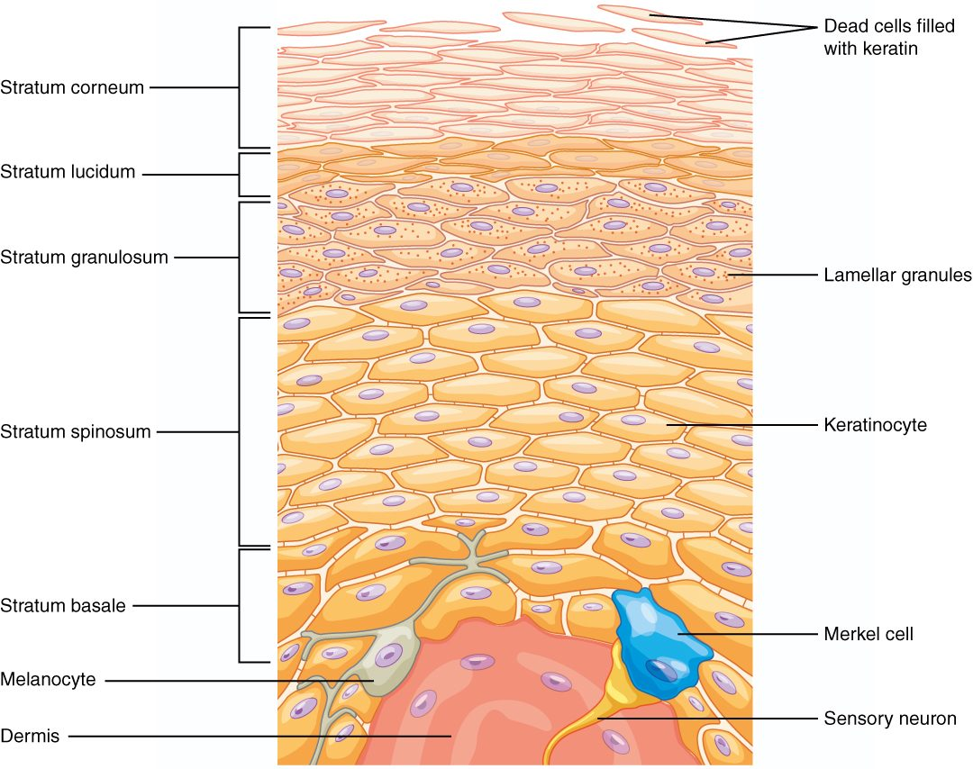
SECTION 5.1
Layers of the Epidermis
Up to five layers in thick skin
Stratum basale up to stratum corneum
Keratinocytes fill with keratin and shed
Melanocytes and immune cells reside here
The strata of the epidermis
PN 104 · Ch 5 — The Integumentary System
5
Notes:
The epidermis builds from the stratum basale upward through the spinosum, granulosum, lucidum (thick skin only), to the corneum. Keratinocytes are produced at the base, fill with tough keratin, and are shed at the surface, with full turnover in about four to six weeks. Melanocytes and immune (Langerhans) cells live among them.

Slide 6
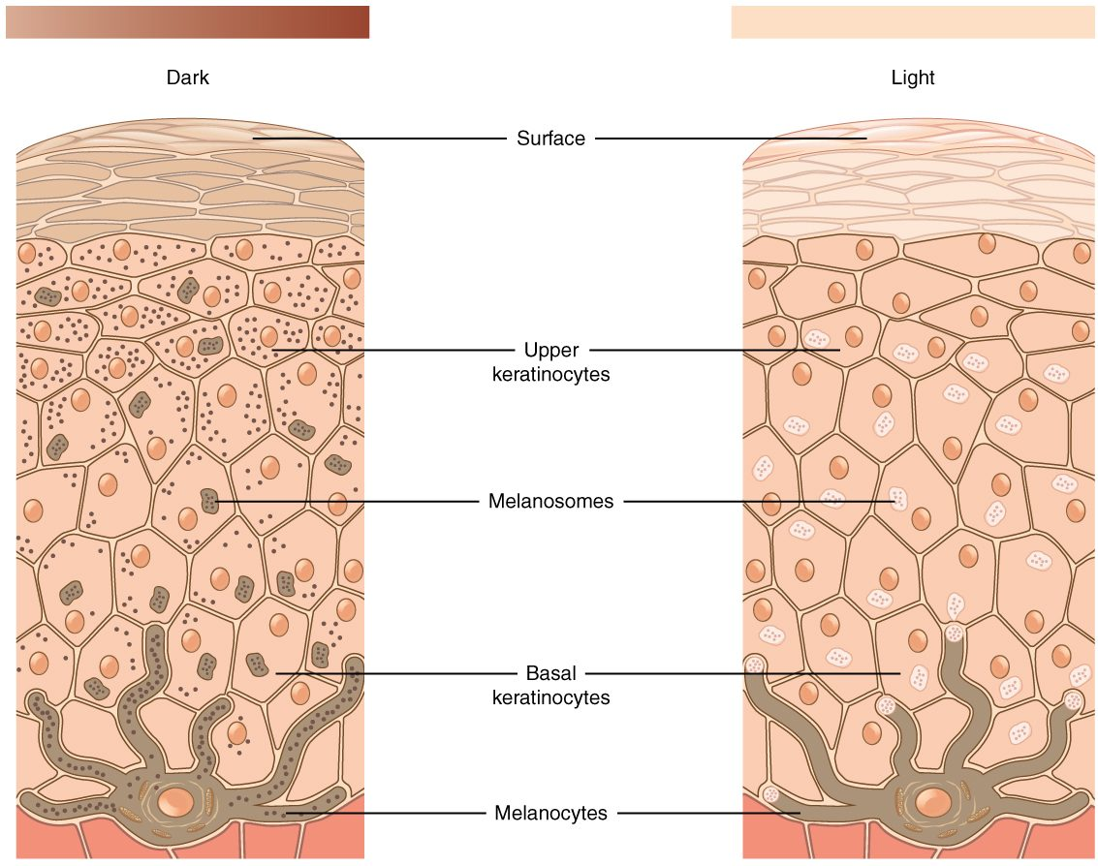
SECTION 5.1
Skin Pigmentation
Melanin determines skin color
Made by melanocytes in the basale
Protects DNA from UV damage
Everyone has similar melanocyte numbers
Melanin production and skin color
PN 104 · Ch 5 — The Integumentary System
6
Notes:
Skin color comes mainly from melanin, produced by melanocytes and packaged to shield keratinocyte DNA from UV radiation. People have similar numbers of melanocytes; color differences reflect how much melanin is made and how it is distributed. Albinism (no melanin) and vitiligo (patchy loss) are clinical variants.

Slide 7
5.2
SECTION
Accessory Structures of the Skin
Hair, nails, and glands — the structures that arise from the skin.

Slide 8
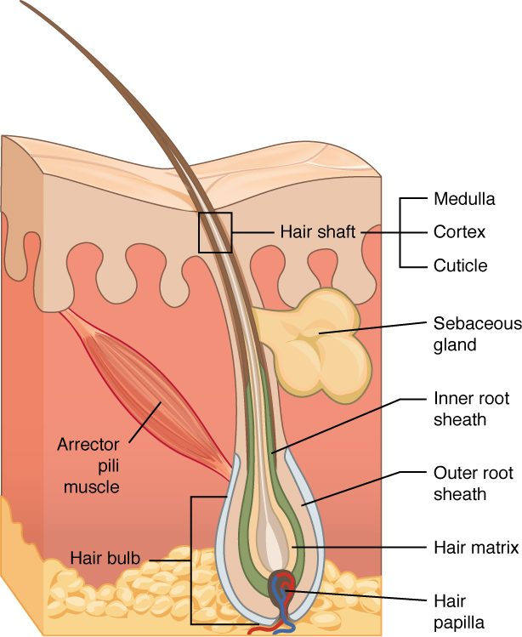
SECTION 5.2
Hair and the Hair Follicle
Hair grows from follicles in the dermis
Shaft is visible; root is embedded
Arrector pili muscle causes goosebumps
Provides protection and sensation
Structure of a hair and its follicle
PN 104 · Ch 5 — The Integumentary System
8
Notes:
Hair grows from follicles rooted in the dermis; the visible shaft is dead keratinized cells while the living root sits in the bulb. The arrector pili muscle erects the hair, producing goosebumps. Hair protects, insulates slightly, and contributes to sensation.

Slide 9
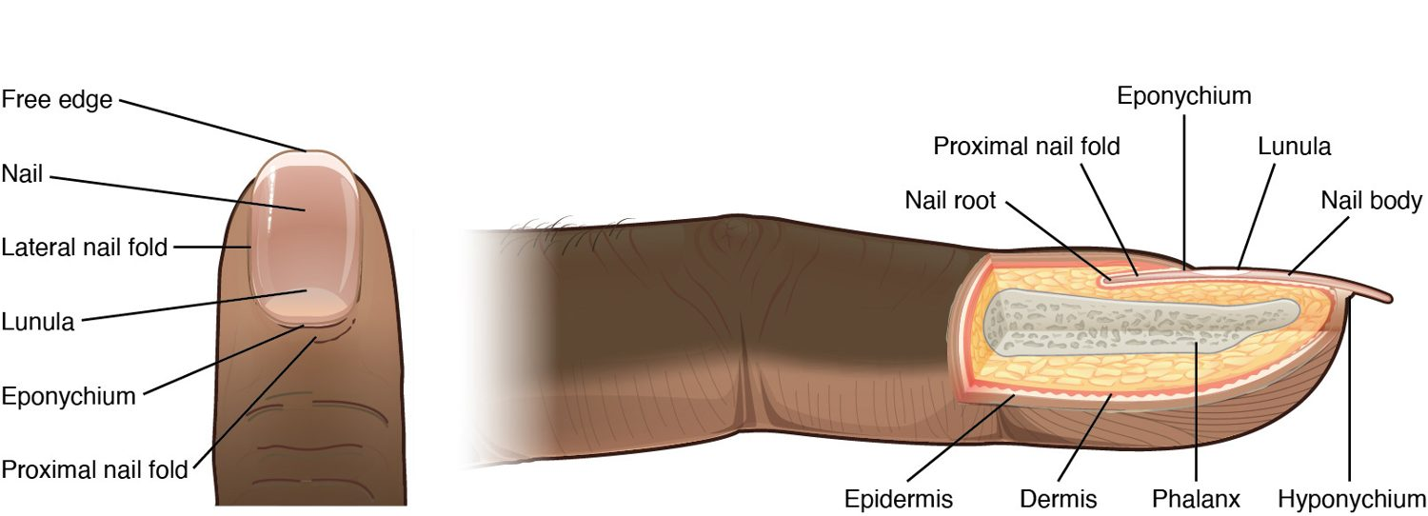
SECTION 5.2
Nails
Structure of a nail
Keratinized plates over the digits
Protect fingertips and toes
Nail bed, lunula, and cuticle
Useful in clinical assessment
PN 104 · Ch 5 — The Integumentary System
9
Notes:
Nails are tightly packed keratinized cells that protect the distal digits and aid fine manipulation. The lunula is the pale crescent and the cuticle seals the proximal edge. Nail color and shape — cyanosis, clubbing, and capillary refill — are quick clinical assessment tools.

Slide 10
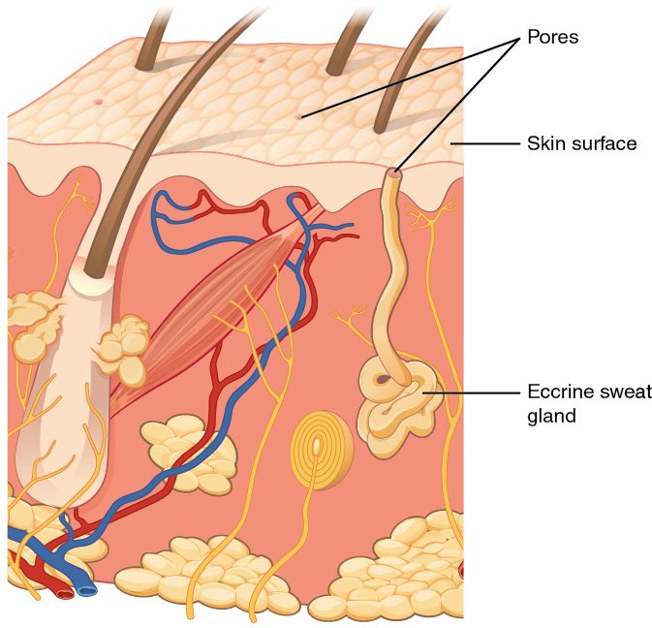
SECTION 5.2
Glands of the Skin
Eccrine sweat glands cool the body
Sweat evaporates to lose heat
Sebaceous glands secrete oily sebum
Sebum lubricates skin and hair
Sweat and sebaceous glands of the skin
PN 104 · Ch 5 — The Integumentary System
10
Notes:
Eccrine sweat glands open onto the surface and cool the body through evaporation; apocrine glands in the axilla and groin activate at puberty. Sebaceous glands secrete sebum that lubricates and waterproofs skin and hair. Blockage and overactivity of these glands contribute to acne.

Slide 11
5.3
SECTION
Functions of the Integumentary System
Protection, sensation, thermoregulation, and vitamin D — what the skin does.

Slide 12
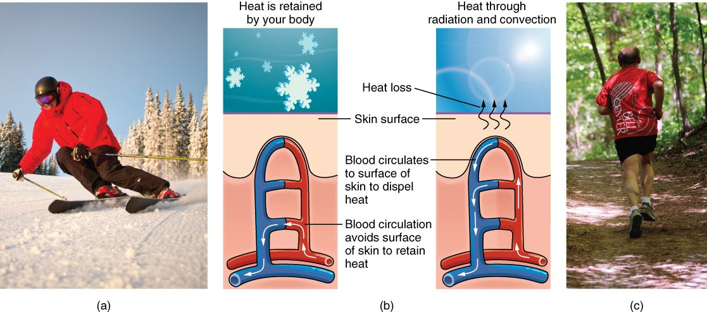
SECTION 5.3
Thermoregulation
The skin's role in thermoregulation
The skin helps control body temperature
Sweating and evaporation cool the body
Vasodilation releases heat
Vasoconstriction conserves heat
PN 104 · Ch 5 — The Integumentary System
12
Notes:
The skin is central to temperature control. When the body is hot, dermal vessels dilate and sweat glands release fluid that evaporates and cools; when cold, vessels constrict to conserve core heat and muscles shiver. This homeostasis is what you assess with every temperature reading. The skin also provides protection, sensation, and vitamin D synthesis.

Slide 13
5.4
SECTION
Diseases, Disorders, and Injuries of the Integumentary System
Burns, skin cancer, acne, and other disorders of the skin.

Slide 14
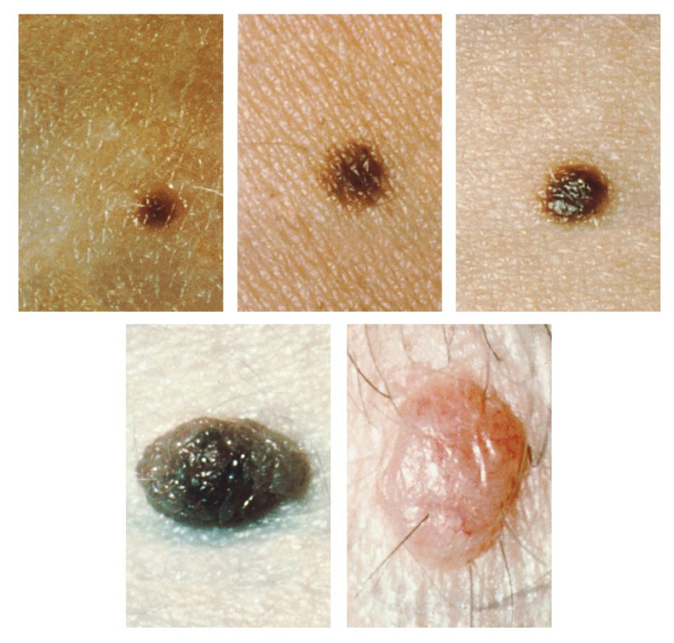
SECTION 5.4
Skin Cancer & the ABCDE Rule
Three main types of skin cancer
Basal cell, squamous cell, melanoma
Melanoma is the most dangerous
Watch moles for ABCDE changes
Moles and the ABCDE signs of melanoma
PN 104 · Ch 5 — The Integumentary System
14
Notes:
The three common skin cancers are basal cell (most common, least dangerous), squamous cell, and melanoma (most lethal). Teach the ABCDE rule for moles — Asymmetry, Border irregularity, Color variation, Diameter over 6 mm, and Evolving change. UV exposure is the major risk factor, so sun protection is key teaching.

Slide 15
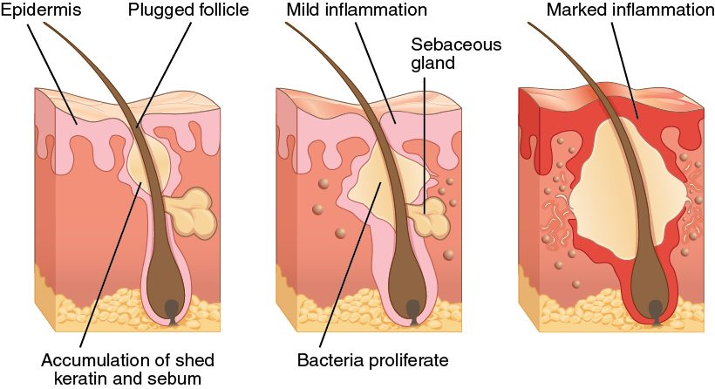
SECTION 5.4
Acne
The development of acne
A follicle becomes plugged with sebum
Bacteria multiply and inflame it
Ranges from comedones to cysts
Common during hormonal changes
PN 104 · Ch 5 — The Integumentary System
15
Notes:
Acne develops when a hair follicle is plugged with sebum and shed keratin, bacteria multiply, and inflammation follows. Severity ranges from blackheads and whiteheads to inflamed cysts. It is most common during adolescence and other times of hormonal change.

Slide 16
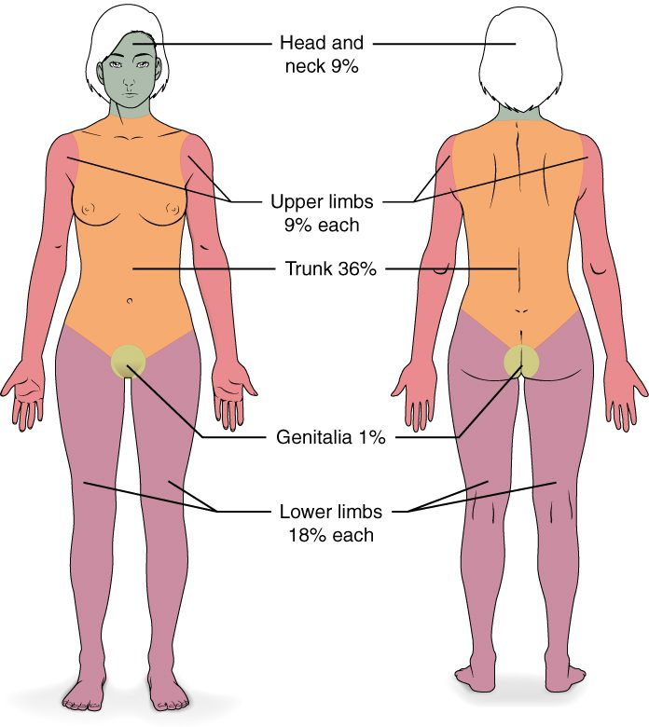
SECTION 5.4
Burns and the Rule of Nines
Classified by depth and extent
Superficial, partial, and full thickness
Rule of nines estimates body area
Guides fluid resuscitation
The rule of nines for estimating burn area
PN 104 · Ch 5 — The Integumentary System
16
Notes:
Burns are classified by depth — superficial (first degree), partial thickness (second), and full thickness (third) — and by the percent of body surface area affected. The rule of nines divides the body into regions of roughly nine percent to estimate extent, guiding fluid resuscitation and transfer decisions. Major burns disrupt the skin's barrier, temperature control, and fluid balance.

Slide 17
CHAPTER 5
Key Takeaways
The skin has three layers — epidermis, dermis, and hypodermis — and is the body's largest organ.
Keratinocytes and melanin give the epidermis its protection and color.
Hair, nails, and glands are accessory structures that arise from the skin.
The skin protects, senses, makes vitamin D, and regulates temperature.
Burns, skin cancers, and infections are common, clinically important disorders.
PN 104 · Ch 5 — The Integumentary System
17

Slide 18
CLINICAL CONNECTIONS
Why the Skin Matters in Practical Nursing
Skin Assessment
Pressure Injuries
Color, temperature, turgor, and lesions reveal a patient's overall status.
Prolonged pressure breaks down skin — prevention is vital in immobile patients.
Burn Care
Infection Barrier
Depth and the rule of nines guide fluid resuscitation and treatment.
Intact skin is the body's first defense against pathogens.
Skin Cancer
Thermoregulation
Teach the ABCDE rule and the importance of sun protection.
Sweating and skin blood flow help control body temperature.

