Slide 1
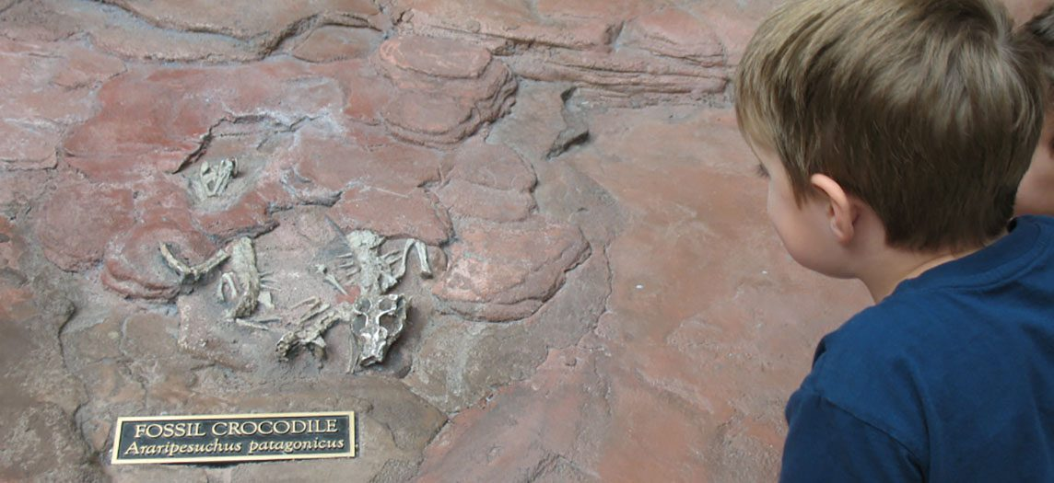
CHAPTER 6
Bone Tissue and the Skeletal System
Bone structure, formation, fractures, and calcium balance.
Anatomy & Physiology · Broward-Miami Health Institute
FACULTY EDITION

Slide 2
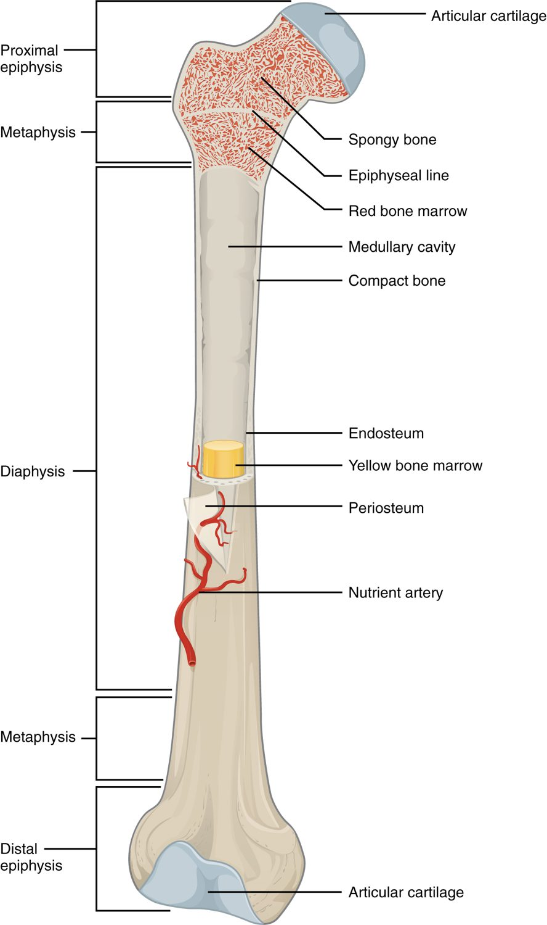
CHAPTER 6
Learning Objectives
After studying this chapter, students will be able to:
1
List and describe the functions of bones
2
Describe the classes of bones
3
Discuss the process of bone formation and development
4
Explain how bone repairs itself after a fracture
5
Discuss the effect of exercise, nutrition, and hormones on bone tissue
6
Describe how an imbalance of calcium can affect bone tissue Bones make good fossils
The anatomy of a long bone.
PN 104 · Ch 6 — Bone Tissue and the Skeletal System
2
Notes:
Preview the skeletal system: bones are living organs that support, protect, move, store minerals, and make blood cells. Cover classification, microscopic structure, how bones form and grow, how they heal, and how the skeleton keeps blood calcium balanced.

Slide 3
6.2
SECTION
Bone Classification
The five shapes of bones and how shape relates to function.

Slide 4
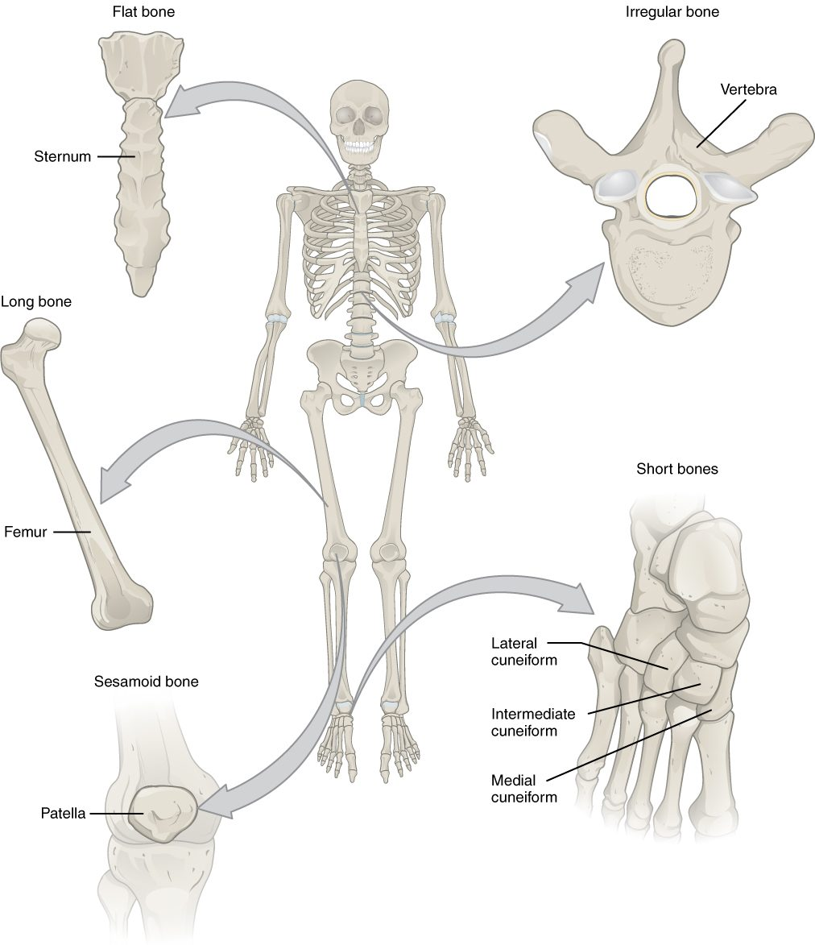
SECTION 6.2
Classification of Bones
Long bones (limbs) act as levers
Short bones (wrist, ankle) add stability
Flat bones (skull, ribs) protect
Irregular and sesamoid bones
The classification of bones by shape
PN 104 · Ch 6 — Bone Tissue and the Skeletal System
4
Notes:
Bones are grouped by shape: long (femur, humerus — for leverage and movement), short (carpals, tarsals — for stability), flat (skull, ribs, sternum — for protection and muscle attachment), irregular (vertebrae, facial bones), and sesamoid (the patella — protecting tendons). Shape reflects function.

Slide 5
6.3
SECTION
Bone Structure
The gross and microscopic structure of bone tissue.

Slide 6
SECTION 6.3
Anatomy of a Long Bone
Diaphysis (shaft) and epiphyses (ends)
Medullary cavity holds marrow
Periosteum covers the outer surface
Articular cartilage cushions the joints
The structure of a long bone
PN 104 · Ch 6 — Bone Tissue and the Skeletal System
6
Notes:
A long bone has a shaft (diaphysis) with a central medullary cavity, two ends (epiphyses) capped by articular cartilage, and a tough periosteum outside (with endosteum lining the inside). Red marrow forms blood cells; yellow marrow stores fat.

Slide 7
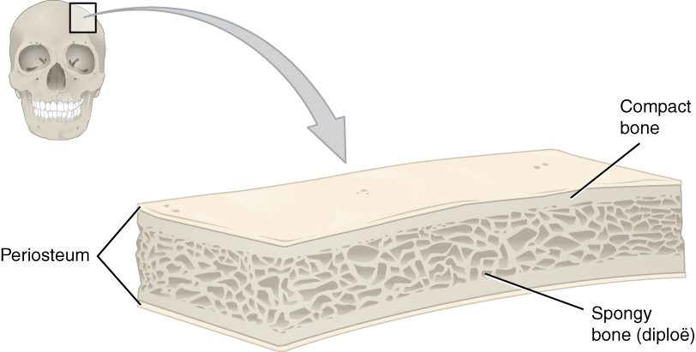
SECTION 6.3
Compact and Spongy Bone
Compact and spongy bone
Compact bone is dense and solid
Forms the strong outer layer
Spongy bone is porous (trabeculae)
Trabeculae resist stress, hold marrow
PN 104 · Ch 6 — Bone Tissue and the Skeletal System
7
Notes:
Compact (cortical) bone forms the dense outer shell that bears weight; spongy (cancellous) bone, a lattice of trabeculae, fills the interior, lightens the bone, and houses red marrow. Trabeculae align along lines of stress, giving strength with minimal weight.

Slide 8
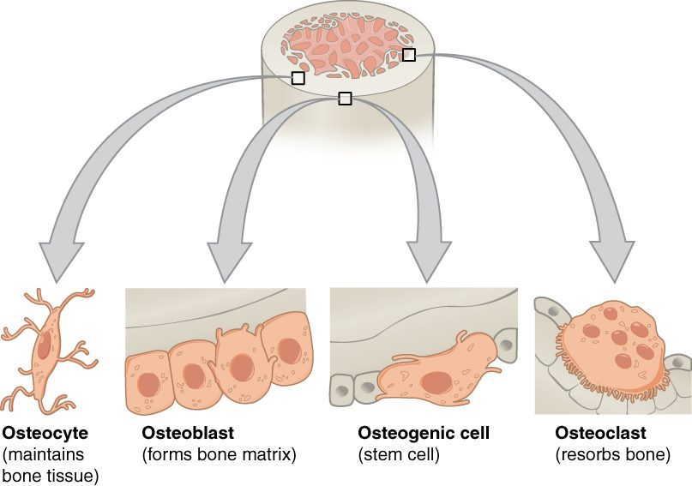
SECTION 6.3
The Four Bone Cells
Osteogenic cells are bone stem cells
Osteoblasts build new bone
Osteocytes maintain bone tissue
Osteoclasts resorb (break down) bone
The cells of bone tissue
PN 104 · Ch 6 — Bone Tissue and the Skeletal System
8
Notes:
Four cell types remodel bone: osteogenic (stem) cells divide into osteoblasts that deposit new matrix; osteoblasts trapped in matrix mature into osteocytes that maintain the tissue; osteoclasts dissolve bone to release minerals. Balance between building and breakdown keeps bone healthy.

Slide 9
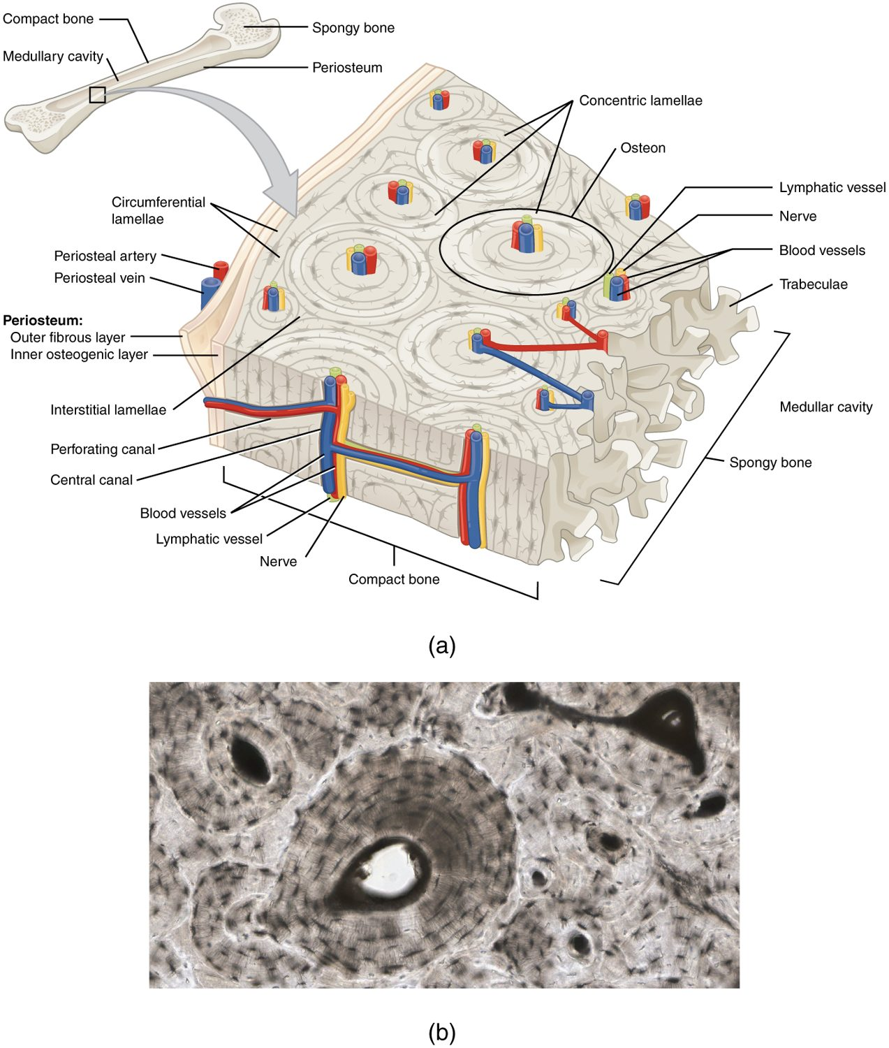
SECTION 6.3
Microscopic Bone — The Osteon
Compact bone is built of osteons
Central canal carries vessels and nerves
Concentric lamellae surround the canal
Osteocytes sit in lacunae
The osteon (Haversian system)
PN 104 · Ch 6 — Bone Tissue and the Skeletal System
9
Notes:
Compact bone is organized into osteons — concentric rings (lamellae) of matrix around a central (Haversian) canal carrying blood vessels and nerves. Osteocytes occupy small spaces (lacunae) and communicate through tiny channels (canaliculi). This structure makes bone strong yet living.

Slide 10
6.4
SECTION
Bone Formation and Development
How bones form before birth and grow throughout childhood.

Slide 11
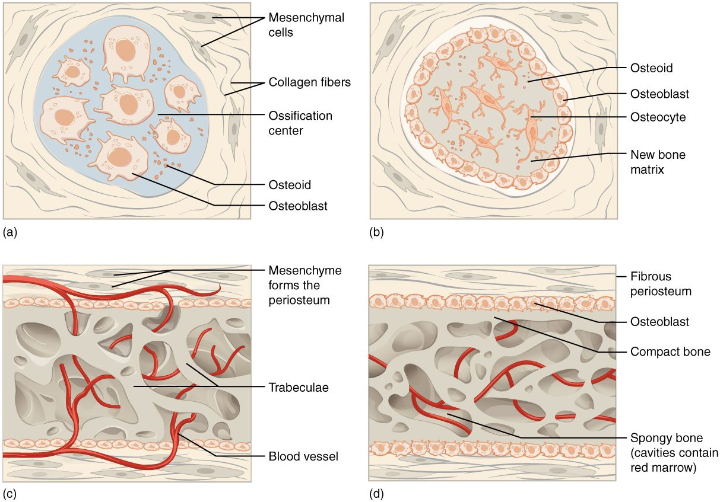
SECTION 6.4
Bone Formation (Ossification)
Intramembranous forms flat bones
Endochondral replaces cartilage
Most bones form from a cartilage model
Begins before birth
Intramembranous and endochondral ossification
PN 104 · Ch 6 — Bone Tissue and the Skeletal System
11
Notes:
Bones form by two routes. Intramembranous ossification builds flat bones (skull, clavicle) directly from connective tissue. Endochondral ossification — the route for most bones — replaces a hyaline cartilage model with bone, starting at primary and secondary ossification centers before birth.

Slide 12
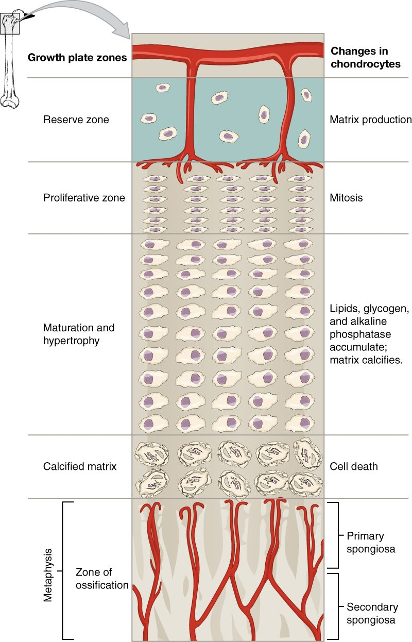
SECTION 6.4
The Epiphyseal (Growth) Plate
A plate of hyaline cartilage
Lengthens long bones in childhood
Cartilage grows, then turns to bone
Closes after puberty
Zones of the epiphyseal plate
PN 104 · Ch 6 — Bone Tissue and the Skeletal System
12
Notes:
Long bones lengthen at the epiphyseal (growth) plate, where cartilage grows on the epiphyseal side and is replaced by bone on the diaphyseal side. Growth hormones drive this process until the plate closes (ossifies) after puberty, ending height growth.

Slide 13
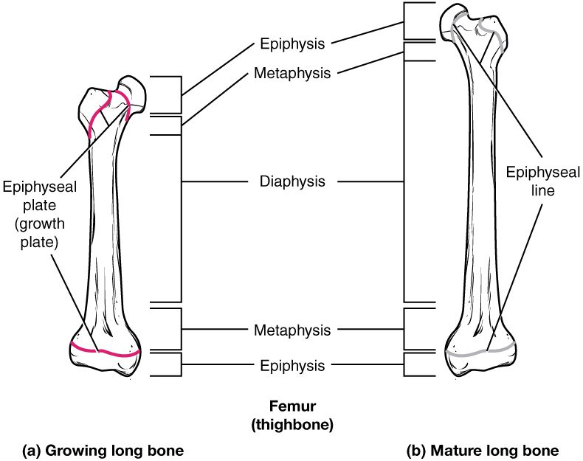
SECTION 6.4
Growing vs. Mature Bone
Active growth plate in children
Epiphyseal line in adults
Marks where growth occurred
Plate injuries can affect growth
Growing and mature long bone
PN 104 · Ch 6 — Bone Tissue and the Skeletal System
13
Notes:
In a growing bone the epiphyseal plate is active cartilage; in the mature bone it becomes the epiphyseal line, a bony remnant. Growth-plate fractures in children need careful management because they can disturb future growth.

Slide 14
6.5
SECTION
Fractures: Bone Repair
Types of fractures and how bone repairs itself.

Slide 15
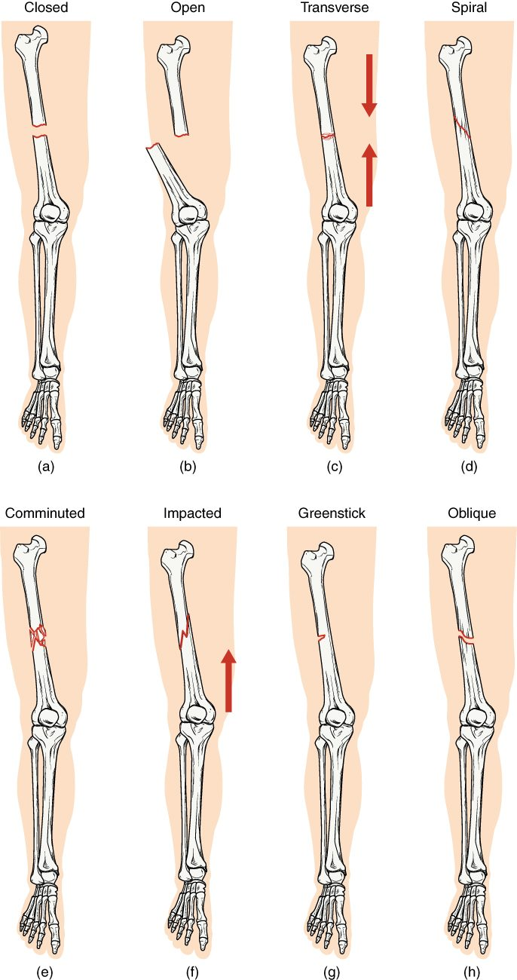
SECTION 6.5
Types of Fractures
Closed (simple) vs. open (compound)
Transverse, oblique, spiral, comminuted
Greenstick (incomplete) in children
Impacted ends driven together
Common types of bone fractures
PN 104 · Ch 6 — Bone Tissue and the Skeletal System
15
Notes:
Fractures are described by pattern and skin involvement: closed (skin intact) versus open (bone through skin), and by line — transverse, oblique, spiral, comminuted (many pieces), greenstick (incomplete, common in children), and impacted. Accurate description guides treatment.

Slide 16
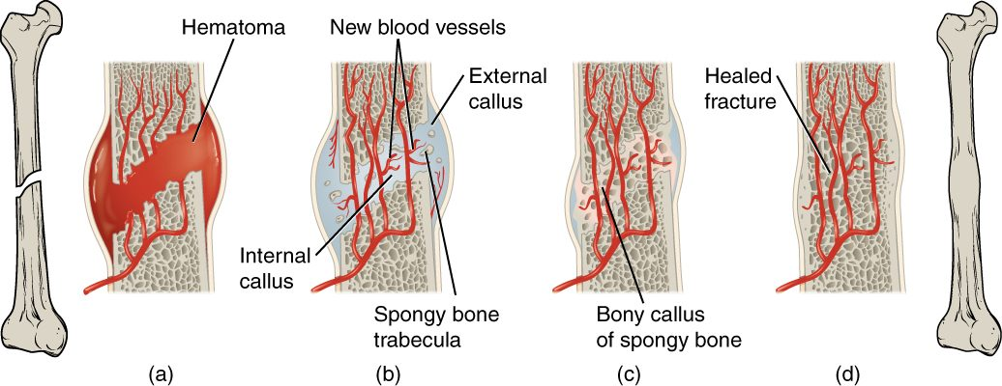
SECTION 6.5
Fracture Repair
The stages of fracture repair
A hematoma forms at the break
A soft (fibrocartilage) callus bridges it
A bony callus replaces it
Remodeling restores the bone
PN 104 · Ch 6 — Bone Tissue and the Skeletal System
16
Notes:
Bone heals in stages: a hematoma forms, then a soft fibrocartilage callus, then a hard bony callus, and finally remodeling restores normal shape. Healing requires good blood supply, immobilization, and nutrition — factors you support in patient care.

Slide 17
6.6
SECTION
Exercise, Nutrition, Hormones, and Bone Tissue
How exercise, nutrition, and hormones keep bone strong.

Slide 18
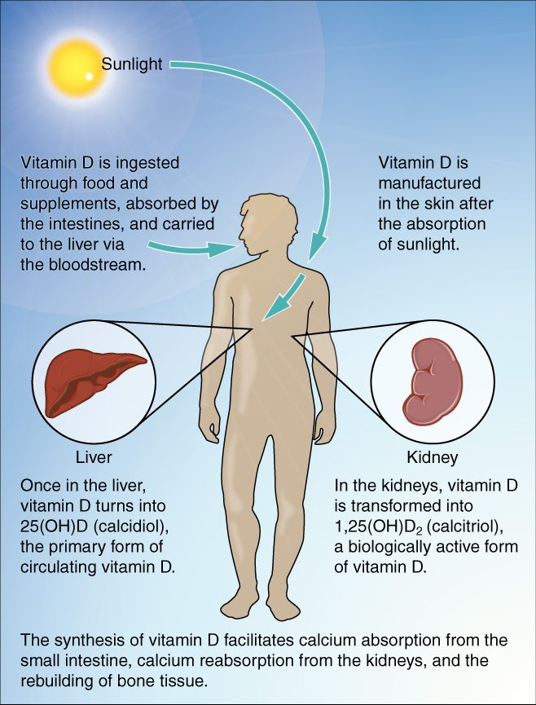
SECTION 6.6
Vitamin D & Calcium Absorption
Sunlight starts vitamin D synthesis
Liver and kidneys activate it
Vitamin D drives calcium absorption
Essential for strong bones
Vitamin D synthesis and calcium absorption
PN 104 · Ch 6 — Bone Tissue and the Skeletal System
18
Notes:
Vitamin D, made in the skin from sunlight and activated by the liver and kidneys, is required to absorb dietary calcium from the gut. Without enough vitamin D and calcium, bones weaken (rickets in children, osteomalacia in adults). Diet, sun exposure, and weight-bearing exercise all support bone.

Slide 19
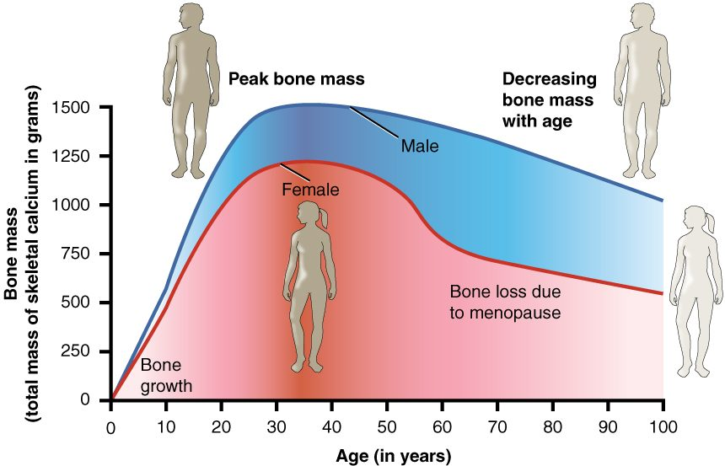
SECTION 6.6
Bone Mass Over the Lifespan
Bone mass across the lifespan
Bone mass peaks in young adulthood
Declines with age, faster after menopause
Low bone mass leads to osteoporosis
Exercise and calcium slow the loss
PN 104 · Ch 6 — Bone Tissue and the Skeletal System
19
Notes:
Bone mass builds to a peak in the twenties, then gradually declines — sharply in women after menopause as estrogen falls. Excessive loss is osteoporosis, which raises fracture risk. Weight-bearing exercise, calcium, and vitamin D help preserve bone — important teaching for older patients.

Slide 20
6.7
SECTION
Calcium Homeostasis: Interactions of the Skeletal System and Other Organ Systems
How the skeleton helps keep blood calcium in a safe range.

Slide 21
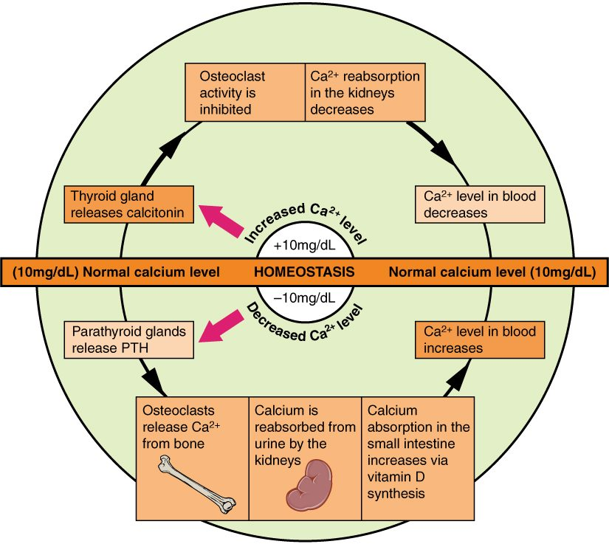
SECTION 6.7
Calcium Homeostasis
Blood calcium is tightly controlled
PTH raises calcium (bone, kidney, gut)
Calcitonin lowers calcium
Bone is the body's calcium reservoir
Hormonal control of blood calcium
PN 104 · Ch 6 — Bone Tissue and the Skeletal System
21
Notes:
Calcium is vital for nerves, muscles, and clotting, so blood levels are tightly regulated. When calcium falls, parathyroid hormone (PTH) releases it from bone, conserves it in the kidney, and boosts gut absorption; calcitonin lowers high calcium. The skeleton serves as the body's calcium bank.

Slide 22
CHAPTER 6
Key Takeaways
The skeleton supports, protects, moves the body, stores minerals, and makes blood cells.
Bones are classified by shape, with structure suited to function.
Bone is living tissue, built of osteons and continuously remodeled by bone cells.
Bones form by ossification and lengthen at the epiphyseal plate until adulthood.
Bone health depends on exercise, nutrition, hormones, and calcium balance.
PN 104 · Ch 6 — Bone Tissue and the Skeletal System
22

Slide 23
CLINICAL CONNECTIONS
Why Bone Matters in Practical Nursing
Fracture Care
Osteoporosis
Knowing fracture types and healing stages guides immobilization and recovery.
Bone loss with age raises fracture risk — central to fall prevention.
Calcium & Vitamin D
Blood Cell Formation
Essential nutrients for bone and for nerve and muscle function.
Red marrow makes the blood cells you monitor in lab work.
Growth Plates
Mobility
Pediatric growth-plate injuries require special attention.
Bone strength underpins safe movement and weight-bearing.

