Slide 1
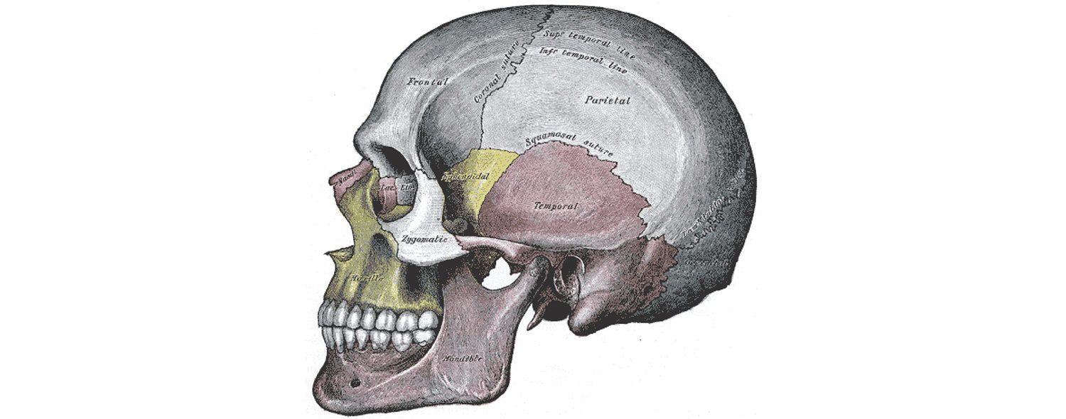
CHAPTER 7
The Axial Skeleton
The skull, vertebral column, and thoracic cage.
Anatomy & Physiology · Broward-Miami Health Institute
FACULTY EDITION

Slide 2
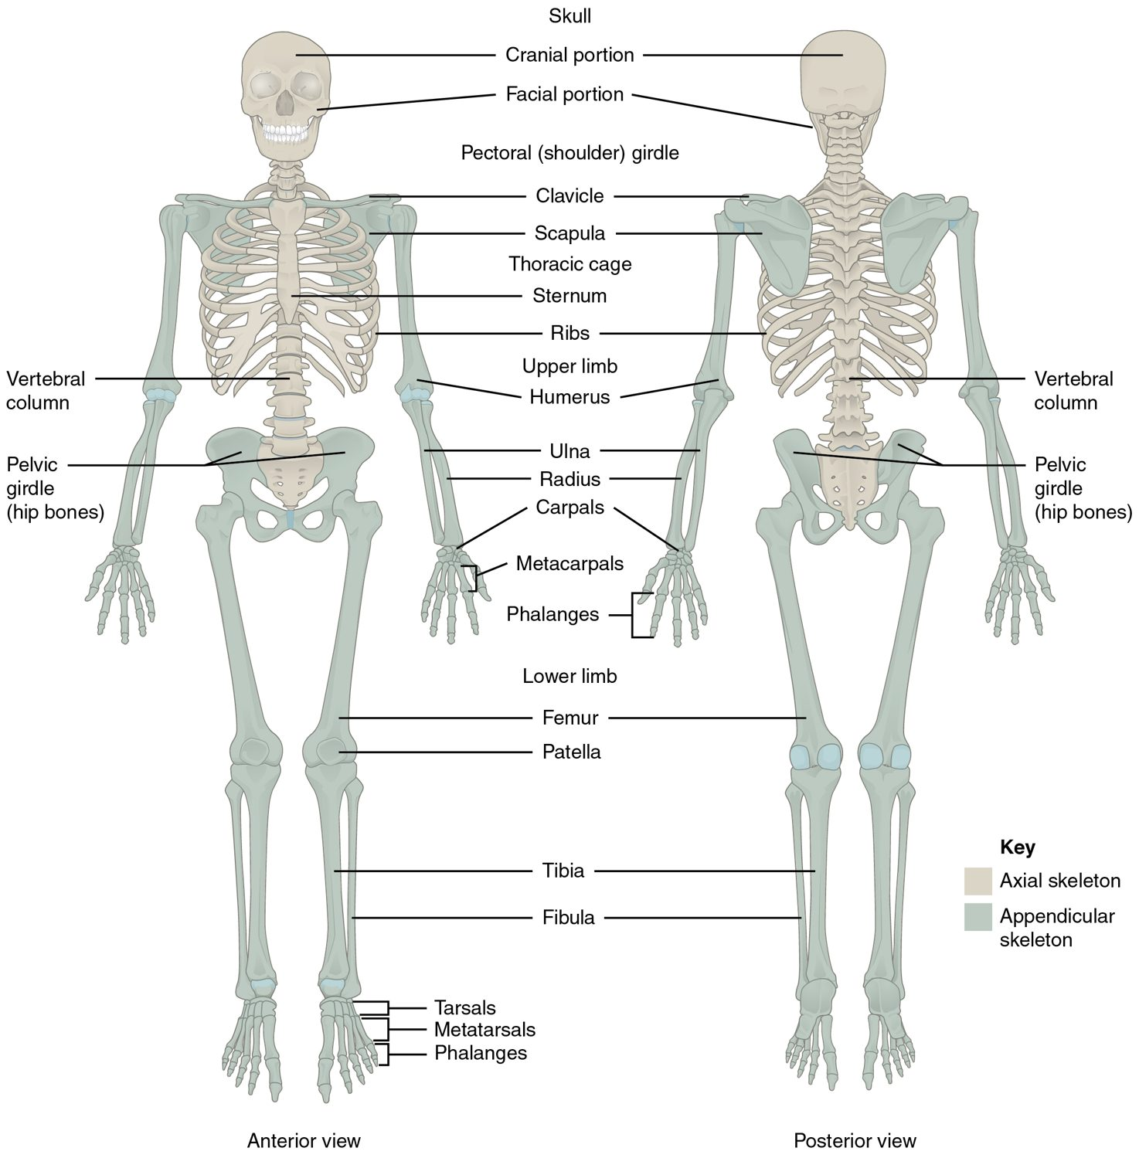
CHAPTER 7
Learning Objectives
After studying this chapter, students will be able to:
1
Describe the functions of the skeletal system and define its two major subdivisions
2
Identify the bones and bony structures of the skull, the cranial suture lines, the cranial fossae, and the openings in the skull
3
Discuss the vertebral column and regional variations in its bony components and curvatures
4
Describe the components of the thoracic cage
5
Discuss the embryonic development of the axial skeleton The skeletal system forms the rigid internal framework of the body
The axial skeleton forms the body's central axis.
PN 104 · Ch 7 — The Axial Skeleton
2
Notes:
Preview the axial skeleton — the central core of 80 bones: the skull that protects the brain, the vertebral column that protects the spinal cord, and the thoracic cage that shields the heart and lungs. Highlight how each region supports the body and connects to clinical assessment.

Slide 3
7.1
SECTION
Divisions of the Skeletal System
Dividing the skeleton into the axial core and the appendicular limbs.

Slide 4
SECTION 7.1
Axial vs. Appendicular Skeleton
206 bones in two divisions
Axial: skull, vertebrae, thoracic cage
Appendicular: limbs and girdles
The axial forms the central axis
The axial and appendicular skeleton
PN 104 · Ch 7 — The Axial Skeleton
4
Notes:
The 206 bones split into the axial skeleton (80 bones — skull, vertebral column, thoracic cage), which forms the central supporting axis, and the appendicular skeleton (126 bones — the limbs and the girdles that attach them). This chapter covers the axial division.

Slide 5
7.2
SECTION
The Skull
The cranial and facial bones that protect the brain and shape the face.

Slide 6
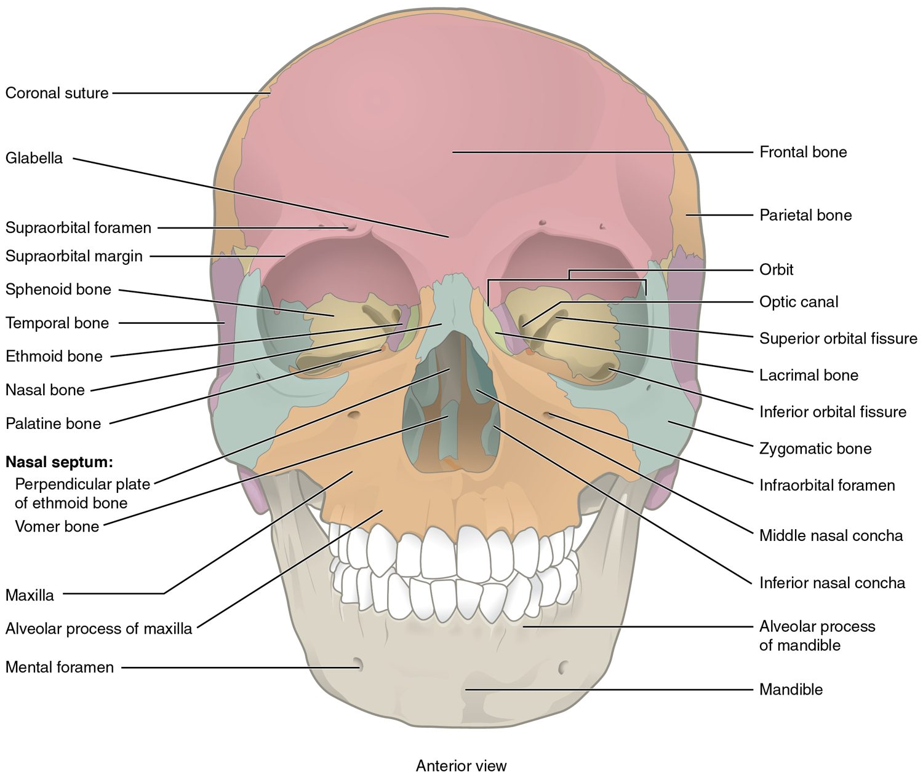
SECTION 7.2
The Skull — Anterior View
22 bones: cranial and facial
Cranial bones enclose the brain
Facial bones shape the face
Joined by immovable sutures
Anterior view of the skull
PN 104 · Ch 7 — The Axial Skeleton
6
Notes:
The skull has 22 bones — 8 cranial bones protecting the brain and 14 facial bones forming the face. From the front you see the frontal bone, the orbits, nasal bones, maxillae, and mandible. Nearly all skull joints are immovable sutures.

Slide 7
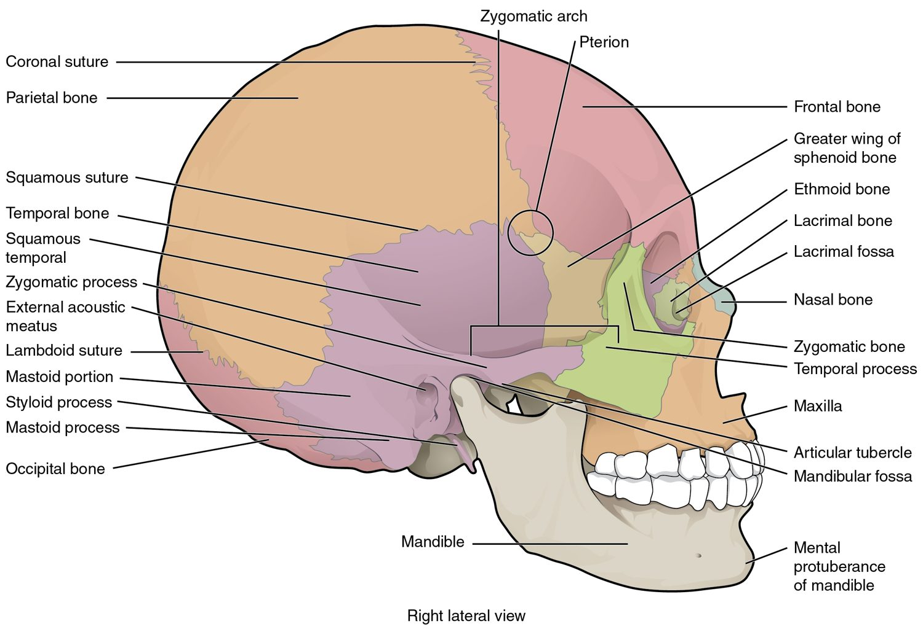
SECTION 7.2
The Skull — Lateral View
Frontal, parietal, temporal, occipital
Sphenoid and ethmoid lie deep within
Cranial bones meet at sutures
Cranial fossae cradle the brain
Lateral view of the skull
PN 104 · Ch 7 — The Axial Skeleton
7
Notes:
From the side, the major cranial bones — frontal, parietal, temporal, occipital, and sphenoid — meet at sutures. The temporal bone houses the ear and the mastoid process. Internally, three cranial fossae step down to cradle different parts of the brain.

Slide 8
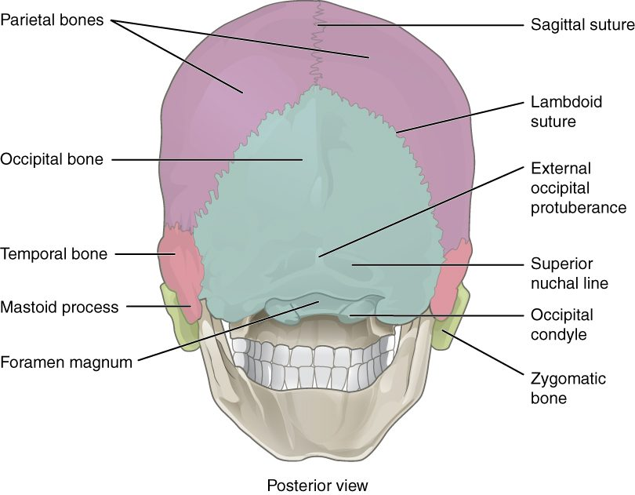
SECTION 7.2
Sutures of the Skull
Sutures are immovable fibrous joints
Coronal, sagittal, and lambdoid
Lock the cranial bones together
Foramen magnum at the base
Posterior skull and cranial sutures
PN 104 · Ch 7 — The Axial Skeleton
8
Notes:
The cranial bones interlock at sutures — coronal (front), sagittal (top midline), and lambdoid (back). The foramen magnum, the large opening through which the spinal cord exits, lies in the occipital bone. Sutures are immovable in adults but flexible in infants.

Slide 9
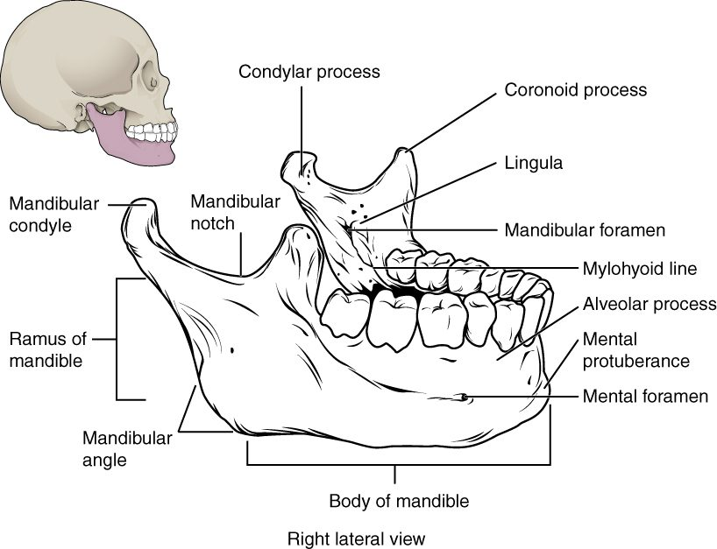
SECTION 7.2
The Mandible
The only movable skull bone
Forms the lower jaw
Holds the lower teeth
Articulates at the TMJ
The mandible (lower jaw)
PN 104 · Ch 7 — The Axial Skeleton
9
Notes:
The mandible is the largest, strongest facial bone and the only one that moves, joining the temporal bone at the temporomandibular joint (TMJ). It holds the lower teeth and is essential for chewing and speech. TMJ disorders are a common clinical complaint.

Slide 10
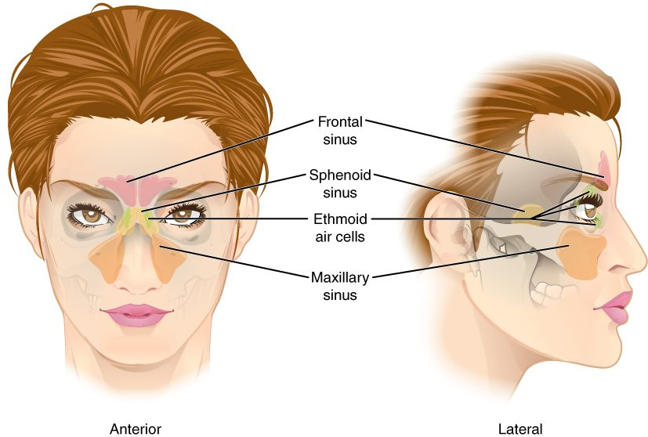
SECTION 7.2
The Paranasal Sinuses
Air-filled spaces in skull bones
Frontal, ethmoid, sphenoid, maxillary
Lighten the skull and warm air
Drain into the nasal cavity
The paranasal sinuses
PN 104 · Ch 7 — The Axial Skeleton
10
Notes:
The paranasal sinuses are air-filled cavities in the frontal, ethmoid, sphenoid, and maxillary bones. They lighten the skull, warm and humidify inhaled air, and add resonance to the voice. Because they drain into the nasal cavity, they can become infected (sinusitis).

Slide 11
7.3
SECTION
The Vertebral Column
Support, protection of the spinal cord, and flexibility of the spine.

Slide 12
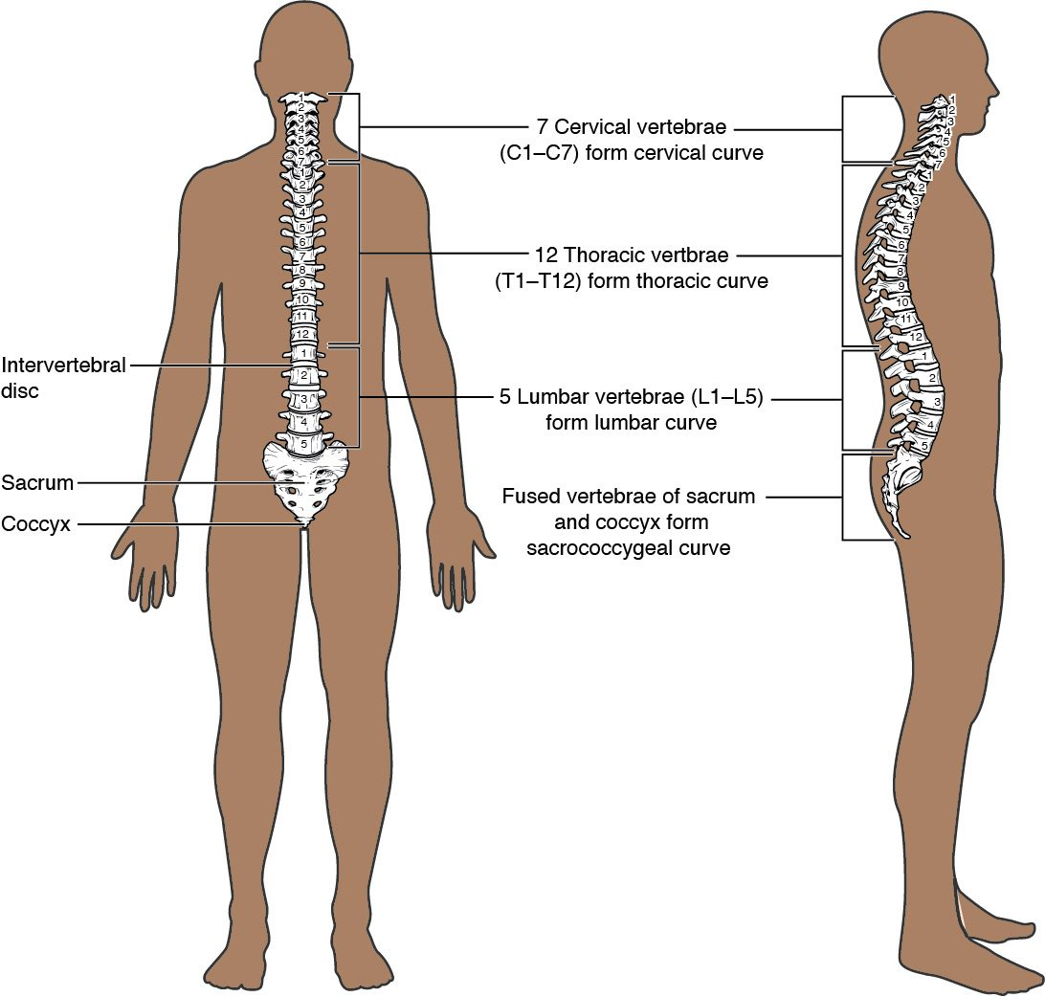
SECTION 7.3
The Vertebral Column
26 bones in five regions
Cervical, thoracic, lumbar, sacrum, coccyx
Four curvatures balance the body
Protects the spinal cord
The vertebral column and its curvatures
PN 104 · Ch 7 — The Axial Skeleton
12
Notes:
The vertebral column has 26 bones in five regions — 7 cervical, 12 thoracic, 5 lumbar, the sacrum, and the coccyx. Its four curvatures (cervical and lumbar concave, thoracic and sacral convex) balance weight and absorb shock while protecting the spinal cord.

Slide 13
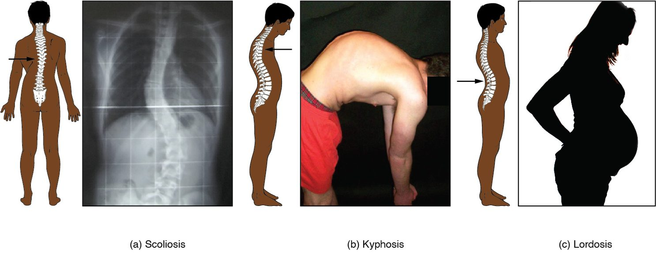
SECTION 7.3
Abnormal Spinal Curvatures
Scoliosis, kyphosis, and lordosis
Scoliosis: a sideways curvature
Kyphosis: exaggerated thoracic curve
Lordosis: exaggerated lumbar curve
Affect posture and breathing
PN 104 · Ch 7 — The Axial Skeleton
13
Notes:
Abnormal curvatures include scoliosis (a lateral S- or C-curve), kyphosis (excessive thoracic convexity, common with osteoporosis), and lordosis (excessive lumbar concavity, or "swayback"). Severe cases affect posture, mobility, and even breathing. Adolescent scoliosis screening is common.

Slide 14
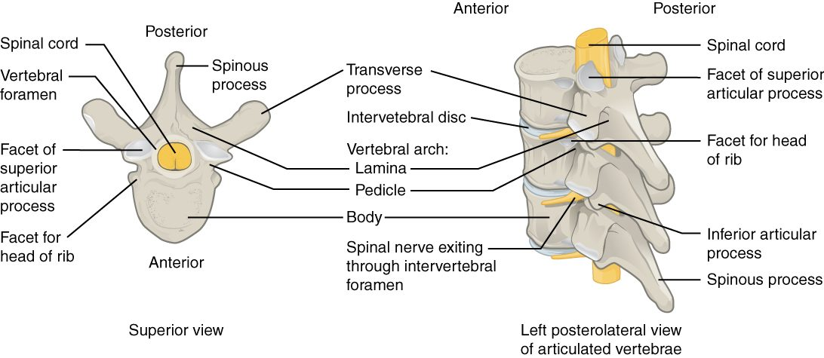
SECTION 7.3
A Typical Vertebra
The structure of a typical vertebra
Body bears weight in front
Vertebral arch surrounds the cord
Spinous and transverse processes
Stacked foramina form the canal
PN 104 · Ch 7 — The Axial Skeleton
14
Notes:
A typical vertebra has a weight-bearing body in front and a vertebral arch behind that encloses the spinal cord. Processes (spinous, transverse, and articular) provide muscle attachment and joints with neighboring vertebrae. The stacked vertebral foramina form the protective vertebral canal.

Slide 15
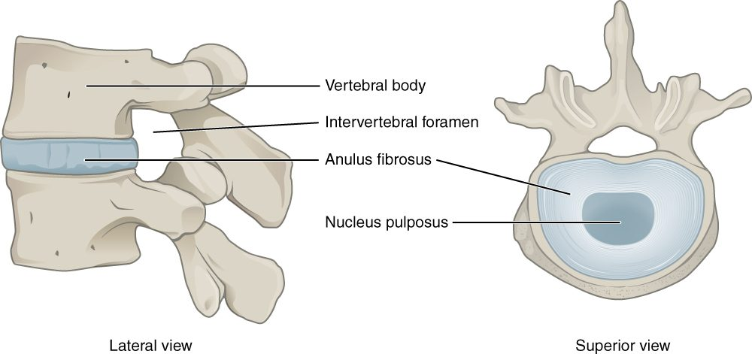
SECTION 7.3
Intervertebral Discs
An intervertebral disc
Cushions between vertebral bodies
Tough outer ring (annulus fibrosus)
Gel-like center (nucleus pulposus)
Absorb shock and allow movement
PN 104 · Ch 7 — The Axial Skeleton
15
Notes:
Intervertebral discs of fibrocartilage sit between the vertebral bodies, cushioning them and allowing movement. Each has a tough outer annulus fibrosus around a gel-like nucleus pulposus. Discs thin with age, contributing to height loss and back problems.

Slide 16
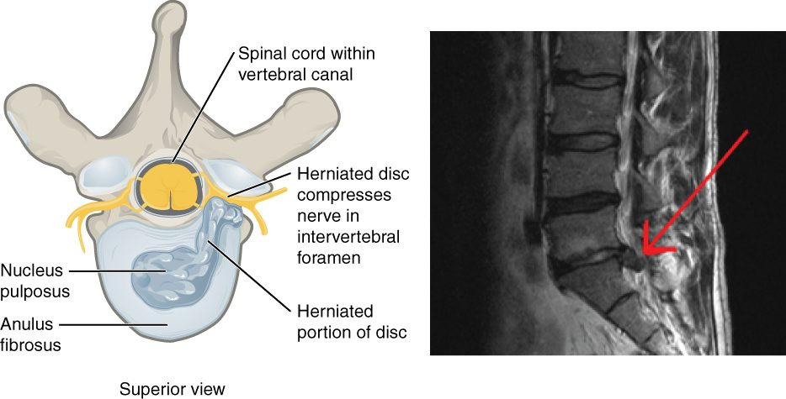
SECTION 7.3
Herniated Disc
A herniated intervertebral disc
Nucleus pushes through the annulus
Can compress spinal nerves
Causes pain, numbness, weakness
Common in the lumbar spine
PN 104 · Ch 7 — The Axial Skeleton
16
Notes:
When the annulus weakens, the nucleus pulposus can bulge or rupture (herniate) and press on a spinal nerve or the cord, causing radiating pain, numbness, or weakness — classically sciatica in the lower back. This is a very common cause of back and leg pain.

Slide 17
7.4
SECTION
The Thoracic Cage
The sternum and ribs that protect the heart and lungs and aid breathing.

Slide 18
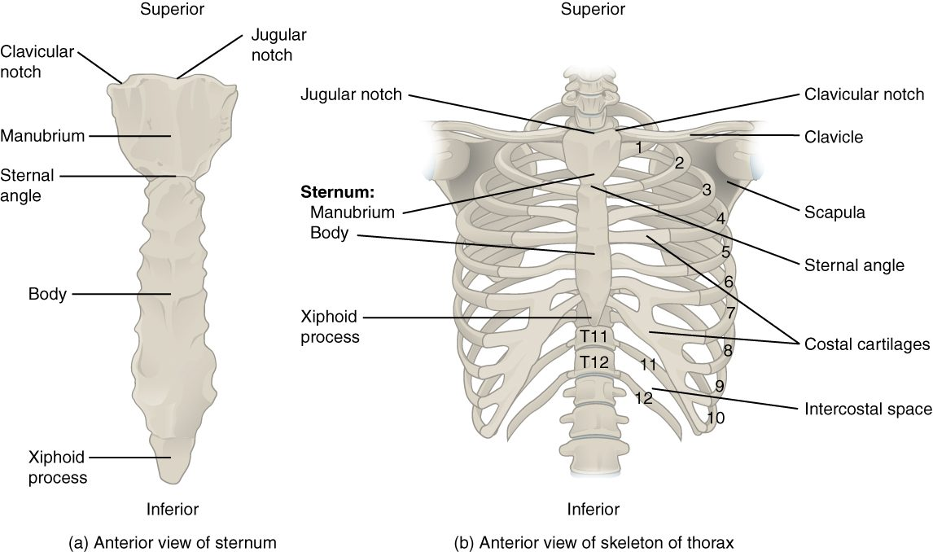
SECTION 7.4
The Thoracic Cage
The thoracic cage (sternum and ribs)
Sternum plus 12 pairs of ribs
True, false, and floating ribs
Protects the heart and lungs
Moves to enable breathing
PN 104 · Ch 7 — The Axial Skeleton
18
Notes:
The thoracic cage is the sternum and 12 pairs of ribs. True ribs (1–7) attach directly to the sternum by costal cartilage, false ribs (8–10) attach indirectly, and floating ribs (11–12) have no anterior attachment. The cage protects the heart and lungs and moves to expand the chest during breathing.

Slide 19
7.5
SECTION
Embryonic Development of the Axial Skeleton
How the skull and spine form before birth and in infancy.

Slide 20
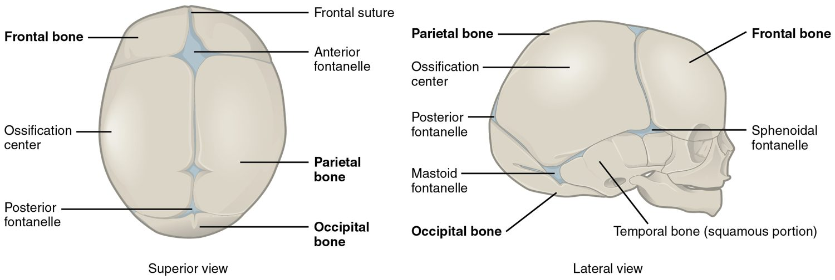
SECTION 7.5
Fontanelles & Skull Development
Fontanelles of the newborn skull
Infant skull bones are not yet fused
Fontanelles ("soft spots") remain
Allow birth passage and brain growth
Close over the first two years
PN 104 · Ch 7 — The Axial Skeleton
20
Notes:
At birth, the cranial bones are connected by fibrous fontanelles ("soft spots") rather than rigid sutures. These let the skull mold during birth and accommodate rapid brain growth, then gradually close over the first two years. A sunken or bulging fontanelle is an important assessment sign in infants.

Slide 21
CHAPTER 7
Key Takeaways
The skeleton divides into the axial (central axis) and appendicular (limbs) divisions.
The skull's 22 bones protect the brain and form the face, joined by immovable sutures.
The vertebral column supports the body, protects the spinal cord, and has four curvatures.
The thoracic cage protects the heart and lungs and assists with breathing.
The infant skull has fontanelles that allow birth and brain growth.
PN 104 · Ch 7 — The Axial Skeleton
21

Slide 22
CLINICAL CONNECTIONS
Why the Axial Skeleton Matters in Practical Nursing
Spine Injuries
Back Pain
Vertebrae protect the spinal cord — spinal precautions prevent paralysis.
Herniated discs and abnormal curvatures are common sources of pain.
Sinusitis
Infant Assessment
The paranasal sinuses drain into the nose and can become infected.
Fontanelles reveal hydration status and intracranial pressure.
Osteoporosis
CPR Landmarks
Thoracic kyphosis often reflects vertebral bone loss in older adults.
The sternum and ribs guide hand placement for chest compressions.

