Slide 1
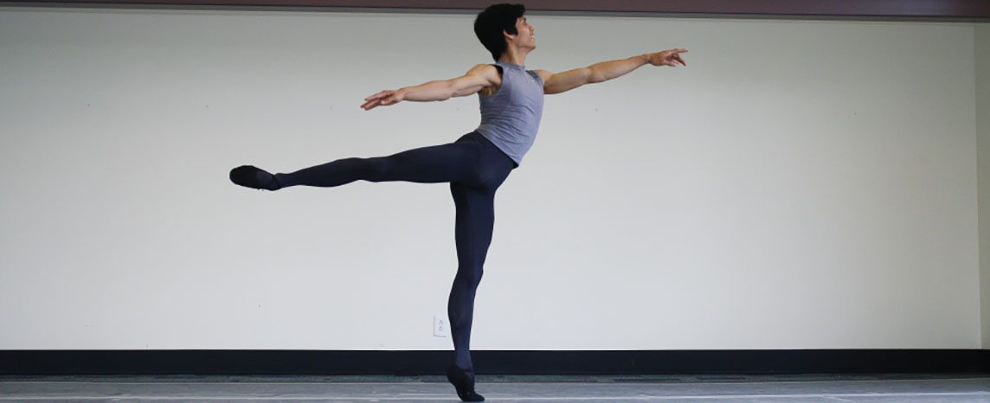
CHAPTER 8
The Appendicular Skeleton
The limbs and the girdles that attach them to the body.
Anatomy & Physiology · Broward-Miami Health Institute
FACULTY EDITION

Slide 2
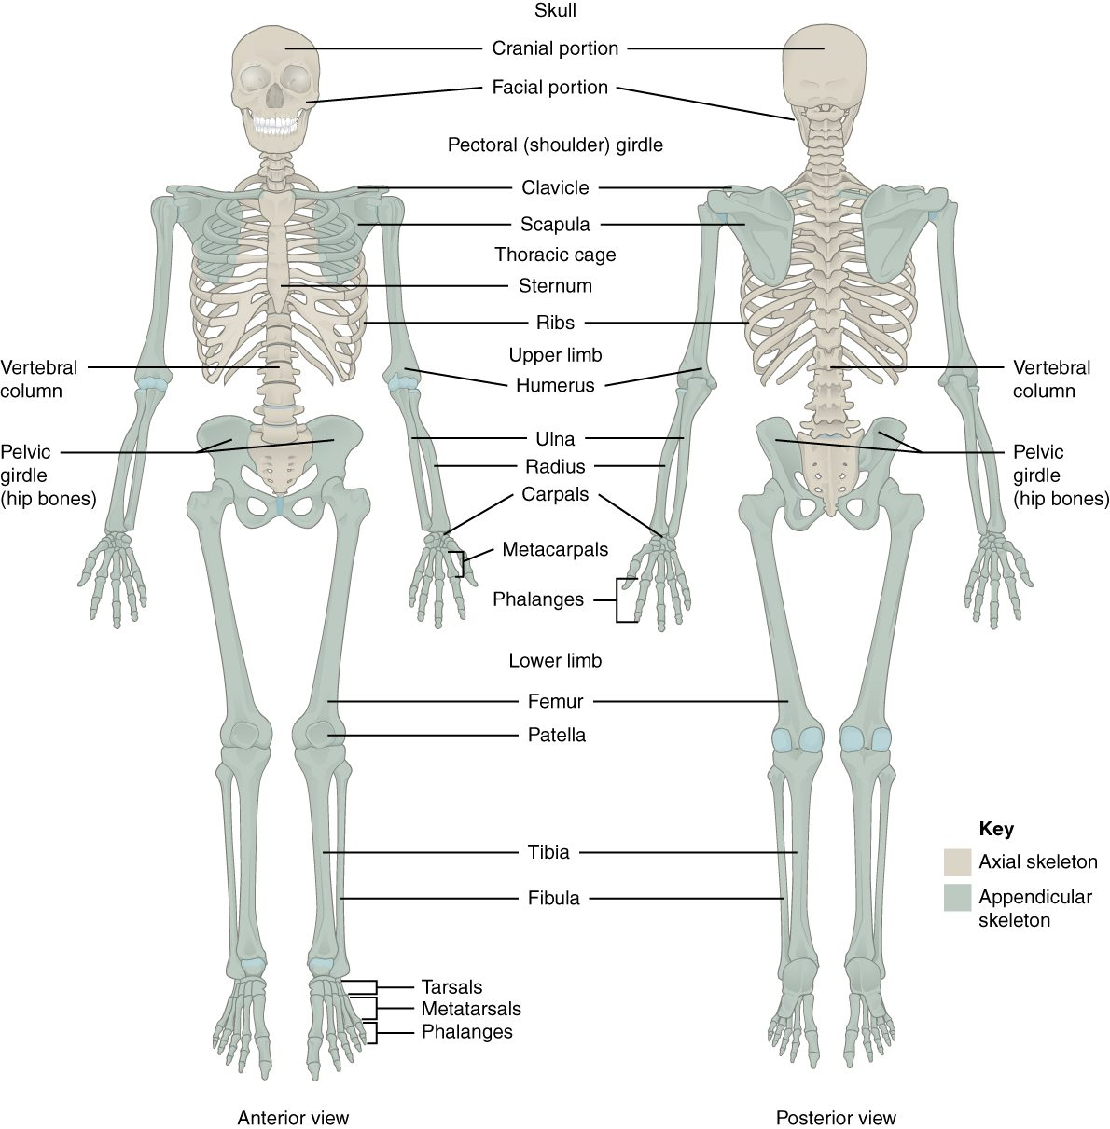
CHAPTER 8
Learning Objectives
After studying this chapter, students will be able to:
1
Discuss the bones of the pectoral and pelvic girdles, and describe how these unite the limbs with the axial skeleton
2
Describe the bones of the upper limb, including the bones of the arm, forearm, wrist, and hand
3
Identify the features of the pelvis and explain how these differ between the adult male and female pelvis
4
Describe the bones of the lower limb, including the bones of the thigh, leg, ankle, and foot
5
Describe the embryonic formation and growth of the limb bones Your skeleton provides the internal supporting structure of the body
The appendicular skeleton — the limbs and their girdles.
PN 104 · Ch 8 — The Appendicular Skeleton
2
Notes:
Preview the appendicular skeleton: the 126 bones of the upper and lower limbs plus the pectoral and pelvic girdles that anchor them. Emphasize the mobility-versus-stability contrast between the shoulder and hip and the clinical relevance of common fracture sites.

Slide 3
8.1
SECTION
The Pectoral Girdle
The clavicle and scapula that anchor the arm to the body.

Slide 4
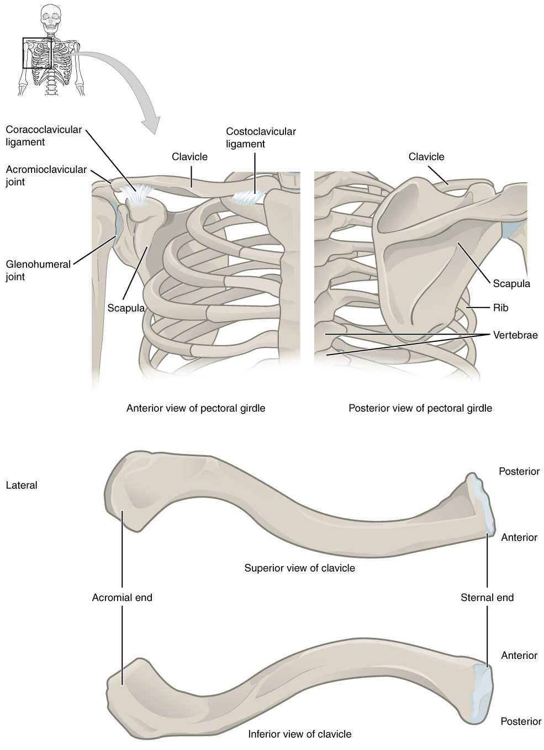
SECTION 8.1
The Pectoral Girdle
Clavicle and scapula on each side
Attaches the arm to the axial skeleton
Highly mobile but less stable
The clavicle is commonly fractured
The pectoral girdle (clavicle and scapula)
PN 104 · Ch 8 — The Appendicular Skeleton
4
Notes:
The pectoral (shoulder) girdle is the clavicle and scapula. It anchors the upper limb to the axial skeleton at only one bony joint, trading stability for a wide range of motion. The clavicle is the most commonly fractured bone in the body.

Slide 5
8.2
SECTION
Bones of the Upper Limb
The humerus, radius, ulna, and the bones of the wrist and hand.

Slide 6
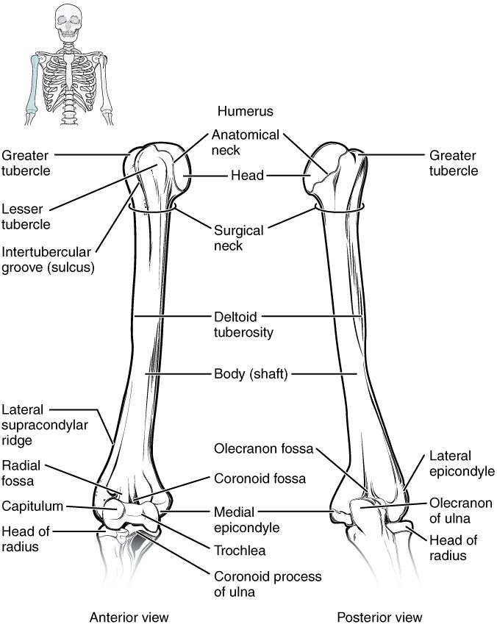
SECTION 8.2
The Humerus
The single bone of the arm
Head fits the scapula's glenoid cavity
Articulates with radius and ulna
Many muscle attachment sites
The humerus (arm bone)
PN 104 · Ch 8 — The Appendicular Skeleton
6
Notes:
The humerus is the long bone of the upper arm. Its rounded head fits the shallow glenoid cavity of the scapula at the shoulder, and its distal end articulates with the radius and ulna at the elbow. Its many landmarks are muscle attachment points.

Slide 7
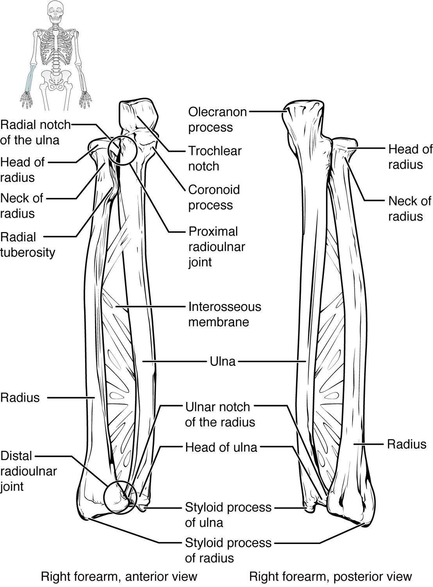
SECTION 8.2
The Radius and Ulna
The two bones of the forearm
Ulna is medial (little-finger side)
Radius is lateral (thumb side)
They cross during pronation
The radius and ulna (forearm)
PN 104 · Ch 8 — The Appendicular Skeleton
7
Notes:
The forearm has two bones: the ulna (medial, dominant at the elbow) and the radius (lateral, dominant at the wrist). The radius rotates over the ulna during pronation and supination, turning the palm down and up.

Slide 8
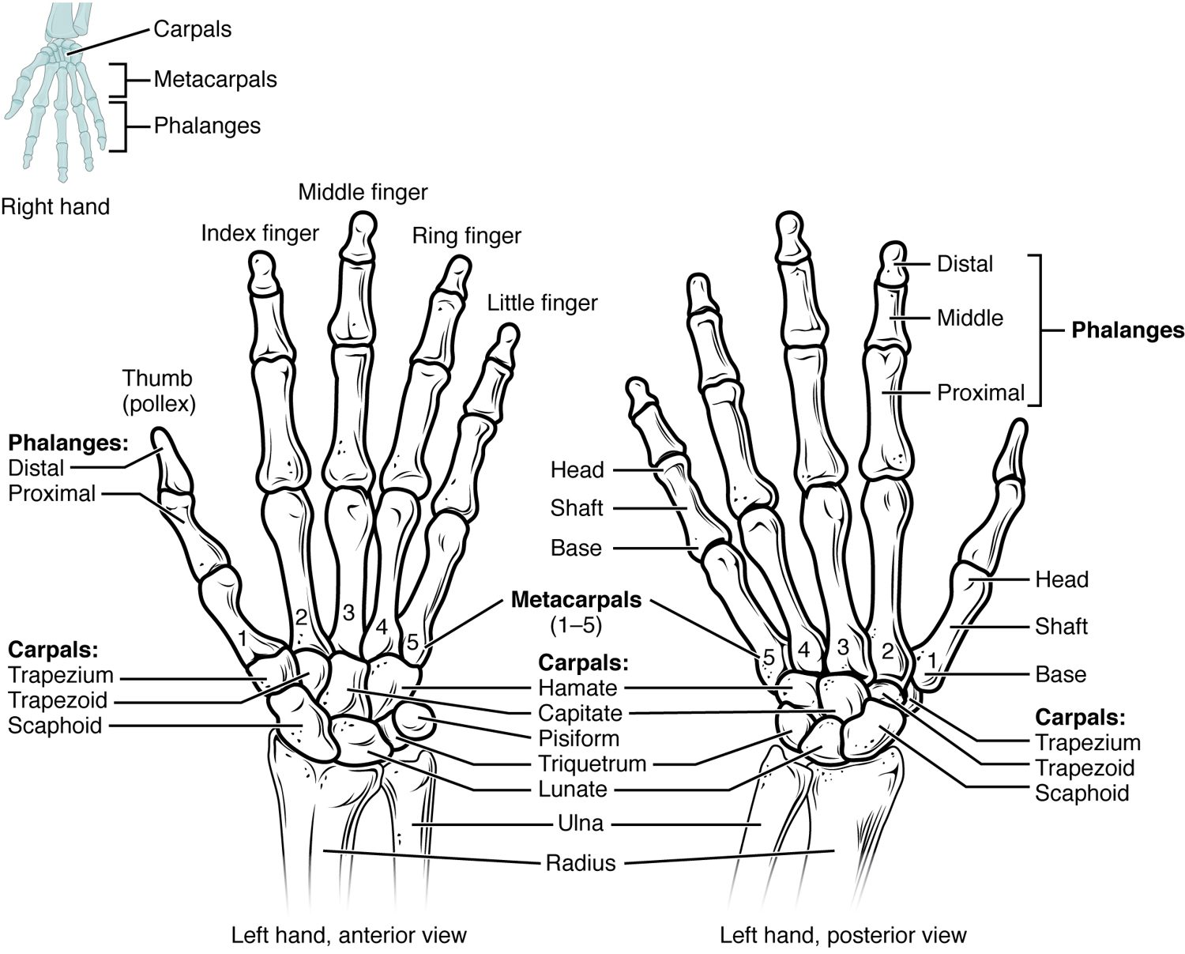
SECTION 8.2
Bones of the Hand
8 carpals form the wrist
5 metacarpals form the palm
14 phalanges form the fingers
Built for fine, precise movement
The bones of the wrist and hand
PN 104 · Ch 8 — The Appendicular Skeleton
8
Notes:
The hand has 27 bones: eight carpals in the wrist, five metacarpals in the palm, and fourteen phalanges in the fingers and thumb. This arrangement allows the precise, dexterous movements unique to the human hand.

Slide 9
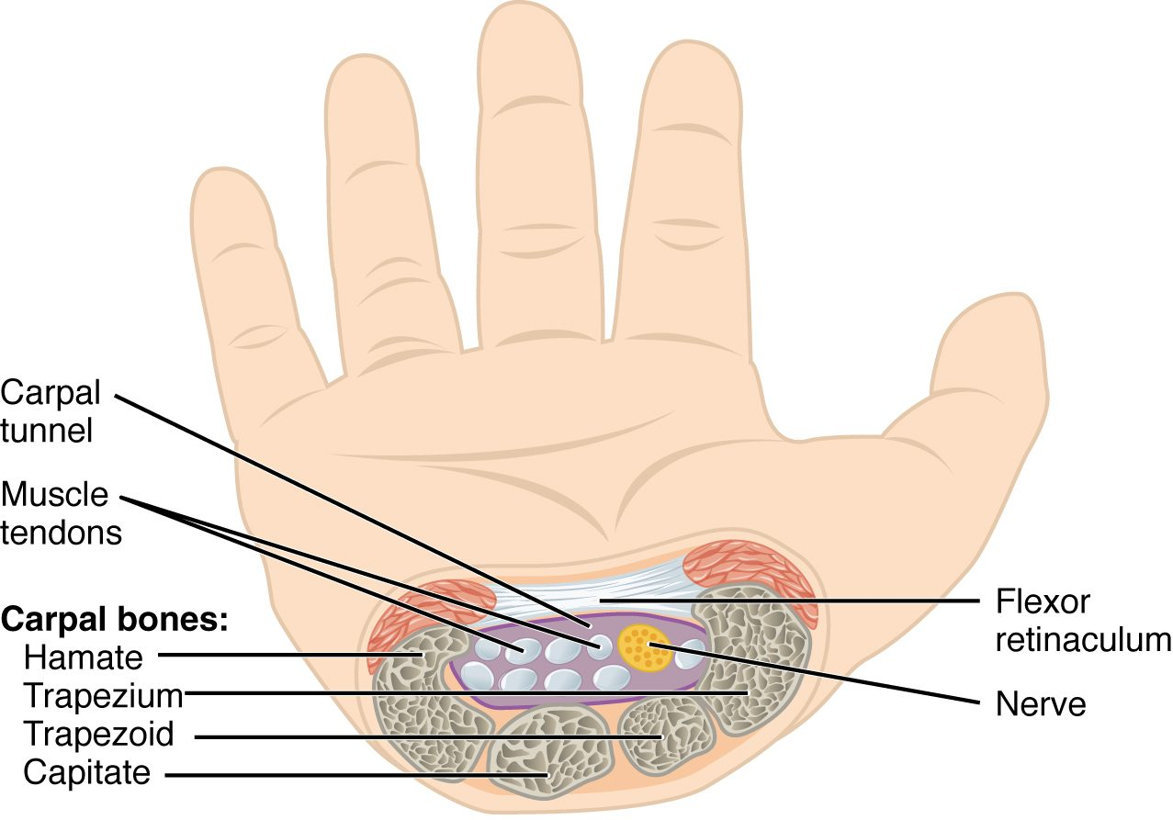
SECTION 8.2
The Carpal Tunnel
A passage at the front of the wrist
Formed by carpals + flexor retinaculum
Carries the median nerve and tendons
Compression causes carpal tunnel syndrome
The carpal tunnel and median nerve
PN 104 · Ch 8 — The Appendicular Skeleton
9
Notes:
The carpal tunnel is a narrow passage on the palm side of the wrist, bounded by carpal bones and the flexor retinaculum, through which the median nerve and finger-flexor tendons pass. Swelling here compresses the nerve, causing carpal tunnel syndrome — numbness, tingling, and thumb weakness.

Slide 10
8.3
SECTION
The Pelvic Girdle and Pelvis
The hip bones, the sacrum, and the pelvis they form.

Slide 11
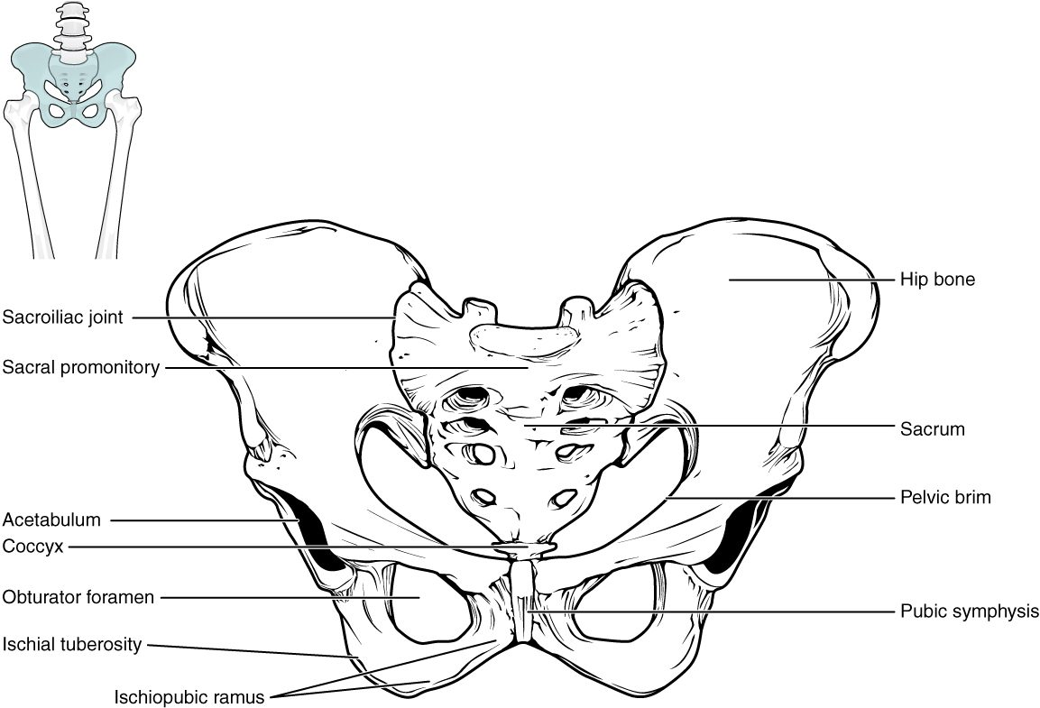
SECTION 8.3
The Pelvis
Two hip bones + sacrum + coccyx
Bears the body's weight
Protects the pelvic organs
A stable, weight-bearing girdle
The pelvis
PN 104 · Ch 8 — The Appendicular Skeleton
11
Notes:
The pelvis is formed by the two hip bones joined to the sacrum behind and at the pubic symphysis in front. Unlike the mobile shoulder, it is built for stability — transferring the upper body's weight to the legs and protecting the pelvic organs.

Slide 12
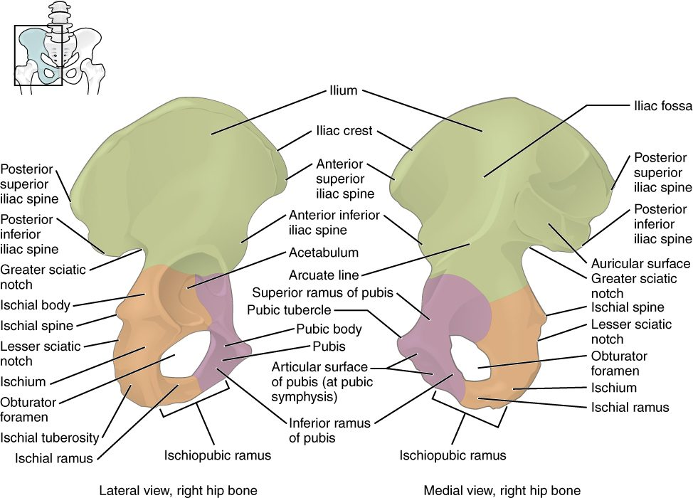
SECTION 8.3
The Hip Bone
Three fused bones: ilium, ischium, pubis
Meet at the acetabulum (hip socket)
Ilium is the broad flaring blade
Many muscle attachments
The hip bone (os coxae)
PN 104 · Ch 8 — The Appendicular Skeleton
12
Notes:
Each hip bone forms from three bones that fuse during growth — the ilium (the broad upper blade), the ischium (the lower-back part you sit on), and the pubis (the front). They meet at the acetabulum, the deep socket for the head of the femur.

Slide 13
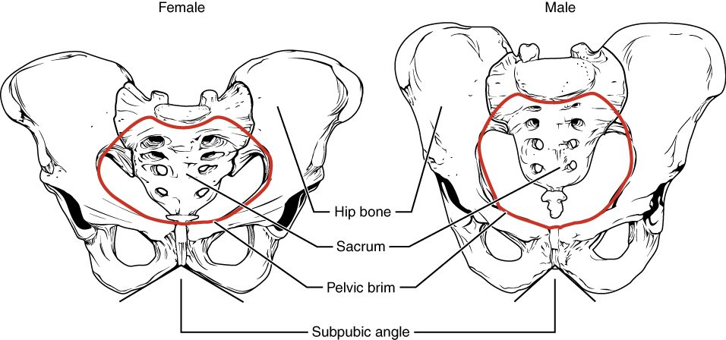
SECTION 8.3
Male vs. Female Pelvis
Differences between the male and female pelvis
Female pelvis is wider and shallower
Larger outlet for childbirth
Male pelvis is narrower and heavier
Sex differences aid identification
PN 104 · Ch 8 — The Appendicular Skeleton
13
Notes:
The female pelvis is adapted for childbirth — wider and shallower, with a broader pubic angle and larger outlet — while the male pelvis is narrower and heavier. These differences matter in obstetrics and are useful in forensic identification.

Slide 14
8.4
SECTION
Bones of the Lower Limb
The femur, tibia, fibula, and the bones of the foot.

Slide 15
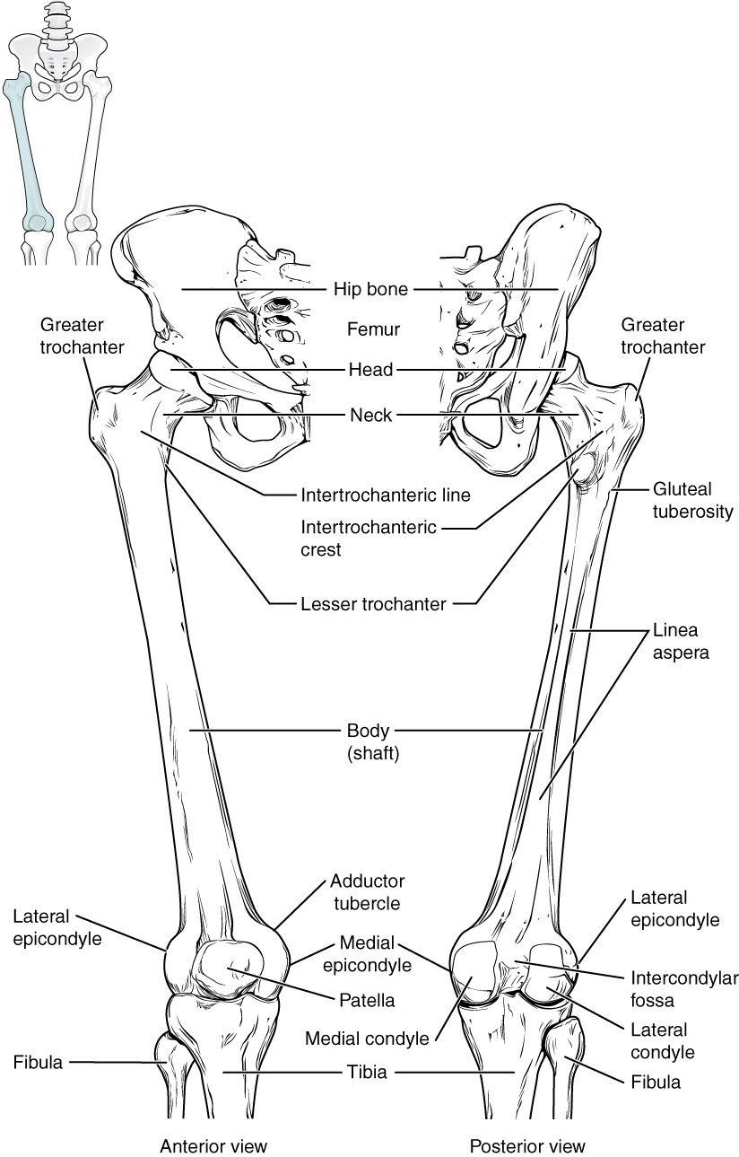
SECTION 8.4
The Femur
The thigh bone — longest, strongest bone
Head fits into the acetabulum
Meets the tibia at the knee
Bears great mechanical loads
The femur (thigh bone)
PN 104 · Ch 8 — The Appendicular Skeleton
15
Notes:
The femur is the longest and strongest bone in the body. Its head fits the acetabulum at the hip; its distal condyles meet the tibia at the knee. The angled neck is a common fracture site in older adults — a "broken hip."

Slide 16
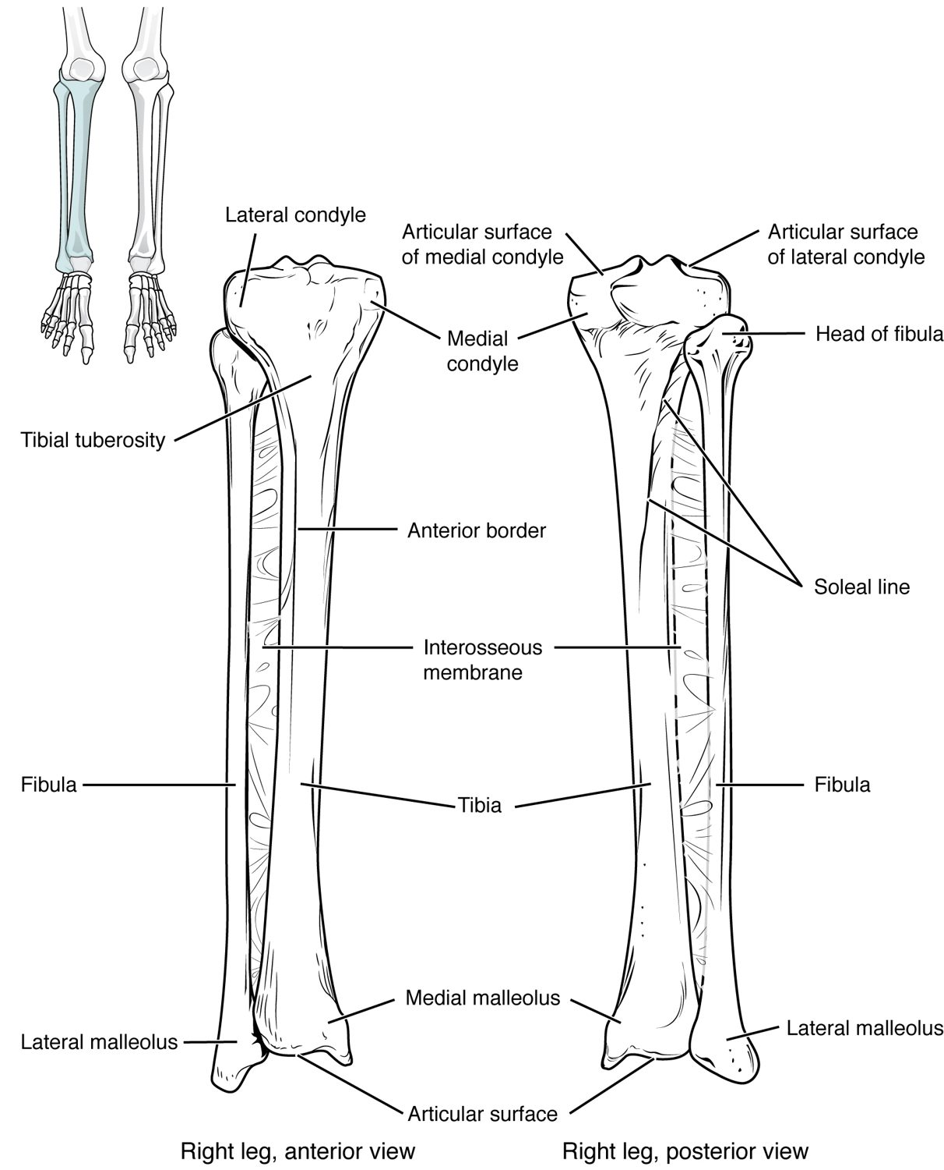
SECTION 8.4
The Tibia and Fibula
The two bones of the lower leg
Tibia (shinbone) bears the weight
Fibula stabilizes the ankle
They form the malleoli of the ankle
The tibia and fibula (lower leg)
PN 104 · Ch 8 — The Appendicular Skeleton
16
Notes:
The lower leg has two bones: the thick tibia (shinbone), which bears the body's weight, and the thin fibula, which adds stability and muscle attachment but bears little weight. Their distal ends form the malleoli — the bony bumps of the ankle.

Slide 17
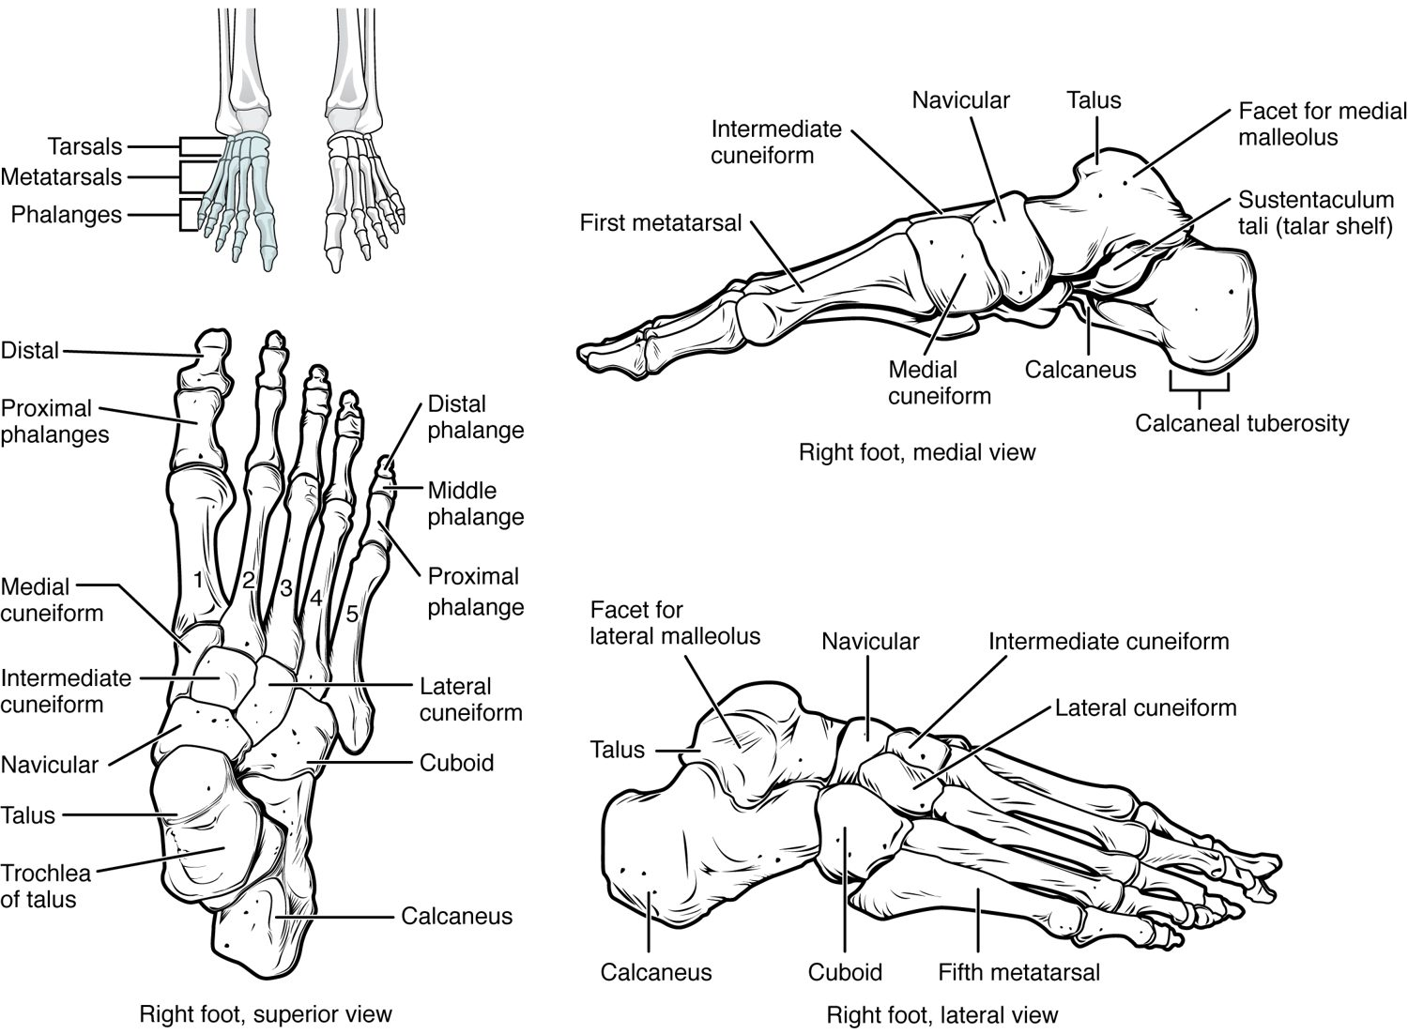
SECTION 8.4
Bones of the Foot
7 tarsals form the ankle and heel
5 metatarsals form the sole
14 phalanges form the toes
Arches support and absorb shock
The bones of the foot
PN 104 · Ch 8 — The Appendicular Skeleton
17
Notes:
The foot has 26 bones: seven tarsals (including the heel bone, the calcaneus), five metatarsals, and fourteen phalanges. They form arches that support body weight, aid balance, and absorb the shock of walking.

Slide 18
8.5
SECTION
Development of the Appendicular Skeleton
How the limbs form before birth, and common congenital differences.

Slide 19
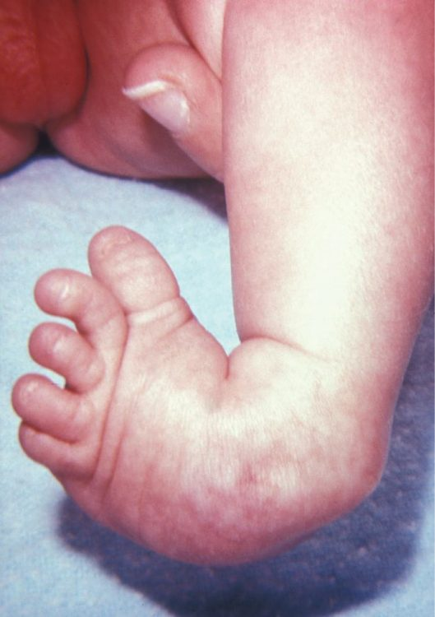
SECTION 8.5
Limb Development & Clubfoot
Limbs form early in the embryo
Bones develop from limb buds
Clubfoot is a common congenital condition
Early treatment improves outcomes
Clubfoot, a congenital foot condition
PN 104 · Ch 8 — The Appendicular Skeleton
19
Notes:
The limbs develop from limb buds early in embryonic life, with bones forming by endochondral ossification. Clubfoot (talipes), in which the foot is turned inward and downward, is a common congenital condition that responds well to early treatment such as casting.

Slide 20
CHAPTER 8
Key Takeaways
The appendicular skeleton is the limbs plus the girdles that attach them.
The mobile pectoral girdle anchors the arm; humerus, radius, ulna, and hand bones complete the upper limb.
The stable pelvic girdle bears weight and differs between the sexes.
The femur, tibia, fibula, and foot bones support the body and enable walking.
The limbs form early in development; congenital conditions like clubfoot are treatable.
PN 104 · Ch 8 — The Appendicular Skeleton
20

Slide 21
CLINICAL CONNECTIONS
Why the Appendicular Skeleton Matters in Practical Nursing
Fracture Sites
Carpal Tunnel
The clavicle, wrist, and hip are common fracture locations.
Median-nerve compression at the wrist causes numbness and weakness.
Hip Fractures
Obstetrics
Femoral-neck fractures are a major risk in older adults.
The female pelvis shape is central to childbirth.
Mobility
Pediatrics
Limb bones support transfers, ambulation, and weight-bearing.
Congenital limb conditions like clubfoot need early intervention.

