Slide 1
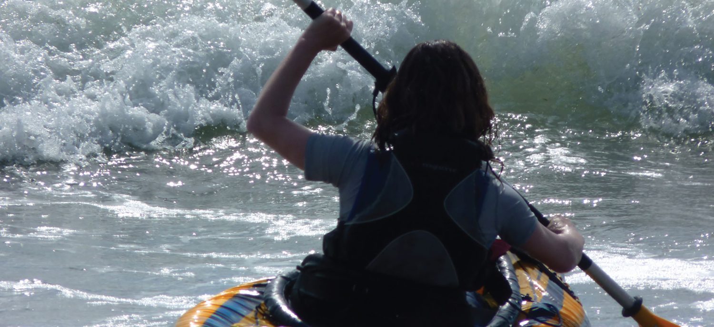
CHAPTER 9
Joints
How bones connect — and how the body moves.
Anatomy & Physiology · Broward-Miami Health Institute
FACULTY EDITION

Slide 2
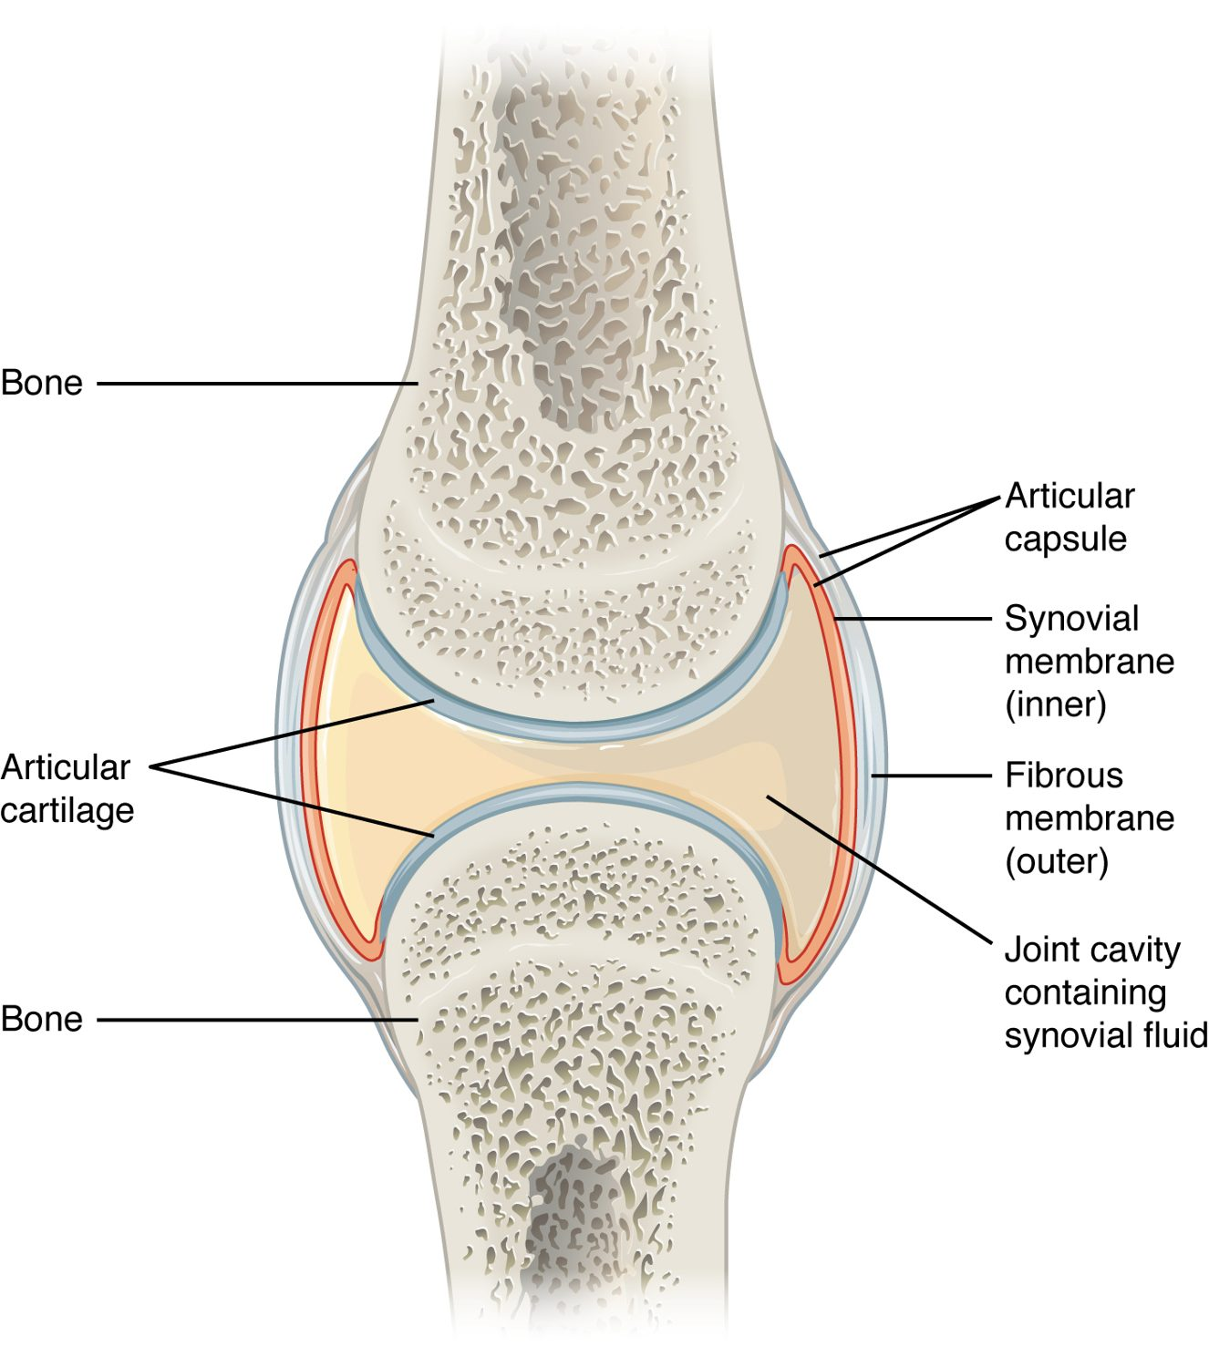
CHAPTER 9
Learning Objectives
After studying this chapter, students will be able to:
1
Discuss both functional and structural classifications for body joints
2
Describe the characteristic features for fibrous, cartilaginous, and synovial joints and give examples of each
3
Define and identify the different body movements
4
Discuss the structure of specific body joints and the movements allowed by each
A synovial joint — the body's most movable joint.
PN 104 · Ch 9 — Joints
2
Notes:
Preview joints by structure (fibrous, cartilaginous, synovial) and function (how freely they move). Focus on synovial joints, the vocabulary of body movement, and the major joints — shoulder, hip, and knee — where the mobility-versus-stability trade-off is clearest.

Slide 3
9.2
SECTION
Fibrous Joints
Joints held by fibrous connective tissue — mostly immovable.

Slide 4
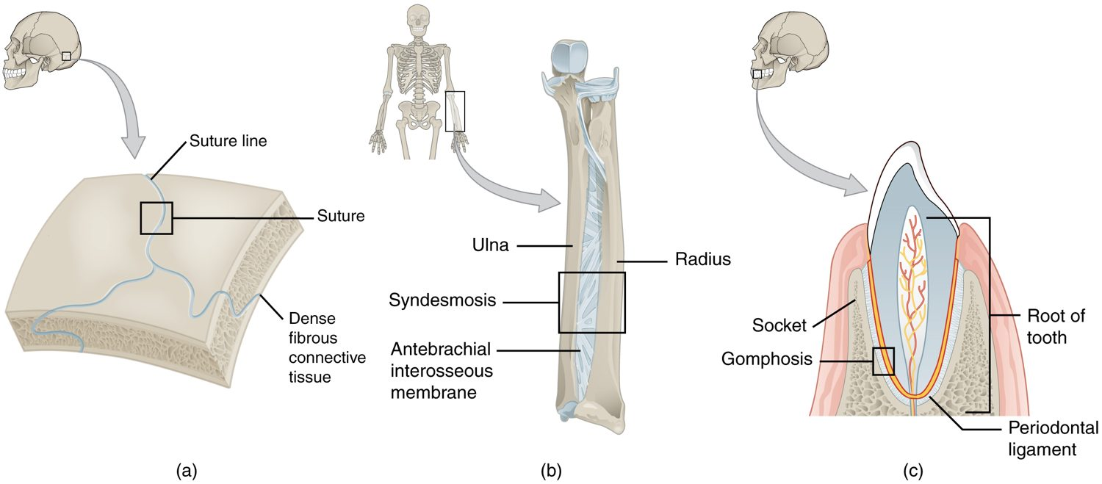
SECTION 9.2
Fibrous Joints
Types of fibrous joints
Bones joined by fibrous tissue
Little or no movement
Sutures join the skull bones
Gomphoses anchor the teeth
PN 104 · Ch 9 — Joints
4
Notes:
Fibrous joints are held by dense connective tissue and allow little or no movement. They include sutures (immovable, between skull bones), syndesmoses (slightly movable, like the radius and ulna), and gomphoses (the pegs anchoring teeth in their sockets).

Slide 5
9.3
SECTION
Cartilaginous Joints
Joints united by cartilage — slightly movable or immovable.

Slide 6
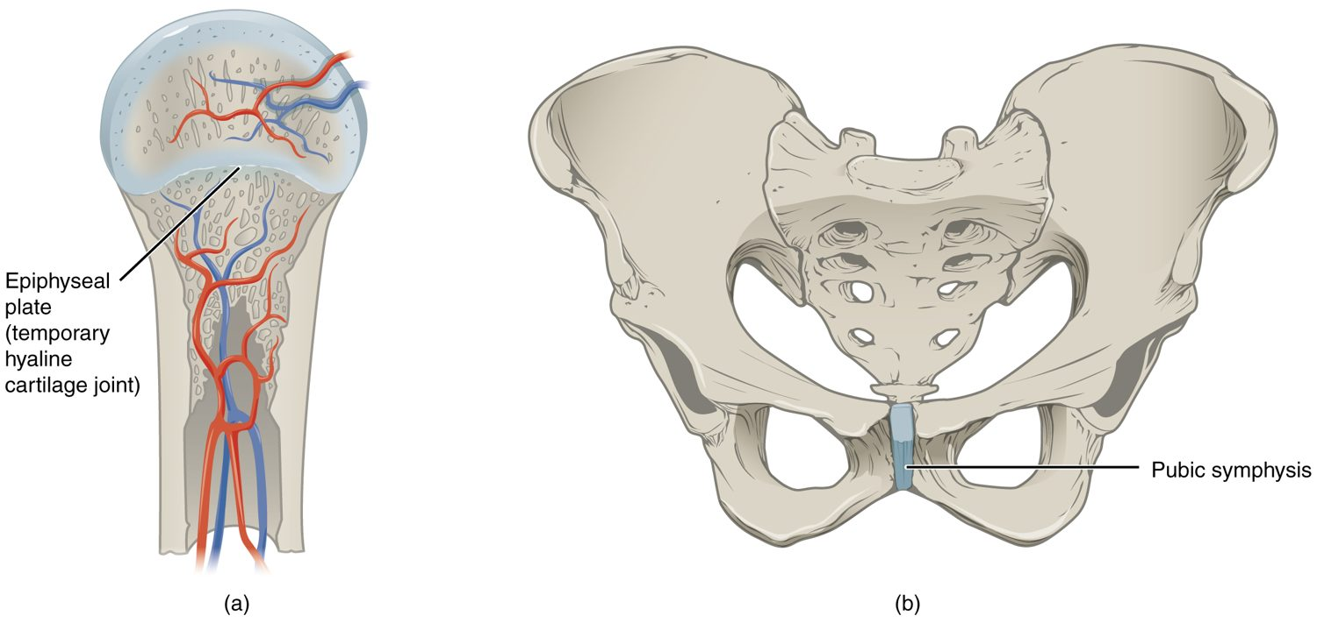
SECTION 9.3
Cartilaginous Joints
Types of cartilaginous joints
Bones joined by cartilage
Slightly movable or immovable
Pubic symphysis allows give in birth
Intervertebral discs cushion the spine
PN 104 · Ch 9 — Joints
6
Notes:
Cartilaginous joints unite bones with cartilage. Synchondroses (hyaline cartilage, like the epiphyseal plate) are immovable; symphyses (fibrocartilage, like the pubic symphysis and intervertebral discs) are slightly movable and absorb shock.

Slide 7
9.4
SECTION
Synovial Joints
Freely movable joints with a fluid-filled cavity — the most common type.

Slide 8
SECTION 9.4
Structure of a Synovial Joint
A fluid-filled joint cavity
Articular cartilage caps the bone ends
Synovial membrane secretes fluid
Capsule and ligaments stabilize it
The structure of a synovial joint
PN 104 · Ch 9 — Joints
8
Notes:
Synovial joints are freely movable and share a common design: a joint cavity filled with lubricating synovial fluid, articular (hyaline) cartilage cushioning the bone ends, a synovial membrane lining a fibrous capsule, and ligaments adding stability. Most limb joints are synovial.

Slide 9
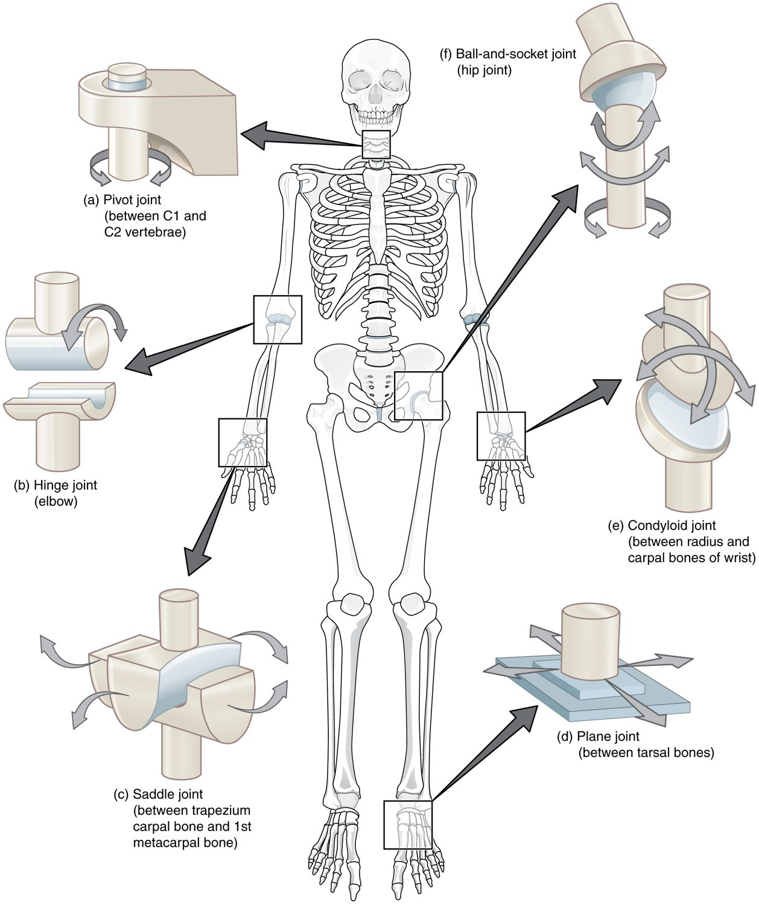
SECTION 9.4
Types of Synovial Joints
Six shapes allow different motions
Hinge (elbow), pivot (neck)
Ball-and-socket (hip, shoulder)
Saddle, plane, and condyloid
The six types of synovial joints
PN 104 · Ch 9 — Joints
9
Notes:
Synovial joints come in six shapes, each permitting characteristic motion: plane (gliding), hinge (elbow, knee — flexion and extension), pivot (rotation, as at the neck), condyloid (wrist), saddle (thumb), and ball-and-socket (hip, shoulder — movement in all directions).

Slide 10
9.5
SECTION
Types of Body Movements
Flexion, extension, rotation, and the other movements joints allow.

Slide 11
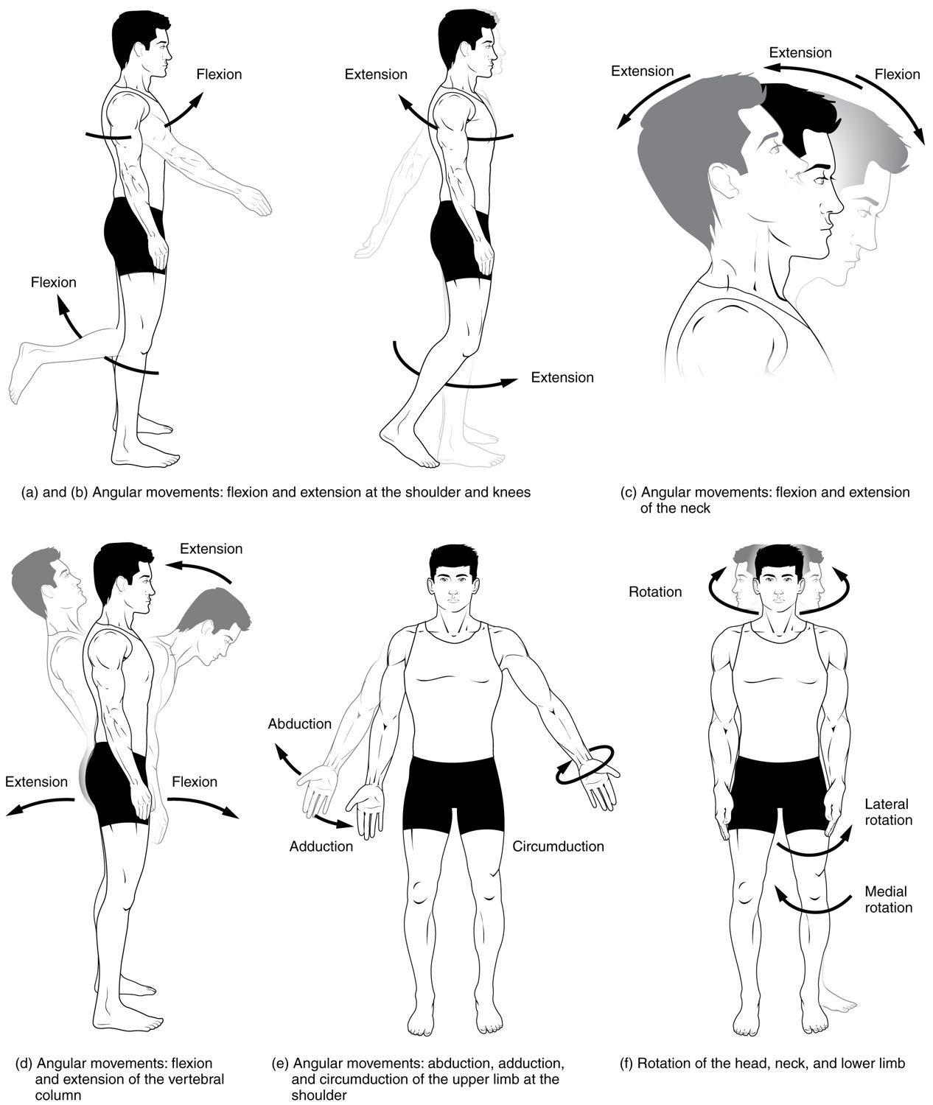
SECTION 9.5
Body Movements — Angular
Flexion decreases a joint angle
Extension increases it
Abduction moves away from midline
Adduction moves toward it
Angular movements at synovial joints
PN 104 · Ch 9 — Joints
11
Notes:
Angular movements change the angle between bones: flexion (bending, decreasing the angle), extension (straightening), abduction (moving away from the midline), and adduction (moving back toward it). Demonstrate each on the body — these terms appear constantly in range-of-motion documentation.

Slide 12
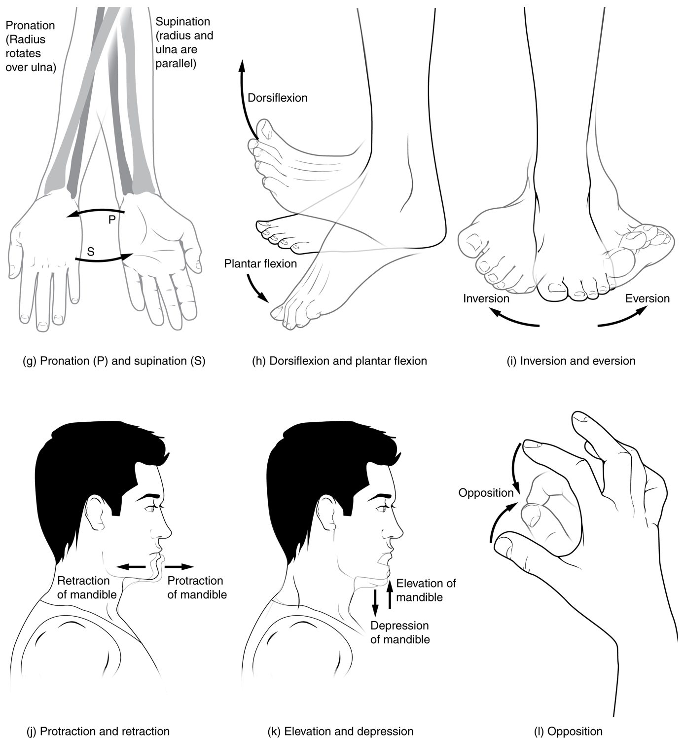
SECTION 9.5
Body Movements — Rotational & Special
Rotation turns a bone on its axis
Pronation and supination of the forearm
Inversion and eversion of the foot
Special movements at specific joints
Rotational and special movements
PN 104 · Ch 9 — Joints
12
Notes:
Other movements include rotation (turning on an axis, like shaking the head "no"), pronation and supination of the forearm, circumduction (a cone-shaped motion), and special movements such as inversion and eversion of the foot and opposition of the thumb. These complete the vocabulary of joint motion.

Slide 13
9.6
SECTION
Anatomy of Selected Synovial Joints
A closer look at the shoulder, hip, and knee.

Slide 14
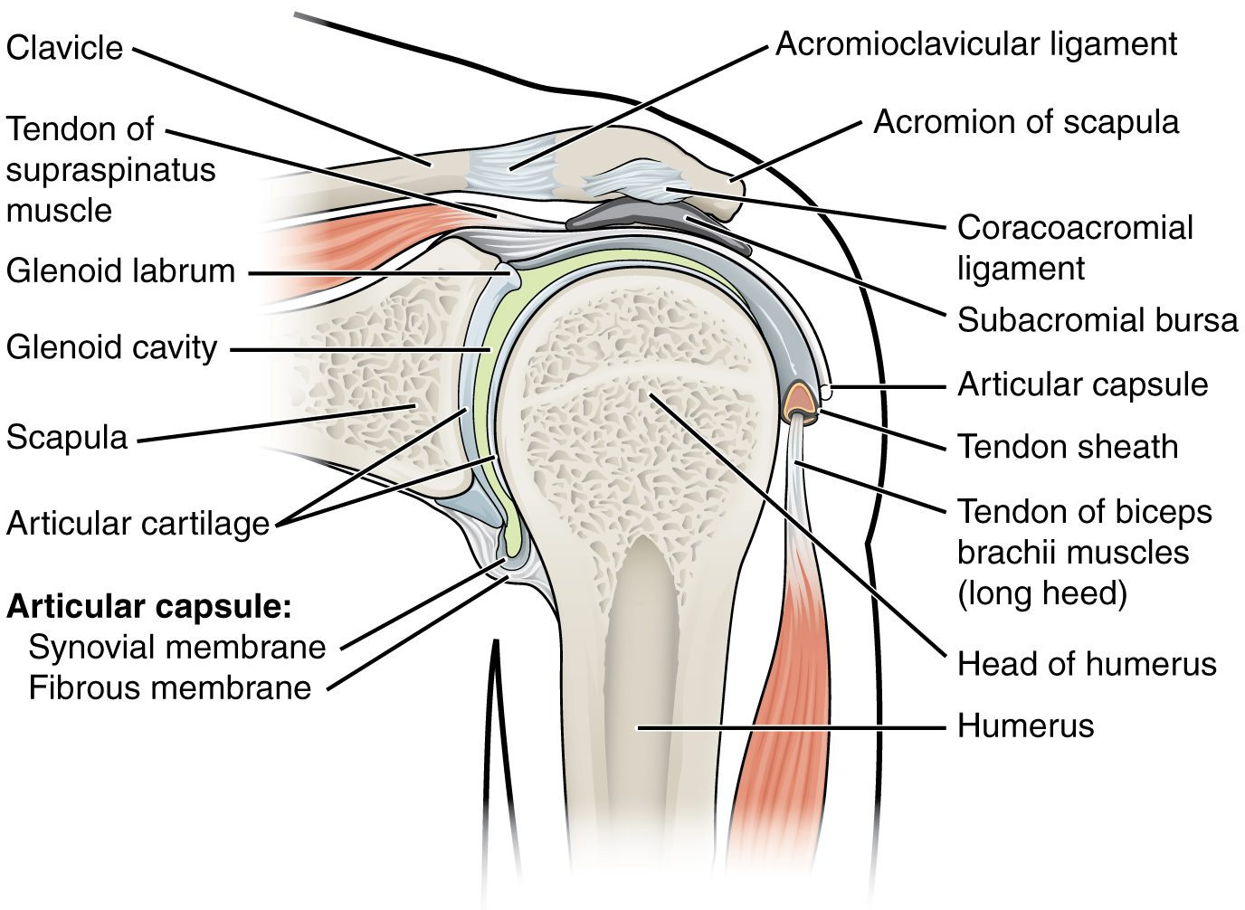
SECTION 9.6
The Shoulder Joint
A ball-and-socket joint
The most mobile joint in the body
Shallow socket = least stable
Rotator cuff provides support
The shoulder (glenohumeral) joint
PN 104 · Ch 9 — Joints
14
Notes:
The shoulder is a ball-and-socket joint with the greatest range of motion — and, because of its shallow socket, the least stability. The rotator-cuff muscles and ligaments hold it together, which is why dislocations and rotator-cuff injuries are common here.

Slide 15
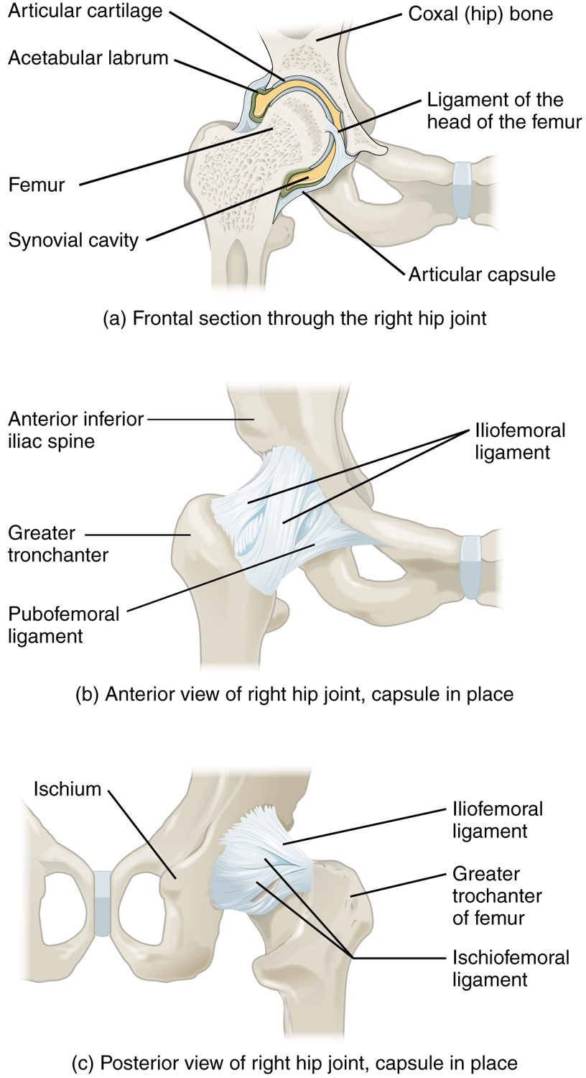
SECTION 9.6
The Hip Joint
A ball-and-socket joint
Deep socket = very stable
Bears the body's weight
Strong ligaments reinforce it
The hip joint
PN 104 · Ch 9 — Joints
15
Notes:
The hip is also a ball-and-socket joint, but its deep acetabulum and strong ligaments make it far more stable than the shoulder, suited to weight-bearing. Hip fractures and arthritis (often requiring replacement) are major concerns in older adults.

Slide 16
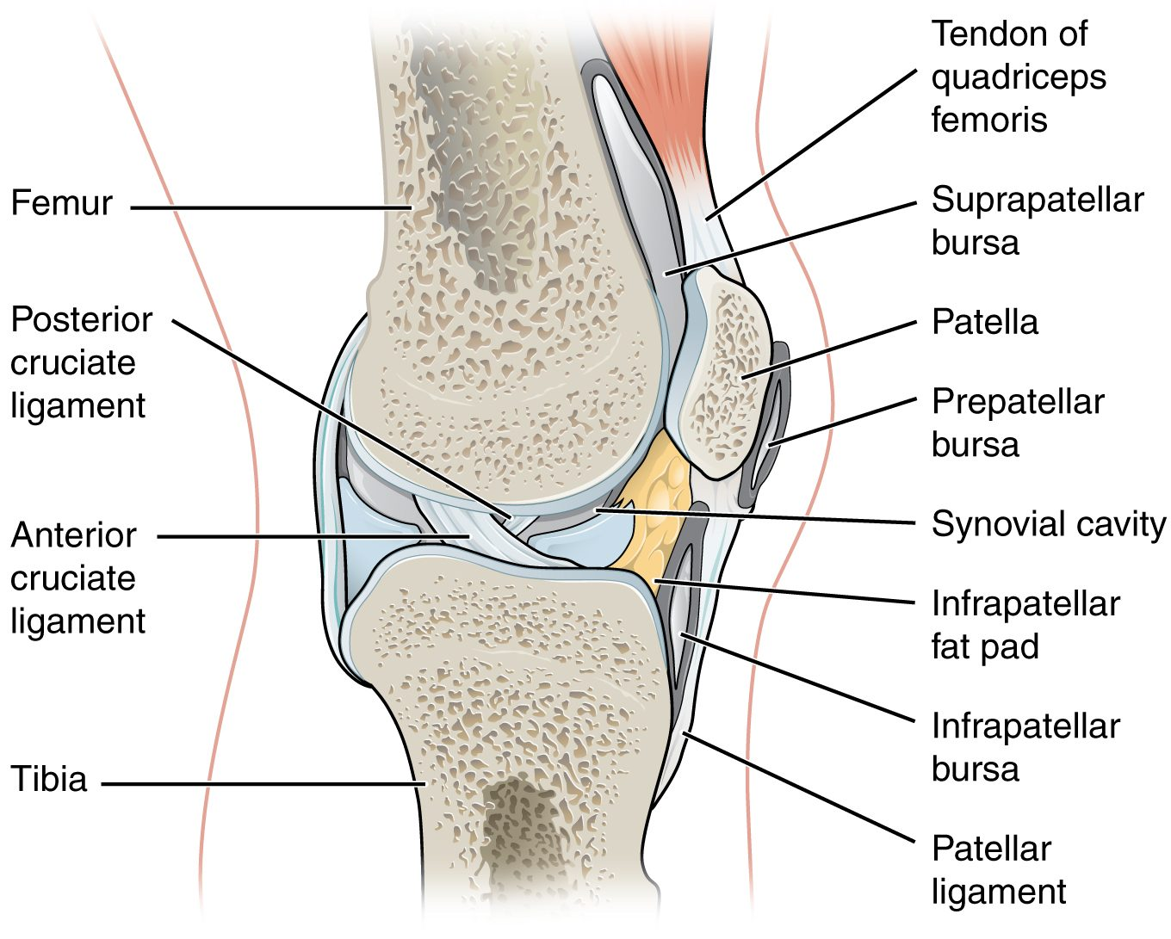
SECTION 9.6
The Knee Joint
The largest, most complex joint
A modified hinge joint
Cruciate ligaments provide stability
Menisci cushion the joint
The knee joint
PN 104 · Ch 9 — Joints
16
Notes:
The knee is the largest and most complex joint — essentially a hinge that allows slight rotation. The cruciate ligaments (ACL and PCL) keep the bones from sliding, and the menisci (fibrocartilage pads) cushion and stabilize it. Bursae reduce friction around it.

Slide 17
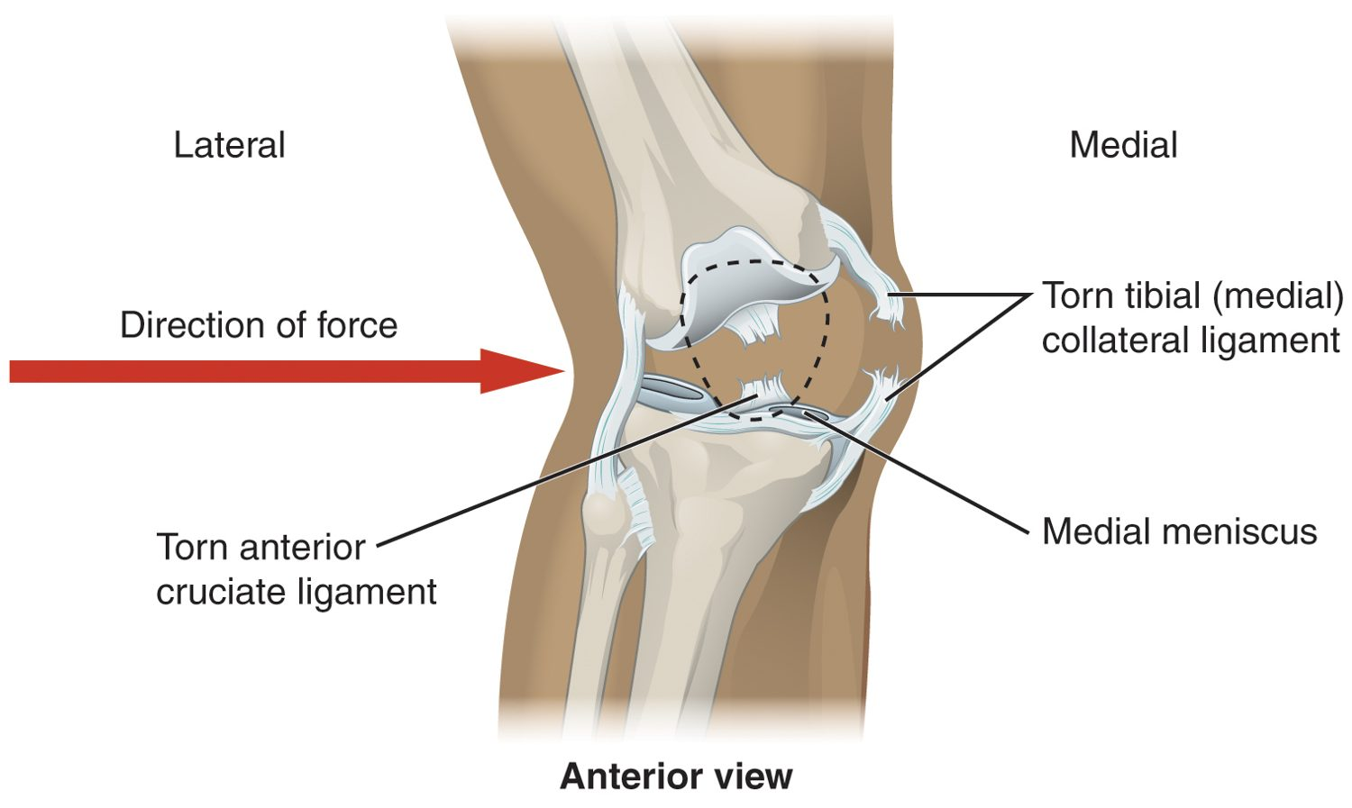
SECTION 9.6
Knee Injuries
Torn ACL and meniscus of the knee
The knee is prone to injury
ACL tears from twisting forces
Meniscus tears with rotation
Common in sports and falls
PN 104 · Ch 9 — Joints
17
Notes:
Because it bears weight while allowing motion, the knee is frequently injured. A sudden twist can tear the anterior cruciate ligament (ACL) or a meniscus, causing pain, swelling, and instability — injuries common in sports and falls and often requiring surgery.

Slide 18
9.7
SECTION
Development of Joints
How joints form before birth, as the skeleton develops.

Slide 19
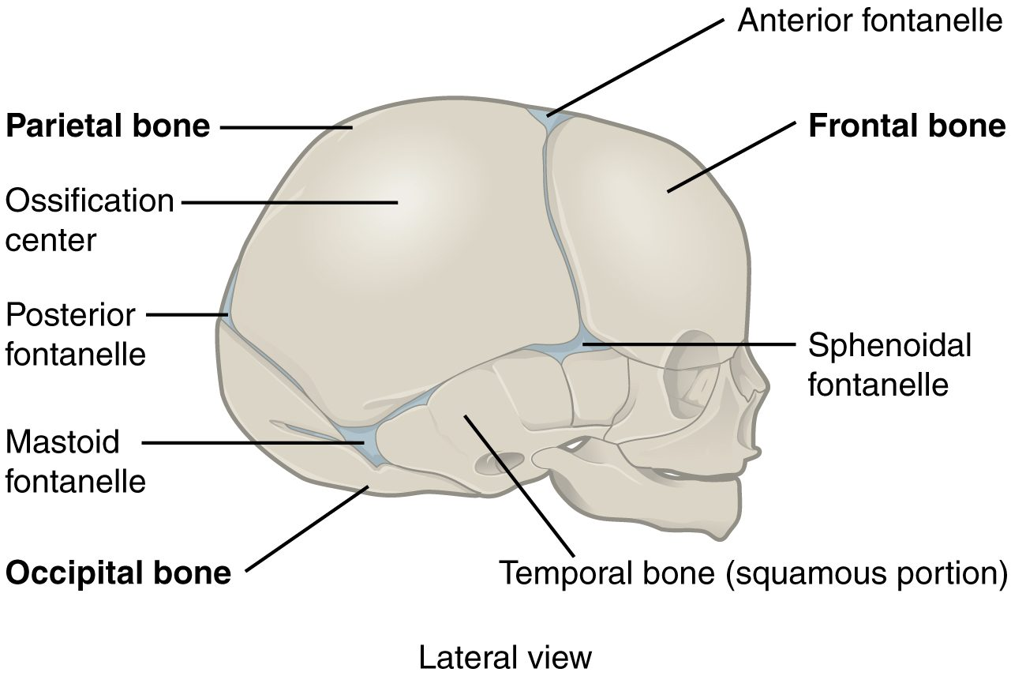
SECTION 9.7
Development of Joints
Joints form as the skeleton develops
Fibrous fontanelles in the infant skull
Allow skull molding and brain growth
Close into sutures over time
Fontanelles of the developing skull
PN 104 · Ch 9 — Joints
19
Notes:
Joints develop alongside the bones from embryonic tissue. In the newborn skull, wide fibrous fontanelles ("soft spots") act as flexible joints that let the skull mold during birth and accommodate rapid brain growth, gradually ossifying into immovable sutures over the first two years.

Slide 20
CHAPTER 9
Key Takeaways
Joints are classified by structure (fibrous, cartilaginous, synovial) and by how much they move.
Fibrous and cartilaginous joints allow little movement but provide strength and shock absorption.
Synovial joints are freely movable, with a fluid-filled cavity and six structural types.
Body movements — flexion, extension, rotation, and more — describe how joints move.
The shoulder, hip, and knee illustrate the trade-off between mobility and stability.
PN 104 · Ch 9 — Joints
20

Slide 21
CLINICAL CONNECTIONS
Why Joints Matter in Practical Nursing
Range of Motion
Arthritis
Movement terms describe and document joint function and limitations.
Cartilage breakdown causes pain and stiffness — a leading cause of disability.
Joint Injuries
Joint Replacement
Sprains, dislocations, and ACL or meniscus tears are common.
Worn hips and knees are often replaced surgically.
Rehabilitation
Synovial Fluid
Restoring joint movement is central to recovery and mobility.
Changes in joint fluid can signal infection or inflammation.

