Slide 1
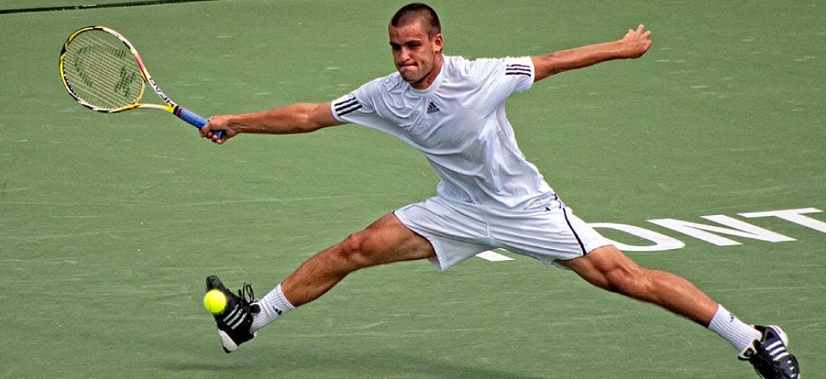
CHAPTER 10
Muscle Tissue
How muscle contracts, from sarcomere to whole-body movement.
Anatomy & Physiology · Broward-Miami Health Institute
FACULTY EDITION

Slide 2
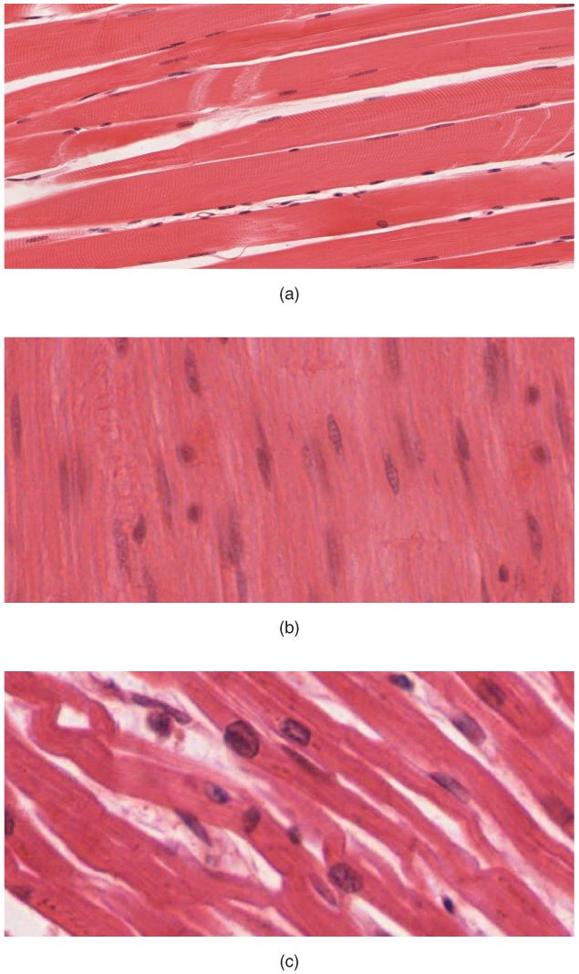
CHAPTER 10
Learning Objectives
After studying this chapter, students will be able to:
1
Explain the organization of muscle tissue
2
Describe the function and structure of skeletal, cardiac muscle, and smooth muscle
3
Explain how muscles work with tendons to move the body
4
Describe how muscles contract and relax
5
Define the process of muscle metabolism
6
Explain how the nervous system controls muscle tension
The three types of muscle tissue.
PN 104 · Ch 10 — Muscle Tissue
2
Notes:
Preview muscle tissue: three types (skeletal, cardiac, smooth), the detailed structure of skeletal muscle, the sliding-filament mechanism of contraction, how the nervous system controls force, and the special features of cardiac and smooth muscle.

Slide 3
10.1
SECTION
Overview of Muscle Tissues
The three muscle types and the shared properties of muscle tissue.

Slide 4
SECTION 10.1
The Three Muscle Types
Skeletal, cardiac, and smooth
All are excitable and contractile
Skeletal is voluntary and striated
Cardiac and smooth are involuntary
Skeletal, cardiac, and smooth muscle
PN 104 · Ch 10 — Muscle Tissue
4
Notes:
The three muscle tissues share four properties — excitability, contractility, extensibility, and elasticity. Skeletal muscle (voluntary, striated) moves the skeleton; cardiac muscle (involuntary, striated) pumps blood; smooth muscle (involuntary, non-striated) lines hollow organs.

Slide 5
10.2
SECTION
Skeletal Muscle
The organized structure of skeletal muscle, from whole muscle to sarcomere.

Slide 6
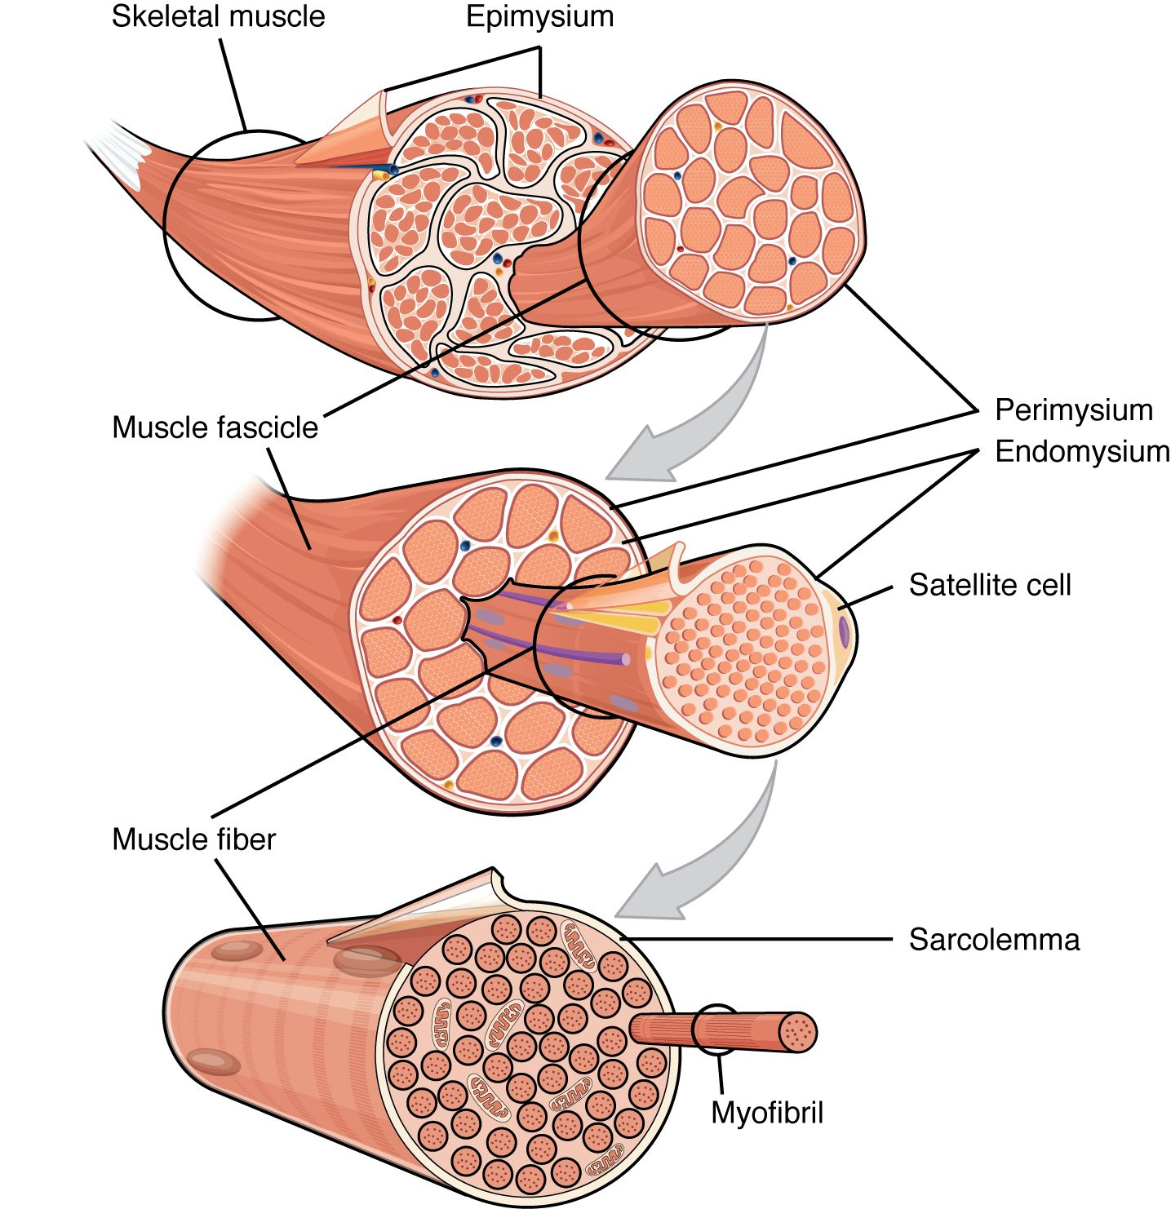
SECTION 10.2
Organization of Skeletal Muscle
Muscle → fascicles → fibers → myofibrils
Connective sheaths wrap each level
Epimysium, perimysium, endomysium
Sheaths merge into the tendon
The connective-tissue organization of skeletal muscle
PN 104 · Ch 10 — Muscle Tissue
6
Notes:
A skeletal muscle is built in nested bundles: the whole muscle (wrapped by epimysium) holds fascicles (perimysium), which hold muscle fibers (endomysium), which hold myofibrils. These connective sheaths converge into the tendon that attaches muscle to bone.

Slide 7
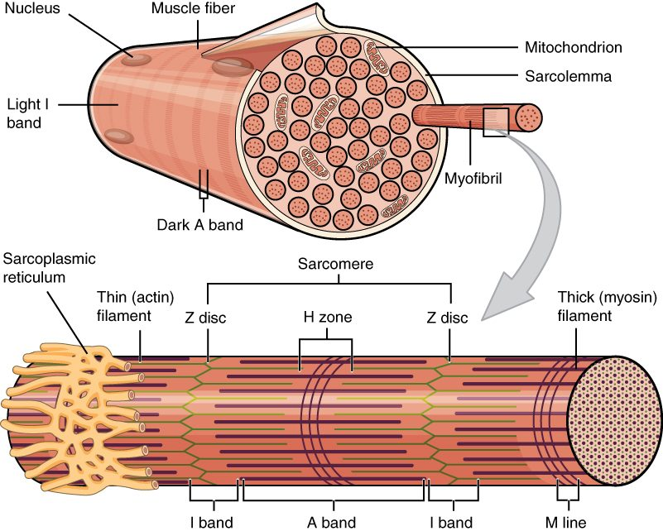
SECTION 10.2
The Muscle Fiber
A muscle cell is called a fiber
Sarcolemma is its membrane
Myofibrils run its length
Striations come from sarcomeres
Structure of a skeletal muscle fiber
PN 104 · Ch 10 — Muscle Tissue
7
Notes:
A muscle fiber (cell) is multinucleated and packed with myofibrils. Its membrane (sarcolemma) has inward T-tubules, and the sarcoplasmic reticulum stores calcium. The repeating sarcomere units along each myofibril create the striped (striated) appearance.

Slide 8
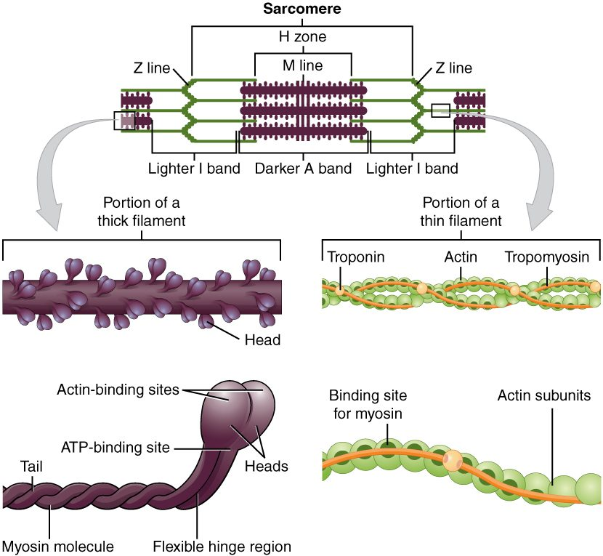
SECTION 10.2
The Sarcomere
The contractile unit of muscle
Thick (myosin) and thin (actin) filaments
Bounded by Z lines
Troponin and tropomyosin regulate it
The sarcomere and its filaments
PN 104 · Ch 10 — Muscle Tissue
8
Notes:
The sarcomere, running between two Z lines, is the functional contractile unit. Thick myosin filaments interdigitate with thin actin filaments; the regulatory proteins troponin and tropomyosin control whether myosin can bind actin. Sarcomere shortening produces contraction.

Slide 9
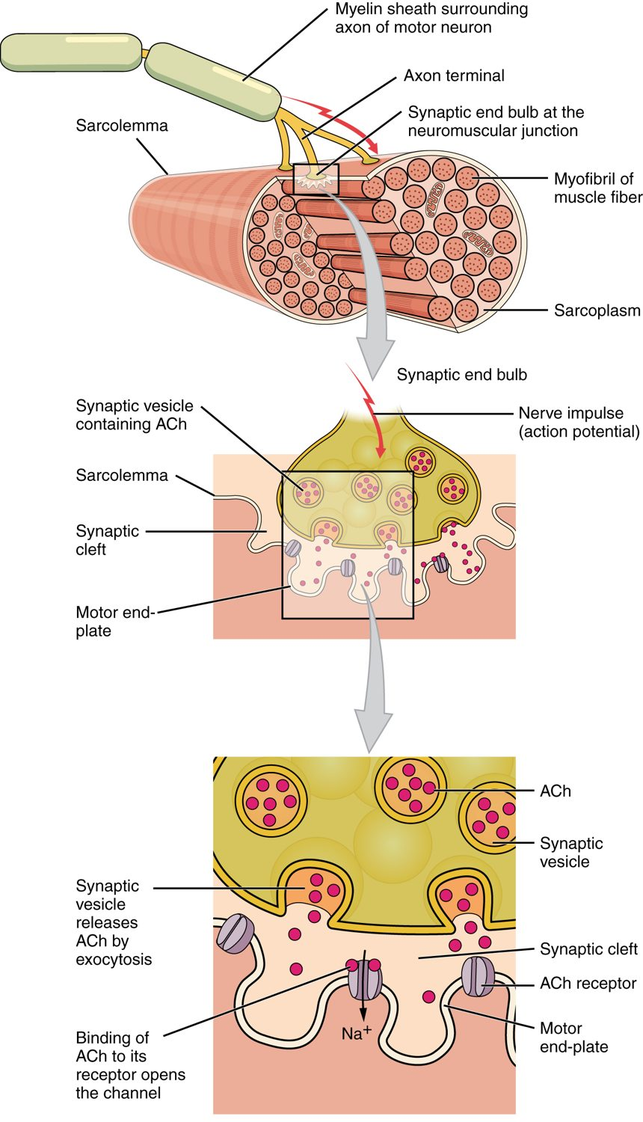
SECTION 10.2
The Neuromuscular Junction
Where a motor neuron meets a fiber
Releases acetylcholine (ACh)
ACh triggers an action potential
Begins excitation–contraction coupling
The neuromuscular junction
PN 104 · Ch 10 — Muscle Tissue
9
Notes:
A skeletal muscle fiber contracts only when signaled by a motor neuron at the neuromuscular junction. The neuron releases acetylcholine, which triggers an action potential across the sarcolemma — the first step linking nerve signal to contraction. Many drugs and toxins act here.

Slide 10
10.3
SECTION
Muscle Fiber Contraction and Relaxation
How a muscle fiber contracts and relaxes — the sliding filament model.

Slide 11
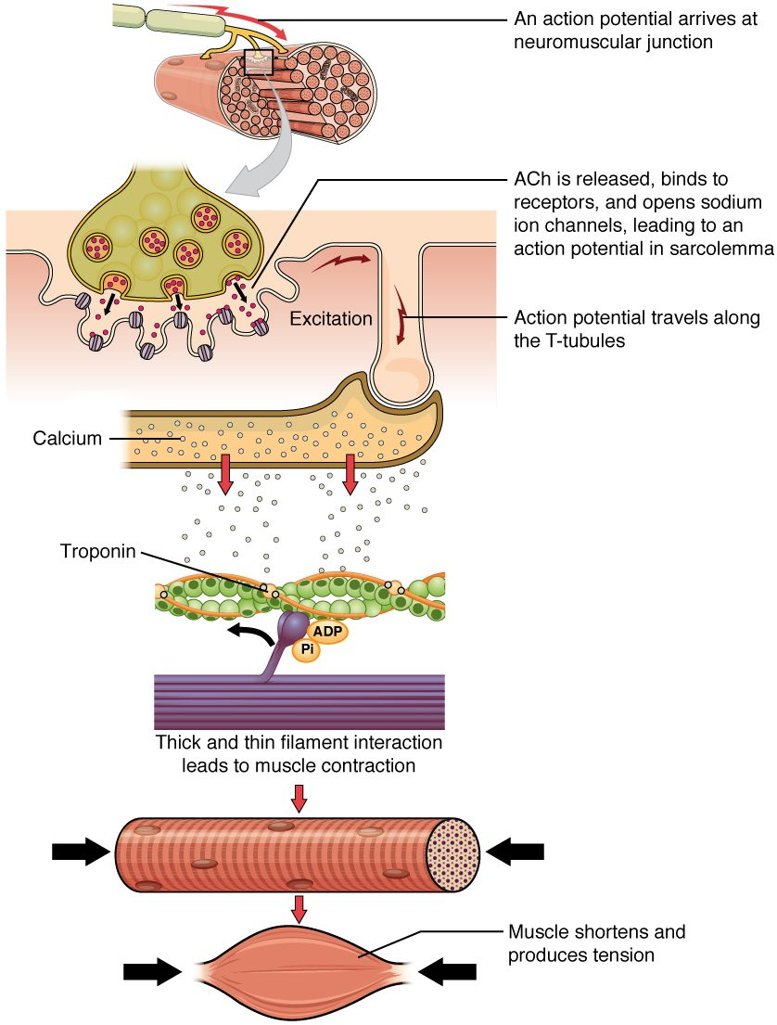
SECTION 10.3
Excitation–Contraction Coupling
Action potential reaches the fiber
Calcium is released from the SR
Calcium exposes actin binding sites
Myosin pulls actin → contraction
The steps of muscle contraction
PN 104 · Ch 10 — Muscle Tissue
11
Notes:
As the action potential travels down the T-tubules, the sarcoplasmic reticulum releases calcium. Calcium binds troponin, shifting tropomyosin off the actin binding sites so myosin heads can attach and pull — coupling the electrical signal to mechanical contraction.

Slide 12
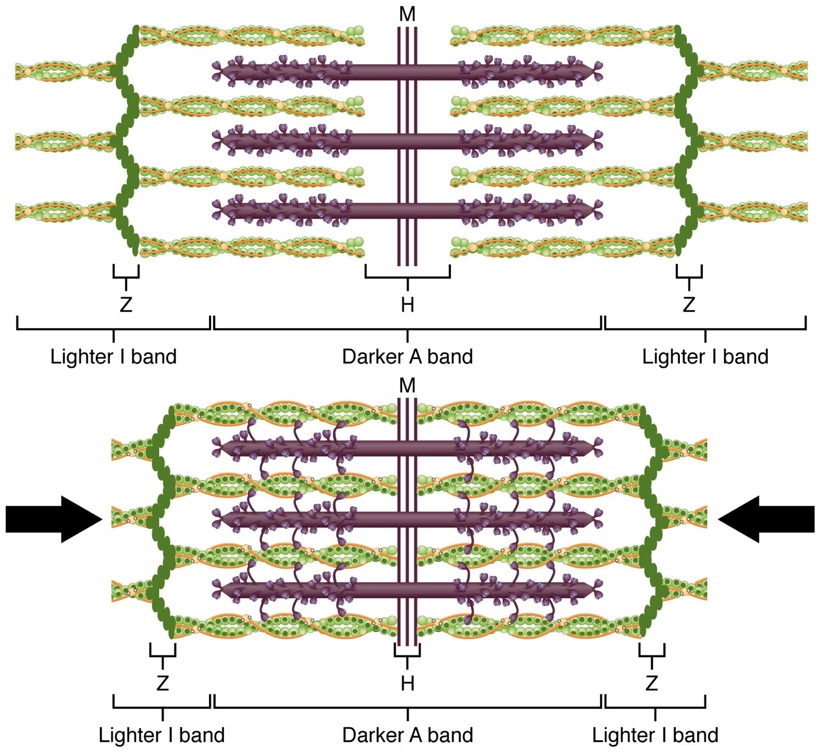
SECTION 10.3
The Sliding Filament Model
Filaments slide; they don't shorten
Myosin heads pull actin inward
The sarcomere shortens
The whole muscle contracts
The sliding filament model of contraction
PN 104 · Ch 10 — Muscle Tissue
12
Notes:
In the sliding filament model, the thick and thin filaments do not shrink — they slide past one another. Myosin heads form cross-bridges, pull the actin toward the sarcomere center, release, and repeat, shortening each sarcomere and the whole muscle. This requires ATP.

Slide 13
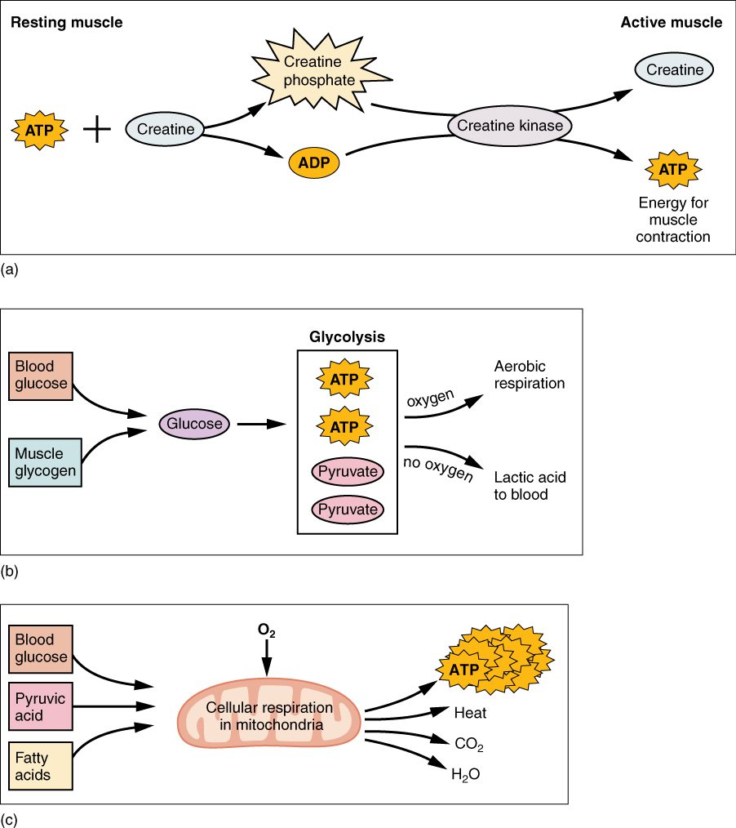
SECTION 10.3
Energy for Contraction
Muscles run on ATP
Creatine phosphate gives a quick burst
Aerobic respiration for endurance
Anaerobic glycolysis makes lactic acid
Sources of ATP for muscle contraction
PN 104 · Ch 10 — Muscle Tissue
13
Notes:
Muscles need a constant ATP supply. Stored ATP lasts only seconds; creatine phosphate regenerates it for short bursts; aerobic respiration powers sustained activity; and anaerobic glycolysis gives fast energy but yields lactic acid, contributing to fatigue. This underlies exercise tolerance.

Slide 14
10.4
SECTION
Nervous System Control of Muscle Tension
How the nervous system grades the strength of contraction.

Slide 15
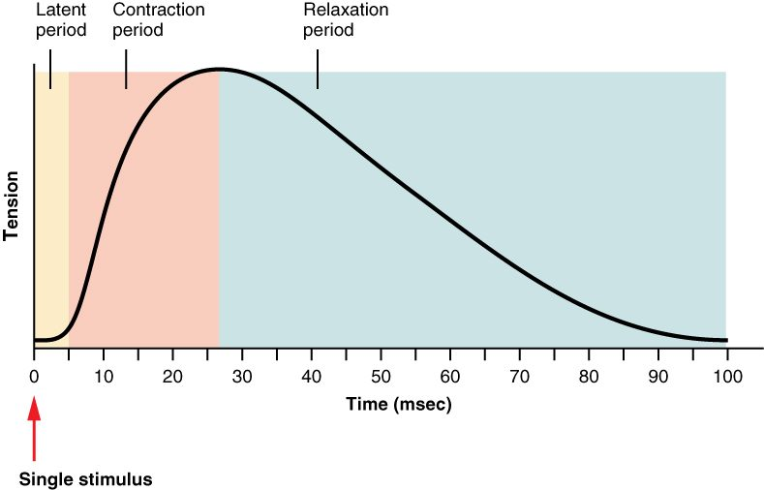
SECTION 10.4
The Muscle Twitch
The phases of a muscle twitch
A twitch is one contraction–relaxation cycle
Latent, contraction, and relaxation periods
Motor units grade fine vs. gross movement
Summation increases force
PN 104 · Ch 10 — Muscle Tissue
15
Notes:
A single stimulus produces a twitch with a latent period, a contraction period, and a relaxation period. The nervous system grades force by recruiting more motor units (a neuron plus its fibers) and by firing them faster (summation), allowing both delicate and powerful movements.

Slide 16
10.5
SECTION
Types of Muscle Fibers
Slow and fast muscle fibers suited to endurance or power.

Slide 17
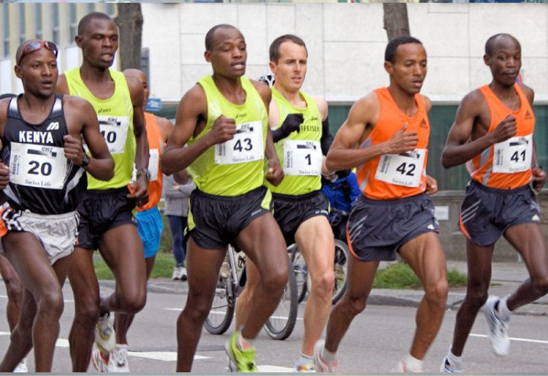
SECTION 10.5
Types of Muscle Fibers
Slow-twitch fibers resist fatigue
Suited to endurance activities
Fast-twitch fibers contract powerfully
They fatigue more quickly
Endurance depends on muscle fiber type
PN 104 · Ch 10 — Muscle Tissue
17
Notes:
Skeletal muscle contains slow-twitch (Type I) fibers — fatigue-resistant and rich in mitochondria for endurance — and fast-twitch (Type II) fibers, which contract quickly and forcefully but tire fast. Most muscles blend both, and training can shift the balance, as in marathoners versus sprinters.

Slide 18
10.6
SECTION
Exercise and Muscle Performance
How exercise and disuse change muscle size and performance.

Slide 19
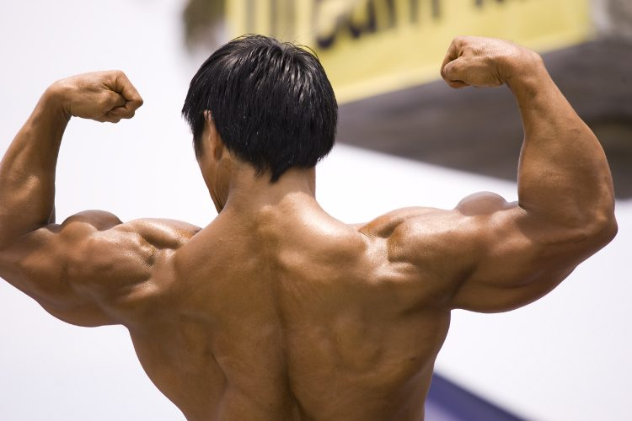
SECTION 10.6
Exercise & Hypertrophy
Muscle hypertrophy from exercise
Resistance exercise enlarges fibers
Builds strength and power
Endurance exercise boosts stamina
Improves blood supply and metabolism
PN 104 · Ch 10 — Muscle Tissue
19
Notes:
Exercise changes muscle. Resistance training causes hypertrophy — existing fibers enlarge and strengthen (muscle does not gain new fibers). Endurance training adds mitochondria and blood supply for stamina. Activity also benefits the cardiovascular and skeletal systems.

Slide 20
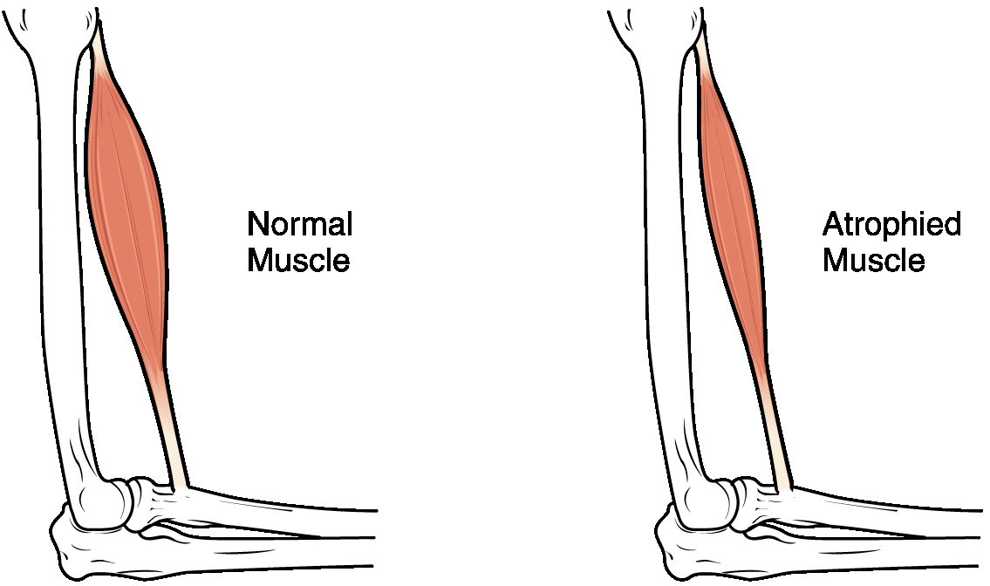
SECTION 10.6
Muscle Atrophy
Normal versus atrophied muscle
Disuse shrinks muscle (atrophy)
Occurs with immobility or bed rest
Strength and mass decline quickly
Prevented by movement and exercise
PN 104 · Ch 10 — Muscle Tissue
20
Notes:
When muscles are not used — during prolonged bed rest, casting, or paralysis — they atrophy, losing mass and strength surprisingly fast. This is why early mobility, repositioning, and physical therapy are priorities for immobile patients.

Slide 21
10.7
SECTION
Cardiac Muscle Tissue
The involuntary striated muscle that pumps the heart.

Slide 22
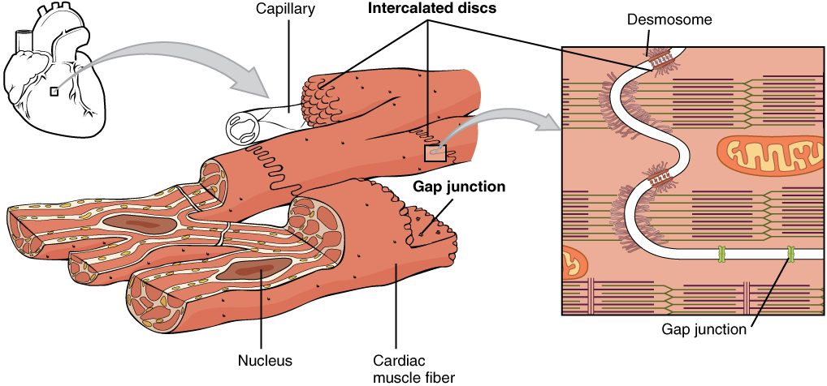
SECTION 10.7
Cardiac Muscle
Cardiac muscle tissue
Found only in the heart
Striated but involuntary
Cells joined by intercalated discs
Gap junctions coordinate the beat
PN 104 · Ch 10 — Muscle Tissue
22
Notes:
Cardiac muscle, found only in the heart, is striated like skeletal muscle but involuntary. Its branching cells are linked by intercalated discs with gap junctions, letting electrical signals spread rapidly so the heart contracts as a coordinated unit. It is highly fatigue-resistant.

Slide 23
10.8
SECTION
Smooth Muscle
The involuntary muscle of hollow organs and vessels.

Slide 24
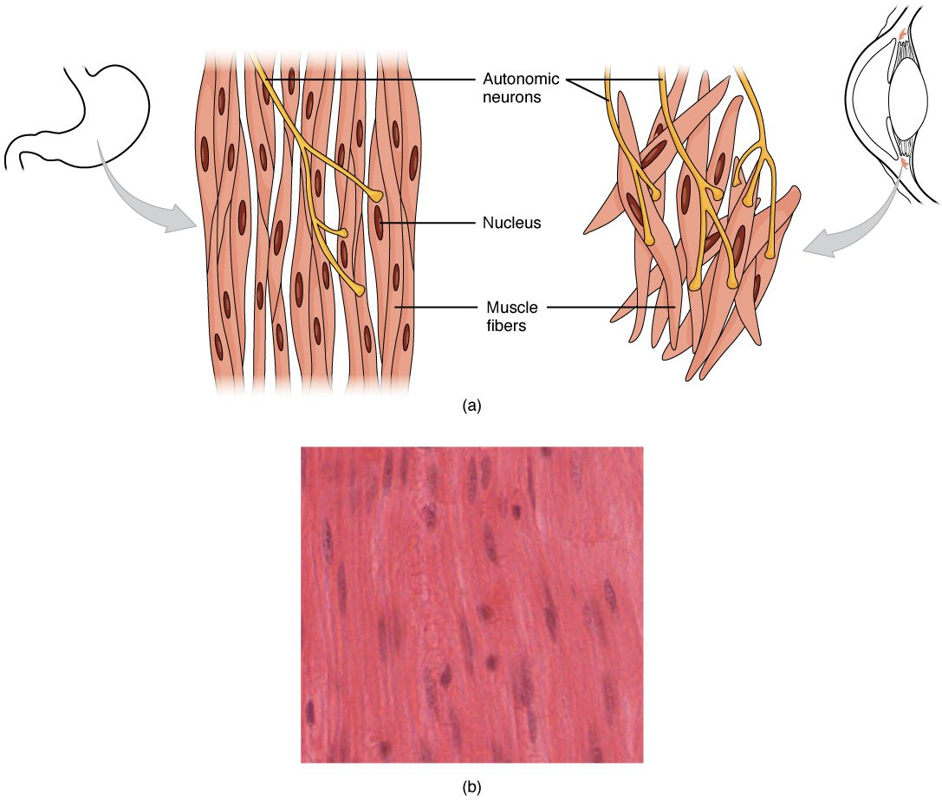
SECTION 10.8
Smooth Muscle
Lines hollow organs and vessels
Involuntary and non-striated
Slow, sustained contractions
Moves food, blood, and urine
Smooth muscle tissue
PN 104 · Ch 10 — Muscle Tissue
24
Notes:
Smooth muscle lines the walls of hollow organs and blood vessels. It is involuntary and lacks striations, contracting slowly and sustainably with little fatigue. It propels food through the GI tract, regulates blood vessel diameter, and controls many other internal functions.

Slide 25
CHAPTER 10
Key Takeaways
The three muscle types — skeletal, cardiac, and smooth — share excitability and contractility.
Skeletal muscle is organized from the whole muscle down to the sarcomere.
Contraction follows the sliding filament model and requires calcium and ATP.
The nervous system grades contraction strength through motor-unit recruitment.
Cardiac and smooth muscle are involuntary, specialized for the heart and hollow organs.
PN 104 · Ch 10 — Muscle Tissue
25

Slide 26
CLINICAL CONNECTIONS
Why Muscle Tissue Matters in Practical Nursing
Mobility & Atrophy
Neuromuscular Drugs
Disuse weakens muscle fast — early movement prevents decline.
Many medications act at the neuromuscular junction.
Energy & Fatigue
Cardiac Muscle
ATP supply and lactic acid shape exercise tolerance.
Coordinated contraction underlies every heartbeat and EKG.
Smooth Muscle
Rehabilitation
It controls blood pressure, airflow, and GI motility.
Understanding contraction guides strengthening and recovery.

