Slide 1
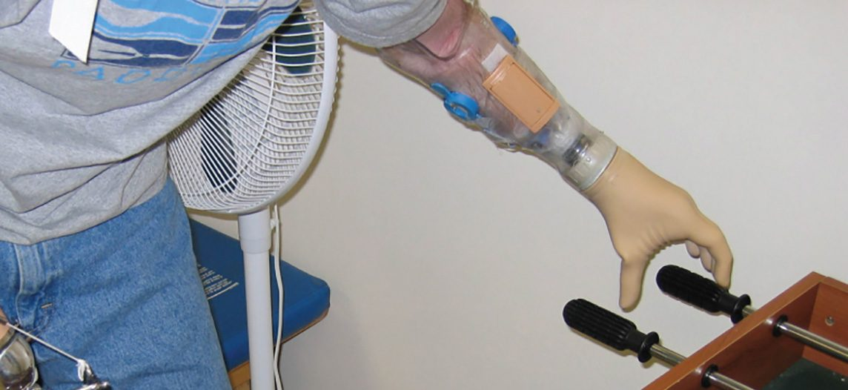
CHAPTER 12
The Nervous System and Nervous Tissue
Neurons, glia, and how nerve signals are generated and passed.
Anatomy & Physiology · Broward-Miami Health Institute
FACULTY EDITION

Slide 2
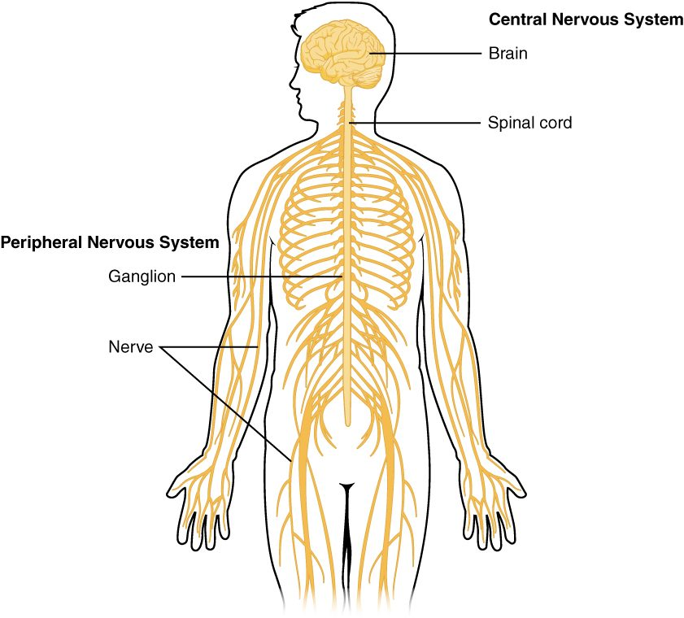
CHAPTER 12
Learning Objectives
After studying this chapter, students will be able to:
1
Name the major divisions of the nervous system, both anatomical and functional
2
Describe the functional and structural differences between gray matter and white matter structures
3
Name the parts of the multipolar neuron in order of polarity
4
List the types of glial cells and assign each to the proper division of the nervous system, along with their function(s)
5
Distinguish the major functions of the nervous system: sensation, integration, and response
6
Describe the components of the membrane that establish the resting membrane potential
The nervous system: central and peripheral divisions.
PN 104 · Ch 12 — The Nervous System and Nervous Tissue
2
Notes:
Preview the nervous system: its central and peripheral divisions and sensory/motor, somatic/autonomic organization; the neurons and glial cells of nervous tissue; the reflex arc; and how neurons signal electrically (action potentials) and chemically (synapses).

Slide 3
12.1
SECTION
Basic Structure and Function of the Nervous System
The organization of the nervous system into central and peripheral divisions.

Slide 4
SECTION 12.1
Central & Peripheral Nervous Systems
Two main anatomical divisions
CNS = brain and spinal cord
PNS = nerves and ganglia
CNS integrates, PNS connects
The central and peripheral nervous systems
PN 104 · Ch 12 — The Nervous System and Nervous Tissue
4
Notes:
The nervous system has two anatomical divisions: the central nervous system (CNS) — the brain and spinal cord, which integrate and process information — and the peripheral nervous system (PNS) — the nerves and ganglia that carry signals between the CNS and the rest of the body.

Slide 5
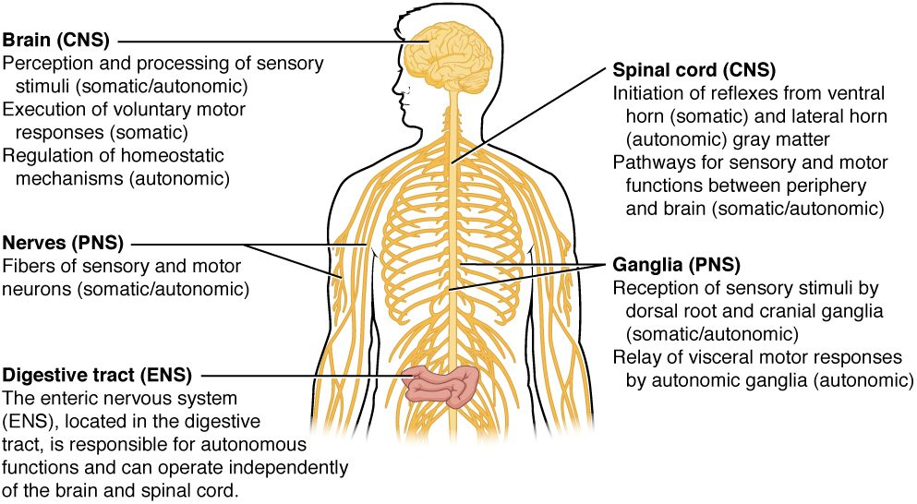
SECTION 12.1
Functional Divisions
The functional divisions of the nervous system
Sensory (afferent) input to the CNS
Motor (efferent) output from the CNS
Somatic controls voluntary muscle
Autonomic controls involuntary functions
PN 104 · Ch 12 — The Nervous System and Nervous Tissue
5
Notes:
Functionally, the PNS has a sensory (afferent) division bringing information in and a motor (efferent) division carrying commands out. The motor division splits into the somatic nervous system (voluntary control of skeletal muscle) and the autonomic nervous system (involuntary control of organs, glands, smooth and cardiac muscle).

Slide 6
12.2
SECTION
Nervous Tissue
Neurons and the supporting glial cells that make up nervous tissue.

Slide 7
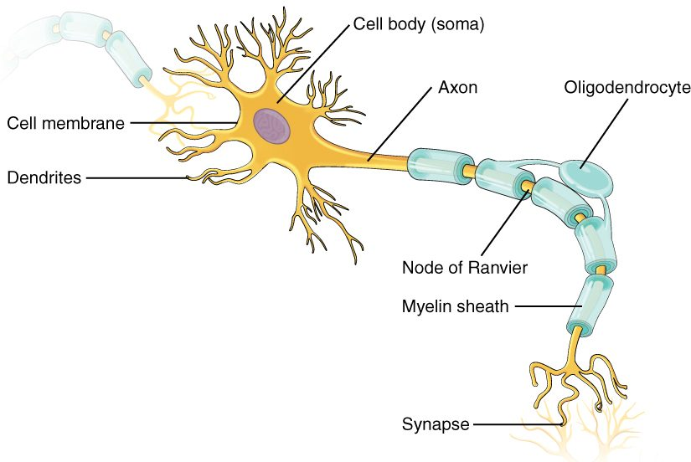
SECTION 12.2
The Neuron
The signaling cell of the system
Dendrites receive incoming signals
Cell body (soma) integrates them
Axon carries the signal away
The structure of a neuron
PN 104 · Ch 12 — The Nervous System and Nervous Tissue
7
Notes:
The neuron is the signaling cell. Dendrites receive incoming signals, the cell body (soma) houses the nucleus and integrates input, and the single axon conducts the impulse away toward other cells. Many axons are wrapped in a myelin sheath that speeds conduction.

Slide 8
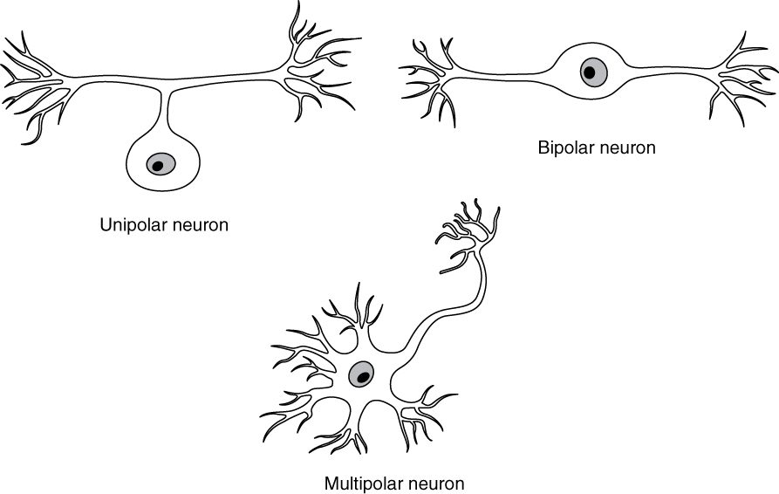
SECTION 12.2
Types of Neurons
Structural classes of neurons
Classified by shape (processes)
Multipolar — most common (CNS)
Bipolar — in special senses
Unipolar — most sensory neurons
PN 104 · Ch 12 — The Nervous System and Nervous Tissue
8
Notes:
Neurons are classed by the number of processes from the cell body: multipolar (one axon, many dendrites — most neurons), bipolar (one axon and one dendrite — in the retina and olfactory system), and unipolar (a single process — most sensory neurons).

Slide 9
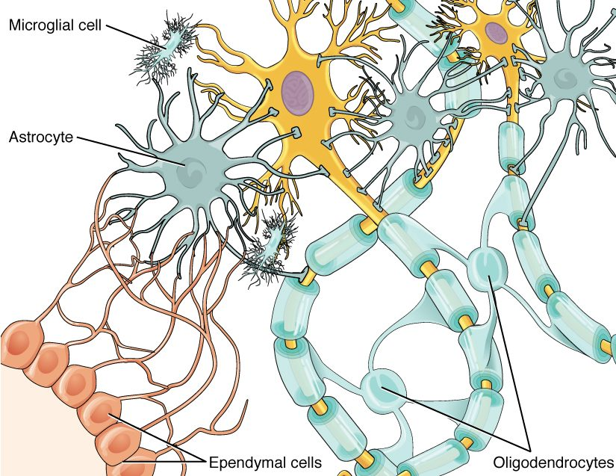
SECTION 12.2
Glial Cells of the CNS
Glia support and protect neurons
Astrocytes maintain the environment
Microglia are immune defenders
Oligodendrocytes myelinate CNS axons
The glial cells of the CNS
PN 104 · Ch 12 — The Nervous System and Nervous Tissue
9
Notes:
Glial cells outnumber neurons and support them. In the CNS, astrocytes regulate the chemical environment and blood-brain barrier, microglia act as immune cells, ependymal cells line the ventricles and make CSF, and oligodendrocytes form myelin around CNS axons.

Slide 10
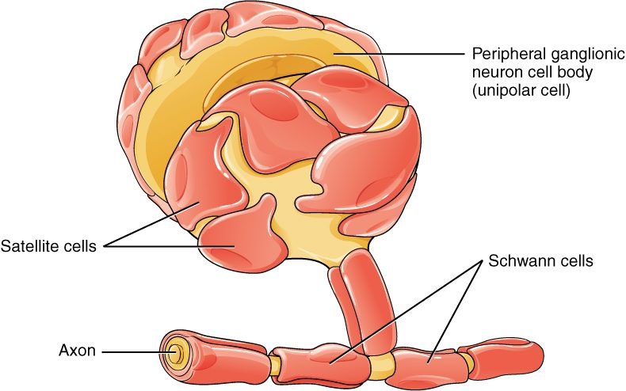
SECTION 12.2
Glial Cells of the PNS
Schwann cells and satellite cells
Schwann cells myelinate PNS axons
One Schwann cell per segment
Satellite cells support cell bodies
Aid repair of peripheral nerves
PN 104 · Ch 12 — The Nervous System and Nervous Tissue
10
Notes:
In the PNS, Schwann cells wrap peripheral axons to form myelin (one cell per segment, with nodes of Ranvier between), and satellite cells surround and support neuron cell bodies in ganglia. Schwann cells also help peripheral nerves regenerate after injury — something CNS axons do poorly.

Slide 11
12.3
SECTION
The Function of Nervous Tissue
How neurons detect stimuli and carry signals — the reflex arc.

Slide 12
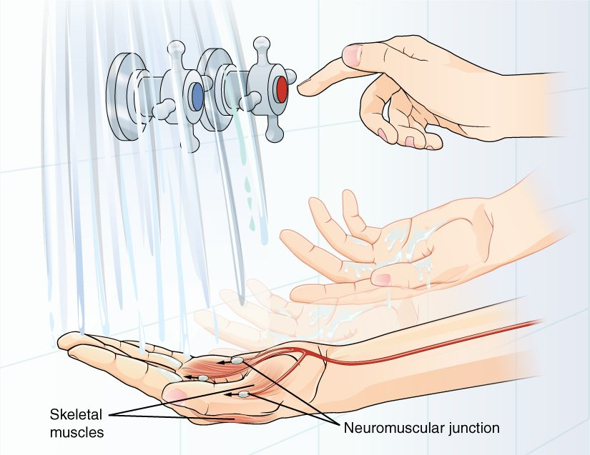
SECTION 12.3
The Reflex Arc
The simplest neural pathway
Receptor → sensory neuron → CNS
Motor neuron → effector response
Produces fast, automatic reflexes
A withdrawal reflex arc
PN 104 · Ch 12 — The Nervous System and Nervous Tissue
12
Notes:
A reflex arc is the simplest functional circuit: a receptor detects a stimulus, a sensory neuron carries it to the CNS, where it synapses (directly or through an interneuron) onto a motor neuron that triggers an effector. The withdrawal reflex — pulling a hand from something hot — is faster than conscious thought because it is processed in the spinal cord.

Slide 13
12.4
SECTION
The Action Potential
The electrical signal — how neurons generate and conduct impulses.

Slide 14
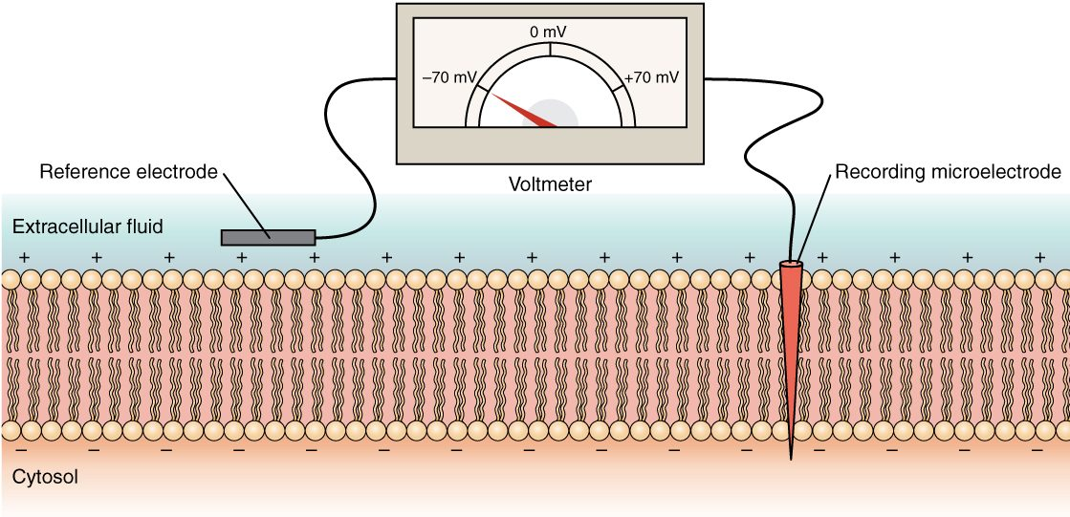
SECTION 12.4
The Resting Membrane Potential
Measuring the resting membrane potential
Neurons are electrically polarized
Inside is negative (about –70 mV)
Maintained by pumps and channels
Ready to fire when stimulated
PN 104 · Ch 12 — The Nervous System and Nervous Tissue
14
Notes:
At rest, a neuron's inside is about –70 mV relative to the outside, maintained by the sodium-potassium pump and selective ion channels. This stored electrical charge is the "ready" state; a sufficient stimulus changes membrane permeability and can trigger a signal.

Slide 15
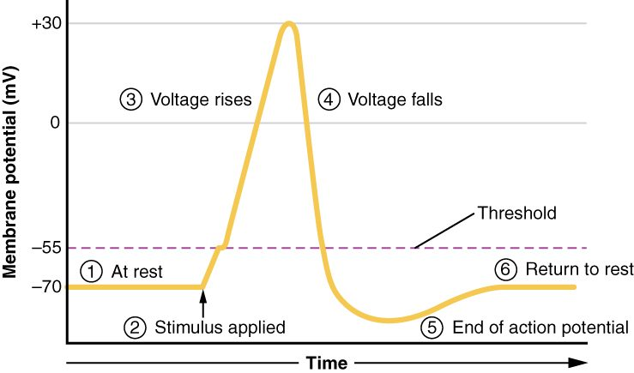
SECTION 12.4
The Action Potential
The phases of an action potential
An all-or-nothing electrical impulse
Threshold triggers depolarization
Sodium in, then potassium out
Self-propagates along the axon
PN 104 · Ch 12 — The Nervous System and Nervous Tissue
15
Notes:
When a stimulus brings the membrane to threshold (about –55 mV), voltage-gated sodium channels open and the cell rapidly depolarizes; then potassium channels open to repolarize it. This all-or-nothing action potential regenerates itself down the axon, and myelin lets it jump node to node for faster conduction.

Slide 16
12.5
SECTION
Communication Between Neurons
How neurons pass signals to other cells — the synapse.

Slide 17
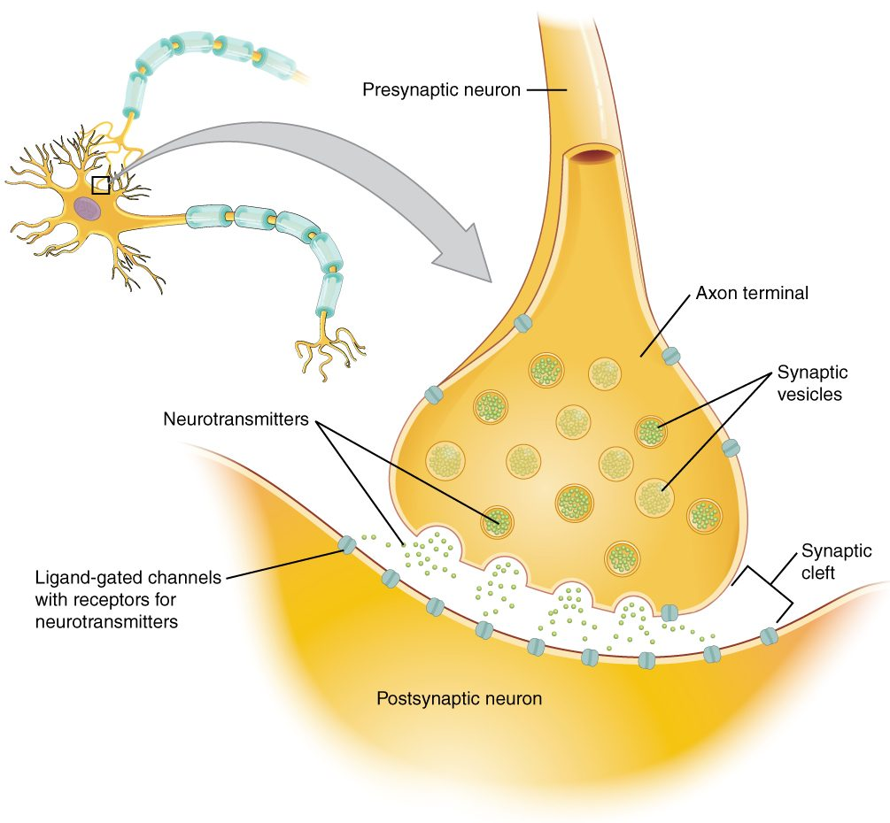
SECTION 12.5
The Synapse
Neurons communicate at synapses
Impulse triggers neurotransmitter release
Chemical crosses the synaptic cleft
Binds receptors on the next cell
Structure of a chemical synapse
PN 104 · Ch 12 — The Nervous System and Nervous Tissue
17
Notes:
At a chemical synapse, the arriving action potential triggers calcium entry, causing vesicles to release neurotransmitter into the synaptic cleft. The neurotransmitter diffuses across and binds receptors on the postsynaptic cell, passing the message on. Most drugs that affect the nervous system act at synapses.

Slide 18
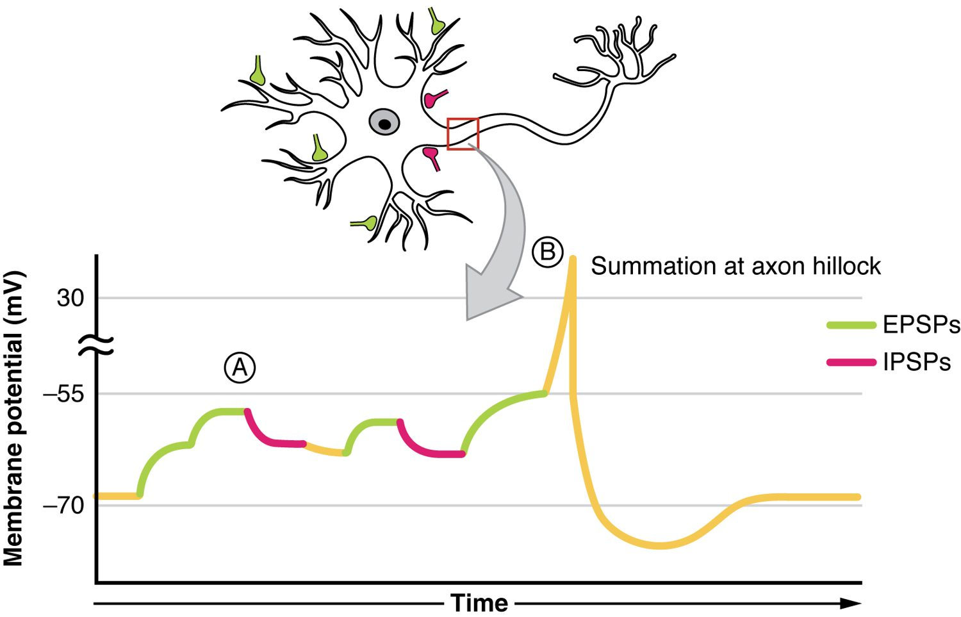
SECTION 12.5
Synaptic Integration
Summation of excitatory and inhibitory signals
Inputs can excite or inhibit
EPSPs push toward firing
IPSPs push away from firing
Summation decides the outcome
PN 104 · Ch 12 — The Nervous System and Nervous Tissue
18
Notes:
A neuron receives thousands of inputs at once. Excitatory signals (EPSPs) depolarize the membrane toward threshold, while inhibitory signals (IPSPs) hyperpolarize it away. The neuron sums these inputs at the axon hillock and fires only if the net effect reaches threshold — this integration is the basis of nervous system processing.

Slide 19
CHAPTER 12
Key Takeaways
The nervous system divides into the CNS (brain and spinal cord) and the PNS (nerves and ganglia).
Neurons carry signals; glial cells support, protect, and myelinate them.
The reflex arc is the simplest functional pathway, producing fast automatic responses.
Neurons signal electrically through resting and action potentials.
Neurons communicate at synapses, integrating excitatory and inhibitory input.
PN 104 · Ch 12 — The Nervous System and Nervous Tissue
19

Slide 20
CLINICAL CONNECTIONS
Why Nervous Tissue Matters in Practical Nursing
Multiple Sclerosis
Neuropathy
Loss of CNS myelin slows or blocks nerve signals.
Peripheral nerve damage causes numbness, tingling, and weakness.
Reflex Testing
Anesthetics
Reflexes are a quick window into nervous system function.
Local anesthetics block sodium channels to stop pain signals.
Synaptic Drugs
Nerve Injury
Many medications act on neurotransmitters at synapses.
Peripheral nerves can regenerate; CNS neurons largely cannot.

