Slide 1

CHAPTER 13
Anatomy of the Nervous System
The brain, spinal cord, their coverings, and the peripheral nerves.
Anatomy & Physiology · Broward-Miami Health Institute
FACULTY EDITION

Slide 2
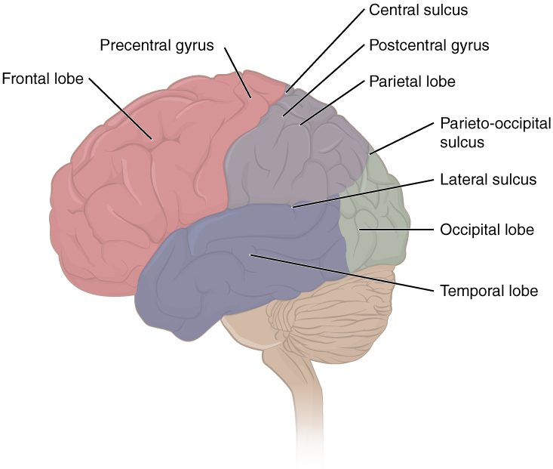
CHAPTER 13
Learning Objectives
After studying this chapter, students will be able to:
1
Relate the developmental processes of the embryonic nervous system to the adult structures
2
Name the major regions of the adult nervous system
3
Locate regions of the cerebral cortex on the basis of anatomical landmarks common to all human brains
4
Describe the regions of the spinal cord in cross-section
5
List the cranial nerves in order of anatomical location and provide the central and peripheral connections
The lobes and landmarks of the cerebrum.
PN 104 · Ch 13 — Anatomy of the Nervous System
2
Notes:
Preview the anatomy of the nervous system: how it develops, the major regions of the brain and the spinal cord, the protective meninges and CSF and the blood supply, and the cranial and spinal nerves of the peripheral nervous system.

Slide 3
13.1
SECTION
The Embryologic Perspective
How the brain and spinal cord develop from the embryonic neural tube.

Slide 4
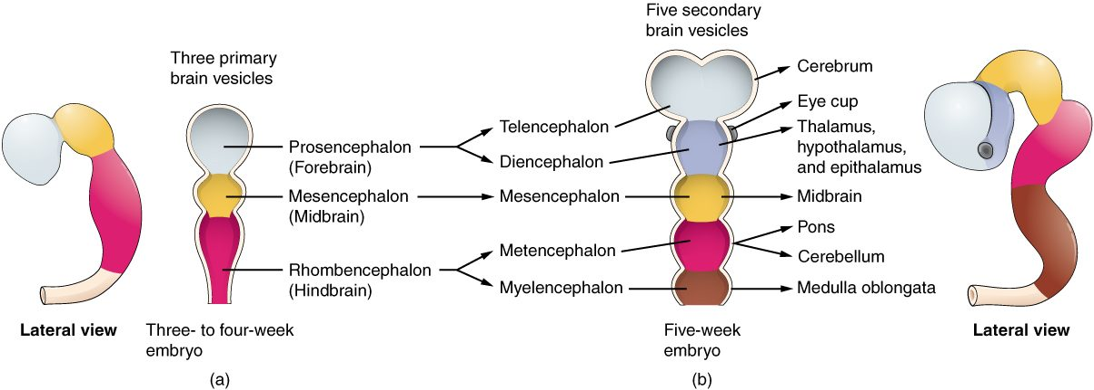
SECTION 13.1
Development of the Brain
Brain vesicles and the developing CNS
The CNS begins as a neural tube
Its front end forms brain vesicles
These become forebrain, midbrain, hindbrain
The rest becomes the spinal cord
PN 104 · Ch 13 — Anatomy of the Nervous System
4
Notes:
The CNS forms from the embryonic neural tube. Its anterior end enlarges into three primary vesicles — forebrain, midbrain, and hindbrain — that further divide into the structures of the adult brain (cerebrum, diencephalon, brainstem, cerebellum). The rest of the tube becomes the spinal cord. Incomplete closure causes neural tube defects such as spina bifida.

Slide 5
13.2
SECTION
The Central Nervous System
The brain and spinal cord — the body's control and integration center.

Slide 6
SECTION 13.2
Lobes of the Cerebrum
The largest part of the brain
Four lobes per hemisphere
Frontal, parietal, temporal, occipital
Cortex handles higher functions
The lobes of the cerebrum
PN 104 · Ch 13 — Anatomy of the Nervous System
6
Notes:
The cerebrum, the largest brain region, is divided into four lobes: frontal (movement, judgment, personality), parietal (sensation), temporal (hearing, memory), and occipital (vision). Its folded outer cortex of gray matter carries out conscious thought, sensation, and voluntary movement. The central sulcus separates motor from sensory cortex.

Slide 7
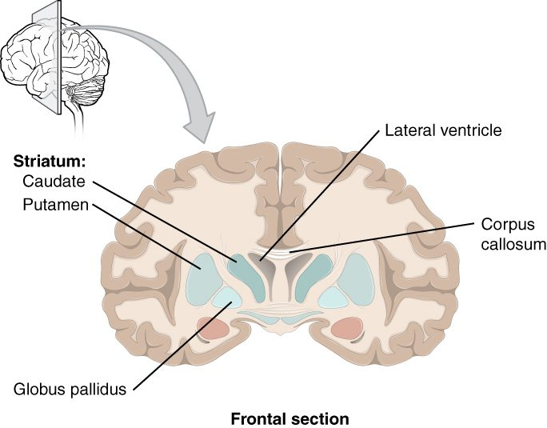
SECTION 13.2
The Basal Ganglia
Deep gray-matter nuclei
Help control movement
Regulate posture and muscle tone
Affected in Parkinson's disease
The basal ganglia (frontal section)
PN 104 · Ch 13 — Anatomy of the Nervous System
7
Notes:
Beneath the cortex lie the basal ganglia — including the caudate, putamen, and globus pallidus — which help initiate and smooth voluntary movement and regulate muscle tone. Their degeneration is central to movement disorders such as Parkinson's and Huntington's disease.

Slide 8
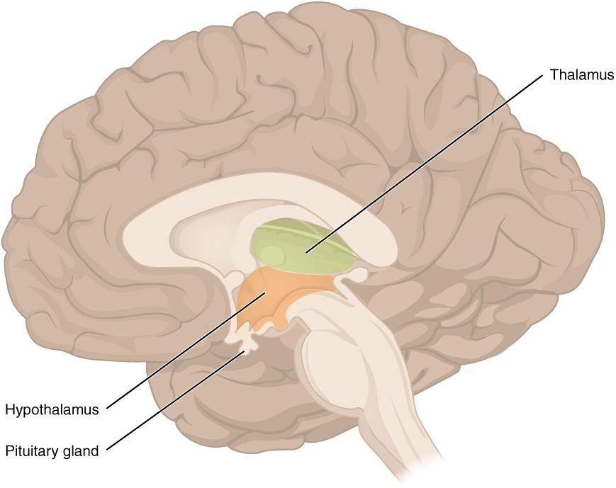
SECTION 13.2
The Diencephalon
Sits between cerebrum and brainstem
Thalamus relays sensory signals
Hypothalamus controls homeostasis
Links to the pituitary gland
The diencephalon: thalamus and hypothalamus
PN 104 · Ch 13 — Anatomy of the Nervous System
8
Notes:
The diencephalon contains the thalamus, the relay station that routes nearly all sensory input to the cortex, and the hypothalamus, the master regulator of homeostasis — temperature, hunger, thirst — controlling the autonomic and endocrine systems via the pituitary gland.

Slide 9
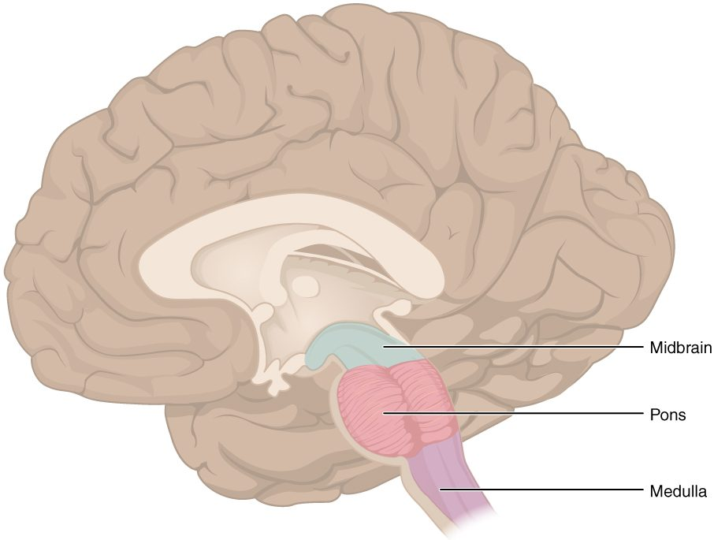
SECTION 13.2
The Brainstem
Connects brain to spinal cord
Midbrain, pons, and medulla
Controls vital automatic functions
Passage for nerve tracts
The brainstem: midbrain, pons, medulla
PN 104 · Ch 13 — Anatomy of the Nervous System
9
Notes:
The brainstem — midbrain, pons, and medulla oblongata — links the brain to the spinal cord and controls vital involuntary functions: the medulla governs heart rate, breathing, and blood pressure. Most cranial nerves arise here, and all signals between brain and body pass through it.

Slide 10
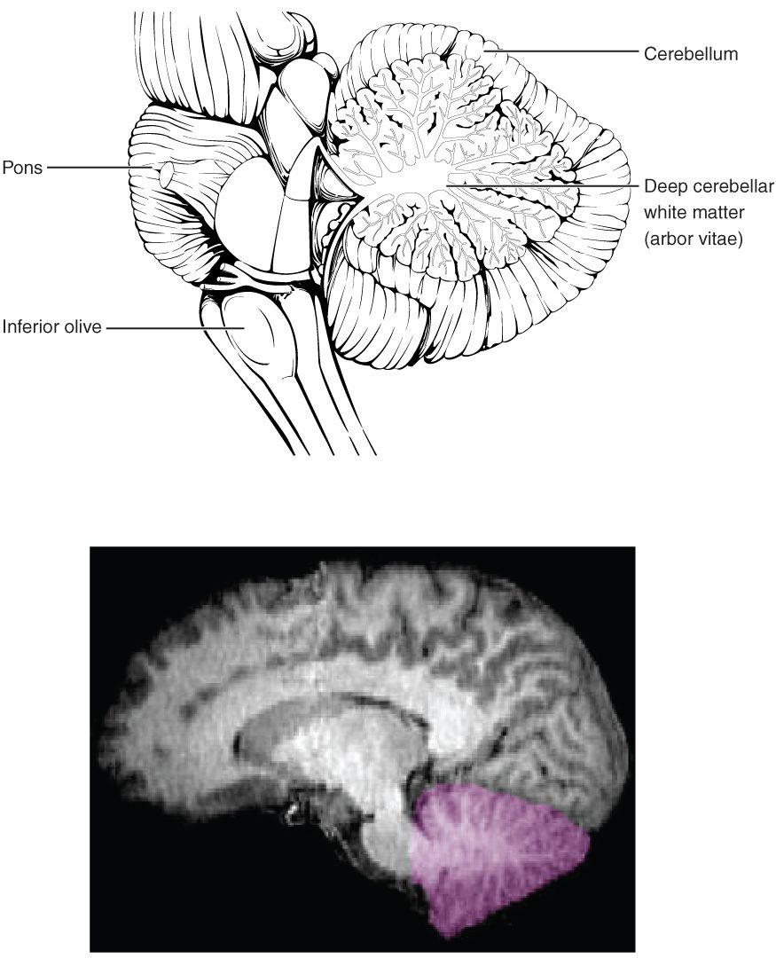
SECTION 13.2
The Cerebellum
Sits behind the brainstem
Coordinates movement and balance
Fine-tunes posture and timing
Enables smooth, accurate motion
The cerebellum
PN 104 · Ch 13 — Anatomy of the Nervous System
10
Notes:
The cerebellum ("little brain") coordinates voluntary movement, balance, posture, and muscle coordination, comparing intended movements with actual ones to keep them smooth. Damage causes clumsiness, tremor, and balance problems (ataxia) — relevant in alcohol intoxication and stroke.

Slide 11
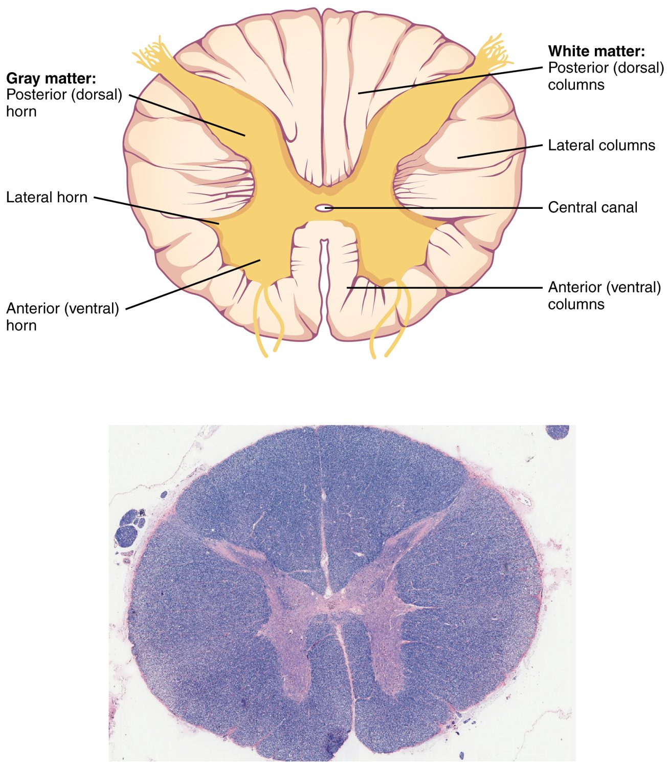
SECTION 13.2
The Spinal Cord
Continuous with the brainstem
Gray matter (H-shaped) inside
White matter tracts outside
Relays signals and runs reflexes
Cross-section of the spinal cord
PN 104 · Ch 13 — Anatomy of the Nervous System
11
Notes:
The spinal cord carries signals between brain and body and processes many reflexes. In cross-section, central H-shaped gray matter (cell bodies and synapses) is surrounded by white matter tracts (myelinated axons) carrying ascending sensory and descending motor information. It exits the skull through the foramen magnum.

Slide 12
13.3
SECTION
Circulation and the Central Nervous System
Blood supply, the protective meninges, and cerebrospinal fluid.

Slide 13
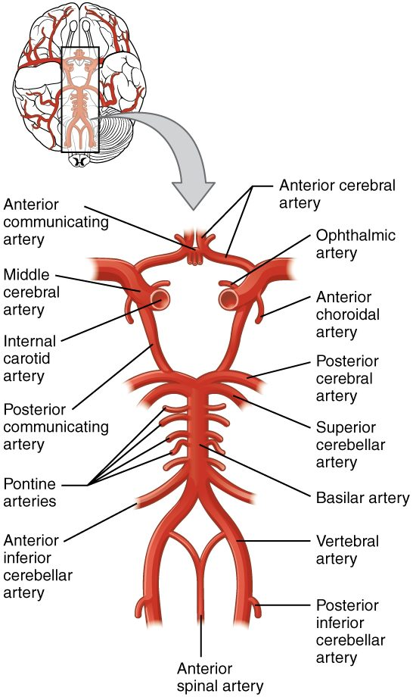
SECTION 13.3
Blood Supply — Circle of Willis
The brain needs constant blood flow
Fed by carotid and vertebral arteries
They join in the Circle of Willis
Provides backup circulation
The cerebral arterial circle (Circle of Willis)
PN 104 · Ch 13 — Anatomy of the Nervous System
13
Notes:
The brain demands a constant blood supply, delivered by the internal carotid and vertebral arteries. These join at the base of the brain in the Circle of Willis, an arterial ring that provides alternate routes if one vessel is blocked. Interruption of flow causes a stroke within minutes.

Slide 14
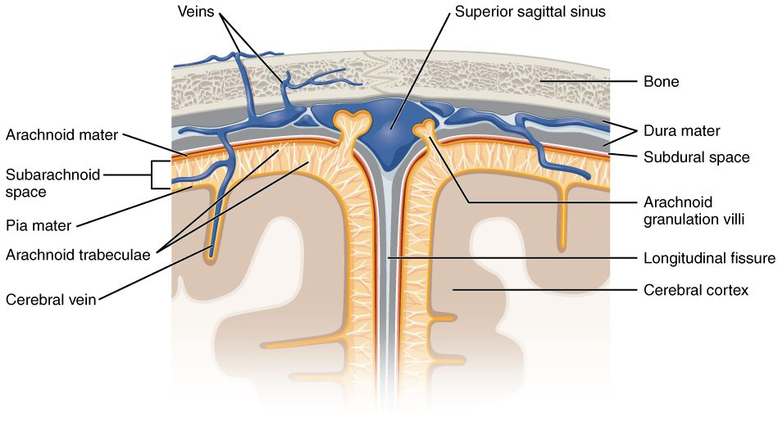
SECTION 13.3
The Meninges
The cranial meninges
Three protective membranes
Dura, arachnoid, and pia mater
Cushion the brain and spinal cord
Site of meningitis and bleeds
PN 104 · Ch 13 — Anatomy of the Nervous System
14
Notes:
Three connective-tissue membranes — the tough dura mater, the web-like arachnoid mater, and the delicate pia mater on the brain surface — protect the CNS. The subarachnoid space between arachnoid and pia holds cerebrospinal fluid. Infection here is meningitis; bleeding between layers forms hematomas.

Slide 15
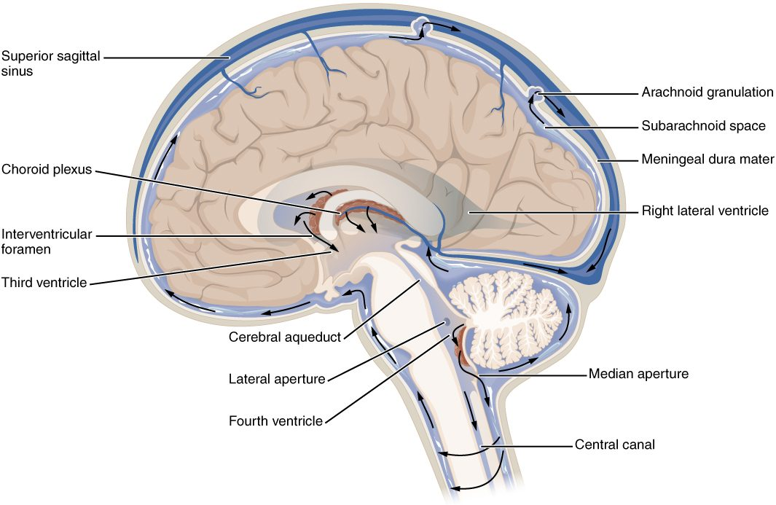
SECTION 13.3
Ventricles & Cerebrospinal Fluid
The ventricles and CSF circulation
Hollow ventricles inside the brain
Produce cerebrospinal fluid (CSF)
CSF cushions and nourishes the CNS
Circulates and is reabsorbed
PN 104 · Ch 13 — Anatomy of the Nervous System
15
Notes:
Four interconnected ventricles contain choroid plexuses that make cerebrospinal fluid. CSF circulates through the ventricles and subarachnoid space, cushioning the brain, supporting its weight, and removing waste. Blocked flow causes hydrocephalus; CSF is sampled in a lumbar puncture.

Slide 16
13.4
SECTION
The Peripheral Nervous System
The nerves and ganglia that connect the CNS to the body.

Slide 17
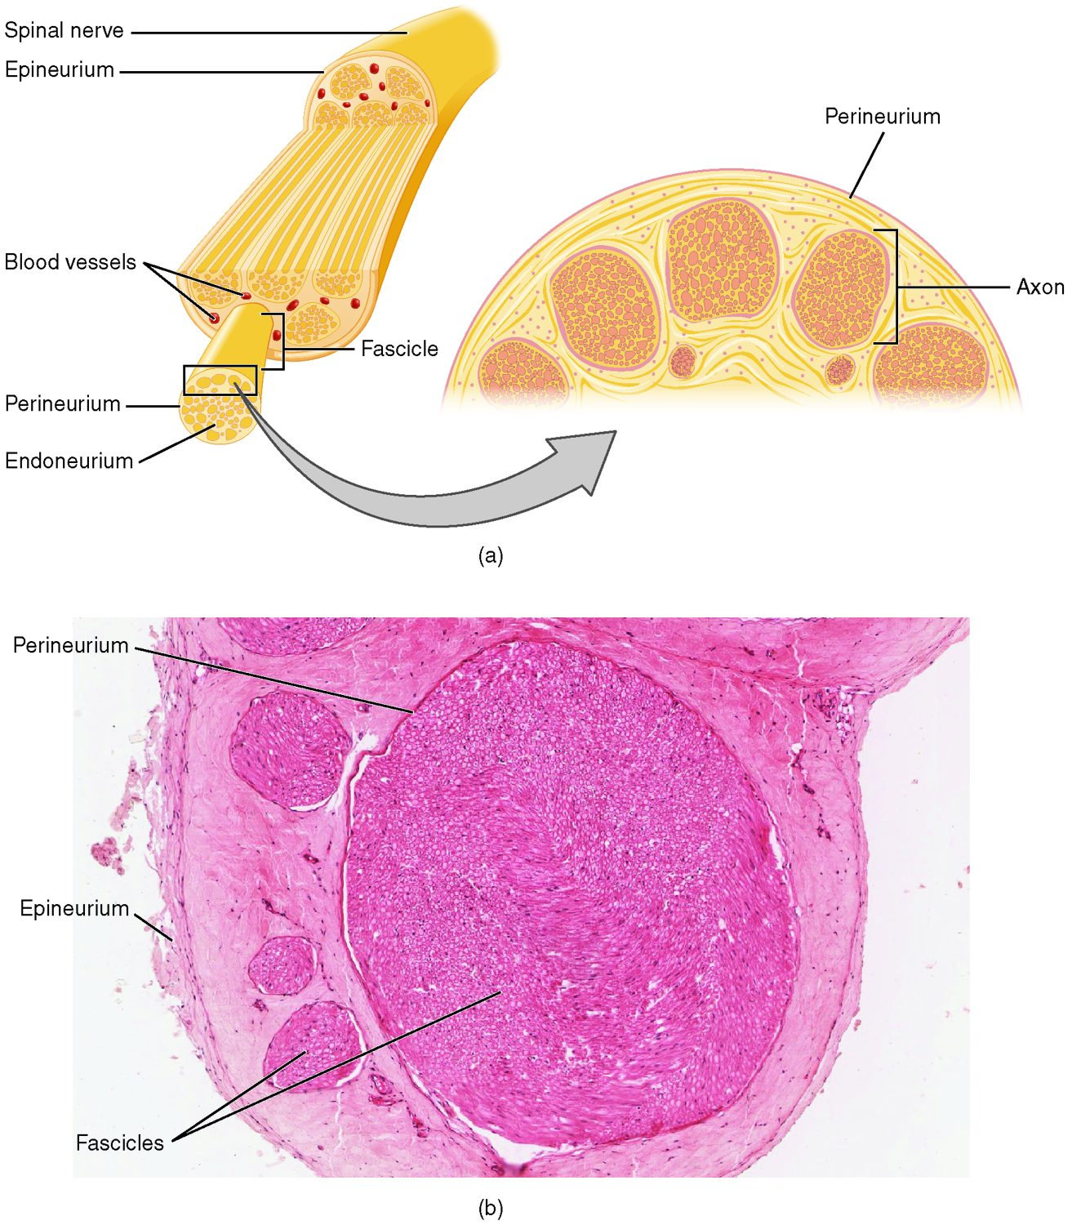
SECTION 13.4
Structure of a Nerve
A nerve is a bundle of axons
Axons grouped into fascicles
Wrapped in connective-tissue sheaths
Carry sensory and/or motor fibers
The structure of a peripheral nerve
PN 104 · Ch 13 — Anatomy of the Nervous System
17
Notes:
A peripheral nerve is a cable of many axons bundled into fascicles, each wrapped in connective tissue (endoneurium around axons, perineurium around fascicles, epineurium around the whole nerve). Nerves may be sensory, motor, or mixed, and the sheaths protect and guide regenerating fibers.

Slide 18
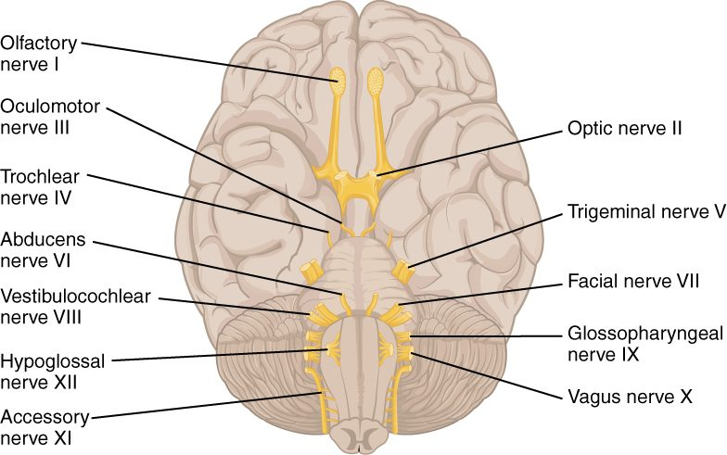
SECTION 13.4
The Cranial Nerves
The twelve cranial nerves
12 pairs arise from the brain
Numbered I through XII
Serve mainly the head and neck
Sensory, motor, or both
PN 104 · Ch 13 — Anatomy of the Nervous System
18
Notes:
Twelve pairs of cranial nerves emerge mainly from the brainstem, serving the head and neck (and, for the vagus, the thorax and abdomen). They handle smell, vision, eye movement, facial sensation and expression, hearing, balance, taste, and more. Testing them is a core part of the neurological exam.

Slide 19
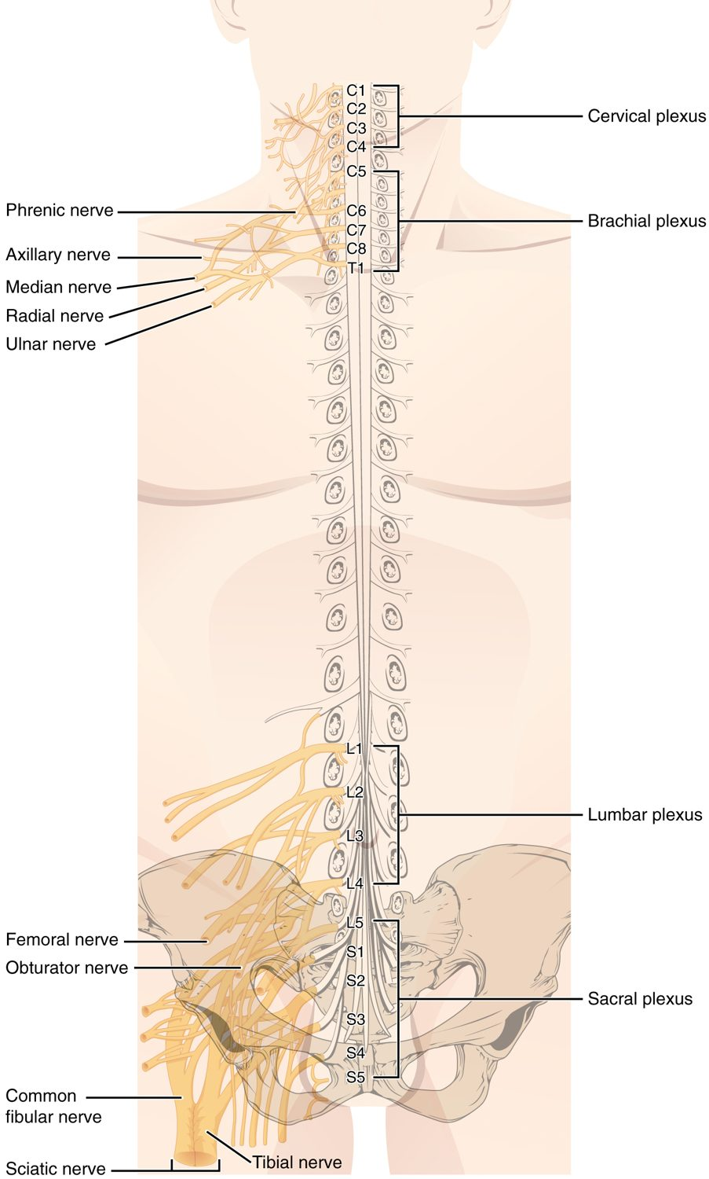
SECTION 13.4
Spinal Nerves & Plexuses
31 pairs of spinal nerves
Exit between the vertebrae
Mixed sensory and motor fibers
Merge into plexuses for the limbs
The spinal nerves and plexuses
PN 104 · Ch 13 — Anatomy of the Nervous System
19
Notes:
Thirty-one pairs of spinal nerves branch from the cord, each a mixed nerve carrying sensory and motor fibers to a region of the body. Many interweave into networks (plexuses) — cervical, brachial, lumbar, and sacral — that supply the neck and limbs. Each supplies a specific skin area, or dermatome.

Slide 20
CHAPTER 13
Key Takeaways
The brain and spinal cord develop from the embryonic neural tube.
The cerebrum, diencephalon, brainstem, and cerebellum each have distinct roles.
The spinal cord relays signals and runs reflexes, with gray matter inside and white matter outside.
The brain is protected by meninges, cushioned by CSF, and supplied by the Circle of Willis.
The PNS connects the CNS to the body through 12 cranial and 31 spinal nerve pairs.
PN 104 · Ch 13 — Anatomy of the Nervous System
20

Slide 21
CLINICAL CONNECTIONS
Why Nervous System Anatomy Matters in Practical Nursing
Stroke
Meningitis
Interrupted brain blood flow causes rapid, lasting damage.
Infection of the meninges is a medical emergency.
Spinal Cord Injury
Neuro Exam
Damage causes loss of function below the level of injury.
Cranial-nerve and reflex testing helps localize problems.
Hydrocephalus
Parkinson's Disease
Blocked CSF flow raises pressure inside the skull.
Basal ganglia degeneration impairs movement.

