Slide 1

CHAPTER 14
The Somatic Nervous System
Sensation, central processing, and voluntary movement.
Anatomy & Physiology · Broward-Miami Health Institute
FACULTY EDITION

Slide 2
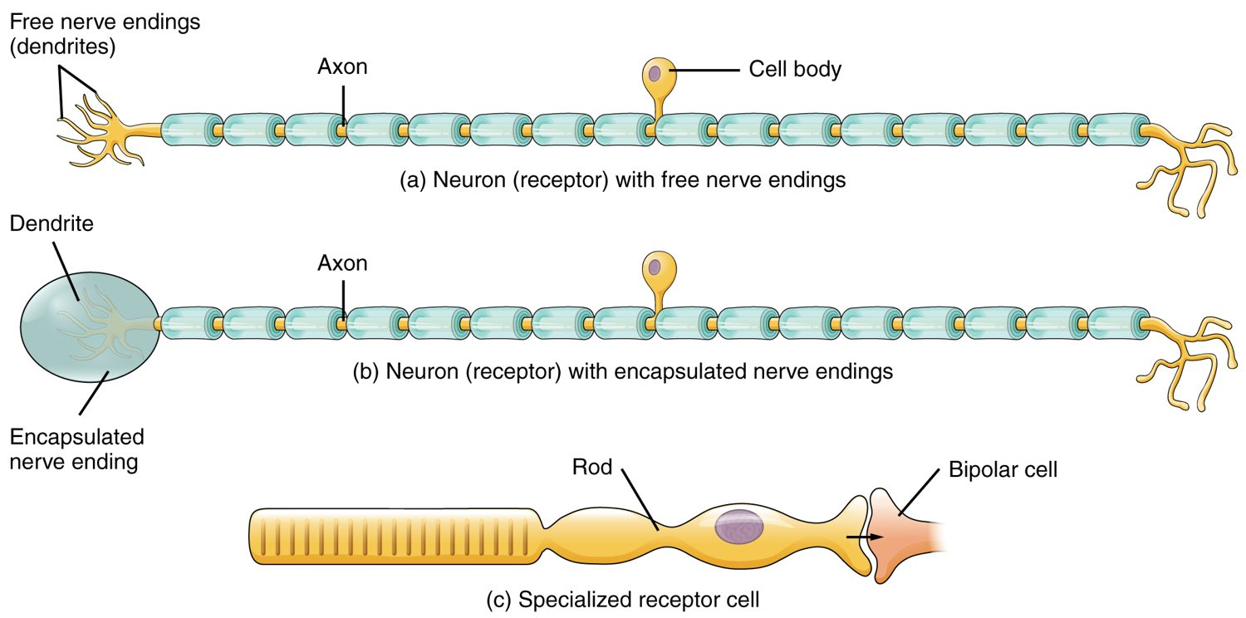
CHAPTER 14
Learning Objectives
After studying this chapter, students will be able to:
1
Describe the components of the somatic nervous system
2
Name the modalities and submodalities of the sensory systems
3
Distinguish between general and special senses
4
Describe regions of the central nervous system that contribute to somatic functions
Sensory receptors detect stimuli from the world and the body.
PN 104 · Ch 14 — The Somatic Nervous System
2
Notes:
Preview the somatic nervous system as a sensory-to-motor circuit: how receptors detect stimuli (general and special senses), how the CNS processes that information into perception, and how the brain sends commands out to produce voluntary movement.

Slide 3
14.1
SECTION
Sensory Perception
How receptors detect stimuli — the general and special senses.

Slide 4
SECTION 14.1
Sensory Receptors
Types of sensory receptors
Receptors detect stimuli
Convert them to nerve signals
Respond to touch, temperature, pain
Free and encapsulated endings
PN 104 · Ch 14 — The Somatic Nervous System
4
Notes:
Sensation begins when receptors detect a stimulus and transduce it into a nerve signal. The general senses use free nerve endings (pain, temperature) and encapsulated endings (touch, pressure, vibration) spread through the skin and body. Receptors are also classed by stimulus type — mechano-, thermo-, photo-, chemo-, and nociceptors.

Slide 5
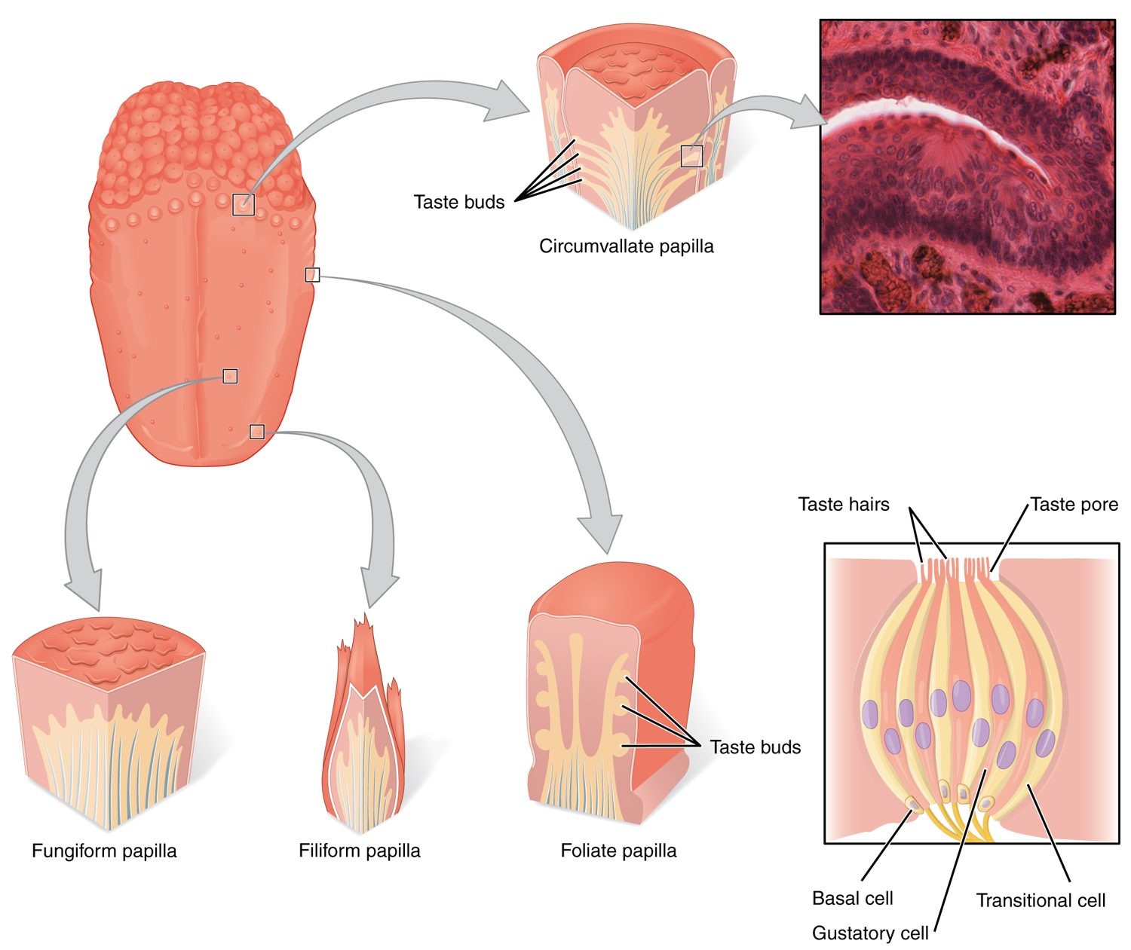
SECTION 14.1
Taste (Gustation)
Taste buds detect dissolved chemicals
Located on tongue papillae
Five basic tastes
A chemical (chemoreceptor) sense
Taste buds and the sense of taste
PN 104 · Ch 14 — The Somatic Nervous System
5
Notes:
Taste (gustation) is a chemical sense. Taste buds, mostly on the tongue's papillae, contain receptor cells that detect dissolved molecules and signal five basic qualities — sweet, sour, salty, bitter, and umami. Taste works closely with smell to create flavor.

Slide 6
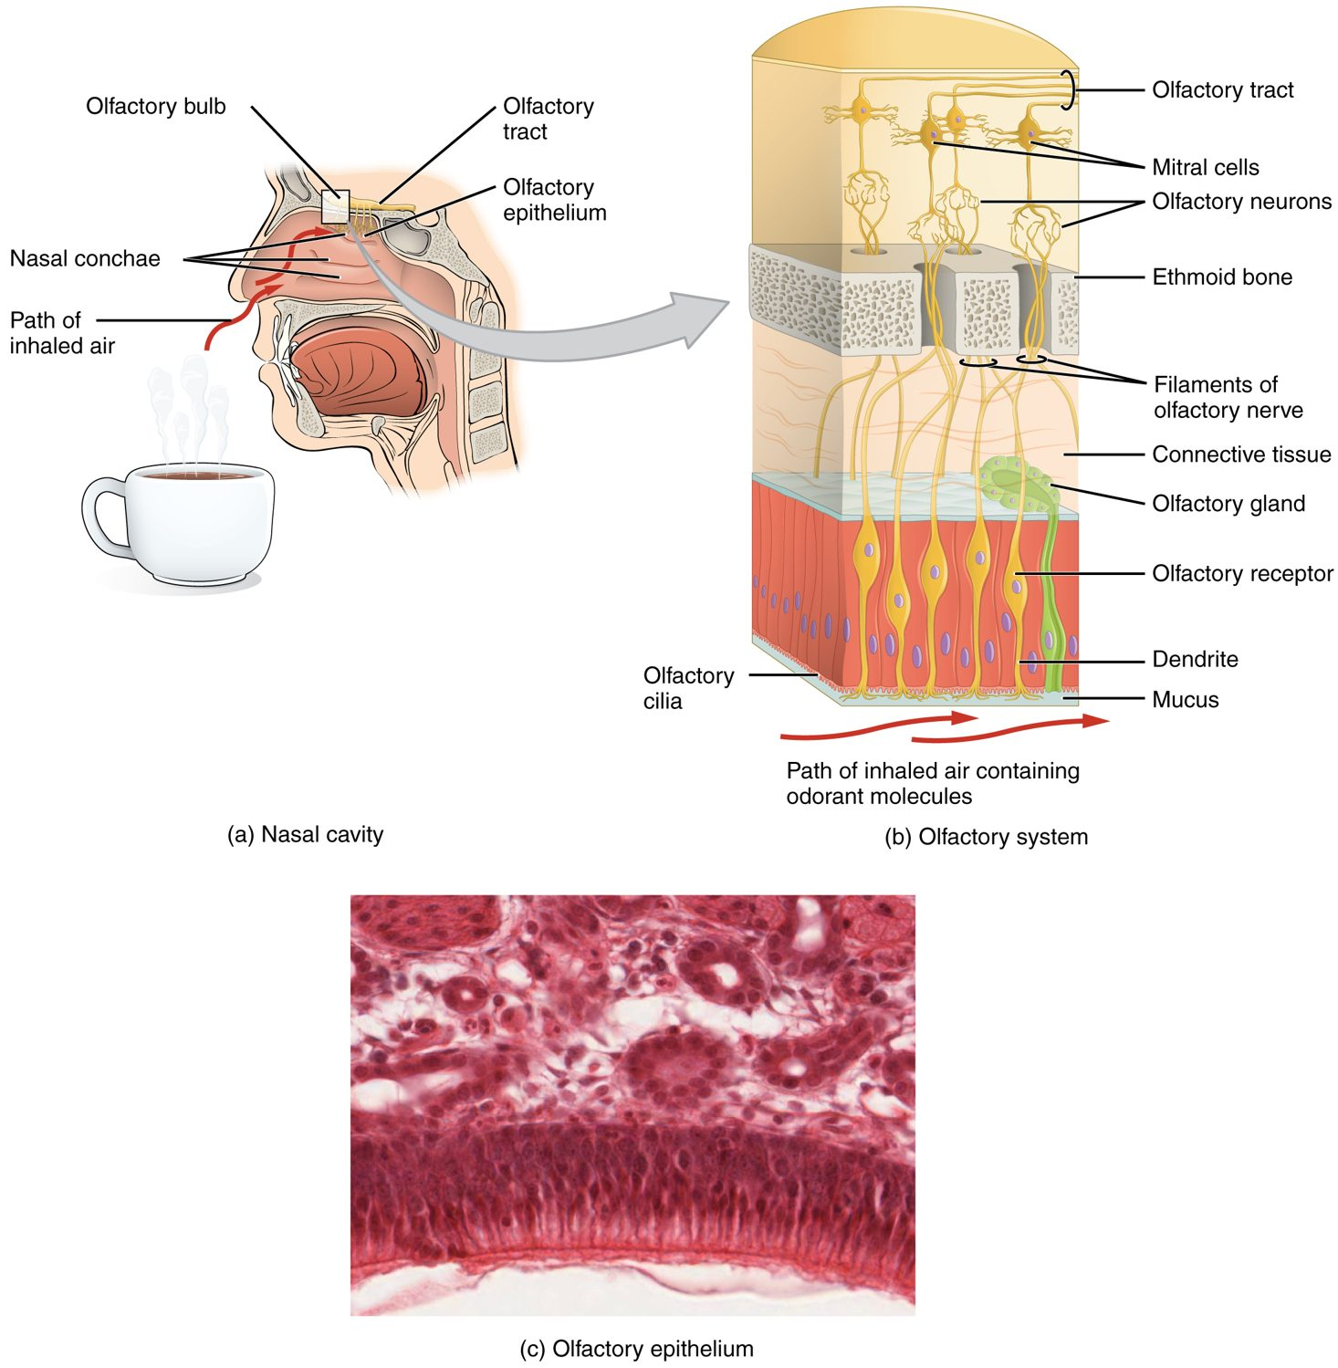
SECTION 14.1
Smell (Olfaction)
Olfactory receptors in the nasal cavity
Detect airborne chemicals
Signal travels to the brain directly
Strongly tied to memory
The olfactory system
PN 104 · Ch 14 — The Somatic Nervous System
6
Notes:
Smell (olfaction) is also a chemical sense. Olfactory receptor neurons high in the nasal cavity bind airborne odor molecules and send signals through the olfactory nerve to the brain. Uniquely, smell connects directly to memory and emotion centers, which is why odors can trigger vivid memories.

Slide 7
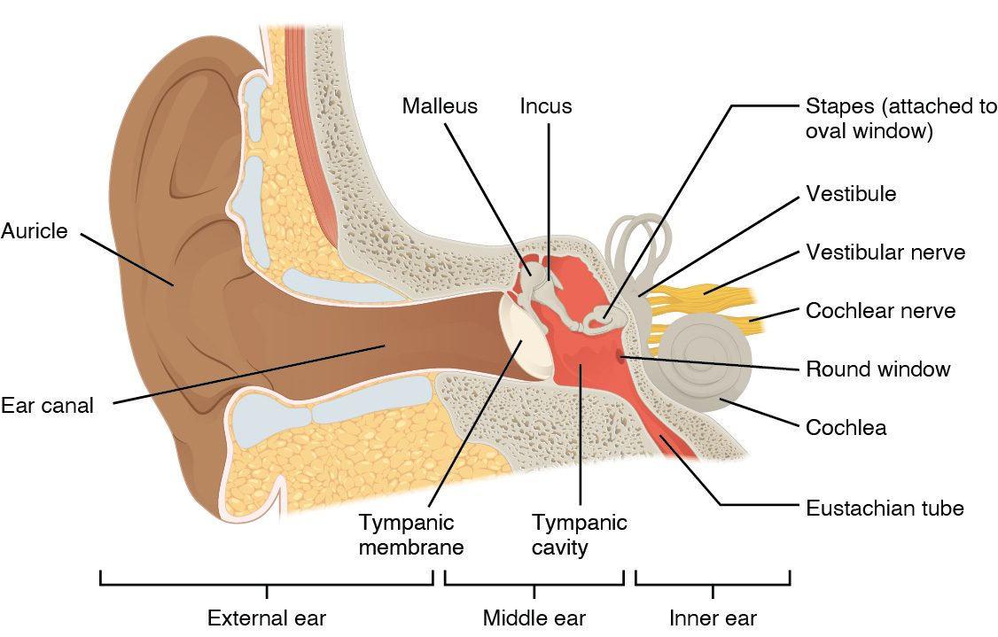
SECTION 14.1
Hearing — The Ear
The anatomy of the ear
Outer ear gathers sound
Middle ear bones amplify it
Inner ear cochlea transduces it
Hair cells signal the brain
PN 104 · Ch 14 — The Somatic Nervous System
7
Notes:
The ear converts sound waves to nerve signals. The outer ear funnels sound to the eardrum; the middle ear ossicles amplify the vibration; and in the inner ear, the fluid-filled cochlea stimulates hair cells that fire the auditory nerve. The inner ear's vestibular apparatus also provides balance.

Slide 8
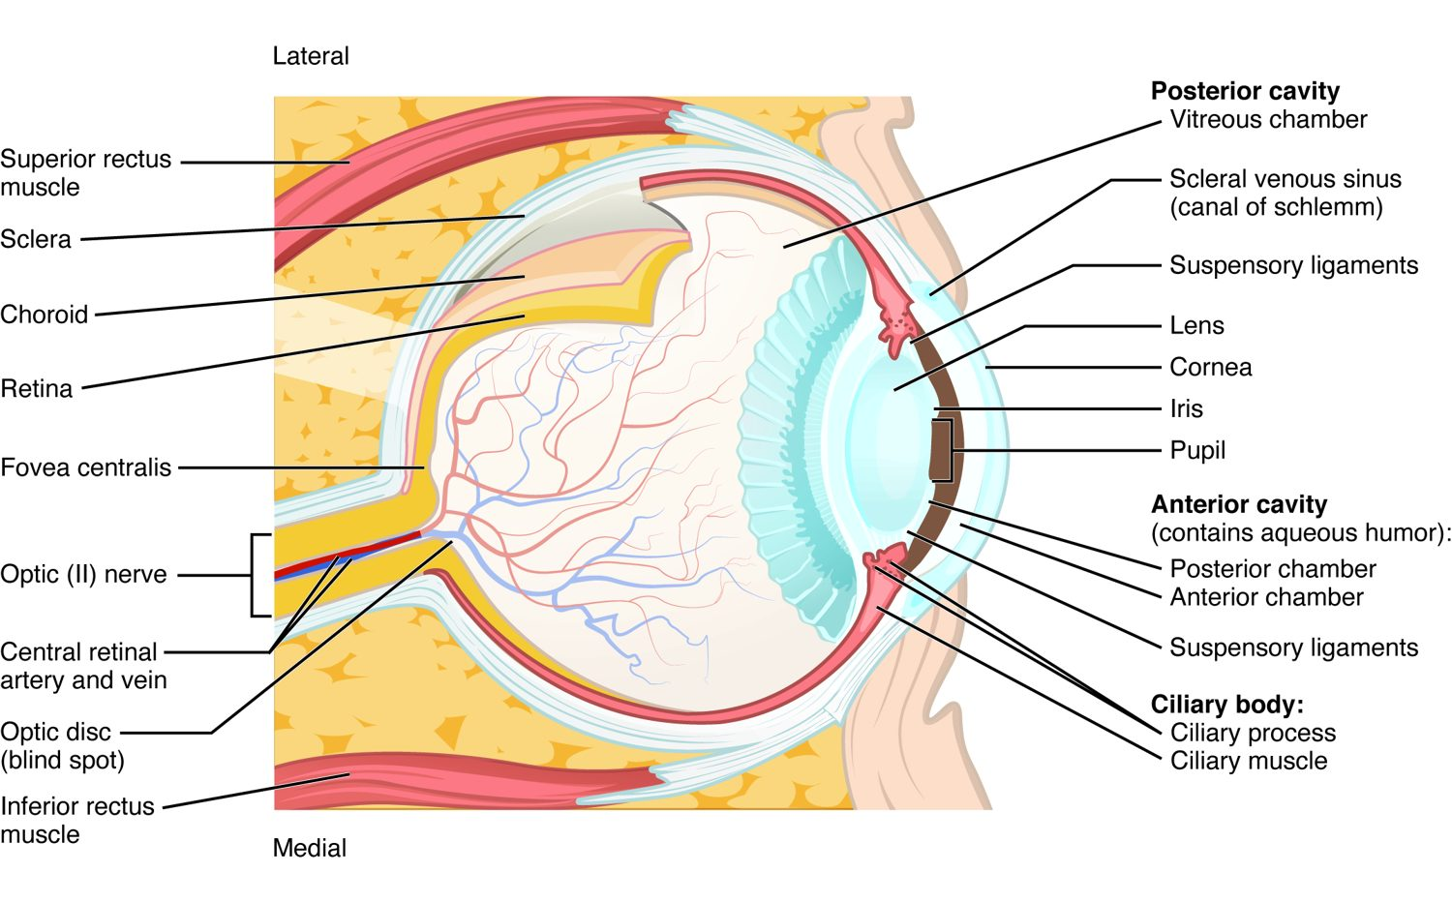
SECTION 14.1
Vision — The Eye
The anatomy of the eye
The cornea and lens focus light
The iris controls light entry
The retina holds photoreceptors
Rods and cones signal the brain
PN 104 · Ch 14 — The Somatic Nervous System
8
Notes:
Vision begins as the cornea and lens focus light onto the retina, with the iris adjusting the pupil. Photoreceptors in the retina — rods (dim light) and cones (color and detail) — transduce light into signals carried by the optic nerve to the brain. Refractive errors and cataracts are common vision problems.

Slide 9
14.2
SECTION
Central Processing
How the CNS processes sensory information into perception.

Slide 10
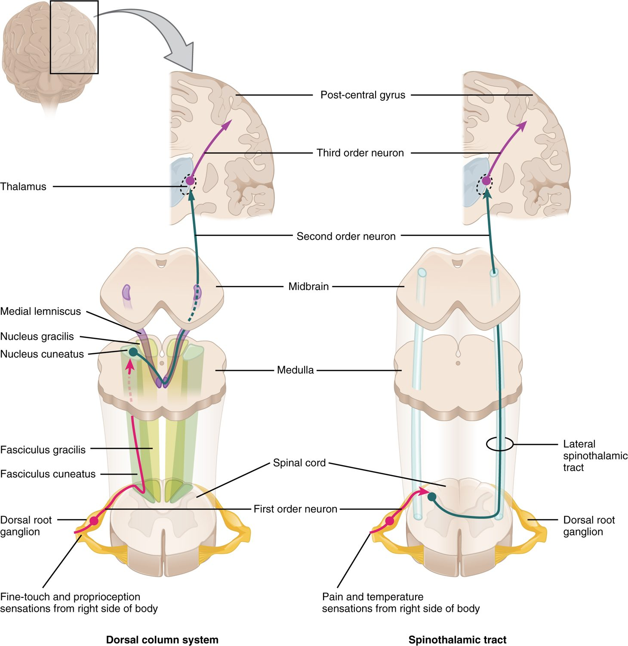
SECTION 14.2
Ascending Sensory Pathways
Sensory signals travel to the brain
Cross to the opposite side
Relay through the thalamus
Reach the sensory cortex
Ascending sensory pathways
PN 104 · Ch 14 — The Somatic Nervous System
10
Notes:
Sensory information ascends the spinal cord in defined tracts — the dorsal column (fine touch, position) and spinothalamic (pain, temperature) — crossing to the opposite side and relaying through the thalamus to the sensory cortex. Because pathways cross, one side of the brain perceives the opposite side of the body.

Slide 11
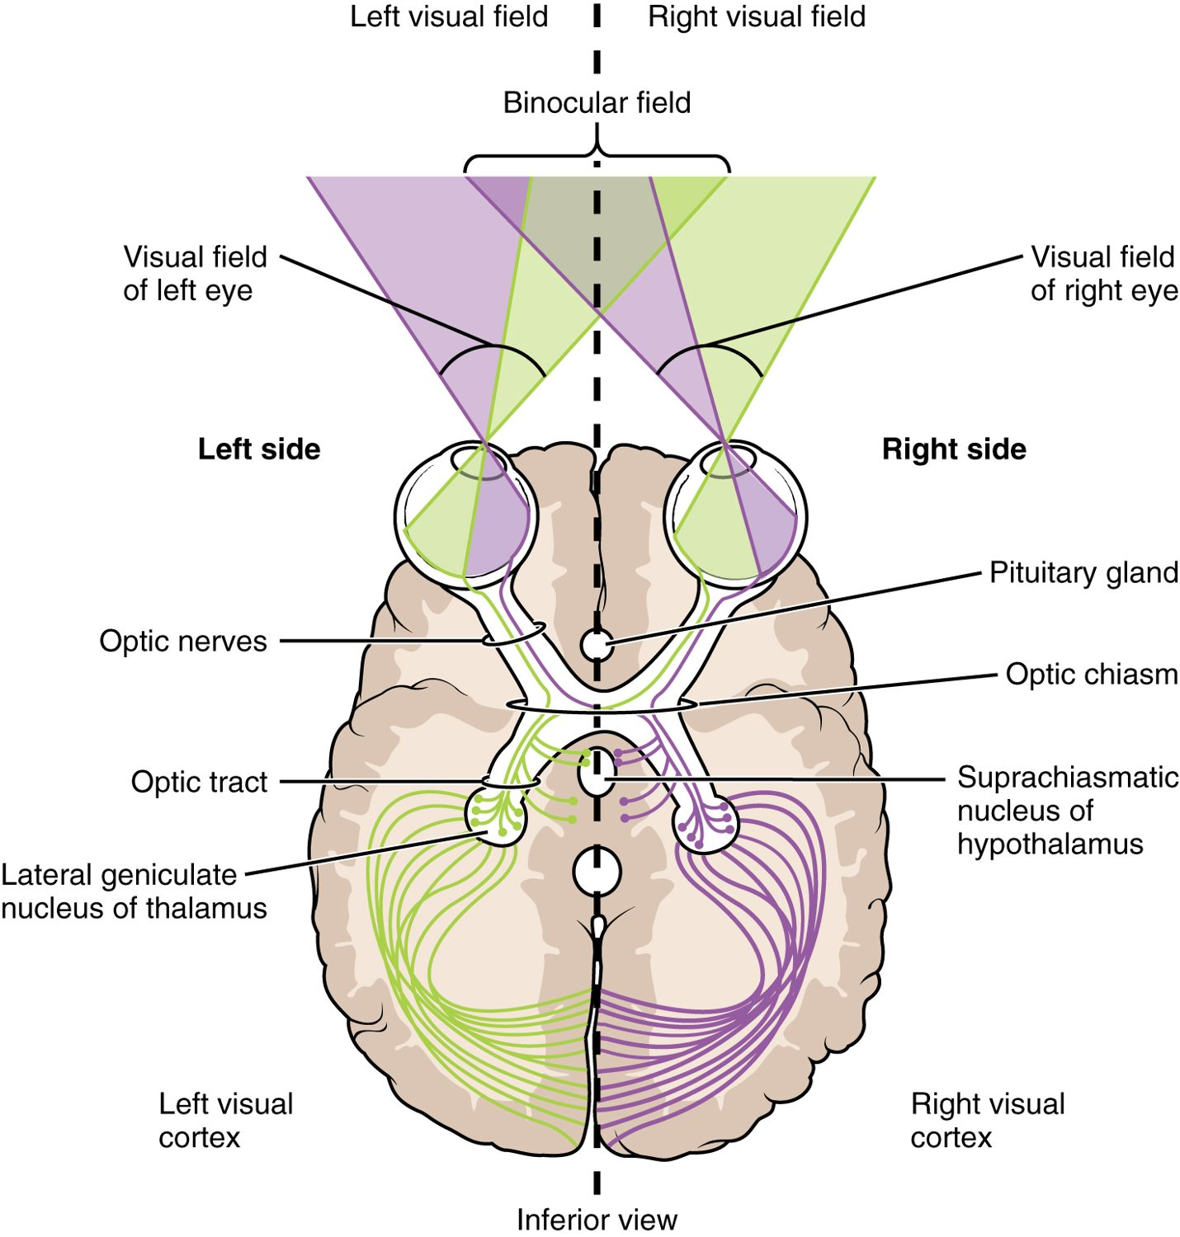
SECTION 14.2
The Visual Pathway
Optic nerves carry signals from each eye
They meet at the optic chiasm
Fibers partly cross
End in the visual cortex
The visual pathway to the cortex
PN 104 · Ch 14 — The Somatic Nervous System
11
Notes:
Signals from each eye travel along the optic nerves to the optic chiasm, where the inner (nasal) fibers cross. Reorganized into optic tracts, they relay through the thalamus to the occipital visual cortex. This crossing is why damage at different points produces characteristic visual-field losses.

Slide 12
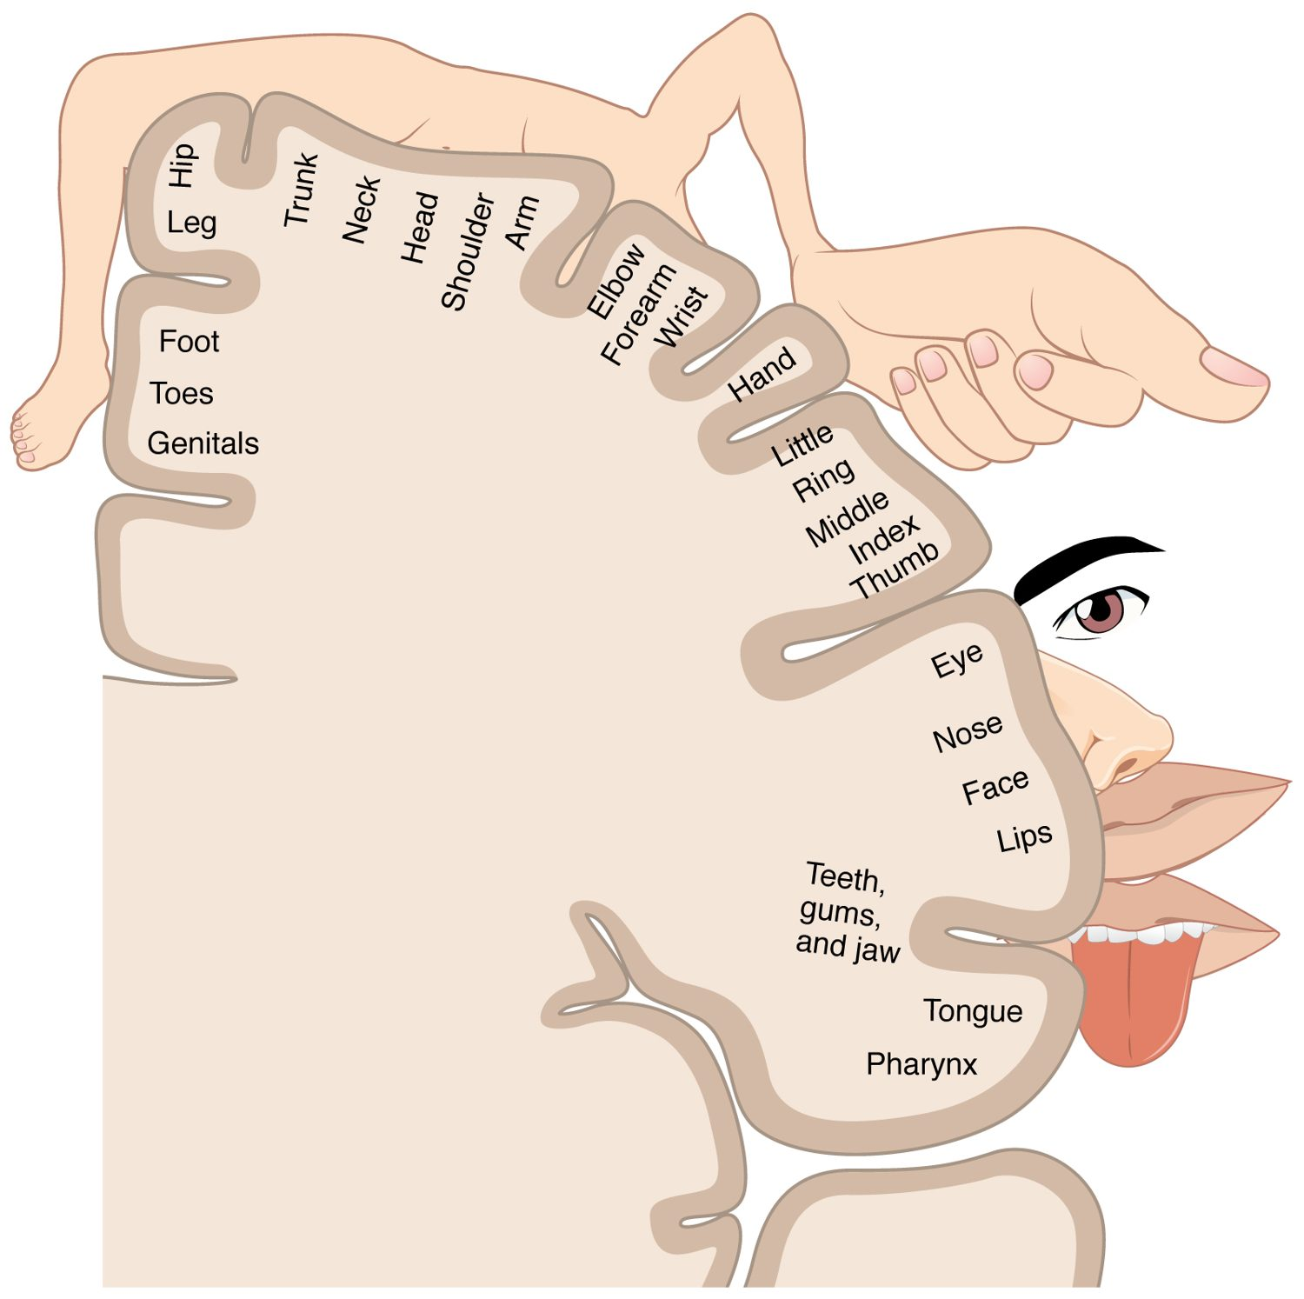
SECTION 14.2
The Sensory Homunculus
The cortex maps the whole body
Each part has a cortical area
Sensitive areas get more space
Hands and face dominate
The sensory homunculus
PN 104 · Ch 14 — The Somatic Nervous System
12
Notes:
The primary sensory cortex maps the body surface in an orderly strip — the sensory homunculus. The amount of cortex devoted to each region reflects its sensitivity, not its size, so the hands, lips, and face occupy large areas while the trunk and legs occupy little.

Slide 13
14.3
SECTION
Motor Responses
How the nervous system produces voluntary movement.

Slide 14
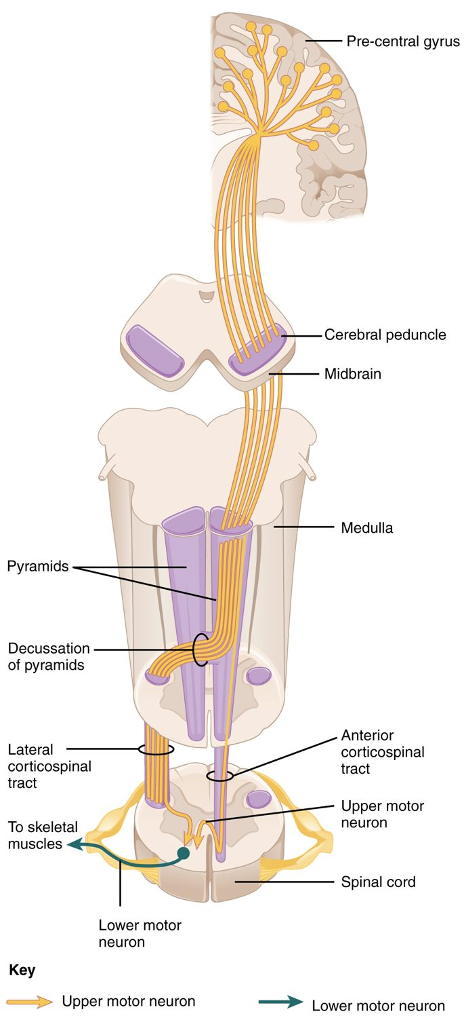
SECTION 14.3
The Motor Pathway
Commands start in the motor cortex
Travel down the corticospinal tract
Cross to the opposite side
Upper and lower motor neurons
The descending motor pathway
PN 104 · Ch 14 — The Somatic Nervous System
14
Notes:
Voluntary movement begins in the motor cortex, where upper motor neurons send commands down the corticospinal tract. The fibers cross in the brainstem, so each hemisphere controls the opposite side of the body, then synapse on lower motor neurons that directly drive the muscles. Damage to upper versus lower motor neurons produces distinct patterns of weakness.

Slide 15
CHAPTER 14
Key Takeaways
Sensation begins when receptors transduce stimuli into nerve signals.
The special senses — taste, smell, hearing, balance, and vision — use specialized receptors.
Sensory pathways cross the midline and relay through the thalamus to the cortex.
The cortex maps the body, devoting the most area to the most sensitive parts.
Voluntary movement travels from the motor cortex down crossed corticospinal pathways.
PN 104 · Ch 14 — The Somatic Nervous System
15

Slide 16
CLINICAL CONNECTIONS
Why the Somatic Nervous System Matters in Practical Nursing
Sensory Loss
Hearing & Vision
Numbness or deficits help localize nerve or CNS damage.
Common deficits that affect safety and communication.
Pain Management
Stroke Effects
Understanding pain pathways guides effective relief.
Crossed pathways explain one-sided weakness or sensory loss.
Pupillary Reflex
Motor Deficits
Pupil response is a key neurological assessment.
Upper vs. lower motor neuron signs guide diagnosis.

