Slide 1
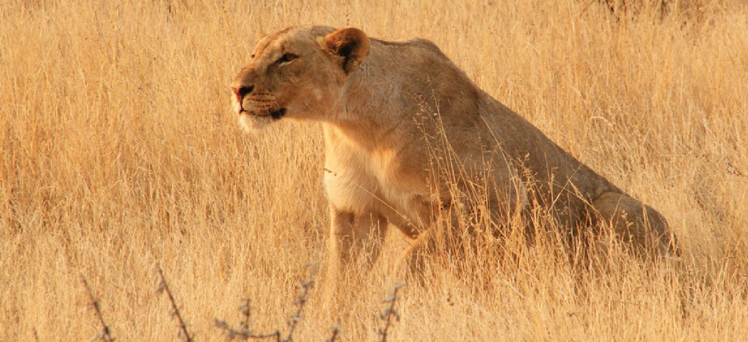
CHAPTER 15
The Autonomic Nervous System
Involuntary control of the body's organs and internal balance.
Anatomy & Physiology · Broward-Miami Health Institute
FACULTY EDITION

Slide 2
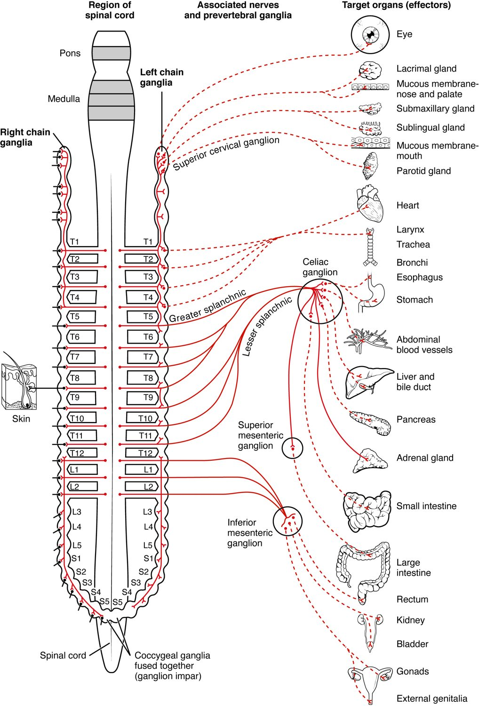
CHAPTER 15
Learning Objectives
After studying this chapter, students will be able to:
1
Describe the components of the autonomic nervous system
2
Differentiate between the structures of the sympathetic and parasympathetic divisions in the autonomic nervous system
3
Name the components of a visceral reflex specific to the autonomic division to which it belongs
4
Predict the response of a target effector to autonomic input on the basis of the released signaling molecule
The autonomic nervous system: involuntary control.
PN 104 · Ch 15 — The Autonomic Nervous System
2
Notes:
Preview the autonomic nervous system: its sympathetic ("fight-or-flight") and parasympathetic ("rest-and-digest") divisions, how autonomic reflexes maintain homeostasis, how the hypothalamus and brainstem control it, and how drugs target it.

Slide 3
15.1
SECTION
Divisions of the Autonomic Nervous System
The sympathetic and parasympathetic divisions of the autonomic system.

Slide 4
SECTION 15.1
The Sympathetic Division
The "fight-or-flight" system
Prepares the body for action
Raises heart rate and breathing
Arises from the thoracolumbar cord
The sympathetic division
PN 104 · Ch 15 — The Autonomic Nervous System
4
Notes:
The sympathetic division mobilizes the body for stress or activity — the "fight-or-flight" response. It speeds the heart, dilates airways and pupils, and shifts blood to muscles while pausing digestion. Its neurons exit the thoracic and lumbar spinal cord and use ganglia near the cord.

Slide 5
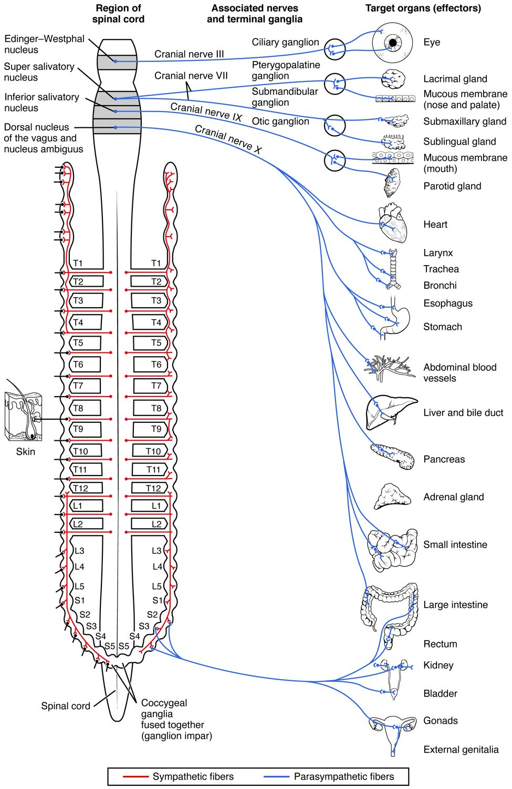
SECTION 15.1
The Parasympathetic Division
The "rest-and-digest" system
Conserves energy at rest
Slows the heart, aids digestion
Arises from cranial and sacral regions
The parasympathetic division
PN 104 · Ch 15 — The Autonomic Nervous System
5
Notes:
The parasympathetic division handles "rest-and-digest" functions, conserving energy: it slows the heart, promotes digestion, and constricts the pupils. Its neurons emerge from the brainstem (notably the vagus nerve) and the sacral cord, with ganglia near the target organs.

Slide 6
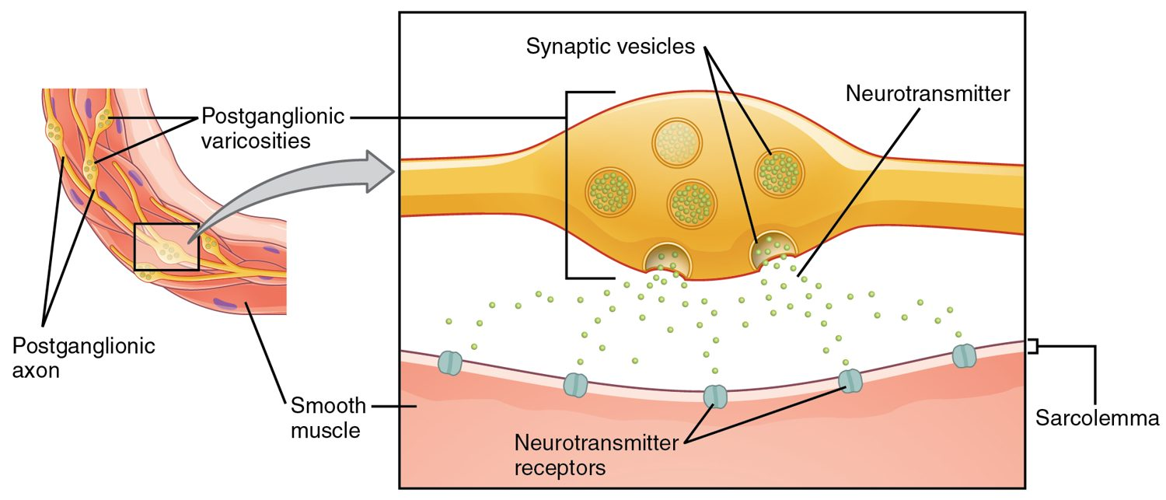
SECTION 15.1
Autonomic Neurotransmitters
Neurotransmitters of the autonomic system
A two-neuron pathway to the target
Acetylcholine and norepinephrine
Receptor type determines the effect
The basis of many drug actions
PN 104 · Ch 15 — The Autonomic Nervous System
6
Notes:
Autonomic signals pass through a two-neuron chain. All preganglionic neurons release acetylcholine; parasympathetic postganglionic neurons also use acetylcholine, while most sympathetic ones release norepinephrine. The receptor type on the target (muscarinic, nicotinic, alpha, beta) decides the response — and is the target of many medications.

Slide 7
15.2
SECTION
Autonomic Reflexes and Homeostasis
How autonomic reflexes keep internal conditions stable.

Slide 8
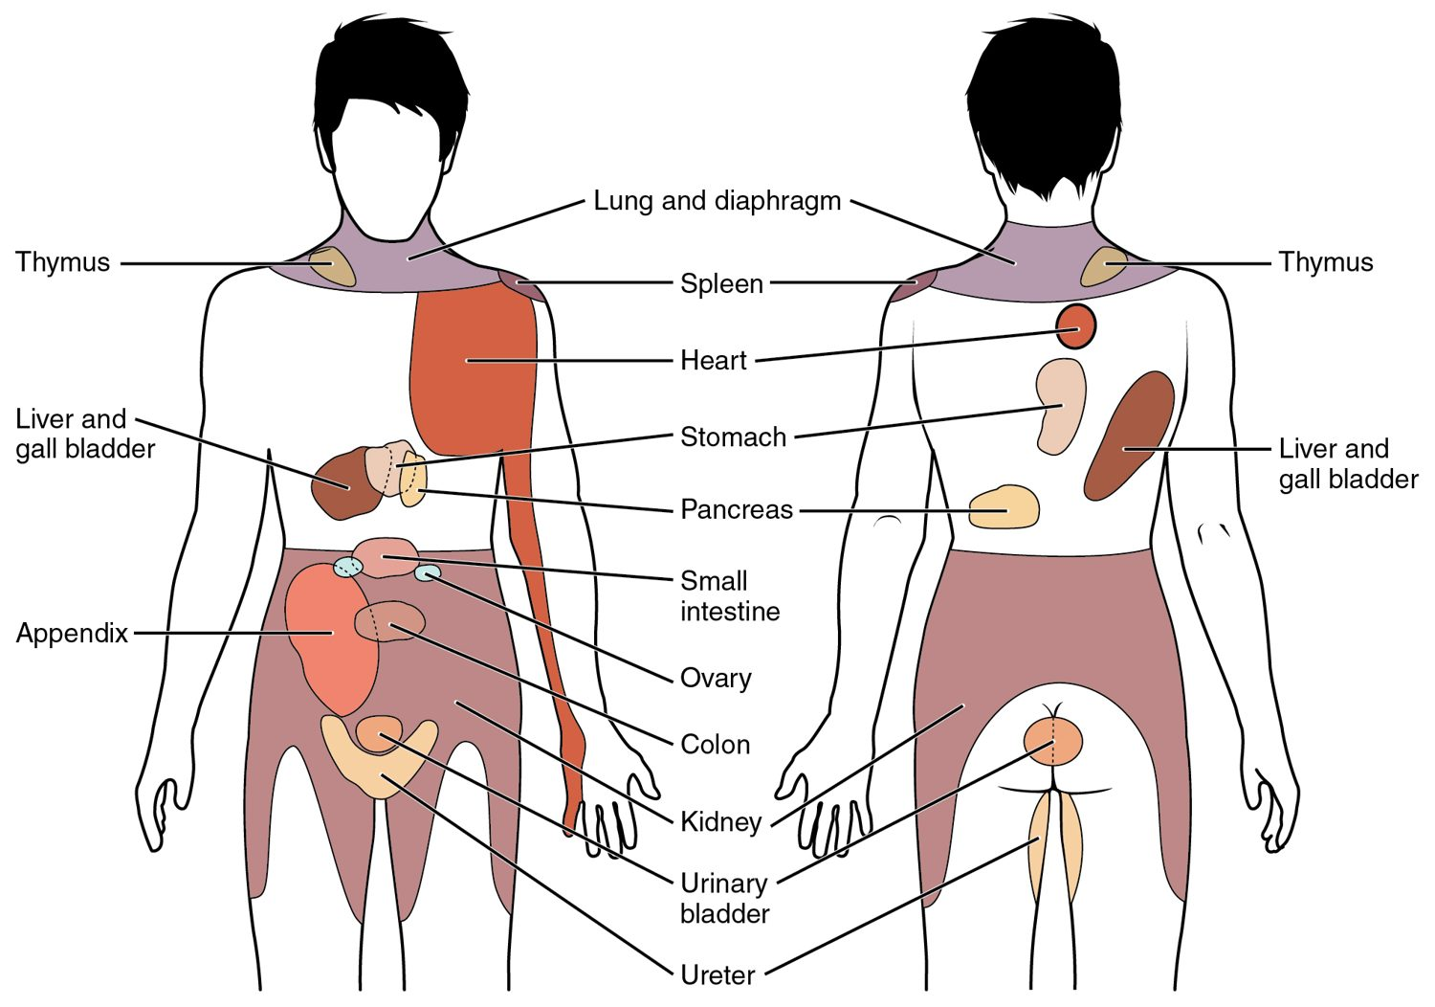
SECTION 15.2
Dual Innervation
Most organs get both divisions
The two usually oppose each other
Balance fine-tunes organ activity
Maintains homeostasis
Sympathetic and parasympathetic effects on organs
PN 104 · Ch 15 — The Autonomic Nervous System
8
Notes:
Most organs receive both sympathetic and parasympathetic input, which generally act in opposition — one speeds the heart, the other slows it. The balance between them continuously adjusts organ activity to meet the body's needs, maintaining homeostasis without conscious effort.

Slide 9
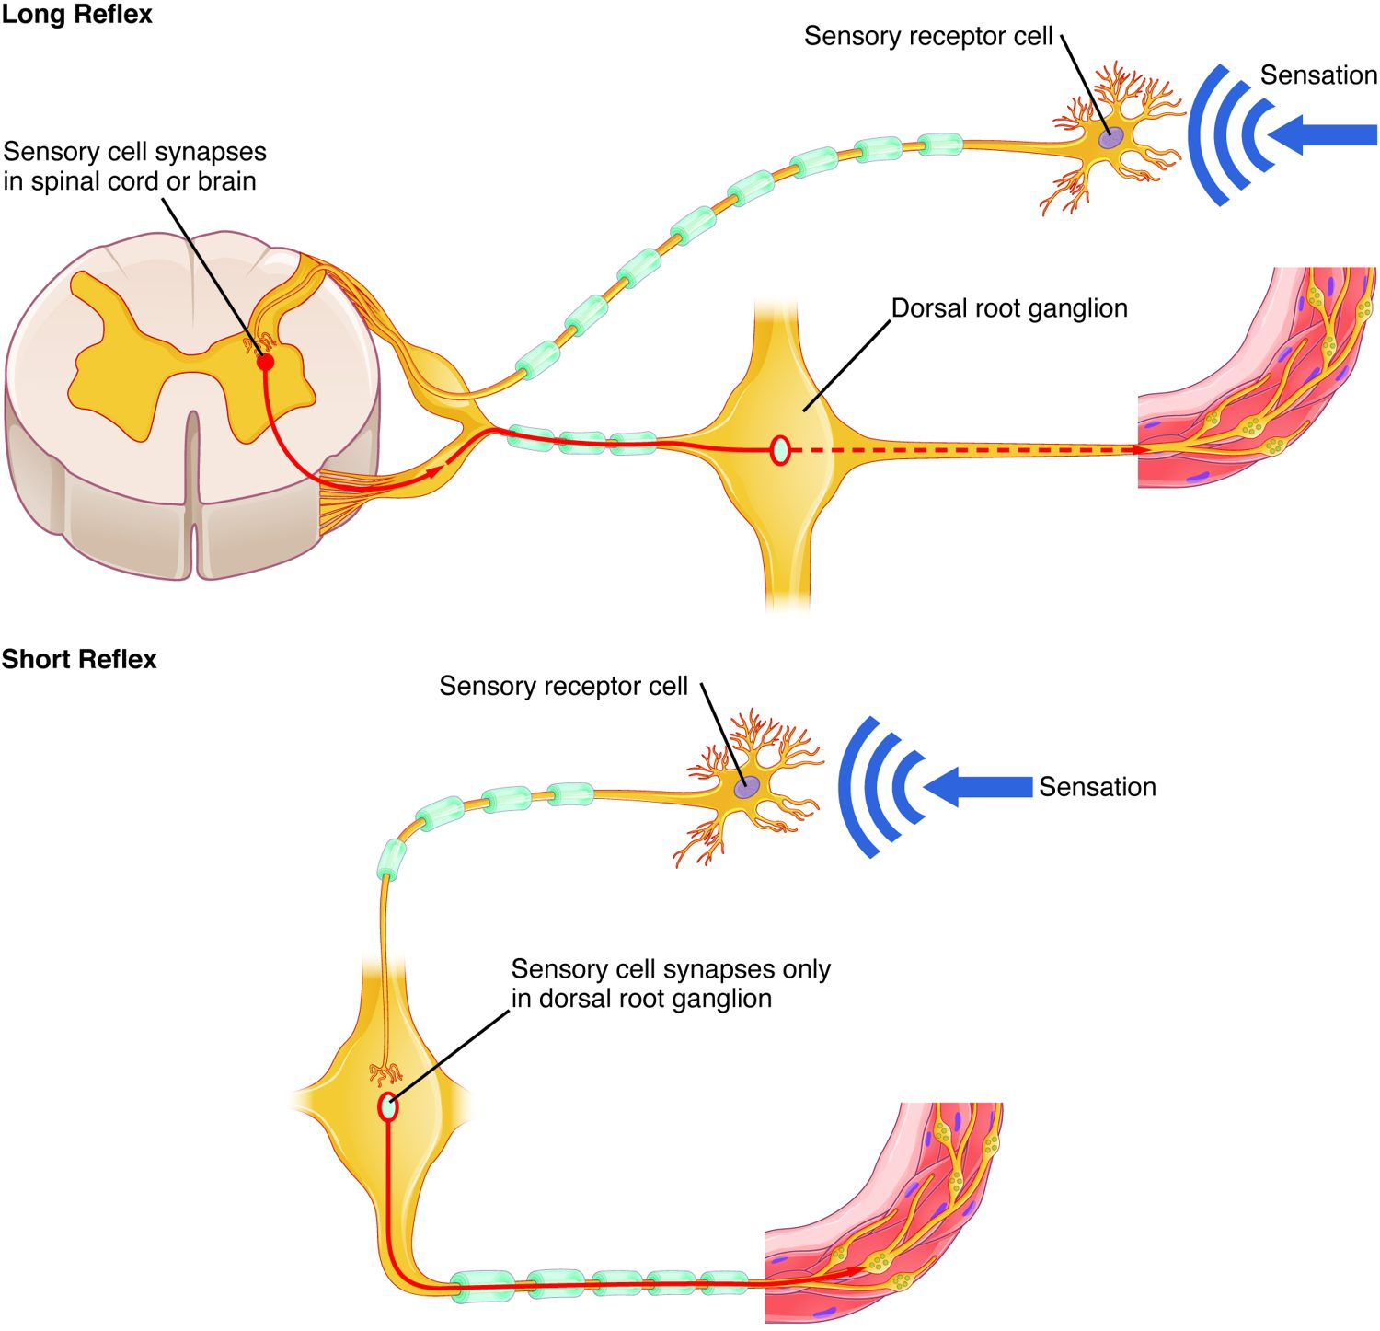
SECTION 15.2
Autonomic Reflexes
Automatic responses to stimuli
Sensory input → CNS → autonomic output
Control heart rate, BP, digestion
Operate without awareness
Long and short autonomic reflexes
PN 104 · Ch 15 — The Autonomic Nervous System
9
Notes:
Autonomic reflexes regulate internal functions automatically. Sensory signals reach the CNS (long reflexes) or local ganglia (short reflexes), triggering autonomic motor output to organs. Examples include the baroreceptor reflex that adjusts blood pressure and reflexes controlling digestion and bladder emptying.

Slide 10
15.3
SECTION
Central Control
How the brain oversees the autonomic nervous system.

Slide 11
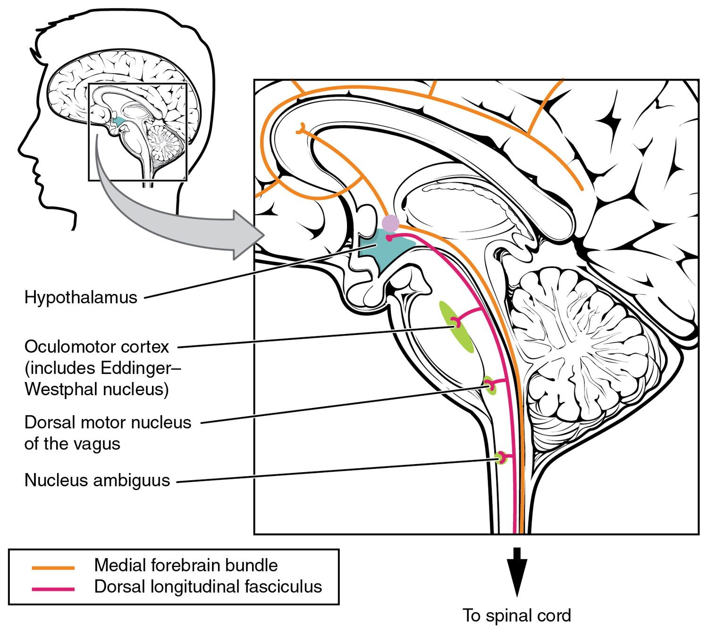
SECTION 15.3
Central Control
The hypothalamus is the main controller
Integrates autonomic and endocrine output
Brainstem centers run vital reflexes
Linked to emotion and stress
Central control of the autonomic system
PN 104 · Ch 15 — The Autonomic Nervous System
11
Notes:
The hypothalamus is the master regulator of the autonomic system, coordinating it with the endocrine system to control temperature, hunger, and the stress response. Brainstem centers run vital reflexes (heart rate, blood pressure, breathing), and connections to the limbic system link emotion to autonomic responses like blushing or a racing heart.

Slide 12
15.4
SECTION
Drugs that Affect the Autonomic System
How drugs act on the autonomic system to treat disease.

Slide 13
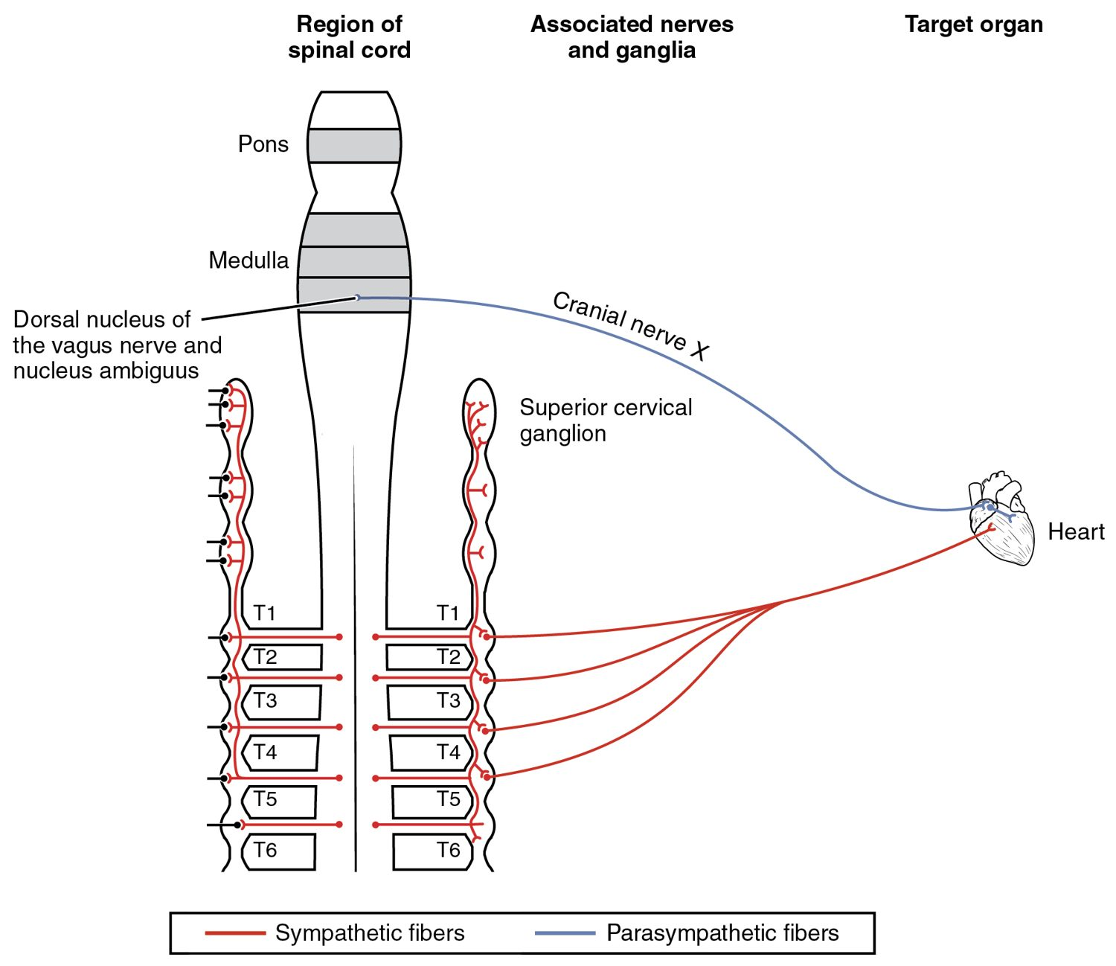
SECTION 15.4
Autonomic Drug Targets
Drugs mimic or block autonomic signals
Affect the heart, vessels, lungs, eyes
Beta-blockers slow the heart
Many common medications act here
Autonomic control of the heart — a drug target
PN 104 · Ch 15 — The Autonomic Nervous System
13
Notes:
Because the autonomic system controls so many organs, it is a major drug target. Agonists mimic and antagonists block its neurotransmitters. For example, beta-blockers slow the heart and lower blood pressure, while drugs acting on the vagus or its receptors alter heart rate — central to cardiac and many other therapies.

Slide 14
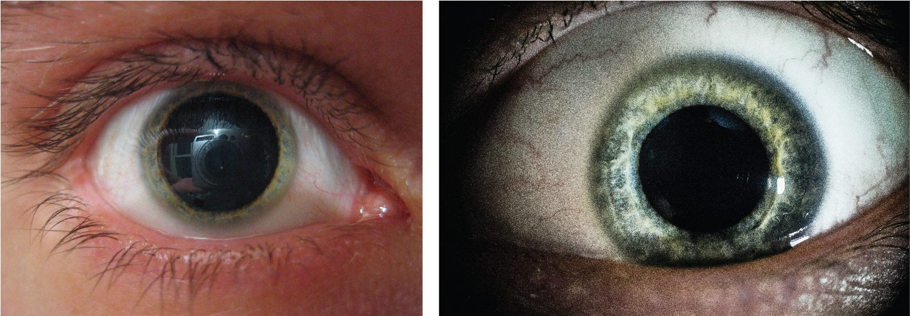
SECTION 15.4
Drug Effects on the Pupil
Autonomic drug effects on the pupil
Autonomic drugs change pupil size
Sympathetic action dilates (mydriasis)
Parasympathetic action constricts (miosis)
Used in eye exams and diagnosis
PN 104 · Ch 15 — The Autonomic Nervous System
14
Notes:
The pupil clearly shows autonomic drug effects. Sympathetic stimulation, or blocking parasympathetic input (as with atropine), dilates the pupil — mydriasis; parasympathetic stimulation constricts it — miosis. Clinicians use such drops in eye exams, and pupil size is a useful diagnostic and assessment sign.

Slide 15
CHAPTER 15
Key Takeaways
The autonomic nervous system controls involuntary functions of organs, glands, and vessels.
The sympathetic division drives "fight-or-flight"; the parasympathetic handles "rest-and-digest."
A two-neuron pathway uses acetylcholine and norepinephrine, with receptor type setting the effect.
Most organs receive both divisions, whose balance maintains homeostasis.
The hypothalamus and brainstem control the system, a major target for drugs.
PN 104 · Ch 15 — The Autonomic Nervous System
15

Slide 16
CLINICAL CONNECTIONS
Why the Autonomic System Matters in Practical Nursing
Blood Pressure
Beta-Blockers
Autonomic reflexes regulate BP and are altered by many drugs.
Block sympathetic signals to slow the heart and lower BP.
Fight-or-Flight
Pupil Assessment
The stress response explains symptoms of anxiety and shock.
Pupil size and reactivity reveal autonomic and brain function.
Bladder & Bowel
Atropine
Autonomic control underlies continence and digestion.
Blocks parasympathetic effects to speed the heart and dry secretions.

