Slide 1
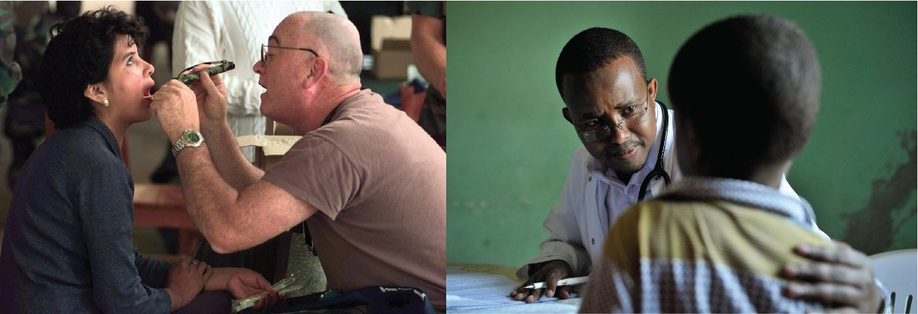
CHAPTER 16
The Neurological Exam
A structured bedside assessment of nervous system function.
Anatomy & Physiology · Broward-Miami Health Institute
FACULTY EDITION

Slide 2
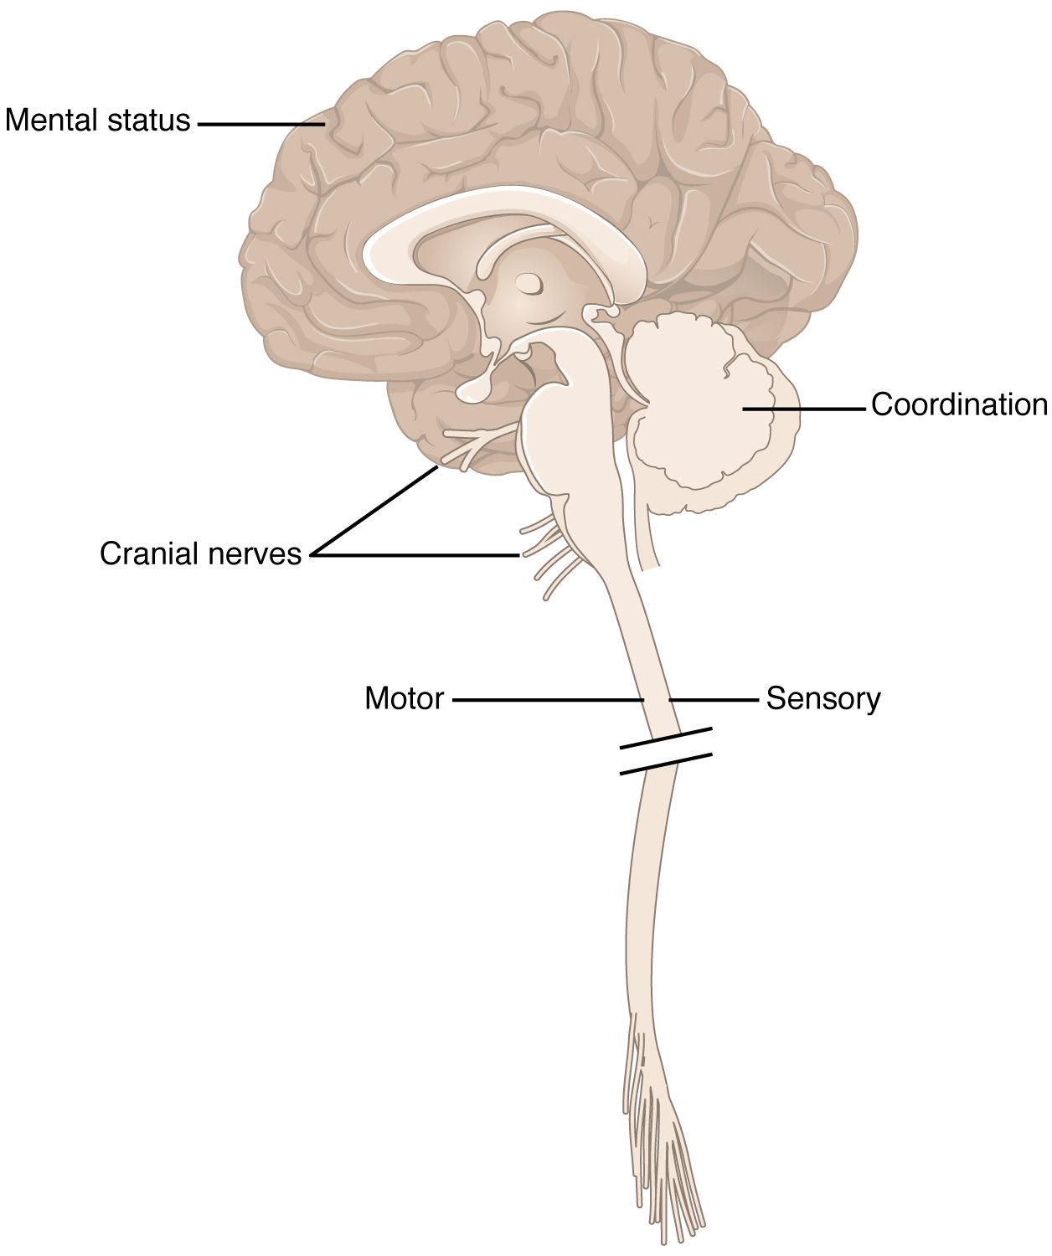
CHAPTER 16
Learning Objectives
After studying this chapter, students will be able to:
1
Describe the major sections of the neurological exam
2
Outline the benefits of rapidly assessing neurological function
3
Relate anatomical structures of the nervous system to specific functions
4
Diagram the connections of the nervous system to the musculature and integument involved in primary sensorimotor responses
The five parts of the neurological exam.
PN 104 · Ch 16 — The Neurological Exam
2
Notes:
Preview the neurological exam as a structured, localizing tool: its five components — mental status, cranial nerves, sensory, motor, and coordination/gait — each testing specific parts of the nervous system so that the pattern of findings reveals where a problem lies.

Slide 3
16.1
SECTION
Overview of the Neurological Exam
The neurological exam as a structured tool to localize problems.

Slide 4
SECTION 16.1
The Neurological Exam
A structured bedside assessment
Five major components
Each tests different brain regions
Helps localize the problem
The components of the neurological exam
PN 104 · Ch 16 — The Neurological Exam
4
Notes:
The neurological exam is a systematic way to assess nervous system function at the bedside. Its five parts — mental status, cranial nerves, sensory, motor, and coordination/gait — each test specific regions, so the pattern of findings helps localize where a problem lies, from cortex to peripheral nerve.

Slide 5
16.2
SECTION
The Mental Status Exam
Testing the higher functions of the cerebral cortex.

Slide 6
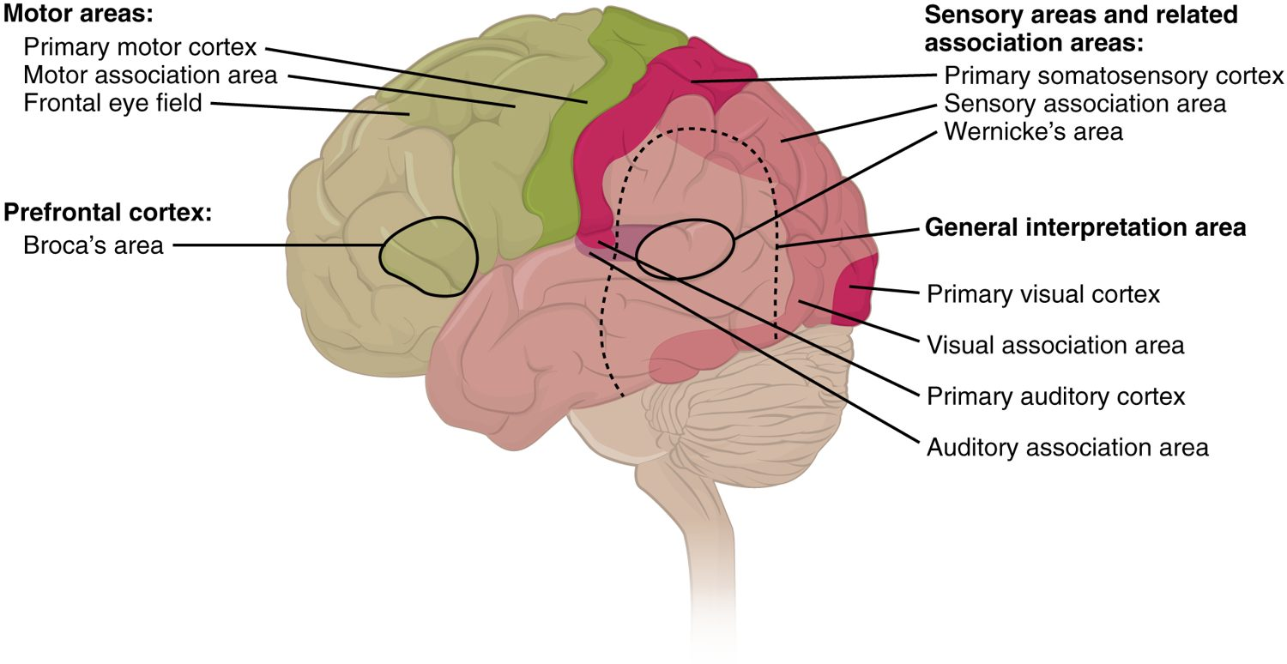
SECTION 16.2
Cortical Functional Areas
Functional areas of the cerebral cortex
The cortex has specialized regions
Motor, sensory, visual, auditory areas
Association areas integrate information
Damage gives specific deficits
PN 104 · Ch 16 — The Neurological Exam
6
Notes:
The mental status exam tests the cerebral cortex — orientation, memory, attention, and language. Different cortical regions have specialized jobs (primary motor, sensory, visual, and auditory areas, plus association areas that integrate them), so a focal deficit points to a particular area, as in stroke.

Slide 7
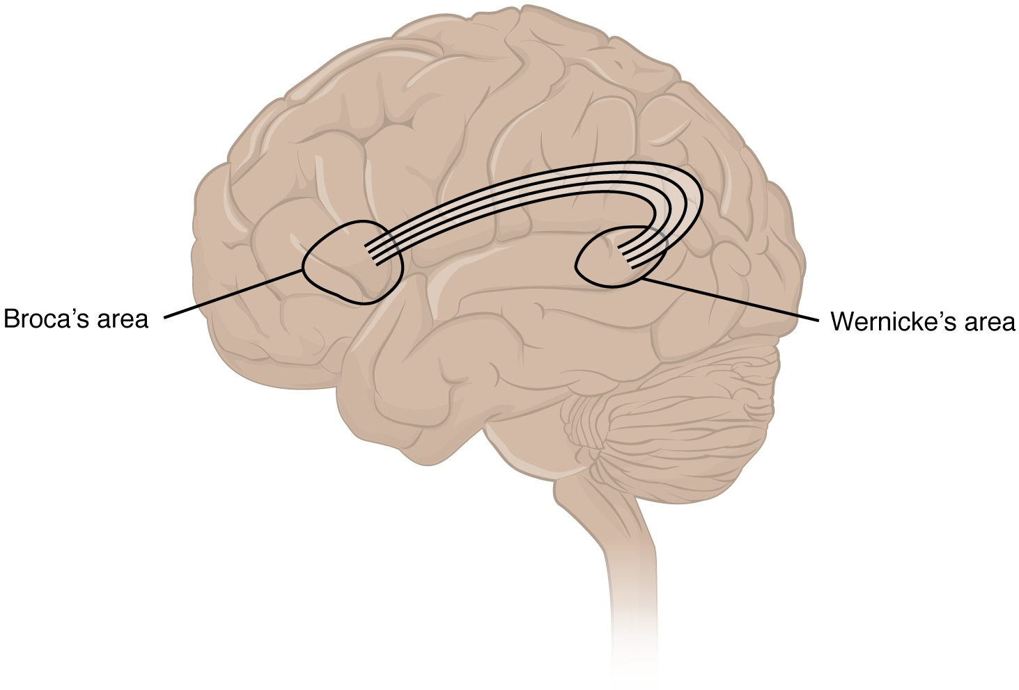
SECTION 16.2
Language Areas
Two key language centers
Broca's area — speech production
Wernicke's area — comprehension
Damage causes aphasia
Broca's and Wernicke's language areas
PN 104 · Ch 16 — The Neurological Exam
7
Notes:
Language relies on two cortical areas, usually in the left hemisphere: Broca's area (frontal) produces speech, and Wernicke's area (temporal) handles comprehension. Damage to Broca's causes halting, effortful speech; damage to Wernicke's causes fluent but nonsensical speech — together called aphasia. Assessing speech is part of every mental status exam.

Slide 8
16.3
SECTION
The Cranial Nerve Exam
Testing the twelve cranial nerves and the regions they serve.

Slide 9
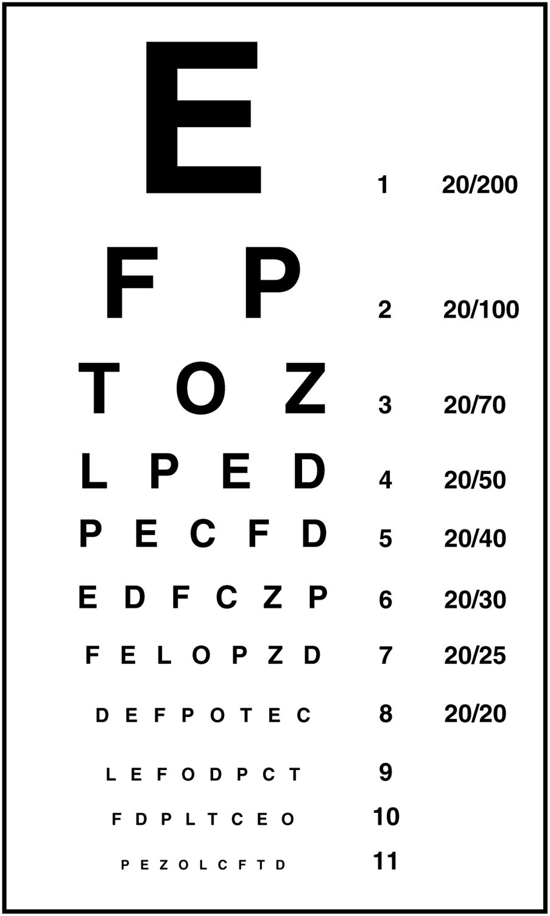
SECTION 16.3
Visual Acuity — CN II
The Snellen chart tests vision
Checks the optic nerve (CN II)
Each eye is tested separately
Part of cranial nerve testing
The Snellen eye chart
PN 104 · Ch 16 — The Neurological Exam
9
Notes:
The cranial nerve exam tests each of the twelve nerves. Visual acuity, checked with a Snellen chart one eye at a time, assesses the optic nerve (CN II) and the visual pathway. Reduced acuity or visual-field loss can localize problems from the eye to the visual cortex.

Slide 10
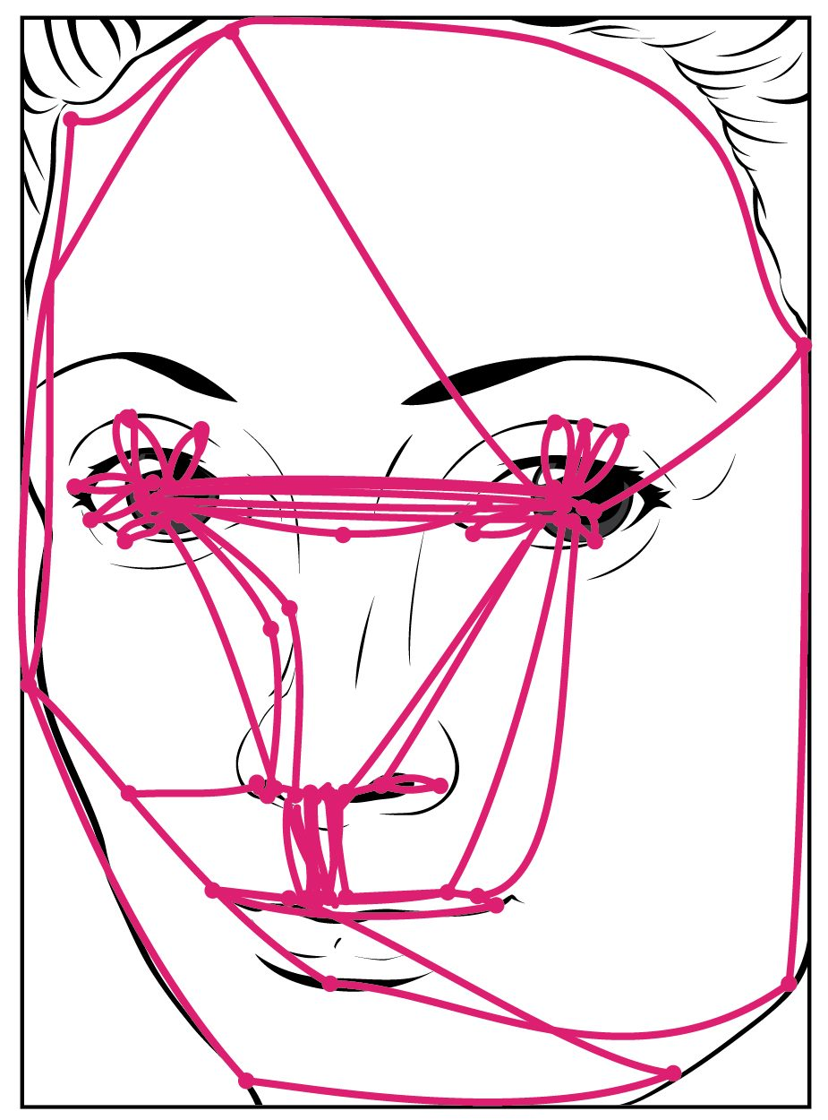
SECTION 16.3
Facial Nerve — CN VII
Tests the facial expression muscles
The facial nerve (CN VII)
Ask the patient to smile and frown
Weakness localizes the lesion
Testing the muscles of facial expression
PN 104 · Ch 16 — The Neurological Exam
10
Notes:
The facial nerve (CN VII) controls the muscles of facial expression. Asking the patient to smile, raise the eyebrows, and puff the cheeks reveals weakness. The pattern — whether the forehead is spared — distinguishes a central lesion (like a stroke) from a peripheral one (like Bell's palsy).

Slide 11
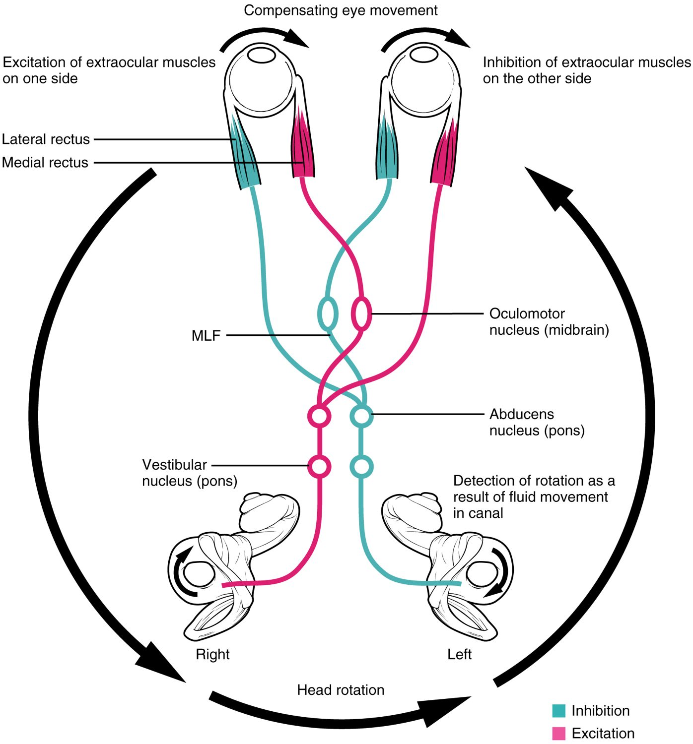
SECTION 16.3
Eye Movements — CN III, IV, VI
Three nerves move the eyes
Oculomotor, trochlear, abducens
Follow a target in all directions
Detects palsies and gaze problems
Control of eye movements
PN 104 · Ch 16 — The Neurological Exam
11
Notes:
Three cranial nerves move the eyes — oculomotor (III), trochlear (IV), and abducens (VI). Having the patient follow a finger through the directions of gaze tests them together, revealing nerve palsies, double vision, or abnormal eye alignment. The oculomotor nerve also controls the pupil and eyelid.

Slide 12
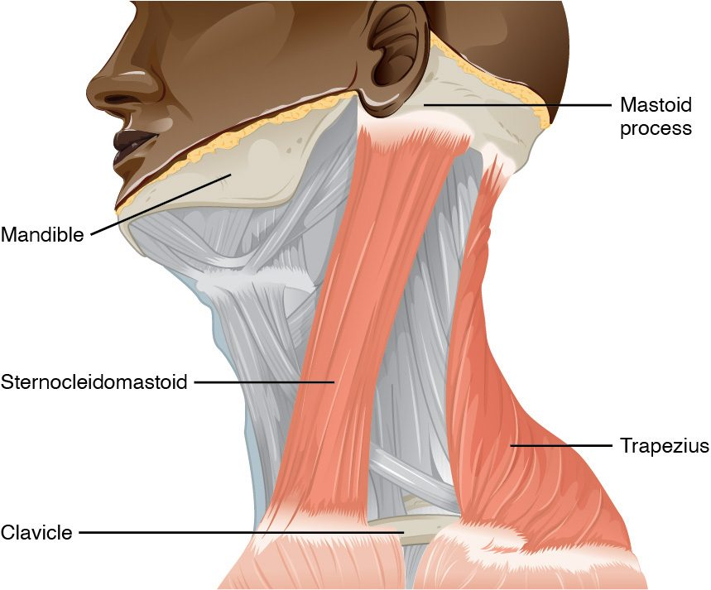
SECTION 16.3
Accessory Nerve — CN XI
Tests neck and shoulder muscles
The accessory nerve (CN XI)
Sternocleidomastoid and trapezius
Shrug and turn-head movements
The sternocleidomastoid and trapezius (CN XI)
PN 104 · Ch 16 — The Neurological Exam
12
Notes:
The accessory nerve (CN XI) supplies the sternocleidomastoid and trapezius muscles. Testing it — asking the patient to shrug the shoulders against resistance and turn the head — checks these muscles and the nerve, completing part of the cranial nerve survey.

Slide 13
16.4
SECTION
The Sensory and Motor Exams
Testing sensation and voluntary movement throughout the body.

Slide 14
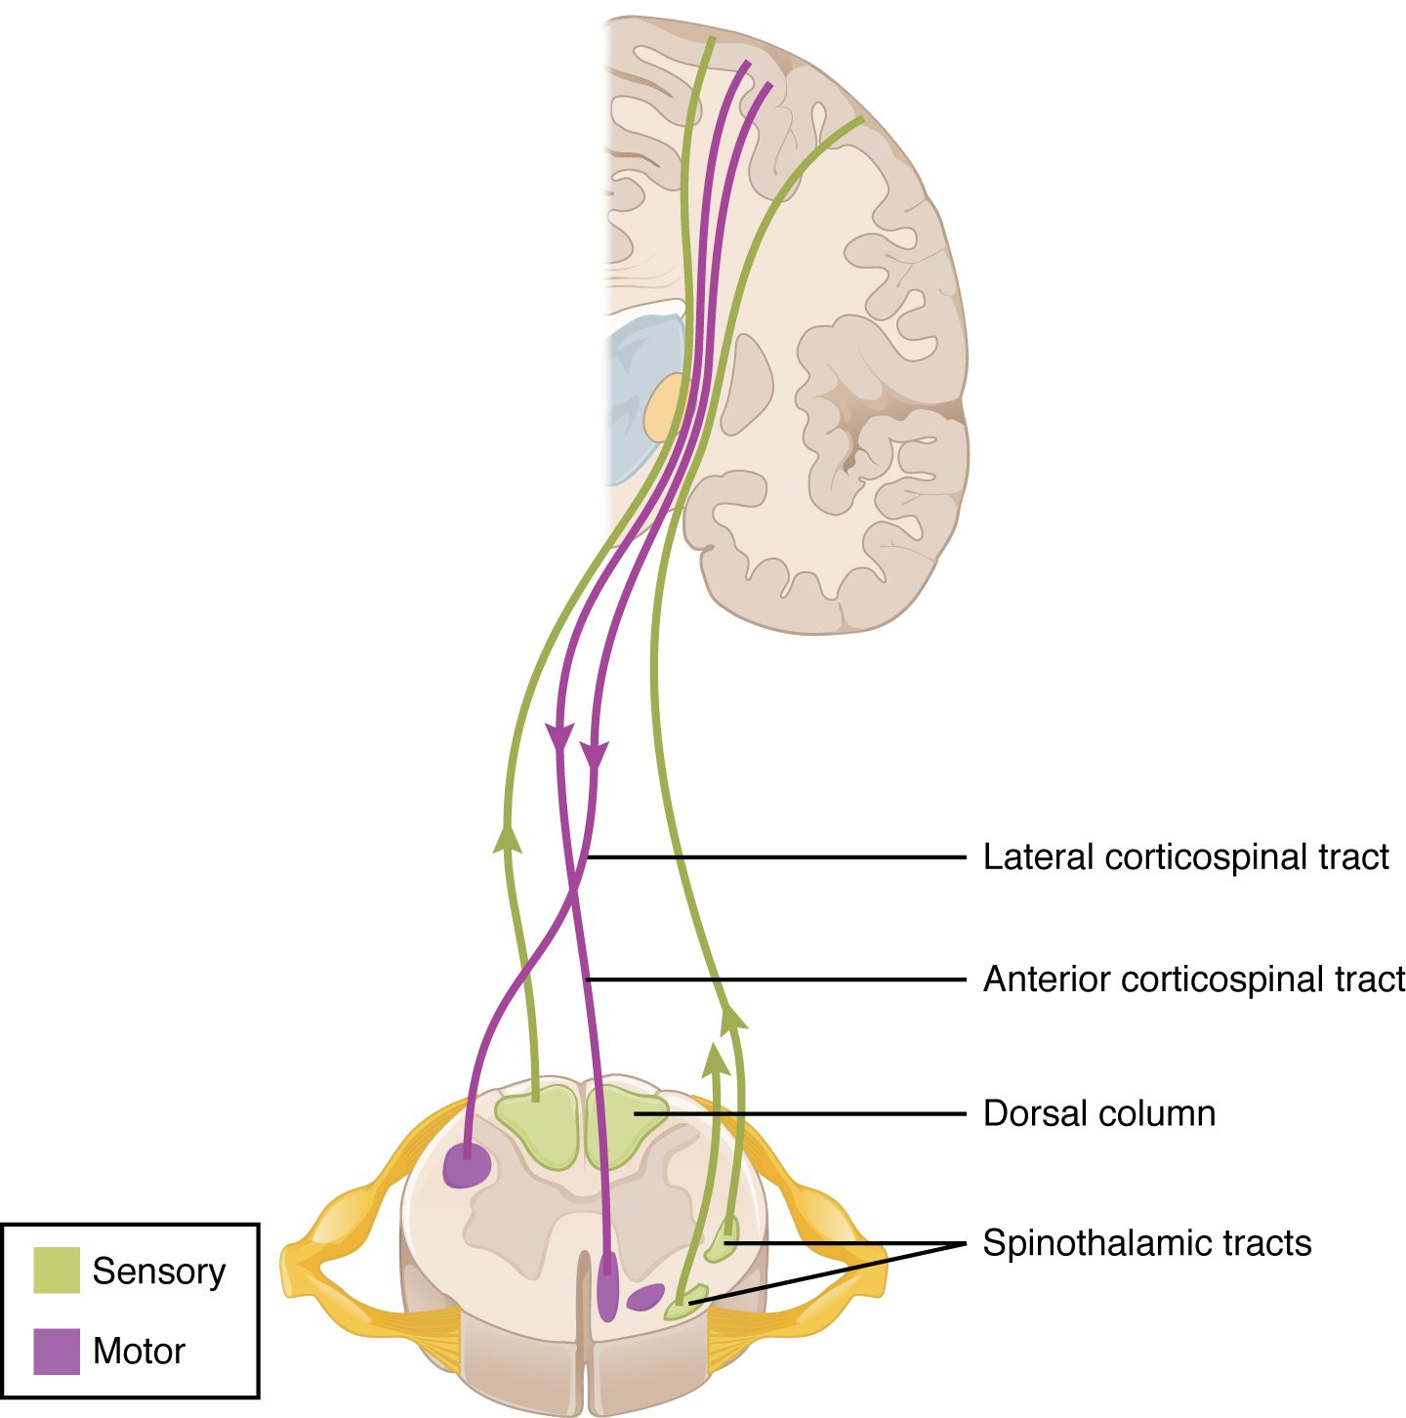
SECTION 16.4
Sensory & Motor Tracts
Distinct pathways in the spinal cord
Dorsal column — fine touch, position
Spinothalamic — pain and temperature
Corticospinal — voluntary movement
Sensory and motor tracts of the spinal cord
PN 104 · Ch 16 — The Neurological Exam
14
Notes:
The sensory and motor exams test the spinal cord pathways. The dorsal columns carry fine touch and position sense, the spinothalamic tracts carry pain and temperature, and the corticospinal tracts carry voluntary motor commands. Testing each separately, on both sides, localizes where the cord or nerve is damaged.

Slide 15
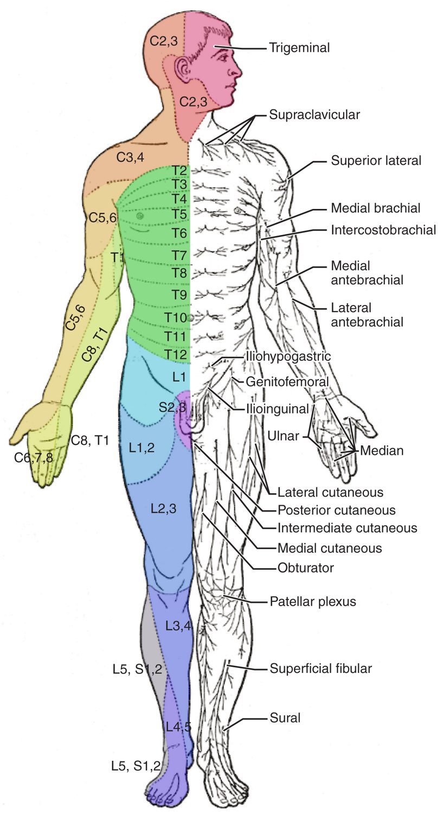
SECTION 16.4
Dermatomes
Each spinal nerve maps to a skin area
These areas are called dermatomes
Testing them localizes nerve damage
Guides the level of spinal injury
The dermatome map
PN 104 · Ch 16 — The Neurological Exam
15
Notes:
Each spinal nerve supplies sensation to a specific strip of skin — a dermatome. Mapping where sensation is lost pinpoints which spinal nerve or cord level is affected, essential for localizing spinal cord injuries and conditions like shingles, which follows a single dermatome.

Slide 16
16.5
SECTION
The Coordination and Gait Exams
Testing the cerebellum through coordination and gait.

Slide 17
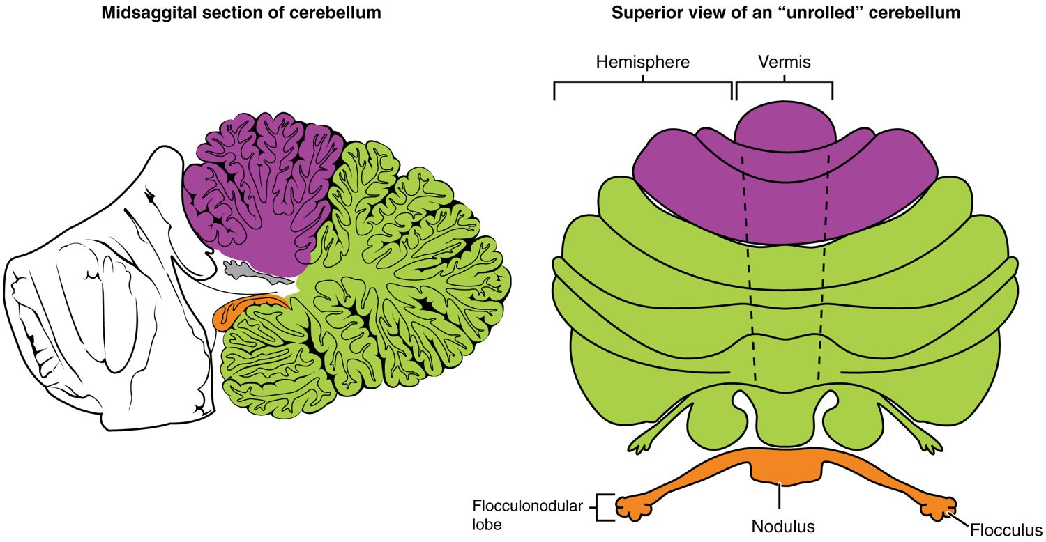
SECTION 16.5
The Cerebellum
The cerebellum and coordination
Coordinates movement and balance
Tested by coordination and gait
Finger-to-nose, heel-to-shin
Damage causes ataxia
PN 104 · Ch 16 — The Neurological Exam
17
Notes:
The coordination and gait exam assesses the cerebellum. Tests like finger-to-nose, rapid alternating movements, and watching the patient walk reveal cerebellar function. Damage produces ataxia — uncoordinated, clumsy movements and an unsteady, wide-based gait — seen in cerebellar stroke and alcohol intoxication.

Slide 18
CHAPTER 16
Key Takeaways
The neurological exam has five parts that together localize nervous system problems.
The mental status exam tests cortical functions, including memory and language.
The cranial nerve exam checks the twelve nerves serving the head and neck.
The sensory and motor exams test spinal cord pathways and dermatomes.
The coordination and gait exam assesses the cerebellum.
PN 104 · Ch 16 — The Neurological Exam
18

Slide 19
CLINICAL CONNECTIONS
Why the Neurological Exam Matters in Practical Nursing
Stroke Assessment
Aphasia
Rapid neuro exam findings localize damage and guide treatment.
Speech changes point to specific language-area damage.
Bell's Palsy
Dermatome Mapping
Facial weakness sparing the forehead suggests a peripheral cause.
Sensory loss localizes spinal nerve or cord injury.
Ataxia
Baseline Exams
Incoordination and unsteady gait suggest cerebellar problems.
Serial neuro checks detect changes early in patient care.

