Slide 1

CHAPTER 17
The Endocrine System
Chemical control of the body through hormones.
Anatomy & Physiology · Broward-Miami Health Institute
FACULTY EDITION

Slide 2
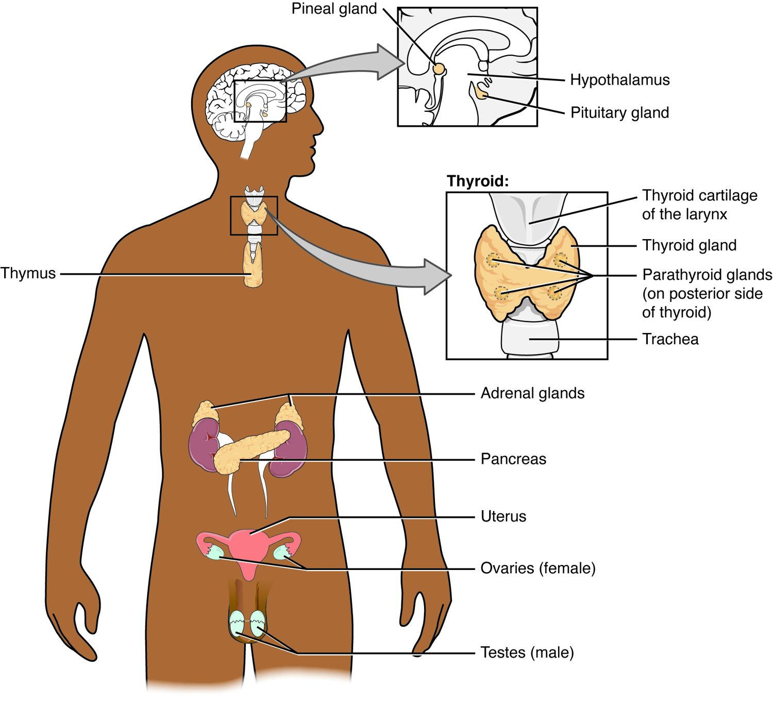
CHAPTER 17
Learning Objectives
After studying this chapter, students will be able to:
1
Identify the contributions of the endocrine system to homeostasis
2
Discuss the chemical composition of hormones and the mechanisms of hormone action
3
Discuss the hormonal regulation of the reproductive system
4
Explain the role of the pancreatic endocrine cells in the regulation of blood glucose
5
Identify the hormones released by the heart, kidneys, and other organs with secondary endocrine functions
6
Discuss several common diseases associated with endocrine system dysfunction
The major endocrine glands of the body.
PN 104 · Ch 17 — The Endocrine System
2
Notes:
Preview the endocrine system: glands that release hormones into the blood to control metabolism, growth, and balance; how hormones act on target cells; negative feedback; and the major glands — pituitary, thyroid, parathyroids, and pancreas — most important in nursing care.

Slide 3
17.1
SECTION
An Overview of the Endocrine System
The endocrine system — chemical control through hormones.

Slide 4
SECTION 17.1
The Endocrine Glands
Glands secrete hormones into the blood
Hormones travel to distant targets
Control slow, widespread processes
Work alongside the nervous system
The major endocrine glands
PN 104 · Ch 17 — The Endocrine System
4
Notes:
The endocrine system controls the body chemically. Glands — pituitary, thyroid, parathyroids, adrenals, pancreas, pineal, and gonads — secrete hormones into the bloodstream that travel to distant target cells. Compared with the fast nervous system, endocrine control is slower but longer-lasting, governing metabolism, growth, reproduction, and balance.

Slide 5
17.2
SECTION
Hormones
What hormones are and how they act on target cells.

Slide 6
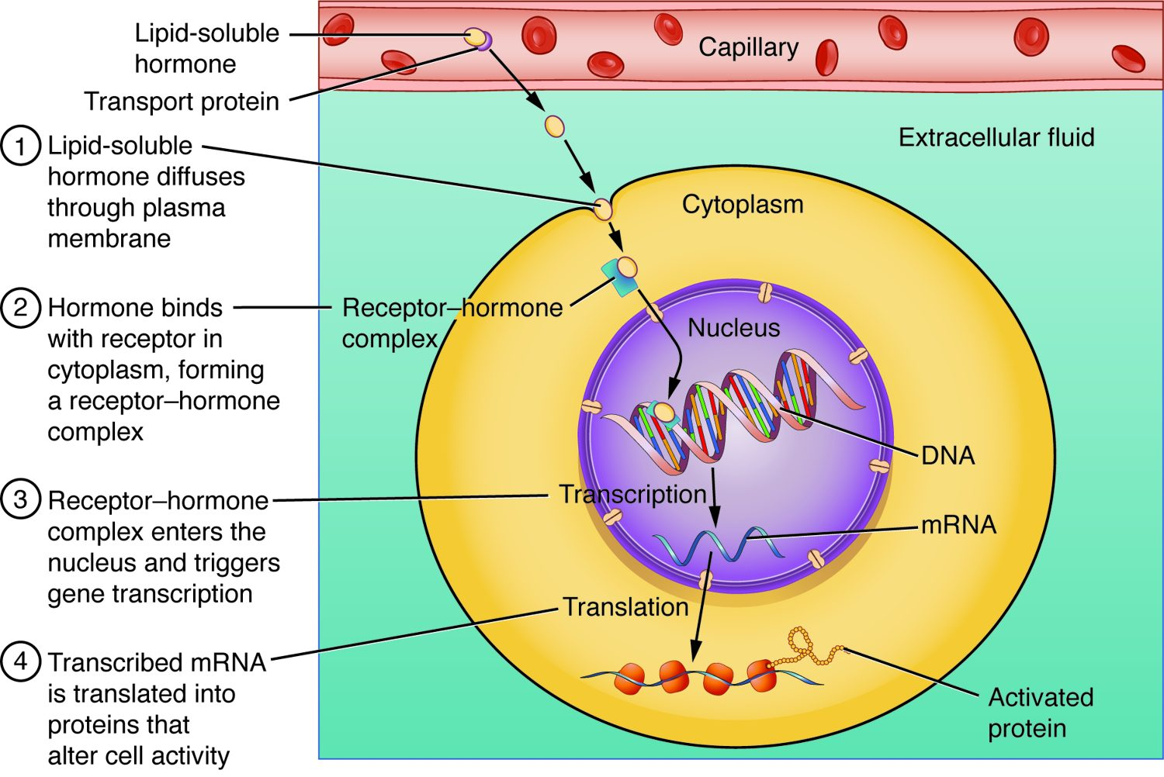
SECTION 17.2
Steroid Hormone Action
Lipid-soluble hormones enter the cell
They pass through the membrane
Bind receptors inside
Switch genes on or off
How a lipid-soluble (steroid) hormone acts
PN 104 · Ch 17 — The Endocrine System
6
Notes:
Lipid-soluble hormones (steroids like cortisol and the sex hormones, plus thyroid hormone) cross the cell membrane and bind receptors inside the cell. The hormone-receptor complex acts on DNA to turn genes on or off, changing which proteins the cell makes. Effects are slower but longer-lasting.

Slide 7
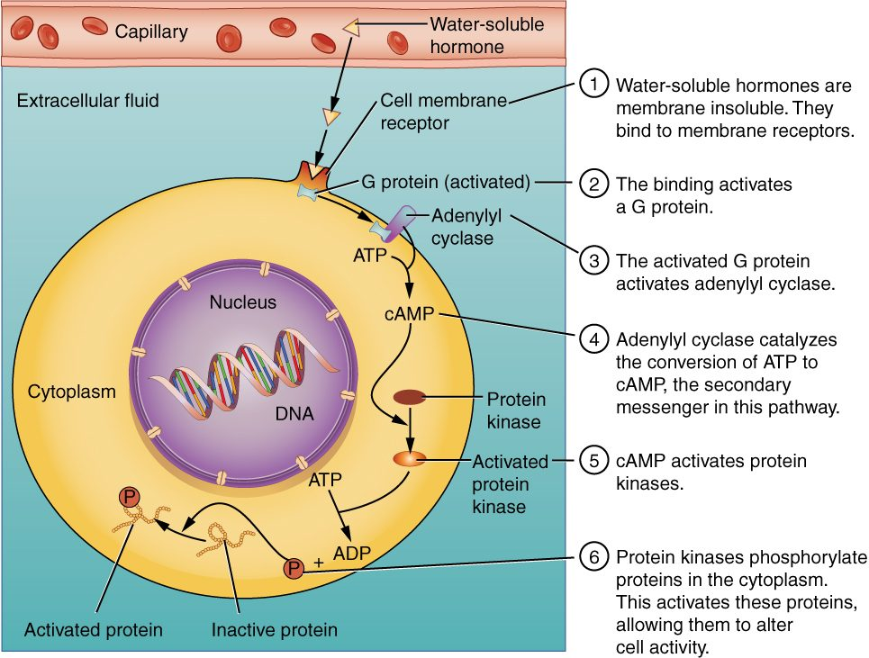
SECTION 17.2
Water-Soluble Hormone Action
Water-soluble hormones can't enter the cell
They bind receptors on the surface
Trigger a second messenger (cAMP)
Produce rapid responses
How a water-soluble hormone acts
PN 104 · Ch 17 — The Endocrine System
7
Notes:
Water-soluble hormones (most, like peptide hormones and epinephrine) cannot cross the membrane, so they bind surface receptors and trigger an internal "second messenger" such as cAMP. This relays the signal inside, activating enzymes for a fast response — the basis of how many hormones and drugs work.

Slide 8
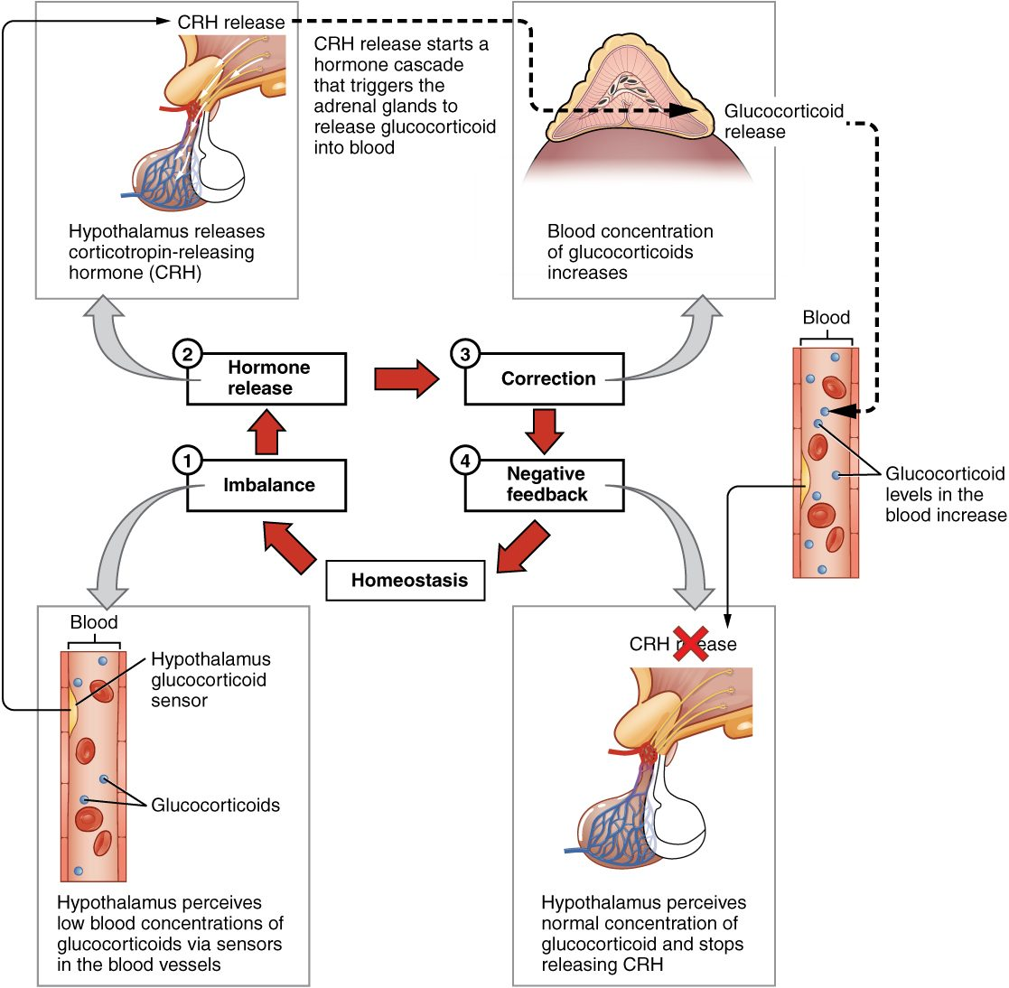
SECTION 17.2
Negative Feedback
Most hormones are feedback-controlled
A change triggers a correcting response
The response shuts off the signal
Keeps levels in a stable range
Negative feedback control of hormones
PN 104 · Ch 17 — The Endocrine System
8
Notes:
Hormone levels are kept stable mainly by negative feedback: a hormone produces an effect that, once sufficient, signals the gland to stop releasing it — like a thermostat. This loop (seen in the hypothalamus-pituitary-adrenal axis for cortisol) keeps hormones in a healthy range and is disrupted in many endocrine disorders.

Slide 9
17.3
SECTION
The Pituitary Gland and Hypothalamus
The pituitary and hypothalamus — the hormonal command center.

Slide 10
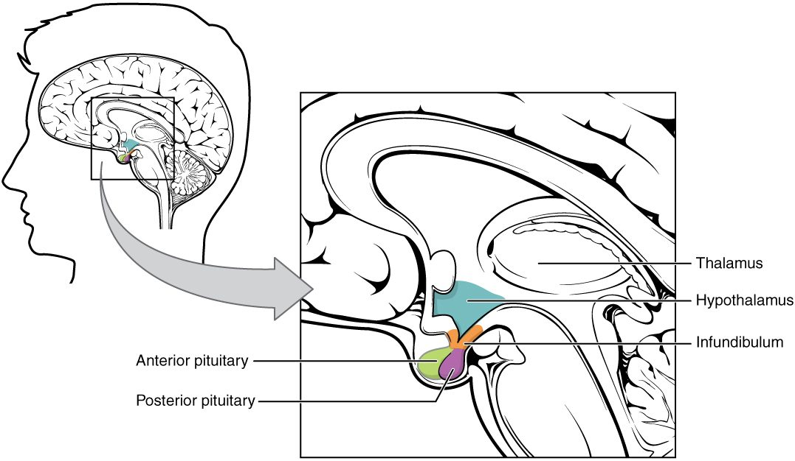
SECTION 17.3
The Pituitary Gland
The pituitary gland and hypothalamus
Sits beneath the hypothalamus
Has anterior and posterior lobes
Controlled by the hypothalamus
Often called the "master gland"
PN 104 · Ch 17 — The Endocrine System
10
Notes:
The pituitary gland hangs below the hypothalamus, which controls it. The posterior lobe stores and releases hypothalamic hormones (ADH and oxytocin), while the anterior lobe makes its own hormones under hypothalamic command. Because it directs several other glands, the pituitary is often called the "master gland."

Slide 11
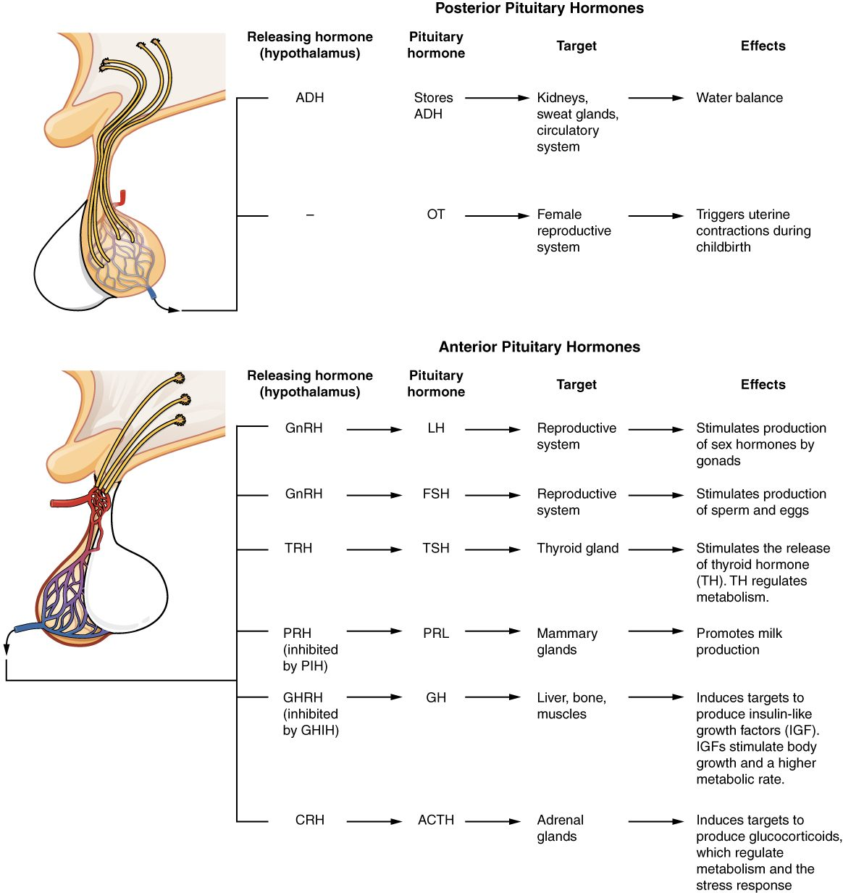
SECTION 17.3
Pituitary Hormones
Anterior lobe makes tropic hormones
Control the thyroid, adrenals, and gonads
Plus growth hormone and prolactin
Posterior releases ADH and oxytocin
Pituitary hormones and their targets
PN 104 · Ch 17 — The Endocrine System
11
Notes:
The anterior pituitary secretes growth hormone, prolactin, and tropic hormones (TSH, ACTH, FSH, LH) that command the thyroid, adrenal cortex, and gonads. The posterior pituitary releases ADH (water balance) and oxytocin (labor and milk release). Together they regulate growth, metabolism, stress, reproduction, and fluid balance.

Slide 12
17.4
SECTION
The Thyroid Gland
The thyroid gland and its role in metabolism.

Slide 13
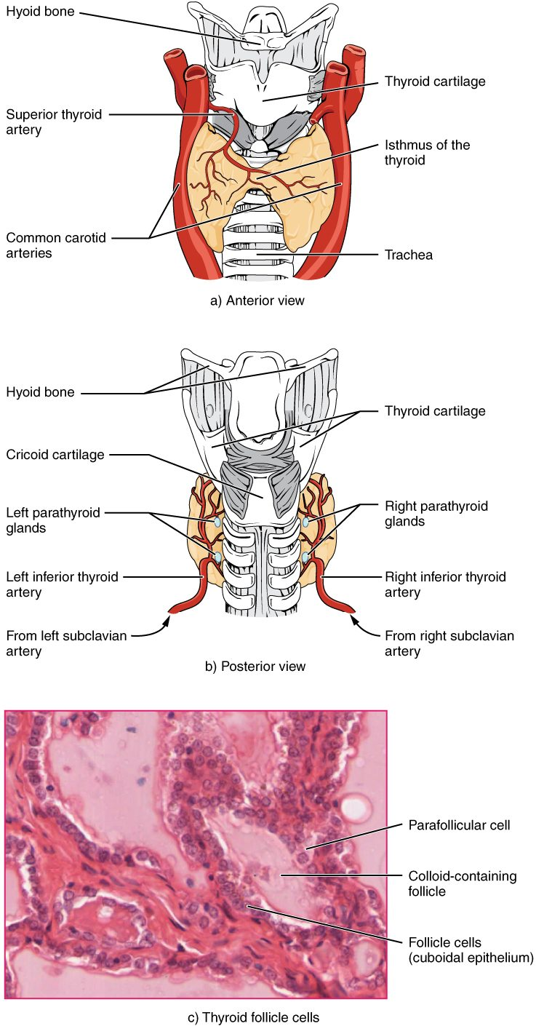
SECTION 17.4
The Thyroid Gland
Located in the front of the neck
Wraps around the trachea
Makes thyroid hormone (T3, T4)
Requires iodine
The thyroid gland
PN 104 · Ch 17 — The Endocrine System
13
Notes:
The thyroid gland sits in the front of the neck, wrapped around the trachea below the larynx. Its follicles make thyroid hormones (T3 and T4) from iodine and tyrosine. These hormones set the body's metabolic rate, affecting nearly every tissue. It also makes calcitonin, which lowers blood calcium.

Slide 14
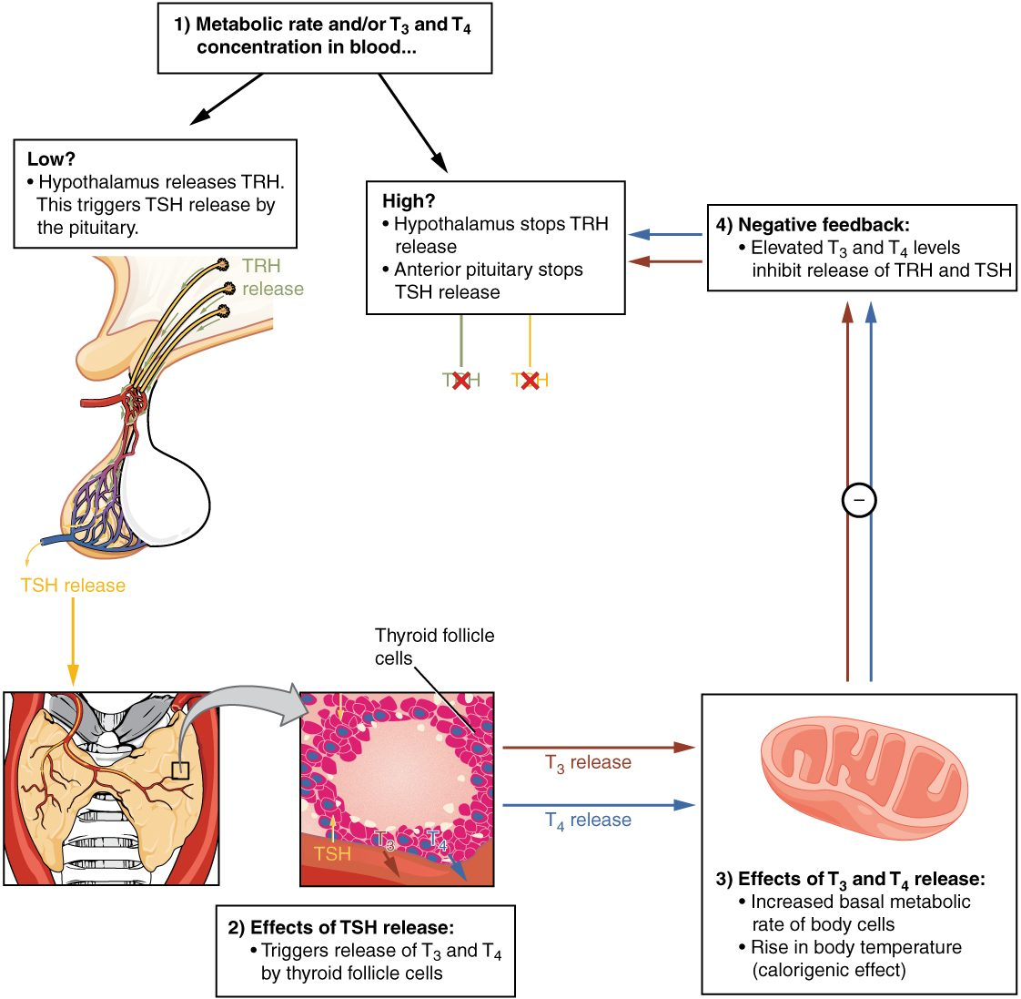
SECTION 17.4
Thyroid Function & Feedback
TSH from the pituitary drives it
T3 and T4 raise metabolic rate
Feedback keeps levels balanced
Imbalance causes disease
Control of thyroid hormone
PN 104 · Ch 17 — The Endocrine System
14
Notes:
The hypothalamus and pituitary control the thyroid: TSH stimulates T3/T4 release, which then feeds back to limit further TSH — classic negative feedback. Too much hormone (hyperthyroidism) speeds metabolism; too little (hypothyroidism) slows it, causing fatigue, weight gain, and cold intolerance.

Slide 15
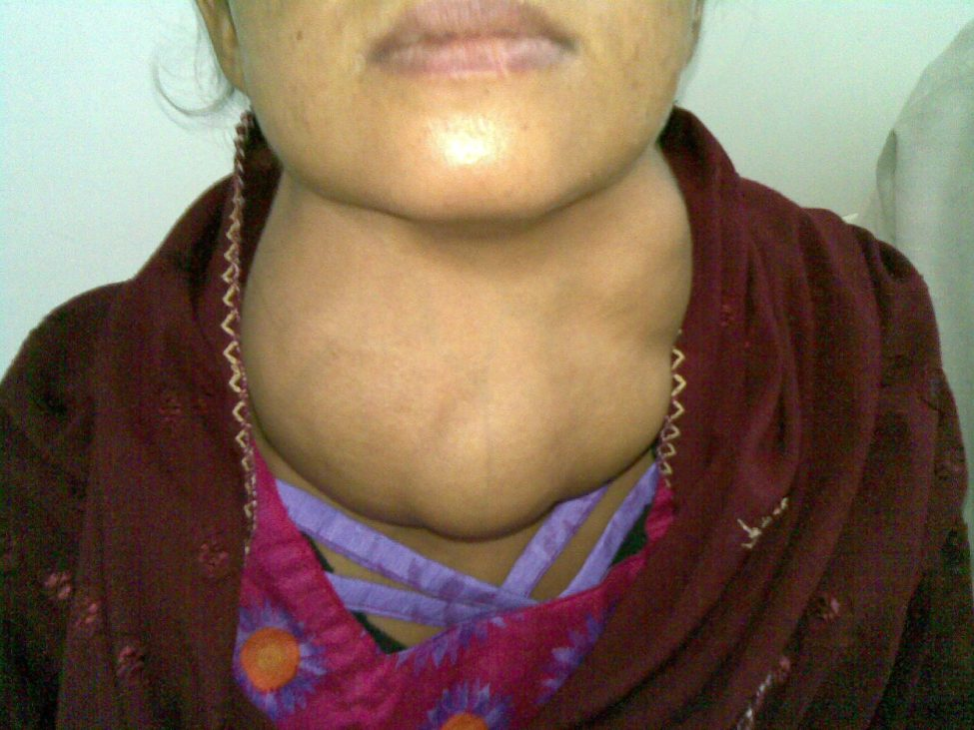
SECTION 17.4
Goiter
An enlarged thyroid gland
Often from iodine deficiency
Can occur with over- or underactivity
A visible neck swelling
Goiter (enlarged thyroid)
PN 104 · Ch 17 — The Endocrine System
15
Notes:
A goiter is an enlarged thyroid, classically from iodine deficiency but also seen in both hyper- and hypothyroidism. It appears as a swelling in the neck. Iodized salt has made deficiency goiter rare in many places, but thyroid disorders remain very common, especially in women.

Slide 16
17.5
SECTION
The Parathyroid Glands
The parathyroid glands and calcium balance.

Slide 17
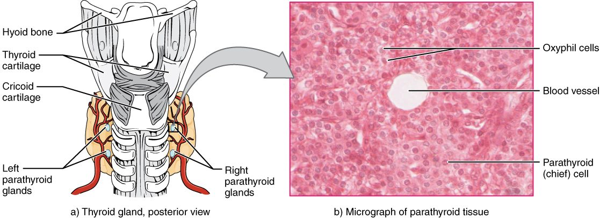
SECTION 17.5
The Parathyroid Glands
The parathyroid glands
Four small glands behind the thyroid
Make parathyroid hormone (PTH)
Tiny but essential
Regulate blood calcium
PN 104 · Ch 17 — The Endocrine System
17
Notes:
Four small parathyroid glands sit on the back of the thyroid. They secrete parathyroid hormone (PTH), the main regulator of blood calcium. Despite their size, they are vital — and may be accidentally damaged in thyroid surgery, causing dangerous calcium drops.

Slide 18
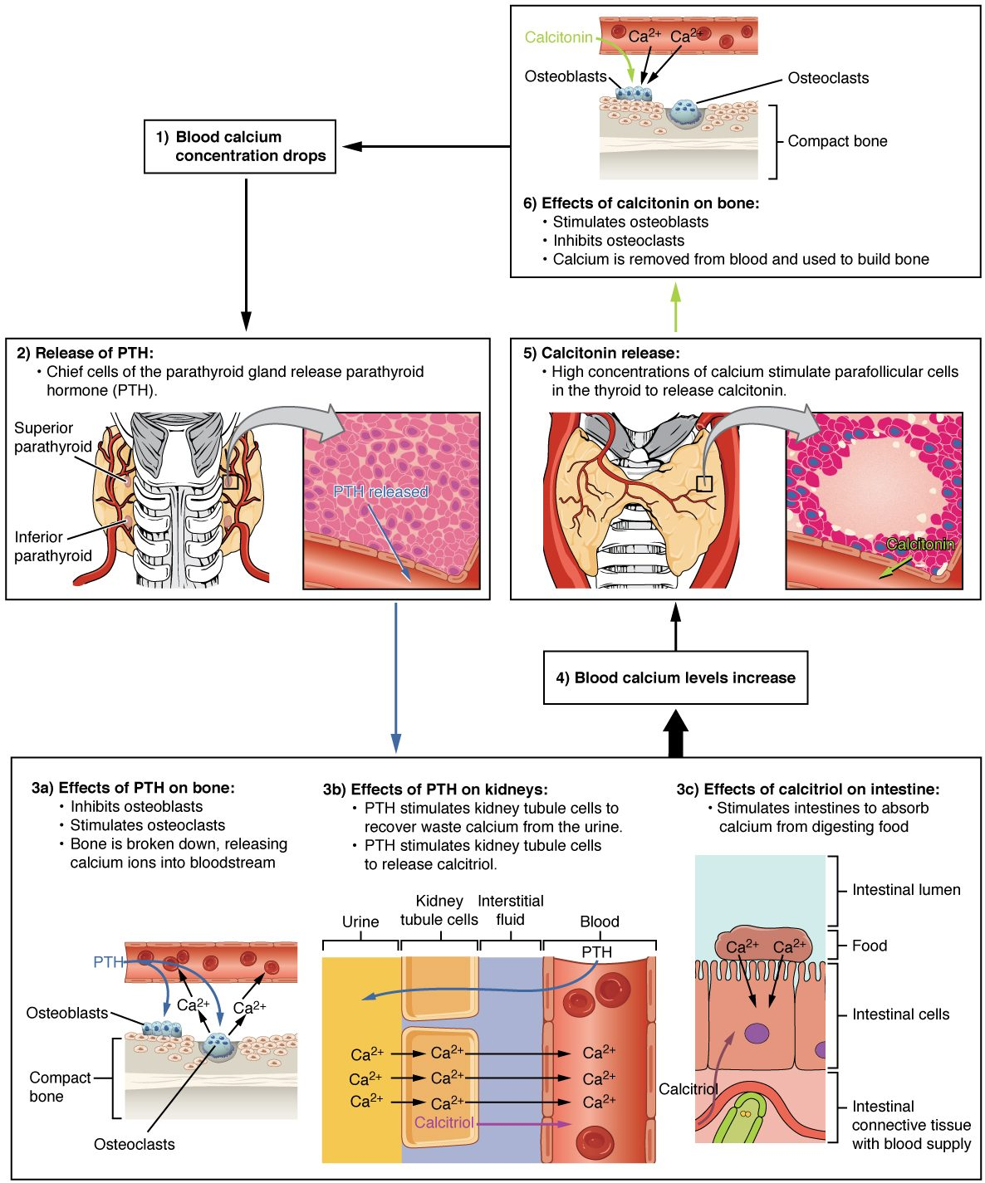
SECTION 17.5
Calcium Regulation
PTH raises blood calcium
Acts on bone, kidney, and intestine
Calcitonin lowers calcium
Balance is tightly controlled
Hormonal control of blood calcium
PN 104 · Ch 17 — The Endocrine System
18
Notes:
When blood calcium falls, PTH raises it by releasing calcium from bone, conserving it in the kidney, and (with vitamin D) increasing intestinal absorption; calcitonin from the thyroid lowers high calcium. This tight balance is essential because calcium controls nerve, muscle, and clotting function.

Slide 19
17.9
SECTION
The Endocrine Pancreas
The pancreas and the control of blood sugar.

Slide 20
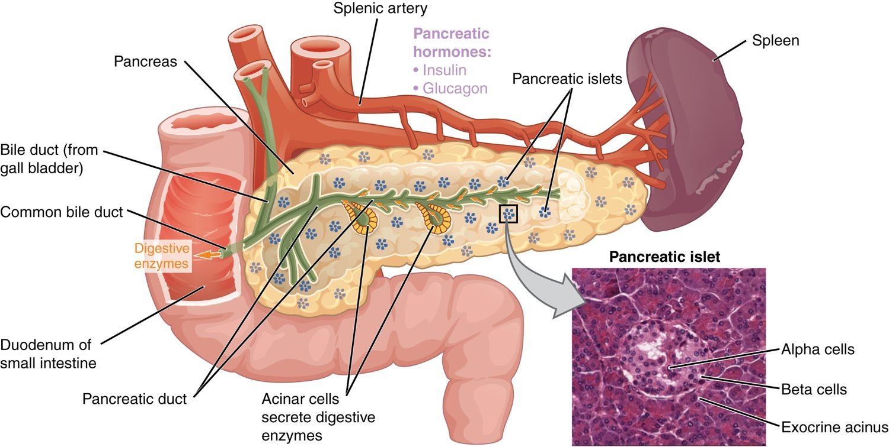
SECTION 17.9
The Endocrine Pancreas
The endocrine pancreas and its islets
Islets scattered in the pancreas
Alpha cells make glucagon
Beta cells make insulin
Both regulate blood glucose
PN 104 · Ch 17 — The Endocrine System
20
Notes:
Within the pancreas, clusters called pancreatic islets carry out its endocrine role. Alpha cells secrete glucagon (which raises blood glucose) and beta cells secrete insulin (which lowers it). The rest of the pancreas is exocrine, making digestive enzymes.

Slide 21
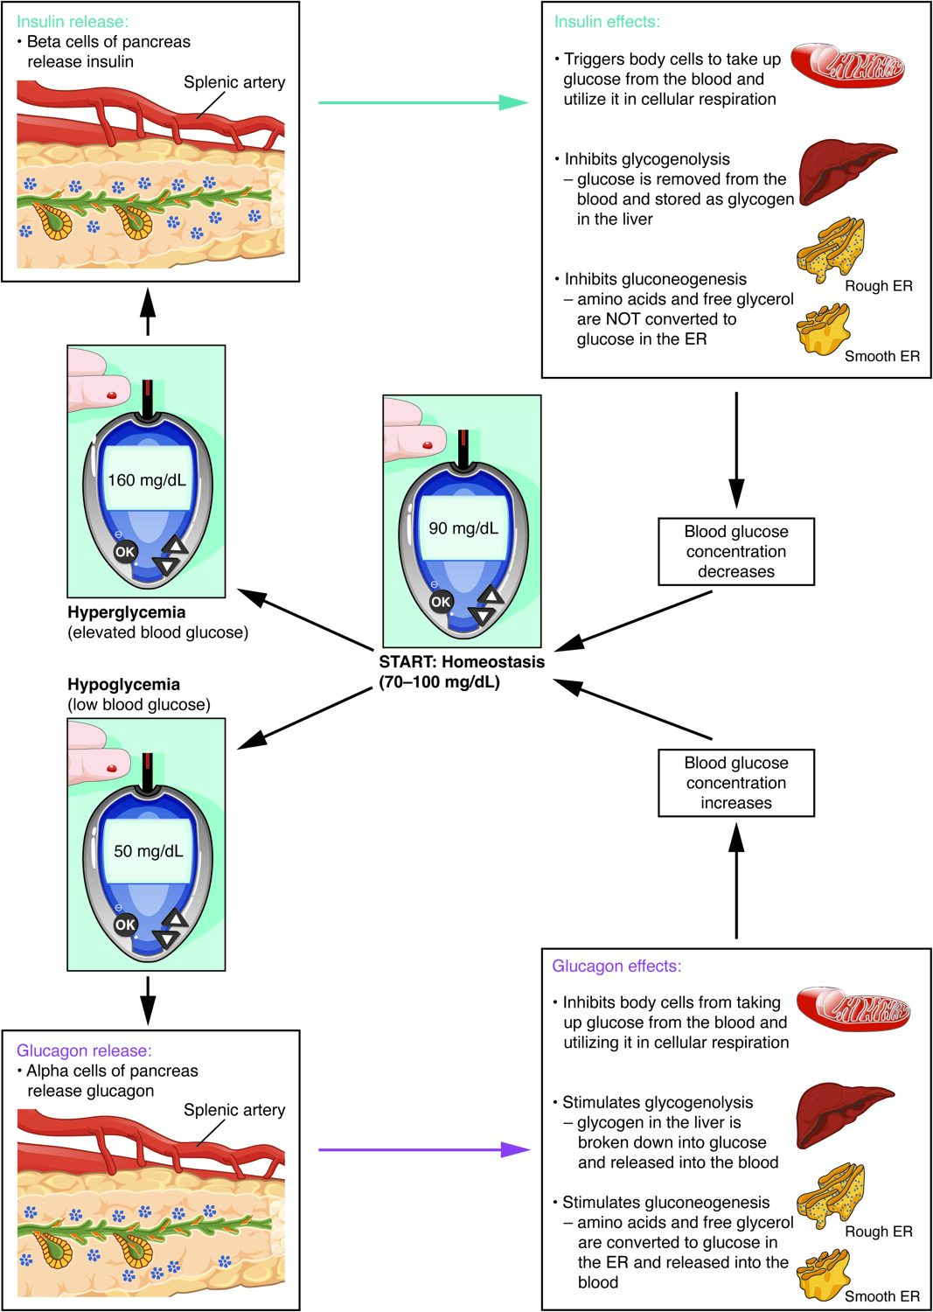
SECTION 17.9
Blood Glucose Regulation
Insulin lowers blood glucose
Glucagon raises it
The two oppose to keep balance
Failure causes diabetes
Insulin, glucagon, and blood glucose
PN 104 · Ch 17 — The Endocrine System
21
Notes:
Insulin and glucagon work in opposition to keep blood glucose stable: after eating, insulin moves glucose into cells; between meals, glucagon releases stored glucose. When insulin is lacking or ineffective, blood glucose rises — diabetes mellitus — a disease central to nursing care and patient teaching.

Slide 22
CHAPTER 17
Key Takeaways
The endocrine system uses hormones in the blood to control slow, widespread body processes.
Lipid-soluble hormones act on genes inside the cell; water-soluble ones use surface receptors.
Negative feedback keeps most hormone levels in a stable range.
The pituitary and hypothalamus direct the thyroid, adrenal glands, and gonads.
The thyroid, parathyroids, and pancreas control metabolism, calcium, and blood sugar.
PN 104 · Ch 17 — The Endocrine System
22

Slide 23
CLINICAL CONNECTIONS
Why the Endocrine System Matters in Practical Nursing
Diabetes Mellitus
Thyroid Disorders
Insulin problems disrupt blood sugar — a major focus of nursing care.
Hypo- and hyperthyroidism are common and very treatable.
Hormone Feedback
Calcium Balance
Many endocrine diseases stem from broken feedback loops.
Parathyroid problems disturb calcium and nerve/muscle function.
The Stress Response
Growth & Development
Cortisol and the HPA axis shape illness and recovery.
Pituitary hormones affect growth across the lifespan.

