Slide 1
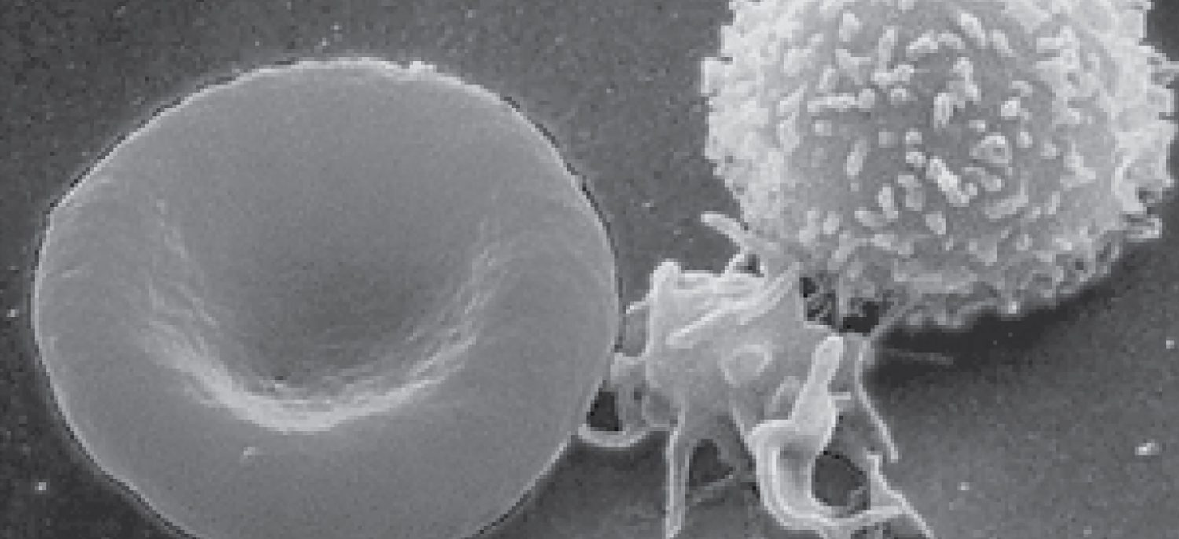
CHAPTER 18
The Cardiovascular System: Blood
Plasma, blood cells, clotting, and blood types.
Anatomy & Physiology · Broward-Miami Health Institute
FACULTY EDITION

Slide 2
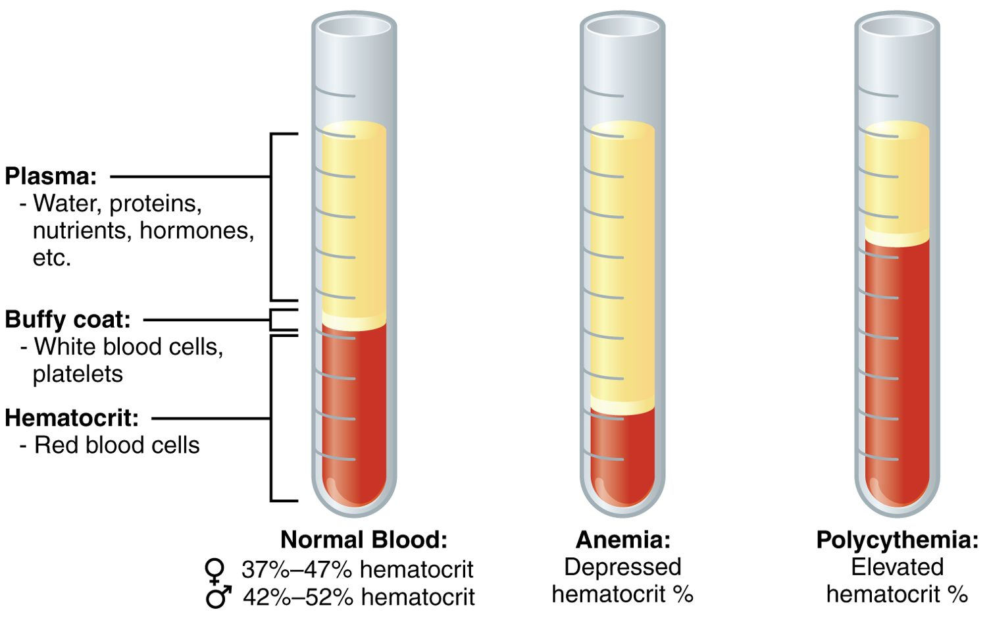
CHAPTER 18
Learning Objectives
After studying this chapter, students will be able to:
1
Identify the primary functions of blood, its fluid and cellular components, and its physical characteristics
2
Identify the most important proteins and other solutes present in blood plasma
3
Describe the formation of the formed element components of blood
4
Discuss the structure and function of red blood cells and hemoglobin
5
Classify and characterize white blood cells
6
Describe the structure of platelets and explain the process of hemostasis
Blood: plasma and formed elements.
PN 104 · Ch 18 — The Cardiovascular System: Blood
2
Notes:
Preview blood: its composition (plasma and formed elements), how blood cells are made, the roles of red cells, white cells, and platelets, how bleeding is stopped (hemostasis), and how blood typing keeps transfusions safe.

Slide 3
18.1
SECTION
An Overview of Blood
What blood is made of and what it does.

Slide 4
SECTION 18.1
Composition of Blood
Blood: plasma and formed elements
Plasma is the liquid portion (~55%)
Formed elements are cells (~45%)
Buffy coat = white cells and platelets
Hematocrit = percent red cells
PN 104 · Ch 18 — The Cardiovascular System: Blood
4
Notes:
Blood is about 55% plasma — water carrying proteins, nutrients, hormones, and wastes — and 45% formed elements: red cells, white cells, and platelets. Spun down, the red cells settle as the hematocrit (normally about 37-52%) with a thin buffy coat above. Too few red cells is anemia; too many is polycythemia.

Slide 5
18.2
SECTION
Production of the Formed Elements
How blood cells are produced in red bone marrow.

Slide 6
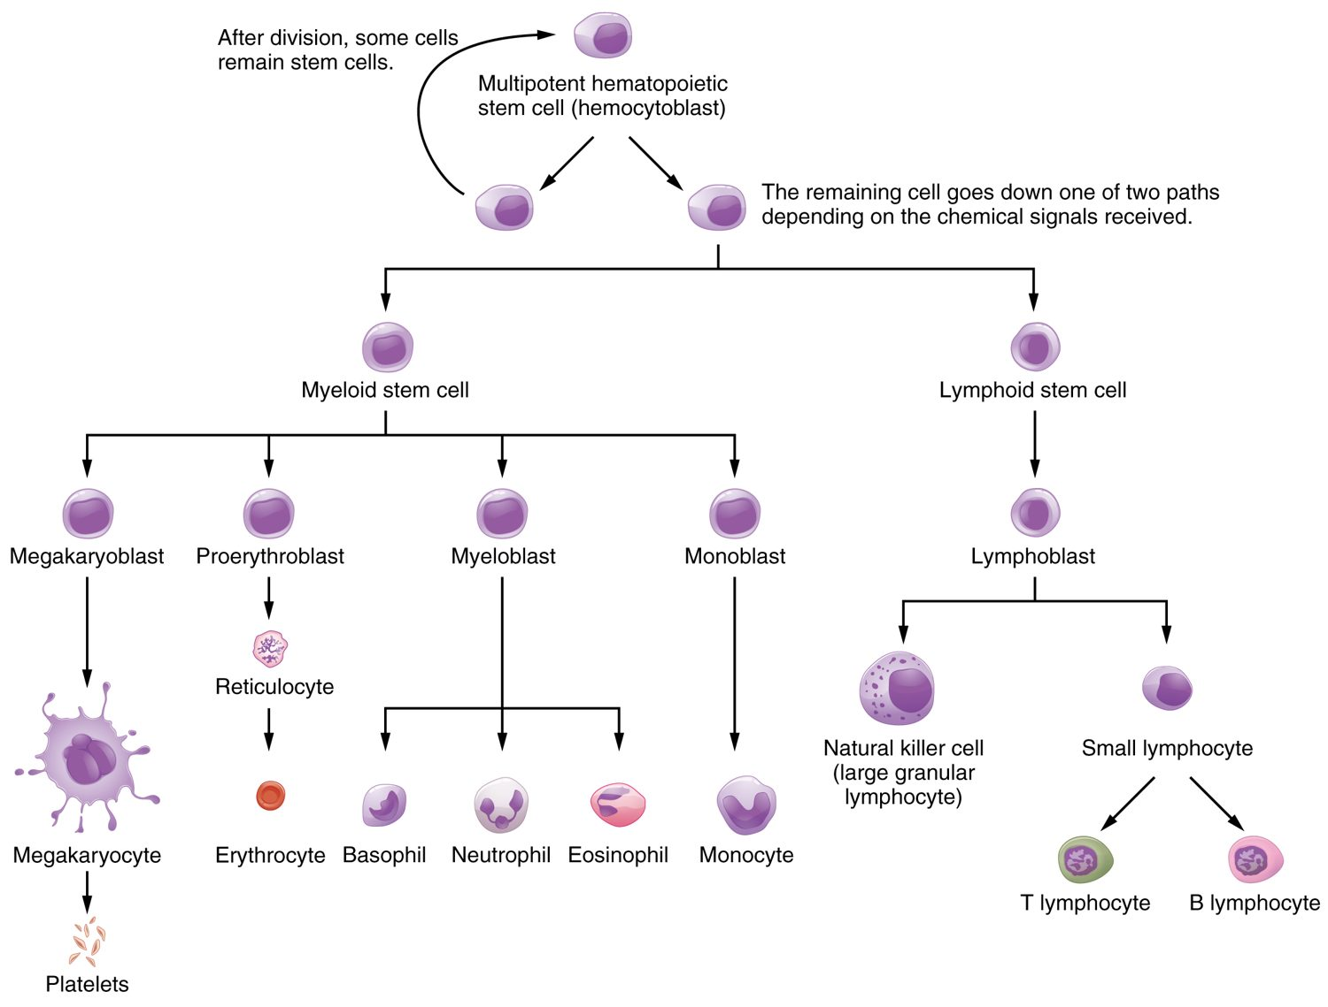
SECTION 18.2
Hematopoiesis
All blood cells form in red marrow
Start from one stem cell
Myeloid line → most cell types
Lymphoid line → lymphocytes
Hematopoiesis: the formation of blood cells
PN 104 · Ch 18 — The Cardiovascular System: Blood
6
Notes:
All blood cells arise from a single hematopoietic stem cell in red bone marrow. It gives rise to a myeloid line (red cells, platelets, and most white cells) and a lymphoid line (lymphocytes). Production is tightly regulated by hormones such as erythropoietin from the kidneys.

Slide 7
18.3
SECTION
Erythrocytes
Red blood cells and oxygen transport.

Slide 8
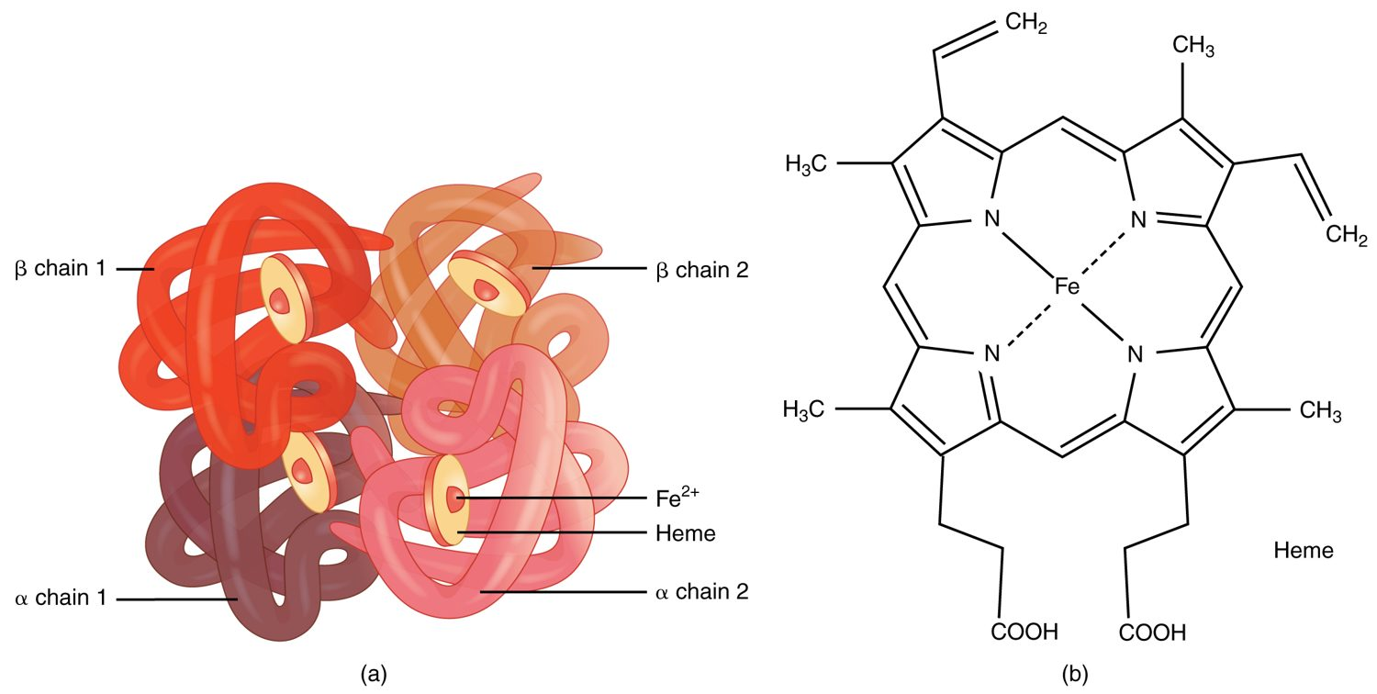
SECTION 18.3
Hemoglobin
The structure of hemoglobin
The oxygen-carrying protein in red cells
Four globin chains
Each holds an iron-rich heme group
Iron binds the oxygen
PN 104 · Ch 18 — The Cardiovascular System: Blood
8
Notes:
Red blood cells are packed with hemoglobin — four protein (globin) chains, each cradling an iron-containing heme group. The iron binds oxygen in the lungs and releases it in the tissues. Each red cell carries about 250 million hemoglobin molecules, making blood an efficient oxygen carrier.

Slide 9
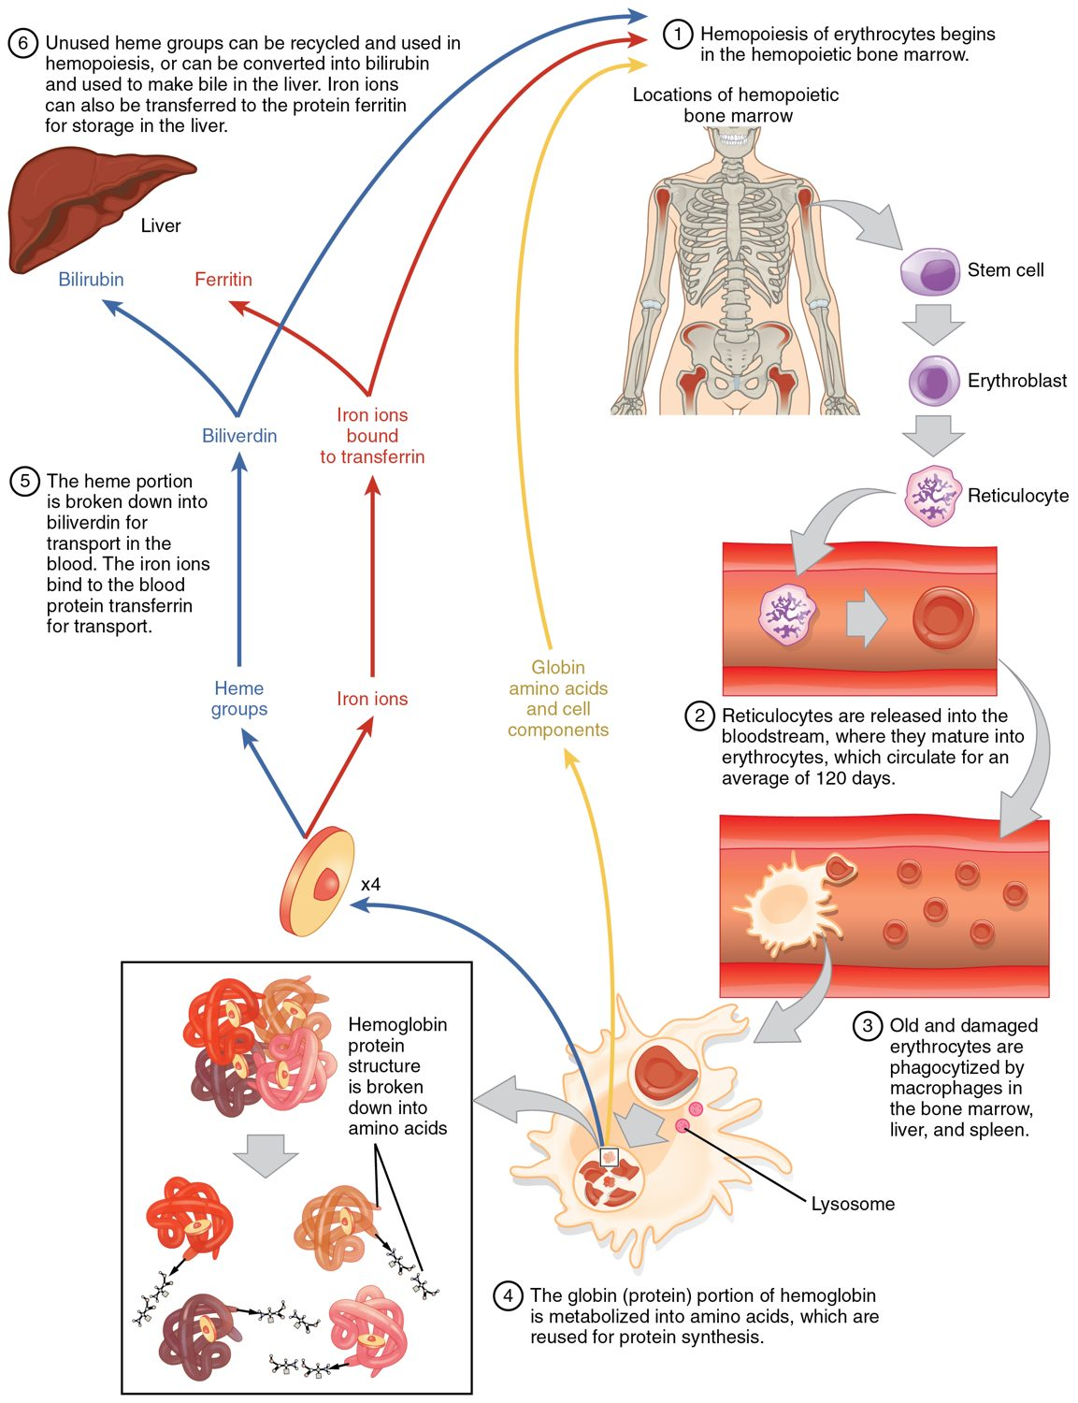
SECTION 18.3
Red Blood Cell Life Cycle
Red cells live about 120 days
Old cells broken down in spleen and liver
Iron is recycled
Heme becomes bilirubin
The life cycle of a red blood cell
PN 104 · Ch 18 — The Cardiovascular System: Blood
9
Notes:
Red blood cells circulate about 120 days before macrophages in the spleen and liver break them down. The iron is salvaged and reused, while the rest of the heme becomes bilirubin, processed by the liver and excreted in bile. Excess bilirubin causes the yellowing of jaundice.

Slide 10
18.4
SECTION
Leukocytes and Platelets
White blood cells and platelets — defense and clotting.

Slide 11
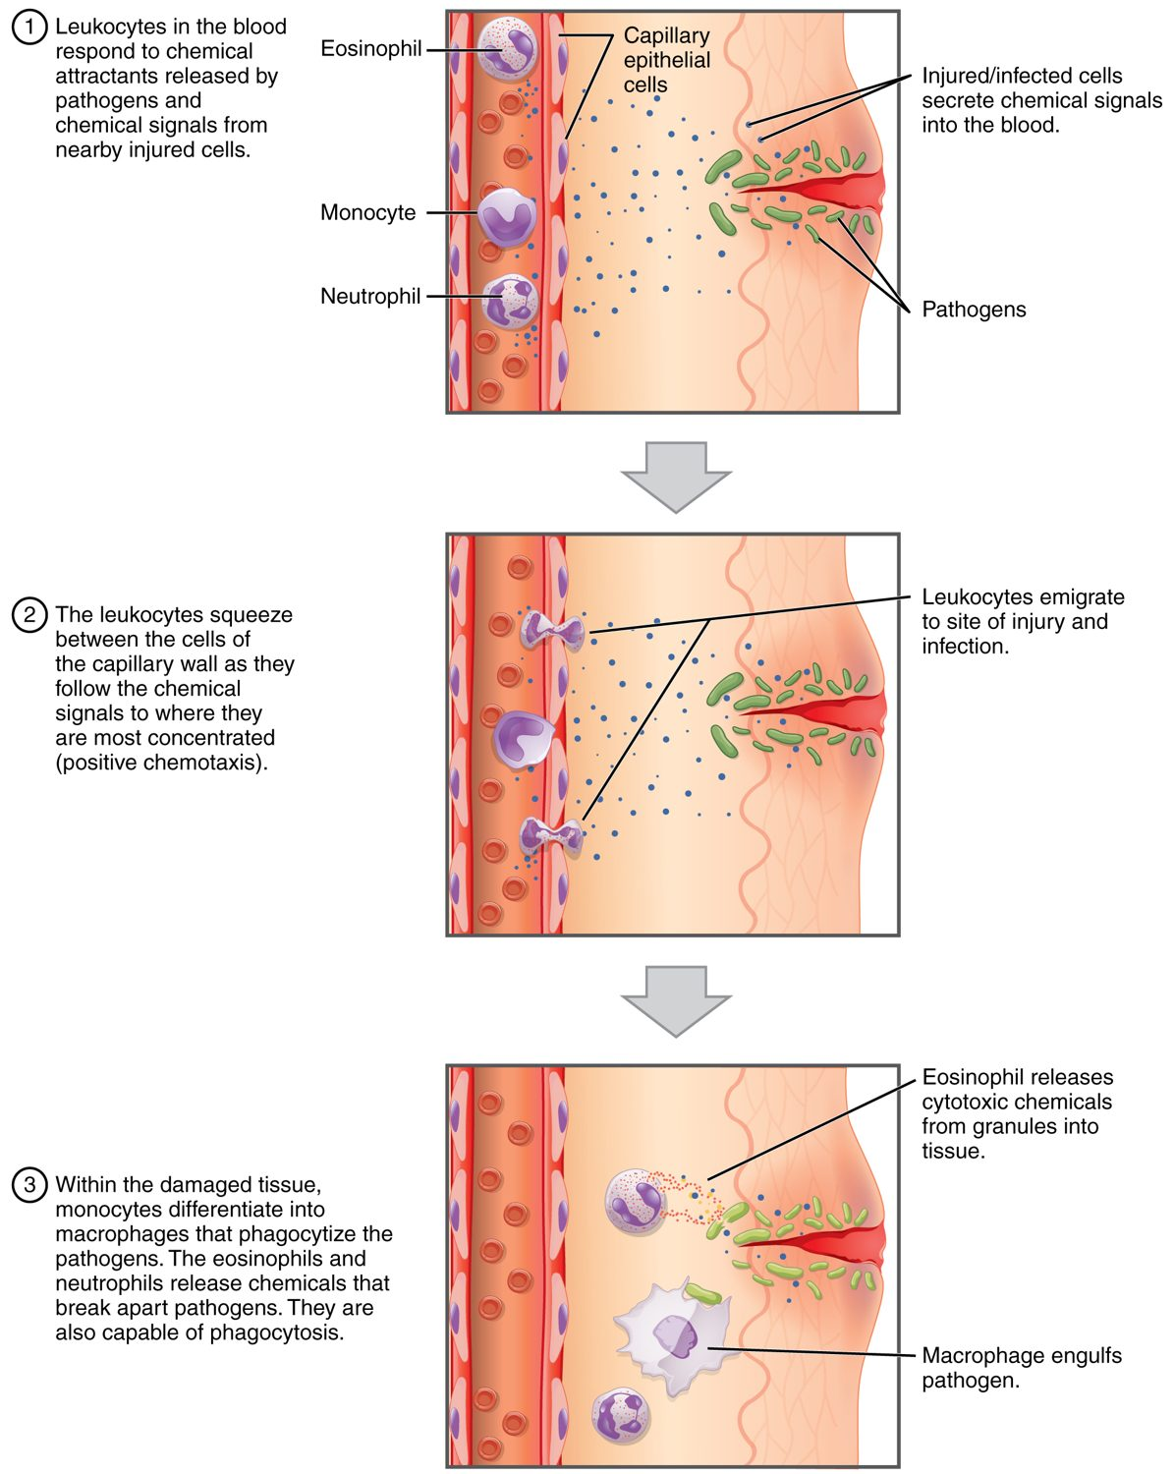
SECTION 18.4
How Leukocytes Fight Infection
White cells defend against infection
Leave vessels by diapedesis
Move toward chemical signals
Engulf pathogens (phagocytosis)
How leukocytes fight infection
PN 104 · Ch 18 — The Cardiovascular System: Blood
11
Notes:
White blood cells protect against infection. They squeeze out of capillaries (diapedesis), follow chemical signals to the site of infection (chemotaxis), and engulf pathogens (phagocytosis) or mount immune responses. Their numbers rise during infection — a key clinical clue.

Slide 12
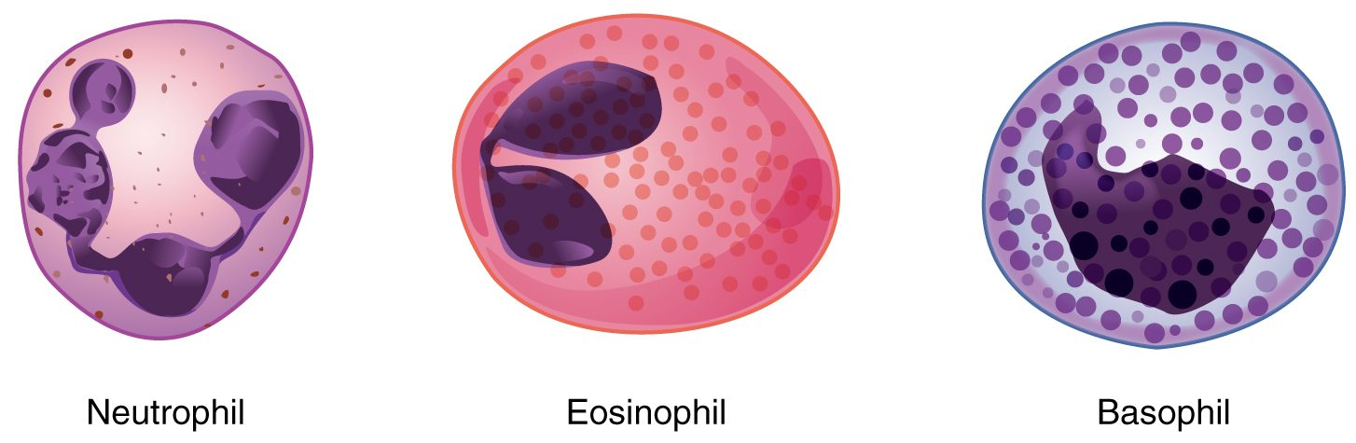
SECTION 18.4
Types of White Blood Cells
The granular leukocytes
Five types of leukocytes
Granulocytes: neutrophil, eosinophil, basophil
Agranulocytes: lymphocyte, monocyte
Each has a specific role
PN 104 · Ch 18 — The Cardiovascular System: Blood
12
Notes:
There are five white cell types. The granulocytes — neutrophils (bacteria), eosinophils (parasites, allergy), and basophils (inflammation) — have visible granules. The agranulocytes are lymphocytes (specific immunity) and monocytes (which become macrophages). A differential count of these guides diagnosis.

Slide 13
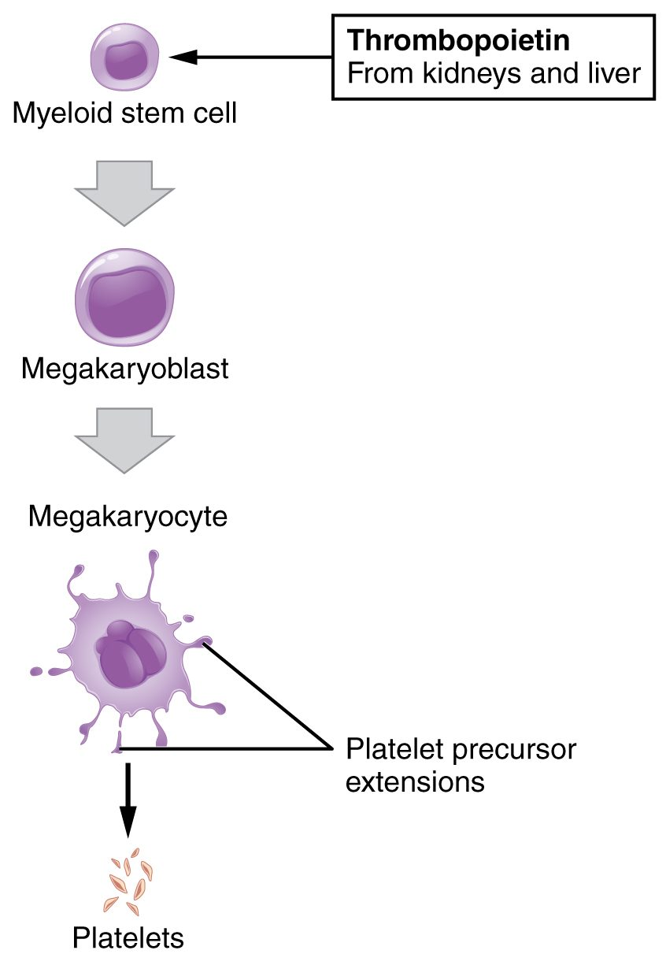
SECTION 18.4
Platelet Formation
Platelets are cell fragments
Shed from megakaryocytes
Driven by thrombopoietin
Essential for clotting
The formation of platelets
PN 104 · Ch 18 — The Cardiovascular System: Blood
13
Notes:
Platelets are not whole cells but fragments pinched off from giant megakaryocytes in the marrow, stimulated by the hormone thrombopoietin. Though tiny and short-lived, they are essential for hemostasis — plugging breaks in vessels and triggering clotting.

Slide 14
18.5
SECTION
Hemostasis
Hemostasis — how the body stops bleeding.

Slide 15
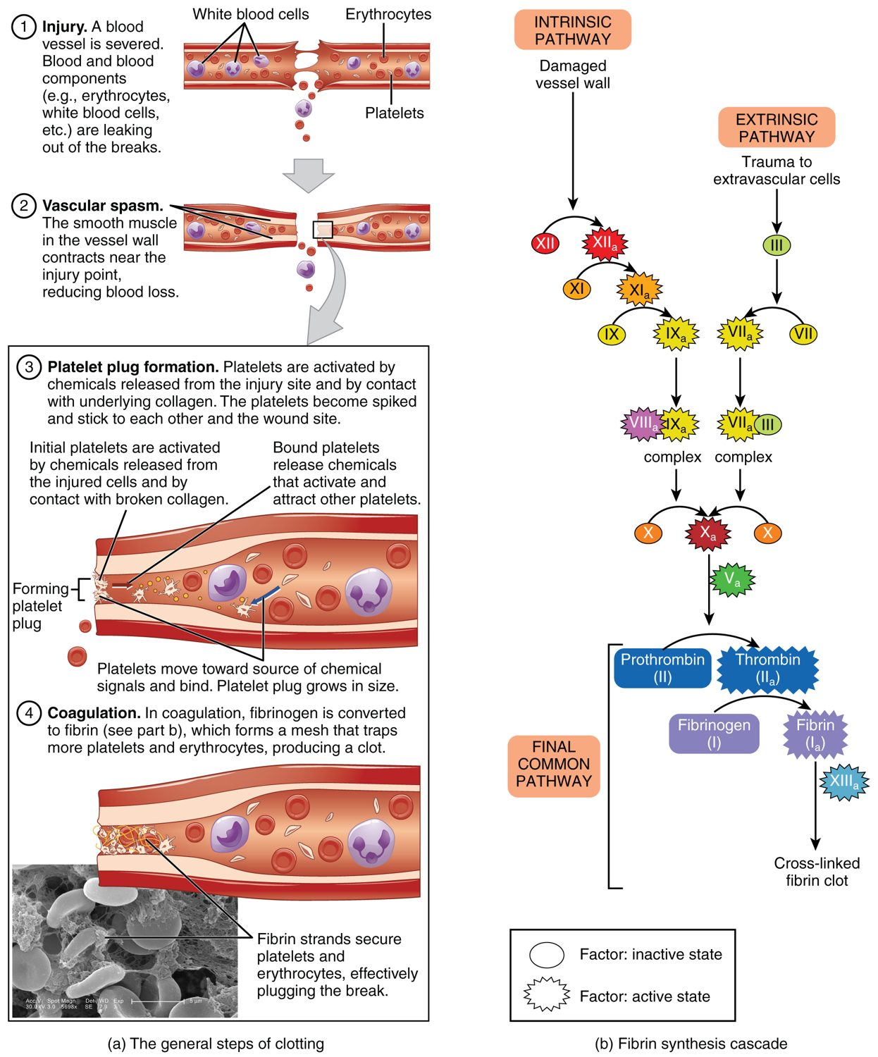
SECTION 18.5
Hemostasis
Stops bleeding in three steps
Vascular spasm narrows the vessel
A platelet plug forms
Coagulation makes a fibrin clot
The steps of hemostasis
PN 104 · Ch 18 — The Cardiovascular System: Blood
15
Notes:
Hemostasis stops bleeding in three overlapping steps: vascular spasm (the vessel constricts), platelet plug formation (platelets stick to the break and each other), and coagulation — a cascade of clotting factors that produces fibrin threads, sealing the clot. Anticoagulant drugs act on this cascade.

Slide 16
18.6
SECTION
Blood Typing
Blood typing and transfusion compatibility.

Slide 17
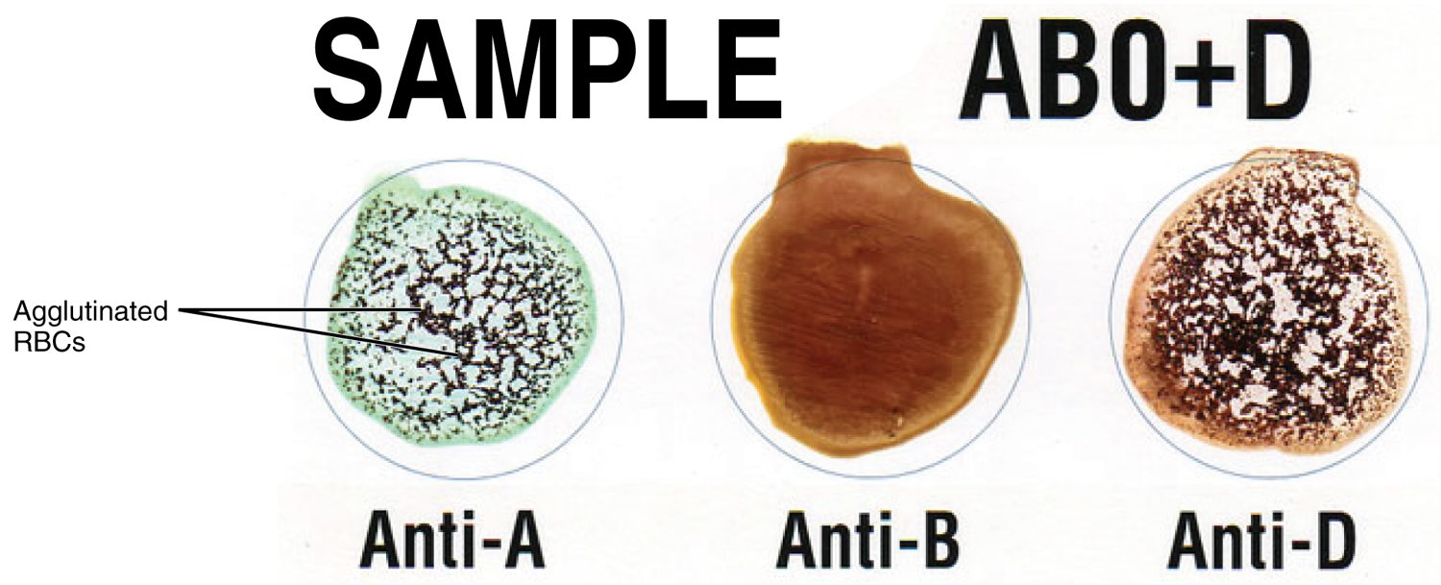
SECTION 18.6
Blood Typing
Blood typing by agglutination
Type set by red-cell surface antigens
ABO system: A, B, AB, O
Rh system: positive or negative
Tested by agglutination
PN 104 · Ch 18 — The Cardiovascular System: Blood
17
Notes:
Blood type is determined by antigens on the red cell surface — the ABO system (A, B, AB, or O) and the Rh factor (positive or negative). Mixing blood with anti-A, anti-B, and anti-D sera shows which antigens are present by clumping (agglutination). Typing is essential before any transfusion.

Slide 18
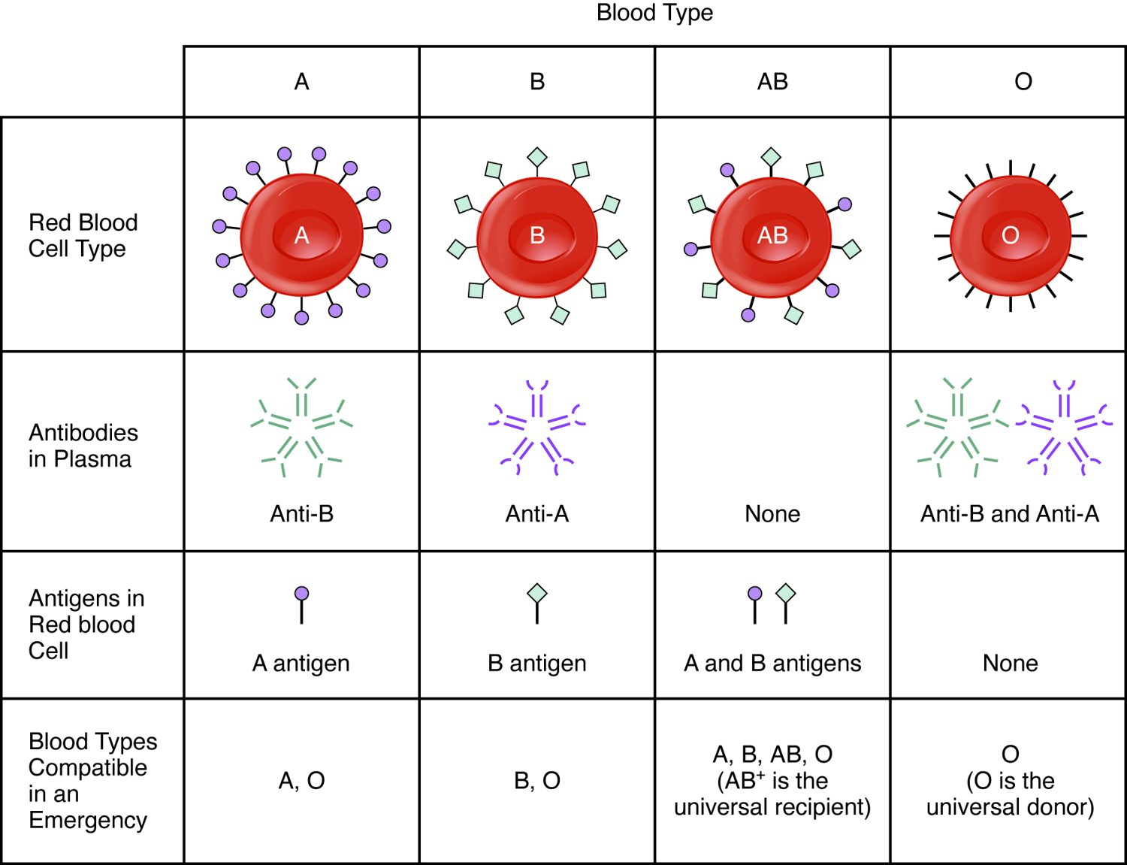
SECTION 18.6
Transfusion Compatibility
Plasma holds antibodies to missing antigens
The wrong type causes agglutination
Type O-negative is universal donor
Type AB-positive is universal recipient
ABO blood type compatibility
PN 104 · Ch 18 — The Cardiovascular System: Blood
18
Notes:
Each person's plasma carries antibodies against the ABO antigens they lack, so an incompatible transfusion causes dangerous clumping and cell destruction. Type O-negative red cells lack A, B, and Rh antigens (universal donor), while AB-positive recipients can receive any ABO type (universal recipient). Matching is a critical safety check.

Slide 19
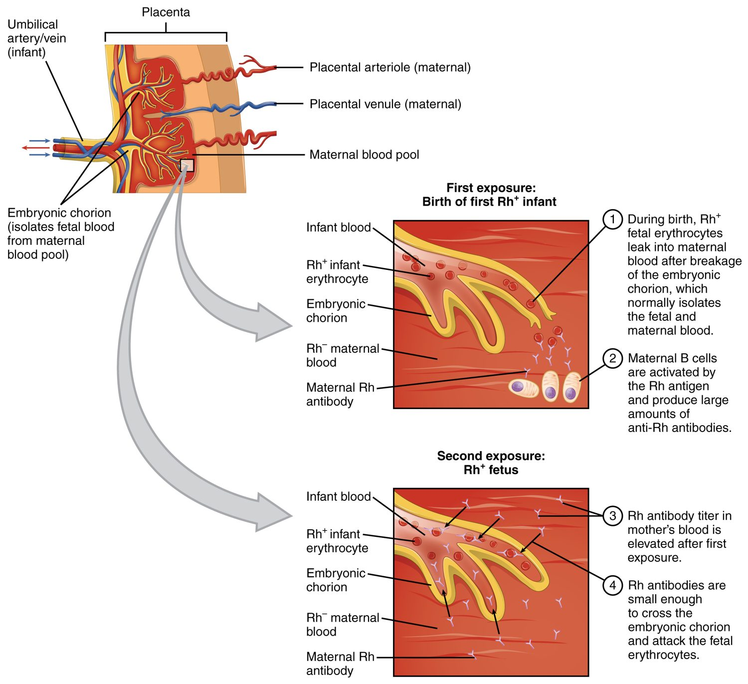
SECTION 18.6
Rh Incompatibility
Rh-negative mother, Rh-positive baby
First exposure sensitizes the mother
Antibodies threaten a later baby
Prevented with Rh immune globulin
Rh incompatibility in pregnancy
PN 104 · Ch 18 — The Cardiovascular System: Blood
19
Notes:
If an Rh-negative mother carries an Rh-positive baby, exposure to fetal blood (usually at delivery) can sensitize her to make anti-Rh antibodies. In a later Rh-positive pregnancy, those antibodies can cross the placenta and destroy the baby's red cells. An injection of Rh immune globulin (RhoGAM) prevents this.

Slide 20
CHAPTER 18
Key Takeaways
Blood is plasma plus formed elements — red cells, white cells, and platelets.
All blood cells form in red bone marrow from a single stem cell.
Red cells carry oxygen on hemoglobin and are recycled after about 120 days.
White cells defend against infection; platelets and clotting factors stop bleeding.
Blood type (ABO and Rh) must be matched before transfusion.
PN 104 · Ch 18 — The Cardiovascular System: Blood
20

Slide 21
CLINICAL CONNECTIONS
Why Blood Matters in Practical Nursing
Anemia
Complete Blood Count
Too few red cells or too little hemoglobin reduces oxygen delivery.
The CBC is one of the most common diagnostic tests.
Transfusion Safety
Clotting Disorders
Matching ABO and Rh type prevents dangerous reactions.
Too little clotting bleeds; too much causes thrombosis.
Anticoagulants
Infection
Drugs like heparin and warfarin act on the clotting cascade.
A rising white cell count is an early sign of infection.

