Slide 1

CHAPTER 20
Blood Vessels and Circulation
Vessels, blood pressure, exchange, and the circulatory pathways.
Anatomy & Physiology · Broward-Miami Health Institute
FACULTY EDITION

Slide 2
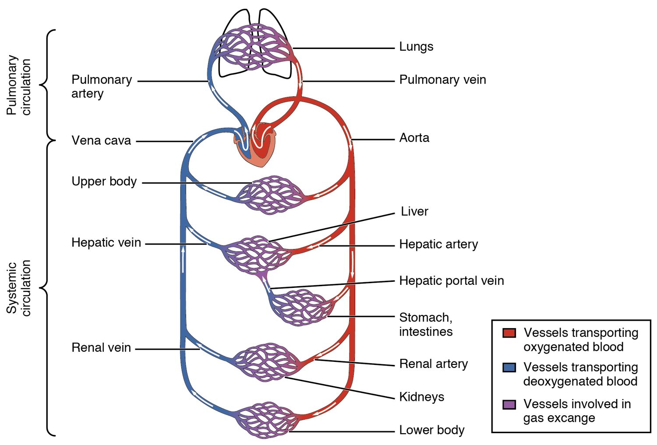
CHAPTER 20
Learning Objectives
After studying this chapter, students will be able to:
1
Compare and contrast the anatomical structure of arteries, arterioles, capillaries, venules, and veins
2
Accurately describe the forces that account for capillary exchange
3
List the major factors affecting blood flow, blood pressure, and resistance
4
Describe how blood flow, blood pressure, and resistance interrelate
5
Discuss how the neural and endocrine mechanisms maintain homeostasis within the blood vessels
6
Describe the interaction of the cardiovascular system with other body systems
The pulmonary and systemic circuits.
PN 104 · Ch 20 — Blood Vessels and Circulation
2
Notes:
Preview blood vessels and circulation: the structure of arteries, veins, and capillaries; blood pressure, flow, and resistance; capillary exchange; the major circulatory pathways; and the special features of fetal circulation.

Slide 3
20.1
SECTION
Structure and Function of Blood Vessels
The structure of arteries, veins, and capillaries.

Slide 4
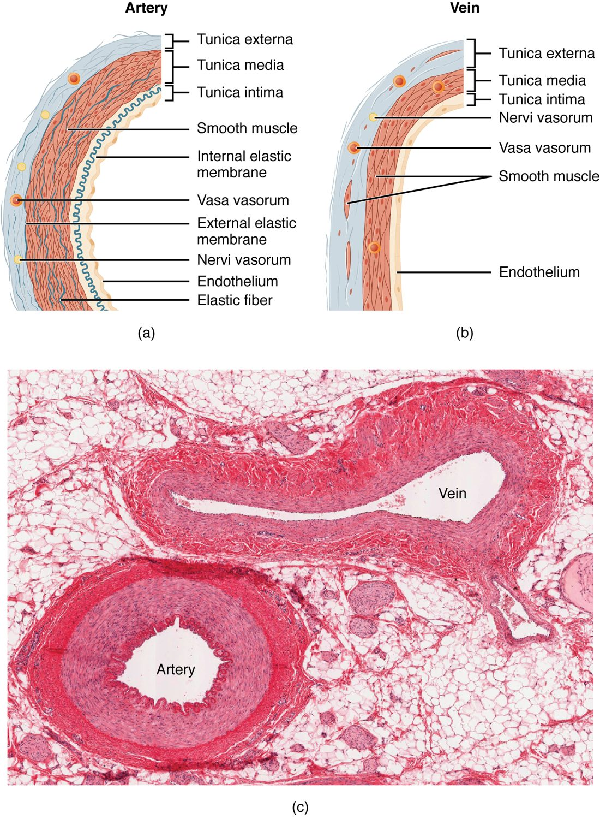
SECTION 20.1
Artery vs. Vein
Both have three wall layers (tunics)
Arteries have thick muscular walls
Veins are thinner, with valves
Valves keep venous blood moving up
The walls of an artery and a vein
PN 104 · Ch 20 — Blood Vessels and Circulation
4
Notes:
Arteries and veins share three wall layers (tunics) but differ in build. Arteries have thick, muscular, elastic walls to withstand the high pressure from the heart; veins have thinner walls and a wider lumen, and many contain one-way valves that keep blood flowing back toward the heart against gravity.

Slide 5
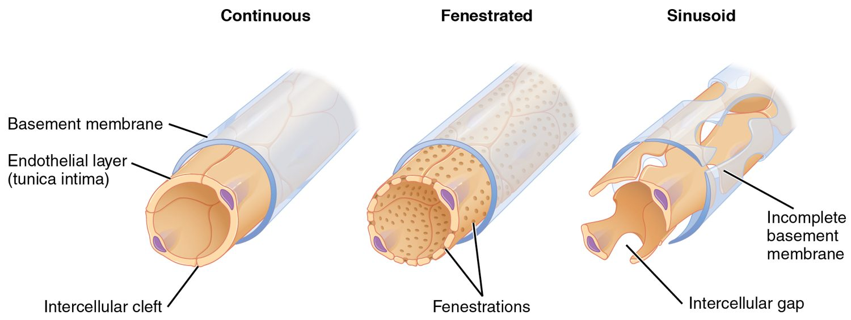
SECTION 20.1
Types of Capillaries
The three types of capillaries
The smallest vessels
Walls just one cell thick
Continuous, fenestrated, sinusoid
The site of all exchange
PN 104 · Ch 20 — Blood Vessels and Circulation
5
Notes:
Capillaries are the tiniest vessels, with walls just one cell thick to allow exchange. Continuous capillaries (most tissues) are the least leaky, fenestrated ones (kidney, intestine) have pores for faster exchange, and sinusoids (liver, marrow) are the leakiest, letting cells and large molecules pass.

Slide 6
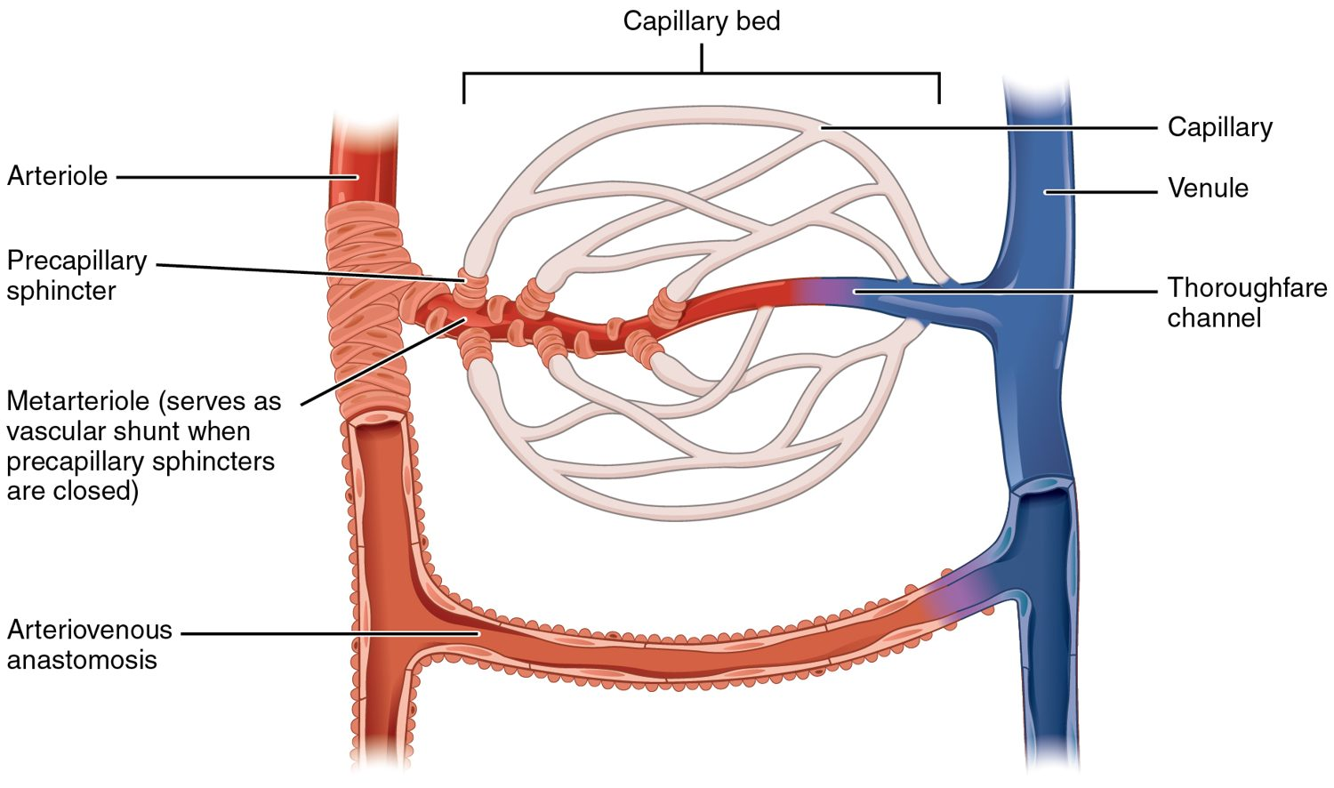
SECTION 20.1
The Capillary Bed
Blood flow through a capillary bed
Capillaries form branching beds
Connect arterioles to venules
Precapillary sphincters control flow
Direct blood where it's needed
PN 104 · Ch 20 — Blood Vessels and Circulation
6
Notes:
Capillaries are arranged in networks (beds) linking arterioles to venules. Rings of muscle called precapillary sphincters open and close to route blood only to tissues that currently need it — for example, to working muscles during exercise or to the gut after a meal.

Slide 7
20.2
SECTION
Blood Flow, Blood Pressure, and Resistance
Blood flow, blood pressure, and resistance.

Slide 8
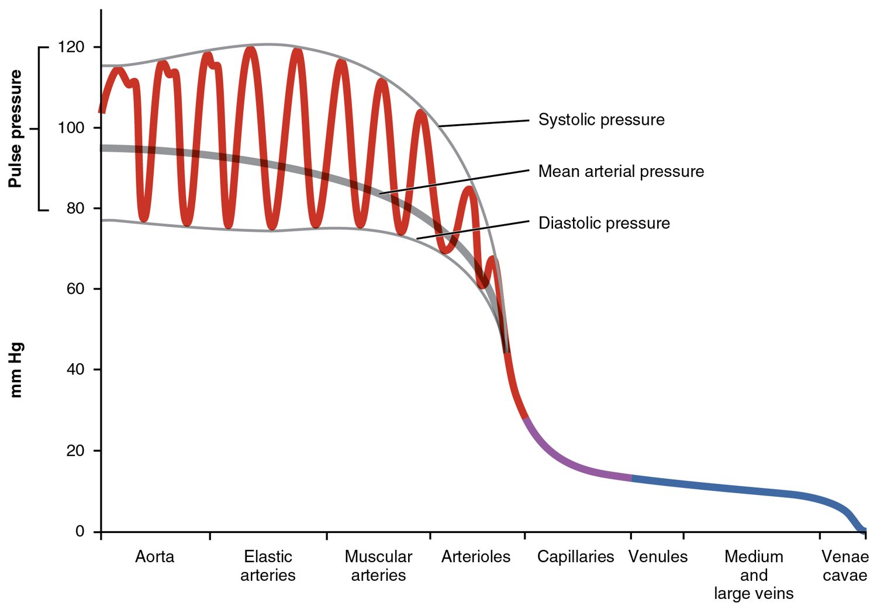
SECTION 20.2
Blood Pressure Across the System
Pressure is highest in the arteries
Drops sharply in the arterioles
Lowest in the veins
The gradient drives blood flow
Blood pressure throughout the circulation
PN 104 · Ch 20 — Blood Vessels and Circulation
8
Notes:
Blood pressure is highest and most pulsatile in the large arteries near the heart, falls steeply across the arterioles (the main site of resistance), and is lowest in the venules and veins. This pressure gradient is what keeps blood moving forward through the entire circuit.

Slide 9
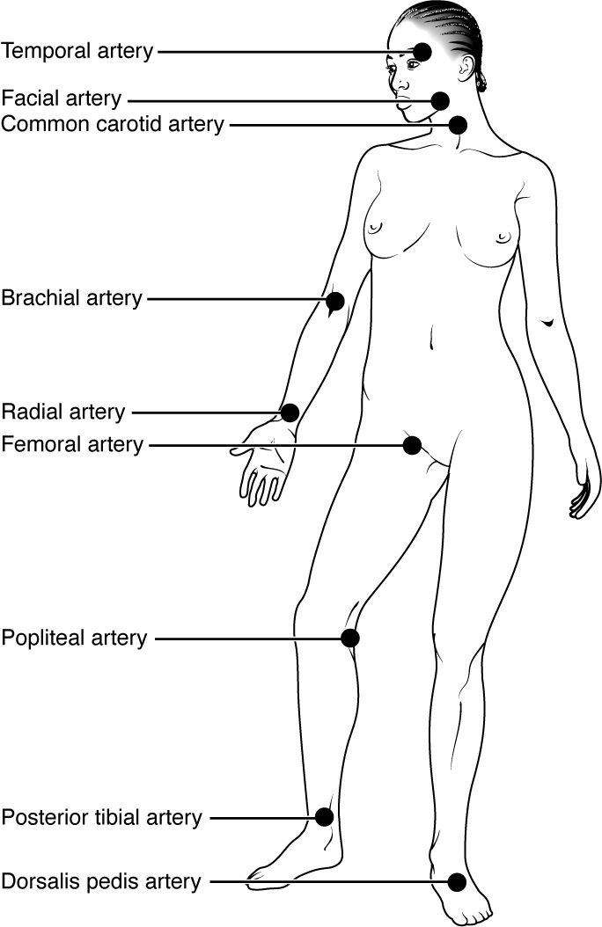
SECTION 20.2
Pulse Points
Pulse = artery expanding with each beat
Felt where arteries are near the surface
Common sites: radial, carotid, femoral
Used to assess rate and rhythm
Pulse points of the body
PN 104 · Ch 20 — Blood Vessels and Circulation
9
Notes:
A pulse is the wave of expansion in an artery with each heartbeat, felt where an artery runs close to the skin over a bone — the radial (wrist), carotid (neck), brachial, and femoral, among others. Pulse points let you assess heart rate and rhythm, and serve as pressure points to control bleeding.

Slide 10
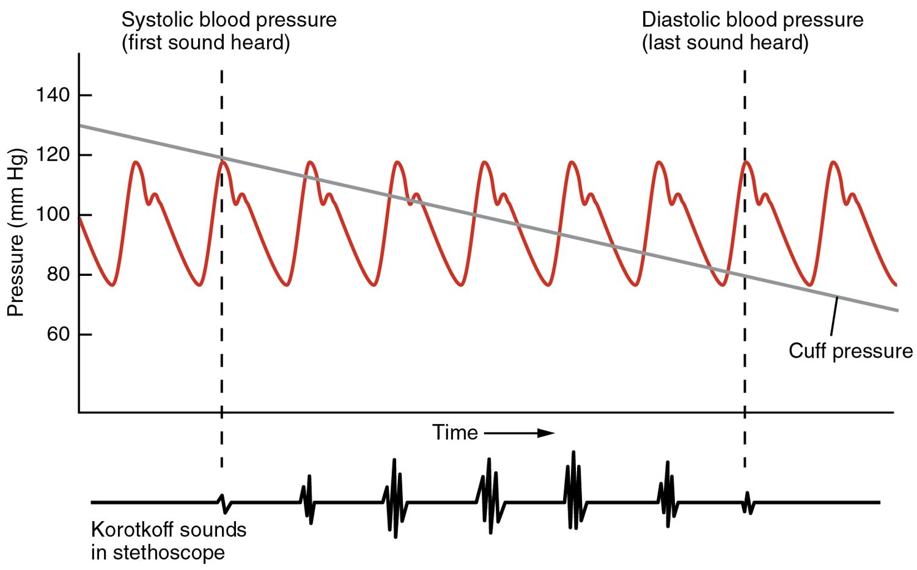
SECTION 20.2
Measuring Blood Pressure
Measuring arterial blood pressure
Measured with a cuff (sphygmomanometer)
Systolic over diastolic
Normal about 120/80 mmHg
A key vital sign
PN 104 · Ch 20 — Blood Vessels and Circulation
10
Notes:
Blood pressure is measured with an inflatable cuff that occludes then releases an artery while listening for Korotkoff sounds. The systolic pressure (top number) is the peak during ventricular contraction; the diastolic (bottom) is the resting pressure between beats. Around 120/80 mmHg is typical; persistently high readings indicate hypertension.

Slide 11
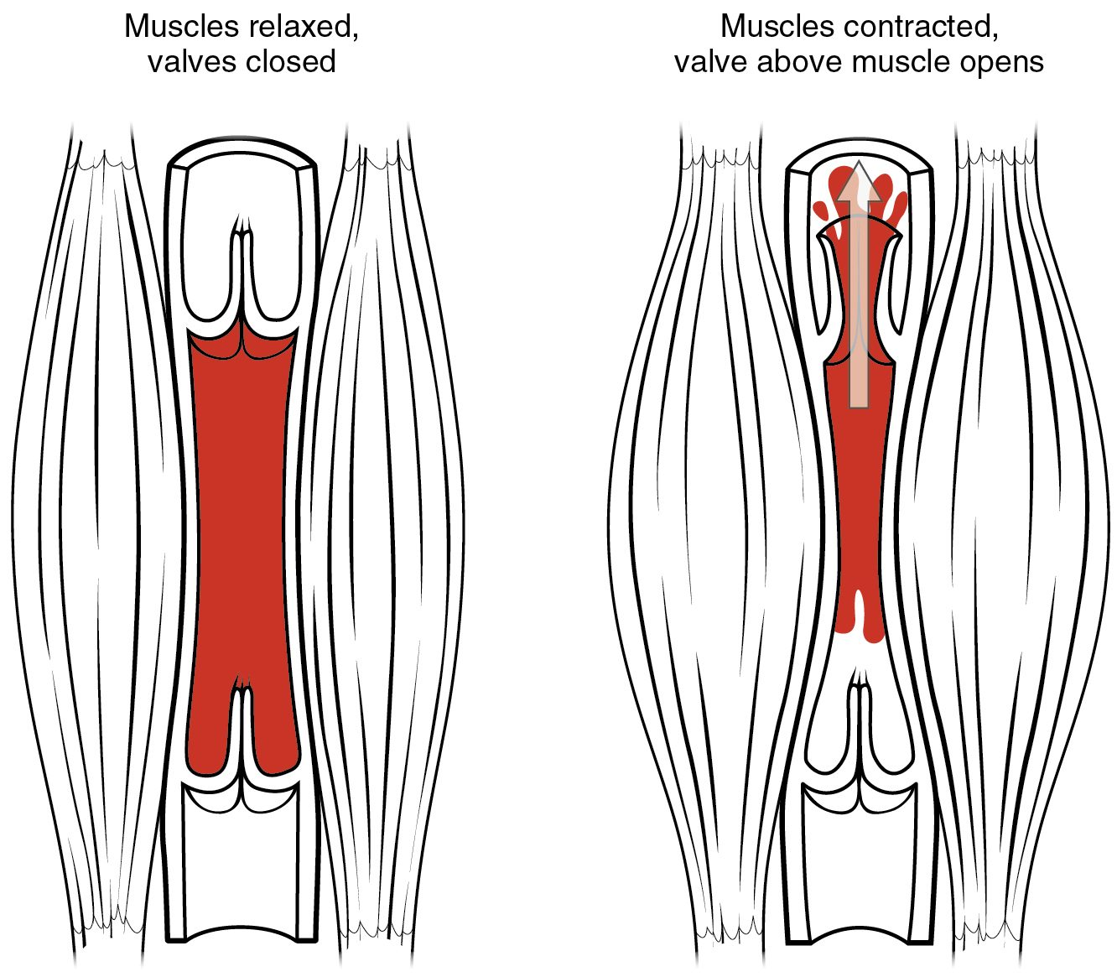
SECTION 20.2
The Skeletal Muscle Pump
Veins need help returning blood
Contracting muscles squeeze veins
Valves keep blood moving up
Aids venous return to the heart
The skeletal muscle pump
PN 104 · Ch 20 — Blood Vessels and Circulation
11
Notes:
Because venous pressure is low, returning blood to the heart needs help. As skeletal muscles contract during movement, they squeeze nearby veins, and the one-way valves ensure blood moves only toward the heart. This skeletal muscle pump is why staying still too long lets blood pool in the legs.

Slide 12
20.3
SECTION
Capillary Exchange
Capillary exchange — where blood serves the tissues.

Slide 13
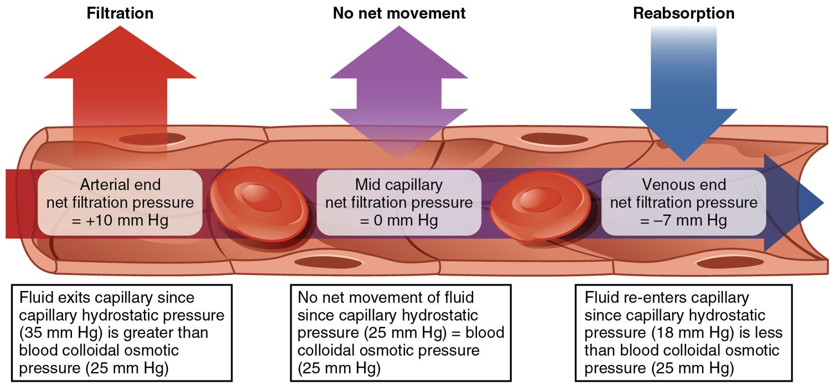
SECTION 20.3
Capillary Exchange
Fluid exchange at the capillary
Materials cross the thin capillary wall
Pressure pushes fluid out (filtration)
Osmosis pulls fluid back (reabsorption)
Delivers nutrients, removes wastes
PN 104 · Ch 20 — Blood Vessels and Circulation
13
Notes:
Capillaries are where blood serves the tissues. At the arterial end, blood pressure pushes fluid and nutrients out (filtration); at the venous end, osmotic pressure from plasma proteins pulls most of it back in (reabsorption). The lymphatic system collects the small excess. Imbalance here causes edema — tissue swelling.

Slide 14
20.5
SECTION
Circulatory Pathways
The major arteries, veins, and circulatory pathways.

Slide 15
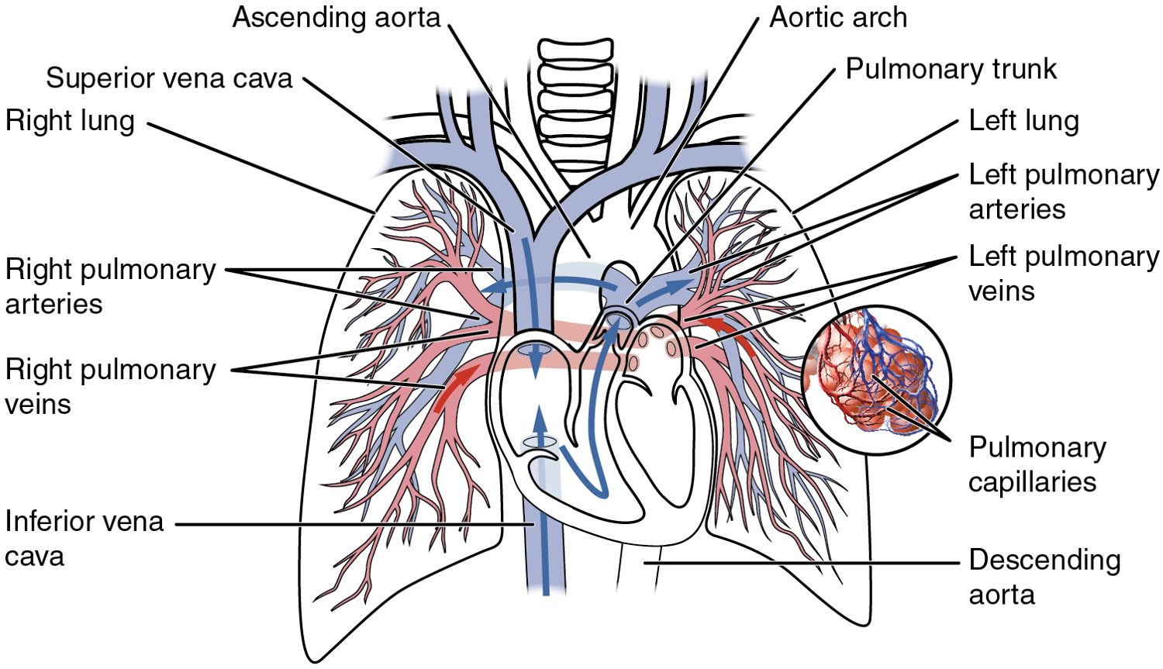
SECTION 20.5
Pulmonary & Systemic Circuits
The pulmonary and systemic circuits
Two linked circuits
Pulmonary: heart ↔ lungs
Systemic: heart ↔ body
Run in series through the heart
PN 104 · Ch 20 — Blood Vessels and Circulation
15
Notes:
The circulation has two circuits in series. The pulmonary circuit carries blood from the right heart to the lungs to pick up oxygen and return to the left heart; the systemic circuit carries oxygen-rich blood from the left heart to all body tissues and back. Every drop passes through both.

Slide 16
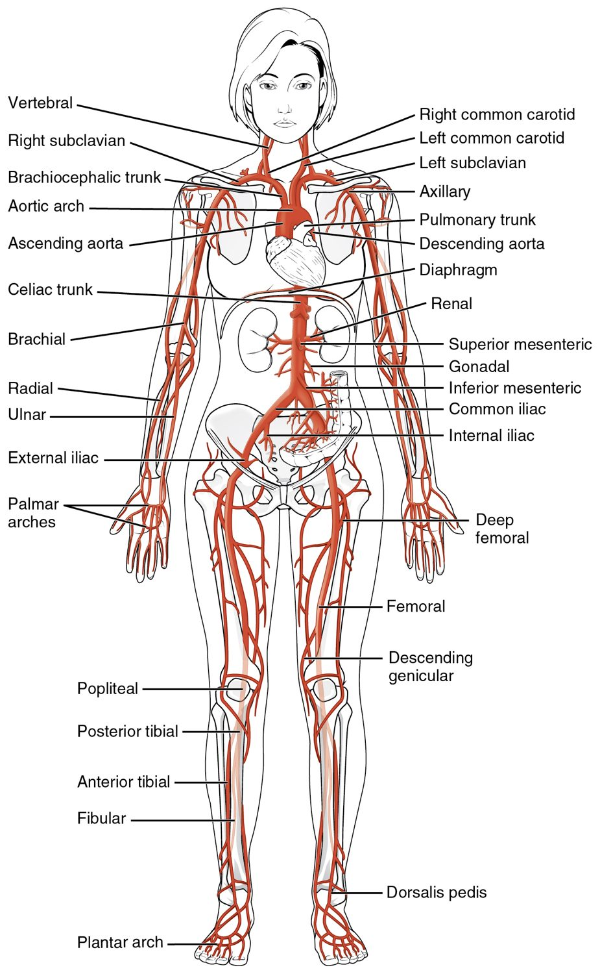
SECTION 20.5
Major Arteries
Arteries carry blood from the heart
The aorta is the largest
Branches supply every region
Usually carry oxygen-rich blood
Major arteries of the body
PN 104 · Ch 20 — Blood Vessels and Circulation
16
Notes:
Arteries carry blood away from the heart, branching from the aorta into named vessels supplying the head, limbs, and organs. They usually carry oxygen-rich blood (the pulmonary arteries are the exception). Knowing the major arteries underlies pulse points, blood pressure, and sites of blockage.

Slide 17
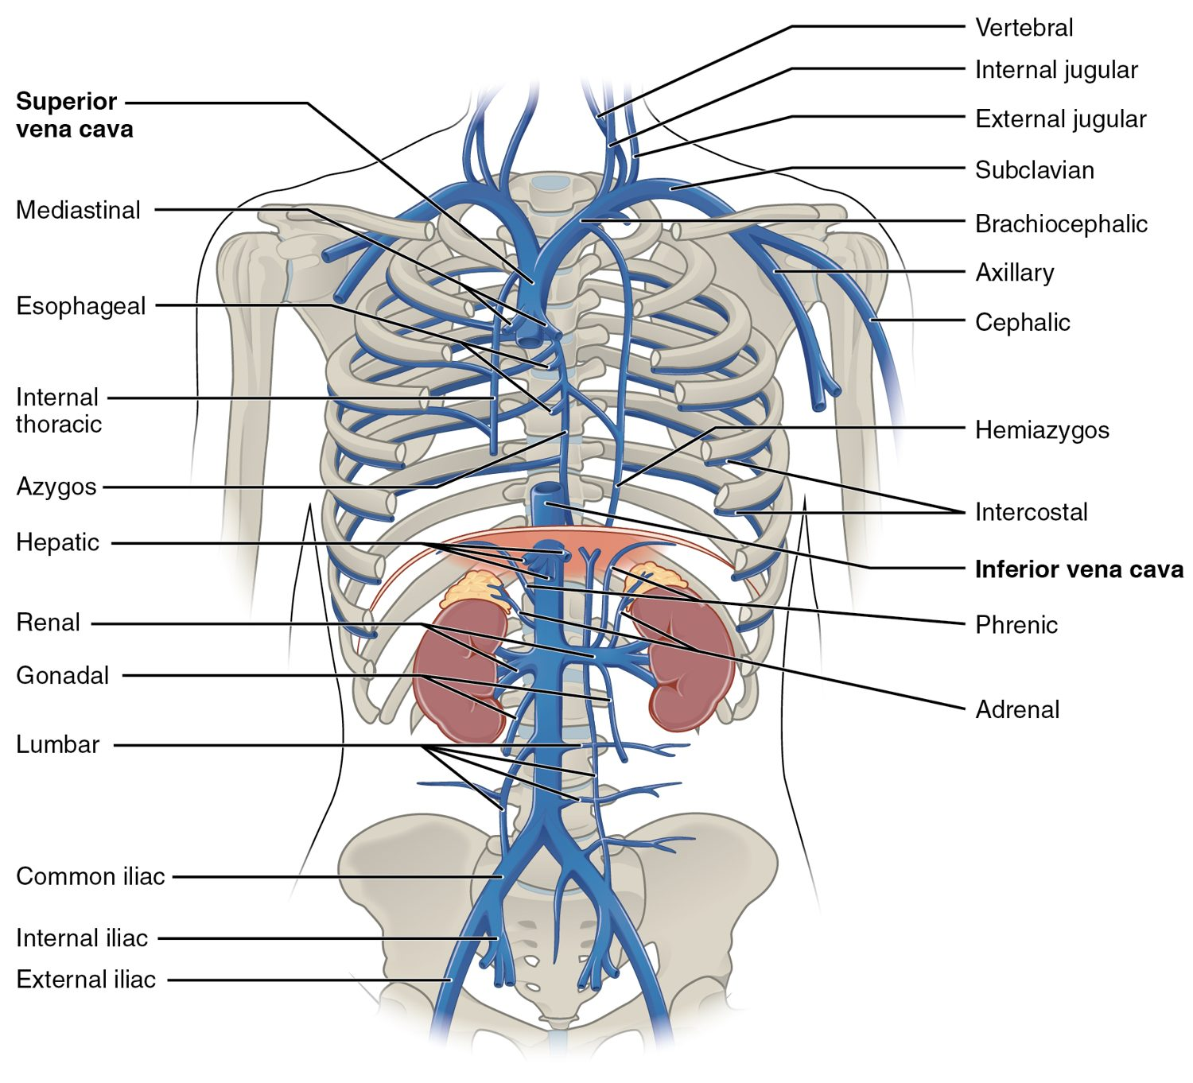
SECTION 20.5
Major Veins
Veins return blood to the heart
The venae cavae are the largest
Drain every body region
Usually carry oxygen-poor blood
Major veins of the body
PN 104 · Ch 20 — Blood Vessels and Circulation
17
Notes:
Veins return blood to the heart, converging into the superior and inferior venae cavae that empty into the right atrium. They usually carry oxygen-poor blood (the pulmonary veins are the exception). Superficial veins, visible at the skin, are common sites for drawing blood and giving IV fluids.

Slide 18
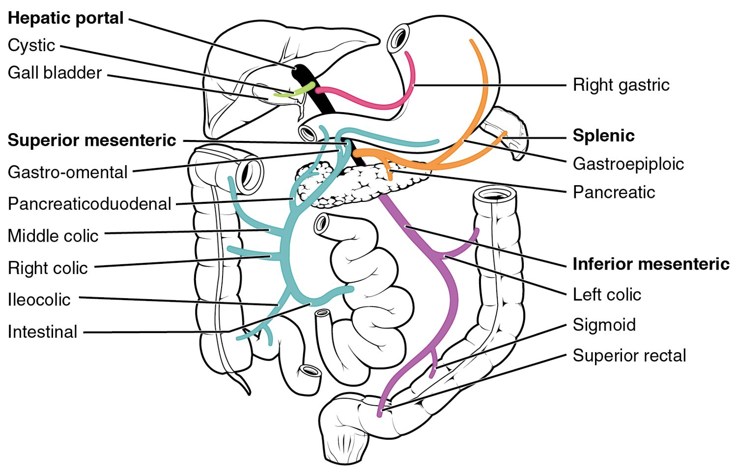
SECTION 20.5
The Hepatic Portal System
The hepatic portal system
A special detour through the liver
Drains the digestive organs
Carries nutrient-rich blood to the liver
Liver processes it before circulation
PN 104 · Ch 20 — Blood Vessels and Circulation
18
Notes:
The hepatic portal system is a special venous detour: blood draining the stomach, intestines, and spleen flows first to the liver, not straight back to the heart. This lets the liver process absorbed nutrients, store glucose, and detoxify substances before the blood rejoins the general circulation.

Slide 19
20.6
SECTION
Development of Blood Vessels and Fetal Circulation
Fetal circulation before birth.

Slide 20
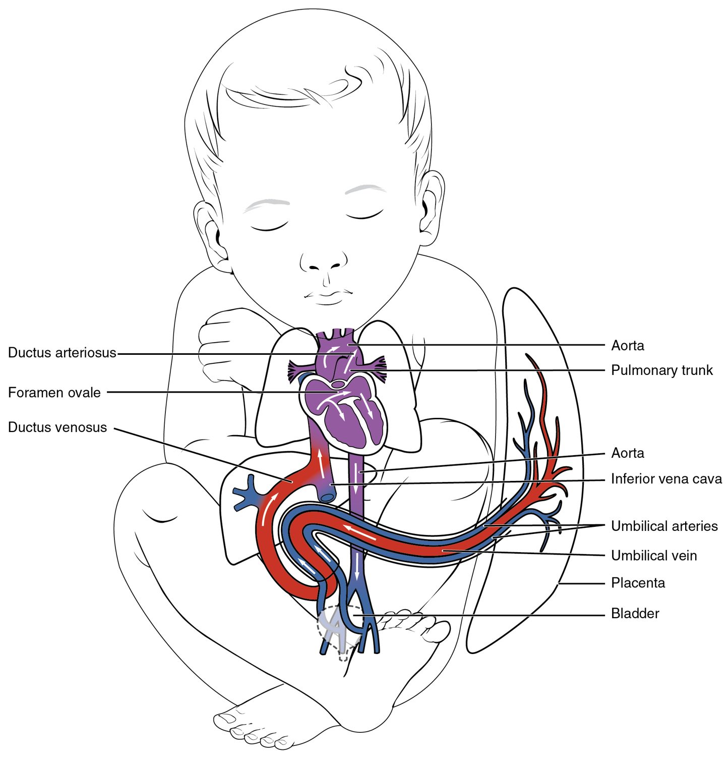
SECTION 20.6
Fetal Circulation
The fetus gets oxygen from the placenta
The lungs are bypassed before birth
Shortcuts: ductus arteriosus, foramen ovale
They close at birth
Fetal circulation
PN 104 · Ch 20 — Blood Vessels and Circulation
20
Notes:
Before birth, the fetus gets oxygen from the placenta, not the lungs, so blood largely bypasses them through shunts — the ductus venosus, foramen ovale (between the atria), and ductus arteriosus. At birth, when breathing begins, these shunts normally close; failure to close causes congenital heart problems.

Slide 21
CHAPTER 20
Key Takeaways
Arteries carry blood from the heart, veins return it, and capillaries are where exchange occurs.
Blood pressure is highest in the arteries and drives flow through the circuit.
Capillary exchange delivers nutrients and removes wastes; imbalance causes edema.
The systemic and pulmonary circuits carry blood to the body and the lungs.
Fetal circulation bypasses the lungs through shunts that close at birth.
PN 104 · Ch 20 — Blood Vessels and Circulation
21

Slide 22
CLINICAL CONNECTIONS
Why Blood Vessels Matter in Practical Nursing
Hypertension
Atherosclerosis
Chronically high blood pressure damages vessels and organs.
Arterial plaque narrows vessels and raises clot risk.
Pulse & BP
Edema
Core vital signs reflecting cardiovascular status.
Fluid leaking from capillaries causes tissue swelling.
Varicose Veins
IV Access
Failed venous valves let blood pool in the legs.
Superficial veins are used for fluids, medications, and blood draws.

