Slide 1
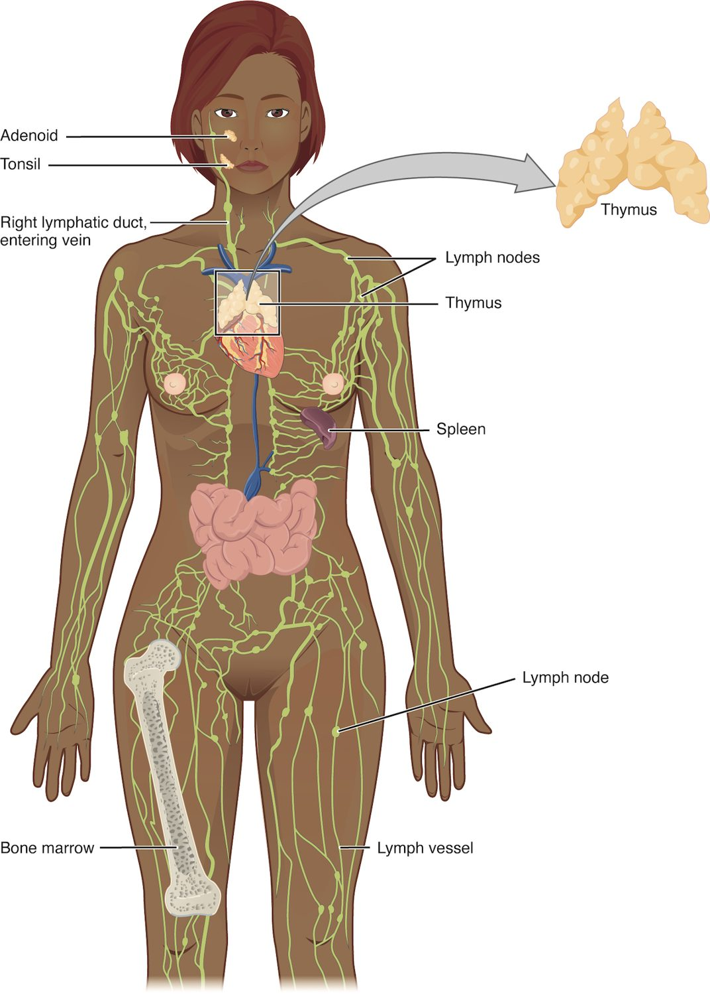
CHAPTER 21
The Lymphatic and Immune System
How the body defends itself against infection.
Anatomy & Physiology · Broward-Miami Health Institute
FACULTY EDITION

Slide 2
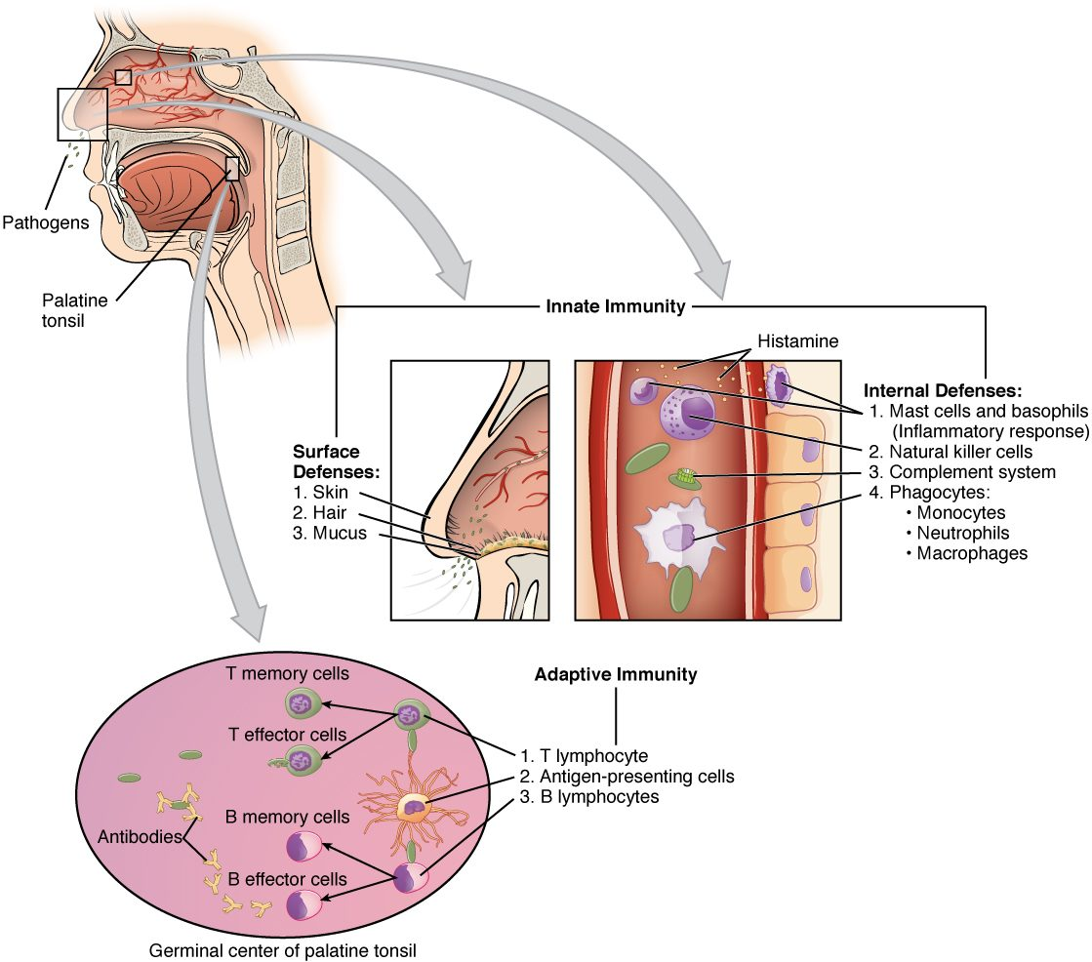
CHAPTER 21
Learning Objectives
After studying this chapter, students will be able to:
1
Identify the components and anatomy of the lymphatic system
2
Discuss the role of the innate immune response against pathogens
3
Describe the power of the adaptive immune response to cure disease
4
Explain immunological deficiencies and over-reactions of the immune system
5
Discuss the role of the immune response in transplantation and cancer
The body's innate and adaptive defenses.
PN 104 · Ch 21 — The Lymphatic and Immune System
2
Notes:
Preview the lymphatic and immune systems: the vessels and organs that drain fluid and house immune cells, the fast innate defenses (barriers and inflammation), and the specific adaptive responses of T and B cells that create lasting immunity.

Slide 3
21.1
SECTION
Anatomy of the Lymphatic and Immune Systems
The lymphatic vessels and organs that drain fluid and house immune cells.

Slide 4
SECTION 21.1
The Lymphatic System
Vessels, nodes, and lymphoid organs
Returns leaked fluid to the blood
Houses and transports immune cells
Includes spleen, thymus, tonsils
The lymphatic system
PN 104 · Ch 21 — The Lymphatic and Immune System
4
Notes:
The lymphatic system is a one-way network of vessels and organs that collects fluid leaked from capillaries and returns it to the blood, absorbs fats from the gut, and houses immune cells. Its organs include the lymph nodes, spleen, thymus, and tonsils.

Slide 5
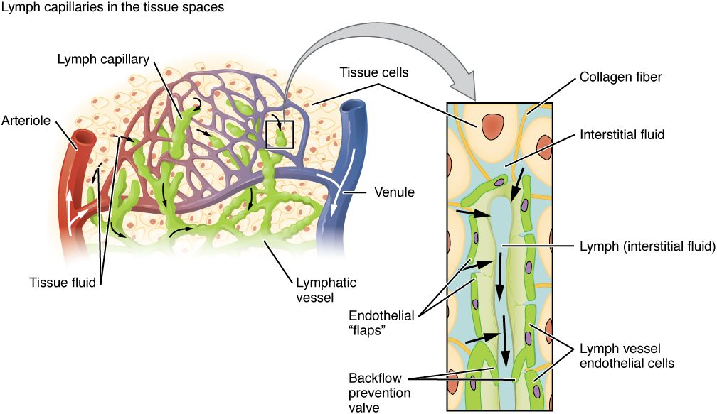
SECTION 21.1
Formation of Lymph
How lymph forms and drains
Capillaries leak fluid into tissues
Lymphatic capillaries collect it
The fluid is now called lymph
It returns to the bloodstream
PN 104 · Ch 21 — The Lymphatic and Immune System
5
Notes:
Blood capillaries constantly leak a little fluid into the tissues. Lymphatic capillaries collect this excess (now called lymph) and carry it through larger vessels and nodes, eventually emptying it back into the great veins near the heart. This keeps tissue fluid balanced and prevents swelling.

Slide 6
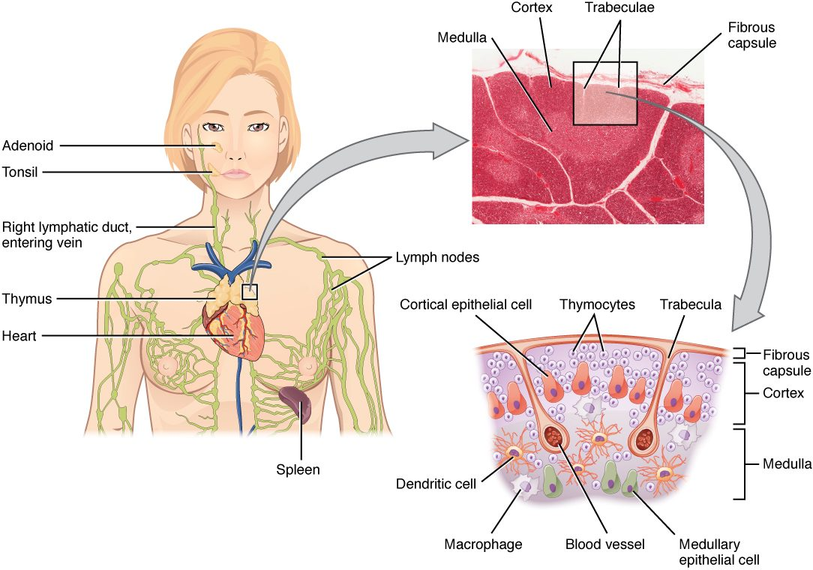
SECTION 21.1
Lymph Nodes
Small filtering organs along the vessels
Trap pathogens and debris
Packed with immune cells
Swell during infection
The structure of a lymph node
PN 104 · Ch 21 — The Lymphatic and Immune System
6
Notes:
Lymph nodes are bean-shaped filters spaced along the lymphatic vessels. As lymph passes through, macrophages and lymphocytes inside trap and destroy pathogens, cancer cells, and debris. Nodes swell and become tender during infection — the "swollen glands" you can feel in the neck.

Slide 7
21.2
SECTION
Barrier Defenses and the Innate Immune Response
The body's first lines of defense — barriers and the innate response.

Slide 8
SECTION 21.2
Innate vs. Adaptive Immunity
Two arms of defense
Innate: fast, general, present at birth
Adaptive: slower, specific, learned
Barriers are the first line
Innate and adaptive immunity
PN 104 · Ch 21 — The Lymphatic and Immune System
8
Notes:
Immunity has two arms. Innate immunity is fast and general — physical barriers (skin, mucous membranes), plus cells and chemicals that attack any invader. Adaptive immunity is slower but specific, learning to target a particular pathogen and remembering it. Together they form a layered defense.

Slide 9
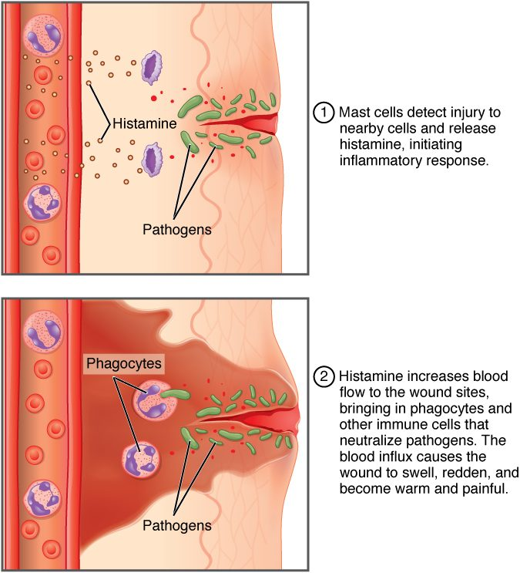
SECTION 21.2
Inflammation
A core innate response to injury
Mast cells release histamine
Vessels dilate and become leaky
Causes redness, heat, swelling, pain
The inflammatory response
PN 104 · Ch 21 — The Lymphatic and Immune System
9
Notes:
Inflammation is a key innate response to injury or infection. Damaged cells and mast cells release histamine, dilating local vessels and making them leaky. This brings more blood and immune cells to the area, producing the classic signs — redness, heat, swelling, and pain — that help wall off and clear the threat.

Slide 10
21.3
SECTION
The Adaptive Immune Response: T lymphocytes and Their Functional Types
Adaptive immunity carried out by T lymphocytes.

Slide 11
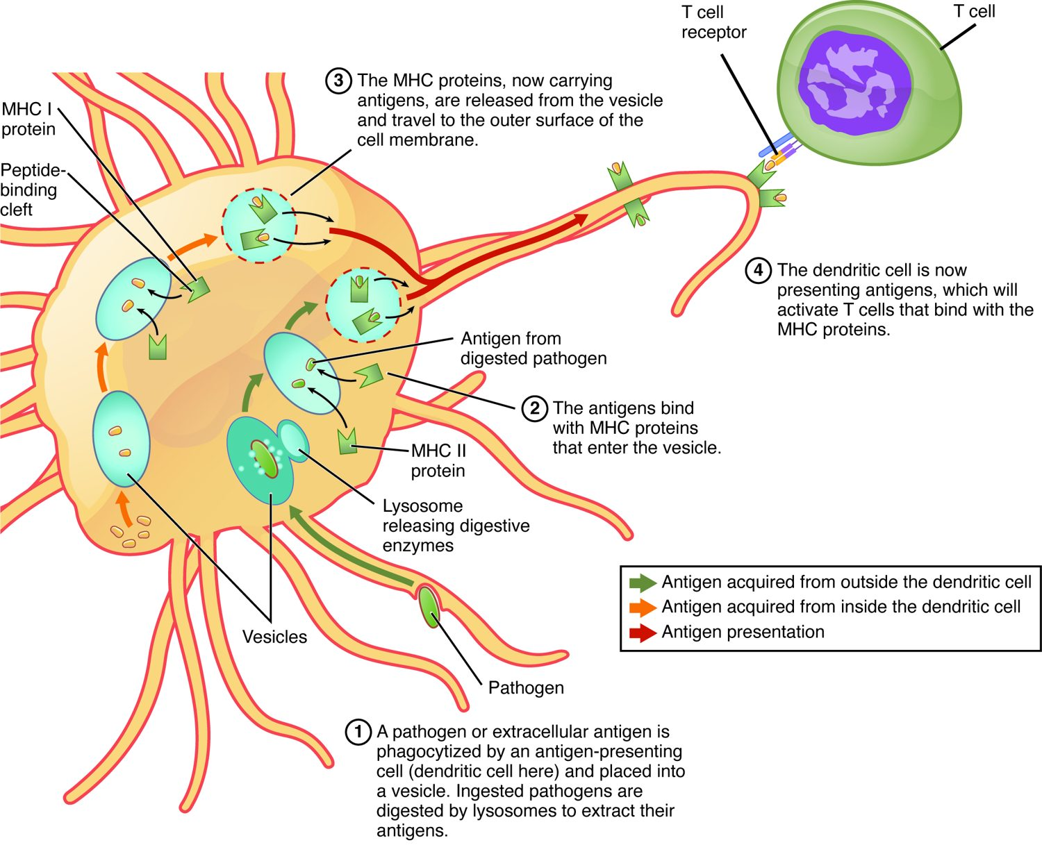
SECTION 21.3
Antigen Presentation
T cells must be shown the enemy
Antigen-presenting cells display antigens
Displayed on MHC molecules
This activates the matching T cell
Antigen presentation to a T cell
PN 104 · Ch 21 — The Lymphatic and Immune System
11
Notes:
T cells can't recognize whole pathogens directly. Antigen-presenting cells (like dendritic cells) engulf a pathogen and display its fragments on MHC molecules at their surface. A T cell whose receptor matches that antigen is activated — the trigger that launches the adaptive response.

Slide 12
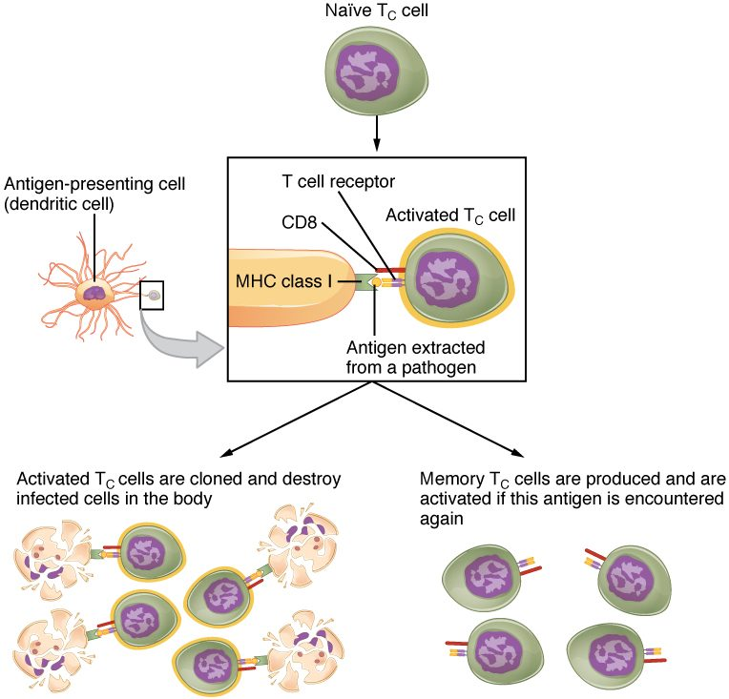
SECTION 21.3
Types of T Cells
Helper T cells coordinate the response
Cytotoxic T cells kill infected cells
Memory T cells remember the pathogen
Central to adaptive immunity
Helper and cytotoxic T cells
PN 104 · Ch 21 — The Lymphatic and Immune System
12
Notes:
Activated T cells specialize. Helper T cells (CD4) release signals that direct and amplify the whole immune response — the cells destroyed in HIV/AIDS. Cytotoxic T cells (CD8) directly kill virus-infected and cancerous cells. Memory T cells persist to respond faster if the same pathogen returns.

Slide 13
21.4
SECTION
The Adaptive Immune Response: B-lymphocytes and Antibodies
Adaptive immunity carried out by B lymphocytes and antibodies.

Slide 14
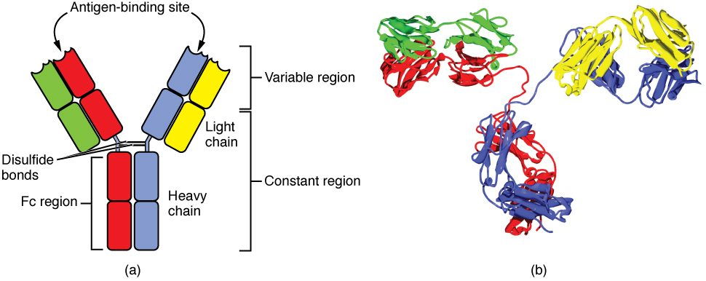
SECTION 21.4
Antibody Structure
The structure of an antibody
Y-shaped proteins made by B cells
Two antigen-binding tips
Each binds one specific antigen
Tag pathogens for destruction
PN 104 · Ch 21 — The Lymphatic and Immune System
14
Notes:
Antibodies (immunoglobulins) are Y-shaped proteins. The two tips of the Y have variable regions that bind one specific antigen, while the stem signals other immune components. Antibodies neutralize toxins, clump pathogens, and flag them for destruction — they don't kill directly but mark targets.

Slide 15
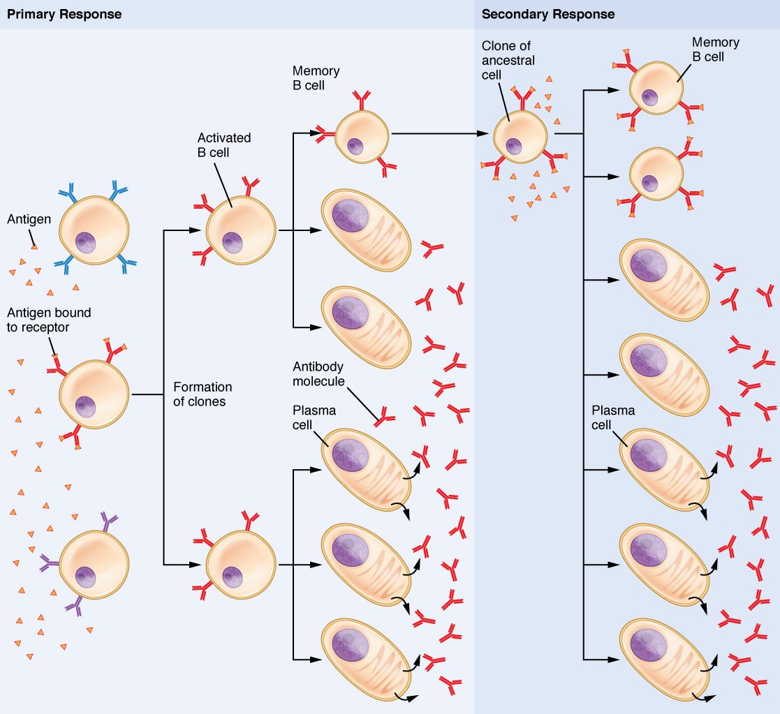
SECTION 21.4
B Cell Activation
B cells make antibodies
Activated B cells become plasma cells
Plasma cells pump out antibodies
Memory B cells remain behind
B cell activation and antibody production
PN 104 · Ch 21 — The Lymphatic and Immune System
15
Notes:
When a B cell meets its matching antigen (usually with helper T cell assistance), it multiplies into plasma cells that mass-produce antibodies against that antigen. Some become memory B cells, ready to respond quickly to a future exposure — the basis of long-term immunity.

Slide 16
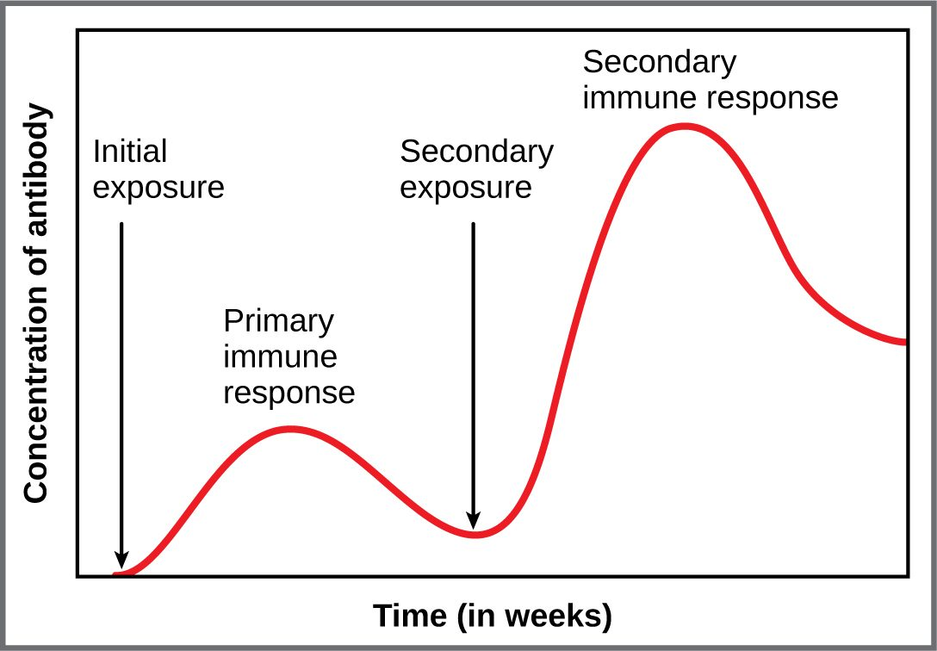
SECTION 21.4
Primary vs. Secondary Response
First exposure → slow, weak response
Memory cells are formed
Second exposure → fast, strong response
The principle behind vaccines
The primary and secondary immune response
PN 104 · Ch 21 — The Lymphatic and Immune System
16
Notes:
The first exposure to a pathogen produces a slow, modest antibody response while memory cells form. A second exposure to the same pathogen triggers a much faster, stronger response that often stops illness before it starts. Vaccines exploit this by safely creating memory without causing disease.

Slide 17
21.5
SECTION
The Immune Response against Pathogens
How the immune defenses work together against an infection.

Slide 18
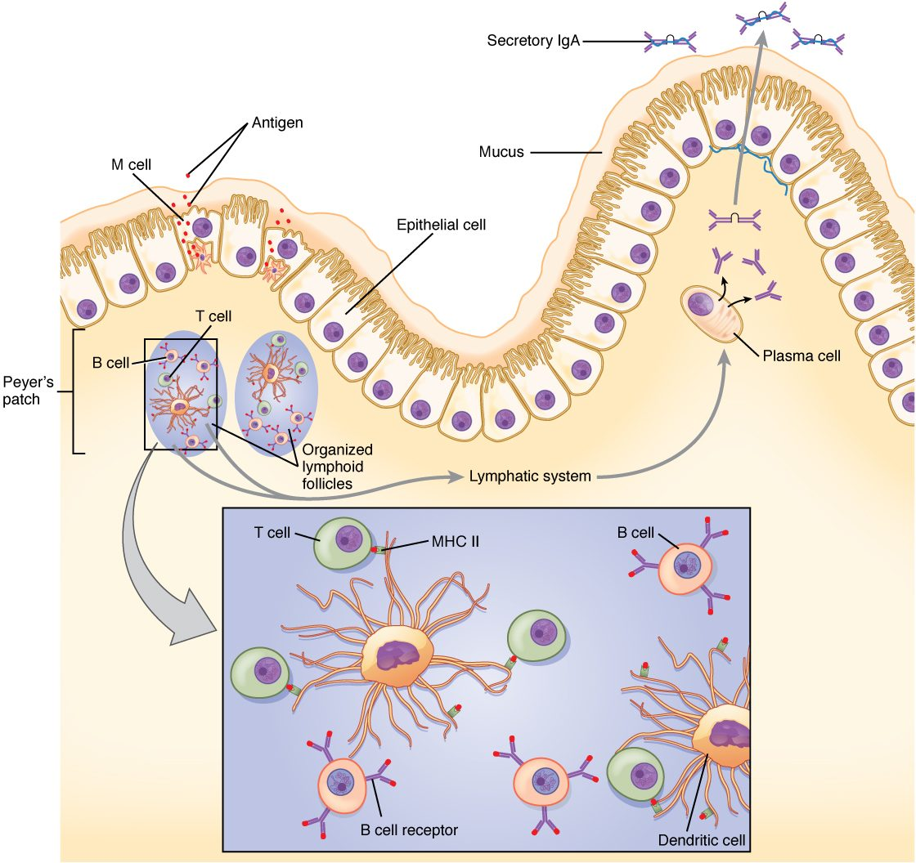
SECTION 21.5
A Coordinated Immune Response
The defenses work as a team
Barriers and innate cells respond first
Adaptive immunity targets the pathogen
Memory protects against reinfection
A coordinated immune response
PN 104 · Ch 21 — The Lymphatic and Immune System
18
Notes:
A real infection calls on every layer at once. Barriers and innate cells respond immediately, antigen-presenting cells alert the adaptive system, T and B cells mount a specific attack, and memory cells remain afterward. This coordinated, overlapping defense is what clears most infections and protects against the next one.

Slide 19
CHAPTER 21
Key Takeaways
The lymphatic system drains tissue fluid and houses the immune system.
Innate immunity provides fast, general defense; adaptive immunity is specific and remembers.
Inflammation brings defenses to the site of injury or infection.
T cells coordinate the response and kill infected cells; B cells make antibodies.
Immune memory underlies long-term protection and the success of vaccines.
PN 104 · Ch 21 — The Lymphatic and Immune System
19

Slide 20
CLINICAL CONNECTIONS
Why the Immune System Matters in Practical Nursing
Vaccination
Allergies
Builds immune memory without causing the disease.
An overactive immune response to harmless substances.
Autoimmune Disease
HIV/AIDS
The immune system attacks the body's own tissues.
The virus destroys helper T cells, crippling immunity.
Lymph Node Exam
Immunocompromise
Swollen nodes can signal infection or, sometimes, cancer.
Weakened immunity raises infection risk in many patients.

