Slide 1
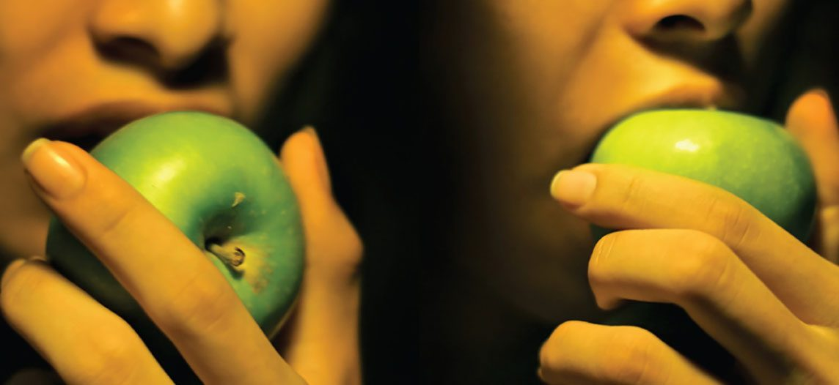
CHAPTER 23
The Digestive System
How the body breaks down food and absorbs nutrients.
Anatomy & Physiology · Broward-Miami Health Institute
FACULTY EDITION

Slide 2
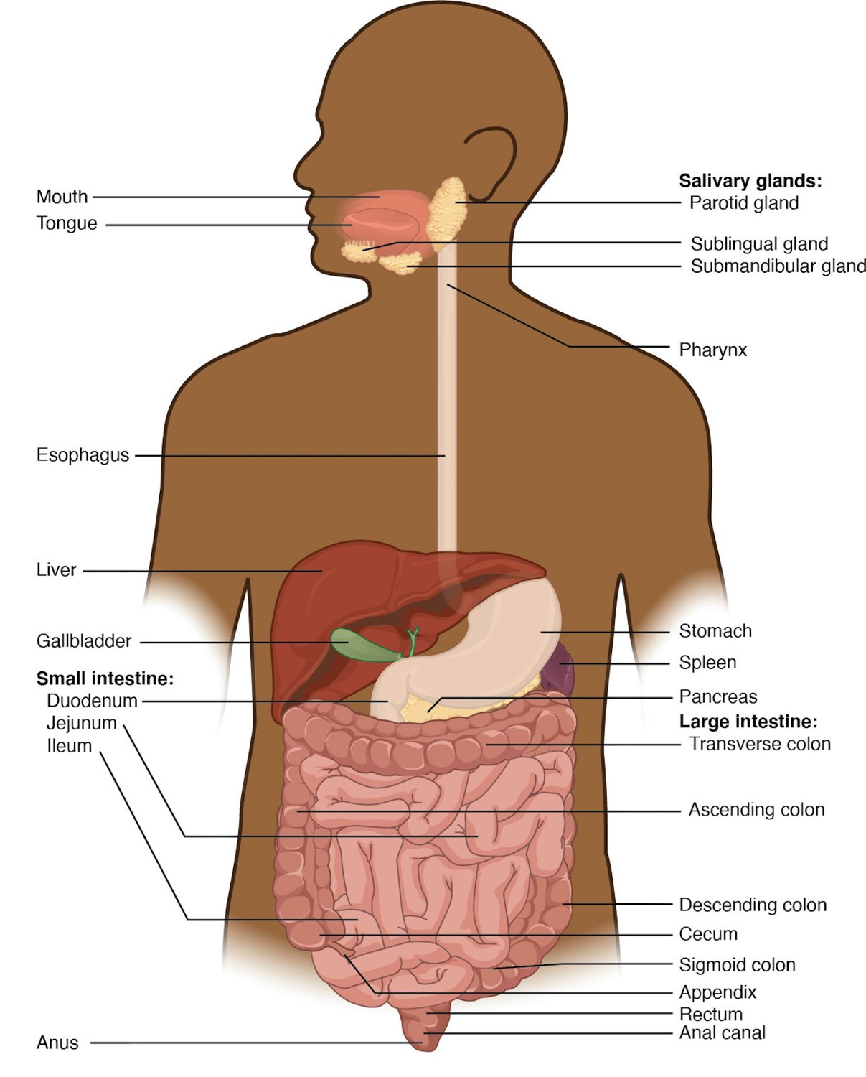
CHAPTER 23
Learning Objectives
After studying this chapter, students will be able to:
1
List and describe the functional anatomy of the organs and accessory organs of the digestive system
2
Discuss the processes and control of ingestion, propulsion, mechanical digestion, chemical digestion, absorption, and defecation
3
Discuss the roles of the liver, pancreas, and gallbladder in digestion
The organs of the digestive system.
PN 104 · Ch 23 — The Digestive System
2
Notes:
Preview the digestive system: the GI tract and accessory organs, the processes of digestion and their regulation, each organ from mouth to large intestine, the liver, gallbladder, and pancreas, and how nutrients are finally absorbed.

Slide 3
23.1
SECTION
Overview of the Digestive System
The organs of the digestive tract and its accessory glands.

Slide 4
SECTION 23.1
The Digestive System
A long tube from mouth to anus
The GI tract (alimentary canal)
Plus accessory organs
Breaks food into absorbable nutrients
The digestive system
PN 104 · Ch 23 — The Digestive System
4
Notes:
The digestive system is a continuous tube — the gastrointestinal (GI) tract — running from mouth to anus, with accessory organs (teeth, tongue, salivary glands, liver, gallbladder, pancreas) that aid digestion. Together they break food into nutrients the body can absorb and eliminate the waste.

Slide 5
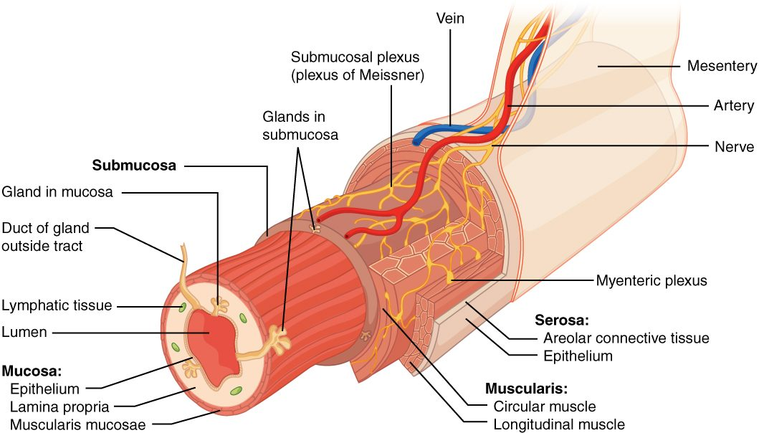
SECTION 23.1
The GI Tract Wall
The layers of the GI tract wall
Four layers throughout the tract
Mucosa lines the lumen
Submucosa carries vessels and nerves
Muscularis moves food along
PN 104 · Ch 23 — The Digestive System
5
Notes:
From the esophagus to the anus, the GI tract wall has four layers: the mucosa (inner lining that secretes and absorbs), the submucosa (connective tissue with vessels and nerves), the muscularis (smooth muscle that mixes and propels), and the outer serosa. This shared plan is modified in each organ.

Slide 6
23.2
SECTION
Digestive System Processes and Regulation
The processes of digestion and how they are regulated.

Slide 7
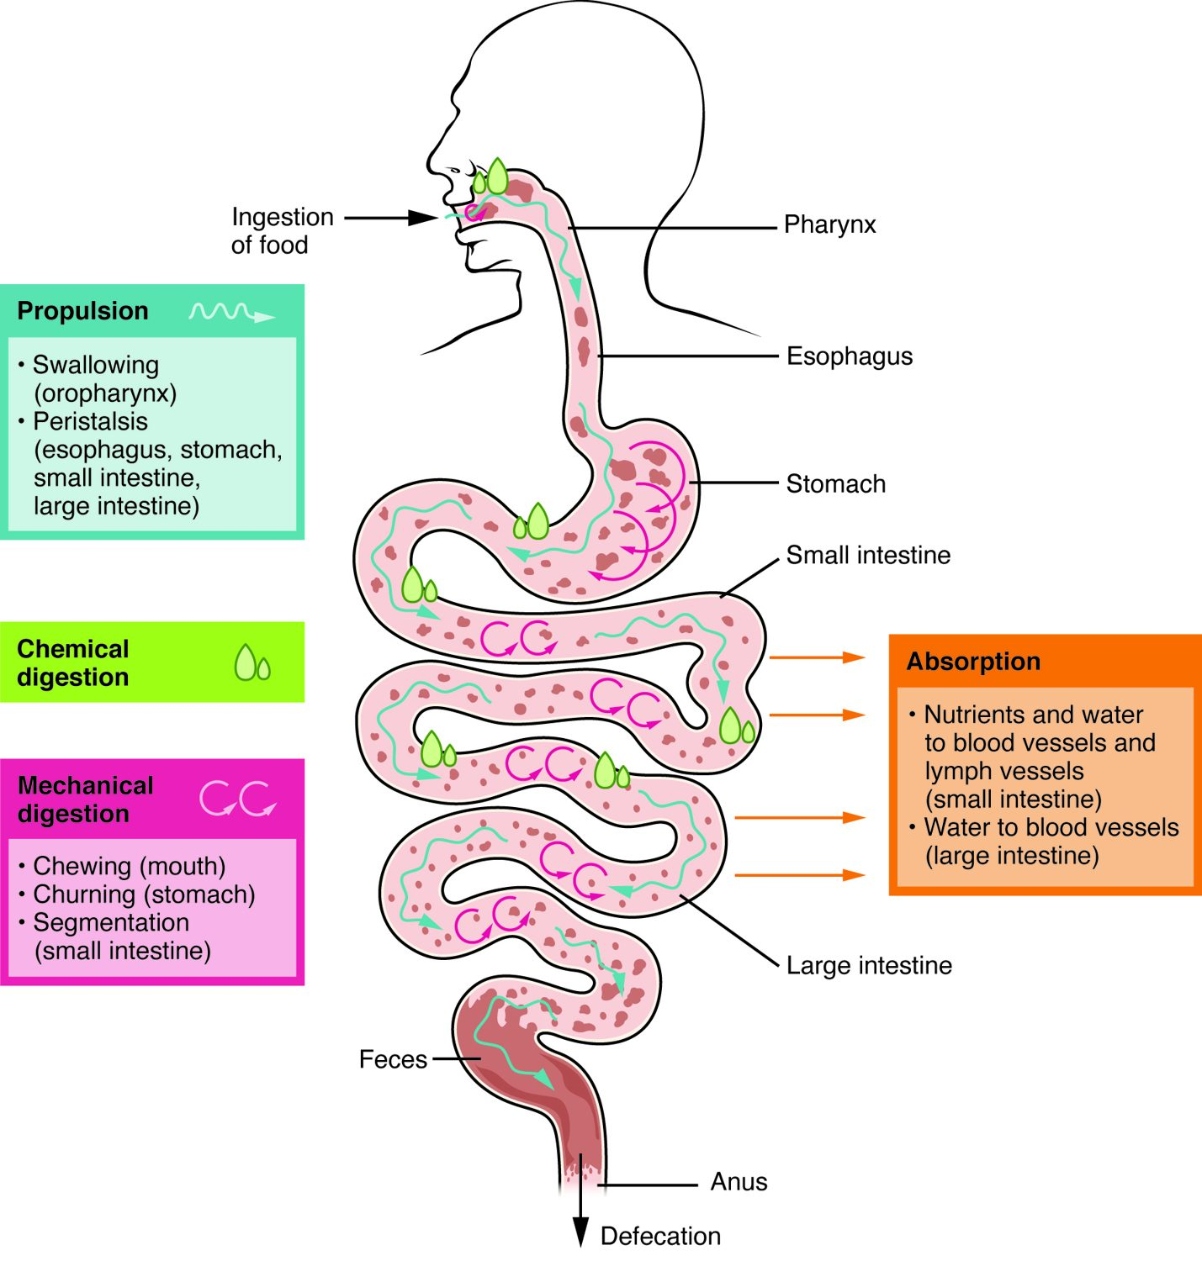
SECTION 23.2
Digestive Processes
Ingestion takes food in
Propulsion moves it along
Mechanical and chemical digestion break it down
Absorption and defecation finish
The processes of the digestive system
PN 104 · Ch 23 — The Digestive System
7
Notes:
Digestion involves six processes: ingestion (eating), propulsion (swallowing and peristalsis), mechanical digestion (chewing, churning), chemical digestion (enzymes breaking bonds), absorption (nutrients into the blood), and defecation (eliminating waste). Nervous and hormonal signals coordinate them.

Slide 8
23.3
SECTION
The Mouth, Pharynx, and Esophagus
Where digestion begins — the mouth, pharynx, and esophagus.

Slide 9
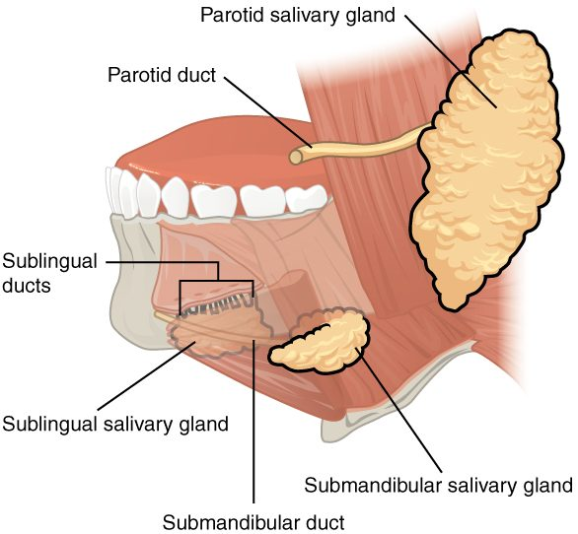
SECTION 23.3
The Salivary Glands
Three pairs of glands
Parotid, submandibular, sublingual
Saliva moistens and begins digestion
Contains an enzyme for starch
The salivary glands
PN 104 · Ch 23 — The Digestive System
9
Notes:
Three pairs of salivary glands — parotid, submandibular, and sublingual — secrete saliva into the mouth. Saliva moistens food for swallowing, cleanses the mouth, and contains salivary amylase, which begins the chemical digestion of starch. (The parotid is the gland that swells in mumps.)

Slide 10
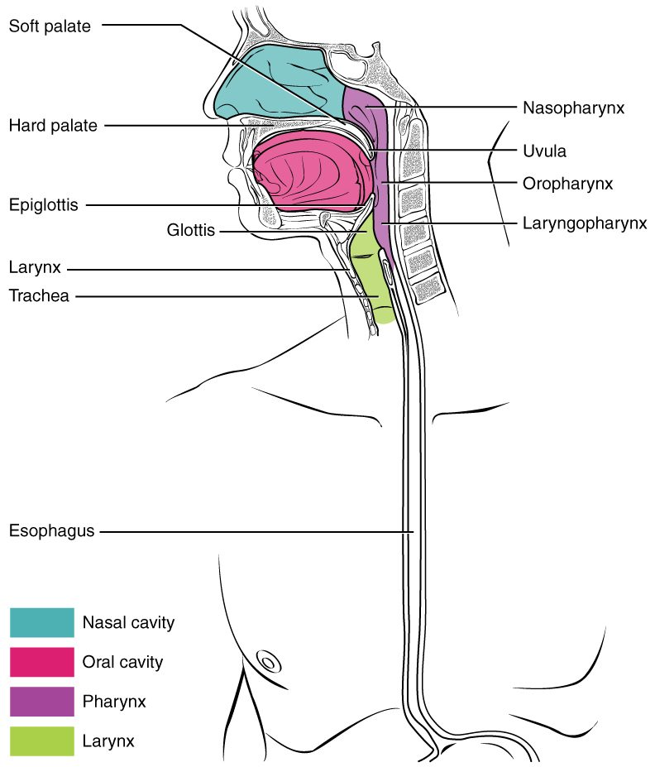
SECTION 23.3
Swallowing & the Pharynx
The pharynx is shared with the airway
Swallowing moves the bolus down
The epiglottis protects the airway
Peristalsis carries food to the stomach
The pharynx and swallowing
PN 104 · Ch 23 — The Digestive System
10
Notes:
The pharynx is a shared passage for food and air, so swallowing must protect the airway: the epiglottis covers the larynx as the bolus passes. Then peristalsis — waves of muscle contraction — carries food down the esophagus to the stomach. Impaired swallowing (dysphagia) raises the risk of aspiration.

Slide 11
23.4
SECTION
The Stomach
The stomach — storing and digesting food into chyme.

Slide 12
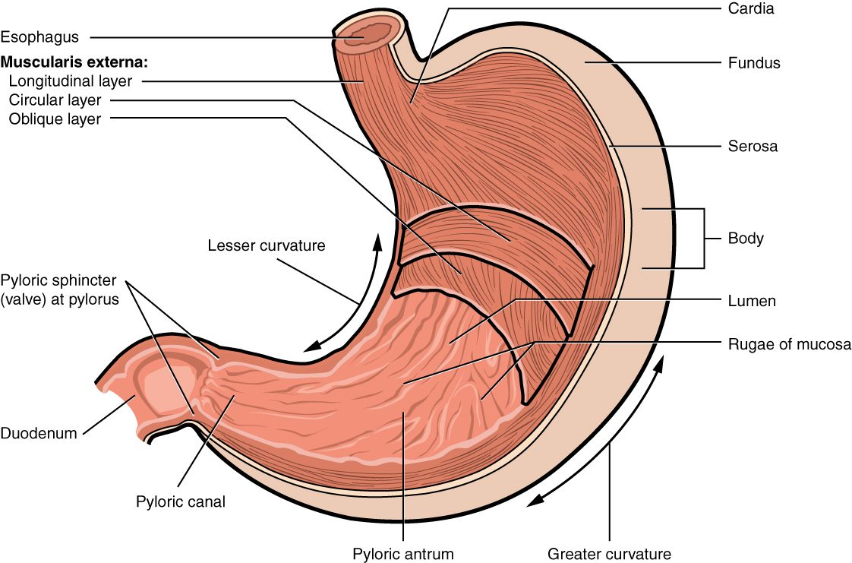
SECTION 23.4
The Stomach
The anatomy of the stomach
A muscular, J-shaped sac
Stores and churns food
Regions: fundus, body, pylorus
Rugae let it expand
PN 104 · Ch 23 — The Digestive System
12
Notes:
The stomach is a muscular sac that stores swallowed food, churns it, and mixes it with gastric juice into a paste called chyme. Its regions are the fundus, body, and pylorus, and internal folds (rugae) let it expand after a meal. The pyloric sphincter controls release into the small intestine.

Slide 13
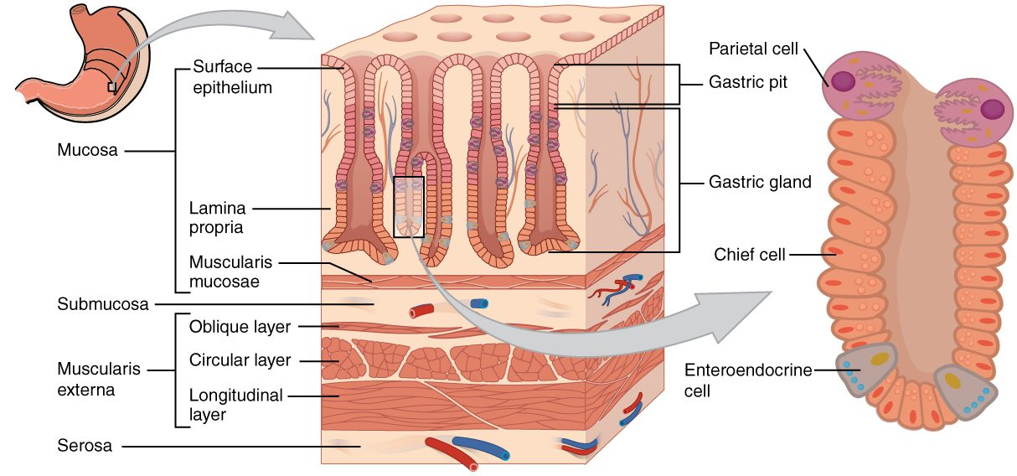
SECTION 23.4
Gastric Glands
The gastric glands
Gastric pits line the stomach
Secrete acid and enzymes
Hydrochloric acid kills microbes
Pepsin digests protein
PN 104 · Ch 23 — The Digestive System
13
Notes:
The stomach lining is dotted with gastric pits leading to glands. Their cells secrete hydrochloric acid (which kills microbes and activates enzymes), the protein-digesting enzyme pepsin, and protective mucus. A breakdown in that protection lets acid damage the wall, causing peptic ulcers.

Slide 14
23.5
SECTION
The Small and Large Intestines
The intestines — where most digestion and absorption happen.

Slide 15
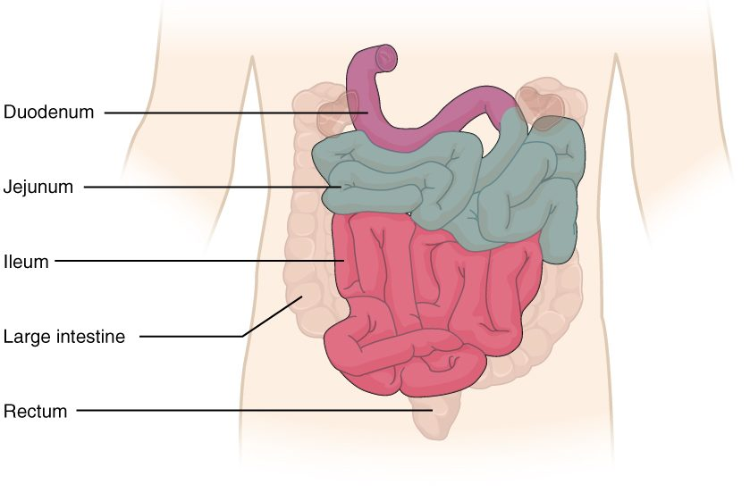
SECTION 23.5
Small & Large Intestines
The small and large intestines
Small intestine: duodenum, jejunum, ileum
Most digestion and absorption happen here
Large intestine absorbs water
Ends at the rectum and anus
PN 104 · Ch 23 — The Digestive System
15
Notes:
The small intestine (duodenum, jejunum, ileum) is where most chemical digestion and nutrient absorption occur, aided by bile and pancreatic enzymes. The large intestine absorbs water and electrolytes, houses helpful bacteria, and compacts waste into feces for elimination.

Slide 16
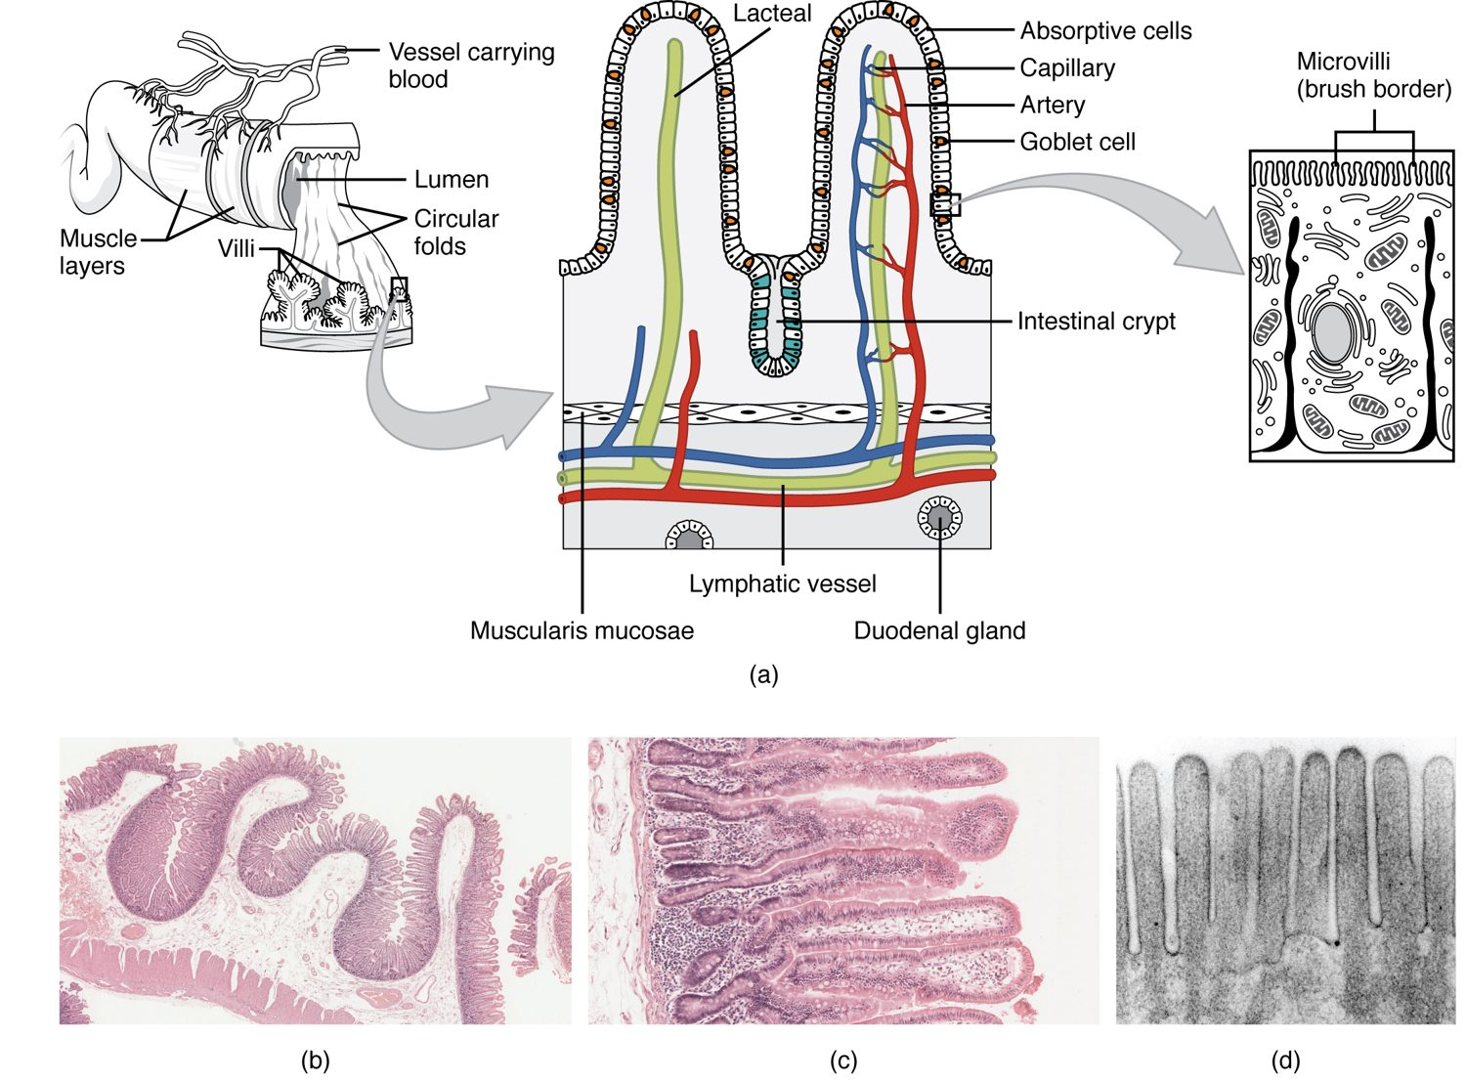
SECTION 23.5
Villi & Absorption
The small intestine maximizes surface area
Folds, villi, and microvilli
A huge area for absorption
Each villus has vessels and a lacteal
Villi of the small intestine
PN 104 · Ch 23 — The Digestive System
16
Notes:
The small intestine's lining is folded into circular folds covered with finger-like villi, themselves covered in microvilli — together multiplying the absorptive surface enormously. Each villus contains a capillary network and a lymphatic lacteal that carry absorbed nutrients into the body.

Slide 17
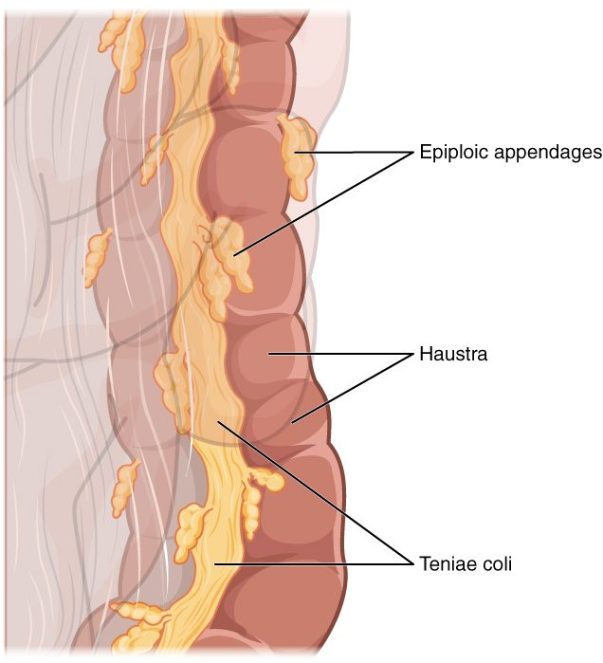
SECTION 23.5
The Large Intestine
Frames the abdomen
Absorbs water and salts
Pouches (haustra) along its length
Bacteria make some vitamins
The large intestine
PN 104 · Ch 23 — The Digestive System
17
Notes:
The large intestine (colon) frames the abdomen and finishes the job: it absorbs remaining water and electrolytes, turning liquid residue into formed stool. Its pouched wall (haustra) and bands of muscle (teniae coli) are distinctive, and resident bacteria produce some vitamins, such as K and several B vitamins.

Slide 18
23.6
SECTION
Accessory Organs in Digestion: The Liver, Pancreas, and Gallbladder
The liver, gallbladder, and pancreas that aid digestion.

Slide 19
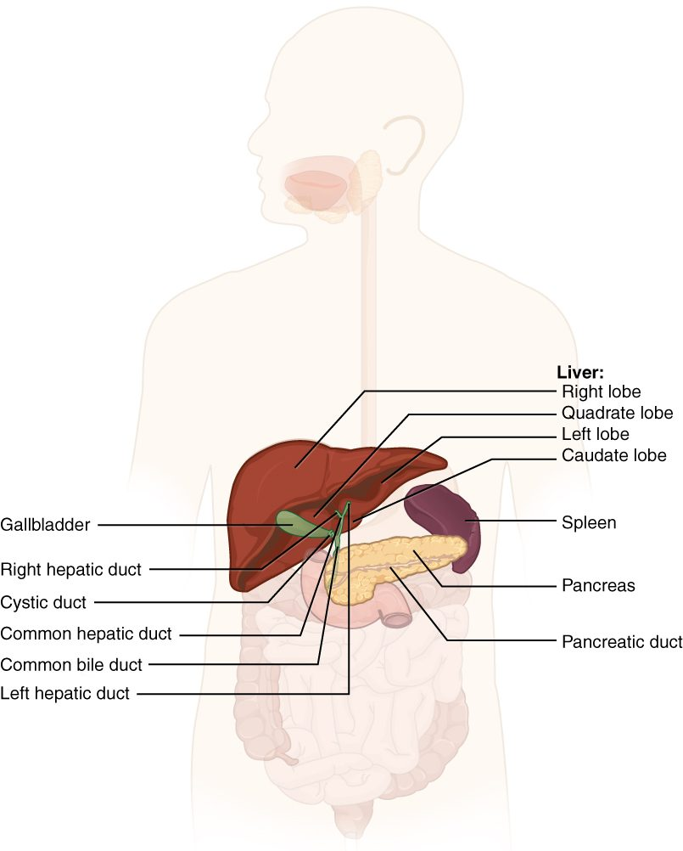
SECTION 23.6
The Accessory Organs
Liver, gallbladder, and pancreas
Secrete into the small intestine
The liver makes bile
The pancreas makes digestive enzymes
Liver, gallbladder, and pancreas
PN 104 · Ch 23 — The Digestive System
19
Notes:
Three accessory organs empty into the duodenum. The liver produces bile (which emulsifies fats) and processes absorbed nutrients; the gallbladder stores and concentrates bile; and the pancreas secretes digestive enzymes and bicarbonate. Their ducts join to deliver these into the small intestine.

Slide 20
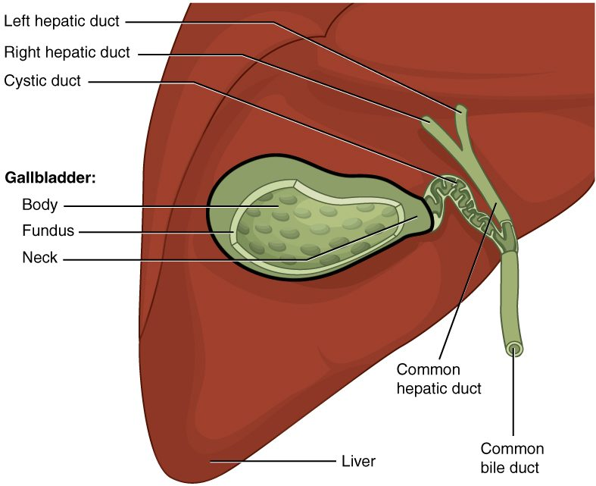
SECTION 23.6
Gallbladder & Bile Ducts
The gallbladder stores bile
Bile emulsifies fats
Ducts carry bile to the intestine
Gallstones can block the ducts
The gallbladder and bile ducts
PN 104 · Ch 23 — The Digestive System
20
Notes:
Bile made by the liver is stored and concentrated in the gallbladder, then released through the cystic and common bile ducts into the duodenum when fatty food arrives. Bile breaks fat into tiny droplets for digestion. Hardened bile (gallstones) can block the ducts, causing pain and jaundice.

Slide 21
23.7
SECTION
Chemical Digestion and Absorption: A Closer Look
How nutrients are chemically broken down and absorbed.

Slide 22
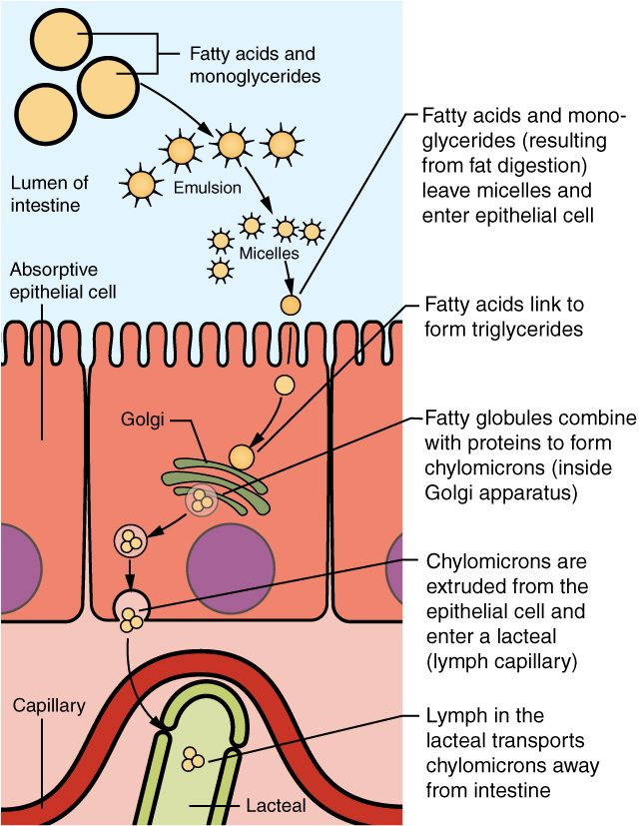
SECTION 23.7
Absorption of Nutrients
Nutrients cross the intestinal lining
Sugars and amino acids enter the blood
Fats enter lymphatic lacteals
Carried to the body's cells
Absorption across the intestinal wall
PN 104 · Ch 23 — The Digestive System
22
Notes:
After chemical digestion breaks food into small molecules, they are absorbed across the intestinal lining. Simple sugars and amino acids pass into the blood capillaries (heading to the liver), while digested fats are packaged and enter the lymphatic lacteals. From there, nutrients reach cells throughout the body.

Slide 23
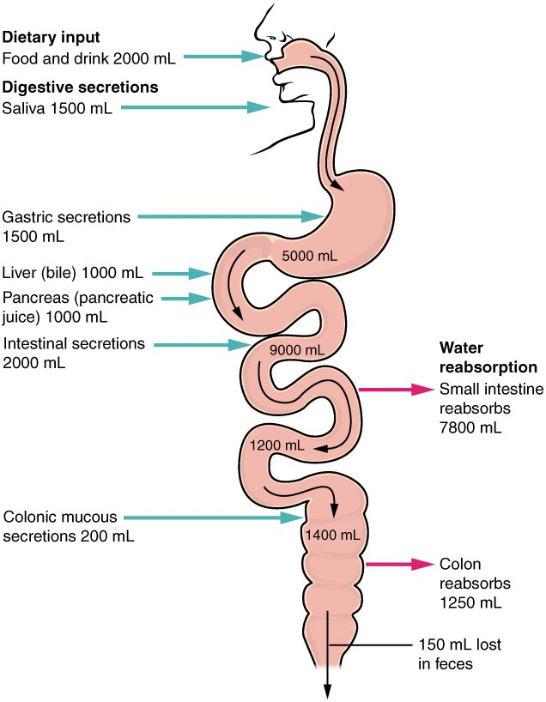
SECTION 23.7
Fluid Balance in Digestion
The gut handles large fluid volumes
Most is reabsorbed, not lost
The small intestine absorbs the most
Diarrhea risks dehydration
Water balance in the digestive tract
PN 104 · Ch 23 — The Digestive System
23
Notes:
The digestive tract processes a remarkable volume of fluid each day — from food, drink, and the body's own secretions (saliva, gastric juice, bile, pancreatic juice). Nearly all of it is reabsorbed, mostly in the small intestine. When this fails, as in severe diarrhea or vomiting, dehydration can develop quickly.

Slide 24
CHAPTER 23
Key Takeaways
The digestive system is a long tract plus accessory organs that process food.
Digestion involves mechanical and chemical breakdown, then absorption.
The mouth and stomach begin digestion; the small intestine completes most of it.
The liver, gallbladder, and pancreas supply bile and enzymes for digestion.
The large intestine absorbs water and forms stool for elimination.
PN 104 · Ch 23 — The Digestive System
24

Slide 25
CLINICAL CONNECTIONS
Why the Digestive System Matters in Practical Nursing
Dysphagia & Aspiration
Peptic Ulcers
Trouble swallowing risks food entering the airway.
Acid damage to the stomach or duodenal lining.
Gallstones
Diarrhea & Dehydration
Hardened bile can block ducts and cause severe pain.
Lost intestinal fluid can quickly unbalance the body.
Nutrition
Liver Function
Digestion and absorption underlie all nutritional care.
The liver is central to digestion, metabolism, and detoxification.

