Slide 1

CHAPTER 24
Metabolism and Nutrition
How the body turns food into energy and building blocks.
Anatomy & Physiology · Broward-Miami Health Institute
FACULTY EDITION

Slide 2
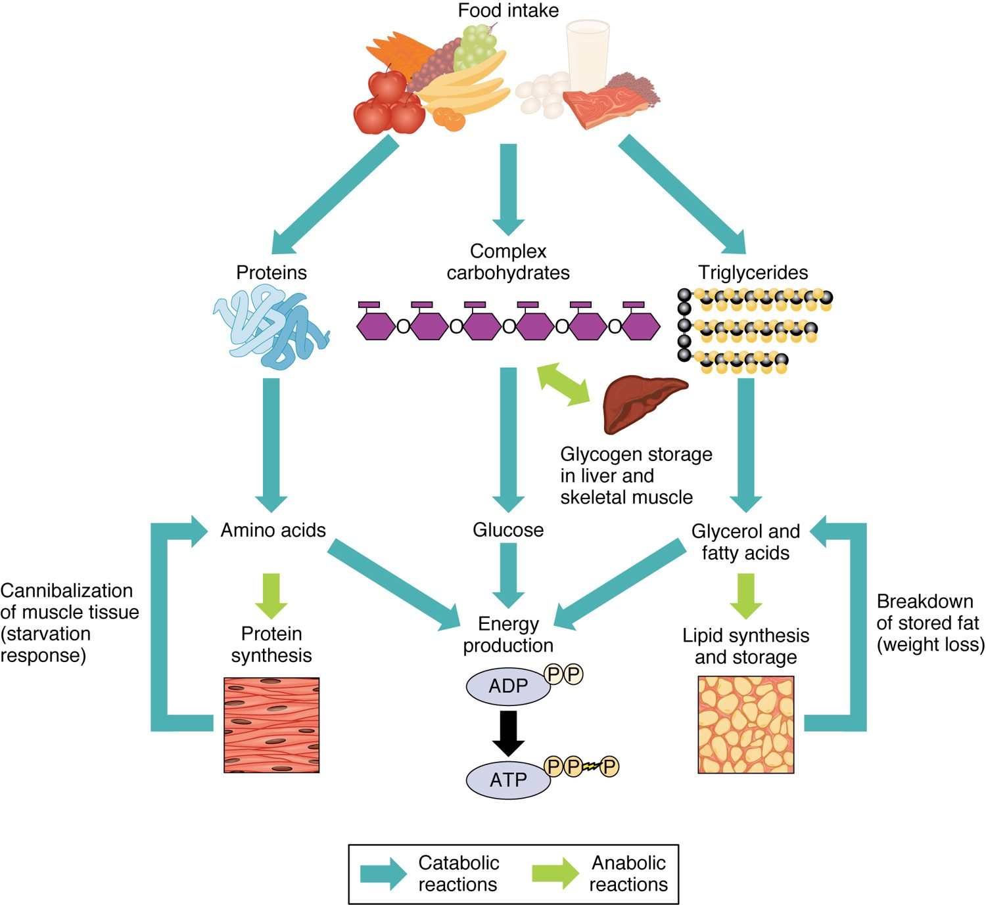
CHAPTER 24
Learning Objectives
After studying this chapter, students will be able to:
1
Describe the processes involved in anabolic and catabolic reactions
2
List and describe the steps necessary for carbohydrate, lipid, and protein metabolism
3
Explain the processes that regulate glucose levels during the absorptive and postabsorptive states
4
Explain how metabolism is essential to maintaining body temperature (thermoregulation)
5
Summarize the importance of vitamins and minerals in the diet Eating is essential to life
Metabolism: building up and breaking down.
PN 104 · Ch 24 — Metabolism and Nutrition
2
Notes:
Preview metabolism and nutrition: how the body extracts energy from carbohydrates, fats, and proteins, stores and mobilizes fuel between meals, balances energy and heat, and meets its nutritional needs through a balanced diet.

Slide 3
24.1
SECTION
Overview of Metabolic Reactions
Metabolism — the chemical reactions that power the body.

Slide 4
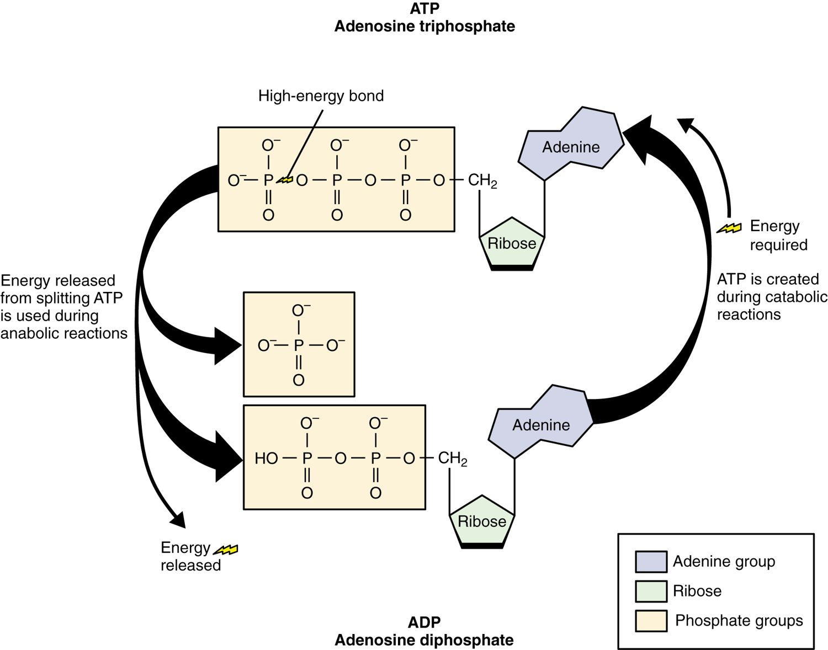
SECTION 24.1
ATP — The Energy Currency
ATP stores and delivers energy
Made by breaking down nutrients
Releases energy when split to ADP
Powers nearly all cell work
The ATP–ADP energy cycle
PN 104 · Ch 24 — Metabolism and Nutrition
4
Notes:
ATP (adenosine triphosphate) is the body's energy currency. Energy released by breaking down food is captured in ATP's high-energy bonds; when ATP is split to ADP, that energy powers muscle contraction, nerve signals, and synthesis. Cells continuously recycle between ATP and ADP.

Slide 5
SECTION 24.1
Anabolism & Catabolism
Metabolism = all chemical reactions
Catabolism breaks molecules down
Anabolism builds molecules up
Food fuels both
Catabolic and anabolic reactions
PN 104 · Ch 24 — Metabolism and Nutrition
5
Notes:
Metabolism is the sum of all chemical reactions in the body, split into two types: catabolism breaks large molecules into smaller ones, releasing energy (like digesting food), and anabolism uses energy to build complex molecules (like making proteins). Nutrients feed both, and the balance shifts with feeding and fasting.

Slide 6
24.2
SECTION
Carbohydrate Metabolism
How the body extracts energy from carbohydrates.

Slide 7
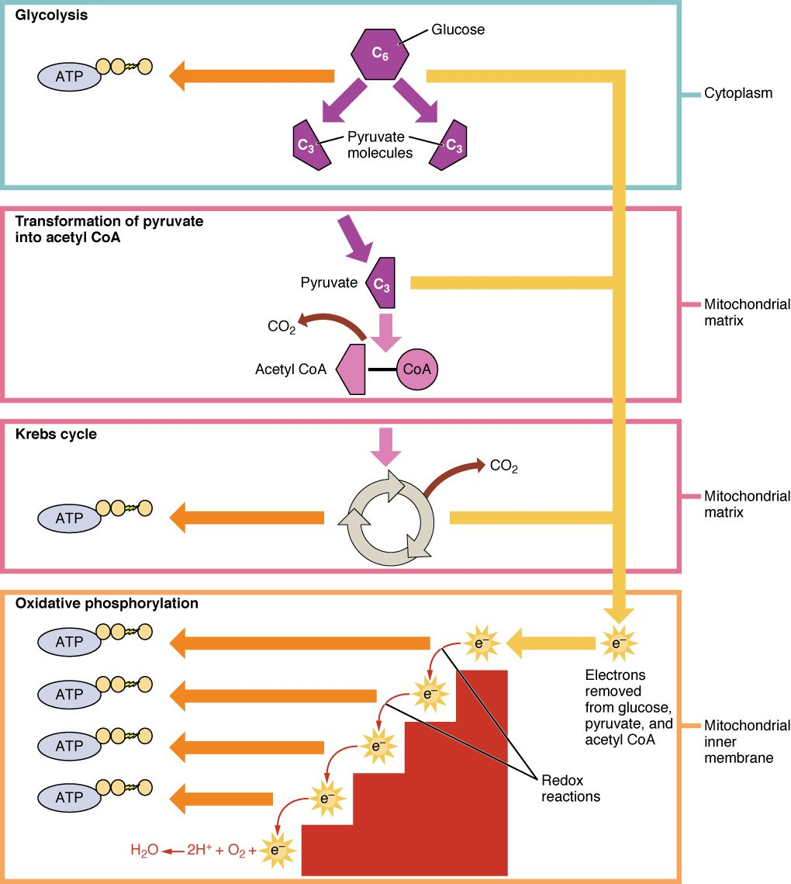
SECTION 24.2
Cellular Respiration
Glucose is broken down for ATP
Glycolysis splits glucose
The Krebs cycle extracts energy
The electron transport chain makes most ATP
An overview of cellular respiration
PN 104 · Ch 24 — Metabolism and Nutrition
7
Notes:
Cells extract energy from glucose in stages: glycolysis splits glucose in the cytoplasm, the Krebs (citric acid) cycle processes the products in the mitochondria, and the electron transport chain uses oxygen to generate the bulk of the ATP. The waste products are carbon dioxide and water. Glucose is the body's preferred fuel.

Slide 8
24.3
SECTION
Lipid Metabolism
How the body uses and transports fats.

Slide 9
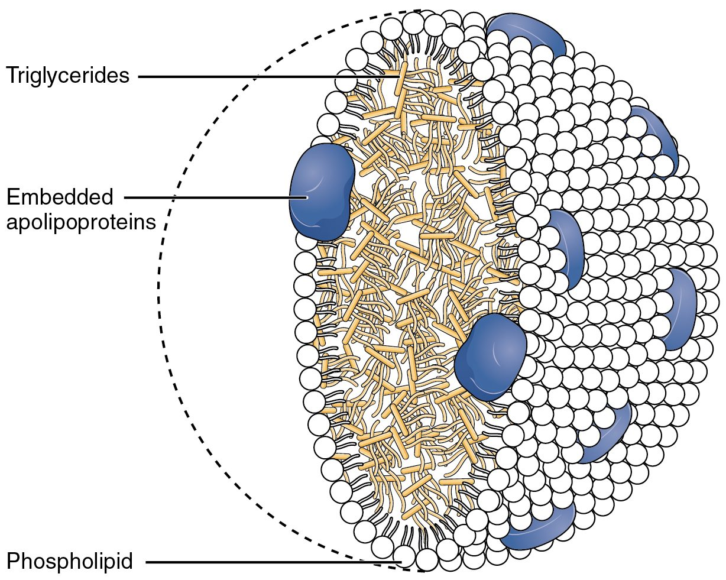
SECTION 24.3
Lipoproteins
Fats don't dissolve in blood
Carried in lipoprotein packages
LDL delivers cholesterol to tissues
HDL returns it to the liver
Lipoprotein structure
PN 104 · Ch 24 — Metabolism and Nutrition
9
Notes:
Because fats can't dissolve in watery blood, they travel wrapped in lipoproteins. Low-density lipoprotein (LDL, "bad" cholesterol) delivers cholesterol to tissues and can build up in artery walls; high-density lipoprotein (HDL, "good" cholesterol) carries it back to the liver. Their balance affects cardiovascular risk.

Slide 10
24.5
SECTION
Metabolic States of the Body
How metabolism shifts between the fed and fasting states.

Slide 11
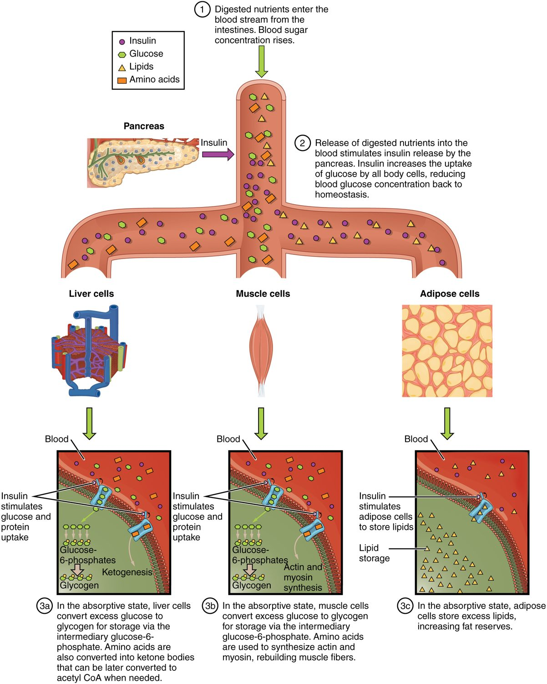
SECTION 24.5
The Absorptive State
The "fed" state after a meal
Blood glucose is high
Insulin drives storage
Glucose, fat, and protein are stored
The absorptive (fed) state
PN 104 · Ch 24 — Metabolism and Nutrition
11
Notes:
After a meal, the body is in the absorptive state: blood glucose rises and insulin signals tissues to take it up. The liver and muscles store glucose as glycogen, excess is converted to fat, and amino acids build protein. The body uses incoming nutrients for energy and stores the rest.

Slide 12
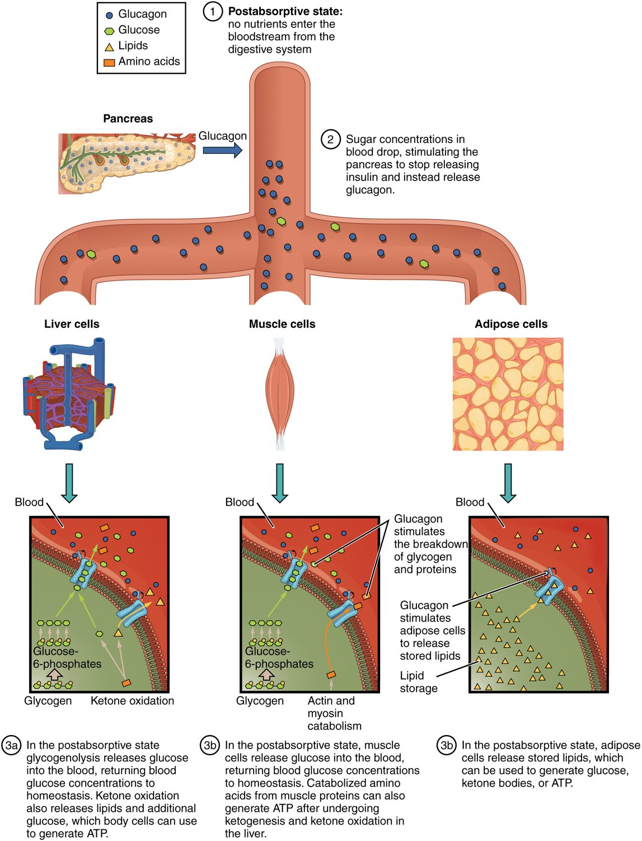
SECTION 24.5
The Postabsorptive State
The fasting state between meals
Blood glucose tends to fall
Glucagon mobilizes stores
Glycogen and fat are broken down
The postabsorptive (fasting) state
PN 104 · Ch 24 — Metabolism and Nutrition
12
Notes:
Between meals, in the postabsorptive state, blood glucose tends to fall, so glucagon and other hormones mobilize stored fuel: the liver breaks down glycogen and makes new glucose, and fat is released for energy. This keeps blood glucose steady to supply the brain, which depends on it.

Slide 13
24.6
SECTION
Energy and Heat Balance
How the body balances energy and regulates temperature.

Slide 14
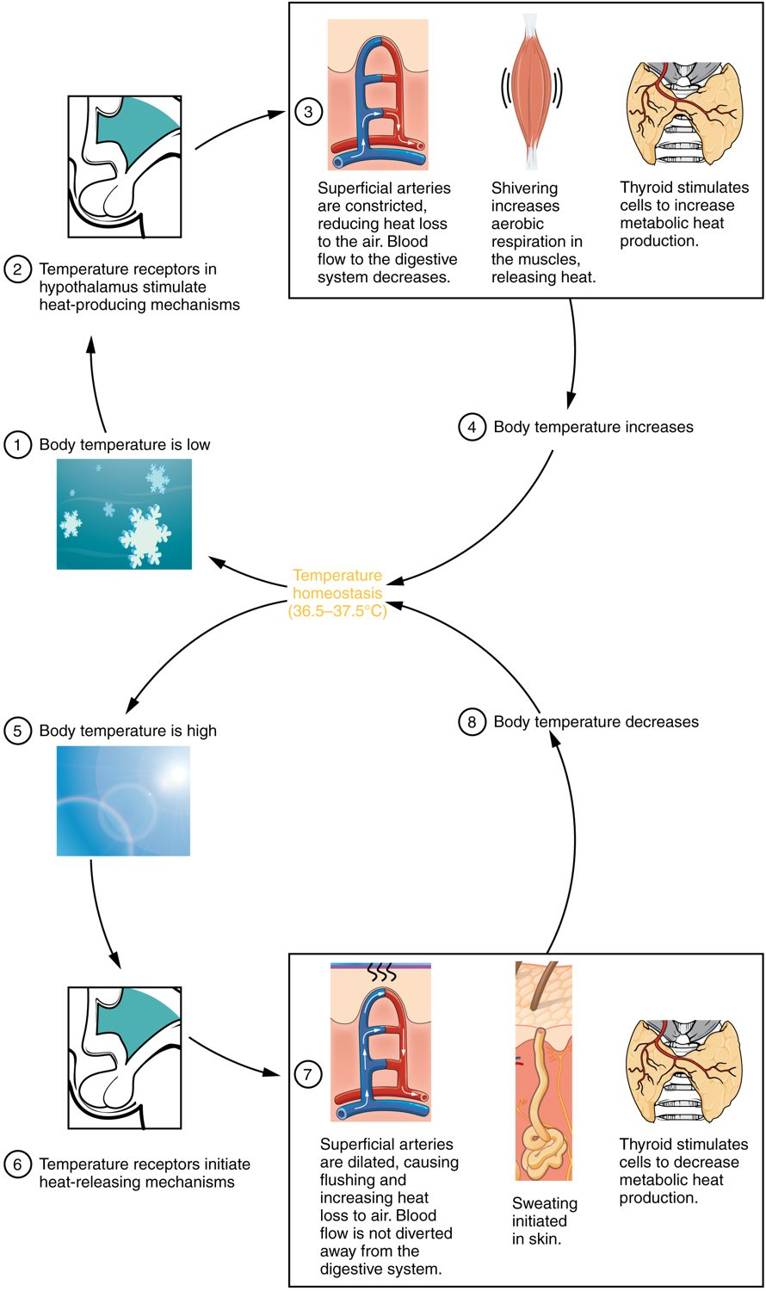
SECTION 24.6
Heat Balance & Thermoregulation
Metabolism produces heat
The hypothalamus is the thermostat
Sweating and blood flow lose heat
Shivering generates heat
Heat balance and thermoregulation
PN 104 · Ch 24 — Metabolism and Nutrition
14
Notes:
Metabolic reactions generate heat, and the body holds its core near 37 degrees Celsius. The hypothalamus acts as a thermostat: when too warm, it triggers sweating and skin vasodilation to lose heat; when too cold, it drives vasoconstriction and shivering to conserve and generate heat. Fever resets this set point during illness.

Slide 15
24.7
SECTION
Nutrition and Diet
The nutrients the body needs and a balanced diet.

Slide 16
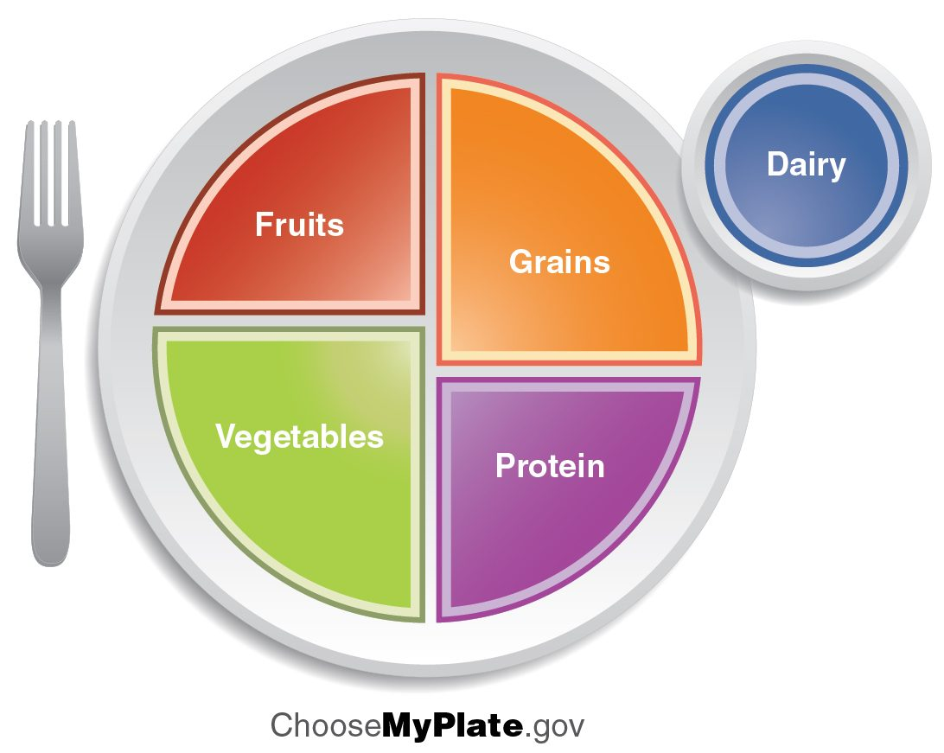
SECTION 24.7
Nutrition & MyPlate
A balanced diet supplies all nutrients
Carbohydrates, fats, proteins for energy
Vitamins and minerals in small amounts
MyPlate guides healthy portions
MyPlate dietary guidelines
PN 104 · Ch 24 — Metabolism and Nutrition
16
Notes:
A healthy diet provides the right balance of macronutrients (carbohydrates, fats, proteins) for energy and building blocks, plus micronutrients (vitamins and minerals) needed in small amounts, and water. The USDA's MyPlate is a simple visual guide to balanced portions of fruits, vegetables, grains, protein, and dairy — useful for patient teaching.

Slide 17
CHAPTER 24
Key Takeaways
Metabolism is all the body's chemical reactions — catabolism releasing energy, anabolism using it.
ATP is the energy currency that powers cellular work.
Cells extract energy from glucose through cellular respiration.
Metabolism shifts between storing fuel after meals and mobilizing it while fasting.
The body balances energy intake, heat, and nutrient needs through diet.
PN 104 · Ch 24 — Metabolism and Nutrition
17

Slide 18
CLINICAL CONNECTIONS
Why Metabolism & Nutrition Matter in Practical Nursing
Diabetes
Cholesterol
Disrupted glucose metabolism affects energy and many organs.
The LDL and HDL balance shapes cardiovascular risk.
Nutrition Teaching
Fever
Balanced-diet guidance supports patient health.
A raised hypothalamic set point during illness.
Malnutrition
Obesity
Nutrient deficiencies impair healing and immunity.
Chronic energy surplus stored as fat raises health risks.

