Slide 1
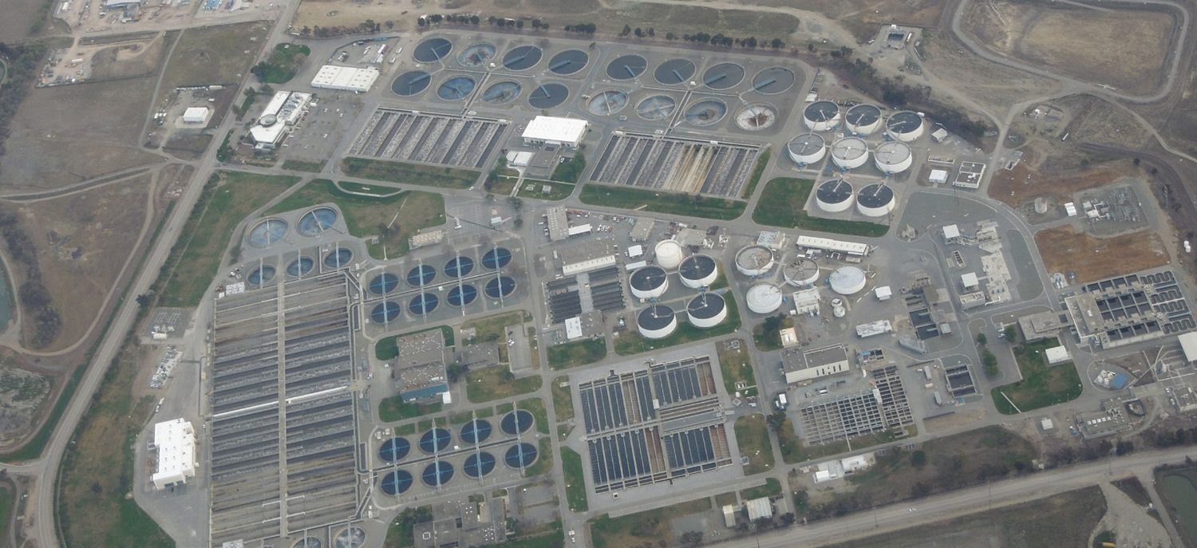
CHAPTER 25
The Urinary System
How the kidneys filter the blood and make urine.
Anatomy & Physiology · Broward-Miami Health Institute
FACULTY EDITION

Slide 2
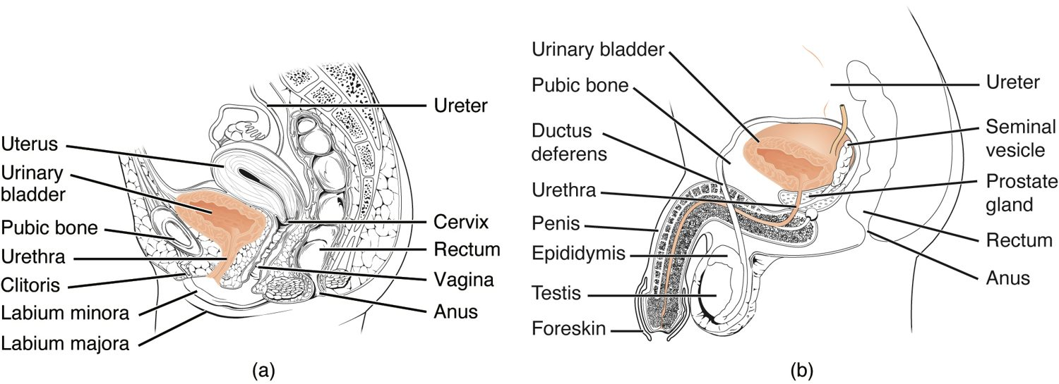
CHAPTER 25
Learning Objectives
After studying this chapter, students will be able to:
1
Describe the composition of urine
2
Label structures of the urinary system
3
Characterize the roles of each of the parts of the urinary system
4
Illustrate the macroscopic and microscopic structures of the kidney
5
Trace the flow of blood through the kidney
6
Outline how blood is filtered in the kidney nephron
The organs of the urinary system.
PN 104 · Ch 25 — The Urinary System
2
Notes:
Preview the urinary system: what urine reveals, the organs that transport it, the gross and microscopic anatomy of the kidney and nephron, how urine is formed through filtration and reabsorption, and how hormones regulate fluid and electrolyte balance.

Slide 3
25.1
SECTION
Physical Characteristics of Urine
What urine reveals about the body's internal balance.

Slide 4
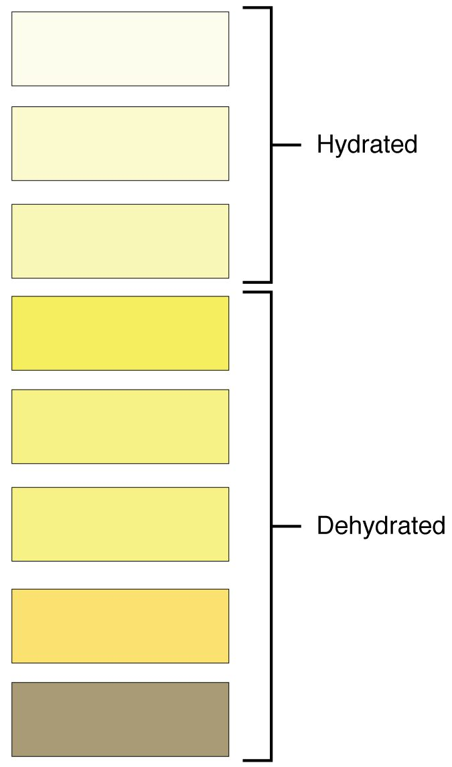
SECTION 25.1
Characteristics of Urine
Urine reflects the body's state
Color signals hydration
Normally clear and yellow
Tested in urinalysis
Urine color and hydration
PN 104 · Ch 25 — The Urinary System
4
Notes:
Urine is the kidneys' output, and its characteristics are a window on health. Color reflects hydration — pale yellow when well-hydrated, dark when dehydrated. Normal urine is clear; cloudiness, blood, or abnormal substances such as glucose or protein detected in a urinalysis can signal disease.

Slide 5
25.2
SECTION
Gross Anatomy of Urine Transport
The ureters, bladder, and urethra that store and transport urine.

Slide 6
SECTION 25.2
The Urinary System
The organs of the urinary system
Two kidneys make urine
Ureters carry it to the bladder
The bladder stores it
The urethra empties it out
PN 104 · Ch 25 — The Urinary System
6
Notes:
The urinary system has four organs. The two kidneys filter blood and make urine; the ureters carry urine to the bladder; the muscular bladder stores it; and the urethra drains it from the body. The female urethra is shorter than the male's, which is why women get more urinary tract infections.

Slide 7
25.3
SECTION
Gross Anatomy of the Kidney
The position and internal structure of the kidneys.

Slide 8
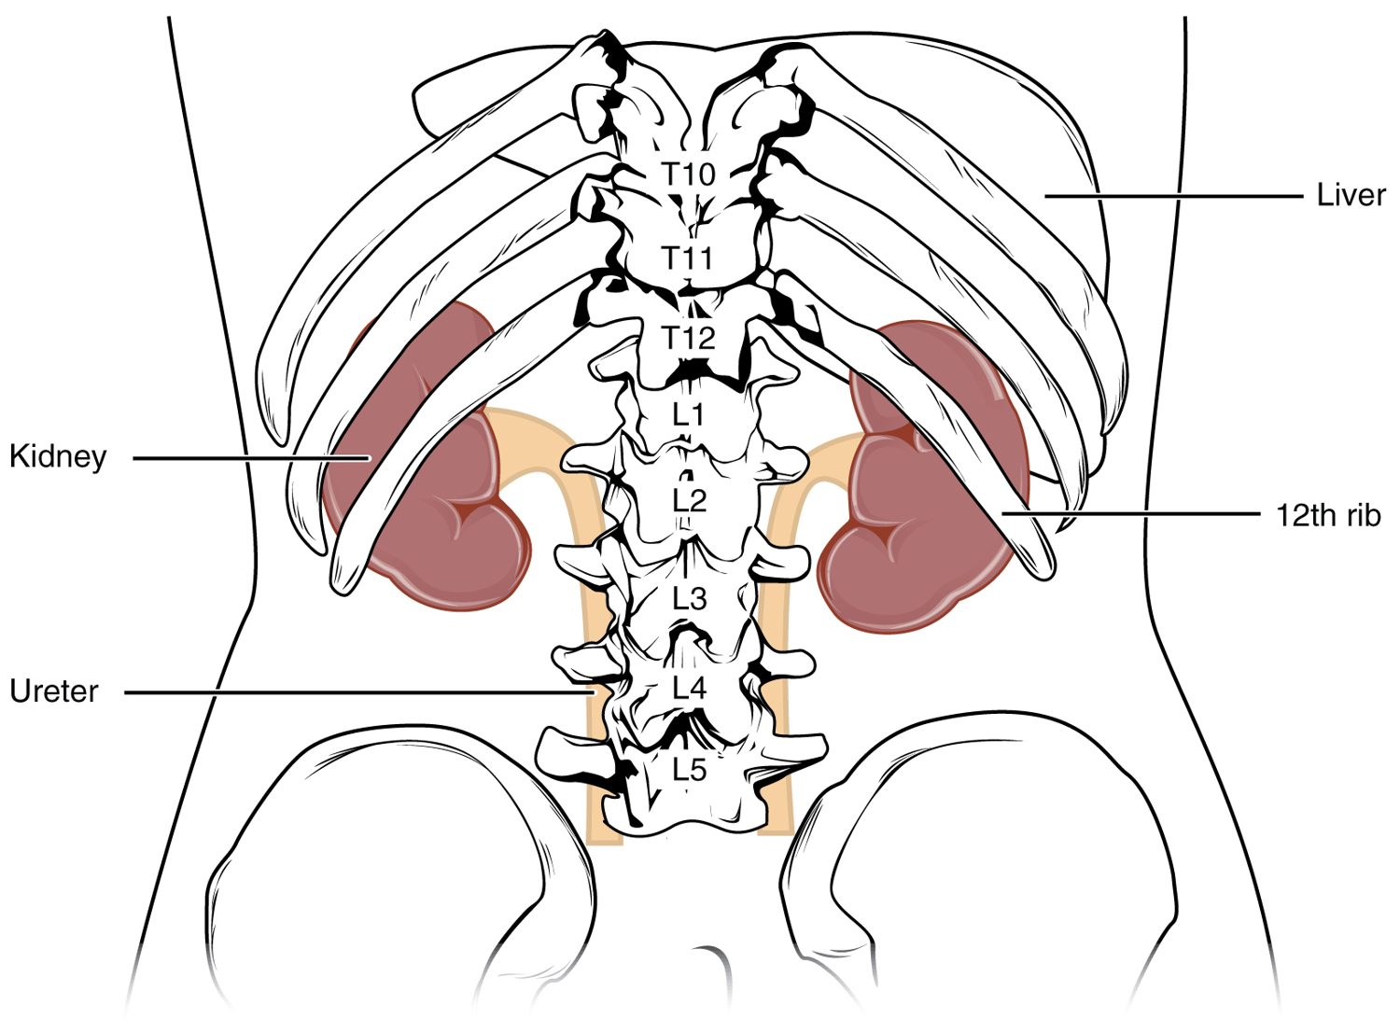
SECTION 25.3
Position of the Kidneys
Two bean-shaped organs
Sit against the back wall
Retroperitoneal (behind the abdomen)
Partly protected by the lower ribs
The position of the kidneys
PN 104 · Ch 25 — The Urinary System
8
Notes:
The kidneys are bean-shaped organs sitting high against the posterior abdominal wall, behind the peritoneum (retroperitoneal), partly sheltered by the lower ribs. This location is why kidney pain is felt in the flank and why the area is checked for tenderness at the costovertebral angle.

Slide 9
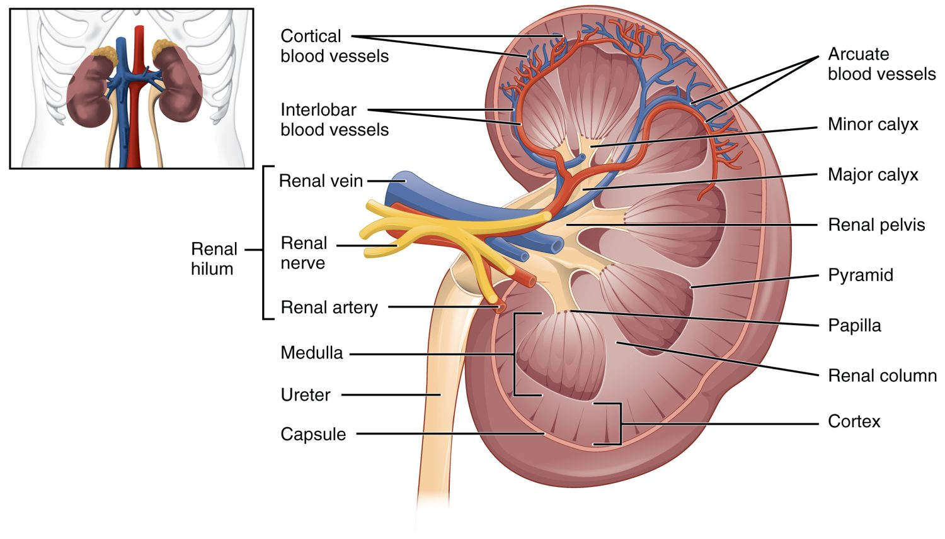
SECTION 25.3
Internal Kidney Anatomy
Internal anatomy of the kidney
Outer cortex, inner medulla
Medulla forms renal pyramids
Urine collects in the renal pelvis
Drains into the ureter
PN 104 · Ch 25 — The Urinary System
9
Notes:
A sectioned kidney shows an outer cortex and inner medulla, the latter forming cone-shaped renal pyramids. Urine made in the nephrons drains from the pyramid tips into calyces, collects in the funnel-shaped renal pelvis, and flows into the ureter.

Slide 10
25.4
SECTION
Microscopic Anatomy of the Kidney
The nephron — the kidney's microscopic filtering unit.

Slide 11
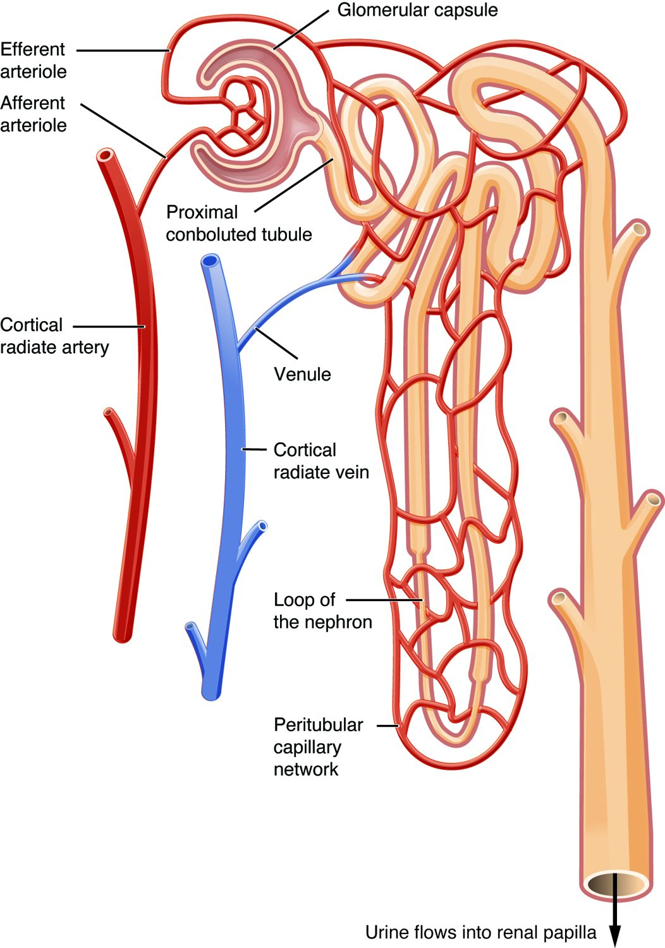
SECTION 25.4
The Nephron
The functional unit of the kidney
About a million per kidney
Has a glomerulus and a tubule
Filters blood and forms urine
The structure of a nephron
PN 104 · Ch 25 — The Urinary System
11
Notes:
Each kidney holds about a million nephrons, the units that actually form urine. A nephron has a renal corpuscle (a glomerulus of capillaries inside a capsule) where blood is filtered, and a long tubule (proximal tubule, loop of Henle, distal tubule) where the filtrate is processed into urine before draining to a collecting duct.

Slide 12
25.5
SECTION
Physiology of Urine Formation
Filtration, reabsorption, and secretion — how urine is made.

Slide 13
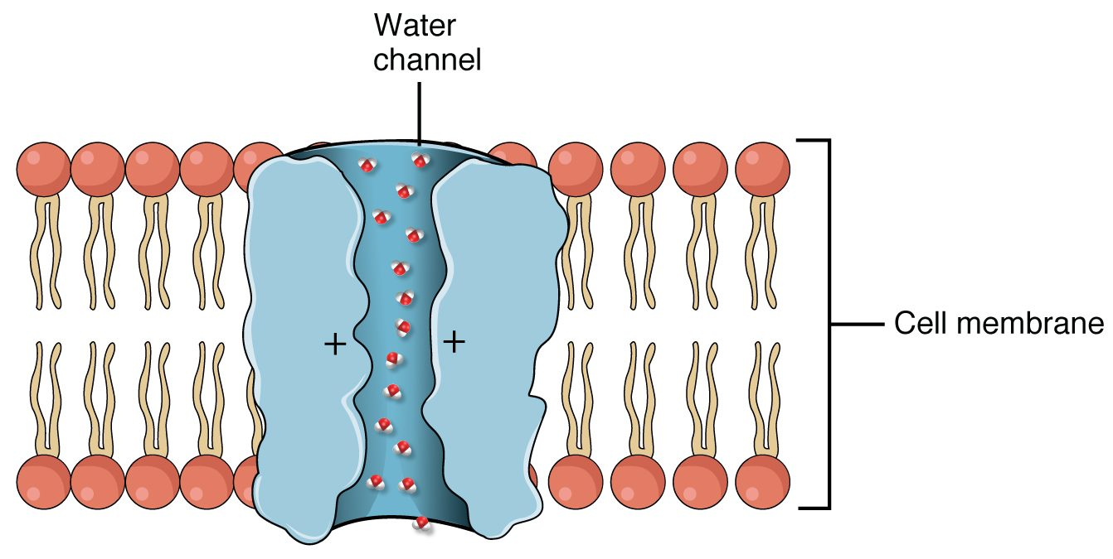
SECTION 25.5
Glomerular Filtration
Glomerular filtration
Urine formation starts with filtration
Blood pressure pushes fluid out
Filters water and small molecules
Keeps cells and proteins in the blood
PN 104 · Ch 25 — The Urinary System
13
Notes:
Urine formation begins in the glomerulus, where blood pressure forces water and small solutes out of the capillaries into the capsule, while blood cells and large proteins stay behind. This filtrate then moves into the tubule. The kidneys filter the entire blood volume many times a day; the rate (GFR) is a key measure of kidney function.

Slide 14
25.6
SECTION
Tubular Reabsorption
Reclaiming what the body needs from the filtrate.

Slide 15
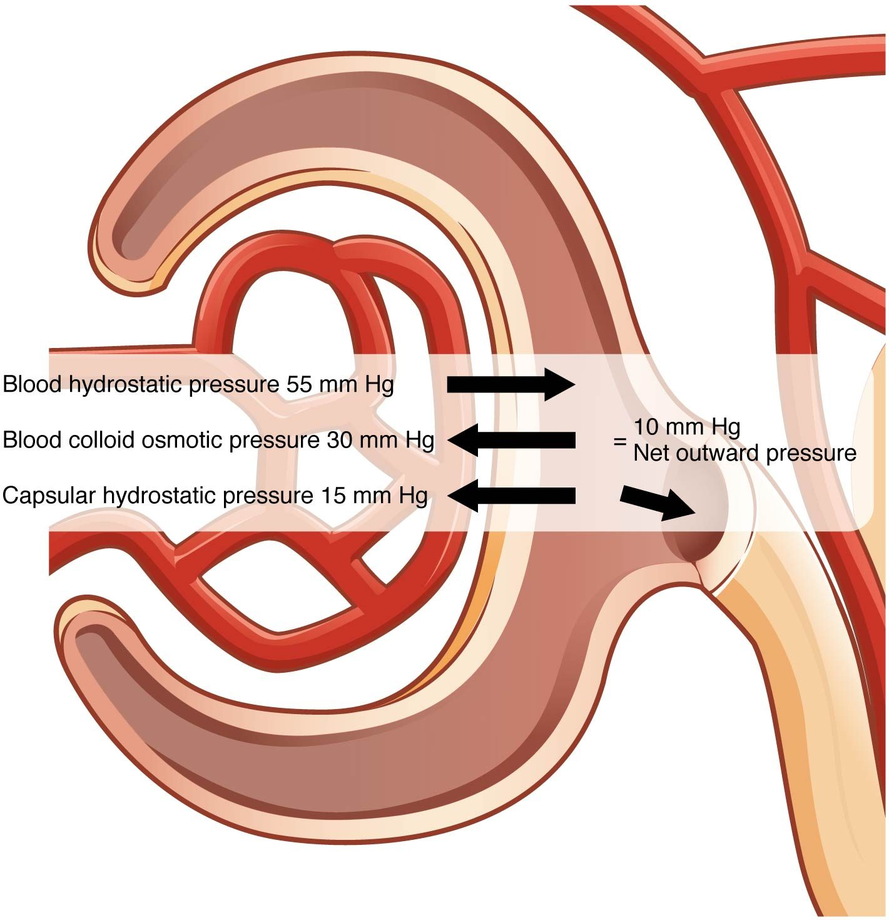
SECTION 25.6
Reabsorption & Secretion
Most of the filtrate is reclaimed
Water, glucose, ions are reabsorbed
Wastes are secreted into the tubule
Only urine remains
Reabsorption and secretion along the nephron
PN 104 · Ch 25 — The Urinary System
15
Notes:
The glomerulus filters far more than the body could afford to lose, so the tubule reabsorbs most of it — nearly all the water, glucose, and useful ions — back into the blood. Meanwhile, extra wastes and ions are secreted from the blood into the tubule. What remains is concentrated urine.

Slide 16
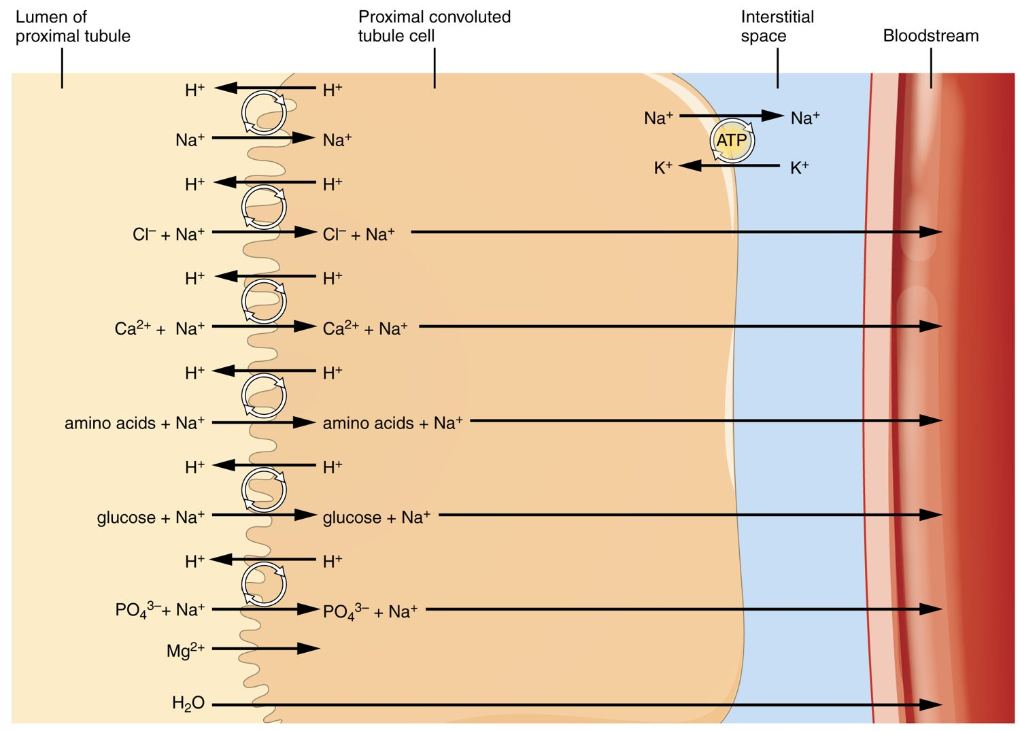
SECTION 25.6
Concentrating the Urine
The loop of Henle builds a salt gradient
The medulla becomes very salty
Water is drawn out of the tubule
Produces concentrated urine
Concentrating the urine in the loop of Henle
PN 104 · Ch 25 — The Urinary System
16
Notes:
The loop of Henle sets up a salt concentration gradient that makes the medulla increasingly salty. As the collecting duct passes through it, water is osmotically pulled out (when ADH is present), concentrating the urine and conserving body water. This is how the kidney adjusts urine concentration to hydration.

Slide 17
25.8
SECTION
Endocrine Regulation of Kidney Function
How hormones fine-tune kidney function and fluid balance.

Slide 18
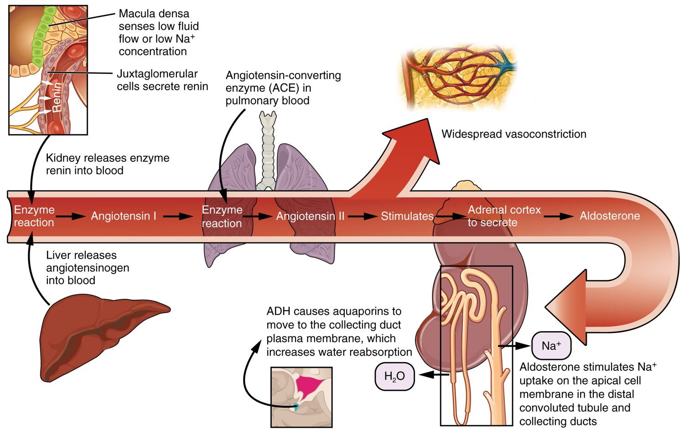
SECTION 25.8
Hormonal Regulation
Endocrine regulation of the kidney
Hormones adjust water and salt
ADH increases water reabsorption
Aldosterone retains sodium
Together they control blood volume and pressure
PN 104 · Ch 25 — The Urinary System
18
Notes:
Hormones tune the kidney's output to the body's needs. ADH (from the pituitary) makes the kidney reabsorb more water, concentrating urine when fluids are low. Aldosterone (from the adrenal cortex) makes it retain sodium and water. Through these, plus the renin-angiotensin system, the kidney regulates blood volume and pressure.

Slide 19
CHAPTER 25
Key Takeaways
The kidneys filter blood and make urine; the ureters, bladder, and urethra store and remove it.
Each kidney has a cortex and medulla and about a million nephrons.
Urine forms by filtration, reabsorption, and secretion along the nephron.
The loop of Henle lets the kidney concentrate urine and conserve water.
Hormones like ADH and aldosterone adjust fluid and electrolyte balance.
PN 104 · Ch 25 — The Urinary System
19

Slide 20
CLINICAL CONNECTIONS
Why the Urinary System Matters in Practical Nursing
Urinary Tract Infection
Kidney Stones
Common, especially in women — watch for symptoms.
Hardened deposits cause severe flank pain.
Kidney Failure
Urinalysis
Lost filtration causes waste buildup; may need dialysis.
A simple test revealing many systemic conditions.
Fluid Balance
Diuretics
The kidneys are central to blood volume and pressure.
Drugs that increase urine output to manage fluid overload.

