Slide 1
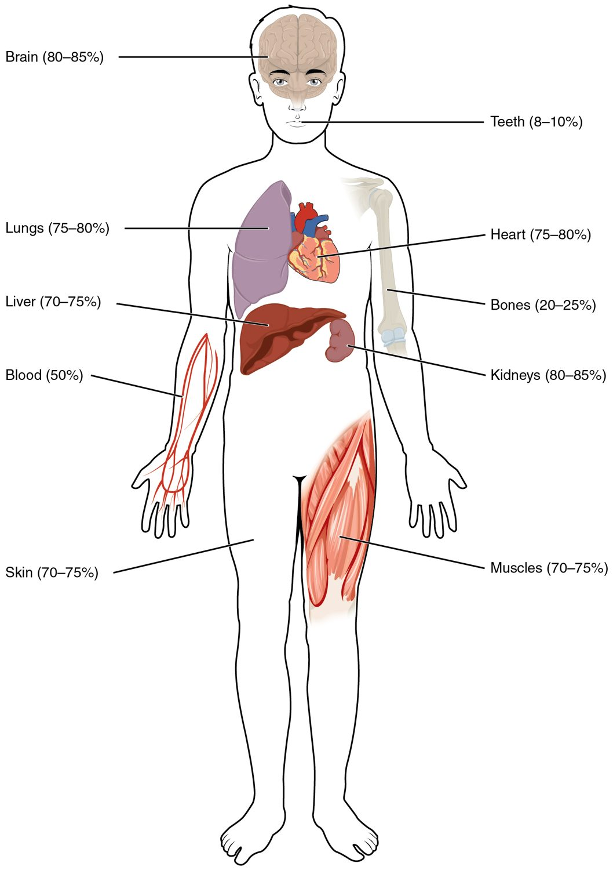
CHAPTER 26
Fluid, Electrolyte, and Acid-Base Balance
Keeping the body's water, ions, and pH in balance.
Anatomy & Physiology · Broward-Miami Health Institute
FACULTY EDITION

Slide 2
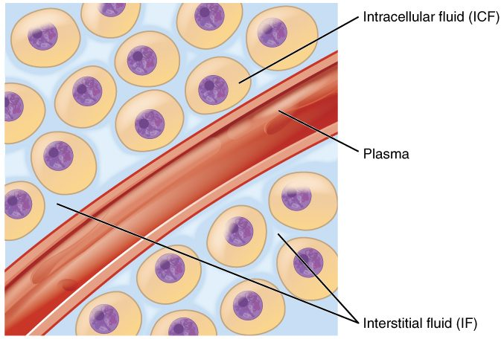
CHAPTER 26
Learning Objectives
After studying this chapter, students will be able to:
1
Identify the body’s main fluid compartments
2
Define plasma osmolality and identify two ways in which plasma osmolality is maintained
3
Identify the six ions most important to the function of the body
4
Define buffer and discuss the role of buffers in the body
5
Explain why bicarbonate must be conserved rather than reabsorbed in the kidney
The body's fluid compartments.
PN 104 · Ch 26 — Fluid, Electrolyte, and Acid-Base Balance
2
Notes:
Preview fluid, electrolyte, and acid-base balance: where body water is held, how water intake and loss are balanced, the electrolytes that drive function, how blood pH is defended, and what happens when acid-base balance fails.

Slide 3
26.1
SECTION
Body Fluids and Fluid Compartments
Where the body's water is and how it is distributed.

Slide 4
SECTION 26.1
Body Water Content
Water is most of the body
About 55-60% of body weight
Varies by tissue and age
Highest in muscle, lowest in fat
Body water content
PN 104 · Ch 26 — Fluid, Electrolyte, and Acid-Base Balance
4
Notes:
Water makes up roughly 55 to 60 percent of adult body weight — more in lean people and infants, less in those with more body fat or older age. Different tissues hold different amounts: muscle is very watery, fat is not. This water is the medium for every chemical reaction in the body.

Slide 5
SECTION 26.1
Fluid Compartments
Body fluid sits in two compartments
Intracellular fluid (inside cells)
Extracellular fluid (outside cells)
ECF = plasma + interstitial fluid
The body's fluid compartments
PN 104 · Ch 26 — Fluid, Electrolyte, and Acid-Base Balance
5
Notes:
Body fluid is divided into the intracellular fluid (ICF) inside cells, about two-thirds of the total, and the extracellular fluid (ECF) outside them — including the plasma in blood vessels and the interstitial fluid bathing the tissues. Water and solutes move between these compartments to keep them balanced.

Slide 6
26.2
SECTION
Water Balance
How the body keeps water intake and loss in balance.

Slide 7
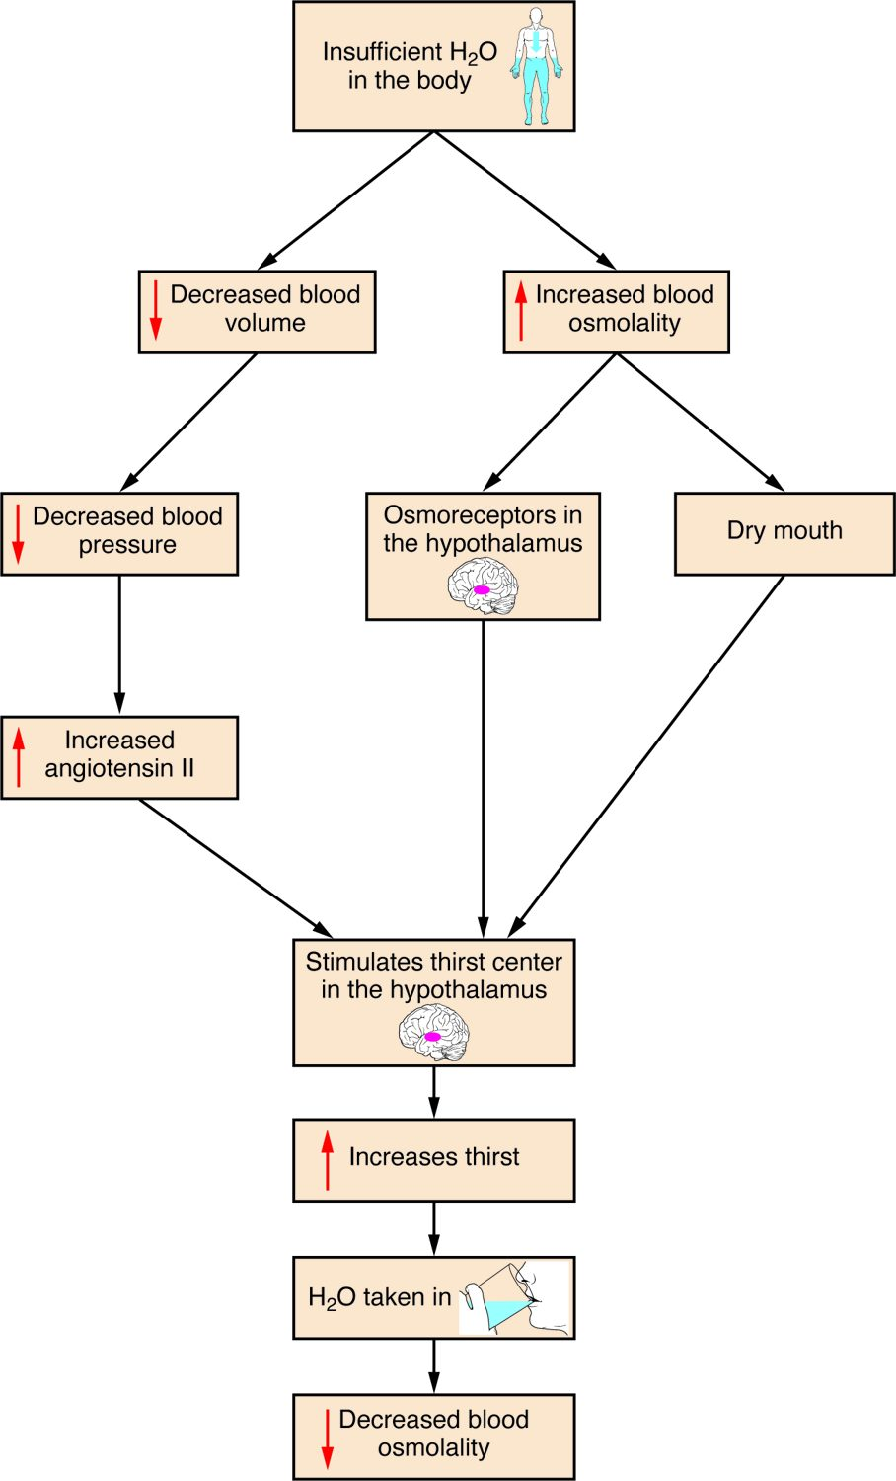
SECTION 26.2
Water Balance
Intake must match output
Thirst drives intake
ADH reduces water loss
The kidneys are the main regulator
Regulation of water balance
PN 104 · Ch 26 — Fluid, Electrolyte, and Acid-Base Balance
7
Notes:
The body balances water gained (from drink, food, and metabolism) against water lost (in urine, sweat, breath, and feces). When fluid is low, the hypothalamus triggers thirst and releases ADH, which makes the kidneys conserve water. The kidneys are the main organ for adjusting water balance.

Slide 8
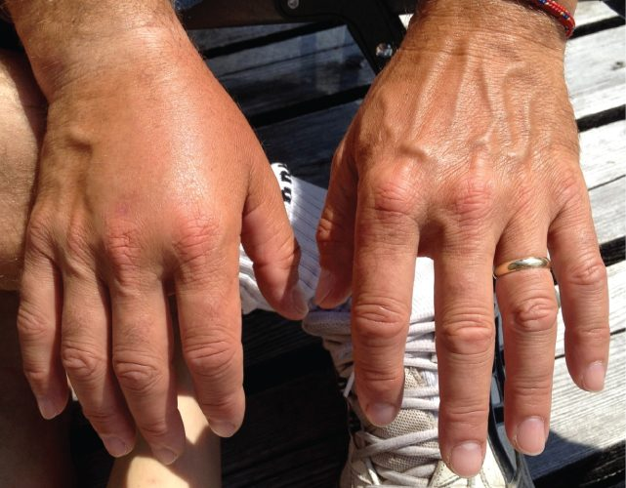
SECTION 26.2
Dehydration
Fluid loss exceeds intake
Common with vomiting, diarrhea, fever
Signs: poor skin turgor, dark urine
Dangerous if severe
Signs of dehydration
PN 104 · Ch 26 — Fluid, Electrolyte, and Acid-Base Balance
8
Notes:
Dehydration occurs when water loss outpaces intake — often from vomiting, diarrhea, fever, or sweating. Signs include thirst, dark urine, dry mouth, and poor skin turgor (skin that "tents" when pinched). The young and elderly are especially vulnerable, and severe cases threaten blood pressure and organ function.

Slide 9
26.3
SECTION
Electrolyte Balance
The electrolytes that drive nerve, muscle, and fluid balance.

Slide 10
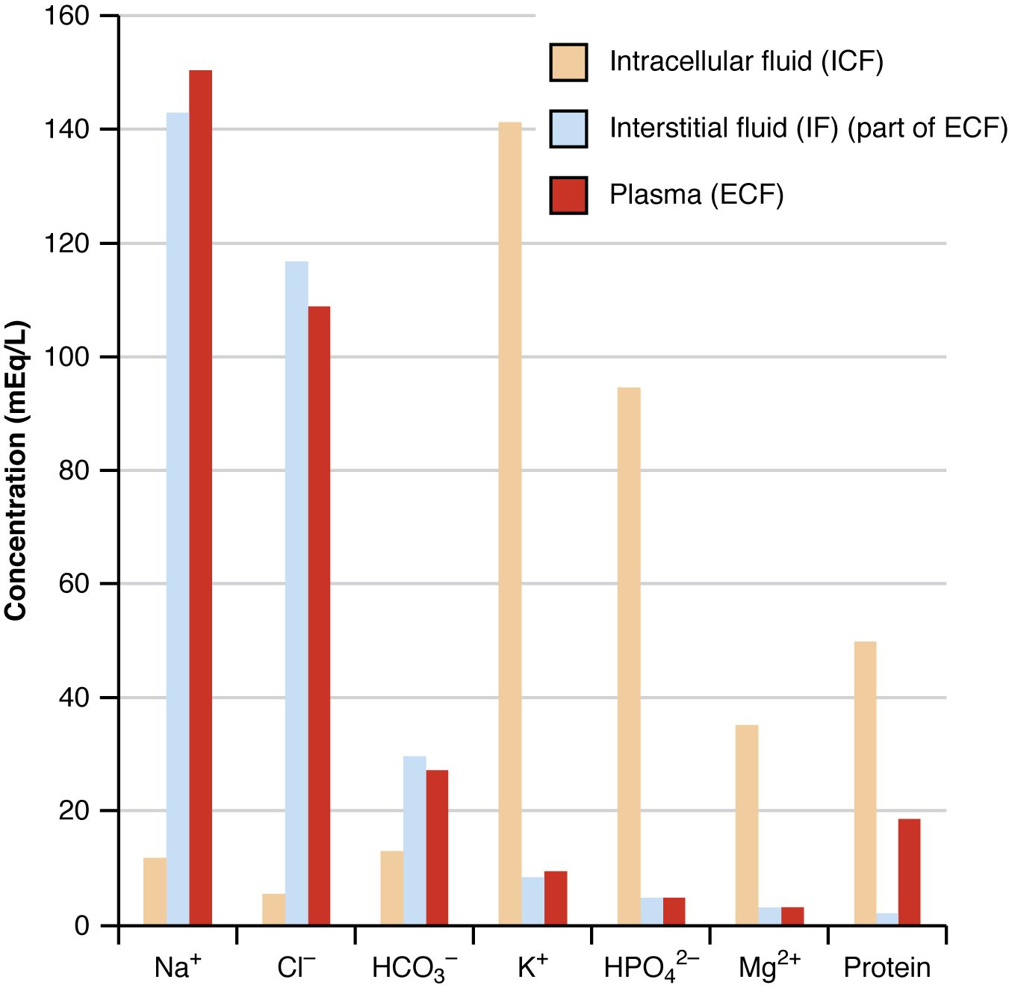
SECTION 26.3
Electrolyte Composition
Electrolytes are charged ions
Concentrations differ between compartments
Sodium dominates outside cells
Potassium dominates inside cells
Electrolyte composition of body fluids
PN 104 · Ch 26 — Fluid, Electrolyte, and Acid-Base Balance
10
Notes:
Electrolytes are dissolved ions — sodium, potassium, chloride, calcium, and others — that carry charge. Their concentrations differ sharply between compartments: sodium is the main ECF ion, potassium the main ICF ion. These differences drive nerve impulses, muscle contraction, and the movement of water by osmosis.

Slide 11
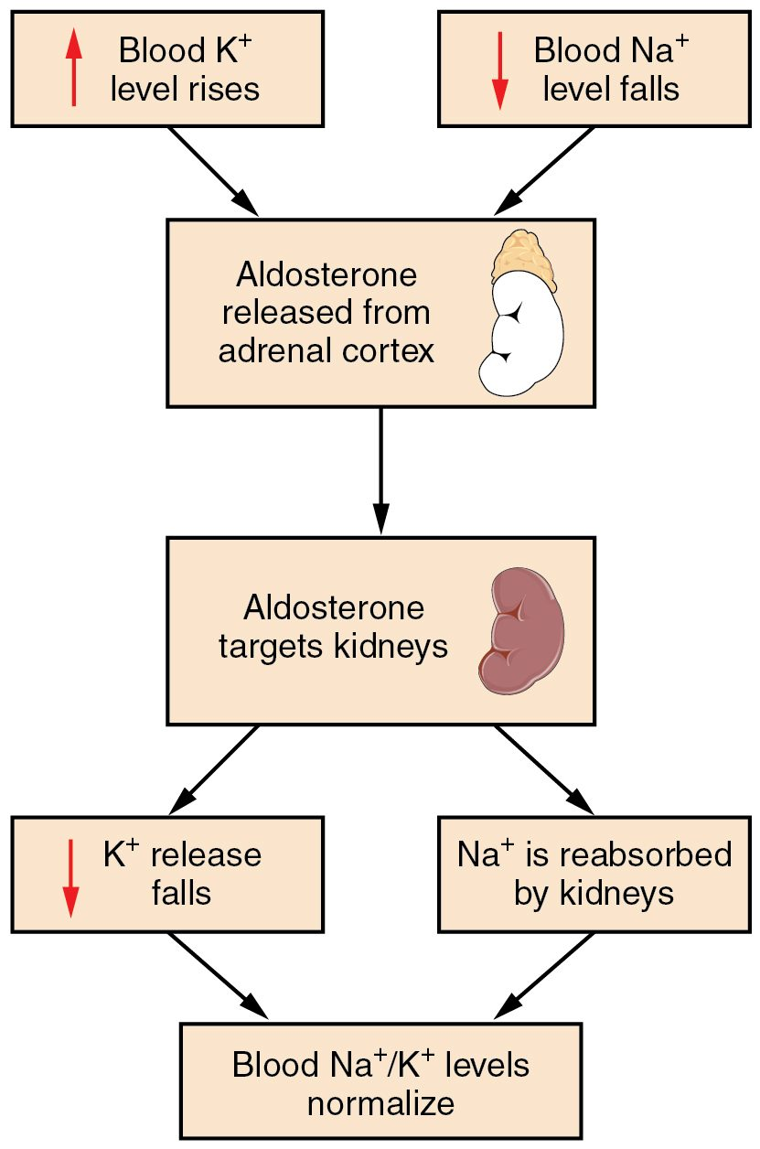
SECTION 26.3
Sodium & Potassium Balance
Sodium and potassium are tightly controlled
Aldosterone retains sodium
And promotes potassium loss
Imbalances affect the heart and nerves
Aldosterone and sodium-potassium balance
PN 104 · Ch 26 — Fluid, Electrolyte, and Acid-Base Balance
11
Notes:
Sodium and potassium levels are tightly regulated, largely by aldosterone, which makes the kidneys retain sodium and excrete potassium. Because these ions govern nerve and muscle function, imbalances are dangerous — abnormal potassium especially can cause life-threatening heart arrhythmias.

Slide 12
26.4
SECTION
Acid-Base Balance
How the body keeps blood pH within a narrow safe range.

Slide 13
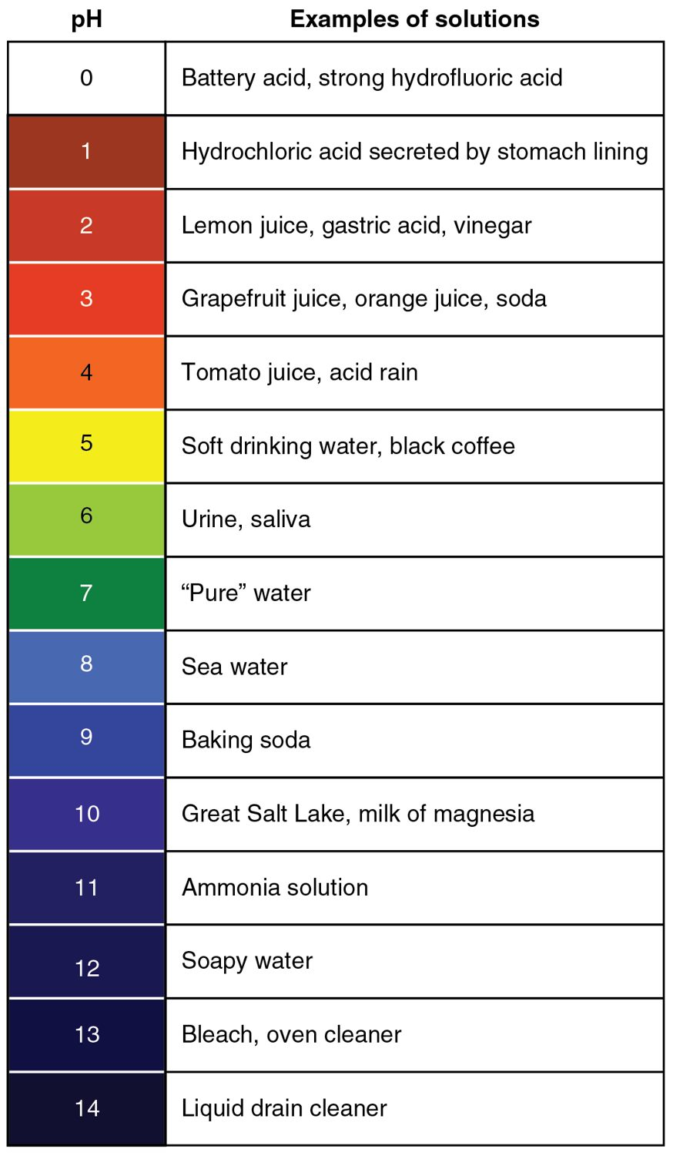
SECTION 26.4
The pH Scale
pH measures acidity
Blood is kept near 7.4
Below 7.35 is acidosis
Above 7.45 is alkalosis
The pH scale
PN 104 · Ch 26 — Fluid, Electrolyte, and Acid-Base Balance
13
Notes:
pH measures how acidic or basic a fluid is, from 0 to 14. Blood pH is held in a very narrow range around 7.4; below 7.35 is acidosis, above 7.45 is alkalosis. Even small deviations disrupt enzymes and cell function, so the body defends pH closely.

Slide 14
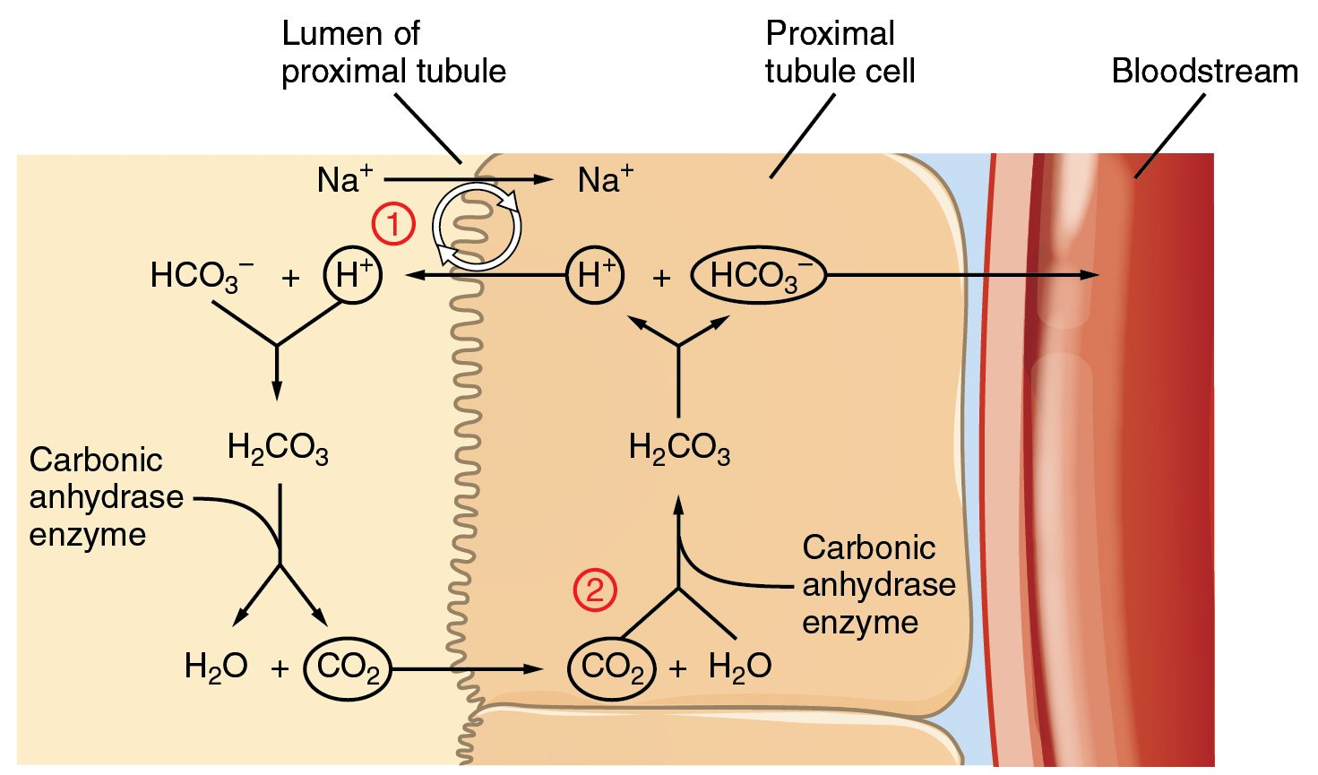
SECTION 26.4
Regulating pH
The kidneys and acid-base balance
Three systems defend blood pH
Buffers act instantly
The lungs adjust CO2
The kidneys adjust bicarbonate and H+
PN 104 · Ch 26 — Fluid, Electrolyte, and Acid-Base Balance
14
Notes:
Three lines of defense control pH. Chemical buffers like bicarbonate neutralize acids instantly; the lungs adjust pH within minutes by changing how much carbon dioxide is exhaled; and the kidneys make the slowest but most powerful correction by excreting hydrogen ions and reclaiming bicarbonate. Together they keep blood pH stable.

Slide 15
26.5
SECTION
Disorders of Acid-Base Balance
What happens when acid-base balance breaks down.

Slide 16
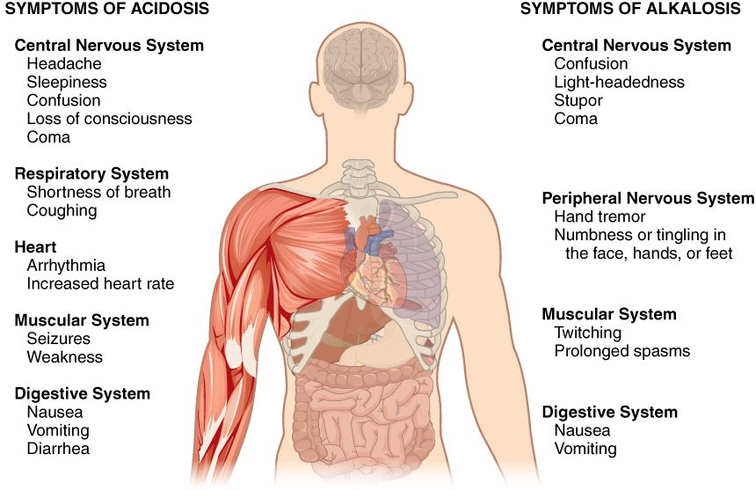
SECTION 26.5
Acidosis & Alkalosis
Symptoms of acidosis and alkalosis
Imbalance affects the whole body
Acidosis: low pH (confusion, coma)
Alkalosis: high pH (tingling, spasms)
Can be respiratory or metabolic
PN 104 · Ch 26 — Fluid, Electrolyte, and Acid-Base Balance
16
Notes:
When pH control fails, the effects are body-wide. Acidosis (low pH) depresses the nervous system, causing confusion and eventually coma; alkalosis (high pH) overexcites it, causing tingling, muscle twitching, and spasms. Each can be respiratory (a carbon dioxide problem) or metabolic (a bicarbonate problem), and identifying the cause guides treatment.

Slide 17
CHAPTER 26
Key Takeaways
Body water is split between intracellular and extracellular compartments.
Water balance matches intake to output, regulated mainly by the kidneys and ADH.
Electrolytes differ between compartments and drive nerve, muscle, and fluid function.
Blood pH is held near 7.4 by buffers, the lungs, and the kidneys.
Acidosis and alkalosis disrupt the whole body and may be respiratory or metabolic.
PN 104 · Ch 26 — Fluid, Electrolyte, and Acid-Base Balance
17

Slide 18
CLINICAL CONNECTIONS
Why Fluid & Acid-Base Balance Matter in Practical Nursing
Dehydration
Electrolyte Imbalance
Fluid loss from vomiting, diarrhea, or fever needs prompt replacement.
Abnormal sodium or potassium can be life-threatening.
IV Fluids
Acid-Base Disorders
Replace fluid and electrolytes when patients can't maintain balance.
Respiratory and metabolic causes guide treatment.
Potassium & the Heart
Edema
High or low potassium causes dangerous arrhythmias.
Excess fluid in tissues signals a balance problem.

